Slide 1
Chapter 4 Clicker questions & Active learning exercises
Notes:
Clicker questions would probably be most effective interspersed within the lecture, although some could be given at the start if students are assigned chapters to read prior to class (so clicker questions would check comprehension and completion of reading assignments). Clicker questions could also be given at the end of lecture to check retention.

Slide 2
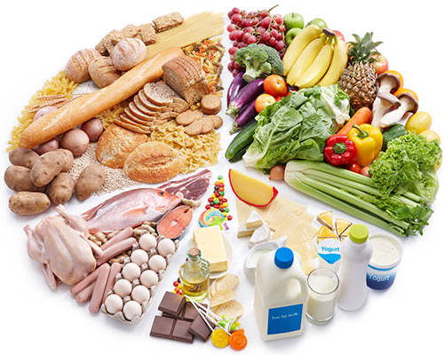
Which foods are rich in protein & fats?
Dairy & vegetables
Meat & grains
Meat & dairy
Legumes & grains
Notes:
DQ#1: macronutrients
Correct = C (meat and dairy)

Slide 3
Which foods are rich in carbohydrates?
Grains & vegetables
Dairy & vegetables
Meat & grains
Legumes & grains
Notes:
DQ#1: macronutrients
Correct = A (grains and vegetables)

Slide 4
Which foods are rich in carbohydrates & proteins?
Vegetables & grains
Meat & grains
Grains
Legumes
Notes:
DQ#1: macronutrients
Correct = D (legumes)

Slide 5
Which is not a macronutrient needed to build and maintain cells?
Enzymes
Proteins
Nucleic acids
Fats
Notes:
DQ#1: macronutrients
Correct = A (enzymes are not macronutrients)

Slide 6
What are essential nutrients?
They are the only things essential for life.
Our bodies can’t make them.
We must get them from our diet.
Both B and C.
Notes:
DQ#2: essential nutrients
Correct = D (our bodies can’t make them so we must get them from our diet)

Slide 7
Which micronutrients can harm you if you ingest too much?
Minerals
Water-soluble vitamins
Fat-soluble vitamins
Both A and C.
Notes:
DQ#1&2 micronutrients and essential nutrients
Correct = D (over-ingestion of both minerals and fat-soluble vitamins can cause harm)
Water-soluble vitamins (B) are unlikely to harm people even if they ingest too much because excess is easily excreted in urine.

Slide 8
True or False? People can make some, but not all, of the amino acids from other components in their diet.
TRUE
FALSE
Don’t know.
Notes:
DQ#2: essential nutrients
Correct = A (true) people can compensate for dietary deficiencies by synthesizing 11 of 20 amino acids from other components of their diet. The other nine amino acids are essential amino acids because they cannot be made by our bodies, and must come from our diet.
** Adding the “don’t know” option allows students the option of expressing that they are confused with the material, and can be useful checkpoints for instructors to proof student comprehension, especially if clicker questions are used as participation points rather than graded.

Slide 9
What do enzymes do?
They are the only things that digest food.
They can break or build macromolecules.
They slow down chemical reactions.
They are essential nutrients that keep us alive.
Notes:
DQ#3: enzymes
Correct = B (they can build up and break down macromolecules)
Not A because food can also be broken down by mechanical digestion and acids in the stomach.
Not C because they speed up chemical reactions (they lower activation energy).
Not D because they are not essential nutrients.

Slide 10
Some people have trouble digesting certain foods, but not others. What is a likely cause?
Malnutrition
Vitamin deficiency
Lack of the proper enzymes
Lack of essential minerals
Notes:
DQ#3: enzymes
Correct = C (lack of proper enzymes needed to break down food)
This question could be a good one to give at the beginning or end of class (see notes, slide 1).
Example: People with lactose intolerance lack the enzyme lactase, so can’t break down the lactose (sugars) in dairy products. This can cause uncomfortable symptoms such as digestive upset, bloating, gas, and vomiting.

Slide 11
Debate the pros and cons of two possible treatments for lactose intolerance:
Take supplemental enzymes
PROS
CONS
Avoid dairy products
PROS
CONS
Notes:
Active learning exercise: debate in pairs, small groups, then discuss debate arguments as a class.
DQ#1&3: micronutrients & enzymes

Slide 12
Which of the following would not be considered a case of malnutrition?
Too little vitamin C causes scurvy.
Too much fat causes obesity.
Too little calcium stunts growth.
All of these could be cases of malnutrition.
Notes:
DQ#4: malnutrition
Correct = B (too much fat is not considered malnutrition, just poor nutrition)
Malnutrition is defined as “the medical condition resulting from the lack of any essential nutrient in the diet.”

Slide 13
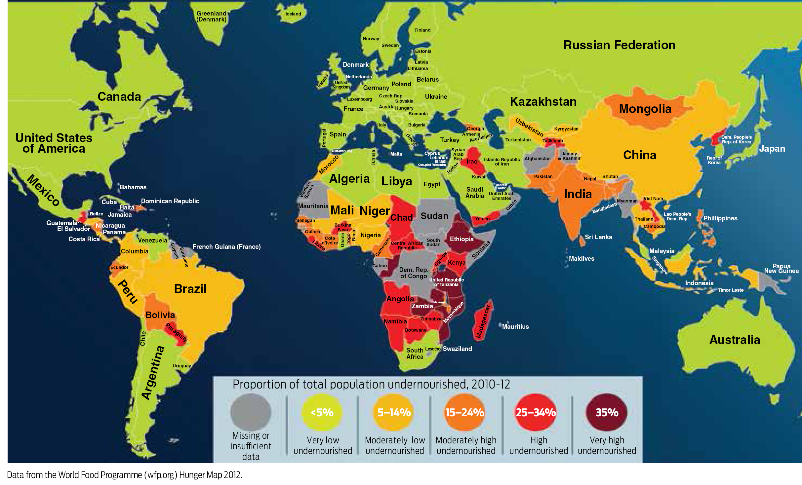
Which country has moderately high proportions of undernourished people?
(c)
(a)
(b)
(d)
Notes:
DQ#4: transitions into lecture topics focusing on the consequences of under/malnourishment;
Correct = C (Mongolia)
Goal: check comprehension of graphic interpretation; think about problem of malnutrition on global scale (this would be a good question to do right before the active learning exercise “design your own non-nut RUTF.”

