Slide 1
Biology for a Changing World, 2e Clicker Questions Chapter 4

Slide 2
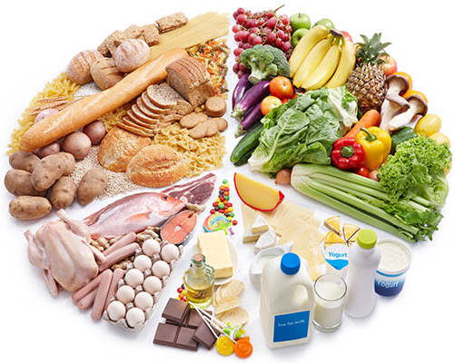
Which foods are rich in protein & fats?
Dairy & vegetables
Meat & grains
Meat & dairy
Legumes & grains
Notes:
Answer: C
Driving Question: 1

Slide 3
Which foods are rich in carbohydrates?
Grains & vegetables
Dairy & vegetables
Meat & grains
Legumes & grains
Notes:
Answer: A
Driving Question: 1

Slide 4
Which foods are rich in carbohydrates & proteins?
Vegetables & grains
Meat & grains
Grains
Legumes
Notes:
Answer: D
Driving Question: 1

Slide 5
Which is not a macronutrient needed to build and maintain cells?
Enzymes
Proteins
Nucleic acids
Fats
Notes:
Answer: A
Driving Question: 1

Slide 6
What are essential nutrients?
They are the only things essential for life
Our bodies can’t make them
We must get them from our diet
Both B and C
Notes:
Answer: D
Answer Notes: Our bodies can’t make them so we must get them from our diet.
Driving Question: 2

Slide 7
Which micronutrients can harm you if you ingest too much?
Minerals
Water-soluble vitamins
Fat-soluble vitamins
Both A and C.
Notes:
Answer: D
Answer Notes: Over-ingestion of both minerals and fat-soluble vitamins can cause harm. Water-soluble vitamins (B) are unlikely to harm people even if they ingest too much because excess is easily excreted in urine.
Driving Questions: 1 and 2

Slide 8
TRUE or FALSE? People can make some, but not all, of the amino acids from other components in their diet.
TRUE
FALSE
Don’t know
Notes:
Answer: A
Answer Notes: People can compensate for dietary deficiencies by synthesizing 11 of 20 amino acids from other components of their diet. The other 9 amino acids are essential amino acids because they cannot be made by our bodies, and must come from our diet.
Driving Question: 2
Note: Option C allows students the option of expressing that they are confused with the material, and can be useful checkpoints for instructors to proof student comprehension.

Slide 9
What do enzymes do?
They are the only things that digest food.
They can break or build macromolecules.
They slow down chemical reactions.
They are essential nutrients that keep us alive.
Notes:
Answer: B
Driving Question: 3
Wrong Answer Notes:
Option A: food can also be broken down by mechanical digestion and acids in the stomach.
Option C: enzymes speed up chemical reactions (they lower activation energy).
Option D: enzymes are not essential nutrients.

Slide 10
Some people have trouble digesting certain foods, but not others. What is a likely cause?
Malnutrition
Vitamin deficiency
Lack of the proper enzymes
Lack of essential minerals
Notes:
Answer: C
Driving Question: 3
Example: People with lactose intolerance lack the enzyme lactase, so can’t break down the lactose (sugars) in dairy products. This can cause uncomfortable symptoms such as digestive upset, bloating, gas, and vomiting.

Slide 11
Debate the pros and cons of two possible treatments for lactose intolerance:
Take supplemental enzymes
PROs
CONs
Avoid dairy products
PROs
CONs
Notes:
Active learning exercise: debate in pairs, small groups, then discuss debate arguments as a class.
Driving Questions :1 and 3

Slide 12
Which of the following would not be considered a case of malnutrition?
Too little vitamin C causes scurvy
Too much fat causes obesity
Too little calcium stunts growth
All of these could be cases of malnutrition.
Notes:
Answer: B
Answer Notes: Too much fat is not considered malnutrition, just poor nutrition. Malnutrition is defined as “the medical condition resulting from the lack of any essential nutrient in the diet”.
Driving Question: 4

Slide 13
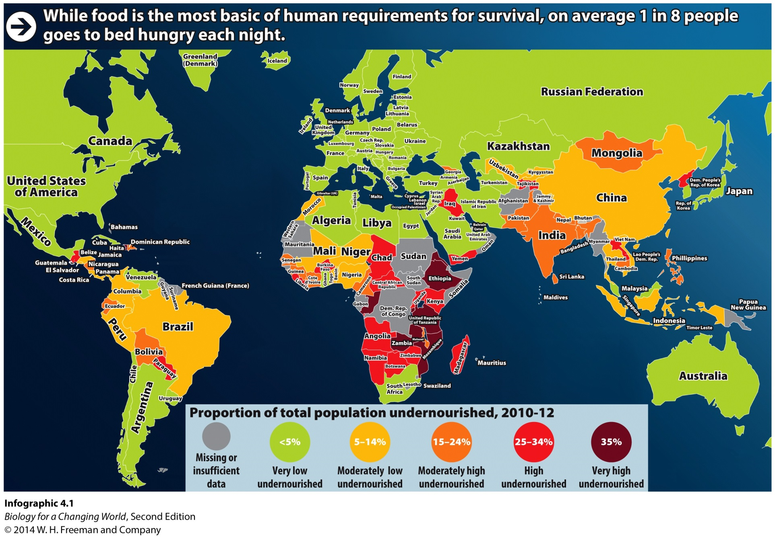
Which country has moderately high proportions of undernourished people?
C
A
B
D
Notes:
Answer: C
Driving Question: 4

