Slide 1
Michèle Shuster • Janet Vigna • Gunjan Sinha • Matthew Tontonoz
Biology for a
Changing World
SECOND EDITION
Lecture PowerPoint
CHAPTER 4
Nutrition, Metabolism, Enzymes
Copyright © 2014 by W. H. Freeman and Company

Slide 2
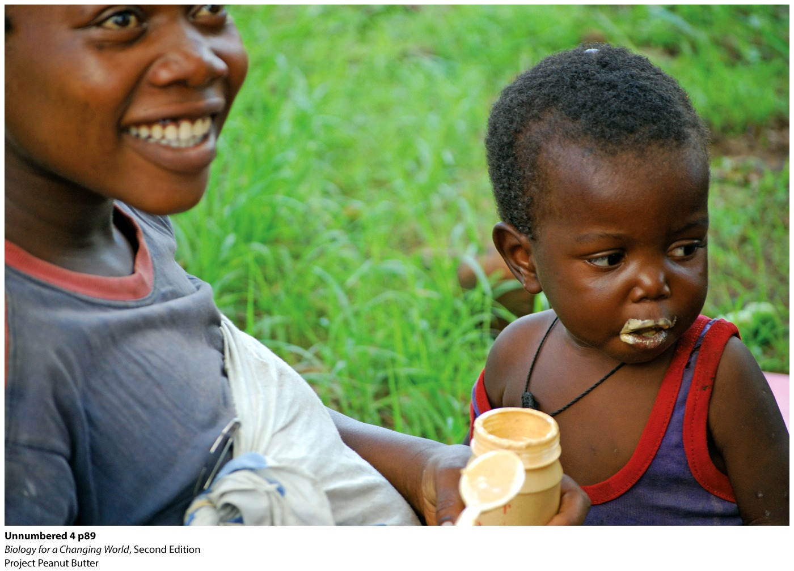
Chapter 4
Chapter 4 Nutrition, Metabolism, Enzymes

Slide 3
Driving Questions
What are the macronutrients and micronutrients provided by food?
What are essential nutrients?
What are enzymes, and how do they work?
What are the consequences of a diet lacking sufficient nutrients?

Slide 4
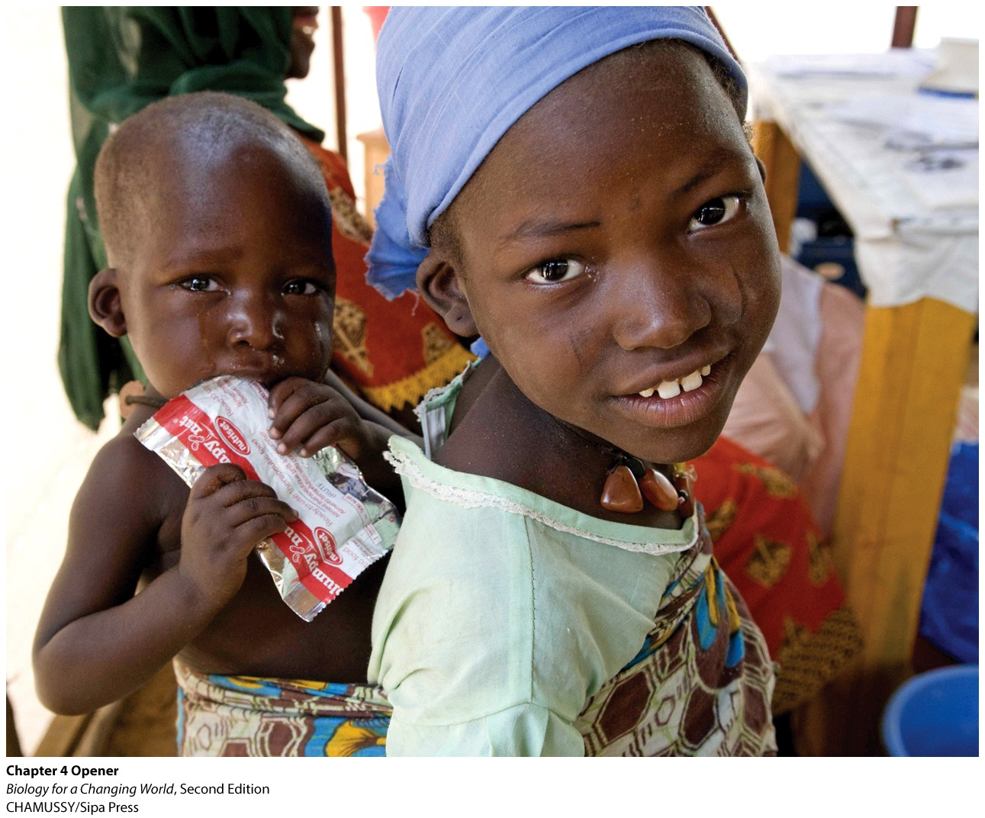
The Peanut Butter Project
Doctor’s effort to end malnutrition in Africa
A nonprofit organization using the American pantry staple to end malnutrition in Africa

Slide 5
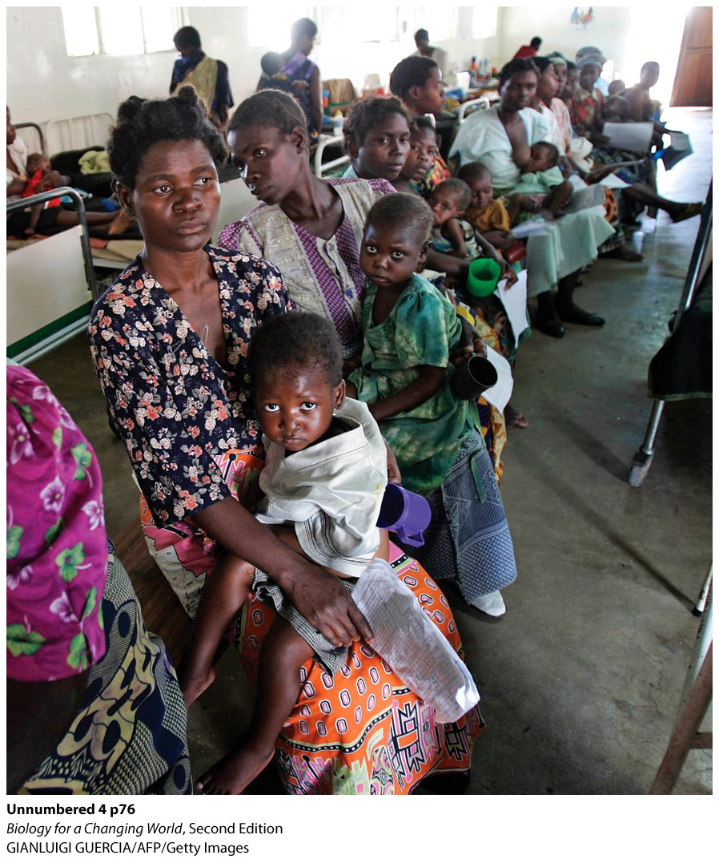
What is malnutrition?
A medical condition resulting from the lack of essential nutrients in the diet
Often, but not always, associated with starvation

Slide 6
Malnutrition around the world
Number one killer of children around the world
More die each year than the number who die from AIDS, tuberculosis, and malaria combined
Notes:
An estimated 3.5 million children die from malnutrition every year.

Slide 7
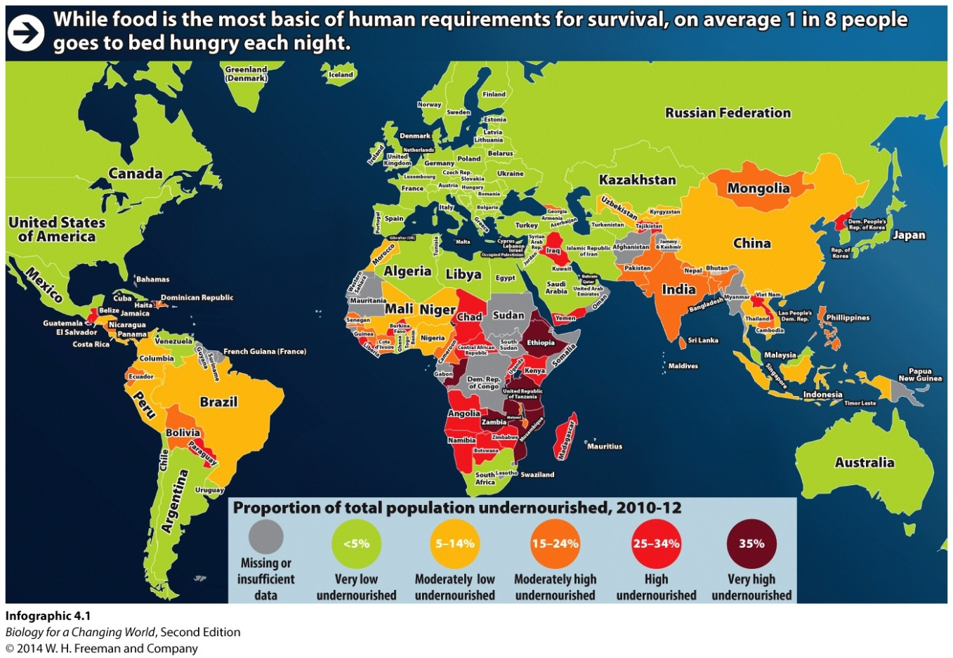
Malnutrition around the world
Most deaths occur in sub-Saharan Africa
Poverty is endemic
Food is scarce most of the year

Slide 8
Why does lack of food lead to malnutrition?
Food contains nutrients
Nutrients
The chemical building blocks our bodies need to live, grow, and repair themselves
Provide energy
Energy is the ability to do work
Powers our activities
Helps build complex muscles

Slide 9
Macronutrients
Nutrients that organisms must ingest in large amounts to maintain health
Carbohydrates, proteins, lipids (fats)

Slide 10
Food provides macronutrients
Foods contain mixtures of macronutrients
A varied diet must include
vegetables
oils
grains
meat
dairy products

Slide 11
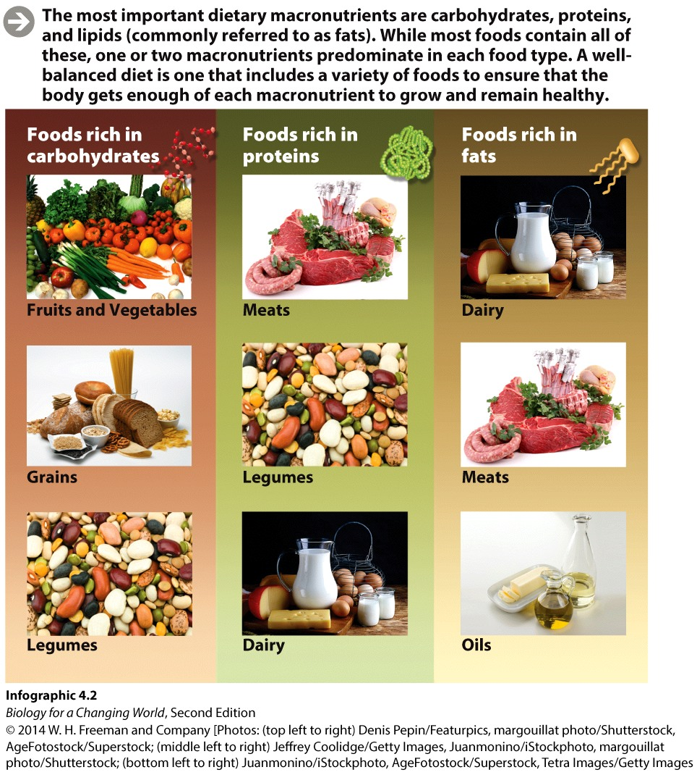
Food provides macronutrients

Slide 12
Food provides macronutrients
Many foods contain all three types of macronutrients
The proportion of each one varies in different foods
Animal products contain more protein per gram than carbohydrate
Most plant products contain more carbohydrate than protein

Slide 13
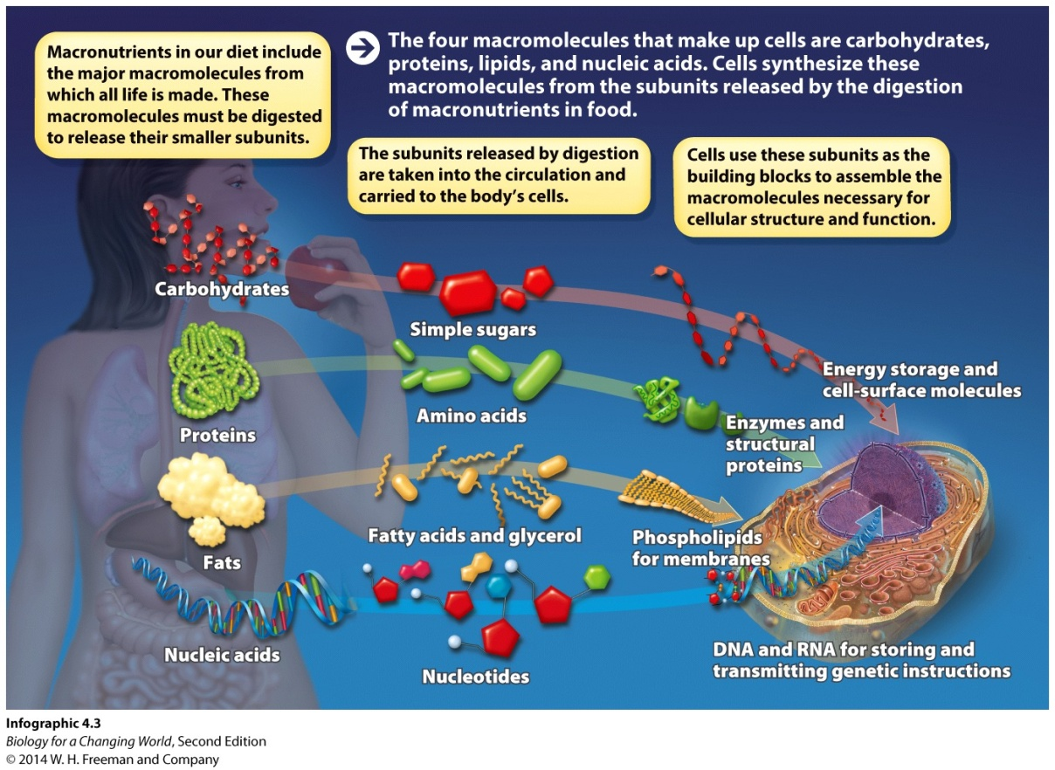
Macronutrients are large molecules
Provide our cells with building blocks
Cannot be used directly from diet
Must be broken down into smaller units
Use subunits as building blocks or energy
Process is digestion

Slide 14
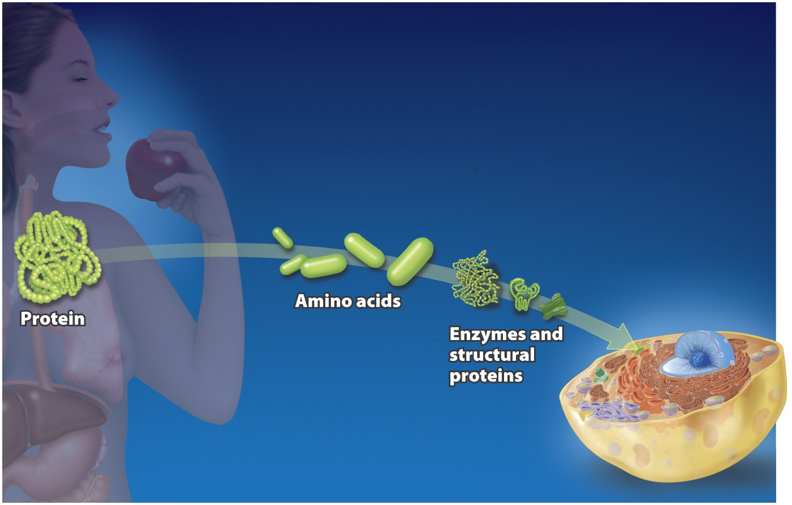
Macronutrients: proteins
Broken down into amino acids
Use to assemble new proteins that have many different functions in the body

Slide 15
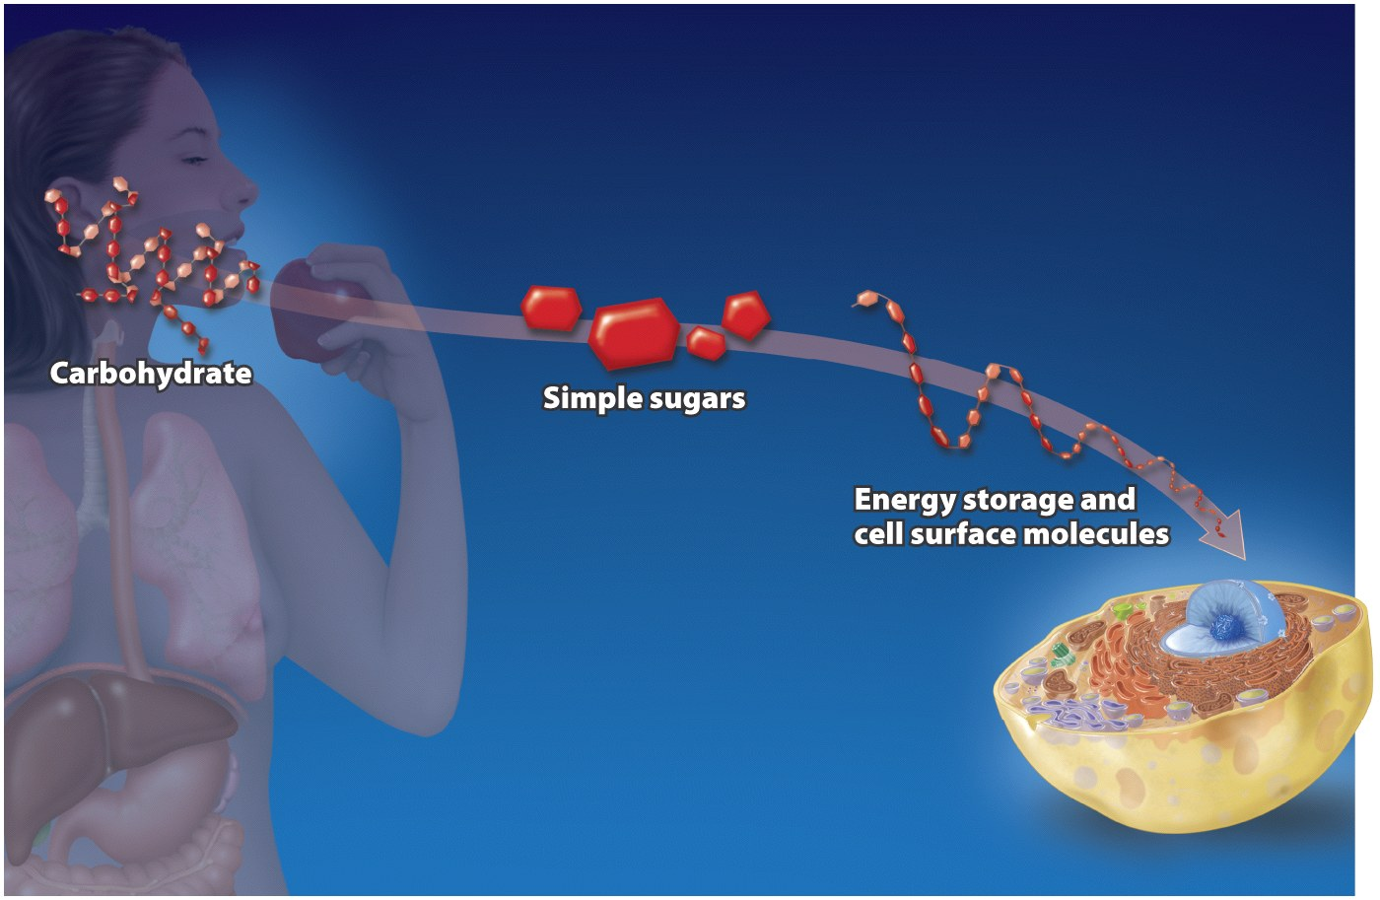
Macronutrients: carbohydrates
Broken down into simple sugars
Used to build cell-surface markers, energy-storage molecules

Slide 16
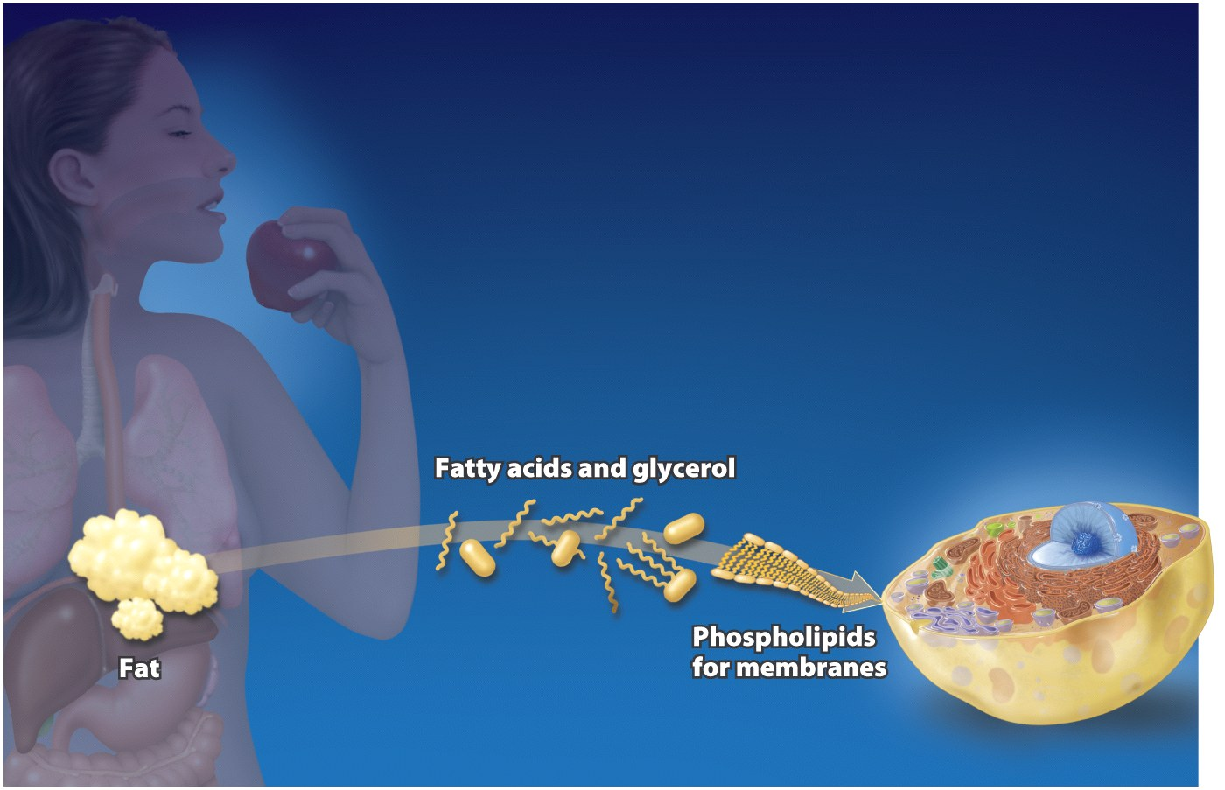
Macronutrients: fats
Broken down into fatty acids and glycerol
Used to build molecules that form cell membranes
Notes:
Used to assemble the phospholipids that make up cell membranes

Slide 17
Nucleic acids
Nucleic acids are not macronutrients
Provided in small amounts
Broken down into individual nucleotides
Used to build DNA and RNA

Slide 18
Essential nutrients
Cells cannot synthesize them
Nutrients that must be obtained through diet
Essential amino acids
20 amino acids used to build proteins
Nine cannot be synthesized
Notes:
Some nutrients our bodies can’t manufacture must be obtained pre-assembled from our diet. Animal products such as meat, eggs, fish, and dairy are the richest sources of essential amino acids, but in many places around the globe these foods are luxuries people can’t afford.

Slide 19
Complete foods
Foods that contain all the nutrients necessary
Ready-to-use food therapeutics (RUTF)
The Peanut Butter Project RUTF
Peanut butter, full-fat milk , sugar, vegetable oil
Notes:
A complete source of nutrition: “If you eat RUTF you don’t need to eat anything else.”

Slide 20
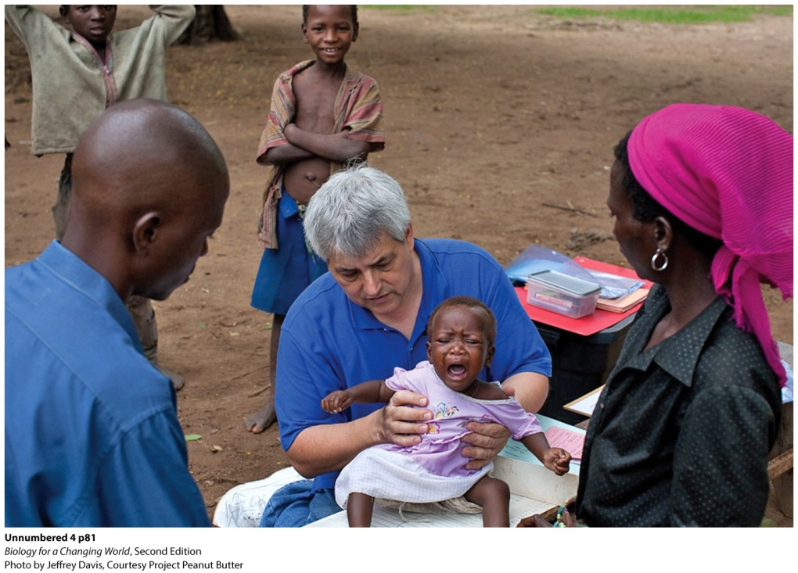
Malnutrition
Results from chronic undereating, especially up to age 2 years
The child lacks nutrients necessary for the chemical reactions of growth and development
All starts with digestion
Notes:
Physician Mark Manary, founder of The Peanut Butter Project, tends to a malnourished child.

Slide 21
What is digestion?
Process of breaking down huge food molecules into smaller pieces so that our body can use them
Series of chemical reactions to break the bonds that hold food molecules together
Starts in our mouths and continues throughout the digestive system

Slide 22
Metabolism
All the chemical reactions occurring in the body
Catabolic reactions break down larger structures into smaller ones (bond breaking)
Anabolic reactions build new structures from smaller subunits (bond building)
Requires the assistance of helper molecules called enzymes

Slide 23
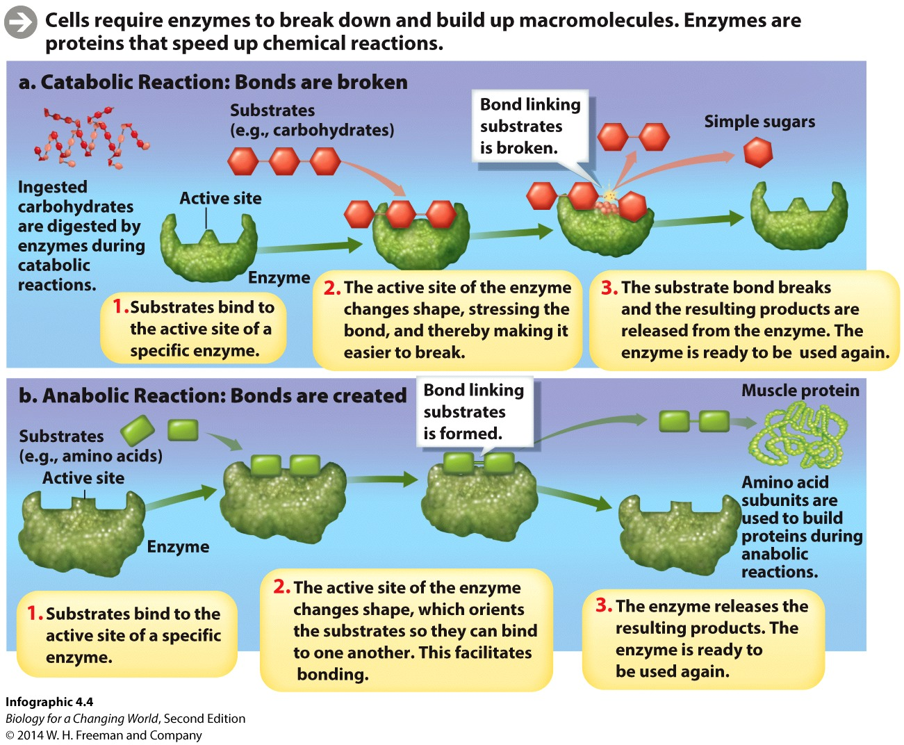
Metabolism
Notes:
Cells require enzymes to break-down and build-up macromolecules. Enzymes are proteins that speed up chemical reactions.

Slide 24
Metabolism: enzymes
Enzyme: protein that speeds up a chemical reaction
Substrate: molecule to which an enzyme binds and on which it acts
Active site: part of an enzyme that binds to the substrate

Slide 25
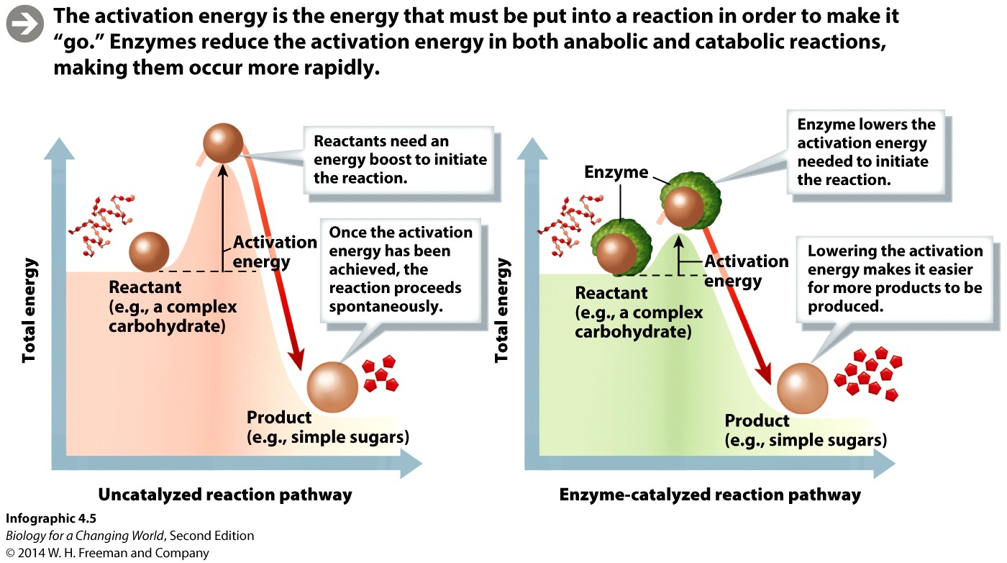
Metabolism: enzymes
Catalysis: the process of speeding up the rate of a chemical reaction (e.g., by enzymes)
Activation energy: energy required for a chemical reaction to proceed
Notes:
Activation energy is the energy that must be put into a reaction in order to make it “go.” Enzymes reduce the activation energy in both anabolic and catabolic reactions, making them occur more rapidly.

Slide 26
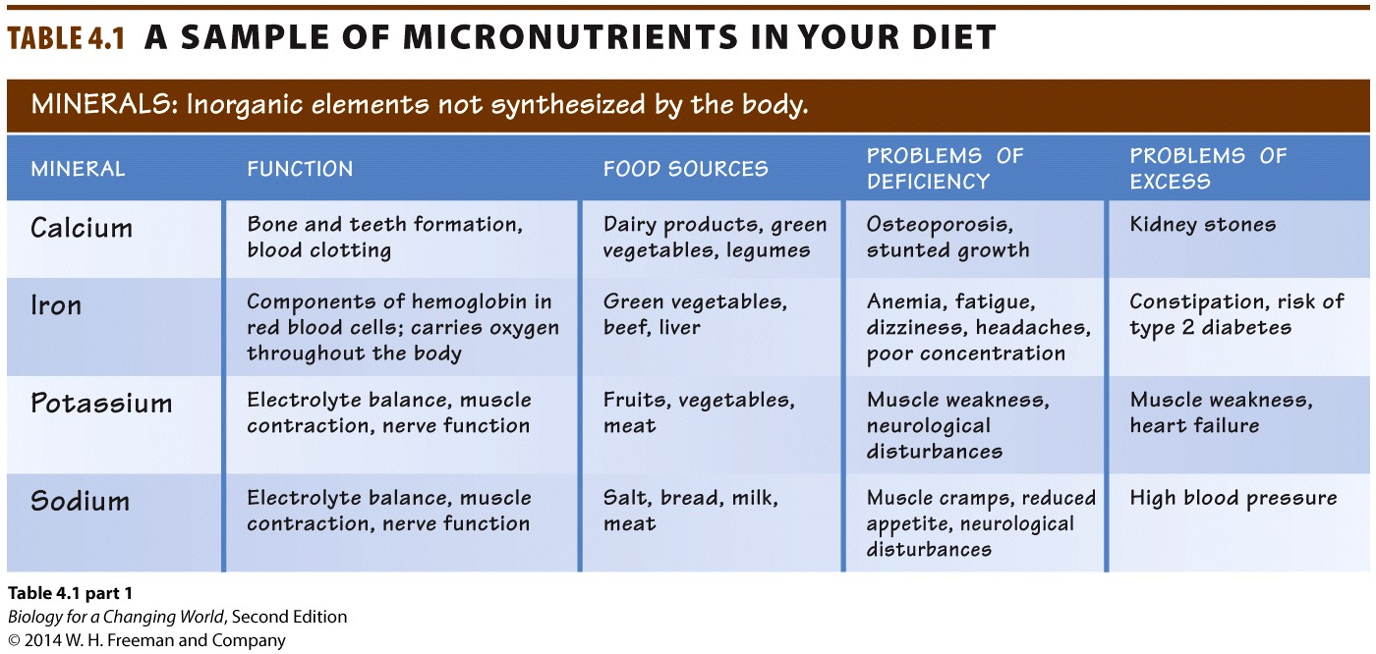
Metabolism: micronutrients
Organisms also need micronutrients
nutrients, including vitamins and minerals, that organisms must ingest in small amounts to maintain health

Slide 27
Micronutrients
Minerals act as cofactors
inorganic micronutrients required to activate an enzyme
zinc, copper, iron
Vitamins act as coenzymes
small organic molecules required to activate enzymes

Slide 28
Micronutrients
Minerals: inorganic elements required by organisms for normal growth, reproduction, and tissue maintenance.
For example: calcium, iron, potassium, zinc
Vitamins: organic molecules required in small amounts for normal growth, reproduction, and tissue maintenance
Play structural and functional roles in the body
Notes:
Bones are made primarily of calcium and phosphorus provided by a healthy diet. Iron deficiency causes a blood disease called anemia, and lack of vitamin C causes a tissue-deteriorating disease called scurvy.

Slide 29
Micronutrients
Notes:
Minerals are micronutrients: nutrients that are essential for health but required in far smaller amounts than macronutrients.

Slide 30
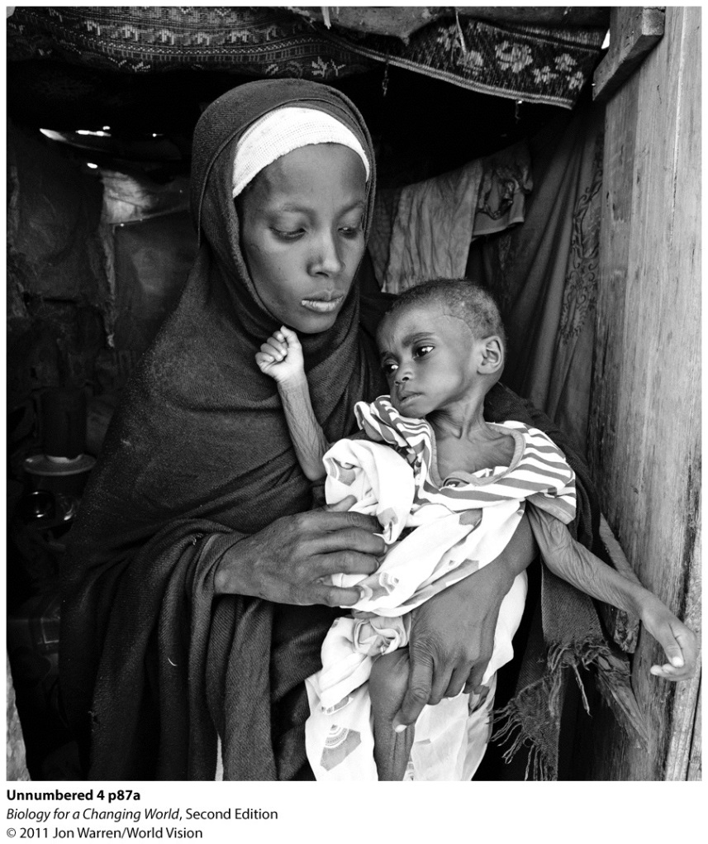
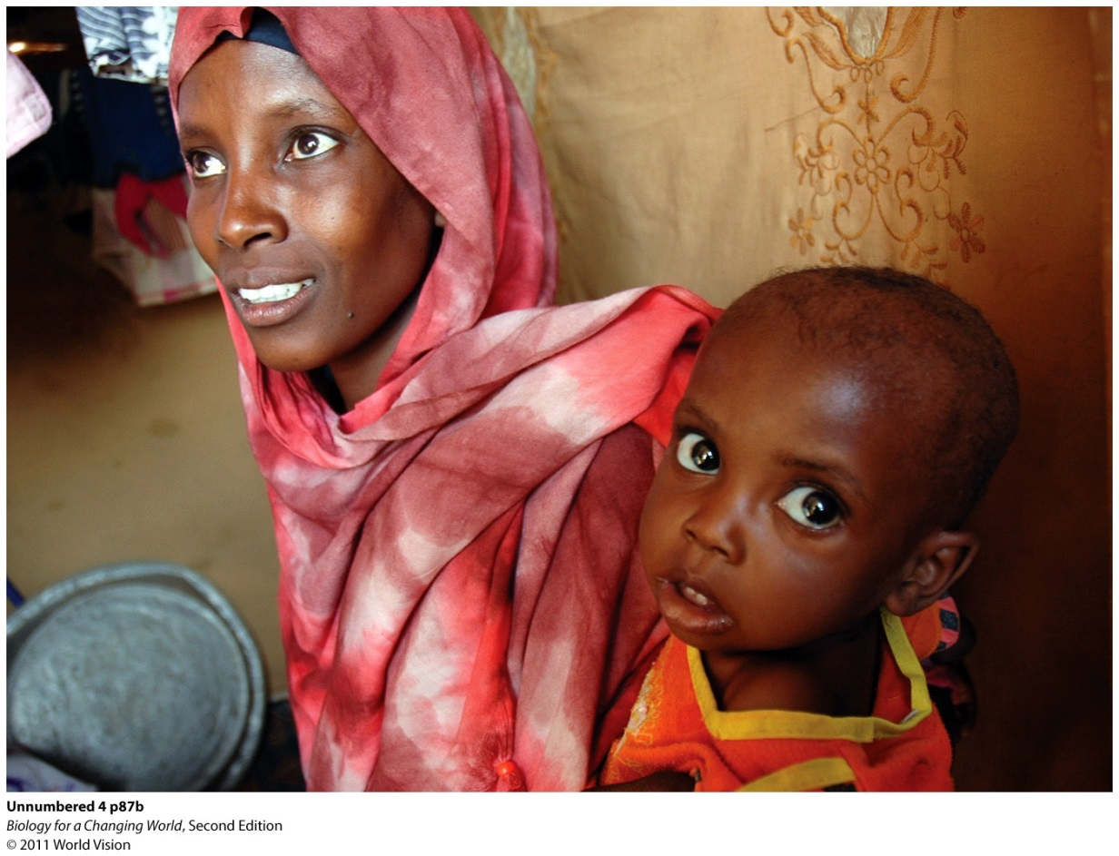
The Peanut Butter Project
Ninety-five percent of hospitalized children who received peanut butter–based RUTF recovered from malnutrition
Notes:
Before and after: For many children in Malawi, peanut butter RUTF has been a lifesaver.

Slide 31
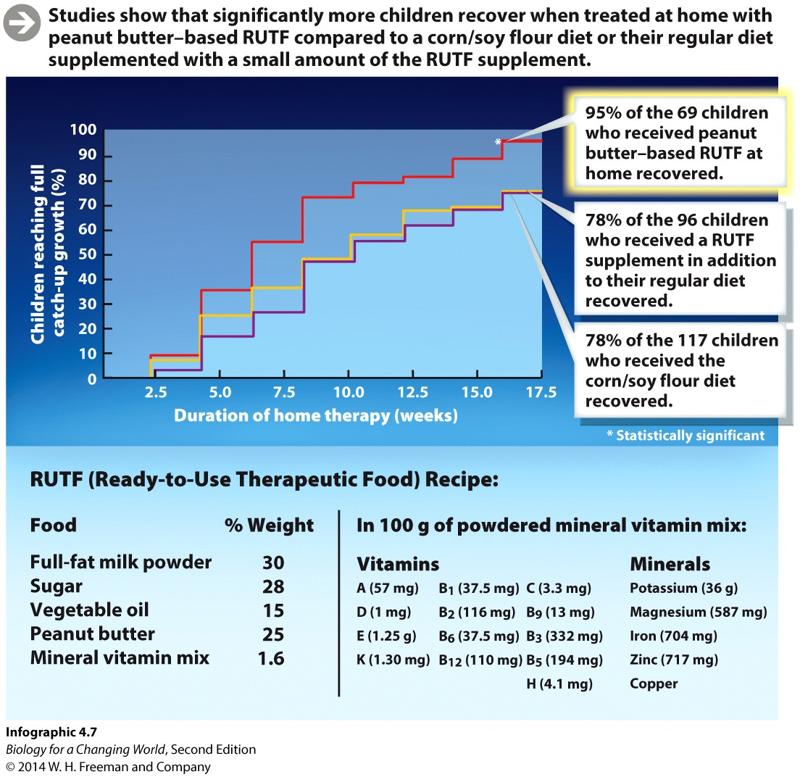
The Peanut Butter Project
Notes:
Studies show that significantly more children recover when treated at home with peanut butter– based RUTF compared to a corn/soy flour diet or their regular diet supplemented with a small amount of the RUTF supplement.
SOURCE: Manary, M. J., et al. (2004) Home based therapy for severe malnutrition with ready-to-use food. Archives of Disease in Childhood 89:557–561.

Slide 32
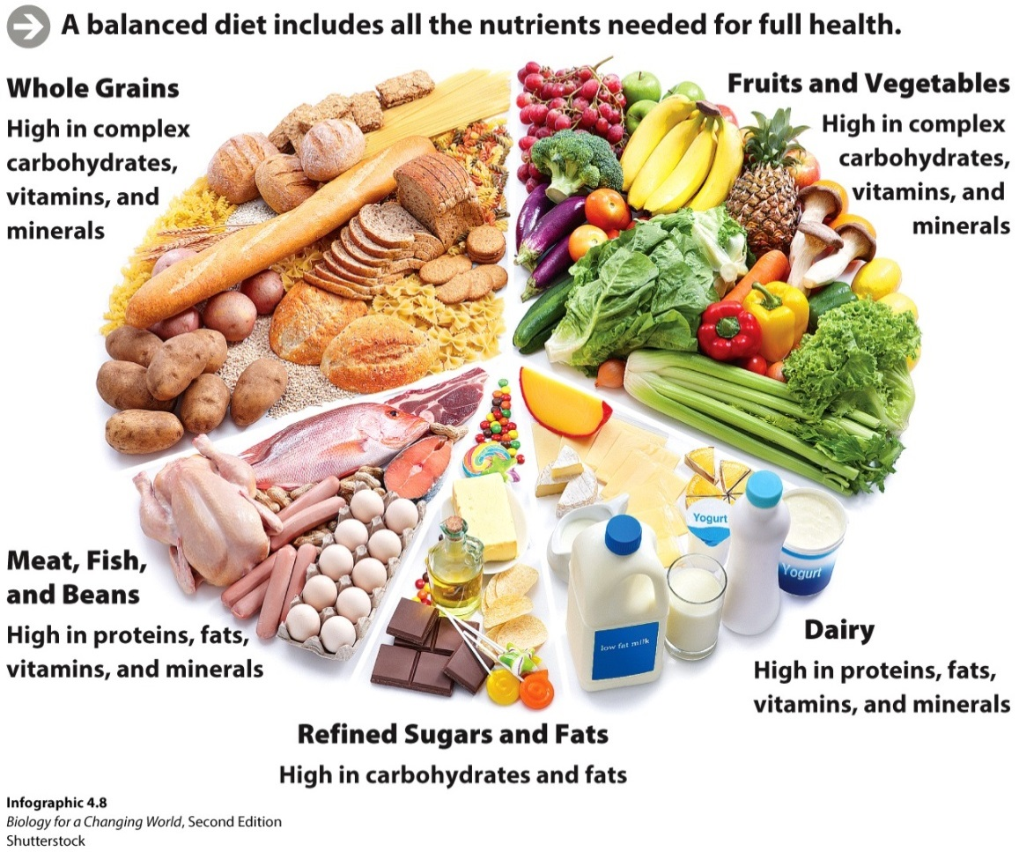
A balanced diet
Most nutritionists recommend that fruits, vegetables, and whole grains make up the largest portion of our diet

Slide 33
Summary
Food is a source of nutrients. Nutrients provide the chemicals required to build and maintain cells and tissues and furnish cells with the energy needed to function.
Nutrients required in large amounts are called macronutrients; nutrients required in smaller amounts are called micronutrients.
Enzymes are proteins that accelerate the rate of chemical reactions by binding specifically to substrates and reducing the activation energy necessary for a reaction to occur.
Enzymes mediate both bond-breaking (catabolic) and bond-building (anabolic) reactions.
Many enzymes require small “helper” chemicals known as cofactors to function. Micronutrients such as minerals and vitamins are important coenzymes.

