Slide 1
Michèle Shuster • Janet Vigna • Gunjan Sinha • Matthew Tontonoz
Biology for a
Changing World
SECOND EDITION
Lecture PowerPoint
CHAPTER 5
Energy Flow and Photosynthesis
Copyright © 2014 by W. H. Freeman and Company

Slide 2
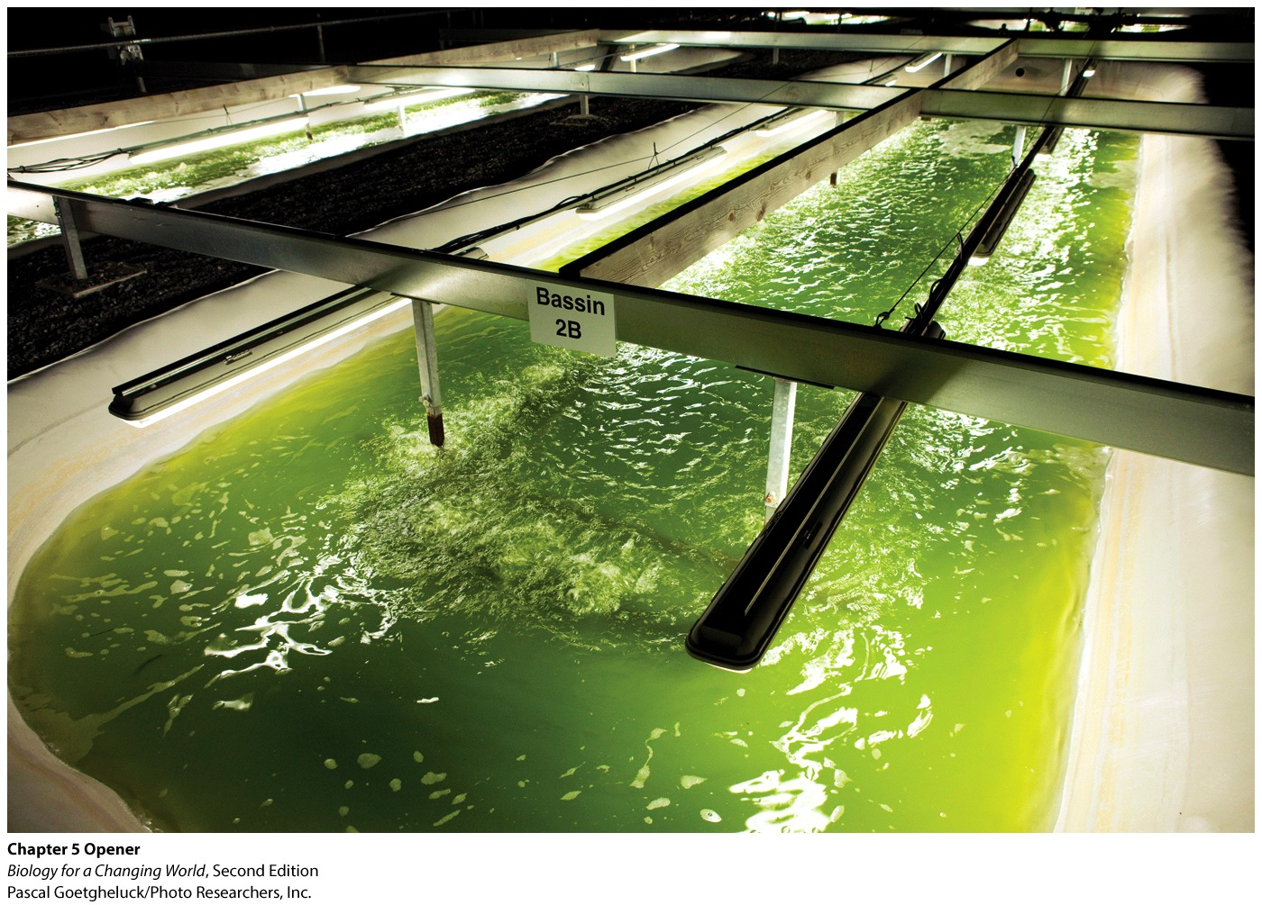
Chapter 5
Energy Flow and Photosynthesis
Copyright © 2014 by W. H. Freeman and Company
Notes:
The future of fuel: Scientists hope to make algae into the next global energy source.

Slide 3
Driving Questions
What are the photosynthetic organisms on the planet, and why are they so important?
What are the different types of energy and what transformations of energy do organisms carry out?
How do plants and algae convert the energy in sunlight into energy-rich organic molecules? (and why can’t humans do this?)
How do algal biofuels compare to other fuels in terms of costs, benefits, and sustainability?

Slide 4
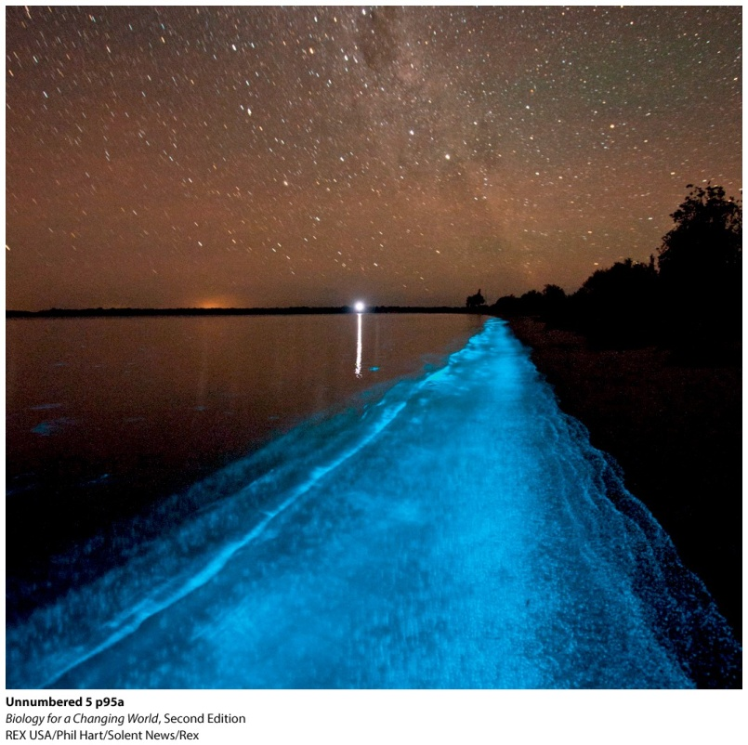
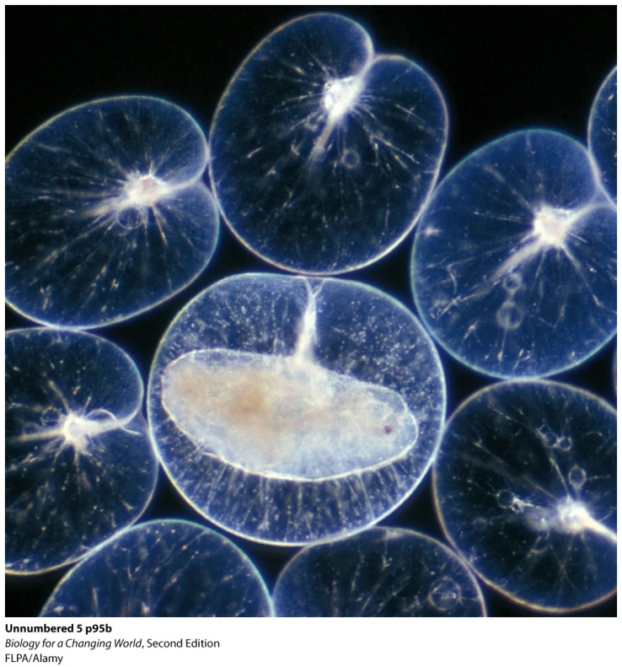
Using algae to make fuel
Algae are best known for the green, red, or brown hues
Also have ability to capture energy of sunlight and convert it into usable forms of energy
Much is in the form of oils ideally suited to making fuel
Notes:
Photo bioluminescent algae glow in the tide along a beach.
The oil that microalgae produce is very similar to common vegetable oil. It accumulates inside the microbes’ tiny cells, and once extracted, it can be processed to make biodiesel.

Slide 5
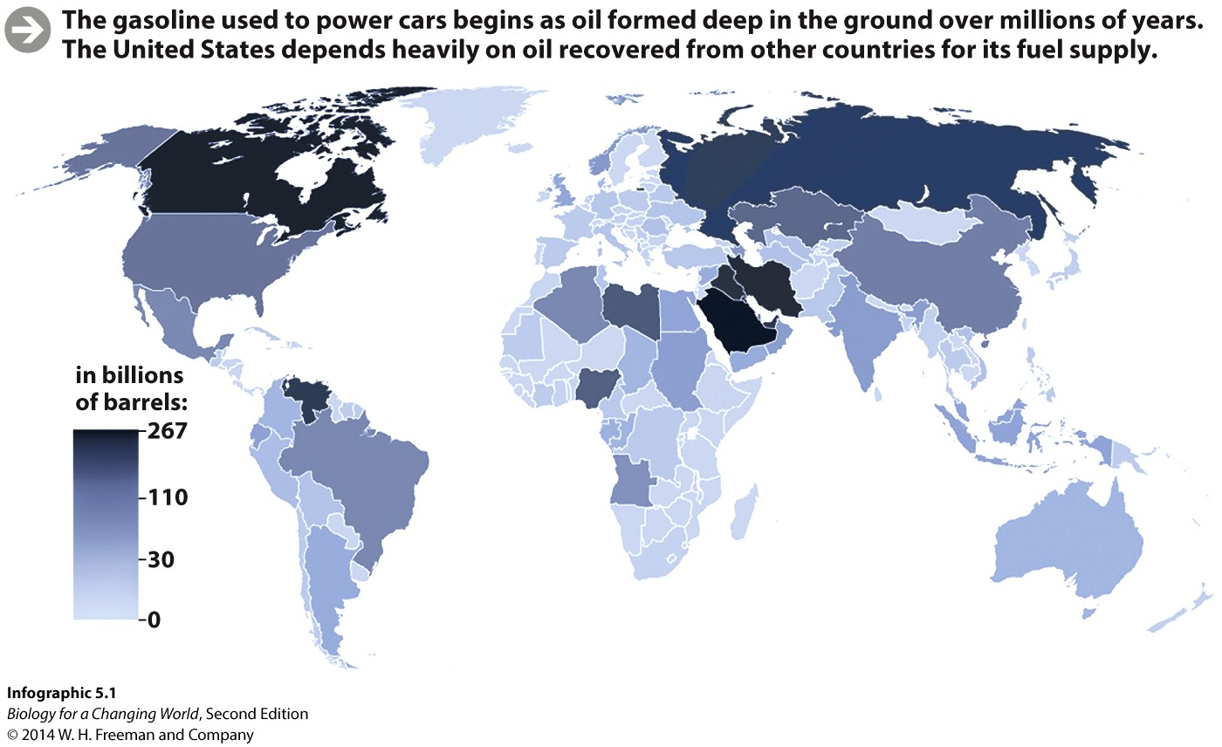
Fossil fuels are limited
Demand for oil will increase over next 25 years
Sources of oil are finite
Takes millions of years to replenish
Notes:
The gasoline used to power cars begins as oil formed deep in the ground over millions of years. The United States depends heavily on oil recovered from other countries for its fuel supply.

Slide 6
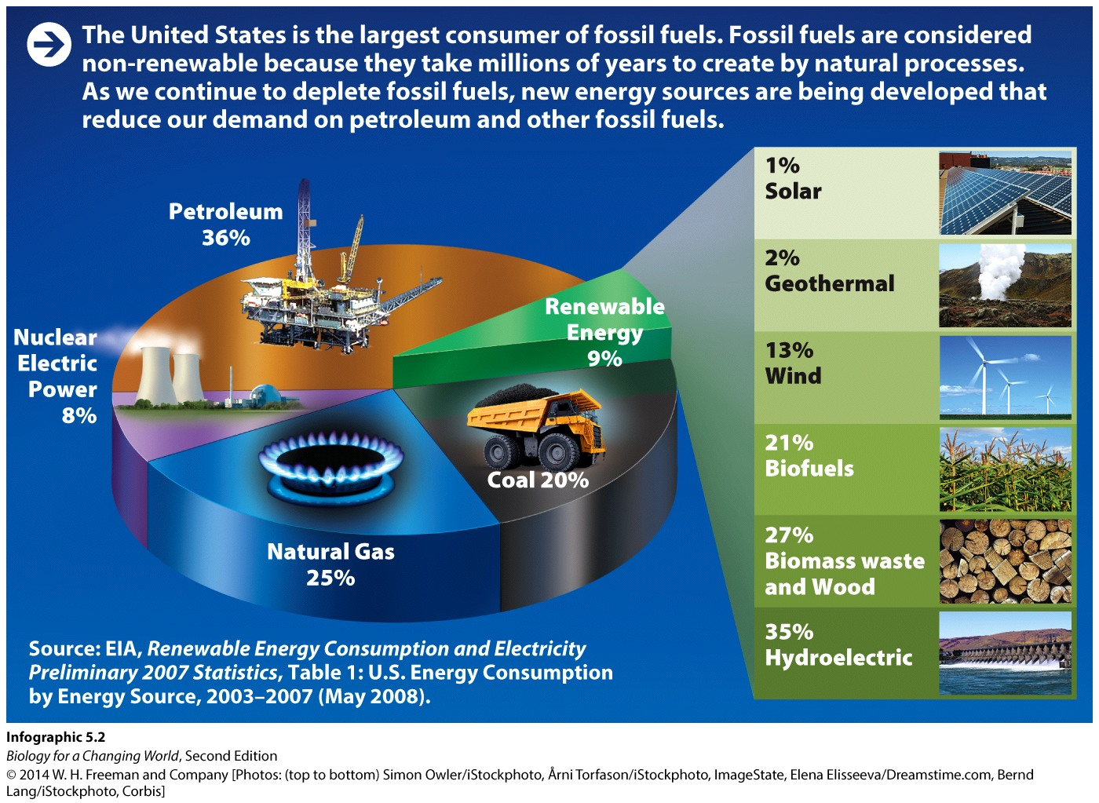
U.S. energy consumption
The United States is the largest consumer of fossil fuels
New energy sources being developed to reduce our demand
Notes:
The United States is the largest consumer of fossil fuels. Fossil fuels are considered nonrenewable because they take millions of years to create by natural processes.

Slide 7
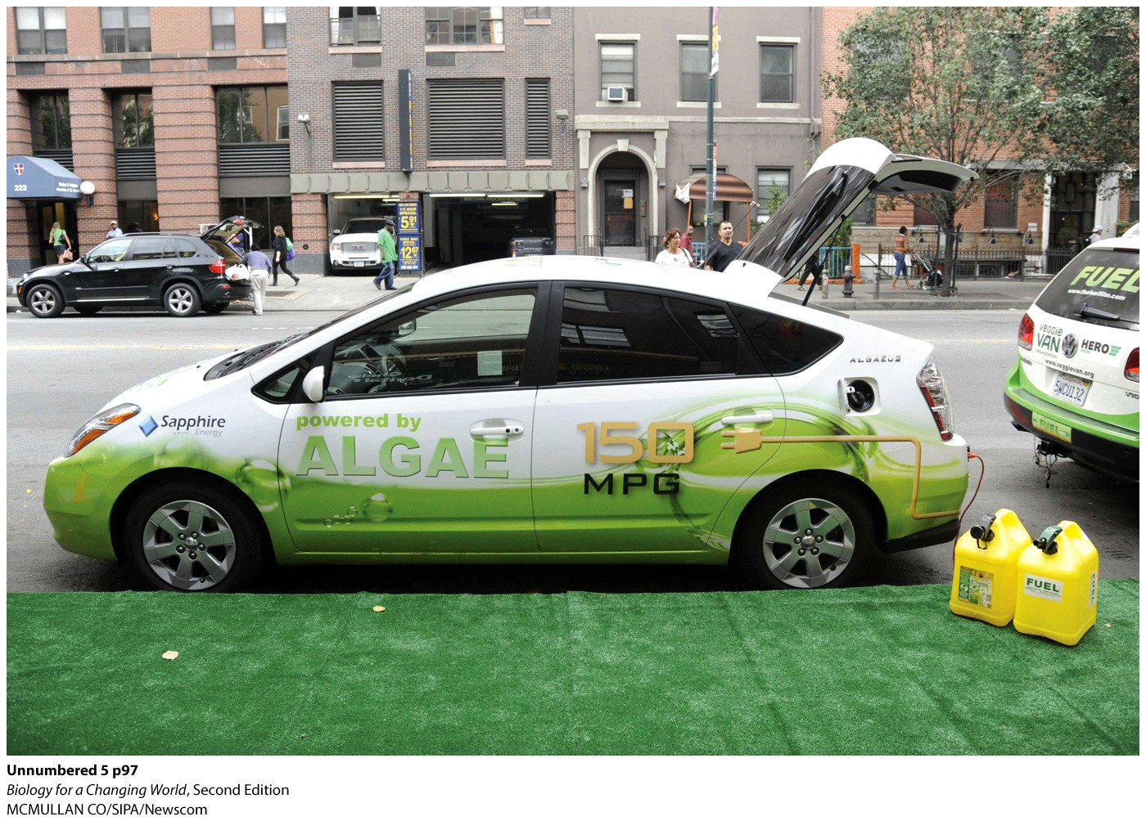
Biofuels
Renewable fuels made from living organisms
In 2012, more than 150 companies were dedicated to making fuel from algae
Notes:
The United States must produce 36 billion gallons of renewable fuels by 2022, of which 21 billion gallons must be advanced biofuels.

Slide 8
Energy basics
Energy
  capacity to do work
  includes processes such as building complex molecules and moving substances in and out of the cells
Without a source of energy, all life on Earth would stop

Slide 9
Energy basics
Energy cannot be created
Humans and other animals obtain energy by eating food
Chemical energy
  potential energy stored in bonds of biological molecules
  break bonds to release stored energy to do work

Slide 10
Energy basics
Algae and plants get energy from sun
Trap energy and store it in molecules
Biofuel produces high in chemical energy

Slide 11
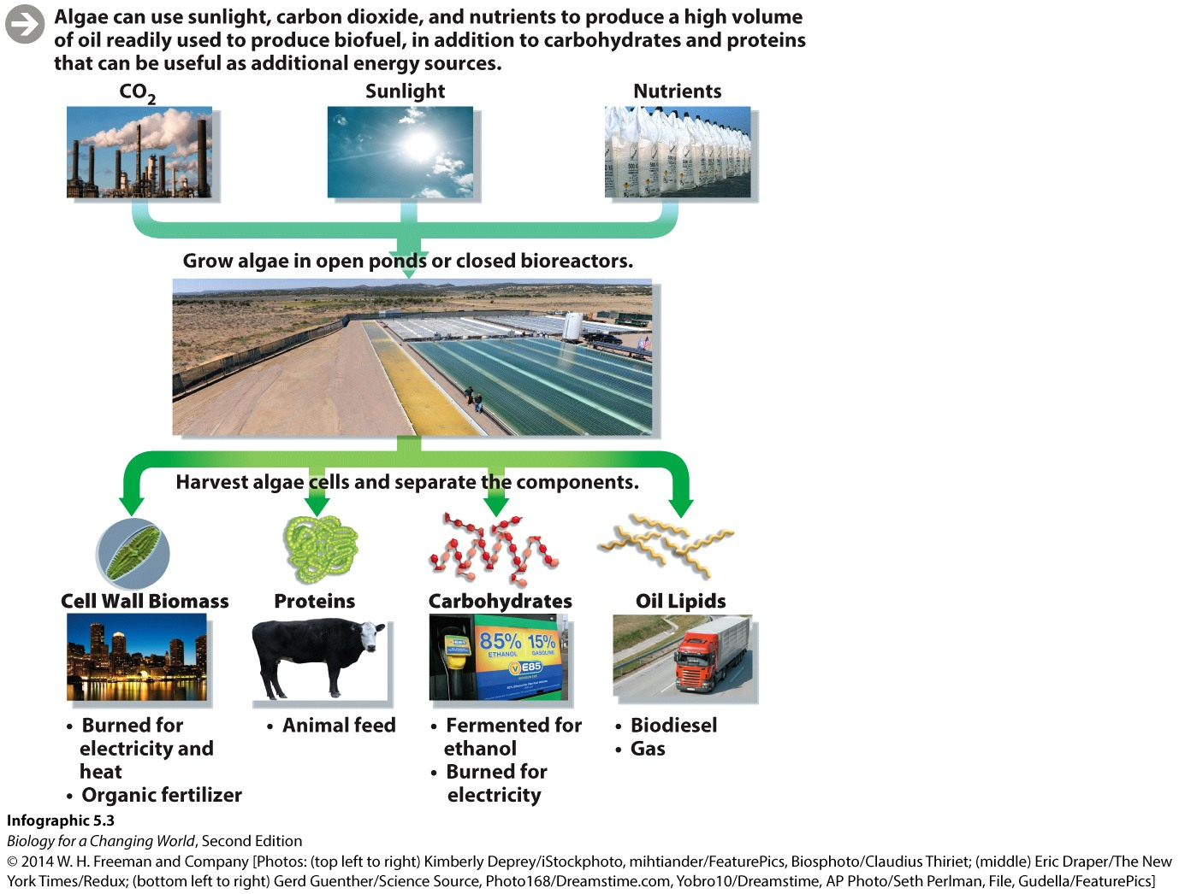
Energy basics
Notes:
Algae capture energy in their molecules.

Slide 12
Energy is conserved
Energy cannot be created or destroyed
Energy can change form
Conservation of energy

Slide 13
Energy is conserved
Potential energy - stored energy in the chemical bonds
Kinetic energy - the energy of motion or movement
Heat - the kinetic energy generated by random movement of molecules or atoms

Slide 14
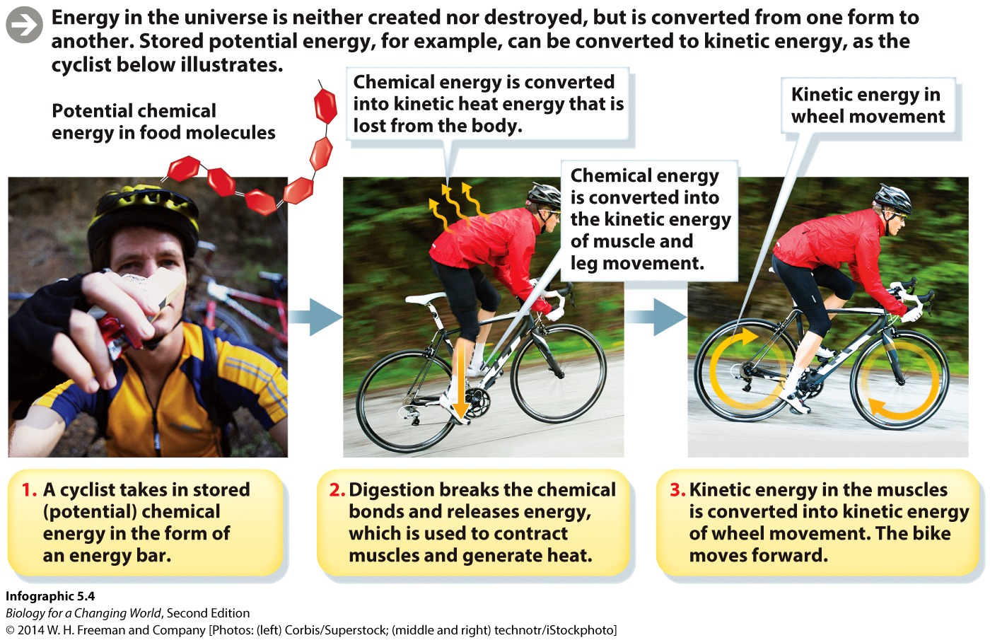
Energy is conserved
Notes:
Energy in the universe is neither created nor destroyed, but is converted from one form to another. Stored potential energy, for example, can be converted to kinetic energy, as the cyclist illustrates.

Slide 15
Energy is conserved
A cyclist takes in potential chemical energy in the form of an energy bar

Slide 16
Energy is conserved
The cyclist digests the bar, chemical bonds are broken down, and stored potential energy is released

Slide 17
Energy is conserved
As the cyclist climbs a hill, potential energy is transformed into kinetic energy and heat
Notes:
From the energy bar to the spinning wheels, energy is converted from one form to another. With every conversion, some energy is lost as heat.

Slide 18
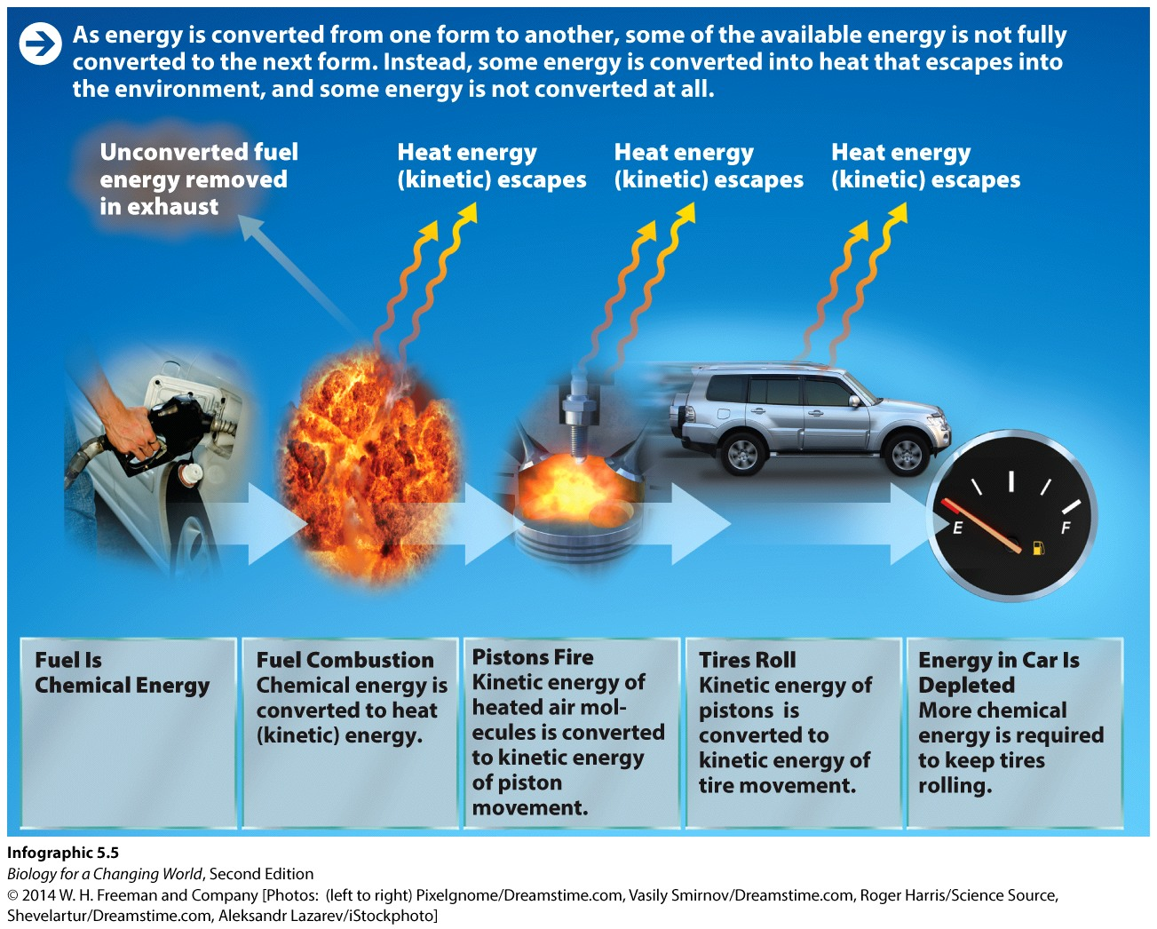
Energy transformation is not efficient
With each energy transformation, some energy is lost as heat
This is why we need to keep supplying energy to any system

Slide 19
Capturing energy: photosynthesis
Photosynthesis
Process by which plants and other autotrophs use the energy of sunlight to make energy-rich molecules
Uses carbon dioxide and water

Slide 20
Capturing energy: photosynthesis
The ultimate source of energy is the sun
Autotrophs capture and transform the energy of sunlight by photosynthesis
Heterotrophs obtain energy by eating other organisms

Slide 21
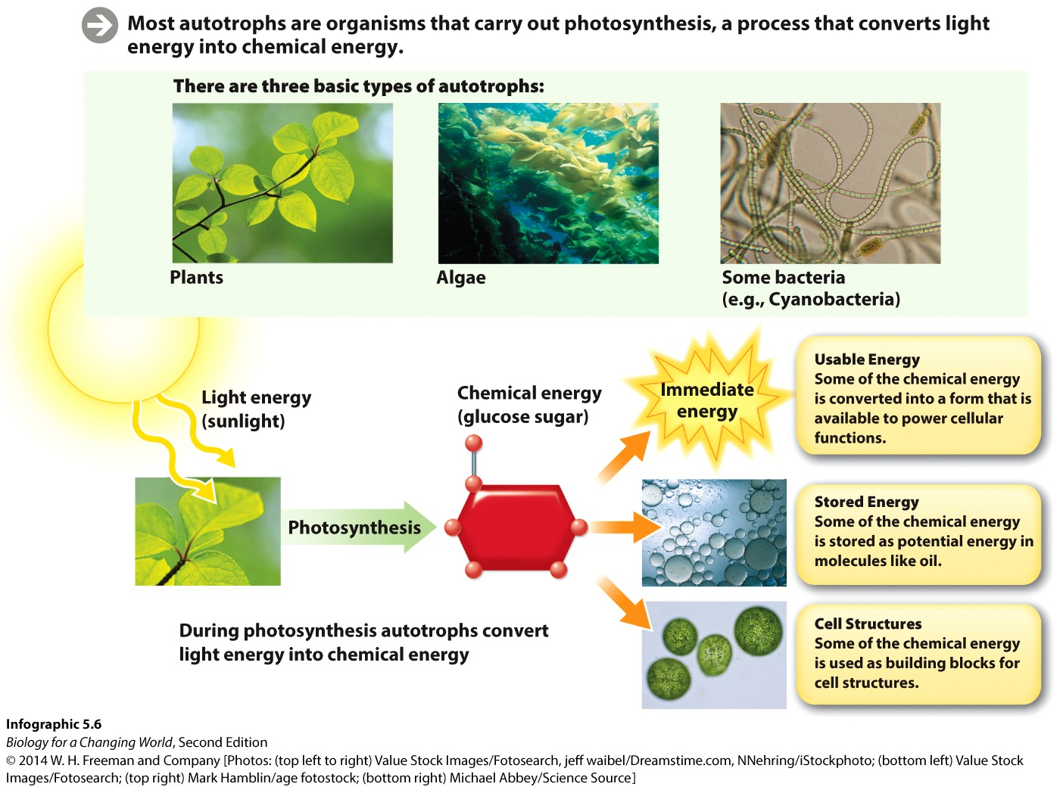
Capturing energy: photosynthesis
Notes:
Plants and other photosynthesizers use the energy of sunlight to make the molecule glucose using carbon dioxide as a source of carbon. In the process, water molecules are split and oxygen is given off as a by-product.

Slide 22
Capturing energy: photosynthesis
Photosynthesis can be summarized as
Sunlight + Water + Carbon Dioxide → Oxygen + Glucose

Slide 23
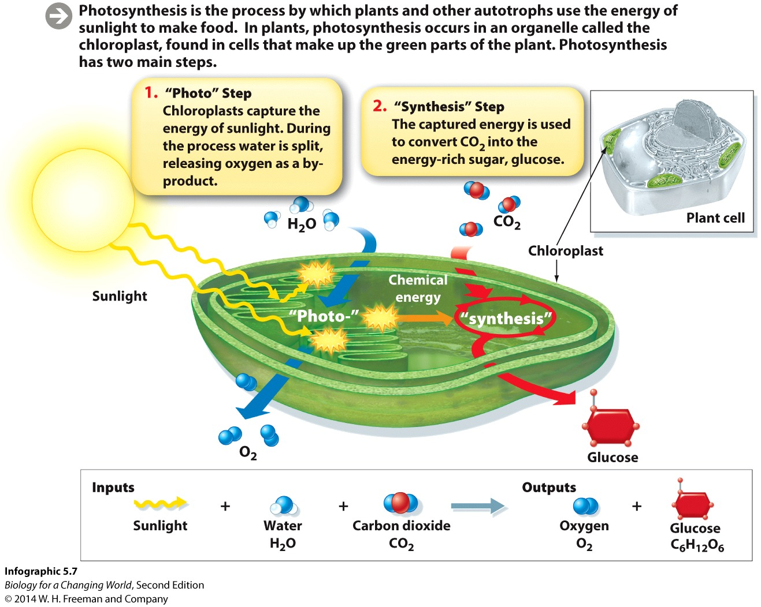
Capturing energy: photosynthesis
Photosynthesis occurs in chloroplasts – organelles present in cells of plants and algae
Notes:
Chloroplast: the organelle in plant and algae cells where photosynthesis occurs.

Slide 24

Capturing energy: photosynthesis
Photosynthesis has two parts
A “photo” part and a “synthesis” part

Slide 25
Capturing energy: photosynthesis
Light energy is captured in chemical form
Chemical energy is used to generate glucose molecules using the carbon atoms of carbon dioxide

Slide 26
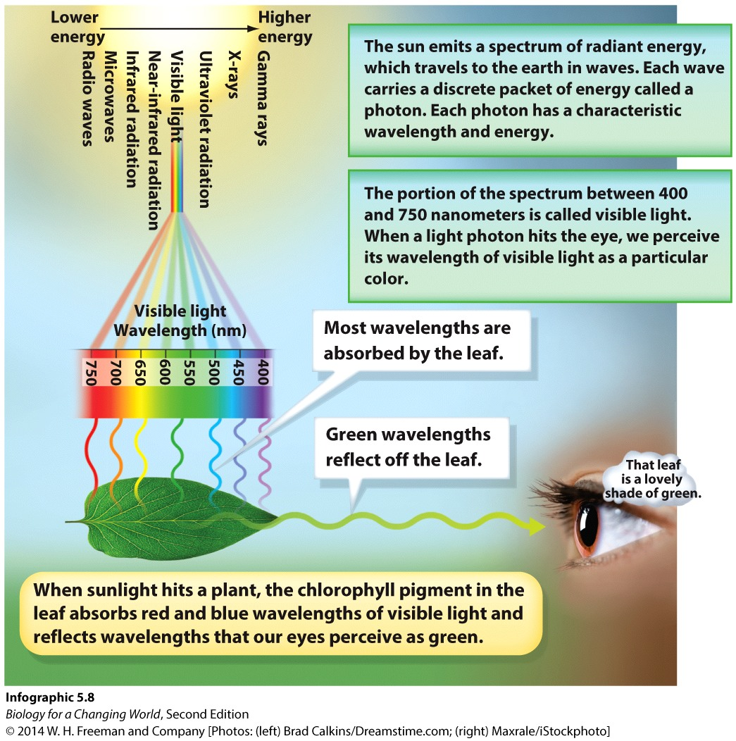
Sunlight energy
Light energy is the energy of the electromagnetic spectrum of radiation

Slide 27
Sunlight energy
Light energy is made of particles called photons, or packets of light energy
Photons of different wavelengths contain different amounts of energy

Slide 28
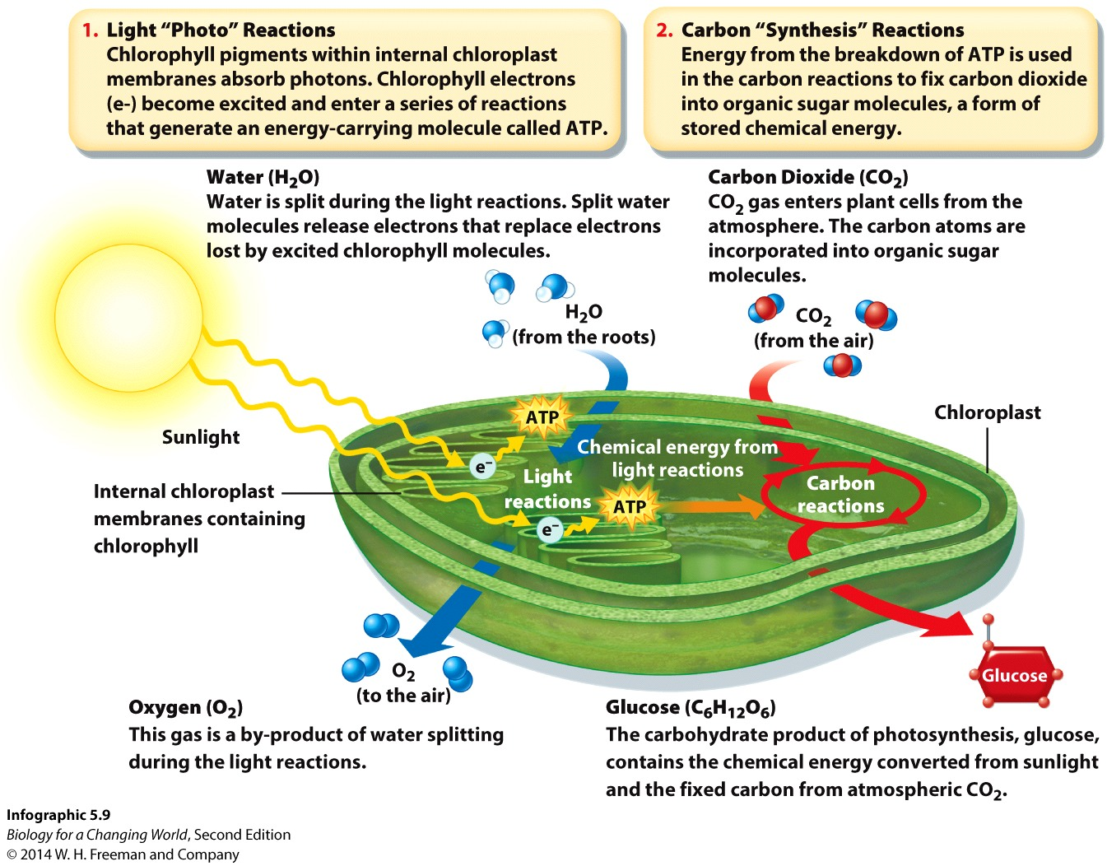
Photosynthesis: a closer look
Chlorophyll is a pigment present in the green parts of plants
It absorbs photons of light energy

Slide 29
Photosynthesis: a closer look
Photons of light are absorbed by chlorophyll
Electrons in the chlorophyll atoms become “excited”
Excited electrons help generate an energy-carrying molecule known as adenosine triphosphate (ATP)
ATP is used to make sugar
Notes:
When red and blue photons of sunlight hit chlorophyll during the light (“photo”) reactions, the electrons in its atoms become excited.

Slide 30
Photosynthesis: a closer look
Photosynthesis captures carbon dioxide gas from the air
Incorporates carbon atoms into sugar
Carbon fixation
Notes:
Sugar is glucose, the building block of carbohydrates.

Slide 31
Carbon fixation
Conversion of inorganic gaseous carbon into an organic molecule
Used by autotrophs and heterotrophs
Main way carbon enters the global energy chain

Slide 32
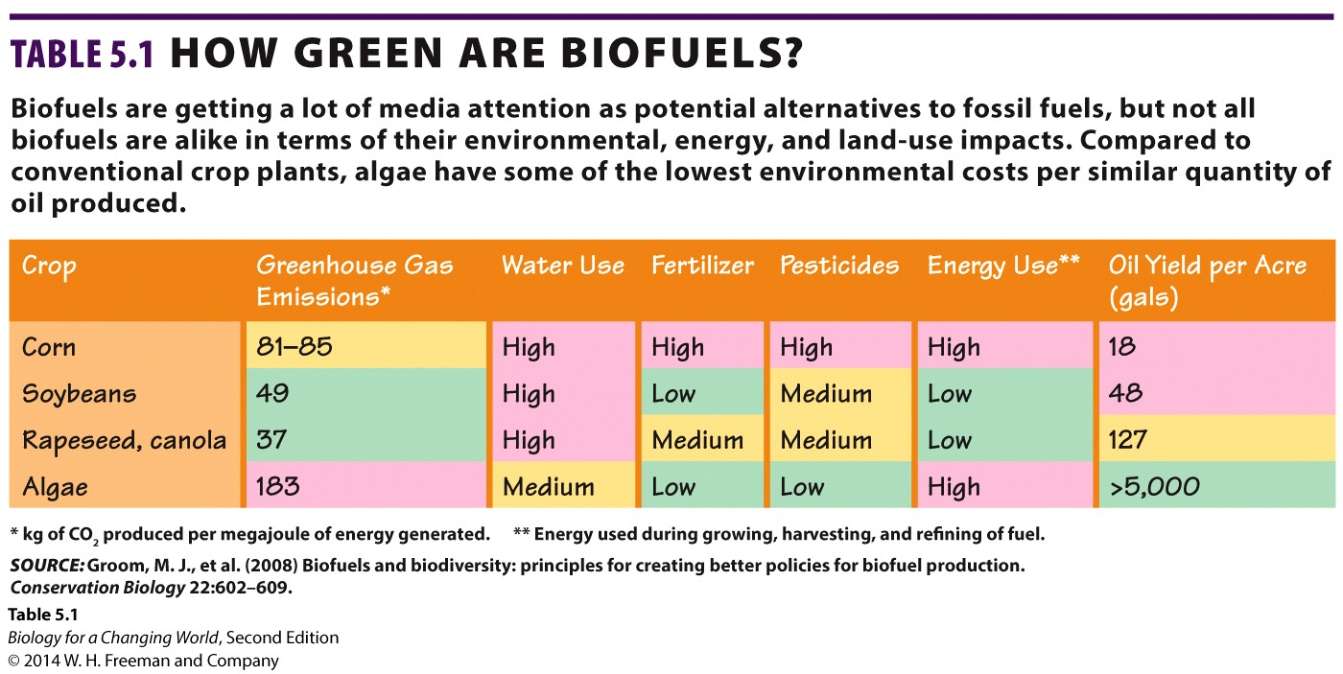
How green are biofuels?
Notes:
Extracting fuel from algae is also less energy intensive than extraction from other biofuel sources. To make ethanol, for instance, farmers typically start with corn, which requires more energy to grow than algae.

Slide 33
Summary
All living organisms require energy to live and grow. The ultimate source of energy on Earth is the sun.
Energy is neither created nor destroyed, but converted from one form to another. Kinetic energy is the energy of motion and includes heat energy and light energy. Potential energy is stored energy and includes chemical energy.
Photosynthesis is a series of chemical reactions that captures the energy of sunlight and converts it to chemical energy in the form of sugar and other energy-rich molecules.
Photosynthetic organisms are known as autotrophs. Animals do not photosynthesize; they are known as heterotrophs.

