Slide 1
Michèle Shuster • Janet Vigna • Gunjan Sinha • Matthew Tontonoz
Biology for a
Changing World
SECOND EDITION
Lecture PowerPoint
CHAPTER 6
Dietary Energy and
Cellular Respiration
Copyright © 2014 by W. H. Freeman and Company

Slide 2
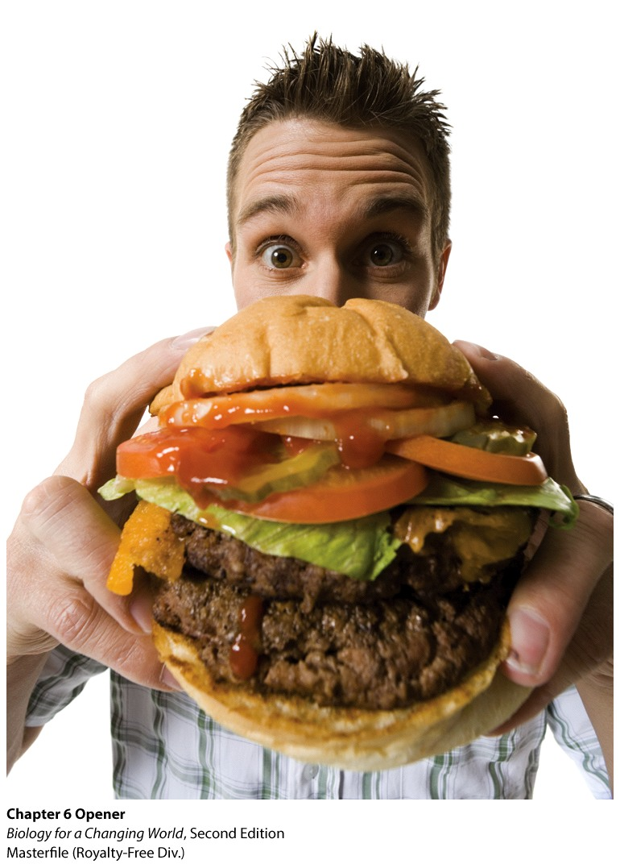
Chapter 6
Dietary Energy and
Cellular Respiration

Slide 3
Driving Questions
Why do humans weigh more than in the past?
How does the body use the energy in food?
How does aerobic respiration extract useful energy from food?
When does fermentation occur, and why can’t it sustain human life?

Slide 4
Why are people getting heavier?
Global obesity rates have doubled since 1980
Biology
Evolution has driven our bodies to adapt to famine so we store extra food as fat
Culture
How we eat and how much we eat
Notes:
Biologists argue that humans are predisposed to gain weight. Throughout human evolution, famine was the norm, and people had to work hard to grow or hunt and gather their food.

Slide 5
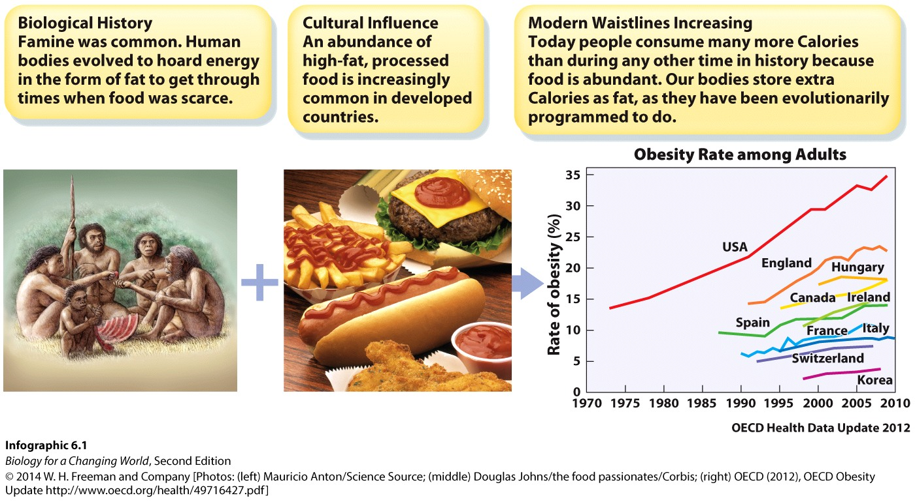
Why are people getting heavier?
Notes:
Obesity is influenced by biology and culture.
American eating habits include fast-food, processed snacks, soda, and large portion sizes.

Slide 6
Obesity is influenced by biology and culture

Slide 7
How heavy is too heavy?
Obese: 20% more fat than recommended for one’s height
Gender, body type, and frame size taken into account
Obesity leads to increased rates of heart disease, diabetes, and other related illnesses

Slide 8
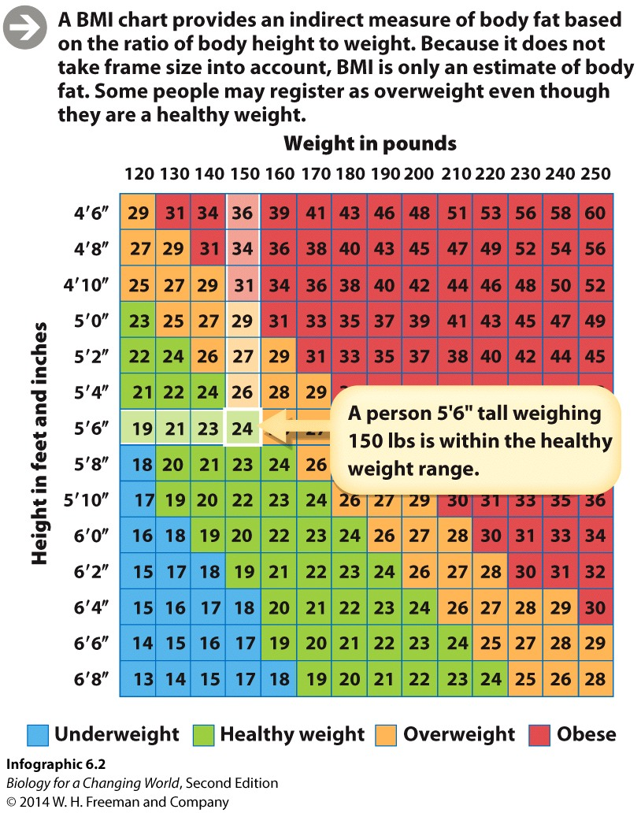
Body mass index (BMI)
Body mass index (BMI) estimates body fat based on height and weight
Notes:
BMI is used by health care professionals to get a rough estimate about whether a person is at risk for health problems related to their weight.

Slide 9
Body mass index (BMI)
Overweight:
BMI = 25 to 29.9
Obese:
BMI = 30 or higher
Notes:
Obesity is having 20% more body fat than is recommended for that height.

Slide 10
Body mass index (BMI)
BMI doesn’t account for muscle mass, gender, or frame size

Slide 11
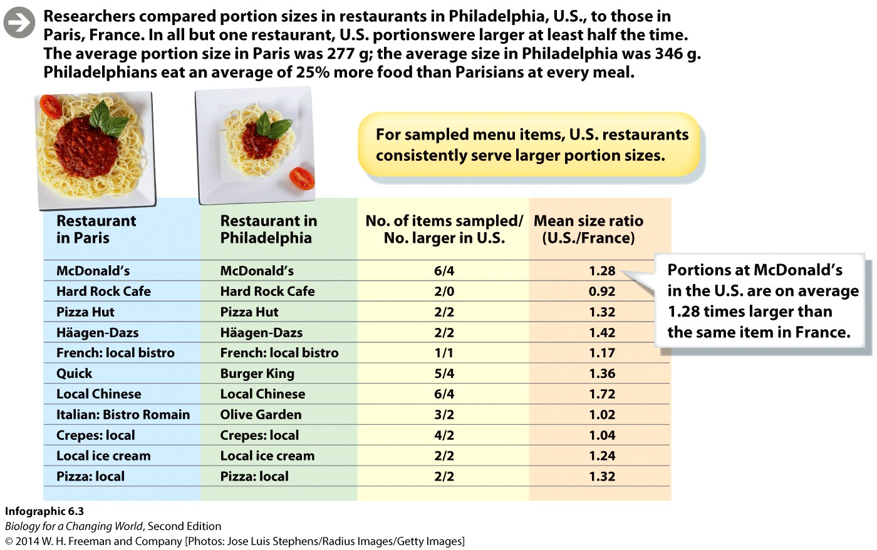
Why are Americans getting heavier?
Notes:
Researchers compared portion sizes in restaurants in Philadelphia, PA, with those in Paris, France. In all but one restaurant, U.S. portions were larger at least half the time. The average portion size in Paris was 277g; the average portion size in Philadelphia was 346g. Philadelphians eat an average of 25% more food than Parisians at every meal.

Slide 12
Why are Americans getting heavier?
Notes:
Taking it slow: the French have a distinct culture of eating.

Slide 13
Why does eating food lead to weight gain?
Food is not only a source of nutrition; it is also a source of energy—the power to do work
calories (c)
the amount of energy required to raise the temperature of 1 g of water by 1°C
Food energy is measured in Calories (capital C)
equal to 1000 calories, or 1 kilocalorie (kcal)

Slide 14
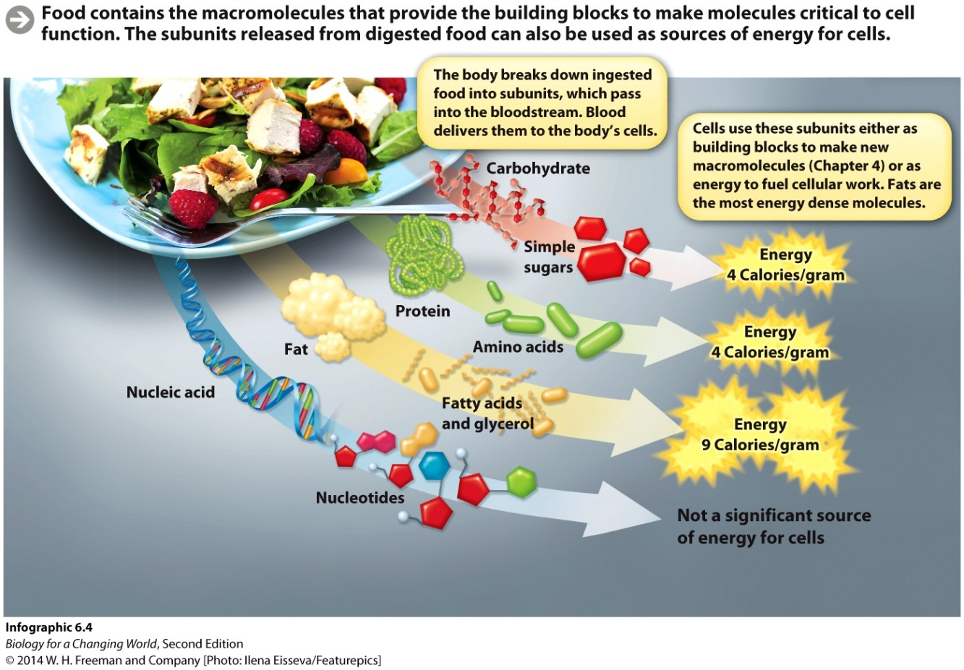
Food is a source of energy
Food contains macromolecules
Broken down into building blocks or subunits
Used to make new molecules and as sources of energy
Notes:
Food is a source of chemical energy.

Slide 15
Food is source of energy
Macromolecules contain different amounts of stored energy
Fat contains 9 C/g
Protein and carbohydrate contains 4 C/g
Nucleic acids are not a significant source of stored energy

Slide 16
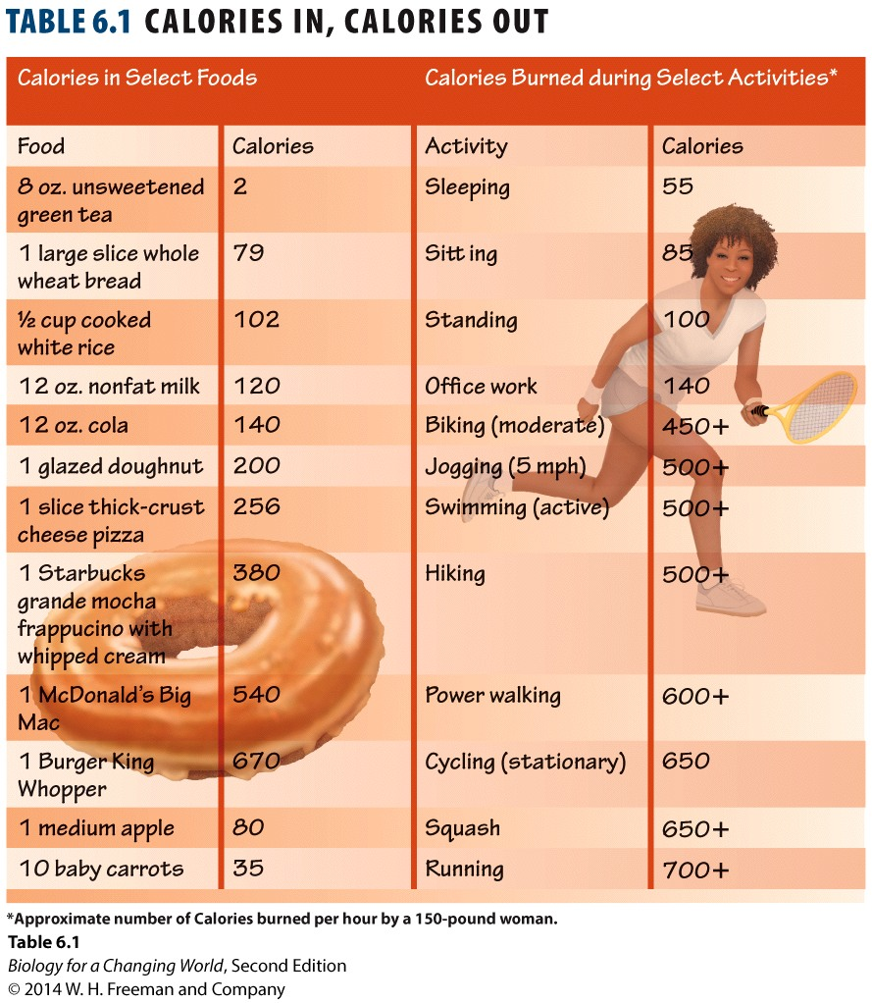
Food is source of energy
Not everyone burns Calories at the same rate
Genetics, muscle mass, and gender all have an effect as well
Notes:
Genetics plays a large role in how much food each one of us actually needs. There are other factors too. Men, because their bodies naturally produce more muscle-building hormones than do women’s bodies, generally have more muscle mass and therefore need to eat more than women do. Since muscle cells require more calories than fat cells, the ratio of muscle mass compared with fat content in our bodies is another factor.

Slide 17
Storing excess Calories
Animals store extra energy as
glycogen in muscle and liver cells
triglycerides in fat cells

Slide 18
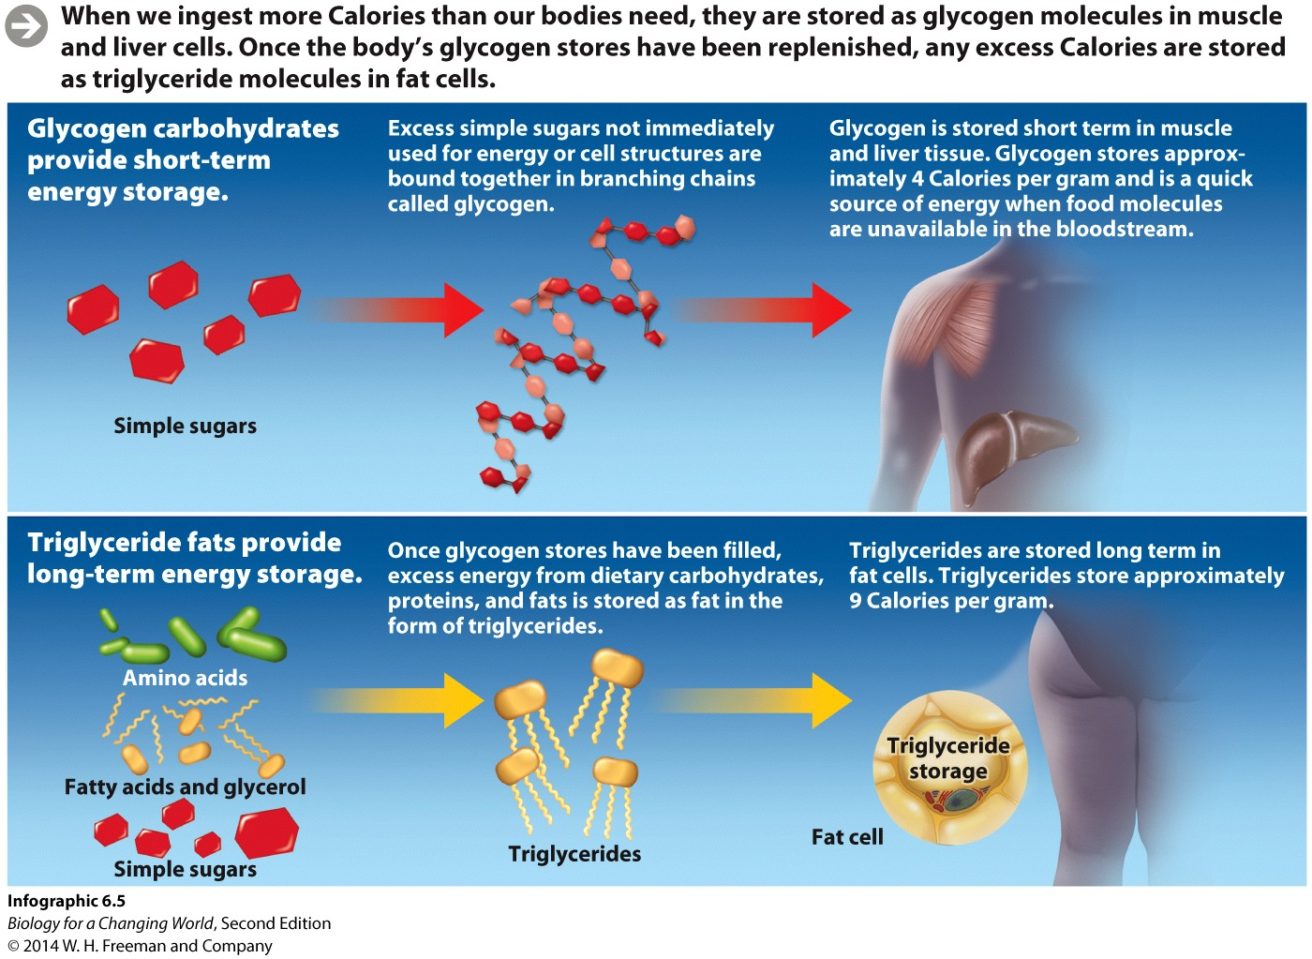
Storing excess Calories
Glycogen is a complex animal carbohydrate, made up of linked chains of glucose molecules. Glycogen is used in our body as short-term energy storage.
Notes:
When we ingest more Calories than our bodies need, they are stored as glycogen molecules in muscle and liver cells. Once the body’s
glycogen stores have been replenished, any excess Calories are stored as triglyceride molecules in fat cells.

Slide 19
Storing excess Calories
Triglycerides are a type of lipid found in fat cells that are used for long-term energy storage
Notes:
Once glycogen stores are refilled, excess Calories are stored as triglyceride molecules in fat cells.

Slide 20
Burning excess Calories
The body burns fat only after it has used up food molecules in the bloodstream and in stored glycogen

Slide 21
Burning excess Calories
Each type of macromolecule stores a different amount of energy
More energy taken in than is needed = excess stored as fat
Notes:
When more food energy is taken in than is used to power cellular reactions and physical movement, the excess (minus what is released as heat with every energy conversion) is stored as fat.

Slide 22
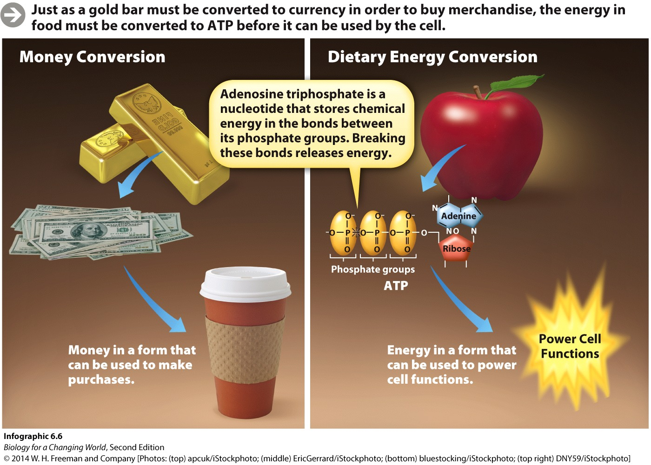
Extracting energy from food
Energy from food is ultimately captured in the molecule adenosine triphosphate (ATP)
Notes:
Food must be broken down into its component subunits—among them, fats and sugars. Then, these breakdown products must go through a series of biochemical reactions that convert the chemical energy stored into a form of fuel we can use.
Energy from food is ultimately captured in a molecule called adenosine tri- phosphate (ATP) that our cells use to carry out energy-requiring functions.

Slide 23
Extracting energy from food
ATP chemical bonds are broken, energy is released, allowing the cells to do work

Slide 24
Extracting energy from food
Through digestion, our bodies break food molecules into their smaller subunits
Subunits enter the bloodstream, where they are carried to the body’s cells

Slide 25
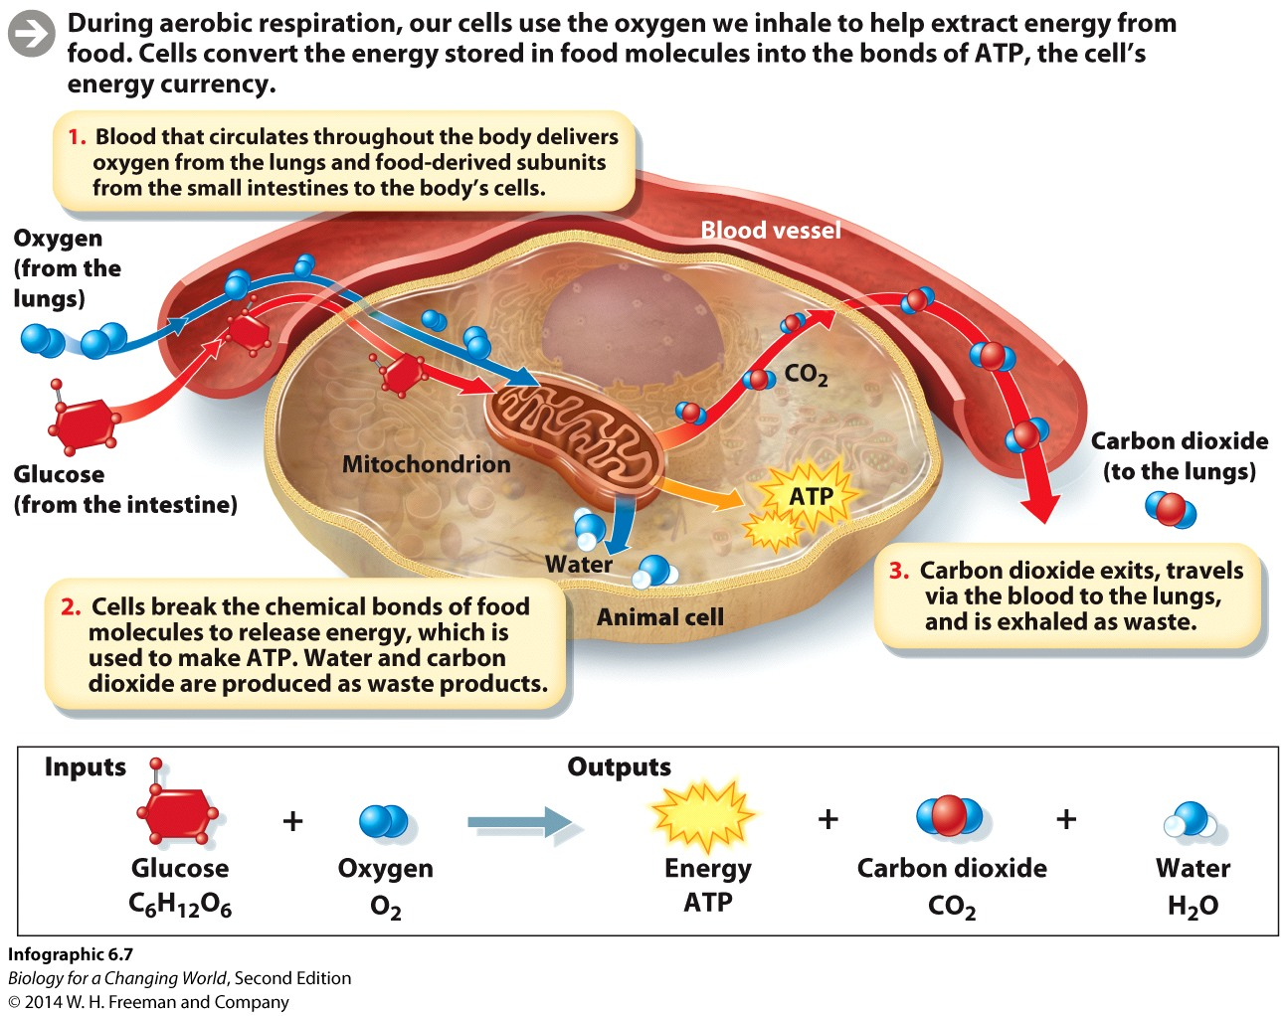
Extracting energy from food
Inside the cells, enzymes break the bonds holding the subunits together
Potential chemical energy stored in the bonds is captured and converted into molecular bonds that make up ATP

Slide 26
Extracting energy from food
Aerobic respiration
a series of reactions that converts stored food energy into ATP
occurs in presence of oxygen
Notes:
Aerobic respiration transfers food energy to ATP.
During aerobic respiration, our cells use the oxygen we inhale to help extract energy from food. Cells convert the energy stored in food molecules into the bonds of ATP, the cell’s energy currency.

Slide 27
Extracting energy from food
Glucose is the most common source of energy for all organisms
Aerobic respiration of glucose is summarized as
Glucose + Oxygen → Carbon Dioxide + Water + Energy (+ Heat)

Slide 28
Extracting energy from food
Notes:
Aerobic respiration: cells use the oxygen we inhale to help extract the energy from food, bonds of glucose are broken, the energy released is used to form ATP and heat. Water and carbon dioxide are given off as waste products.

Slide 29
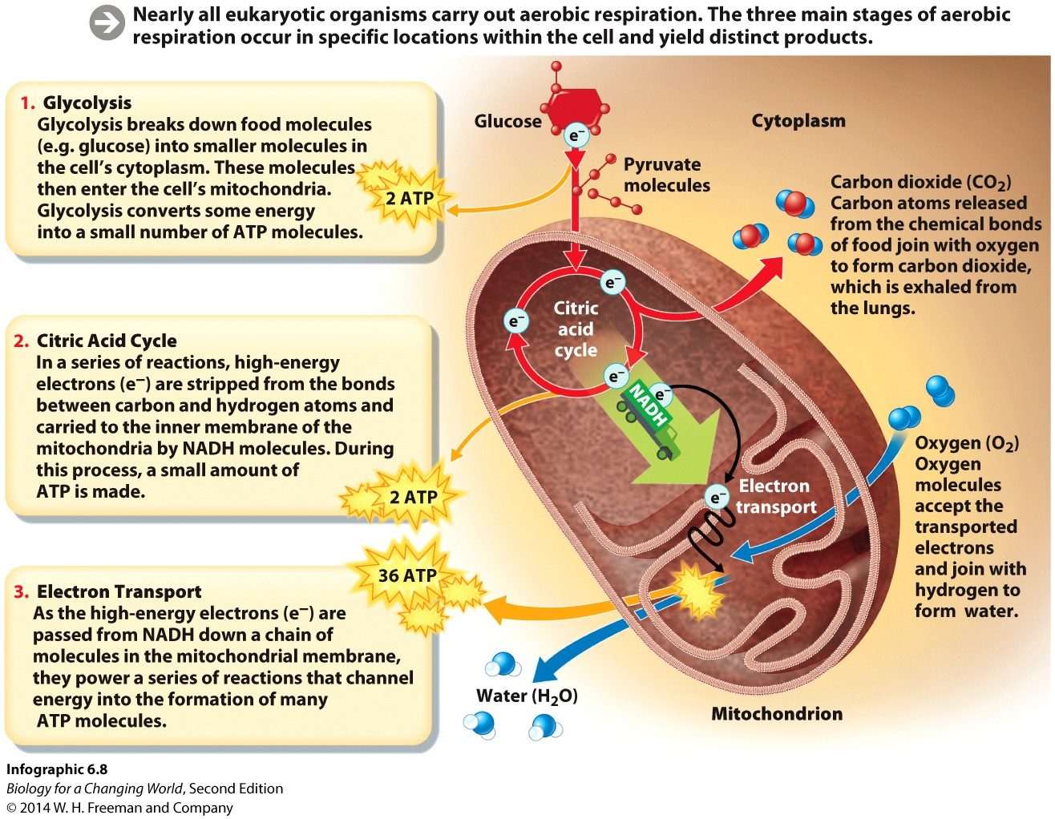
Aerobic respiration: a closer look
Aerobic respiration is a multistep process that takes place in different parts of the cell

Slide 30
Aerobic respiration: a closer look
Glycolysis
First step
Occurs in the cytoplasm
Series of reactions that breaks down sugar into smaller units (pyruvate)
Notes:
Glycolysis is a series of chemical reactions that splits glucose in half, into two smaller molecules of pyruvate. Each of these pyruvate molecules has three carbon atoms in its backbone.

Slide 31
Aerobic respiration: a closer look
Citric acid cycle
Second step of aerobic respiration
Series of reactions that helps extract energy (high-energy electrons) from food
NAD⁺ picks up and transfers electrons
Releases carbon dioxide
Notes:
A series of reactions strips electrons from the bonds between the carbon and hydrogen atoms that were originally in glucose (and are now in pyruvate).
NAD+ picks up electrons, it be-comes NADH (the electron-carrying form of the molecule). NADH then carries and deposits the electrons to the inner membrane of the mitochondria.
Carbon dioxide is which is ultimately exhaled from an organism’s lungs.

Slide 32
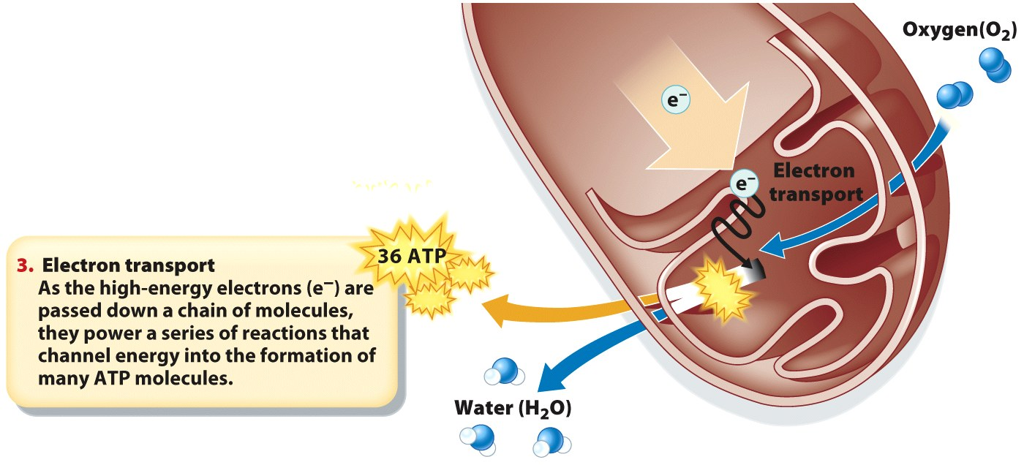
Aerobic respiration: a closer look
Electron transport chain
Final step of aerobic respiration
Electrons stripped during the citric acid cycle are carried to the inner membranes of the mitochondria
Electrons are passed down a chain of molecules to oxygen
Oxygen accepts the electrons and combines with hydrogen atoms to produce water
Produces most of the ATP
REPLACE with comparable section of infographic 6.8 2e)

Slide 33
Cells can also also burn other molecules for fuel
Fats and amino acids are also fuel for aerobic respiration
Fats have more electrons and therefore produce more ATP

Slide 34
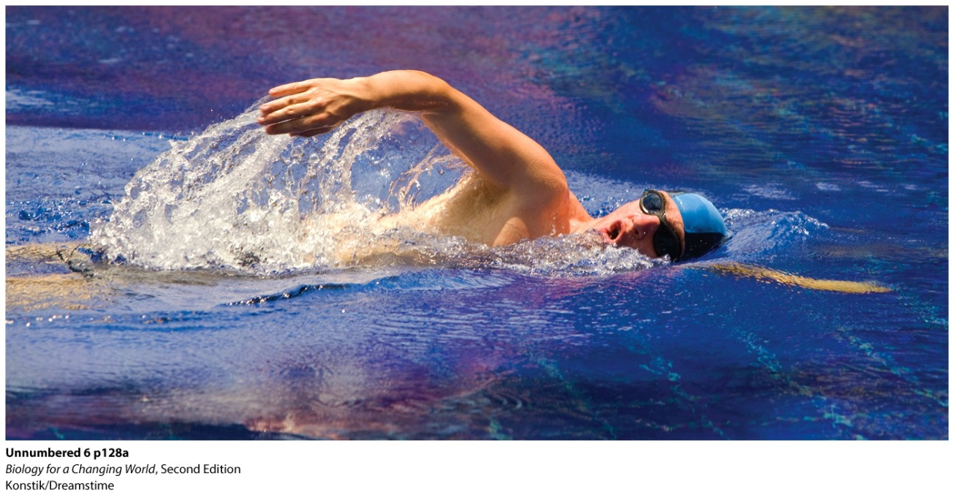
When oxygen is scarce
Sometimes oxygen consumption exceeds oxygen intake
Electron transport chain has no oxygen to receive electrons

Slide 35
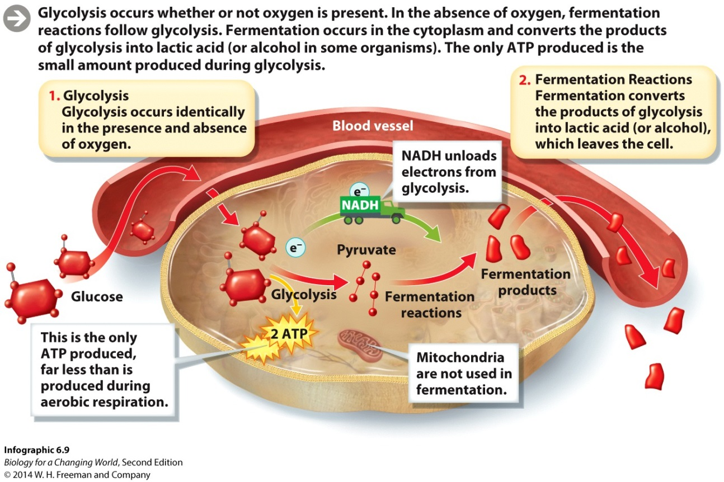
Fermentation
Glycolysis occurs in the absence of oxygen
Products now undergo fermentation
Occurs in cytoplasm
Makes lactic acid or alcohol

Slide 36
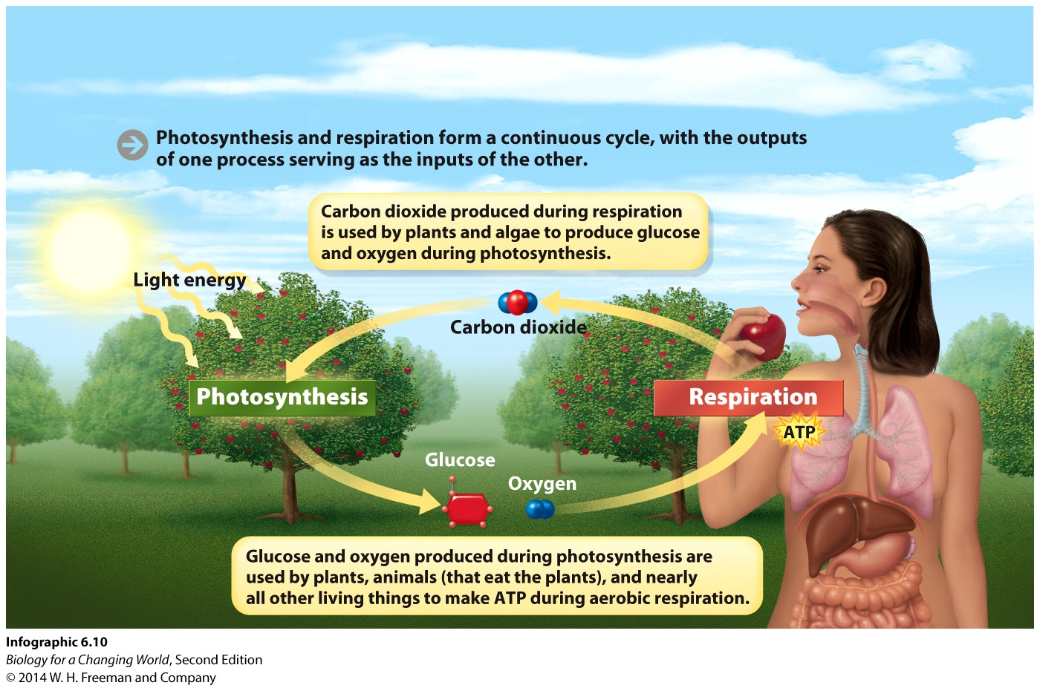
Photosynthesis and aerobic respiration form a cycle
Photosynthesis and respiration form a continuous cycle, with the outputs of one process serving as the inputs of the other
Notes:
Aerobic respiration doesn’t create energy – it extracts it from food. All the food we eat originally gets its energy from the sun through photosynthesis.
Photosynthesis allows plants and algae to capture the energy of sunlight and convert it into chemical energy stored in sugar. Eating this sugar (or animals that have eaten this sugar) makes that stored energy available to us.

Slide 37
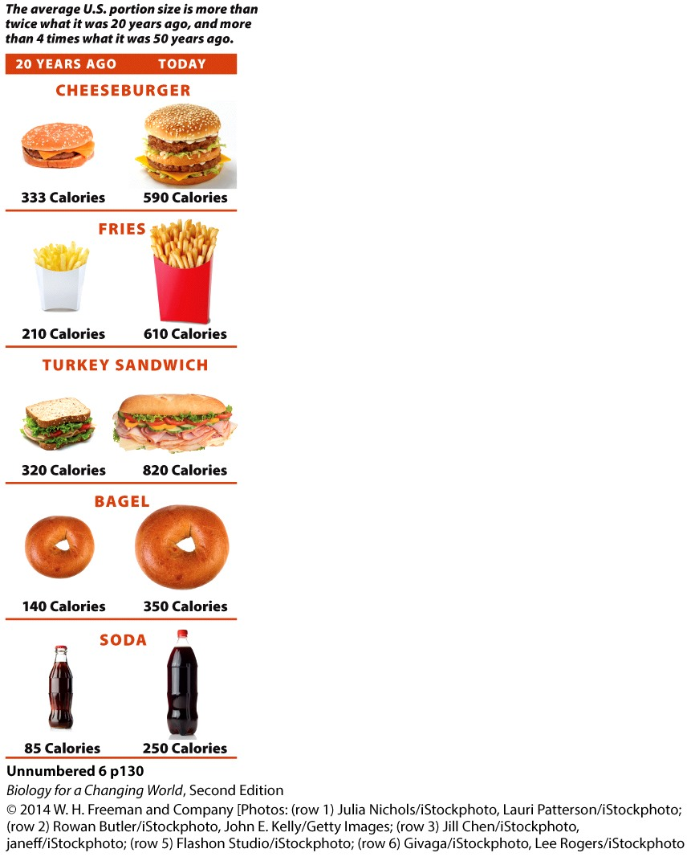
Obesity is influenced by biology and culture
Notes:
The average U.S. portion size is more than twice what it was 20 years ago, and more than 4 times what it was 50 years ago.

Slide 38
Obesity is influenced by biology and culture
Trans fat is a type of vegetable fat that has been hydrogenated (hydrogen atoms have been added) to make it solid at room temperature
Hydrogenated fat behaves in the body much like saturated fat – animal fat, like butter. Saturated fat is solid at room temperature

Slide 39
Obesity is influenced by biology and culture
Food manufacturers add trans fats to their products to give them a longer shelf life or a pleasing texture
Eating large amounts of trans fats or saturated fats can clog arteries

Slide 40
Obesity is influenced by biology and culture
Unsaturated fats, which come from plants, are liquid at room temperature and are considered more healthful
Olive oil, for example

Slide 41
Summary
The macronutrients in our food (proteins, carbohydrates, and fats) are sources of dietary energy.
Cells carry out chemical reactions that break down food to obtain usable energy in the form of ATP.
Photosynthesis and respiration form a cycle: the carbon dioxide given off during aerobic respiration is used by photosynthesizers to make glucose and oxygen.
Exercise helps burn stored Calories.
During exercise, glycogen is used first. Stored fats are tapped only when glycogen stores have been depleted.
When we consume more Calories than we use, our bodies store the excess energy in the bonds of glycogen and body fat.

