Slide 1
Biology for a Changing World, 2e Clicker Questions Chapter 9

Slide 2
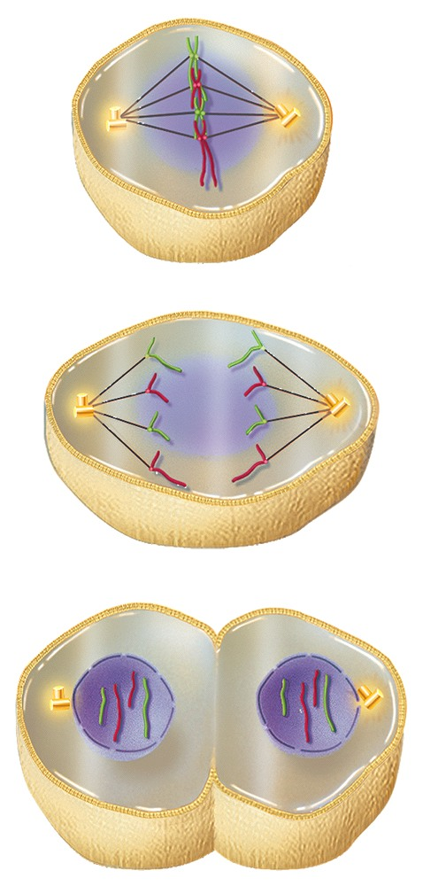
From top to bottom, which three phases of mitosis are shown?
metaphase, anaphase, telophase
prophase, metaphase, anaphase
telophase, anaphase, metaphase
anaphase, metaphase, telophase
prophase, metaphase, telophase
Notes:
2
Answer: A
Driving Question: 1
2

Slide 3
The part of the cell cycle during which a cell is preparing to divide is called___________.
mitosis
anaphase
S phase
interphase
None of the above.
Notes:
3
Answer: D
Driving Question: 1
3

Slide 4
If a cell has 20 chromosomes during G₁ phase, how many chromosomes will this cell have in G₂ phase?
10
20
40
60
None of the above.
Notes:
4
Answer: C
Driving Question: 1
4

Slide 5
Which of the following best describes what would happen if cells skipped past both G₁ and G₂ phases of the cell cycle (but still went through S phase)?
Daughter cells would inherit half the normal number of chromosomes.
Daughter cells would inherit twice the normal number of chromosomes.
Daughter cells would inherit half the normal number of organelles.
Daughter cells would be half the normal size.
Both C and D.
Notes:
5
Answer: E
Driving Question: 1
5

Slide 6
A cell with 20 chromosomes during G₁ phase undergoes mitosis. If a pair of sister chromatids somehow lost its centromere, how many chromosomes would the two daughter cells inherit assuming mitosis and cytokinesis were otherwise unaffected?
19 and 21
0 and 20
0 and 40
20 and 20
40 and 40
Notes:
6
Answer: A
Driving Question: 1
6

Slide 7
The role of spindle fibers during mitosis is to ____________.
divide the cytoplasm into two daughter cells
prepare the cell for DNA synthesis
condense the DNA into chromosomes
replicate each chromosome once
separate sister chromatids
Notes:
7
Answer: E
Driving Question: 1
7

Slide 8
Cancer is caused by___________.
DNA damage
uncontrolled cell growth
cells escaping apoptosis
All of the above.
None of the above.
Notes:
8
Answer: D
Driving Question: 2
8

Slide 9
Which of the following normally occurs when DNA is damaged during interphase?
The cell undergoes apoptosis.
The DNA damage is repaired before the cell proceeds to divide.
The cell proceeds into mitosis and makes changes after cytokinesis.
All of the above are normal mechanisms.
A and B only.
Notes:
9
Answer: E
Driving Question: 2
9

Slide 10
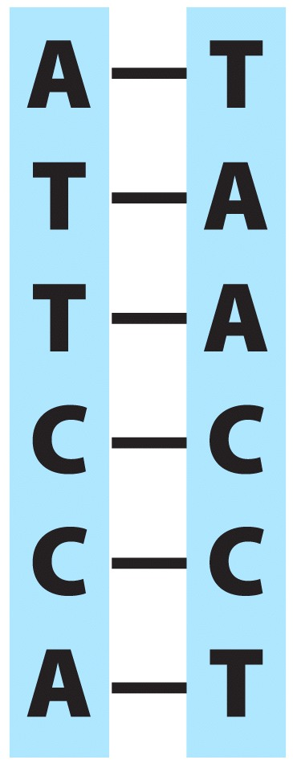
If the DNA sequence pictured below is found in a normal cell, which of the following is most likely true?
The cell will use repair mechanisms before proceeding through mitosis.
The cell will proceed through mitosis because the DNA is correctly paired.
The cell will become cancerous.
The cell is a human cell.
A, C, and D are correct.
Notes:
10
Answer: A
Driving Question: 2
10

Slide 11
Which of the following cells would be expected to undergo apoptosis?
a skin cell that has been damaged by UV light
a human liver cell exposed to a mutagen
a kidney cell that has undergone mitosis
a human cell with 23 pairs of chromosomes
A, B, and D are correct.
Notes:
11
Answer: A
Driving Question: 2
11

Slide 12
Chemotherapy is________________.
any treatment used to treat cancer
using chemicals to treat a disease
treatment to cure chemical addictions
Both A and B are correct.
None of the above.
Notes:
12
Answer: 3
Driving Question: 3
12

Slide 13
Cell division occurs frequently in which of the following biological processes?
embryo development
wound healing
muscle contraction
Both A and B.
None of the above.
Notes:
13
Answer: D
Driving Question: 3
13

Slide 14
In which of the following cancer patients would chemotherapy likely be used?
a pregnant woman with breast cancer
a man with a tumor in his liver
a child with cancer that has undergone metastasis
an elderly woman with a tumor in her uterus
All of the above.
Notes:
14
Answer: C
Driving Question: 3
14

Slide 15
Why do radiation and chemotherapy treatments cause side effects in cancer patients?
They both damage all body cells.
Both damage all rapidly dividing cells.
Cancer patients have weak immune systems and therefore experience more side effects.
Older treatments causes side effects, but modern treatments do not.
All of the above.
Notes:
15
Answer: B
Driving Question: 3
15

Slide 16
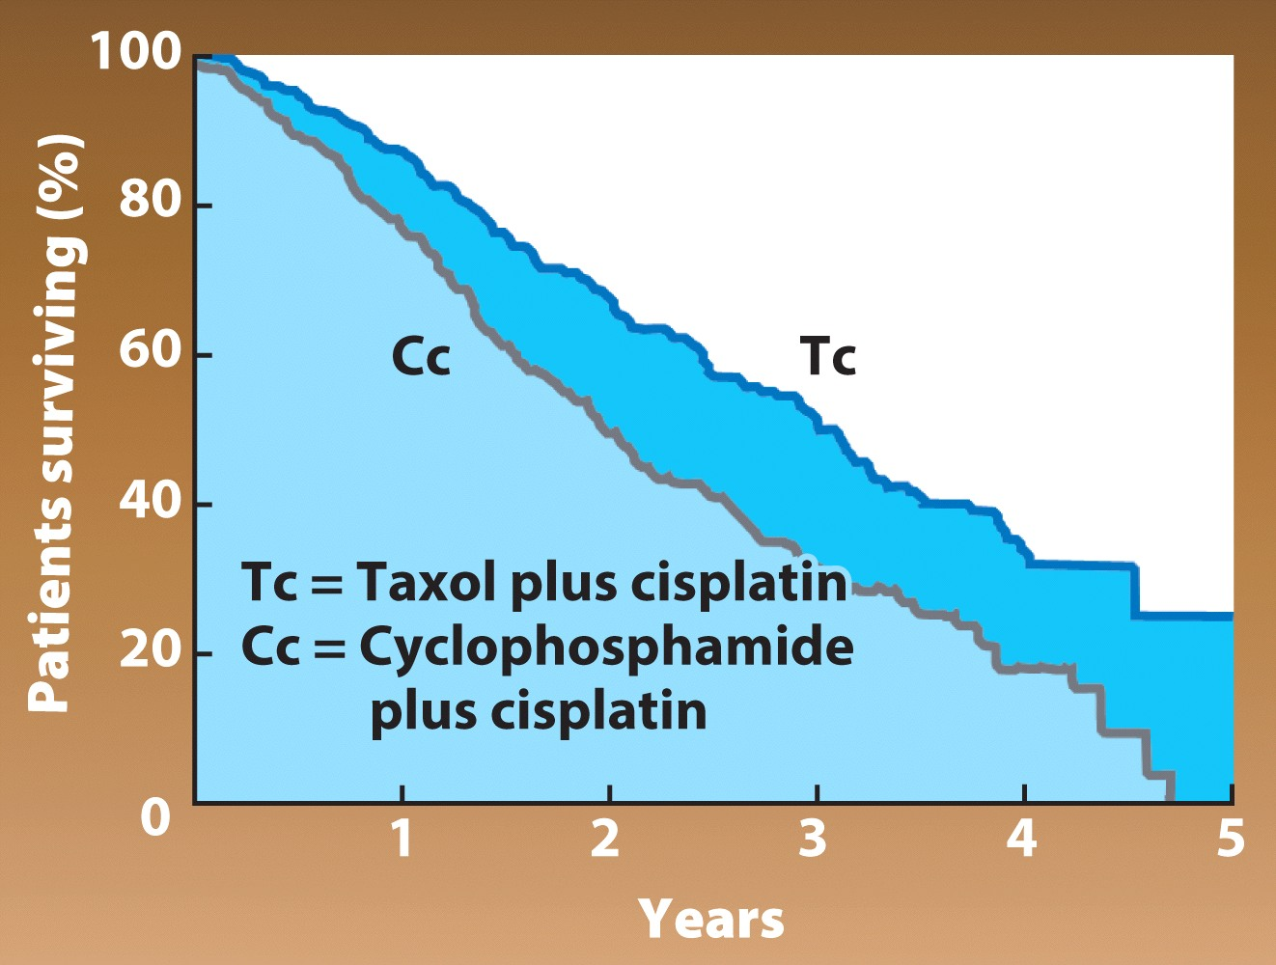
Which of the following statements is the most accurate about the data presented in the graph to the right?
Cc is an effective treatment for long-term survival 5 years and beyond.
Tc treatment shows an increased survival rate in comparison to Cc.
Cc had no effect on tumor growth because the size of the tumors changed the least.
Cc causes more side effects than Tc and is less likely to be tolerated by patients.
B, C, and D are correct.
Notes:
16
Answer: B
Driving Question: 3
16

Slide 17
Taxol was isolated from
sea sponges.
spotted owls.
Pacific yew trees.
redwood trees.
lichens growing on Pacific yew trees.
Notes:
17
Answer: C
Driving Question: 4
17

Slide 18
Why is Taxol used to treat ovarian, breast, and lung cancers, but not colon or renal cancers?
Taxol is more effective in women.
Taxol is too expensive to use in treating all cancers.
Taxol usually causes allergic reactions in people with colon or renal cancer.
The cells in the colon contain different genes than cells in other parts of the body.
Taxol only works on certain cancers.
Notes:
18
Answer: E
Driving Question: 4
18

Slide 19
What similarity between trees and sea sponges lead researchers to think sea sponges might be a source of chemicals for cancer treatment?
Sea sponges and trees are very closely related.
Sea sponges and trees are both sessile and require chemical defenses.
Sea sponges and trees are the only organisms that do not develop cancer.
All of the above.
Both A and B.
Notes:
19
Answer: B
Driving Question: 4
19

Slide 20
How does Taxol prevent cancer cells from spreading?
It keeps DNA from replicating.
It prevents the normal assembly of the mitotic spindle.
It corrects DNA damage.
It directs cancer cells to undergo apoptosis.
It blocks telophase from occurring.
Notes:
20
Answer: B
Driving Question: 4
20

