Slide 1
Michèle Shuster • Janet Vigna • Gunjan Sinha • Matthew Tontonoz
Biology for a
Changing World
SECOND EDITION
Lecture PowerPoint
CHAPTER 9
Cell Division and Mitosis
Copyright © 2014 by W. H. Freeman and Company

Slide 2
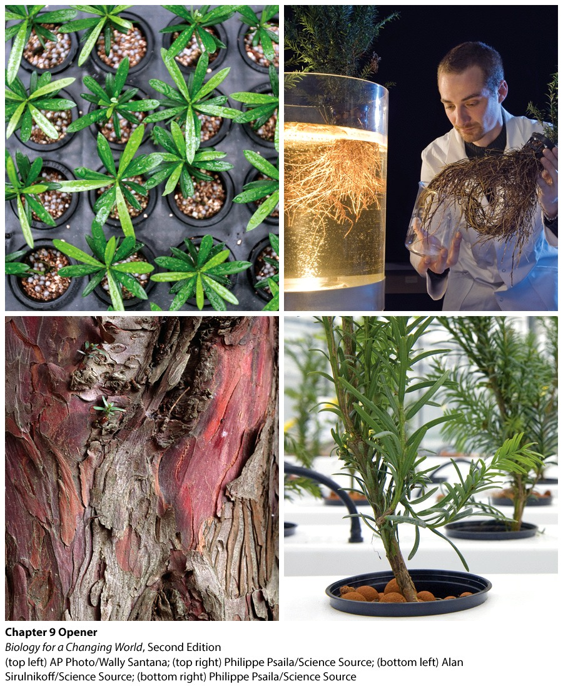
Chapter 9
Cell Division and Mitosis

Slide 3
Driving Questions
1. When and how does normal cell division occur in the
body?
2. How do normal cells and cancer cells differ with
respect to cell division?
3. How are cancer treatment decisions made for a given
patient?
4. How are new cancer drugs developed?

Slide 4
Cancer
disease of unregulated cell division: cells divide inappropriately and accumulate, in some instances forming a tumor
treatment
surgery
administration of chemicals: chemotherapy

Slide 5
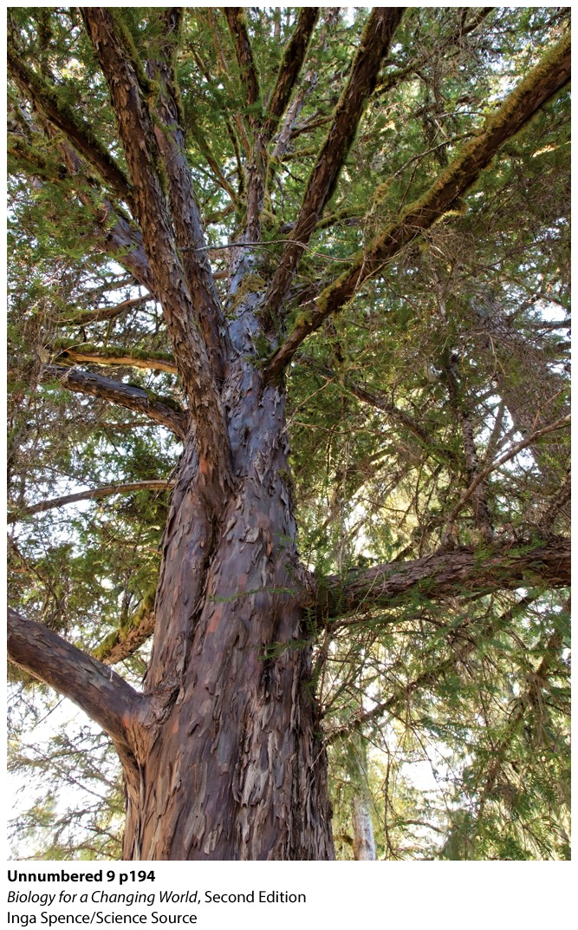
Cancer
Taxol
highly effective chemotherapy agent
extracted from the Pacific yew tree

Slide 6
Cancer
Most chemotherapy drugs work by interfering
with cell division
process by which a cell reproduces itself
Important for normal growth, development, and repair
Notes:
Most of our tissues are in constant flux as cells divide periodically to replace cells that have reached the end of their life span.

Slide 7
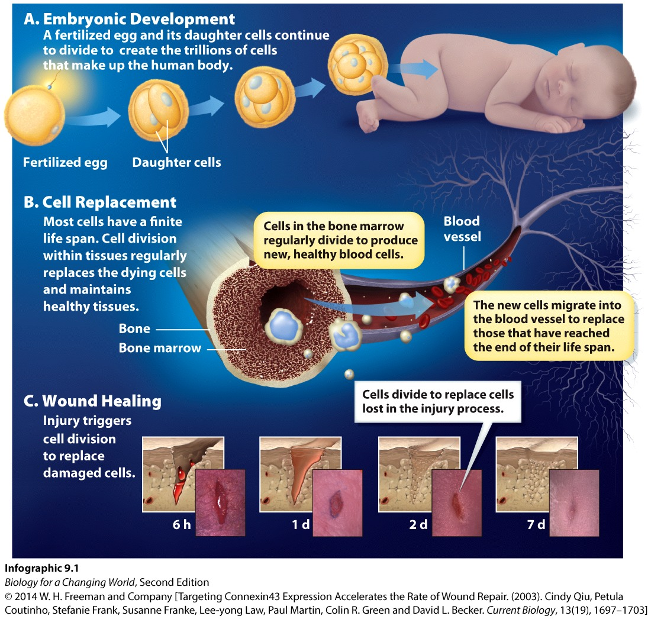
Why do normal, healthy cells divide?

Slide 8
Why do normal, healthy cells divide?
growth and development

Slide 9
Why do normal, healthy cells divide?
cell replacement

Slide 10
Why do normal, healthy cells divide?
heal wounds
Notes:
Certain cells divide more frequently than others. Bone marrow cells divide continuously, for example, whereas brain cells divide at a much slower rate or not at all. And cancer cells divide uncontrollably.

Slide 11
How do cells divide?
cell does not simply split in half
pass through a series of phases
Cell cycle
ordered sequence of stages
preparatory and division phases
one cell to two identical cells
Notes:
If cells simply split in half, each new cell would be smaller than the original cell, and each cell would lose half of its contents with each division.

Slide 12
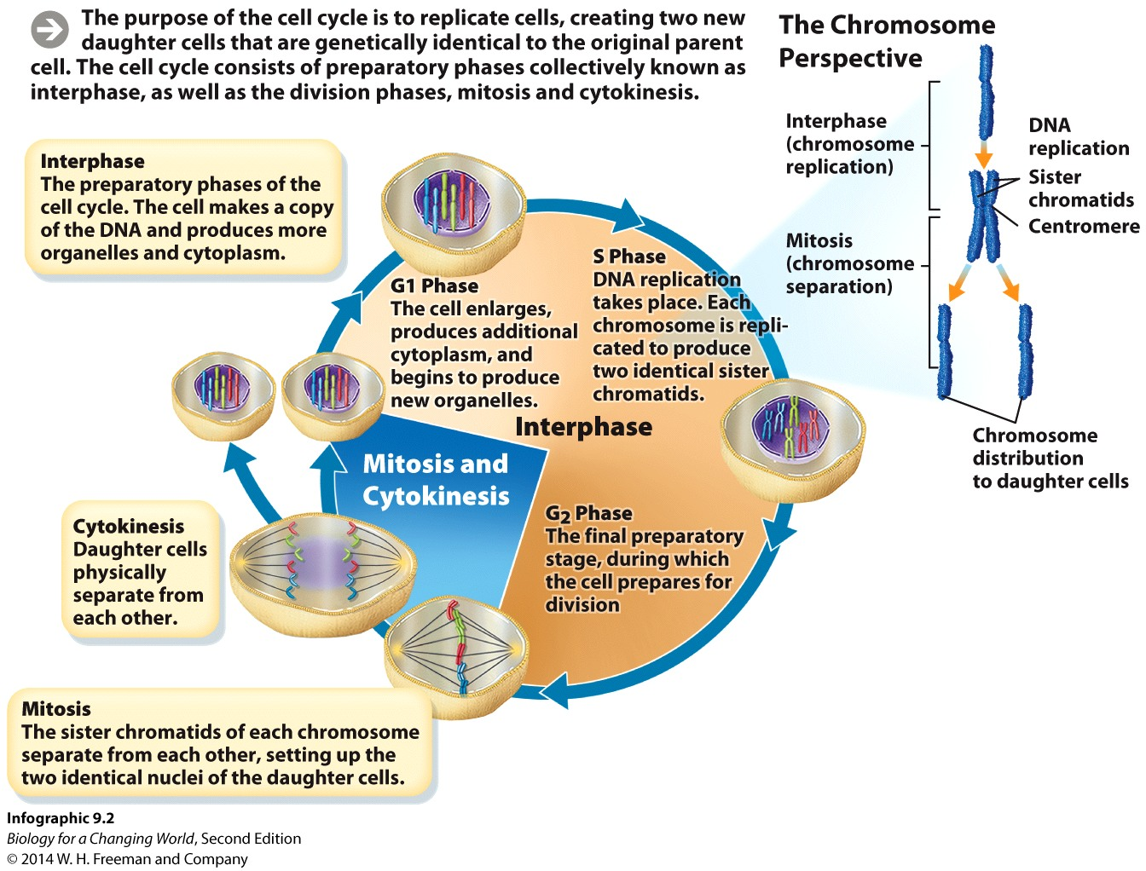
How do cells divide?
Preparatory phase
copy cellular contents
duplicate organelles, DNA, and cytoplasm
each new cell has the same amount as original cell
interphase
G₁, S, G₂
Notes:
Interphase: The stage of the cell cycle in which cells spend most of their time, preparing for cell division. There are three distinct sub-phases: G1, S, and G2.
G1 phase, when the cell grows larger and begins to produce more cytoplasm and organelles; synthesis phase (S), when DNA replicates and chromosomes are therefore duplicated; and G2 phase, when the cell is ready to enter the division phases.

Slide 13
How do cells divide? Interphase
G₁ phase
cell grows, makes extra cytoplasm
S phase
DNA replication occurs, chromosomes
idenitical sister chromatids
G₂ phase
cell prepares for division

Slide 14
How do cells divide?
Division phase
mitosis
cytokinesis

Slide 15
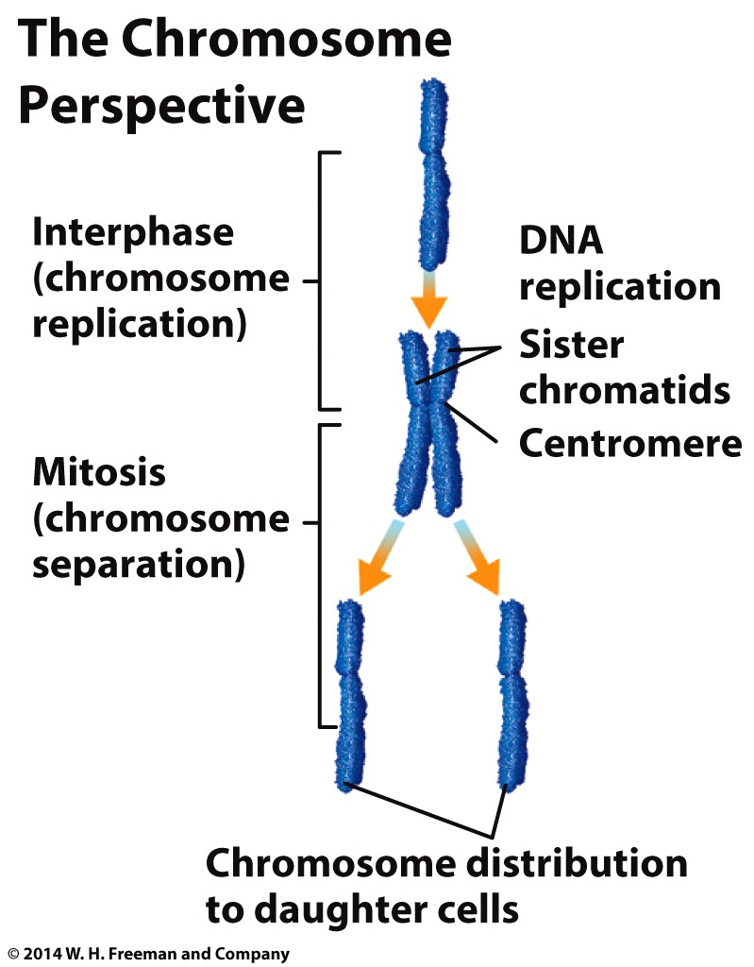
How do cells divide? Mitosis
Mitosis
chromosomes are evenly divided
sister chromatids are separated
centromere
Notes:
Sister chromatids: the two identical DNA molecules that make up a duplicated chromosome following DNA replication.
Centromere: The specialized region of a chromosome where the sister chromatids are joined; critical for proper alignment and separation of sister chromatids during mitosis.
The two sister chromatids of each replicated chromosome are then pulled apart from each other. Each chromatid will form one of two genetically identical
chromosomes in a daughter cell.

Slide 16
How do cells divide? Cytokinesis
Cytokinesis
enlarged cell splits into two cells
each has full complement of DNA
one parent cell, into two daughter cells

Slide 17
Up close: cell cycle and mitosis
Mitosis
occurs in a series of phases
M phase

Slide 18
Up close: cell cycle and mitosis
Interphase

Slide 19
Up close: cell cycle and mitosis
Prophase

Slide 20
Up close: cell cycle and mitosis
Metaphase

Slide 21
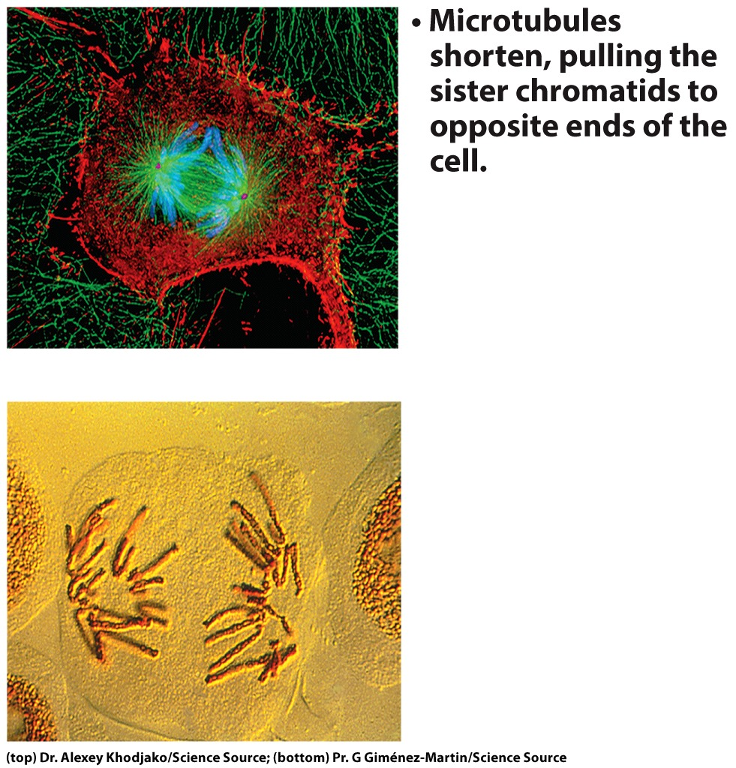
Up close: cell cycle and mitosis
Anaphase

Slide 22
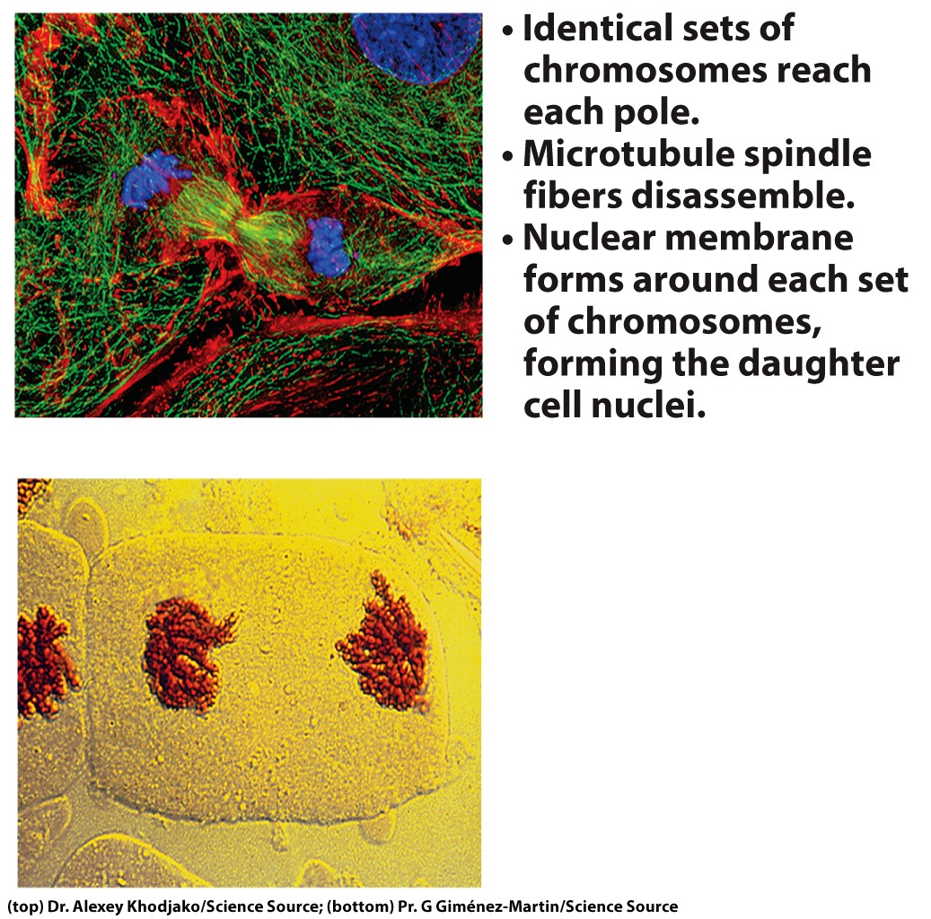
Up close: cell cycle and mitosis
Telophase

Slide 23
Up close: the phases of mitosis
Cytokinesis
Notes:
Each daughter cell has the same number of chromosomes as the parent cell.

Slide 24
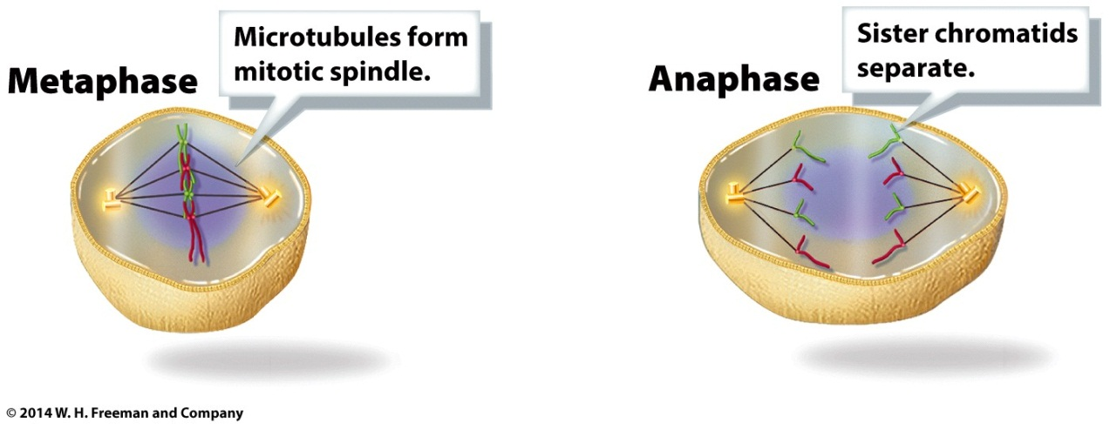
The mitotic spindle
The structure that separates sister chromatids during mitosis
Made of microtubules
hollow protein fibers
key components of cytoskeleton
attach to centromere on chromosome via kinetochore proteins

Slide 25
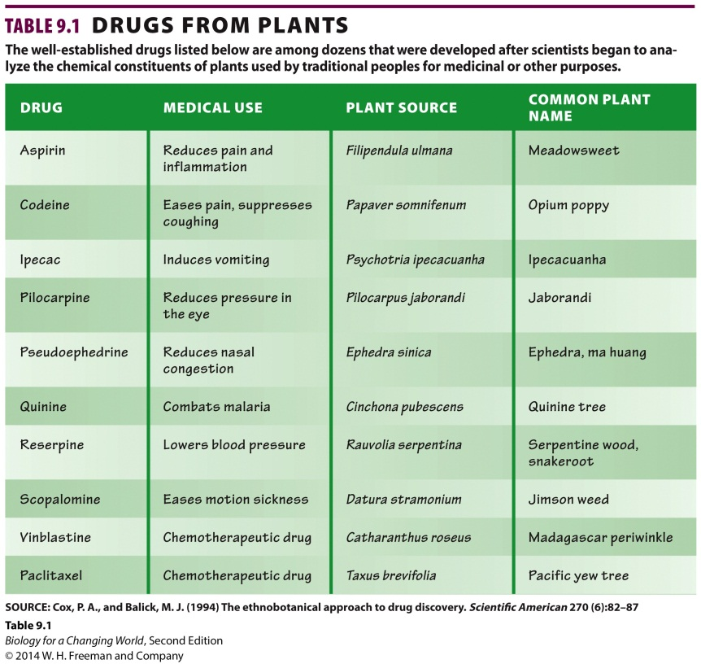
Cancer and cell division
Most chemotherapy drugs target cell cycle
interfere with DNA replication, chromosome separation
look to plants as source of drugs
Notes:
Table 9.1 drugs from plants
The well-established drugs listed below are among dozens that were developed after scientists began to analyze the chemical constituents of plants used by traditional peoples for medicinal or other purposes.

Slide 26
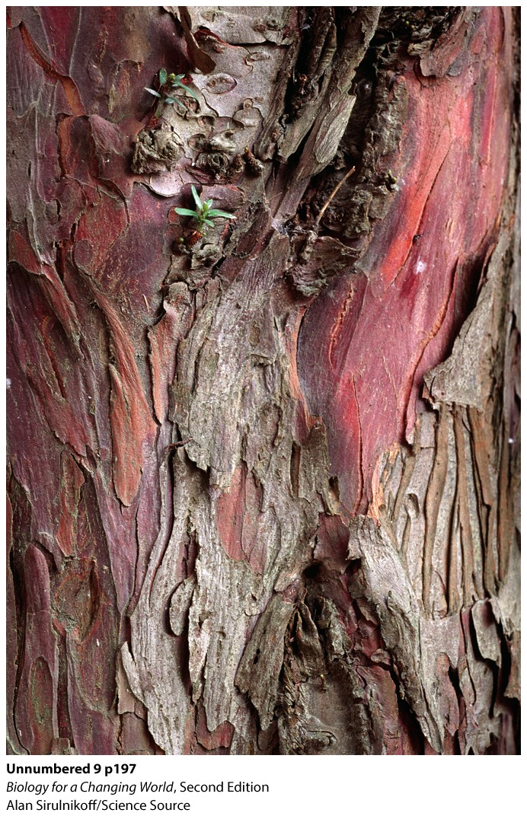
Cancer and cell division
Taxus brevifolia, the pacific yew, is one species of a family of related evergreen trees
extract from bark kills cancer cells
Taxol
Notes:
The reddish bark of the yew tree is famous for being poisonous.

Slide 27
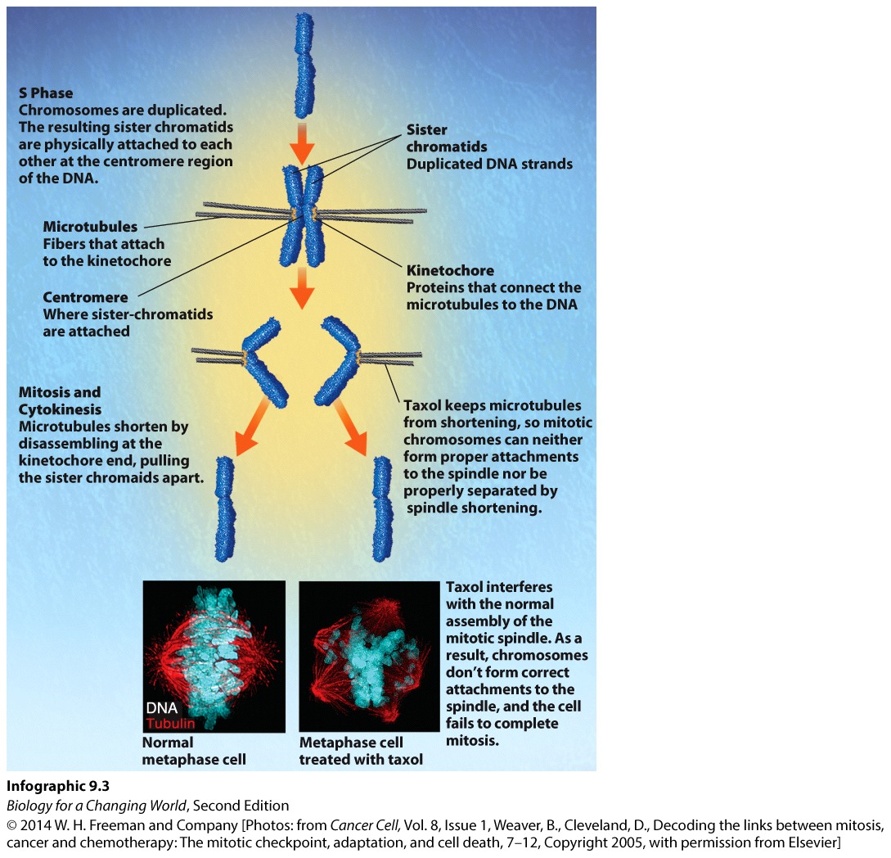
Cancer and cell division
Taxol
interferes with the normal organization of microtubule
prevents microtubules from shortening
chromatids not separated

Slide 28
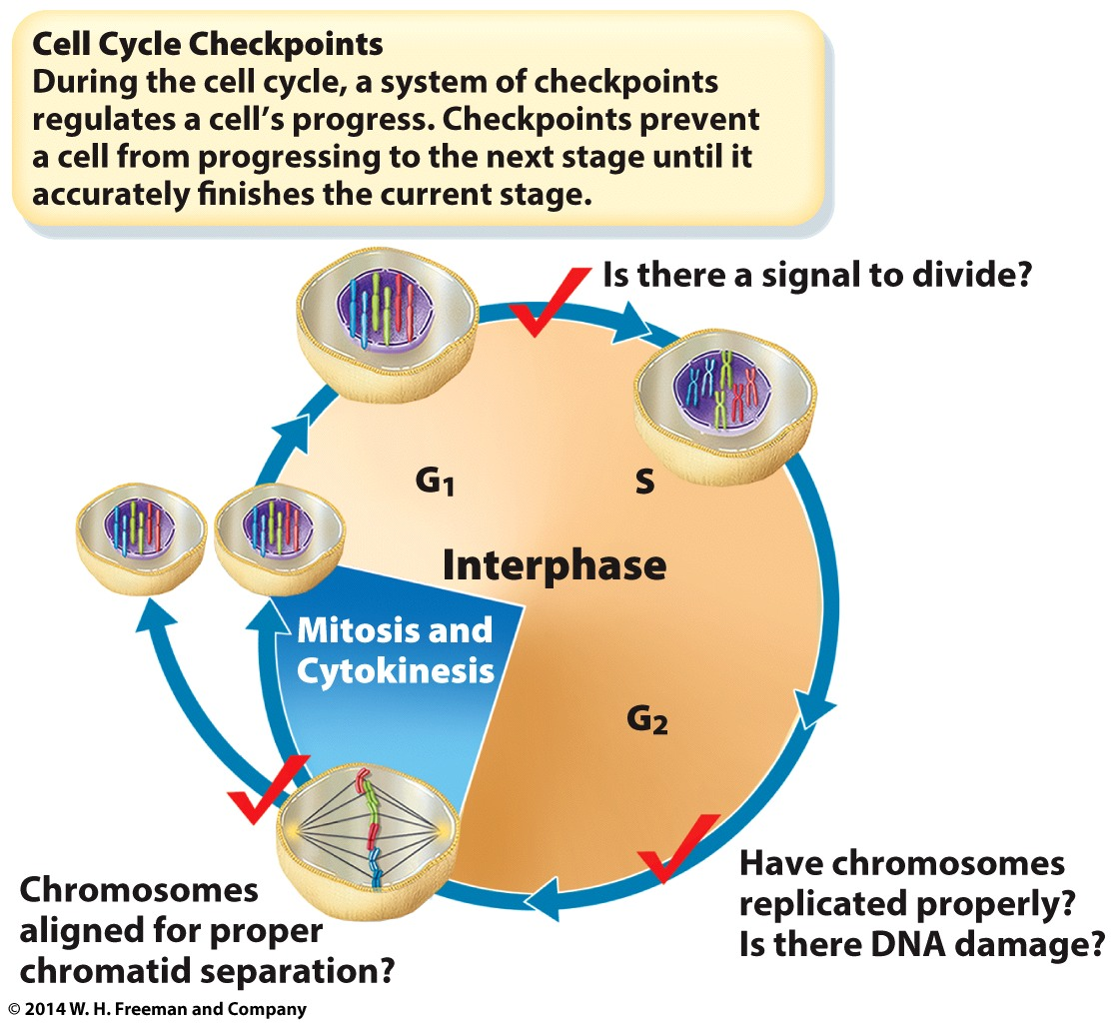
Cell division is tightly regulated
Cell cycle checkpoints
cellular mechanisms
regulate cells progression through cell cycle
ensures each stage is completed accurately

Slide 29
Cell division is tightly regulated
Mutation occurs
Cell cycle checkpoints
either repair damage
OR
direct cell to commit suicide (apoptosis)
Notes:
Mutation: a change in the nucleotide sequence of DNA.

Slide 30
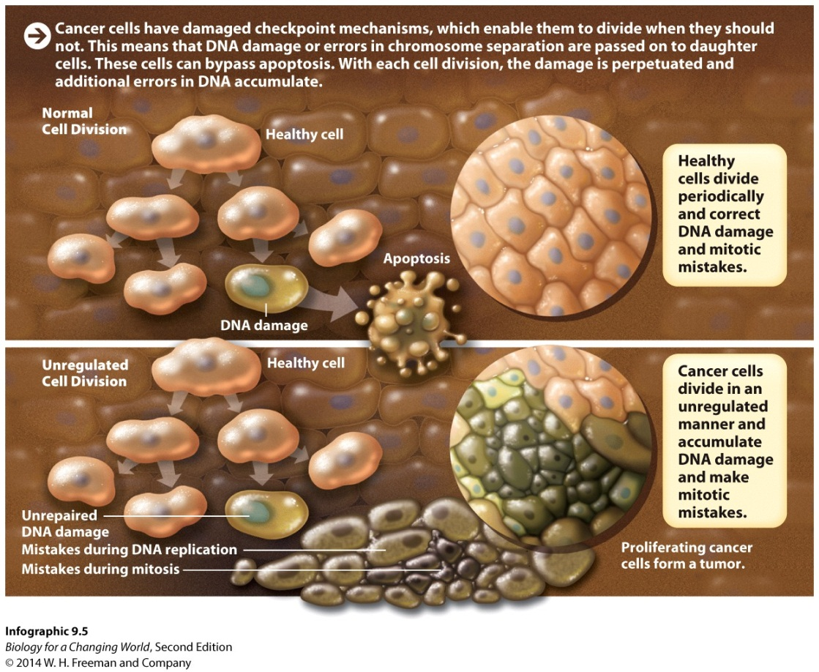
Cancer: when checkpoints fail
If there’s enough DNA damage to interfere with multiple checkpoints:
cancer: cells divide uncontrollably
tumor may form
Notes:
Tumor: a mass of cells resulting from uncontrolled cell division.

Slide 31
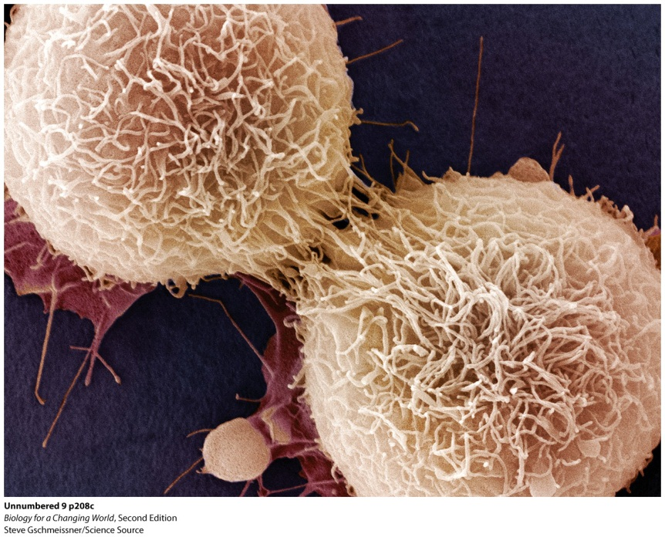
Cancer
Kills by
crowding out normal cells
invading other organs
secreting poisonous chemicals

Slide 32
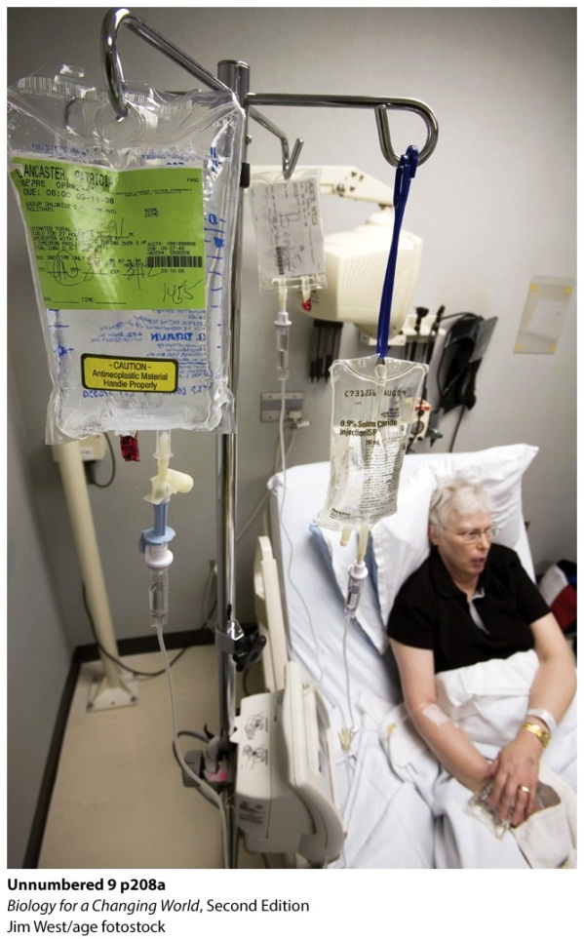
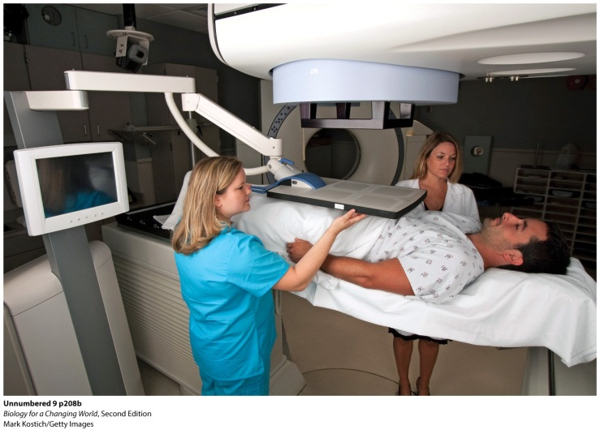
Fighting cancer
Surgery to remove the cancerous tumor
not effective if cancer metastasized
Radiation therapy
high-energy radiation beams
kills dividing cells
damages DNA
triggers apoptosis
Notes:
Metastasis: the spread of cancer cells from one location in the body to another location

Slide 33
Fighting cancer
Chemotherapy
Drugs interfere with cell division
Taxol
Notes:
Taxol improves patients’ chances, especially when combined with other chemotherapy drugs and other forms of treatment.

Slide 34
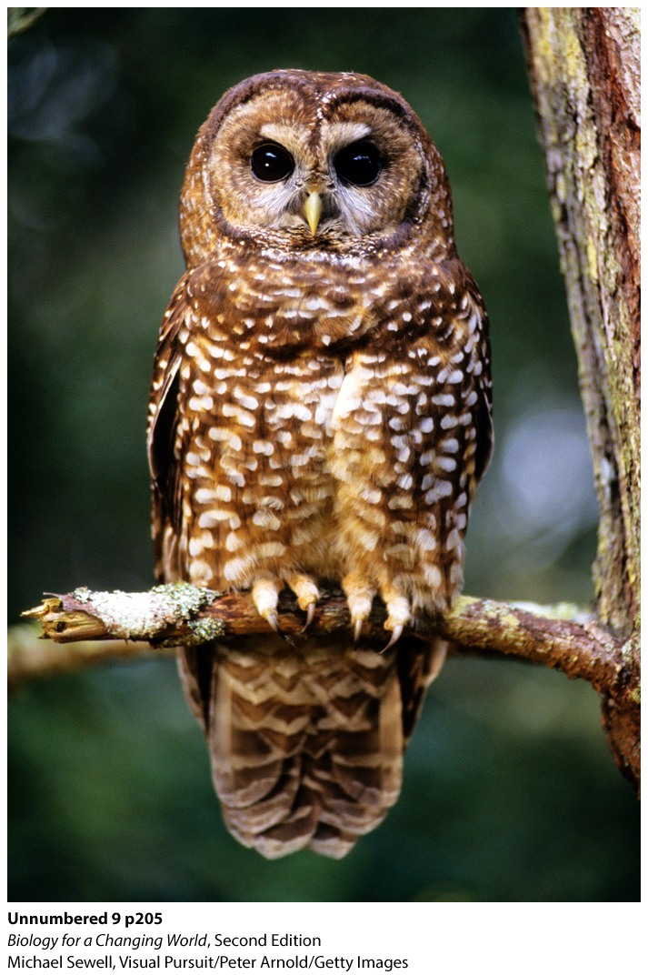
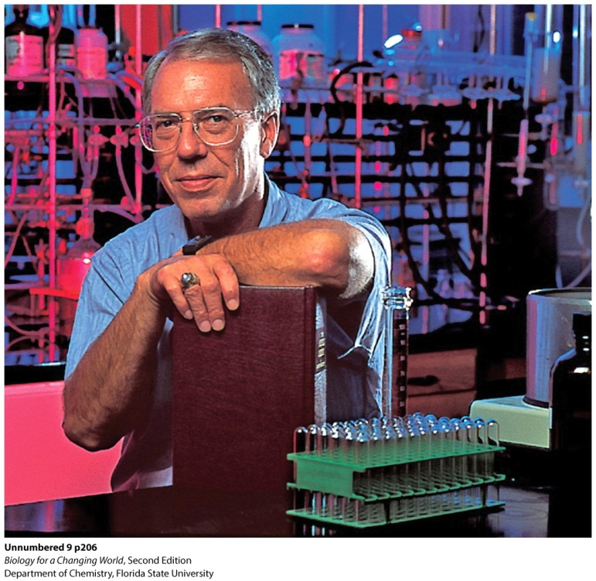
Challenges
Taxol is highly effective
demand increased
yew tree removed from forests
threatened spotted owl
development of synthetic taxol
Notes:
Photos: The northern spotted owl and Chemist Robert Holton (whose work led to the development of synthetic taxol) in his lab at the University of Florida.
- If Holton’s method could be developed for use on an industrial scale, then Taxus trees would no longer have to be killed, and the spotted owl would be spared as well.
- Holton’s method brings a plentiful supply of the drug to market.

Slide 35
Summary
Cell division is, necessary for normal growth, development, and repair of the body.
The cell cycle is the sequence of steps that a cell undergoes in order to divide. Stages of the cell cycle include interphase, mitosis, and cytokinesis.
In mitosis, which takes place in several stages, replicated chromosomes segregate to opposite poles of the dividing cell; during cytokinesis, the cell physically divides into two daughter cells.
Cell cycle checkpoints ensure accurate progression through the cell cycle; repair mechanisms at each checkpoint can fix mistakes that occur, such as DNA damage.
Mistakes in the course of cell division can lead to cancer, which is unregulated cell division.
Chemotherapy drugs work by interfering with some part of the cell cycle.

