Slide 1
Michèle Shuster • Janet Vigna • Gunjan Sinha • Matthew Tontonoz
Biology for a
Changing World
SECOND EDITION
Lecture PowerPoint
CHAPTER 14
Natural Selection and Adaptation
Copyright © 2014 by W. H. Freeman and Company

Slide 2
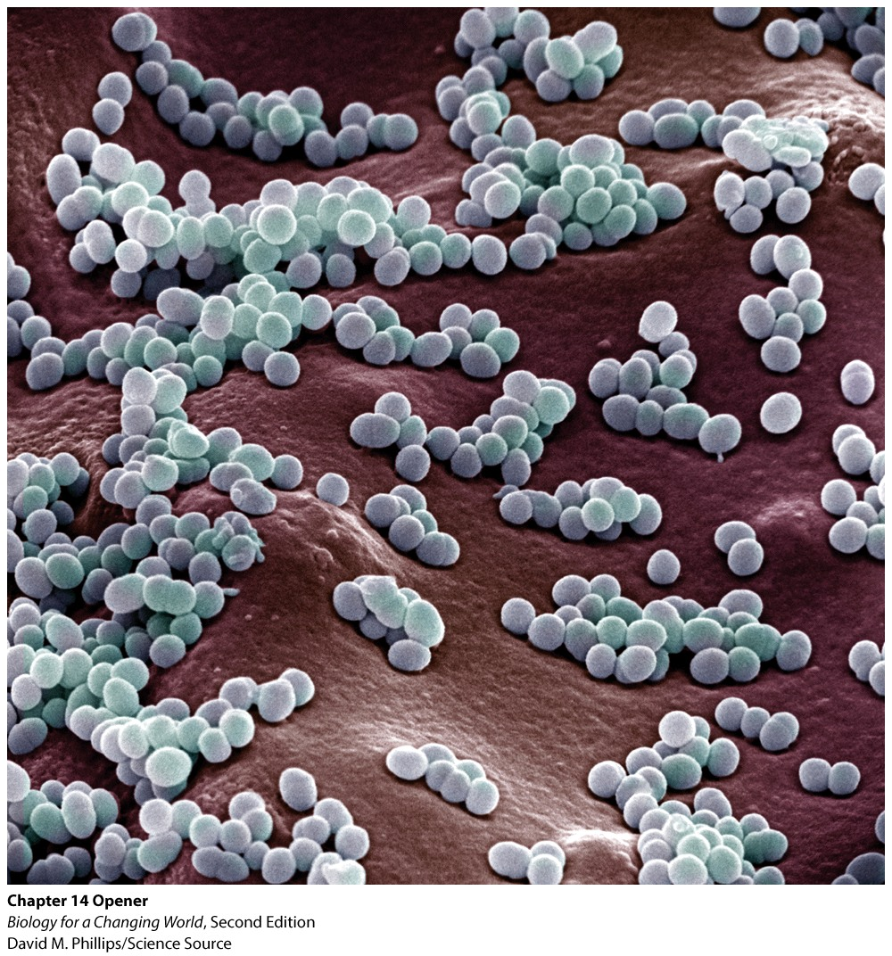
Chapter 14
Natural Selection and Adaptation

Slide 3
Driving Questions
1. What is staph, and can it be present in the absence
of an infection?
2. How do bacteria resist the effects of antibiotics?
3. How do populations evolve, and what is the role of
evolution in antibiotic resistance?

Slide 4
Methicillin-resistant Staphylococcus aureus (MRSA)
Infectious bacterium
Difficult to treat with antibiotics
Kills 19,000 people in the United States each year
Notes:
According to a 2007 study.

Slide 5
Staphylococcus aureus
S. aureus (also known as “staph”)
Some strains are harmless, other cause disease
Drug-resistant strains exists
Notes:
Staph bacteria cause no harm to most of the people who carry them. Between 30% and 40% of the population carries staph on their skin or in their noses, and about 1% of the population carries drug-resistant strains, according to the CDC.

Slide 6
Methicillin-resistant Staphylococcus aureus (MRSA)
Developed resistance to antibiotic drugs
Adversely affects people with weakened immune system
Ricky Lannetti was already weakened by the flu
Notes:
The young, whose immune systems are still developing, and the elderly are at especially high risk. People who are already sick and fighting off other infections can be at high risk, too.
Ricky Lannetti was a healthy 21-year-old football player. Top right: Ricky with his mother, Theresa Drew.

Slide 7
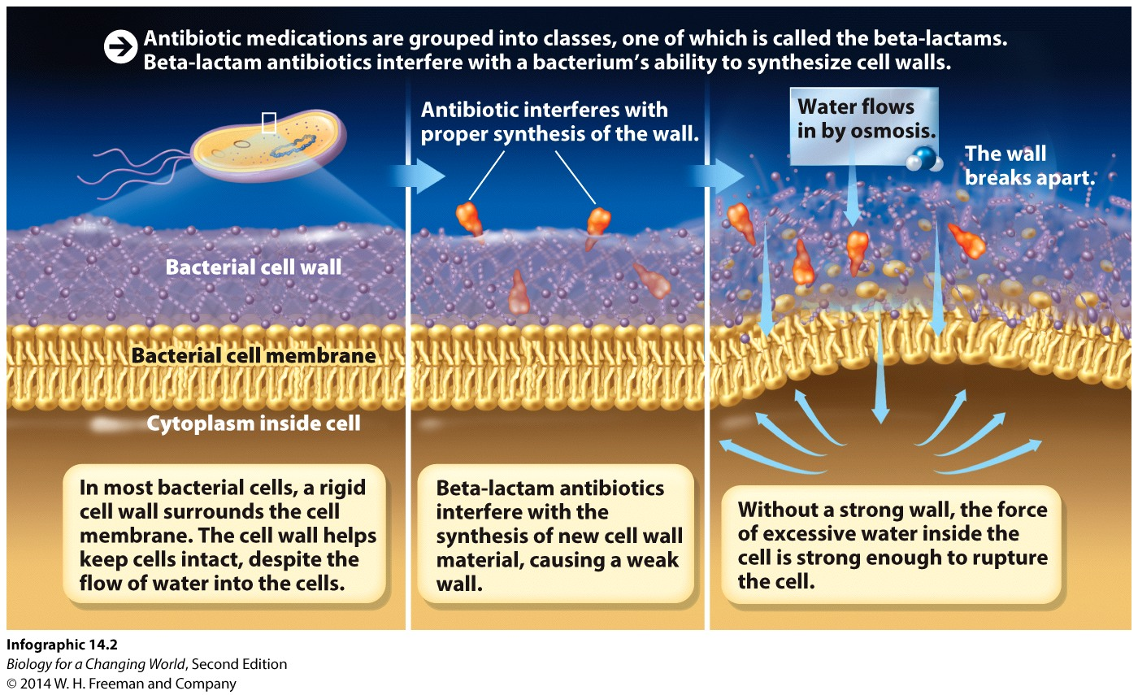
Antibiotics
Chemicals that either kill bacteria or slow their growth
Interfere with function of essential bacterial cell structures
Notes:
Beta-lactams are the most commonly prescribed class of antibiotics. They work by interfering with a bacterium’s ability to synthesize cell walls.

Slide 8
Antibiotic resistance
Bacteria emerge that survive antibiotics
Acquire random mutations when DNA replicates during asexual reproduction
Binary fission: one parental cell into two daughter cells
Notes:
Binary fission: a type of asexual reproduction in which one parental cell divides into two.

Slide 9
Binary fission

Slide 10
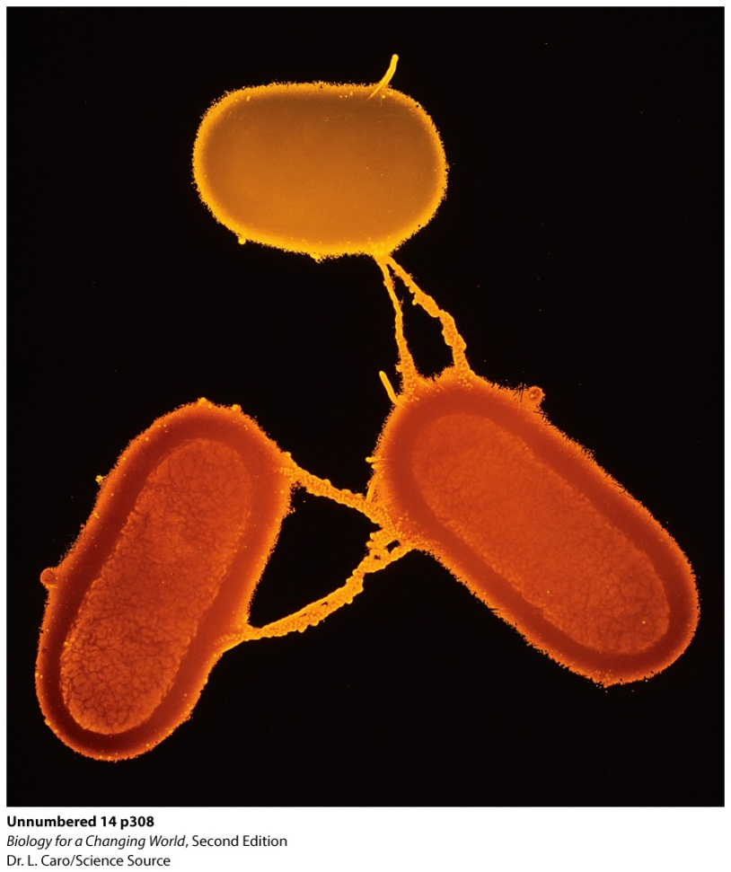
Antibiotic resistance
Acquisition of new alleles in bacteria may result in antibiotic resistance
random mutation
gene transfer

Slide 11
Antibiotic resistance
Notes:
The genetic changes ultimately altered bacterial proteins in ways that helped staph dodge antibiotic drugs. Specifically, the altered or acquired genes either code for proteins that can disable antibiotics, or they code for proteins with altered shapes to which antibiotics can no longer bind. Some bacteria produce enzymes called beta-lactamases that chew up beta-lactam antibiotics.

Slide 12
How populations evolve
A population is a group of organisms of the same species living together in the same geographic area
An entire population can change (evolve) when some traits are favored over others
For example, a drug-resistant trait

Slide 13
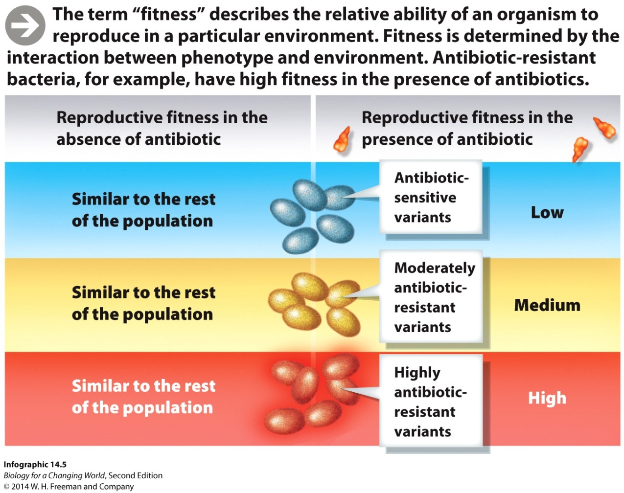
How populations evolve
Genetically diverse population
Varying allele frequency
Environment favors some alleles over others
Allele frequency changes over time (called evolution)

Slide 14
How populations evolve
Fitness: organisms ability to survive and reproduce in a particular environment
Higher fitness = increased likelihood of alleles being passed to next generation
Alleles that confer resistance to antibiotics increase an organism’s fitness

Slide 15
How populations evolve
Organism’s alleles, or genotype, determine phenotype
Interplay between phenotype and environment determine frequency of traits in a population
If traits improve fitness, traits become more common in population
Population evolves
Natural selection

Slide 16
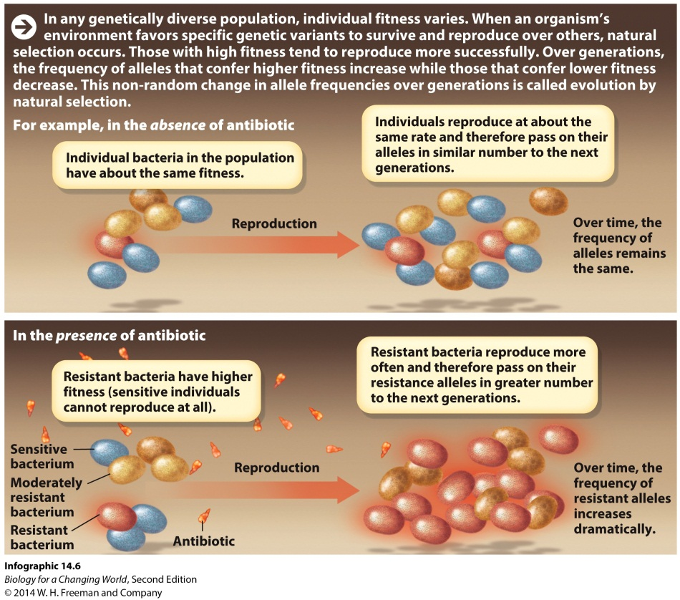
How populations evolve
Natural selection: differential survival and reproduction of individuals within a population in response to environmental pressure
Advantageous traits become more common and population becomes better suited, or adapted, to environment
Notes:
Adaptation: the process by which a population becomes better suited to its environment as a result of natural selection.

Slide 17
How populations evolve
Populations, not individuals, evolve
Populations experience changes in allele frequencies over time

Slide 18
Natural selection occurs in patterns
Directional selection: predominant phenotype shifts in a particular direction
Stabilizing selection: phenotype of populations settles near middle of range
Diversify selection: phenotype of population is at both extremes of range

Slide 19
Natural selection occurs in patterns
Directional selection

Slide 20
Natural selection occurs in patterns
Stabilizing selection

Slide 21
Natural selection occurs in patterns
Diversifying selection

Slide 22
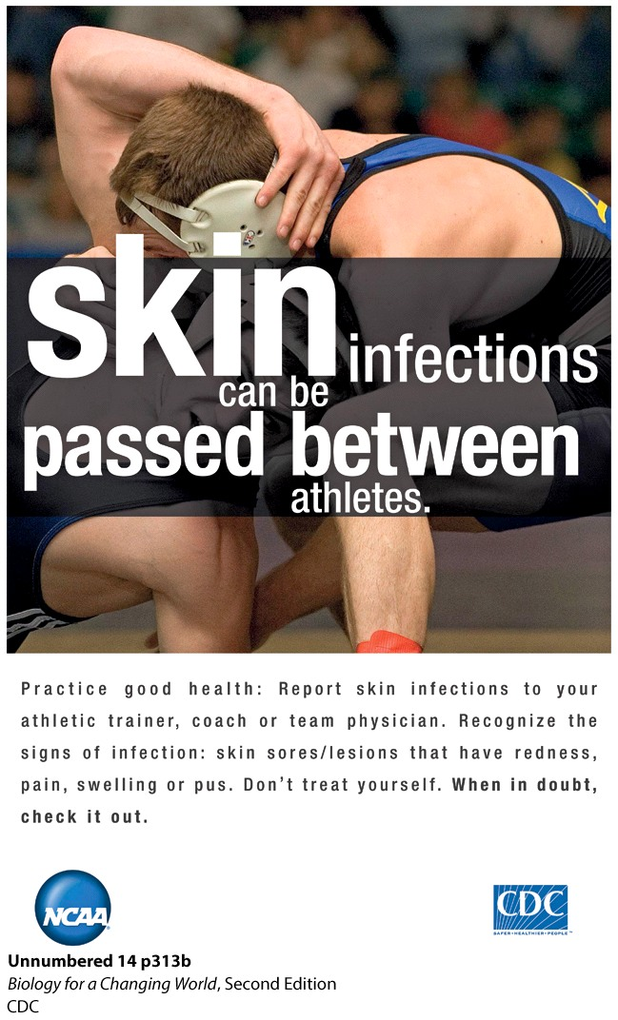
Stopping superbugs
Control resistance by changing practices that enable resistant strains to thrive
Wash hands, use hand sanitizers, stop misuse of antibiotics
Notes:
The CDC teamed up with the National Collegiate Athlete Association to create a series of educational posters to raise awareness about infections. Hand washing can reduce the spread of infections.

Slide 23
Stopping superbugs

Slide 24
Summary
Populations are groups of individuals of the same species living together in the same geographic area.
Bacterial populations, which reproduce asexually, acquire genetic variation by mutation and gene transfer.
Individuals with different phenotypes will have differing abilities to survive and reproduce in a population; that is, they will differ in fitness.
The differential survival and reproduction of individuals in a population over time in response to environmental pressure is called natural selection.
Over time, natural selection leads to adaptation as advantageous traits become more common in the population.
Evolution is defined as a change in the allele frequency of a population over time.

