Slide 1
Biology for a Changing World, 2e Clicker Questions Chapter 15

Slide 2
Evolution is
a change within an individual organism.
more frequently seen in populations that live in urban areas.
always occurring to some degree in any population.
always beneficial to an organism.
Both B and C.
Notes:
2
Answer: C
Driving Question: 3
2

Slide 3
In a population of 25 mice there are ___ alleles in the gene pool and ___ alleles in each individual.
25; 4
100; 2
50; 25
50; 2
Not enough information to know the number of alleles.
Notes:
3
Answer: D
Driving Question: 1
3

Slide 4
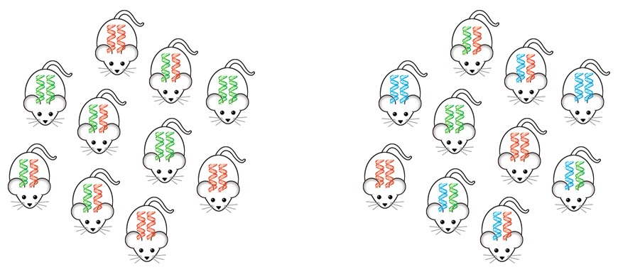
Which of the two populations shown is more likely to survive environmental change?
A
B
Population A
Population B
Both are equally likely to survive.
Notes:
4
Answer: B
Driving Question: 1
4

Slide 5
Close relatives breeding are more likely to produce offspring with birth defects because
The chance of two recessive harmful alleles within the gene pool coming together increases.
Outbreeding depression may occur.
More heterozygotes will be produced.
Hybrid infertility will occur.
Both A and B.
Notes:
5
Answer: A
Driving Question: 1
5

Slide 6
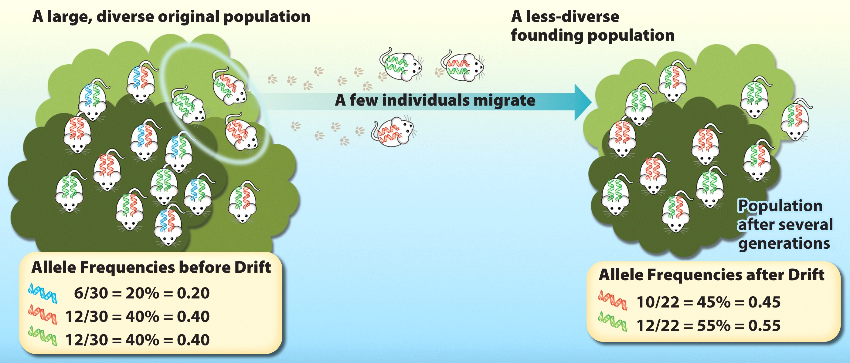
The figure shown illustrates
founder effect.
bottleneck effect.
adaptive evolution.
inbreeding depression.
Both A and C.
Notes:
6
Answer: A
Driving Question: 2
6

Slide 7
The bottleneck effect is an example of
adaptive evolution.
nonadaptive evolution.
genetic drift.
Both A and C.
Both B and C.
Notes:
7
Answer: E
Driving Question: 2
7

Slide 8
All of the following generally work to reduce genetic diversity except:
mutation.
bottleneck effect.
founder effect.
genetic drift.
inbreeding.
Notes:
8
Answer: A
Driving Question: 2
8

Slide 9
Bottlenecks are most detrimental to
small populations.
large populations.
genetically diverse populations.
small mammals.
Both A and C.
Notes:
9
Answer: A
Driving Question: 2
9

Slide 10
Inbreeding tends to
increase the proportion of homozygous individuals.
decrease the frequency of recessive alleles.
increase the frequency of recessive alleles.
Both A and B.
Both A and C.
Notes:
10
Answer: A
Driving Question: 2
10

Slide 11
When mice from one population breed with other mice from a second population, this is an example of
adaptive evolution.
gene flow.
heterozygosity.
the founder effect.
inbreeding.
Notes:
11
Answer: B
Driving Question: 2
11

Slide 12
Which population will be in Hardy-Weinberg equilibrium?
a population in which mates are chosen based on their fur color
a population in which individuals with black fur survive and breed more often than individuals with white fur
a population undergoing a bottleneck effect
a population undergoing genetic drift
No population is ever in perfect Hardy-Weinberg equilibrium.
Notes:
12
Answer: E
Driving Question: 3
12

Slide 13
If a recessive disease affects 1 out of 10,000 people, using the Hardy-Weinberg equilibrium equation, what is the approximate expected frequency of carriers for this disease in the human population?
99 out of 100
2 out of 100
1 out of 100
2 out of 10,000
1 out of 10,000
Notes:
13
Answer: B
Driving Question: 3
13

Slide 14
Researchers want to know if a population of monkeys might be inbreeding. They observe one trait for eye color. Brown eye color (B) is dominant to blue eye color (b). Genotyping of 250 monkeys reveals the following: 99 monkeys are BB 100 monkeys are Bb 51 monkeys are bb What is the expected number of homozygous dominant monkeys in this population?
39 out of 250
40 out of 250
89 out of 250
99 out of 250
Notes:
14
Answer: C
Driving Question: 3
14

Slide 15
Researchers want to know if a population of monkeys might be inbreeding. They observe one trait for eye color. Brown eye color (B) is dominant to blue eye color (b). Genotyping of 250 monkeys reveals the following: 99 monkeys are BB 100 monkeys are Bb 51 monkeys are bb Is there evidence that these monkeys might be inbreeding?
Yes
No
I don’t know.
Notes:
15
Answer: A
Driving Question: 3
15

Slide 16
Researchers want to know if a population of monkeys might be inbreeding. They observe one trait for eye color. Brown eye color (B) is dominant to blue eye color (b). Genotyping of 250 monkeys reveals the following: 99 monkeys are BB 100 monkeys are Bb 51 monkeys are bb What is the evidence that these monkeys might be inbreeding?
There are more heterozygotes than expected.
There are fewer heterozygotes than expected.
There are fewer homozygous dominant monkeys than expected.
p + q > 1
p + q < 1
Notes:
16
Answer: B
Driving Question: 3
16

Slide 17
In which of the following cases would the biological species concept NOT be useful in identifying a species?
A scientist has fossils of two dinosaurs.
Two zoos in different cities have a similar looking mammal.
Two frog populations have slightly different color patterns.
Two groups of foxes live in slightly different environments.
The biological species definition would not be useful in identifying whether any of the above are separate species.
Notes:
17
Answer: A
Driving Question: 4
17

Slide 18
If two groups of flowers can mate and produce fertile offspring, then they are
inbreeding.
the same species.
different species.
possibly the same species, but it is not clear.
Both A and D.
Notes:
18
Answer: B
Driving Question: 4
18

Slide 19
If ant populations living in the same median strip have mating organs that are incompatible, which of the following is true?
They are separate species.
They would most likely produce hybrid offspring.
They are ecologically isolated.
All of the above.
Both A and B.
Notes:
19
Answer: E
Driving Question: 4
19

Slide 20
Two groups of flowers can no longer mate and produce fertile offspring. Originally both were part the same population but were separated by a geographical boundary. What has happened?
speciation
allopatry
reproductive isolation
All of the above.
None of the above.
Notes:
20
Answer: D
Driving Question: 4
20

