Slide 1
Michèle Shuster • Janet Vigna • Matthew Tontonoz • Gunjan Sinha
Biology for a
Changing World
SECOND EDITION
Lecture PowerPoint
CHAPTER 15
Nonadaptive Evolution and Speciation
Copyright © 2014 by W. H. Freeman and Company

Slide 2
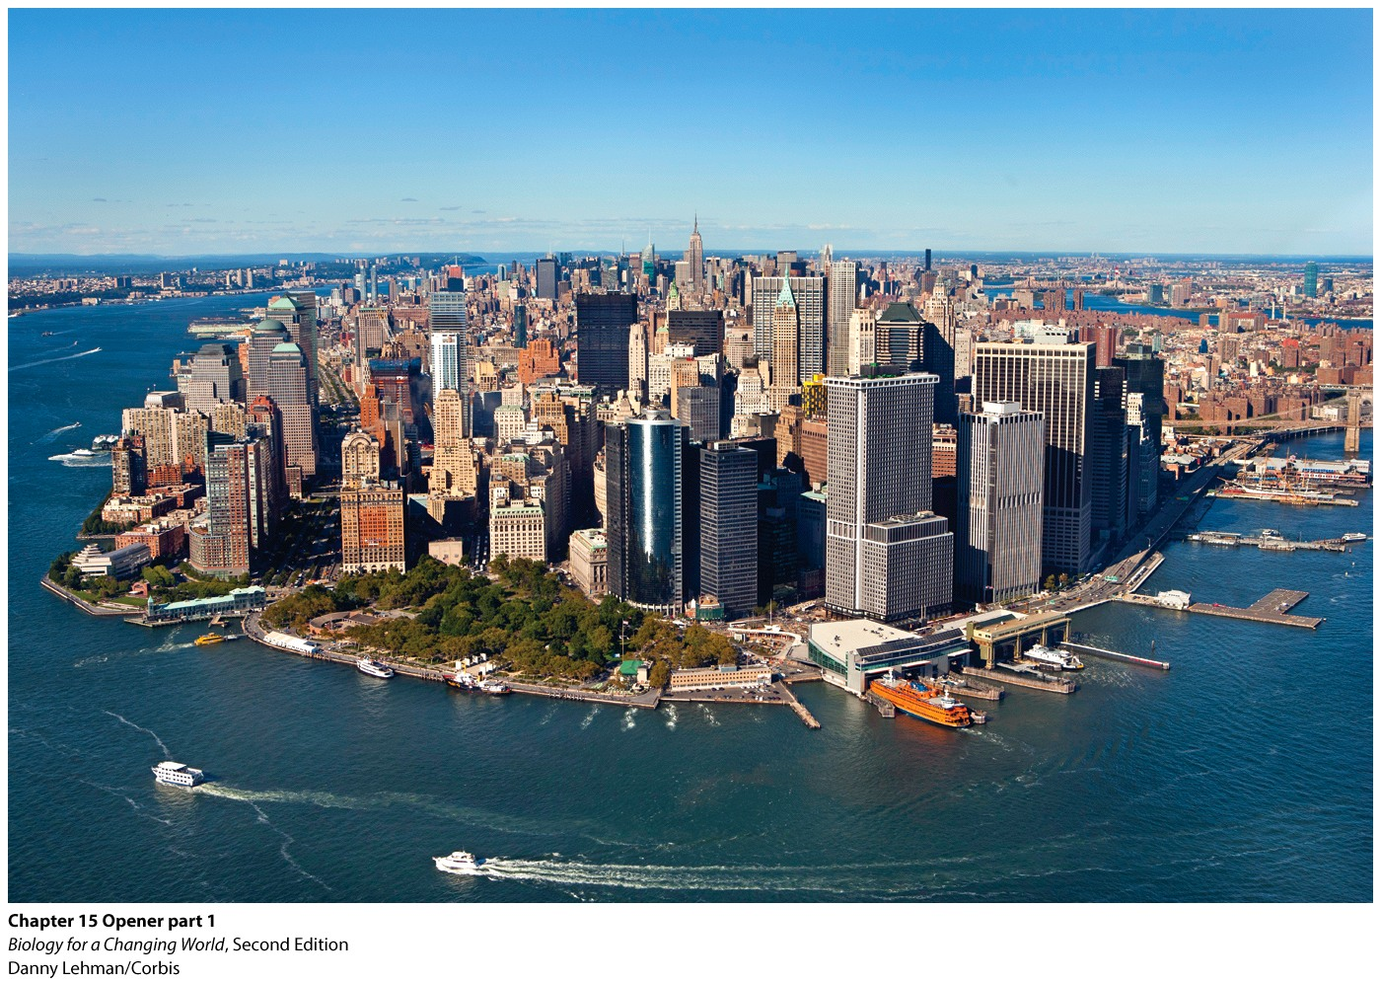
Chapter 15
Nonadaptive Evolution and Speciation

Slide 3
Driving Questions
1. What is a gene pool (and can you swim in it)?
2. How do different evolutionary mechanisms influence
the composition of a gene pool?
3. How does the gene pool of an evolving population
compare to the gene pool of a nonevolving
population?
4. How do new species arise, and how can we recognize
them?

Slide 4
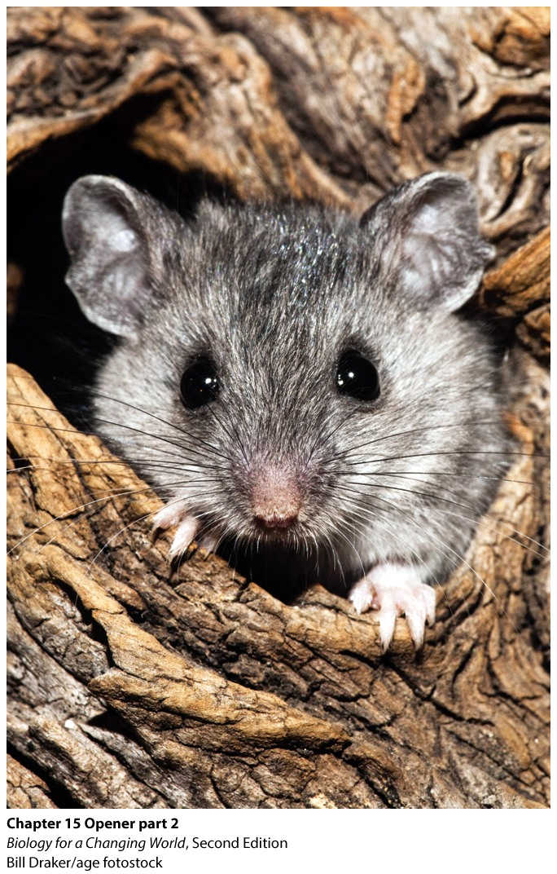
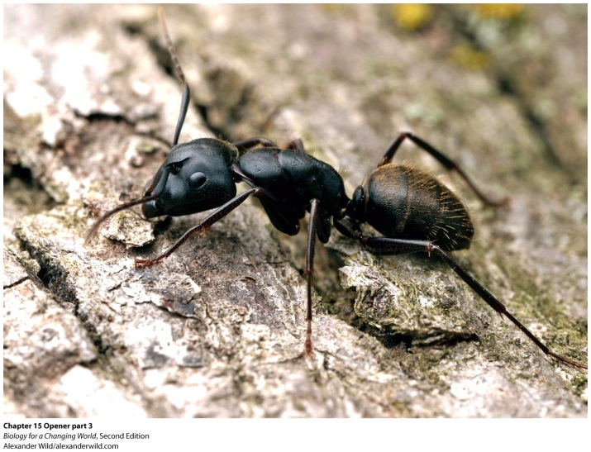
Urban evolution
studying evolution in Manhattan

Slide 5
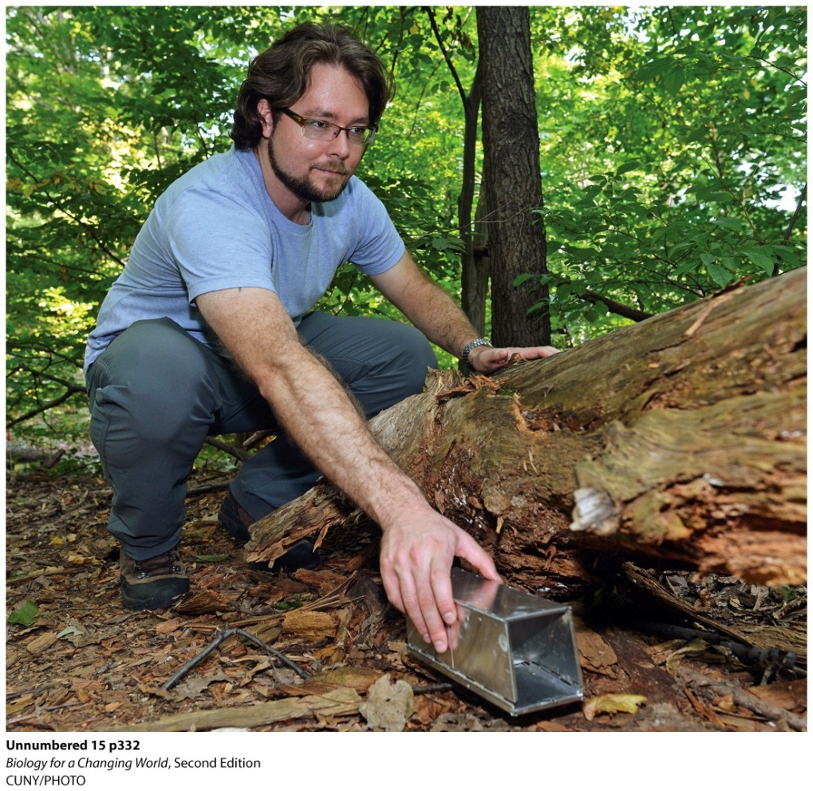
Population genetics
Study of the genetic makeup of populations and how genetic composition changes
Understand how a group of organisms is coping with environmental changes
Notes:
Biologist Jason Munshi-South lays a trap for white-footed mice.

Slide 6
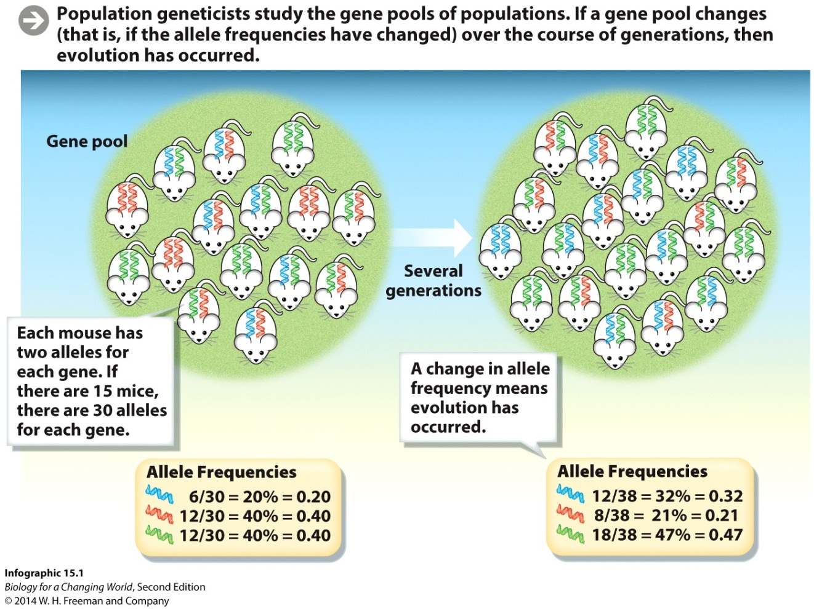
Populations genetics
Gene pool; total collection of alleles in a population
Identify allele frequency
Notes:
Allele frequency: the relative proportion of an allele in a population

Slide 7
Population genetics
Changes in allele frequency over time
Population evolves
Good, bad, or neutral consequences result in the population becoming more adapted to its environment—natural selection results in a population adapting

Slide 8
What causes changes in allele frequency?
natural selection
– population is better adapted
nonadaptive evolution
caused by mutation, genetic drive, and gene flow

Slide 9
What causes changes in allele frequency?

Slide 10
Nonadaptive evolution
Genetic drift
change in allele frequencies between generations that occurs purely by chance
subset of population reproduces
subset of alleles represented in next generation
decreases genetic diversity of a population

Slide 11
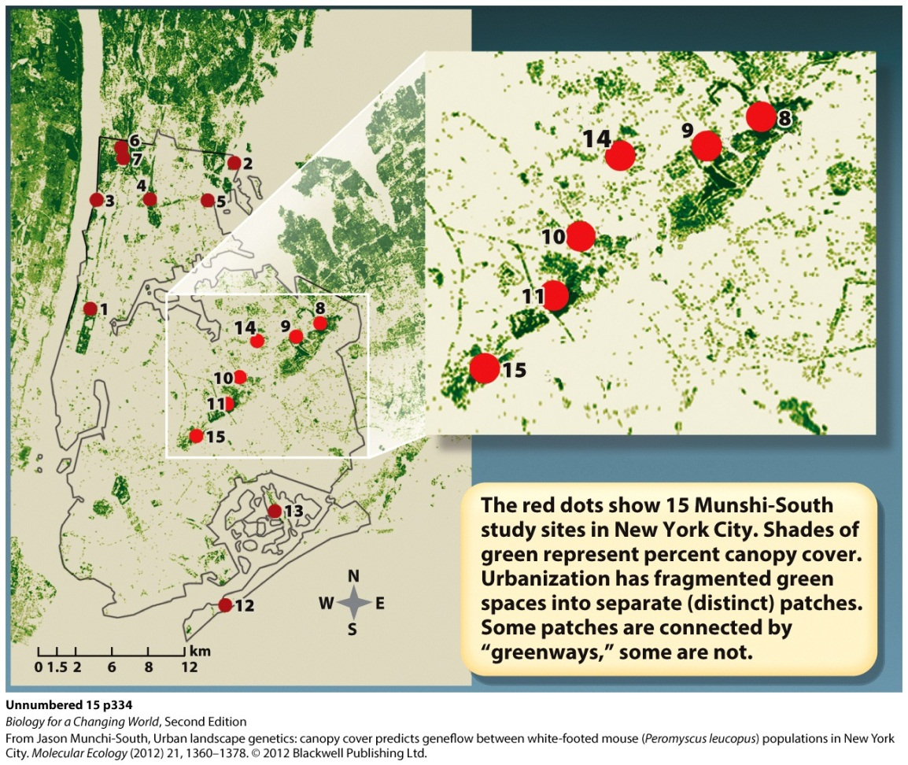
Nonadaptive evolution
Genetic drift
For example, populations get separated
Notes:
Genetic drift tends to have more dramatic effects in smaller populations because in a population with fewer individuals any individual that does not reproduce could spell the loss of alleles from the population.

Slide 12
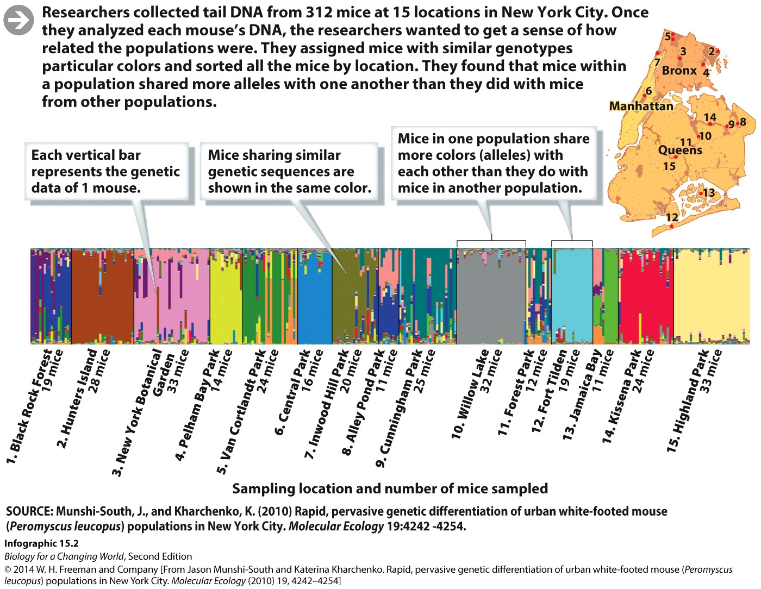
Nonadaptive evolution
Genetic drift
Notes:
DNA sequences at 18 different chromosome locations from all 312 mice were assessed and the results showed distinct clustering of alleles. Mice within one population tended to share more alleles with one another than with mice from other populations.

Slide 13
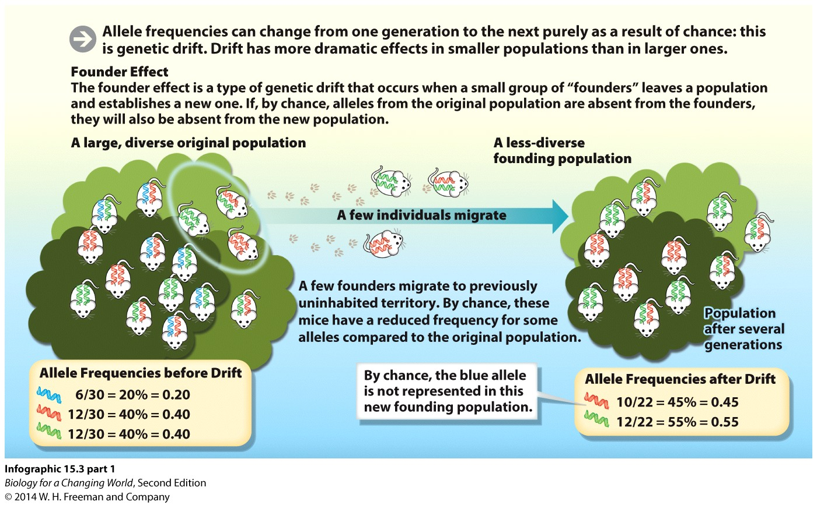
Nonadaptive evolution
Genetic drift
Founder effect
Notes:
Founder effect is a type of genetic drift in which a small number of individuals leave one population and establish a new population. By chance, the newly established population may have lower genetic diversity than the original population. The genetic diversity of the new population reflects the reduced diversity of the founders.

Slide 14
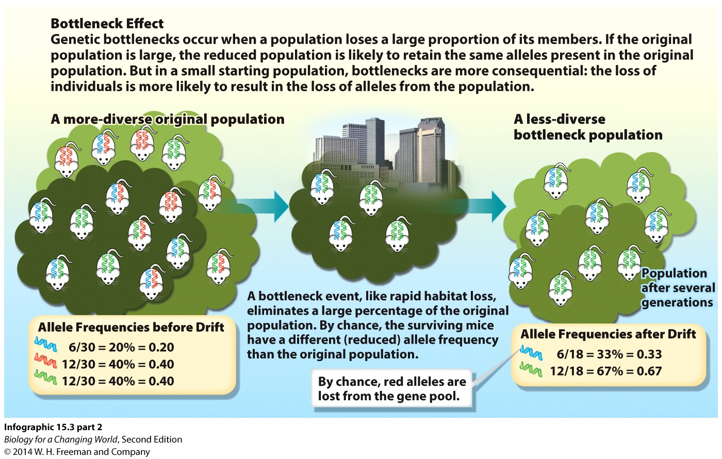
Nonadaptive evolution
Genetic drift
Bottleneck effect
Notes:
Bottleneck effect is a type of genetic drift that occurs when a population is suddenly reduced to a small number of individuals and alleles are lost from the population as a result.

Slide 15
Why is genetic diversity important?
Diverse gene pool gives a population more flexibility to survive in a changing environment
The more genetically diverse a population, the more ways it has to adapt

Slide 16
Reintroducing genetic diversity
Must bring in new alleles
Mutation
Gene flow; movement of alleles from one population to another
Notes:
Gene flow: the movement of alleles from one population to another, which may increase the genetic diversity of a population

Slide 17
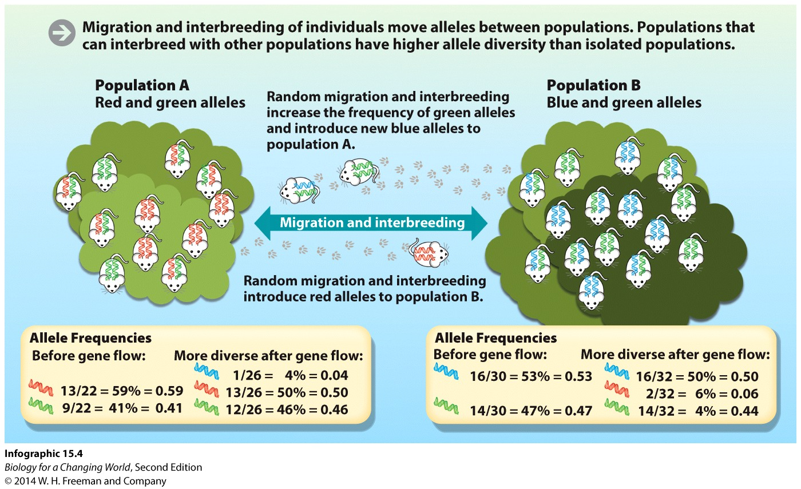
Gene flow
Notes:
Different New York City mice populations had different levels of gene flow, meaning that some populations exchanged alleles with other populations more than others.

Slide 18
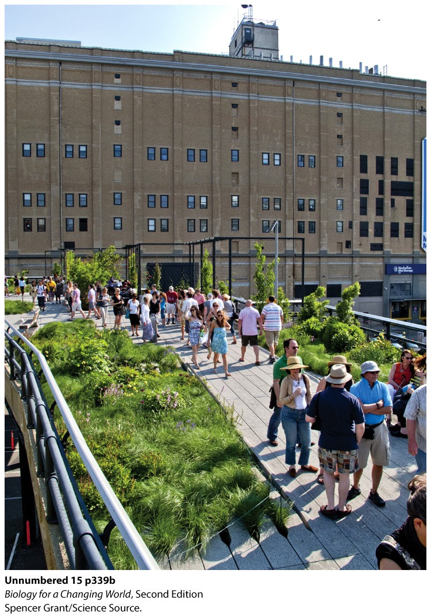
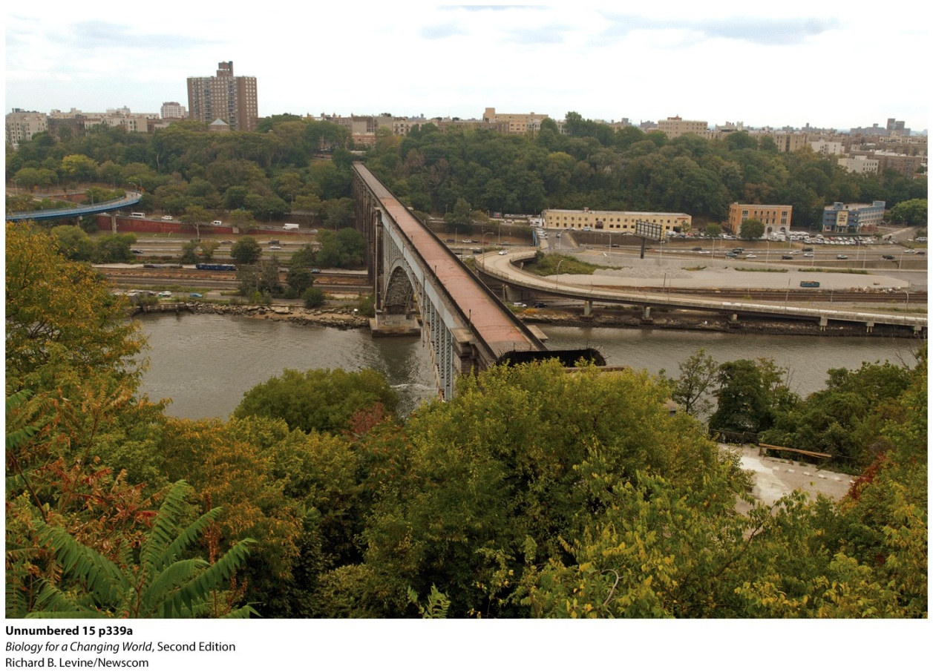
Gene flow
Urbanization can prevent gene flow, can lead to inbreeding

Slide 19
Inbreeding
Mating between closely related individuals
Does not change the allele frequency within a population
Increases the proportion of homozygous individuals to heterozygotes

Slide 20
Inbreeding depression
Closely related individuals are more likely to share the same alleles
Negative reproductive consequences for a population
Associated with high frequency of homozygous individuals possessing harmful recessive alleles
Notes:
The increased chance of two recessive alleles coming together during a mating is high. When that happens, homozygous recessive genotypes are created, and previously hidden recessive alleles start to affect phenotypes.

Slide 21
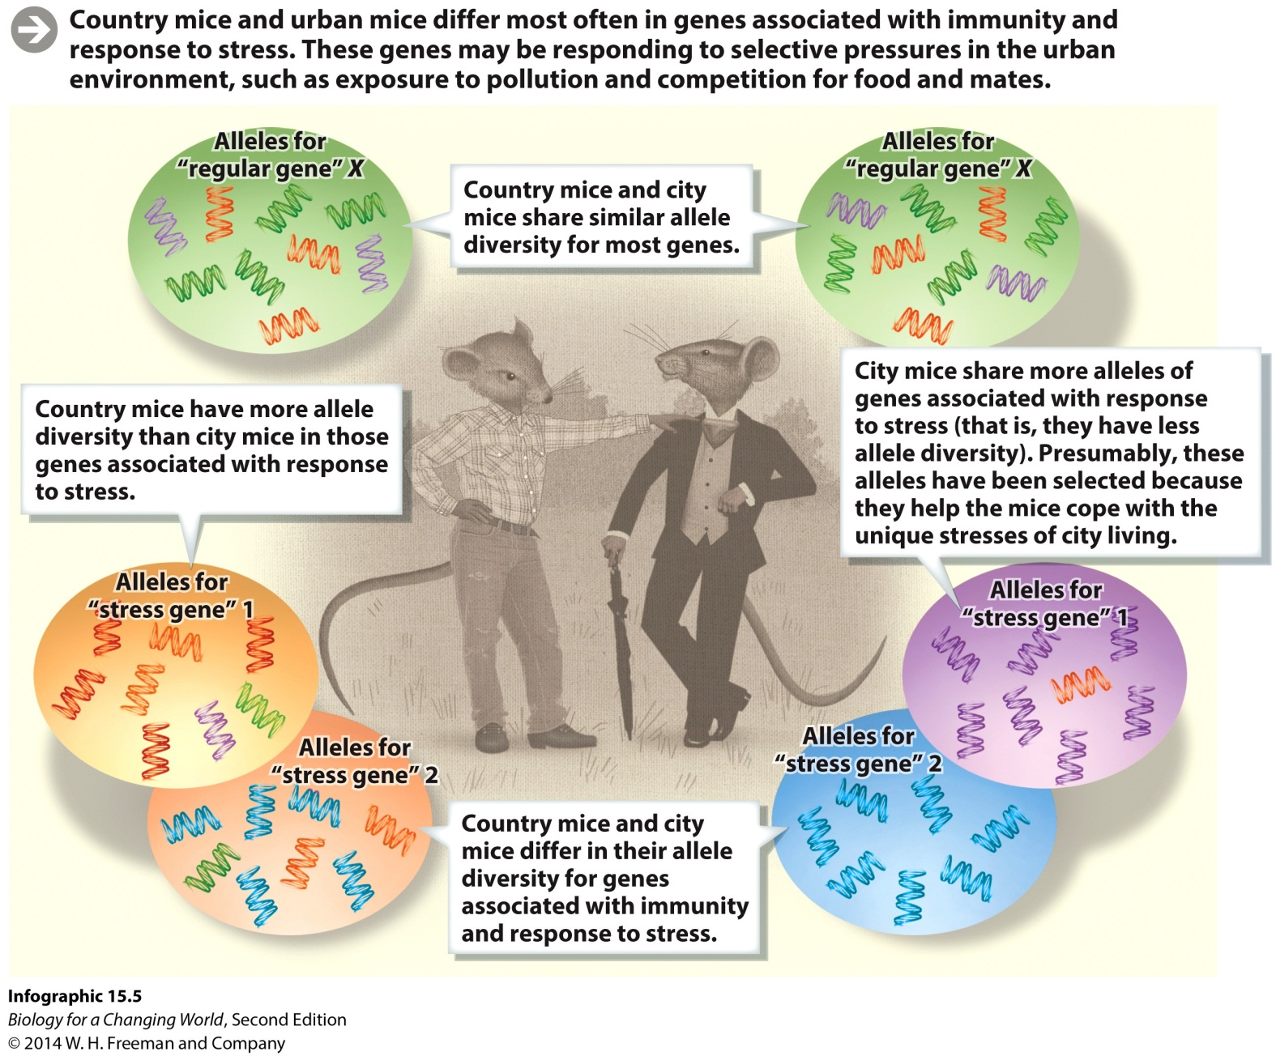
Affects of urbanization

Slide 22
Mechanisms of evolution
Notes:
For most natural populations, all four mechanisms of evolution—selection, mutation, gene flow, and genetic drift—are continually operating at the same time, fostering unique evolutionary outcomes.

Slide 23
Hardy-Weinberg equilibrium
In a nonevolving population, allele and genotype frequencies do not change over time
Hardy-Weinberg equilibrium
Use to identify genes that have changed because of evolutionary mechanisms

Slide 24
Hardy-Weinberg equilibrium
Baseline to judge if a population is evolving
Hardy-Weinberg equation
p² + 2 pq + q² = 1
p² is the frequency of homozygous dominants
2 pq is the frequency of heterozygotes
q² is the frequency of homozygous recessives
Notes:
The Hardy-Weinberg equation is a mathematical formula that relates allele frequencies to genotype frequencies in a population at the Hardy-Weinberg equilibrium.

Slide 25
Hardy-Weinberg equilibrium
Five necessary conditions
No mutation introducing new alleles into the population
No natural selection favoring some alleles over others
An infinitely large population size (and, therefore, no genetic drift)
No influx of alleles from neighboring populations (i.e., no gene flow)
Random mating of individuals
Notes:
In nature, no population can ever be in strict Hardy-Weinberg equilibrium.

Slide 26
Hardy-Weinberg equilibrium

Slide 27
What is a species?

Slide 28
What is a species?
Biological species concept
A population of individuals whose members can interbreed and produce fertile offspring
Different species cannot mate because they are reproductively isolated

Slide 29
What is a species?
Reproductive isolation
Ecological isolation
Temporal isolation
Behavioral isolation
Notes:
Reproductive isolation: mechanisms that prevent mating (and therefore gene flow) between members of different species

Slide 30
What is a species?
Reproductive isolation
Mechanical isolation
Gametic isolation
Hybrid inviability
Hybrid infertility

Slide 31
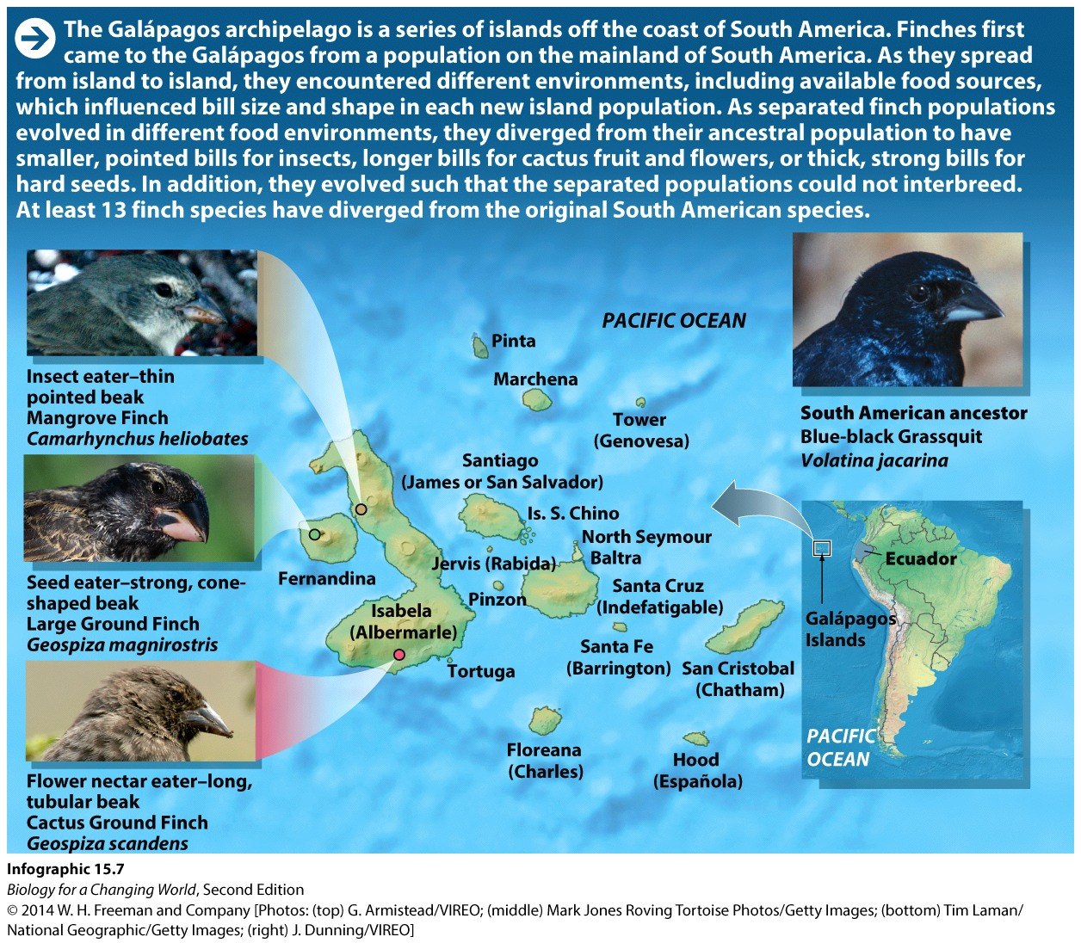
Speciation
Genetic divergence of populations, leading over time to reproductive isolation and the formation of new species

Slide 32
Summary
Population is identified by the particular collection of alleles in its gene pool.
Genetic diversity is reflected by the number of different alleles in a population’s gene pool.
Evolution is a change in allele frequencies in a population over time. Evolution can be adaptive or nonadaptive. Mutation, genetic drift, and gene flow are nonadaptive forms.
Founder and bottleneck effects are types of genetic drift.
Gene flow is the movement of alleles between different populations of the same species.
Inbreeding of closely related individuals may occur in small, isolated populations.
Hardy-Weinberg equilibrium describes the frequency of genotypes in a nonevolving population.
Speciation can occur when gene pools are separated, gene flow is restricted, and populations diverge genetically over time.

