Slide 1
Michèle Shuster • Janet Vigna • Matthew Tontonoz • Gunjan Sinha
Biology for a
Changing World
SECOND EDITION
Lecture PowerPoint
CHAPTER 16
Evidence for Evolution
Copyright © 2014 by W. H. Freeman and Company

Slide 2
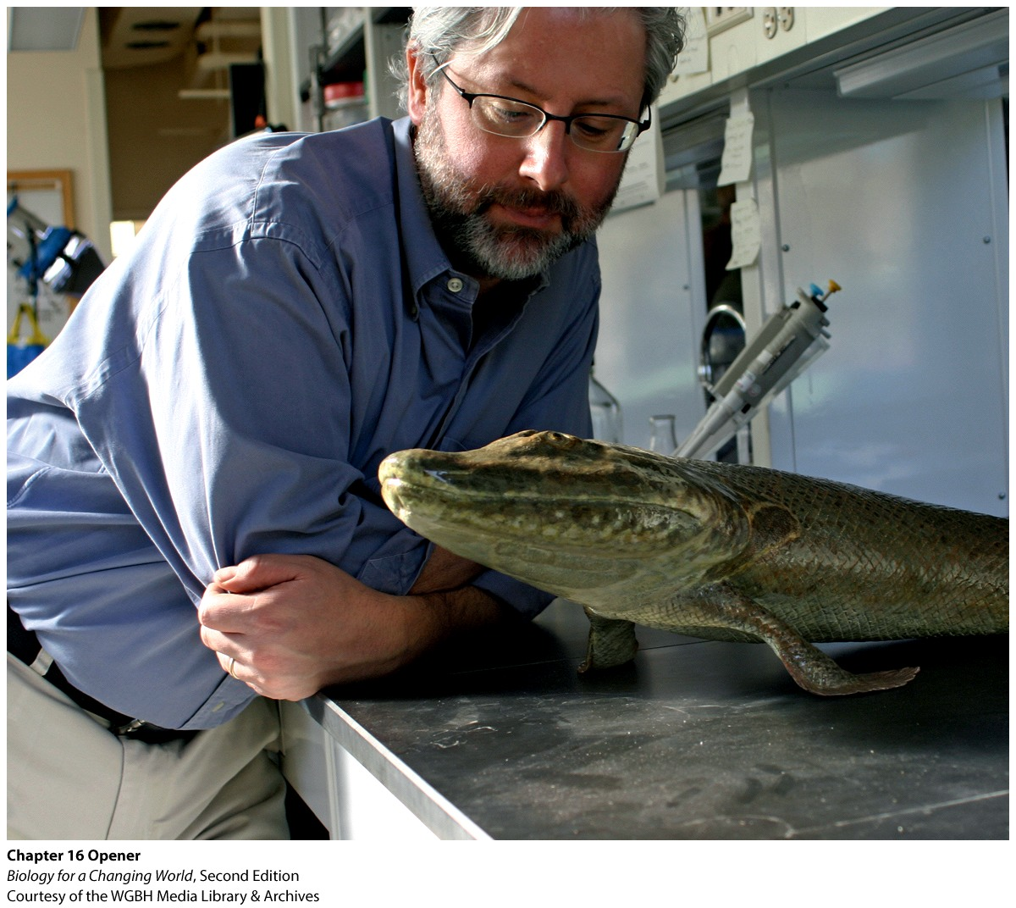
Chapter 16
Evidence for Evolution

Slide 3
Driving Questions
1. How does the fossil record reveal information about
evolutionary changes?
2. What features make Tiktaalik a transitional fossil,
and what role do these types of fossil play in the
fossil record?
3. What can anatomy and DNA reveal about evolution?

Slide 4
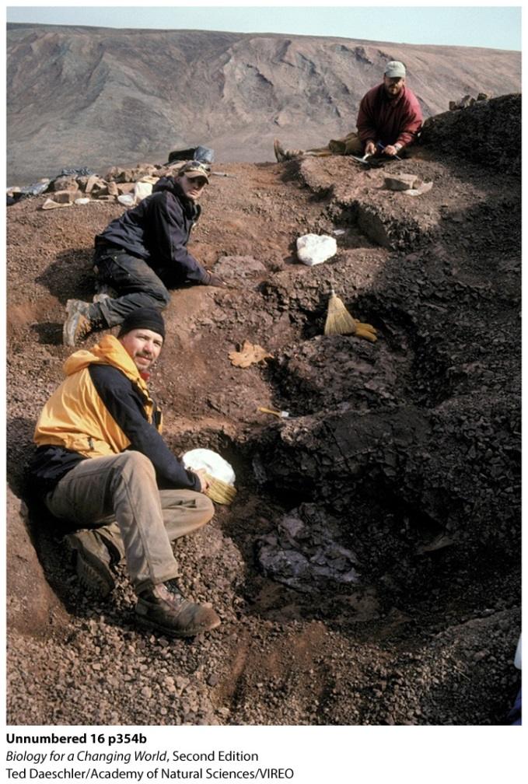
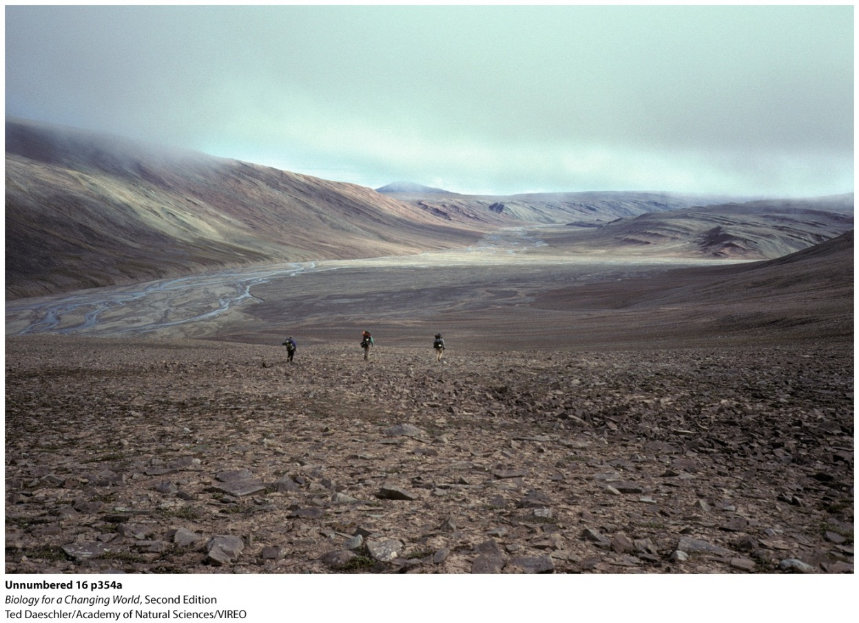
The fossil record
Paleontologists: scientists who study ancient life by means of the fossil record
Notes:
Fossil hunting in the vast wilderness of Ellesmere Island in the Canadian Arctic.

Slide 5
The fossil record
Fossil: the preserved remains or impressions of once-living organisms
Fossil record: an assemblage of fossils arranged in order of age, which provides evidence of changes in species over time

Slide 6
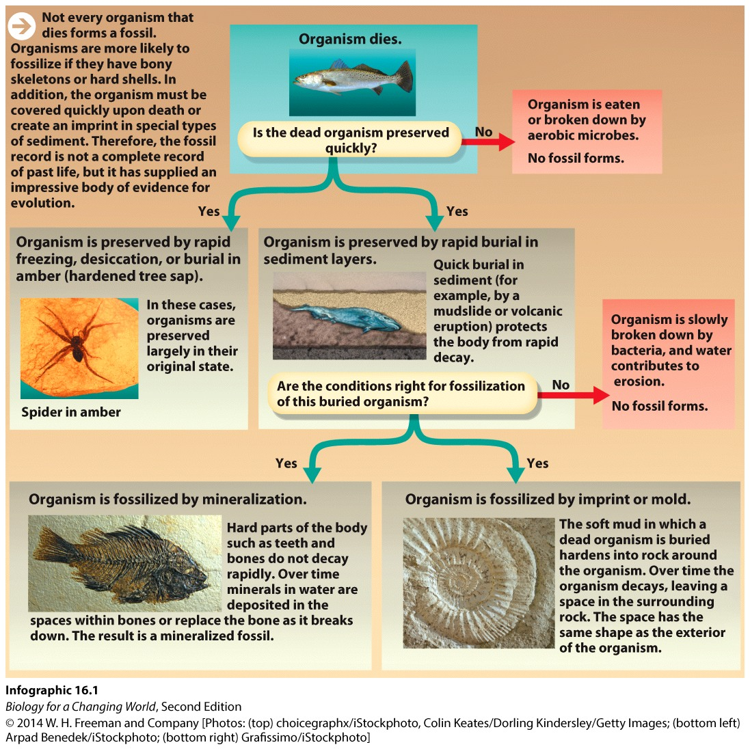
How do fossils form?
Notes:
Fossils are like snapshots of past life, capturing what life was like at particular moments in time.

Slide 7
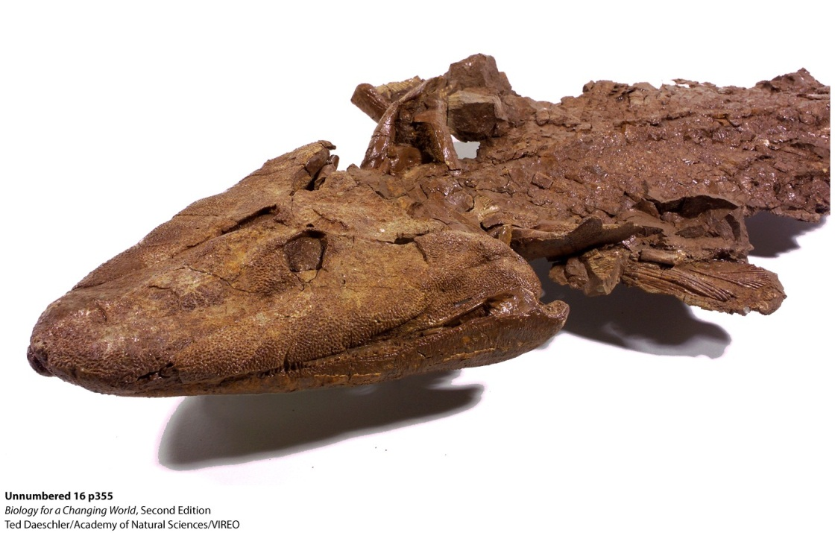
Reading the fossil record
Discovered fossil remains of Tiktaalik
Important part of evolution of vertebrate
animals with bony or cartilaginous backbones
Notes:
Tiktaalik roseae: this ancient hybrid animal no longer exists, but it represents a critical phase in the evolution of four-legged, land-dwelling vertebrates (including humans).

Slide 8
Reading the fossil record
Tiktaalik
transition between fish and land-dwelling animals
Descent with modification (aka evolution)
all living things are related
different species emerged over time due to natural selection
Notes:
The theory of evolution is what Darwin called descent with modification.

Slide 9
Reading the fossil record
Not all organisms are preserved
The fossil record is not a complete record of past life
Extensive enough to show arc of life

Slide 10
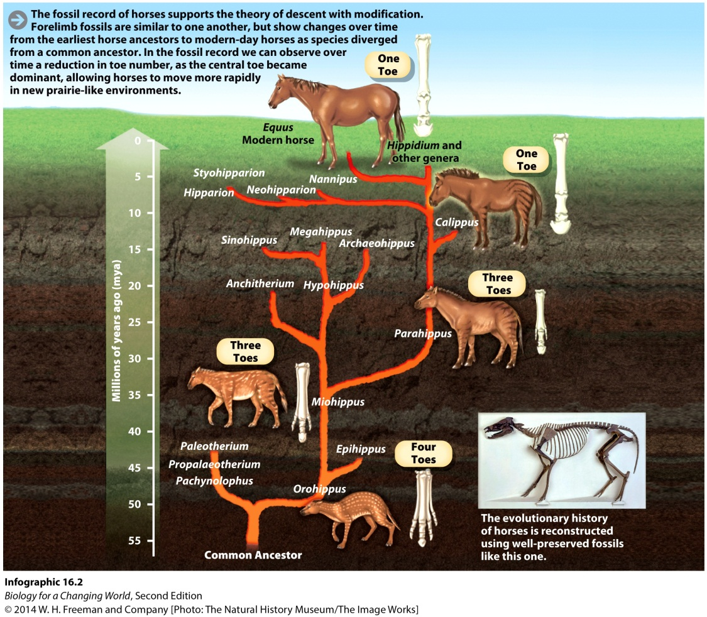
Reading the fossil record
Shows an ordered succession of evolution
See changes over time in family of organisms
Notes:
All organisms have descended from a single common ancestor billions of years ago. The fossil record shows an ordered succession of evolutionary comparisons of modern-day horse bones with fossils of horse ancestors and reveals how, in the course of evolution, horses have lost most of their toes.

Slide 11
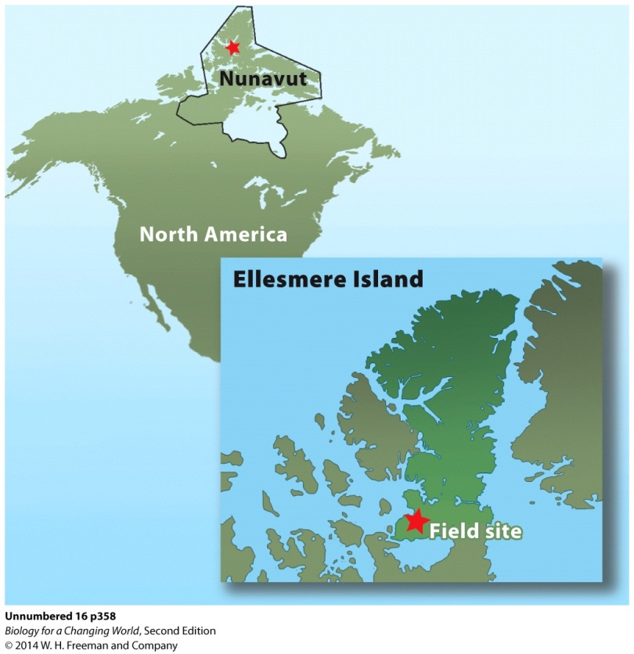
Reading the fossil record
Shows intermediate fossils like Tiktaalik
375-380 million years ago
No land-dwelling vertebrates
Notes:
Shubin and Daeschler began their hunt for fossils in the Canadian arctic in 1999 after stumbling upon a map in an old geology textbook.
The map showed that the region contained large swaths of exposed rock dating back 375–380 million years (just the period that interested the researchers).

Slide 12
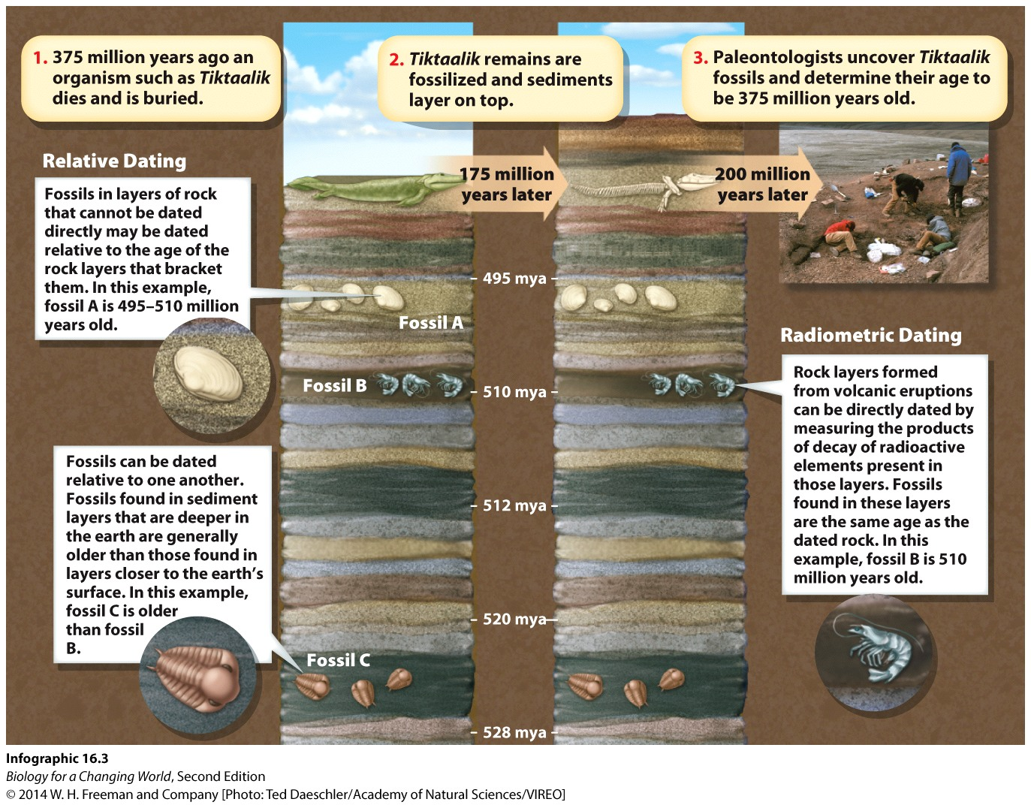
How are fossils dated?
Fossils are at least as old as the rocks that encase them
Some types of rocks can be dated directly using radiometric dating

Slide 13
How are fossils dated?
Relative dating
determine age of the fossil from its position relative to layers of rocks or fossils of known age
Radiometric dating
use radioactive isotopes as a measure of age

Slide 14
Evolution of life on land
400-350 million years ago
Most land submerged under water
age of fishes
Some plants and invertebrates on land
animal without a backbone
Over time land became more available

Slide 15
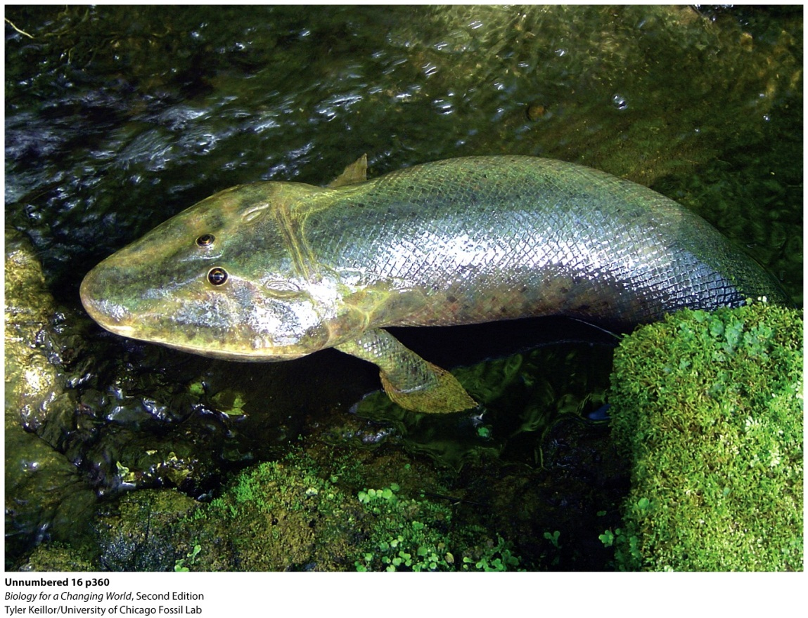
Evolution of life on land
Living on the land requires
sturdier structure
prevention of water loss
a different way to take in oxygen
limbs
Notes:
An artist’s representation of what tiktaalik may have looked like.

Slide 16
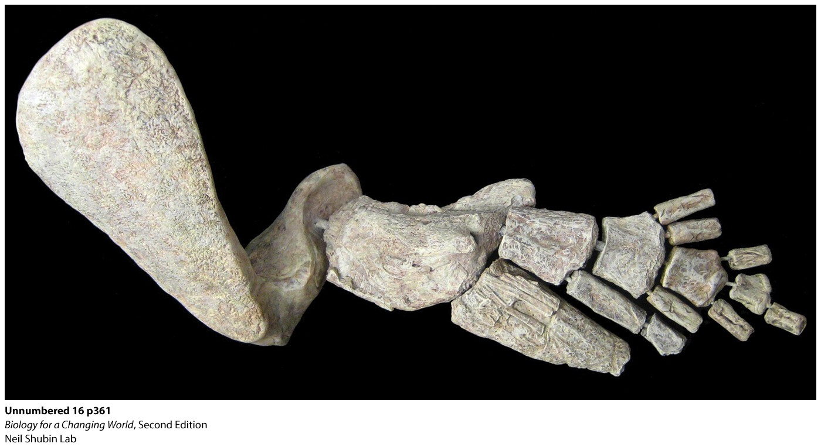
Evolution of life on land
Tetrapods
Vertebrate with four true limbs
Jointed, bony appendages with digits
Notes:
Amphibians, most reptiles, and mammals all have two pairs of limbs, defining them as tetrapods (from the Greek for “four-footed”).
This is a physical model of tiktaalik’s forelimb fin, made from replicas of fossil bones fused with flexible wire.

Slide 17
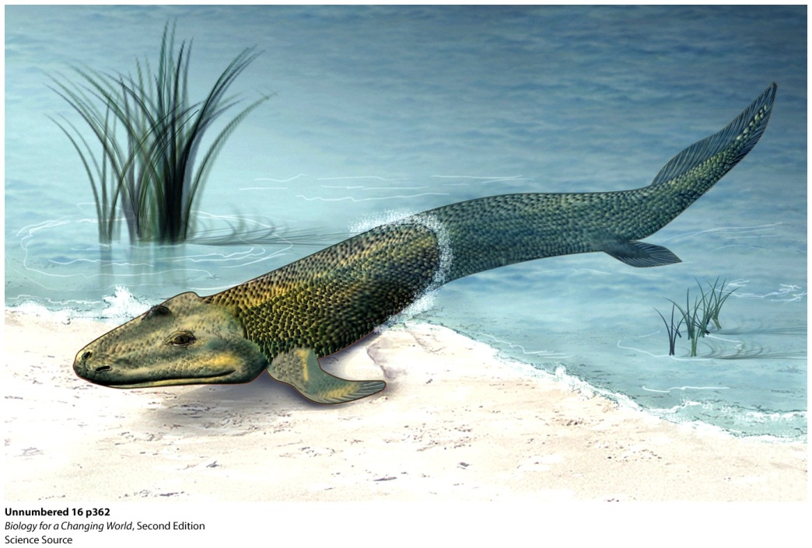
Evolution of life on land
Tiktaalik
Possessed many features of a lobe-finned fish
Also had a jointed elbow, wrist, and fingerlike bones
Notes:
Tiktaalik likely used its sturdy forelimb fins to pull itself out of the water for short excursions on land.
Lobe-finned fish have fleshy fins supported by a stalk of bones that resemble primitive limb bones. (Gave rise to tetrapods.)

Slide 18
Evolution of life on land
Notes:
Tiktaalik is thought to have had both lungs and gills, which explains how it could breathe out of water for these short excursions.
Tiktaalik is still considered a fish because its limbs lack the true jointed fingers and toes that characterize tetrapod limbs (in other words, they’re still fins).

Slide 19
Common ancestry
All tetrapods share the same forelimb bones, arranged in the same order
Homology: similarity due to common ancestry
Homologous structures are those that are similar because they are inherited from the same ancestor
Notes:
Homology: anatomical, genetic, or developmental similarity among organisms due to common ancestry

Slide 20
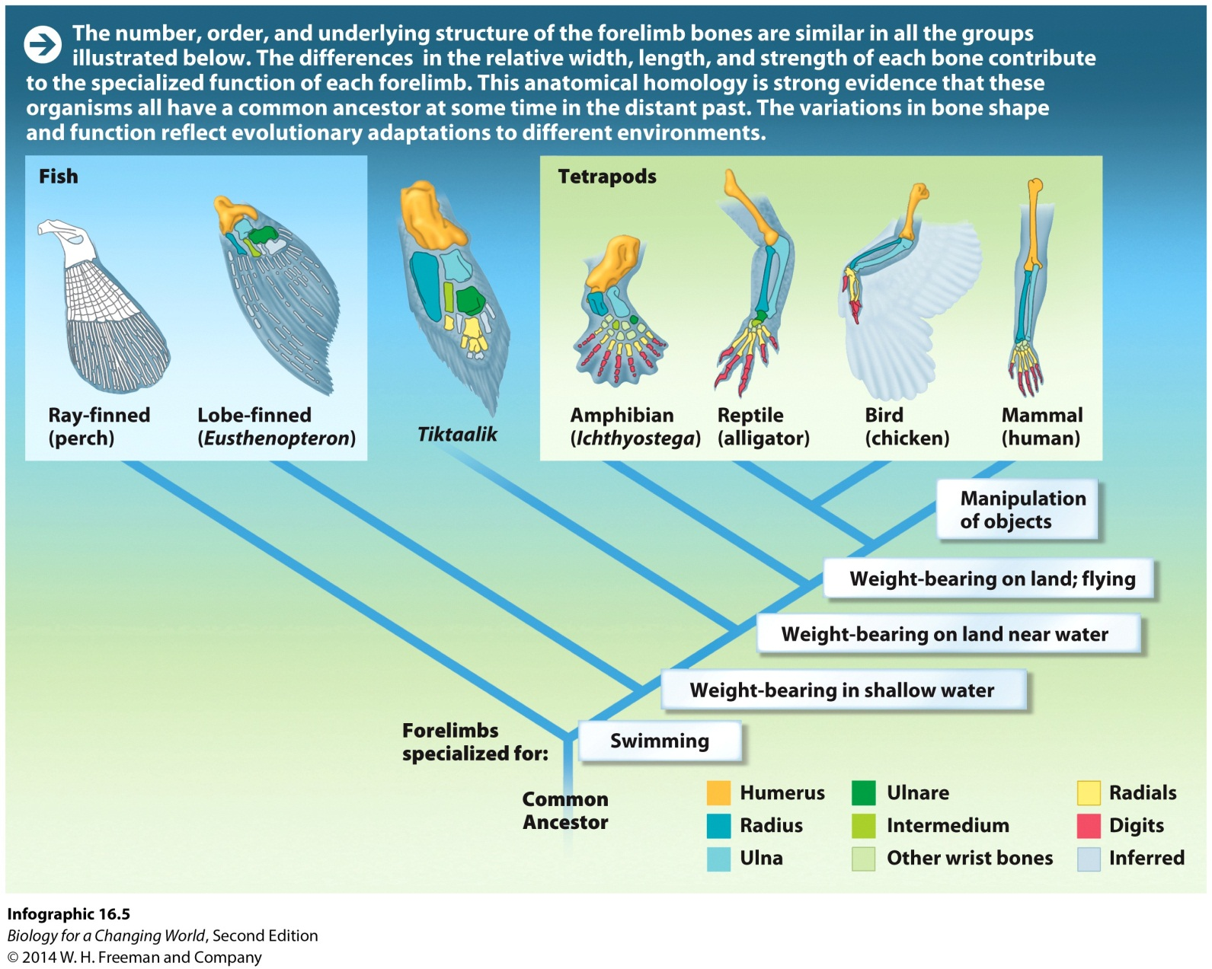
Common ancestry

Slide 21
Common ancestry
Homology is also seen in early development
Similar embryological structures exist
Vertebrates shared a common ancestor

Slide 22
Common ancestry
Vestigial structure
Inherited from an ancestor and no longer serves a clear function in the organism that possesses it
For example, a snake embryo has limb buds
Notes:
Strong evidence for evolution: These now apparently useless features are inherited from an ancestor in whom they did serve a function.

Slide 23
Common ancestry
Related organisms share DNA sequences
Notes:
The more distantly related two species are, the more sequence differences in DNA sequences you will see. In essence, DNA serves as a kind of molecular clock. Each additional sequence difference is like a tick of the clock, showing the amount of time that elapsed.
When combined with evidence from the fossil record, anatomy, and development, molecular data become a powerful tool for understanding evolution.

Slide 24
Common ancestry
Closely related species have fewer DNA sequence differences than species more distantly related

Slide 25
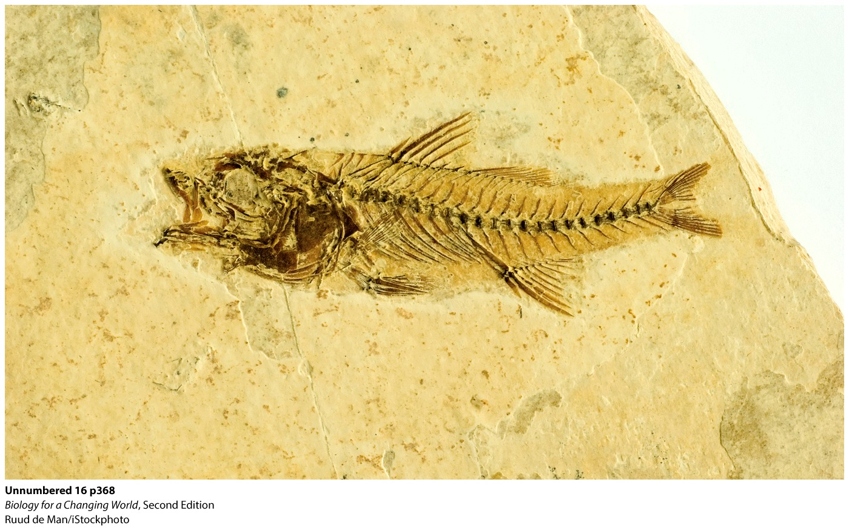
The fossil record
Fossil record is an excellent source of evidence

Slide 26
Summary
Evolution, descent with modification: All living things are related, sharing a common ancestor species and are the result of natural selection operating over millions of years.
Evolution is supported by a wealth of evidence, including fossil, anatomical, and DNA evidence.
Fossils are preserved remains or impressions of once-living organisms that provide a record of past life on Earth.
Fossils can be dated directly or indirectly.
Descent with modification also predicts the existence of “intermediate” organisms.
Homology—anatomical, developmental, or genetic similarities shared among groups of related organisms.
DNA can be used as a molecular clock.

