Slide 1
Biology for a Changing World, 2e Clicker Questions Chapter 21

Slide 2
An ecologist is studying a species of bird in a group of 20. What ecological scale is this?
Individual
Population
Community
Ecosystem
Notes:
Answer: B
Driving Question: 1

Slide 3
Why is Isle Royale a great place to base ecological research?
It is a protected area without human development
It is an island that is pretty isolated
The island is big enough to support populations of large animals, but small enough that detailed studies are feasible
All of the above.
Notes:
Answer: D
Driving Question: 1

Slide 4
You are an ecologist with two projects: What ecological scale are you working on?
6 groups of ducks - each group lives 500km from each other and do not mix
10 ant groups - each group lives 1 km from each other and do not mix
Individual
Population
Community
Ecosystem
Notes:
Answer: B
Driving Question: 1

Slide 5
You are an ecologist whose research focuses on the community level. You are interested in moving towards ecosystem research. What would you add to move to the ecosystem scale?
Data for more species
Data for more communities
Data on environmental factors
Data on both plants and animals.
Notes:
Answer: C
Answer Notes: Data on environmental factors. Ecosystem research focuses on how species interact with other species AND their environment.
Driving Question: 1

Slide 6
Which graph shows what would happen if a population’s birth rate is higher than its death rate?
Population size
Population size
Population size
Time
Time
Time
A
B
C
Notes:
Answer:
Answer Notes: A if the birth rate is higher than the death rate, the population size is likely to increase over time.
Driving Question: 32

Slide 7
You are studying a population of bacteria in the lab. The population size keeps growing and growing and despite years of research, the growth rate just keeps increasing. What kind of population growth pattern are you seeing?
Logistic growth
Capacity growth
Habitat growth
Exponential growth
Notes:
Answer: D
Answer Notes: Exponential growth. The population growth of your bacteria appears to be growing at a constant rate indefinitely and is apparently not limited by environmental factors or resource availability.
Driving Question: 2

Slide 8
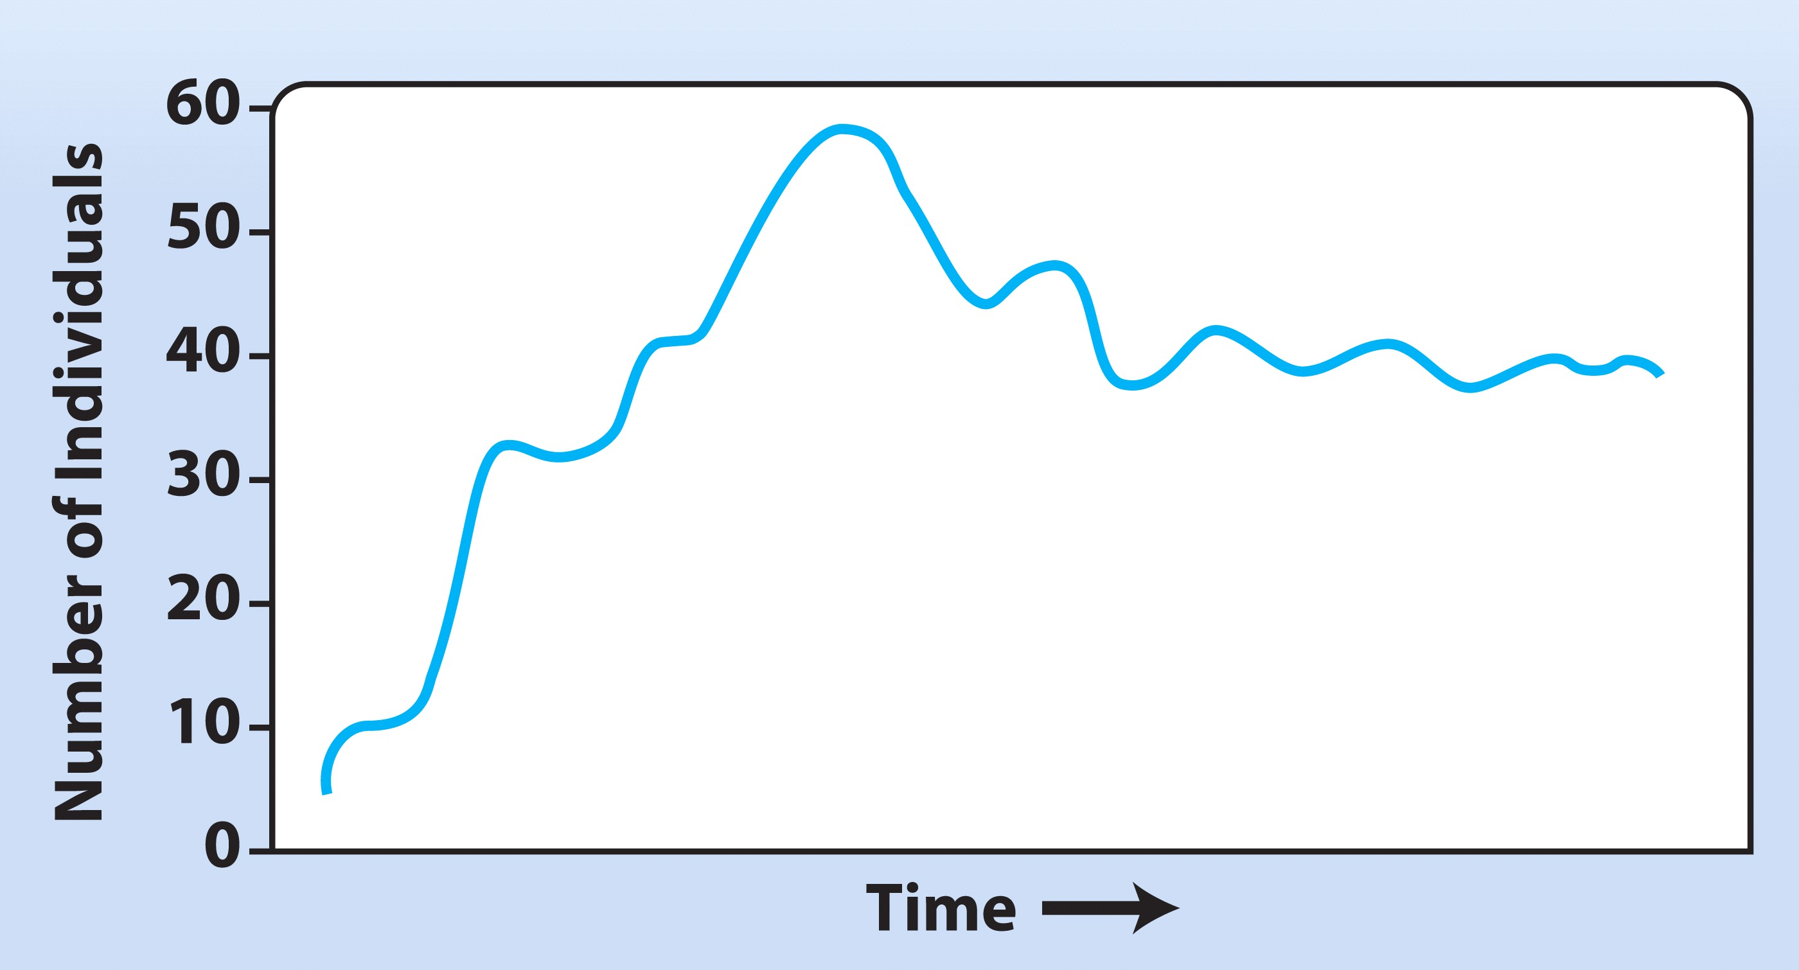
When is the population birth rate less than the death rate?
A
B
C
D
Notes:
Answer: C
Answer Notes: The number of individuals is decreasing here, so the death rate is likely greater than the birth rate.
Driving Question: 2

Slide 9
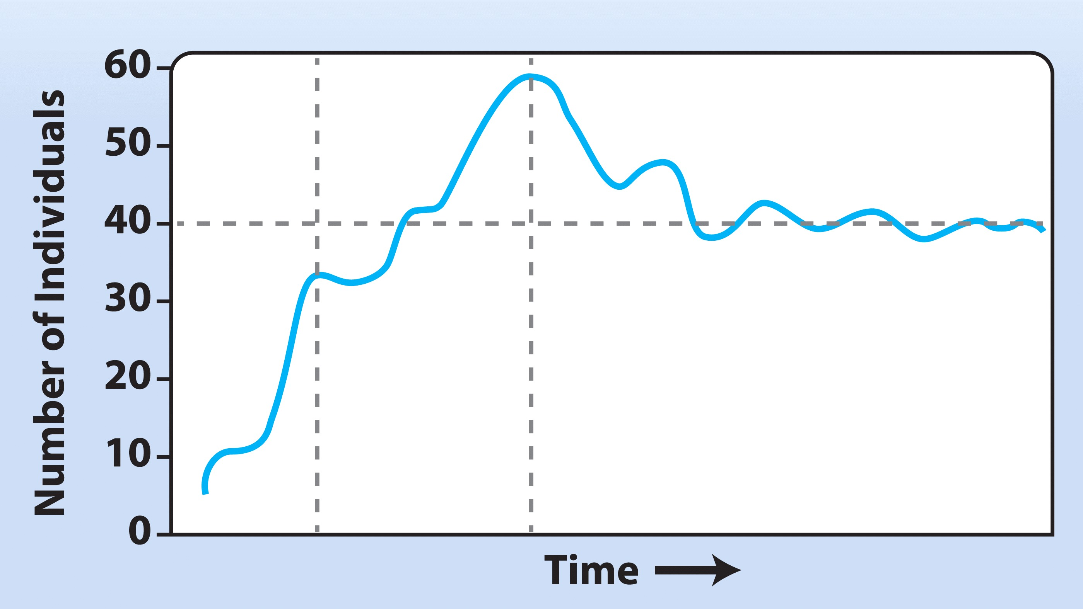
What is the carrying capacity of this population?
B
C
A
D. Carrying capacity is not reached
Notes:
Answer: C
Answer Notes: The population level stabilizes here, so this is likely the carrying capacity of the environment.
Driving Question: 2

Slide 10
A bird species eats a beetle species that eats a tree species. Changes in the bird population have what kind of affect on the tree population?
Direct effect
Mixed effect
Indirect effect
None of the above
Notes:
Answer: C
Answer Notes: Indirect effect. Similar to how wolves eat moose which eat trees: when wolf populations get bigger or smaller, moose populations also change in size, and that changes the amount of trees that get eaten. Wolf populations have an indirect effect on tree populations.
Driving Question: 3

Slide 11
Which is an example of a density-independent influence on population growth?
Disease
Temperature
Food
Predators
Notes:
Answer: B
Answer Notes: Temperature is the only density independent influence in this list (the rest are density-dependent).
Driving Question: 3

Slide 12
What effect do abiotic factors usually have on populations?
Density-dependent
Density-independent
Notes:
Answer: B
Answer Notes: Usually density-independent influences on population (temperature, precipitation, etc. affect all individuals regardless of density).
Driving Question: 3

Slide 13
Does food have a density-dependent effect on populations?
No, the food resources are available regardless of the number of individuals in the population.
Yes, the availability of food influences the population growth of species that rely on these resources.
Notes:
Answer: B
Driving Question: 3

