Slide 1
Biology for a Changing World, 2e Clicker Questions Chapter 23

Slide 2
Which description best describes all of the elements of an ecosystem?
the predators and prey in an area
all the species living in an area and the physical and chemical environments
all the plants and animals in an area
all the living species that live and interact in the same area
Notes:
Answer: B
Driving Question: 1
Incorrect Answer Notes: The answer is not A or C or D because the descriptions only include living components, not the nonliving ones.

Slide 3
How are ecosystems being affected by climate change?
Climate change affects the living components by causing differences in the presence and interactions among species.
Climate change affects the nonliving components of the environment by changing temperature, precipitation, etc.
Both A and B.
Notes:
Answer: C
Driving Question: 1

Slide 4
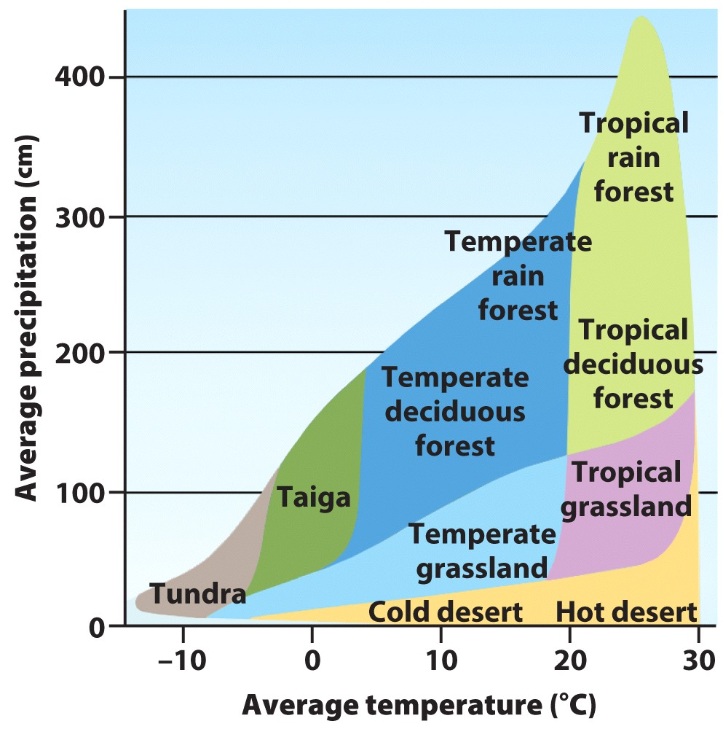
How would a taiga biome ( ) change if average temperatures increased 5°C?
Taiga would become tundra.
Taiga would become temperate deciduous forest.
Taiga would become tropical grassland.
Notes:
Answer: B
Answer Notes: The taiga biome would probably become temperate deciduous forest if the temperatures increased from about 2°C to 7°C, and if precipitation remained the same.
Driving Question: 1

Slide 5
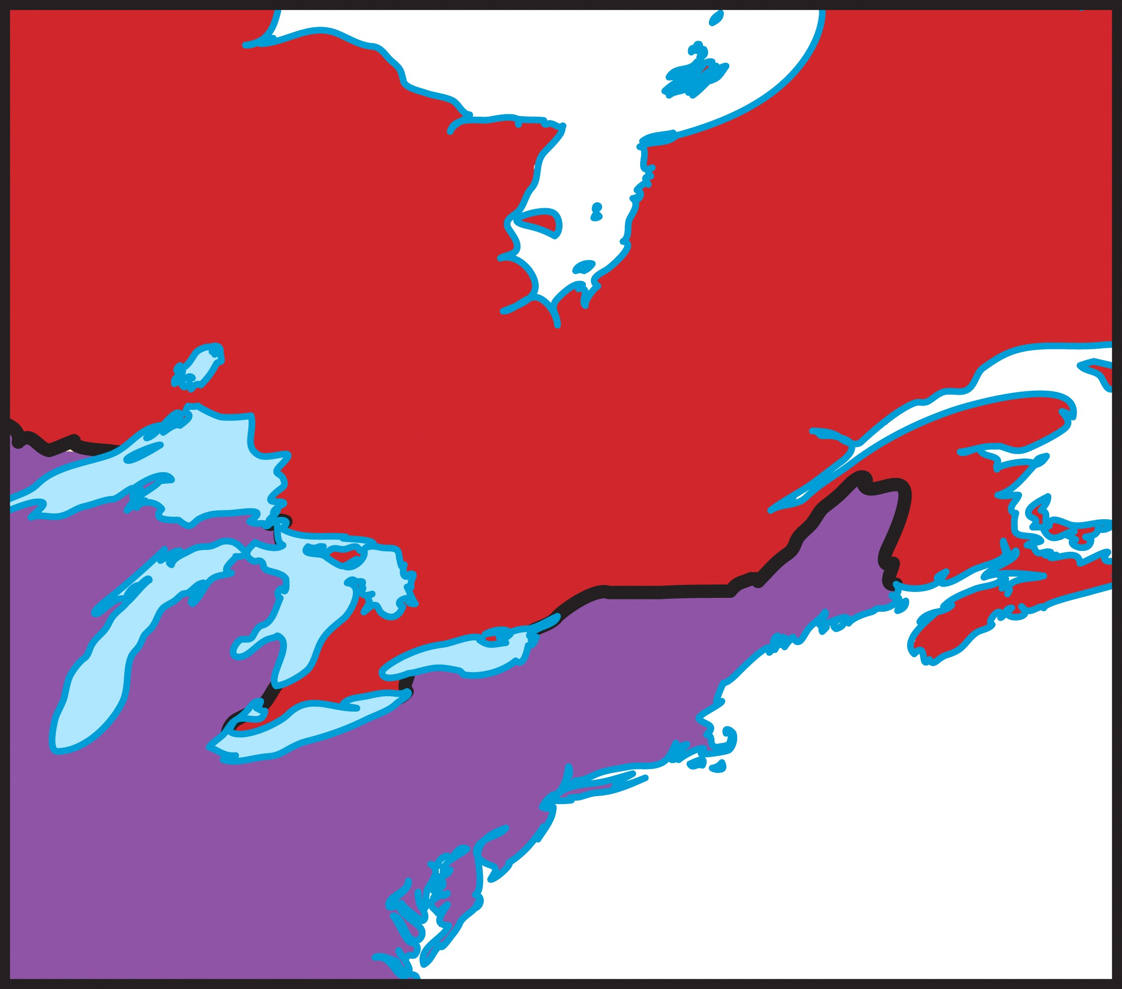
You are starting a new sugar farm to produce maple syrup. Where would be probably the most productive location over the next 100 years?
A
Canada
North
B
C
South
D
USA
Notes:
Answer: A
Driving Question: 1

Slide 6
Which of these contribute to the greenhouse effect?
carbon dioxide
water vapor
methane
All of these contribute to the greenhouse effect.
Notes:
Answer: D
Driving Question: 2

Slide 7
TRUE or FALSE? The greenhouse effect is an unnatural effect caused only by human actions.
TRUE
FALSE
Notes:
Answer: B f
Answer Notes: The greenhouse effect is a naturally occurring phenomenon. While humans have increased the effect, they are not the sole cause of the effect. Without the greenhouse effect, the Earth’s temperature would be much colder (−18°C or 0°F).
Driving Question: 2

Slide 8
How does the greenhouse effect warm temperatures on Earth?
Energy from the Sun enters Earth’s atmosphere and heats the surface.
Some of the energy is reflected off the surface and leaves Earth’s atmosphere.
Gases absorb some of the energy and keep it in the atmosphere.
All of the above.
Notes:
Answer: C
Driving Question: 2
Incorrect Answer Notes: Although the other choices are steps in the process, they do not describe how the greenhouse effect specifically works to keep Earth warm.

Slide 9
Which of these does NOT contain carbon?
pure water
humans
air
plants
Notes:
Answer: A
Driving Question: 3

Slide 10
How quickly does carbon move through the carbon cycle?
very quickly
at a moderate speed
very slowly
it depends
Notes:
Answer: D
Answer Note: The speed at which a carbon molecule can move through the carbon cycle depends on many factors. Carbon can cycle relatively quickly if it is taken up by an organism and then released soon after in respiration. Carbon can cycle very slowly if it ends up in a carbon sink (carbon molecules have been “stuck” in fossil fuels for millions of years).
Driving Question: 3

Slide 11
If all greenhouse gas emissions stopped today, what would happen to Earth’s climate?
Temperatures would immediately stabilize.
Temperatures would continue to increase for decades.
Temperatures would immediately decrease.
Temperatures would continue to decrease over time.
Notes:
Answer: B
Answer Notes: Temperatures would continue to increase for decades, even if emissions were stopped today. Earth would still warm due to the leftover effects of emissions that were already emitted, due to the lag time between emission of greenhouse gases and the warming of the atmosphere and oceans.
Driving Question: 2

Slide 12
What is a major difference between how molecules of nitrogen and phosphorus cycle?
Phosphorus can only cycle very slowly, while nitrogen always cycles very quickly.
Nitrogen cycles through organisms while phosphorous does not.
Most phosphorous does not cycle through the air, whereas nitrogen does.
Notes:
Answer: C
Answer Notes: Phosphorous is not a major component of gases in the atmosphere and cycles primarily through soil, water, and organisms. Nitrogen cycles through the air, soil, water, and organisms.
Driving Question: 3

Slide 13
Why would scientists want to collect data on atmospheric carbon dioxide levels?
Long-term data can show how CO₂ levels change over time.
Short-term measurements do not give perspective on long-term changes.
Identifying how CO₂ levels change over time can help pinpoint the causes.
All of the above.
Notes:
Answer: D
Driving Question: 4

Slide 14
Where do scientists get data on the levels of atmospheric CO₂?
They set up several long-term monitoring stations to directly sample the CO₂ in the atmosphere.
They drill soil cores to sample air bubbles to determine past CO₂ levels.
They sample levels of carbon in deposits such as fossil fuels.
Notes:
Answer: A
Answer Notes: Long-term monitoring stations directly sample CO₂ levels in the air (e.g., a long-term project is based on Mauna Loa in Hawaii).
Driving Question: 4
Incorrect Answer Notes: The correct answer is not B because ICE cores are drilled to sample air bubbles, not soil cores.

Slide 15
Why is it useful to understand climate change?
A better understanding of past climate changes and their effects on ecosystems can help us predict what will happen this time.
It could help us find ways to slow, stop, or adapt to climate change before catastrophic change happens.
Both A and B.
Notes:
Answer: C
Driving Question: 4

