Slide 1
Michèle Shuster • Janet Vigna • Gunjan Sinha • Matthew Tontonoz
Biology for a
Changing World
SECOND EDITION
Lecture PowerPoint
CHAPTER 26
Digestive System
Copyright © 2014 by W. H. Freeman and Company

Slide 2
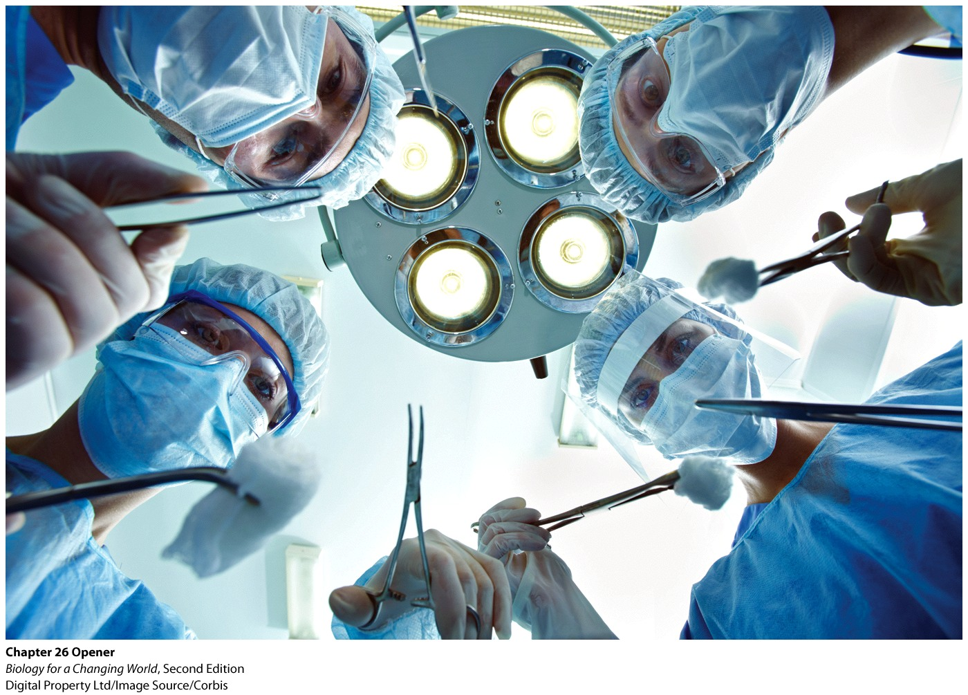
Chapter 26
Digestive System

Slide 3
Driving Questions
1. What is the anatomy of the digestive system?
2. How is food broken down and utilized as it moves through the
digestive tract?
3. What are the risks and benefits of bariatric surgery?

Slide 4
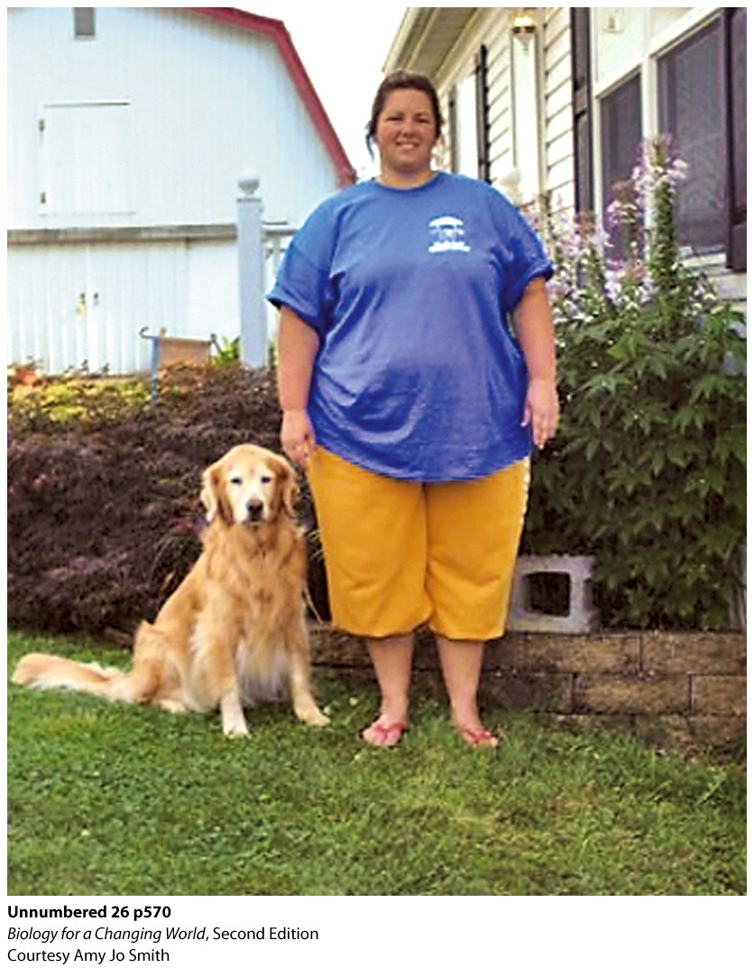
Bariatric surgery
Surgically reduces the size of the stomach, either temporarily or permanently
Reduces the amount of food the stomach can hold
Prevents a person from overeating
Notes:
Recommended only for people considered morbidly obese. People whose risk of death from diabetes or heart disease because of excess weight is five to seven times greater than for those of average weight.

Slide 5
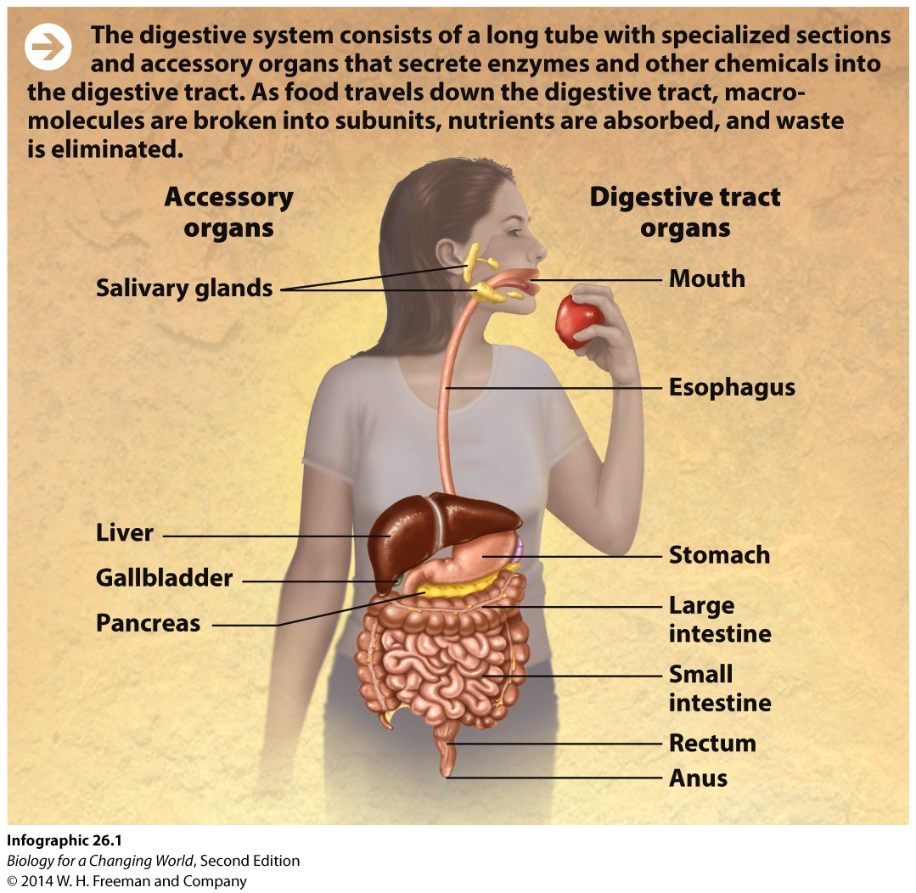
The digestive system
Stomach: part of digestive system
Composed of digestive tract
long tube lined with muscles that extends from the mouth to anus
Assists in digestion
Notes:
Digestive system: the organ system that breaks down food molecules into smaller subunits, absorbs nutrients, and eliminates waste; it is composed of the digestive tract and accessory organs

Slide 6
The digestive system
Digestion
Mechanical and chemical breakdown of food into subunits so that nutrients can be absorbed
Begins immediately after ingestion
the act of taking food into the mouth

Slide 7
The upper digestive system

Slide 8
The upper digestive system
Esophagus: section between the mouth and the stomach

Slide 9
The upper digestive system
Stomach: expandable muscular organ that stores, mechanically breaks down, and digests proteins in food
Notes:
The enzyme pepsin, which is produced in the stomach, chemically breaks proteins apart into individual amino acids. The stomach acid mixes with the food, producing a soupy mixture called chyme.

Slide 10
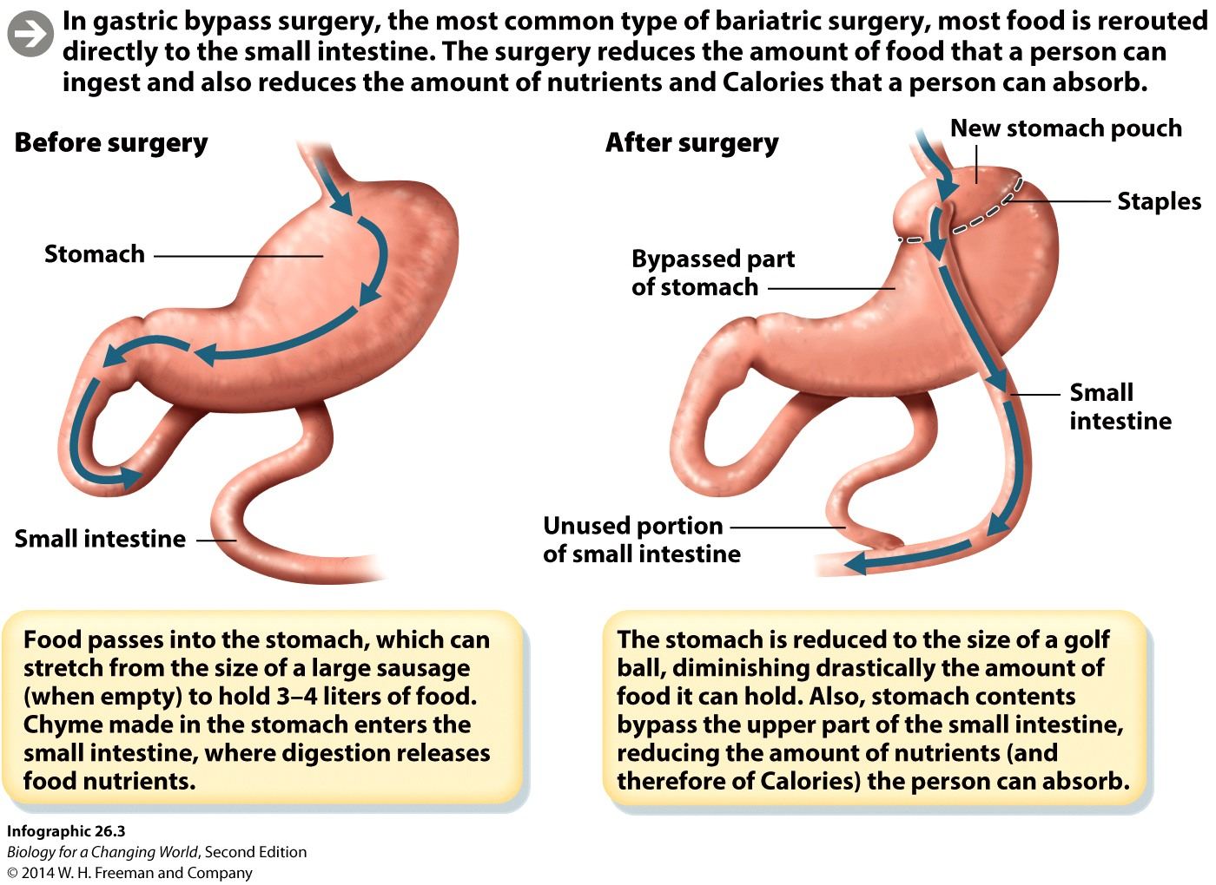
Gastric bypass surgery
Involves altering the small intestine

Slide 11
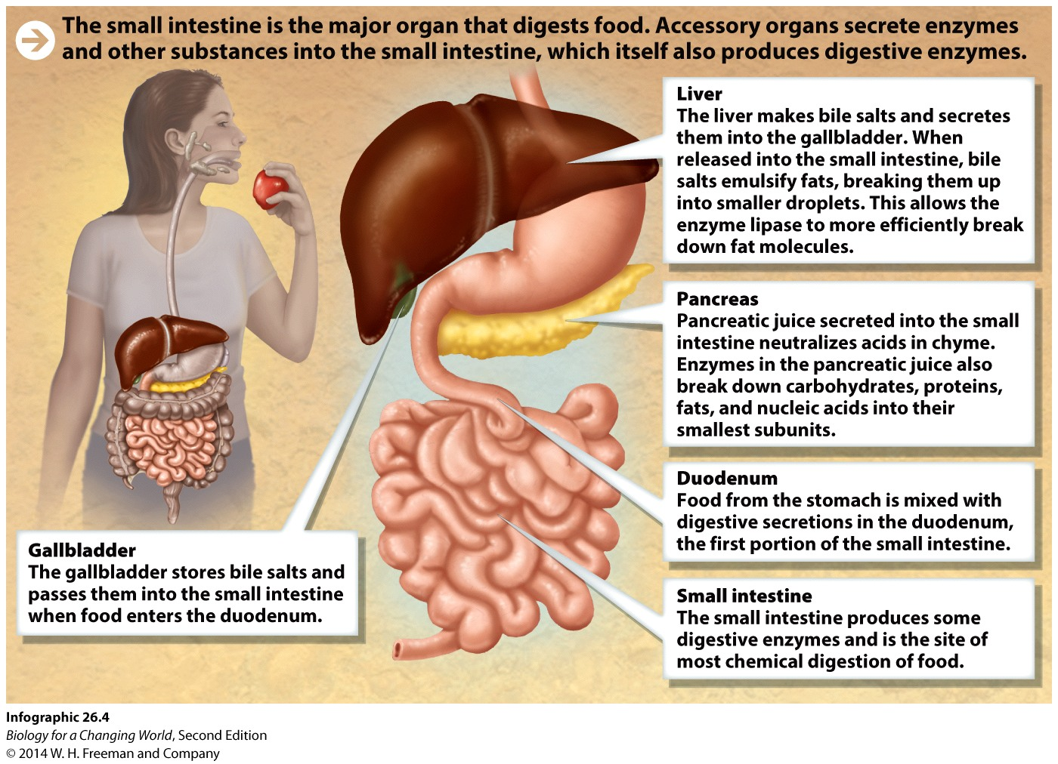
The small intestine
Primary organ that extracts nutrients

Slide 12
The small intestine
Duodenum
First portion of the small intestine
Receives chyme from the stomach
Mixes it with digestive secretions from other organs
pancreatic juice neutralizes chyme
Notes:
The small intestine measures about 20 feet. It’s called “small” because its diameter is smaller than that of the large intestine, which comes later in the digestive tract.
Pancreas: an organ that helps digestion by producing enzymes (such as lipase) that act in the small intestine, and by secreting a juice that neutralizes acidic chyme

Slide 13
The small intestine
Works with the liver and gallbladder
Bile salts
produced in liver
aids fat digestion
emulsifyer: divides large hydrophobic fat globules into smaller droplets
stored in gallbladder
passed into small intestine
Lipase (pancreas) finally digests the fats
Notes:
Liver: an organ that aids digestion by producing bile salts that emulsify fats
Bile salts: chemicals produced by the liver and stored by the gallbladder that emulsify fats so that they can be chemically digested by enzymes
Emulsify: to break up large fat globules into smaller fat droplets that can be more efficiently chemically digested by enzymes
Gallbladder: an organ that stores bile salts and releases them as needed into the small intestine
Lipase: a lipid-digesting enzyme secreted by the pancreas, chemically breaks them down to release their constituent fatty acids and glycerol

Slide 14
The small intestine

Slide 15
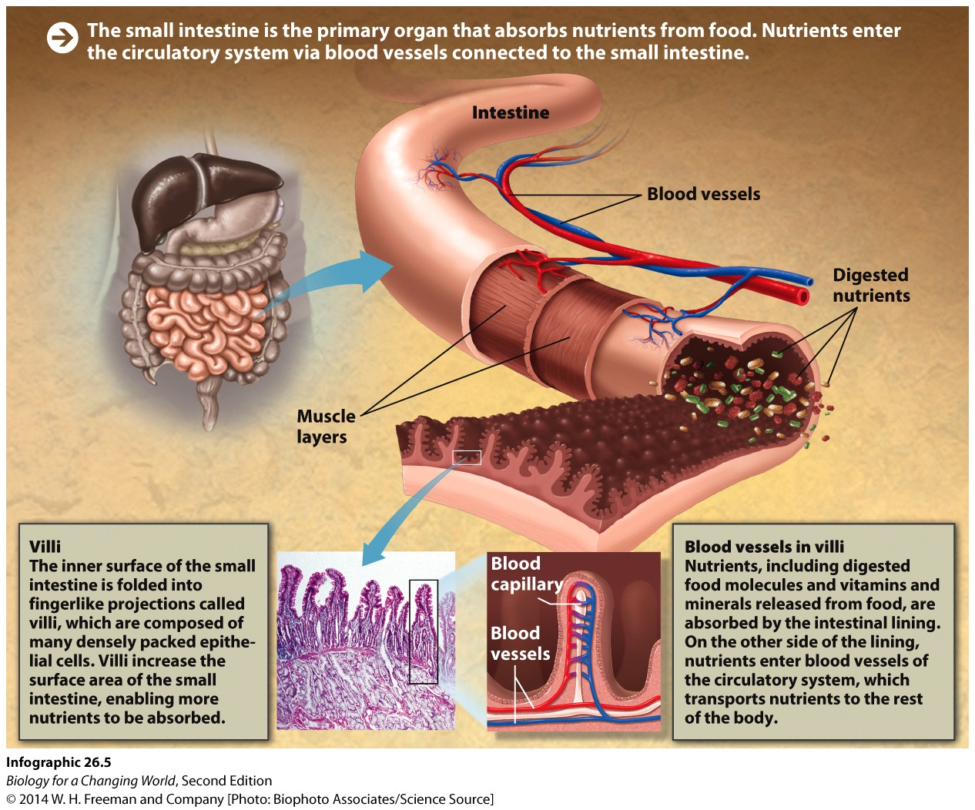
The small intestine
Food molecules are absorbed by epithelial cells
Line the small intestine
Absorption via villi
Notes:
Epithelial cells: cells that line organs and body cavities; in the digestive tract they sit in direct contact with food and its breakdown products
Absorption: the uptake of digested food molecules by the epithelial cells lining the small intestine
Villi (singular: villus): fingerlike projections of folds in the lining of the small intestine that are responsible for most nutrient and water absorption

Slide 16
The small intestine
Food molecules then pass into the blood vessels of the circulatory system
Used as a source of nutrients and energy to build and maintain cells

Slide 17
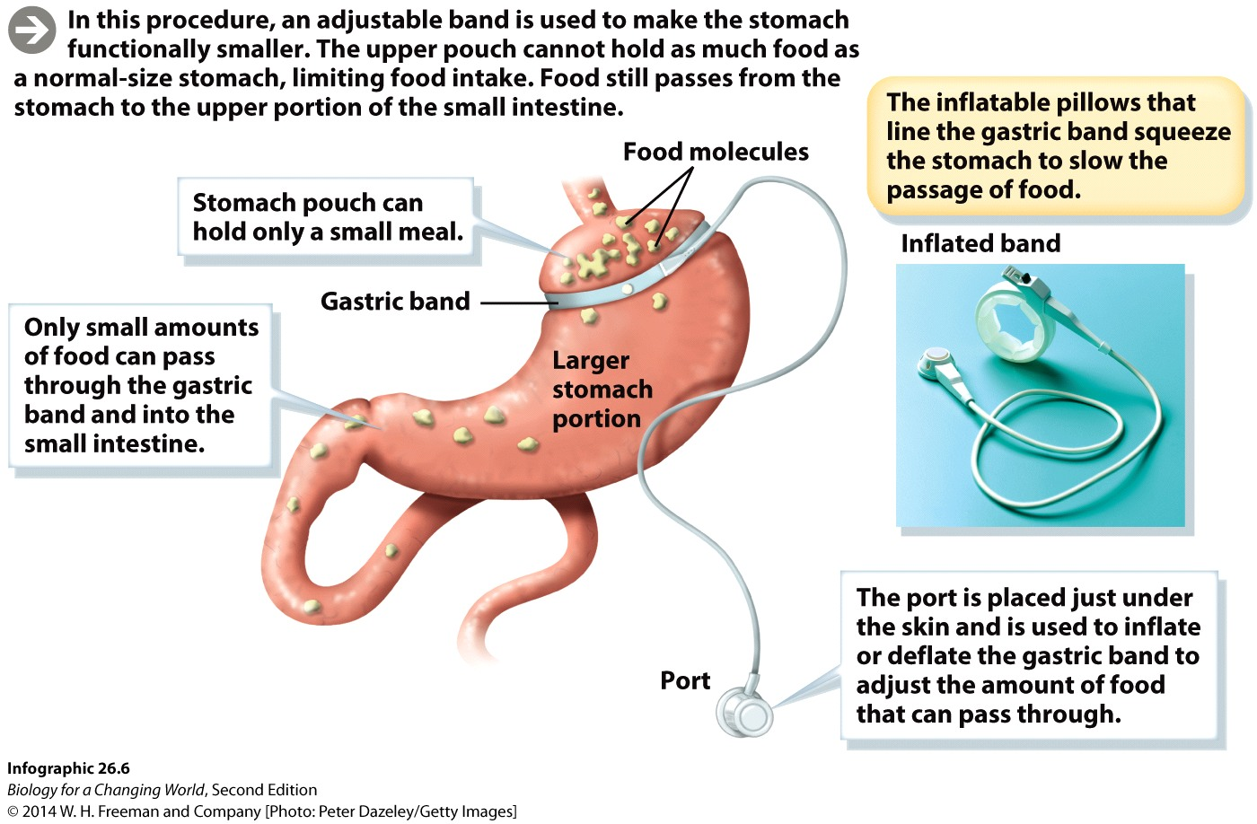
Gastric banding surgery
Notes:
The other main type of weight-loss surgery (called adjustable gastric banding) does not involve altering the small intestine. The procedure involves partitioning the stomach into two parts by wrapping an inflatable plastic band around the upper part of the stomach to seal it off and create a small pouch. It’s simpler and has a lower complication rate than gastric bypass surgery.

Slide 18
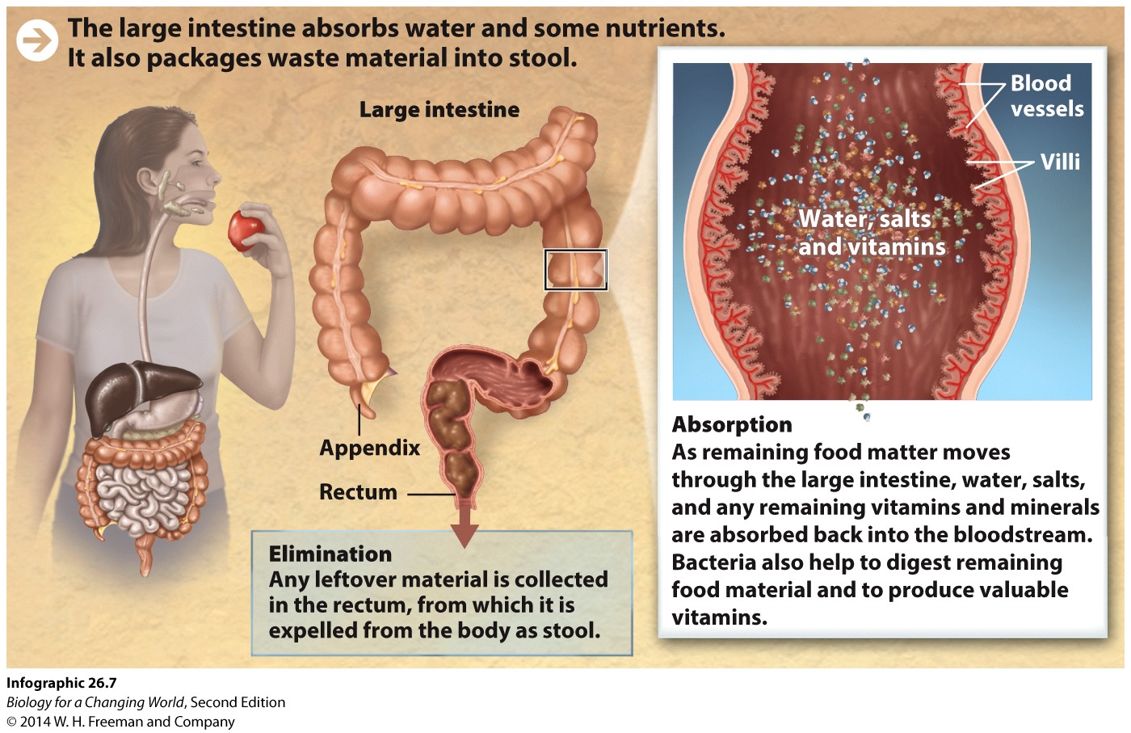
The large intestine
Remaining water is absorbed and solid stool is formed
Notes:
Large intestine: the last organ of the digestive tract, in which remaining water is absorbed and solid stool is formed

Slide 19
The large intestine
Colon
First portion
Fiber, water, and vitamins, mix with mucus and bacteria that live in large intestine
Most water re-absorbed
Stool expelled by elimination
Notes:
Colon: the first and longest portion of the large intestine; the colon plays an important role in water re-absorption
Stool: solid waste material eliminated from the digestive tract
Elimination: the expulsion of undigested matter in the form of stool

Slide 20
The large intestine

Slide 21
Does bariatric surgery work?
Notes:
Both major types of weight-loss surgery can reverse type 2 diabetes, a condition in which the body can no longer regulate blood sugar levels and can damage organs and nerves.

Slide 22
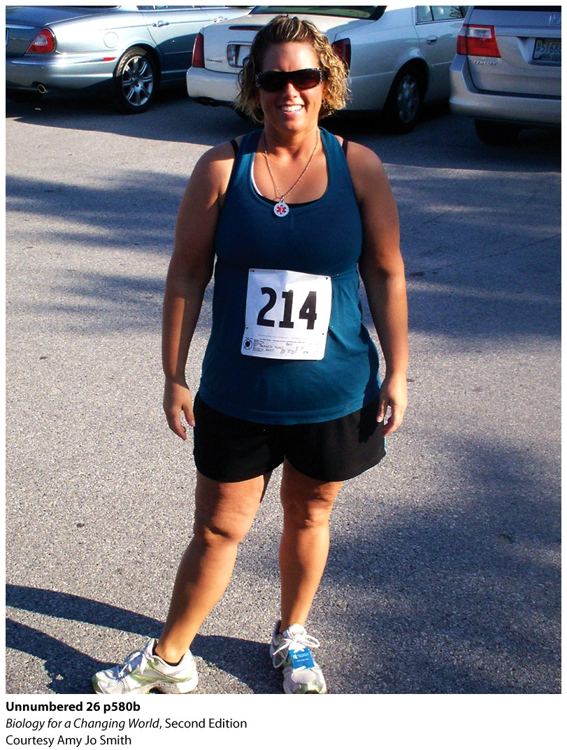
Does bariatric surgery work?
Notes:
CAPTION: After having gastric bypass, patients must reduce food portion size. Since her surgery, this patient can only comfortably eat about a half cup of food at Thanksgiving (plate on the left).
Mary Jo Smith in 2011 after her weight-loss surgery.

Slide 23
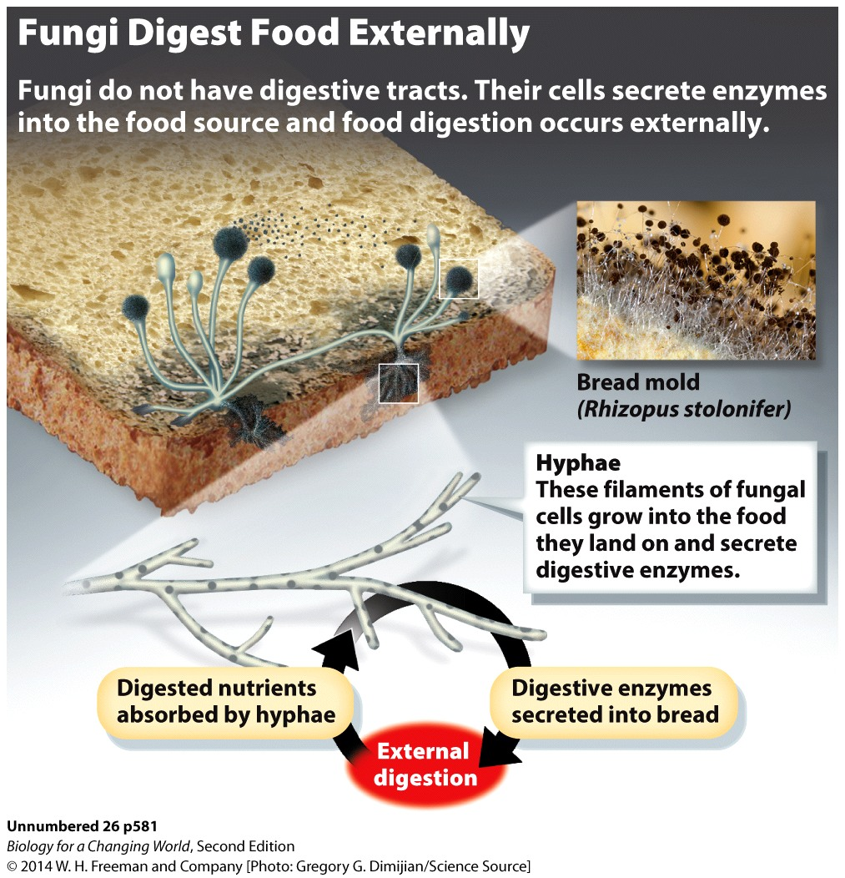
How do other organisms process food?
Fungi
No digestive tract
Extend hyphae into food sources
Cells release digestive enzymes
Cells absorb the released nutrients

Slide 24
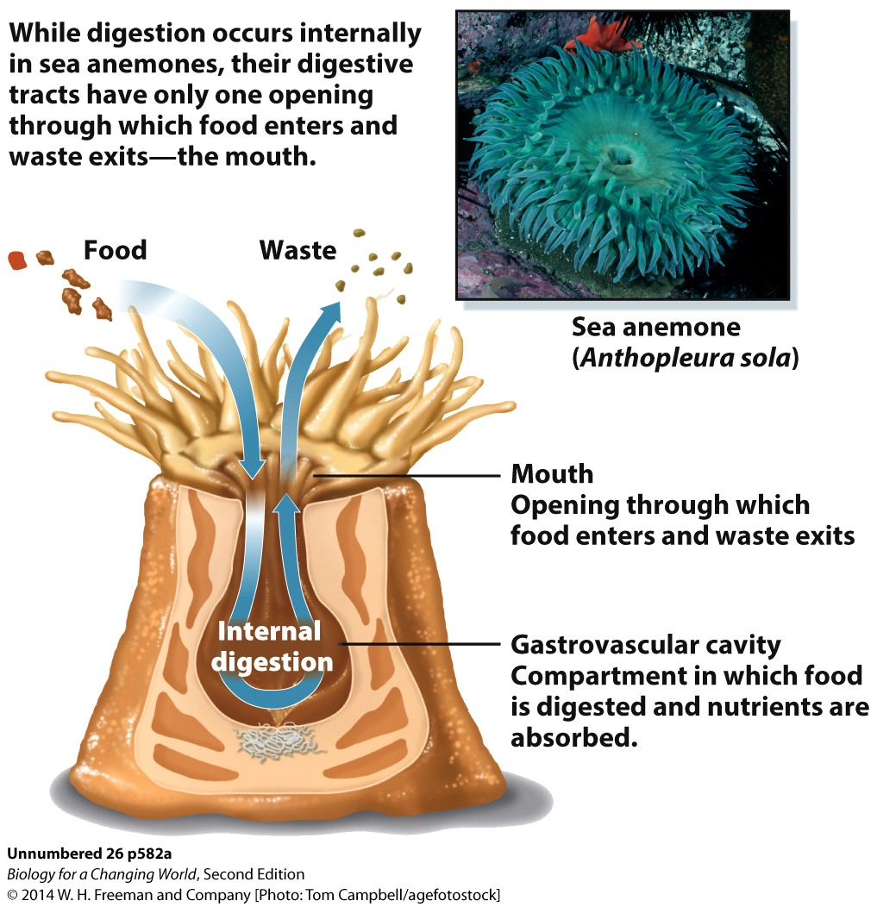
How do other organisms process food?
Sea anemones
No digestive tract
Single, multifunctional digestive cavity
Gastrovascular cavity

Slide 25
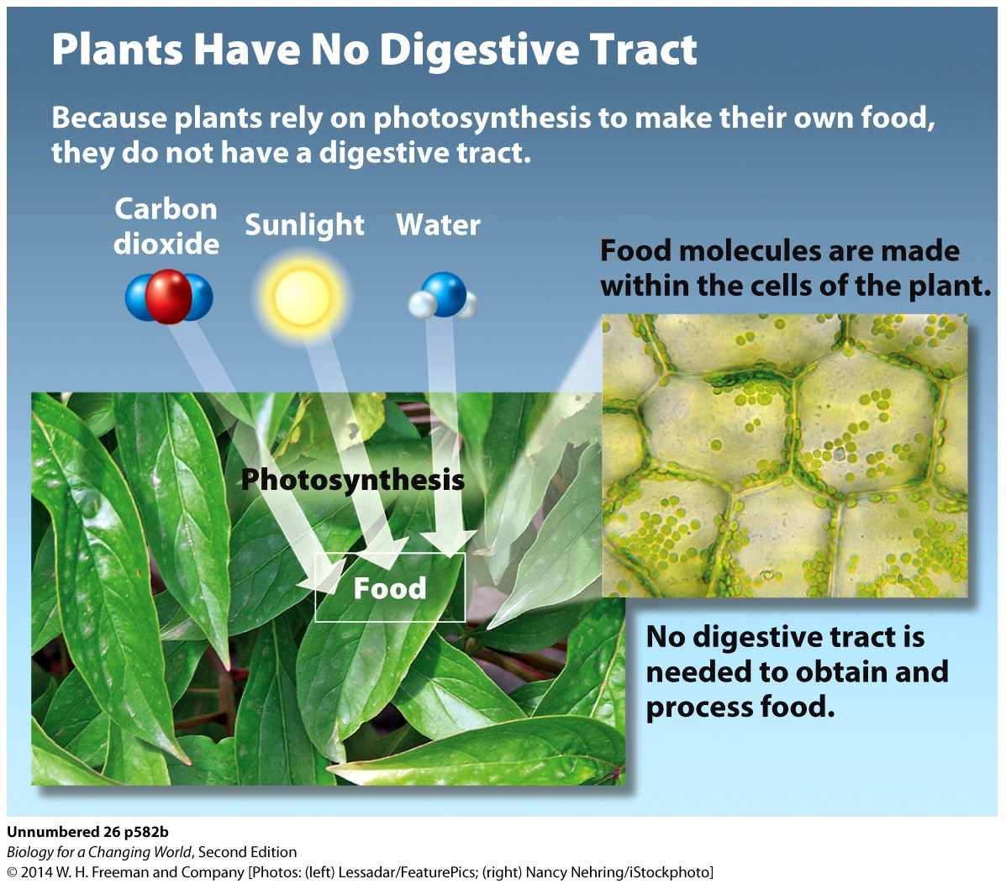
How do other organisms process food?
Photosynthetic organisms
No digestive systems
Autotrophs

Slide 26
Summary
The digestive system consists of a central digestive tract and accessory organs. Its function is to break down food molecules into smaller subunits, absorb nutrients, and eliminate waste.
Food passes from the mouth into the stomach, through the esophagus, propelled by peristalsis.
The stomach is muscular and acidic and contains an enzyme called pepsin, which chemically breaks apart proteins.
Food, processed in the stomach into chyme, passes into the small intestine.
Enzymes from the pancreas digest organic molecules in the small intestine and bile salts from liver emulsify fats.
Epithelial cells that line the small intestine absorb the broken-down products of food.
The large intestine absorbs water and forms solid stool from indigestible matter in food such as fiber.
Bariatric surgery reduces the size of the stomach so that it can no longer hold as much food.

