Slide 1
Michèle Shuster • Janet Vigna • Gunjan Sinha • Matthew Tontonoz
Biology for a
Changing World
SECOND EDITION
Lecture PowerPoint
CHAPTER 29
Central Nervous System
Copyright © 2014 by W. H. Freeman and Company

Slide 2
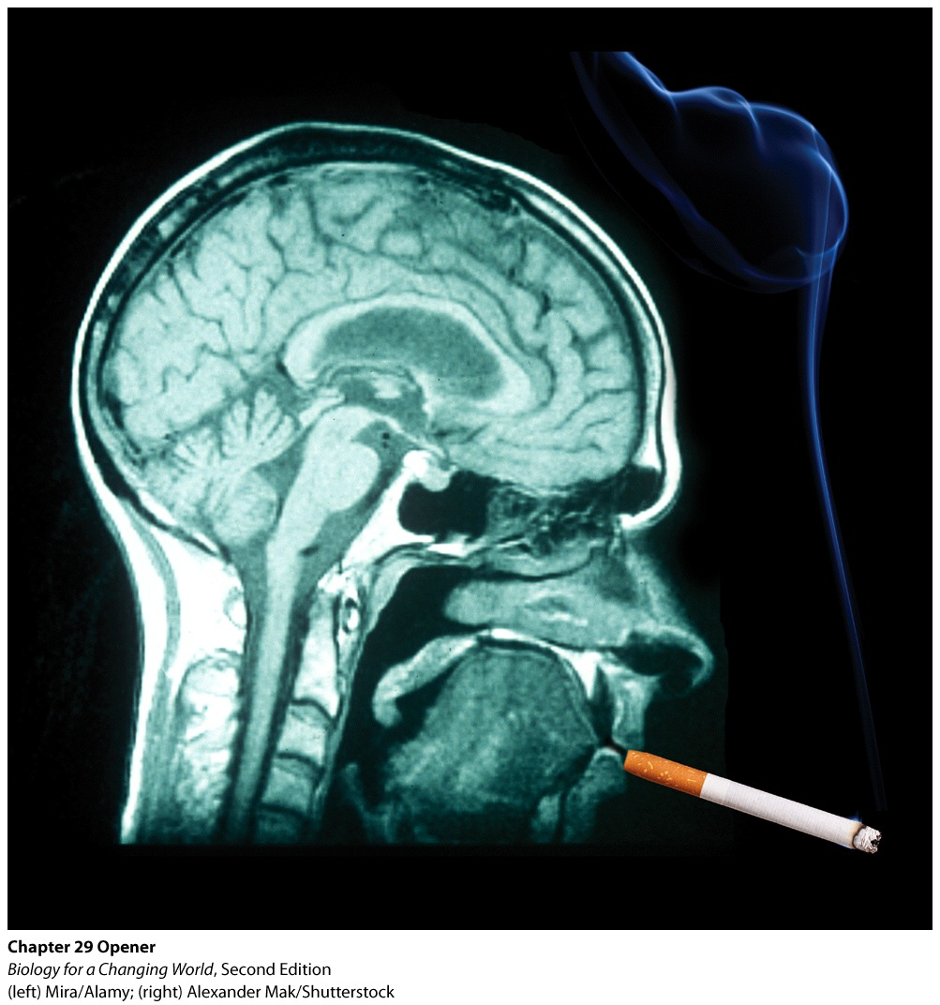
Chapter 29
Central Nervous System

Slide 3
Driving Questions
1. How is the nervous system organized?
2. How do cells in the nervous system transmit signals?
3. Why are some drugs (and some behaviors) addictive?

Slide 4
Addiction and the brain
Cigarette smoking is highly addictive
Smokers develop physical and psychological need
Stimulate the brain’s reward system
Notes:
Despite public health campaigns, smoking remains a common practice.
Reward system: a complex circuit of brain cells that evolved to make us feel good after eating or having sex—activities we must engage in if we are to survive and pass along our genes

Slide 5
Addiction and the brain
Brain
Organ of the central nervous system
Integrates and coordinates all functions of the body
Nicotine
Component in tobacco that makes cigarettes addictive
Notes:
The brain integrates and coordinates all functions of the body, including sensation, movement, intellect, and just about all involuntary actions. The brain is also the seat of memory. Pleasurable experiences recorded in our memories serve as motivation. Nicotine is addictive because it stimulates feelings of pleasure in the brain.

Slide 6
Addiction and the brain

Slide 7
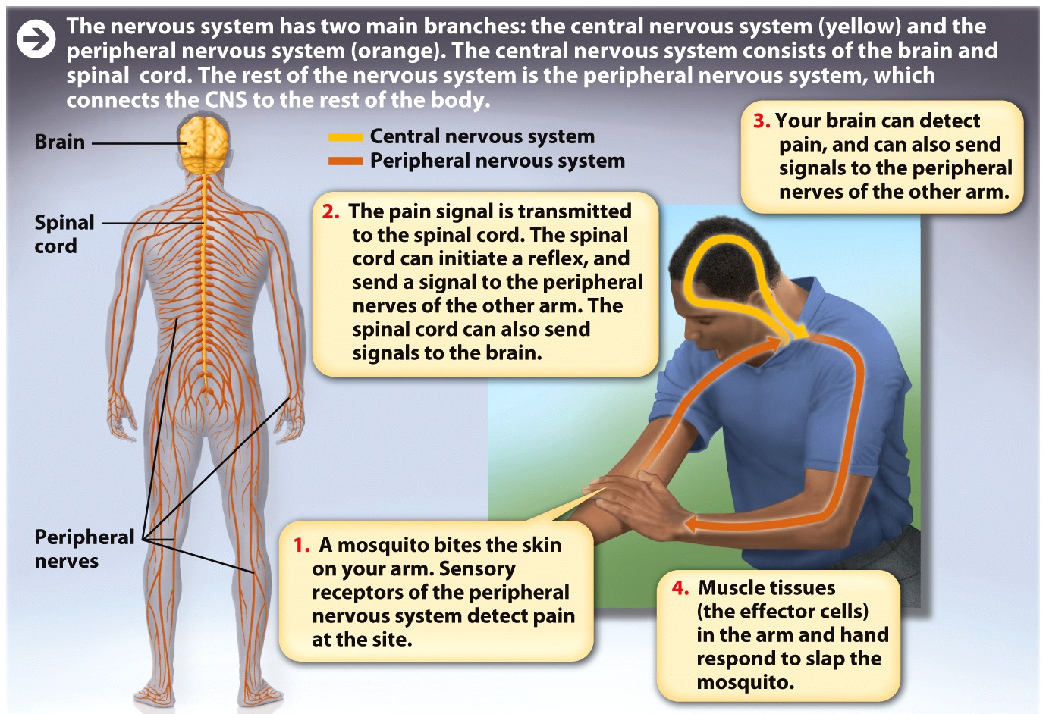
Central nervous system (CNS)
Brain and spinal cord
Bundle of nerve fibers within the bony spinal column
Transmits signals between brain and body
Signals travel along nerves
Long fibers made up of specialized cells and supportive tissue
Transmit signals through the nervous system

Slide 8
Peripheral nervous system (PNS)
All the nervous tissue outside the central nervous system
Nerves to distant body sites
Fingers, toes, and heart muscle
Notes:
Peripheral nervous system (PNS): all the nervous tissue outside the central nervous system, which transmits signals from the CNS to the rest of the body

Slide 9
The nervous system
CNS and PNS work together to sense and respond to stimuli in the environment
Allows us to perceive and understand the world around us
Translates thought into action
Notes:
Sensory receptors of the PNS in our ears, our eyes, and in our skin, for example, enable us to sense changes in our environment—a sudden loud noise, for example, or the sting of a mosquito.
Stimuli are transmitted to the brain and spinal cord, which assess the incoming signals and trigger an appropriate response, such as a reflex. The reflex is carried out by effector tissues such as muscles that allow us to respond—by jumping or swatting our arm.

Slide 10
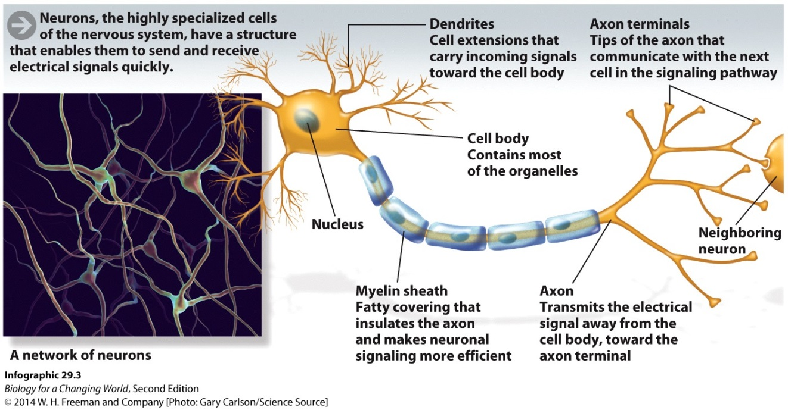
Brain cells
Organized into networks that receive, process, and send information
Neurons
specialized cells that generate electrical signals
cell body, dendrites, axons, axon terminal
Notes:
Neurons have a unique structure that enables them to send and receive signals: a large cell body with branched extensions called dendrites that receive signals and a single large axon that carries signals away from the neuronal cell body. The end of the axon, called the axon terminal, transmits the signals to the next cell in the network, which could be another neuron, a muscle cell, or an endocrine cell.

Slide 11
Neurons
Sensory neurons
Receive information from the external world and transmit it to the CNS
Motor neurons
Transmit information from the CNS to muscle cells, signaling them to contract or relax
Notes:
Sensory neurons: cells that convey information from both inside and outside the body to the CNS
Motor neurons: neurons that control the contraction of skeletal muscle

Slide 12
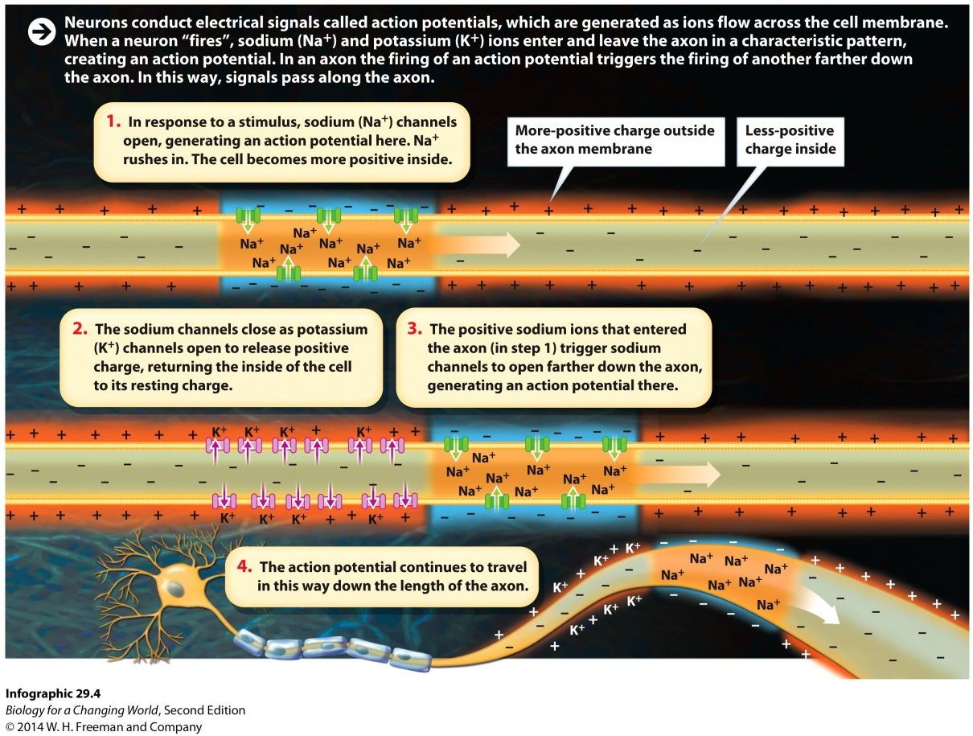
Neurons
Signals sent along a neuron are electric currents
Neurons can change the charge difference across the membrane
Action potential: coordinated ion flow
Notes:
Like other cells in the body, neurons have a slight difference in electrical charge across the membrane: the inside of the neuron has a negative charge relative to the charge outside the cell. Ion channels in the axon membrane open and close to allow specific ions to cross. When axons of neurons allow positive ions to cross the cell membrane, the charge across the membrane changes.
Action potential: an electrical signal within a neuron caused by ions moving across the cell membrane

Slide 13
Neurons
Myelin sheath
Coats and insulates neurons
Prevents leakage of electrical charge
Produced by a glial cell
Notes:
Myelin: a fatty substance that insulates the axons of neurons and facilitates rapid conduction of action potentials

Slide 14
Regions of the brain
Four major regions
Cerebellum
Brain stem
Diencephalon
Cerebrum
Notes:
Cerebellum: the part of the brain that processes sensory information and is involved in movement, coordination, and balance
Brain stem: the part of the brain that is closest to the spinal cord and controls vital functions such as heart rate, breathing, and blood pressure
Diencephalon: a brain region located between the brain stem and the cerebrum that includes the thalamus and hypothalamus and regulates homeostatic functions like body temperature, hunger, thirst, and the sex drive
Cerebrum: the region of the brain that controls intelligence, learning, and perception

Slide 15
Regions of the brain
Cerebellum
Processes sensory information
Involved in movement, coordination, and balance

Slide 16
Regions of the brain
Brain stem
Base of the brain
Coordinates involuntary functions like reflexes, heart rate, and breathing

Slide 17
Regions of the brain
Diencephalon
Above the brain stem
Regulates homeostatic functions like body temperature, hunger, thirst, and sex drive

Slide 18
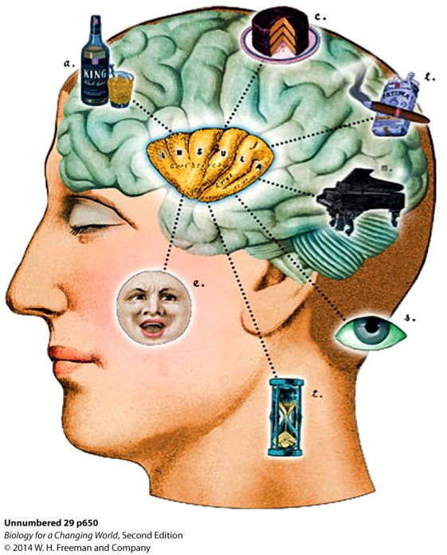
Regions of the brain
Cerebrum
Largest part of the brain
cerebral cortex is the outer layer
involved in many advanced brain functions
intelligence, learning, perception, and emotion
Notes:
Regions deep within the cerebral cortex, illustrated here, may be involved in many human experiences, from emotional response to drug use.
Cerebral cortex: the outer layer of the cerebrum; involved in many advanced brain functions

Slide 19
Brain’s pleasure center
Cerebrum
Hippocampus, amygdala, and ventral tegumental area (VTA)
Components of limbic system
Primary seat of emotions and memories
Major involvement in addiction
Notes:
Hippocampus: a subregion of the brain involved in learning and memory
Amygdala: a subregion of the brain that processes emotions, especially fear and anxiety, and is the seat of emotional memories
Nucleus accumbens and the ventral tegumental area (VTA) are components of the limbic system, which is stimulated during pleasurable activities, and are involved in addiction.

Slide 20
The anatomy of addiction
Dopamine
Chemical messenger
Released from VTA
Stimulated by nicotine
Notes:
Dopamine: a neurotransmitter that is involved in conveying a sense of pleasure in the brain
Neurotransmitter: a chemical signaling molecule released by a neuron to transmit a signal to a neighboring cell

Slide 21
Neurotransmitters
Chemical signaling molecule
Released by neuron at end of axon
Transmits signal to a neighboring cell
Synapse
Site of transmission of a signal from a neuron to another cell
Axon terminal, gap between cells, and receptor
Notes:
Neurotransmitters are chemical signals released by neurons at the end of their axons when an action potential reaches the tip of the axon.
Synapse: the site of transmission of a signal between a neuron and another cell; the synapse includes the axon terminal of the signaling neuron, the space between the cells, and receptors on the receiving cell

Slide 22
Neurotransmitters
Notes:
Synaptic cleft: the physical space between a neuron and the cell with which it is communicating

Slide 23
Alteration of dopamine signaling
Drugs of abuse overstimulate dopamine signaling
Notes:
Dopamine levels in the synaptic cleft increase dramatically. With so much dopamine available, practically all of the brain’s dopamine receptors become activated simultaneously. The immediate effect is euphoria. So much dopamine is produced, the brain becomes overwhelmed and tries to dampen the drug’s effect by switching off some of its dopamine receptors.

Slide 24
Alteration of dopamine signaling
Notes:
Without drugs, many addicts suffer the physical symptoms of withdrawal, which may include depression, anxiety, and intense cravings.

Slide 25
Drugs alter brain activity
Notes:
Scientists have observed other structural brain changes in drug addicts, too.

Slide 26
Drugs alter brain activity

Slide 27
Nervous systems in other animals
Invertebrates
Neurons that sense and send information
Not organized into a brain
Nerve net

Slide 28
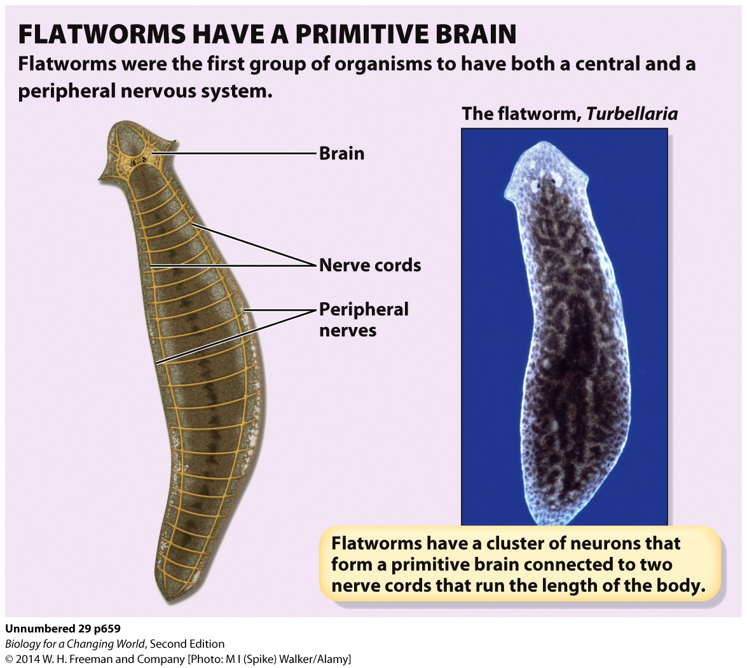
Nervous systems in other animals
Flatworms
Primitive brain, CNS, PNS

Slide 29
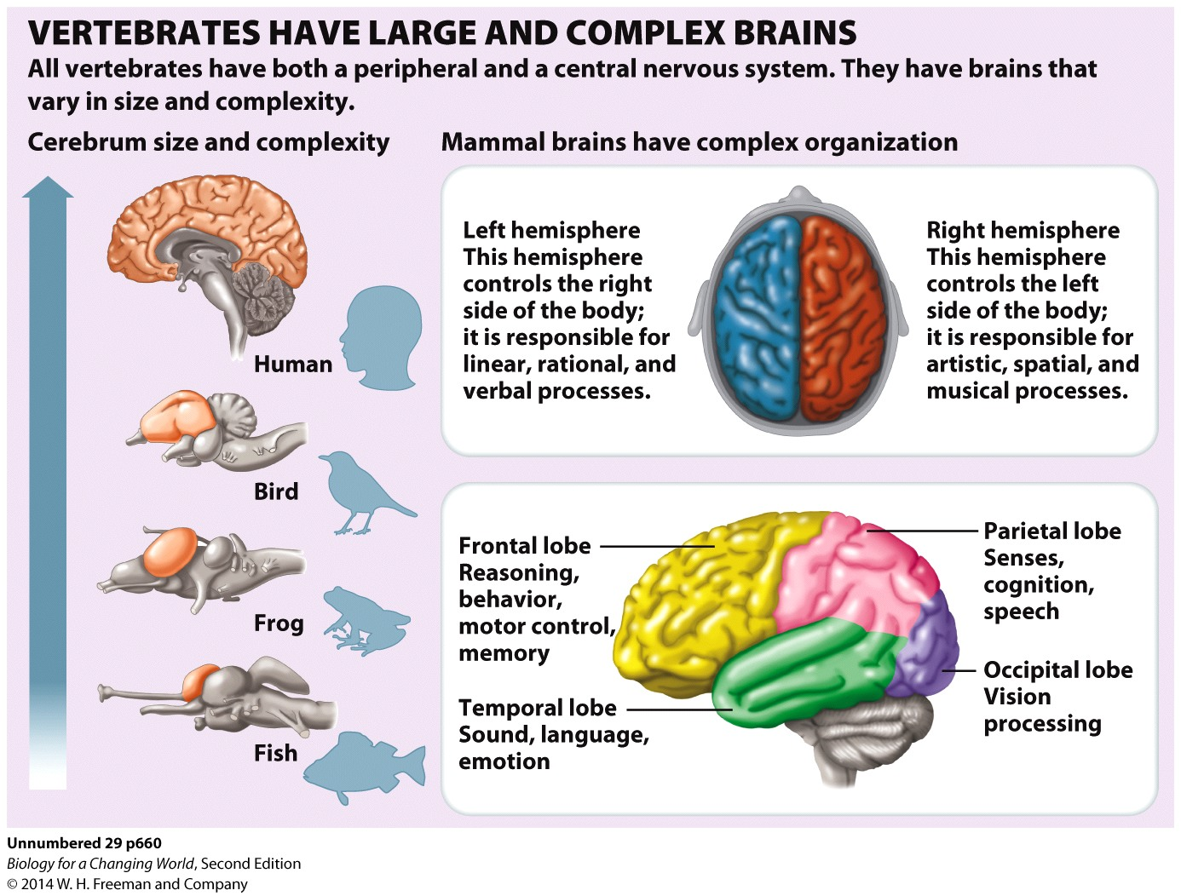
Nervous systems in other animals
Vertebrates
Large, complex brains

Slide 30
Summary
The nervous system senses and responds to signals from the environment and coordinates bodily actions, including moving, breathing, and thinking.
The central nervous system (CNS) consists of the brain and the spinal cord; the peripheral nervous system (PNS) consists of all the nerves extending from the spinal cord to the limbs and internal organs.
Different parts of the brain coordinate different functions. The four main regions of the brain are the cerebellum, brain stem, diencephalon, and cerebrum. Neurons are specialized cells that consist of a cell body, branched dendrites, and a long axon. Neurons conduct electrical signals known as action potentials.
Neurotransmitters are chemical signaling molecules that are released from neuron axon terminals into the synaptic cleft of a synapse and bind to the receptors of other cells.
Neurotransmitters bind to receptors on their target cells. The number of receptors can be down-regulated in response to persistently high levels of a neurotransmitter.

