Slide 1
Michèle Shuster • Janet Vigna • Gunjan Sinha • Matthew Tontonoz
Biology for a
Changing World
SECOND EDITION
Lecture PowerPoint
CHAPTER 30
Reproductive System
Copyright © 2014 by W. H. Freeman and Company

Slide 2
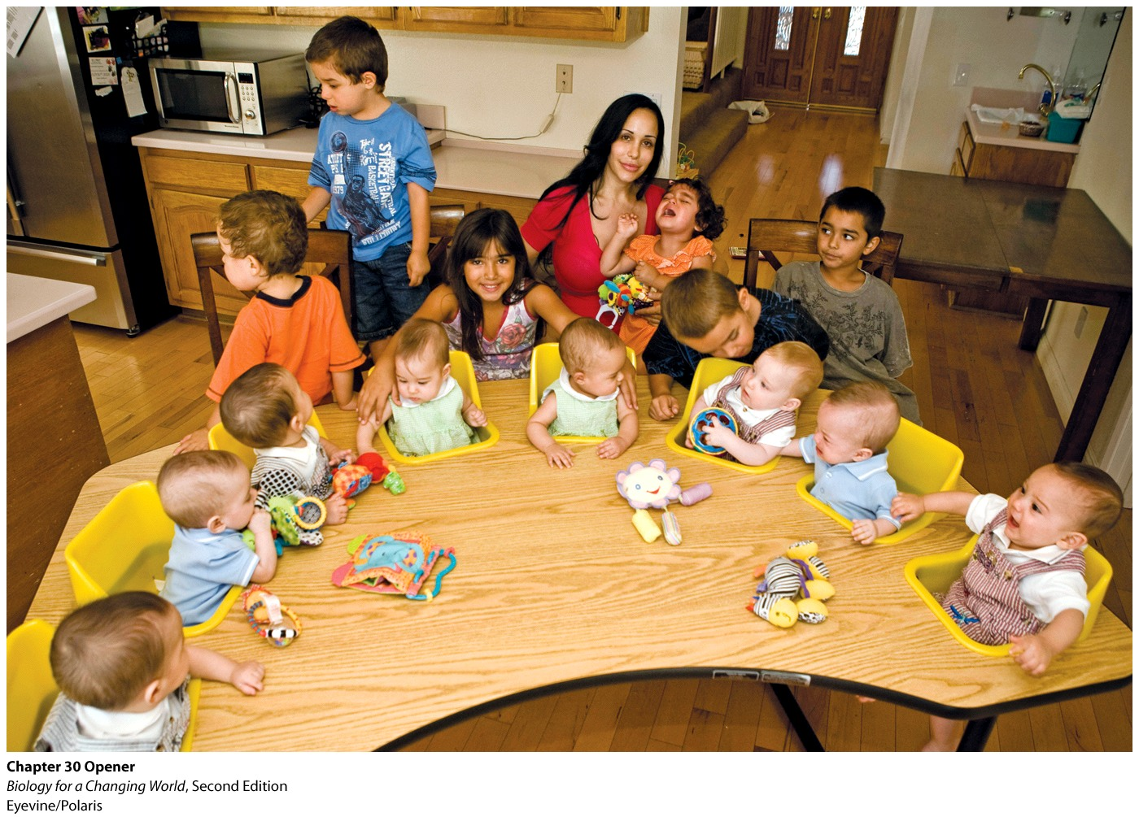
Chapter 30
Reproductive System

Slide 3
Driving Questions
1. What is the anatomy of the male and female reproductive tracts?
2. What hormones are involved in reproduction, and how do they work?
3. What are the different types of assisted reproduction, and how do they work?

Slide 4
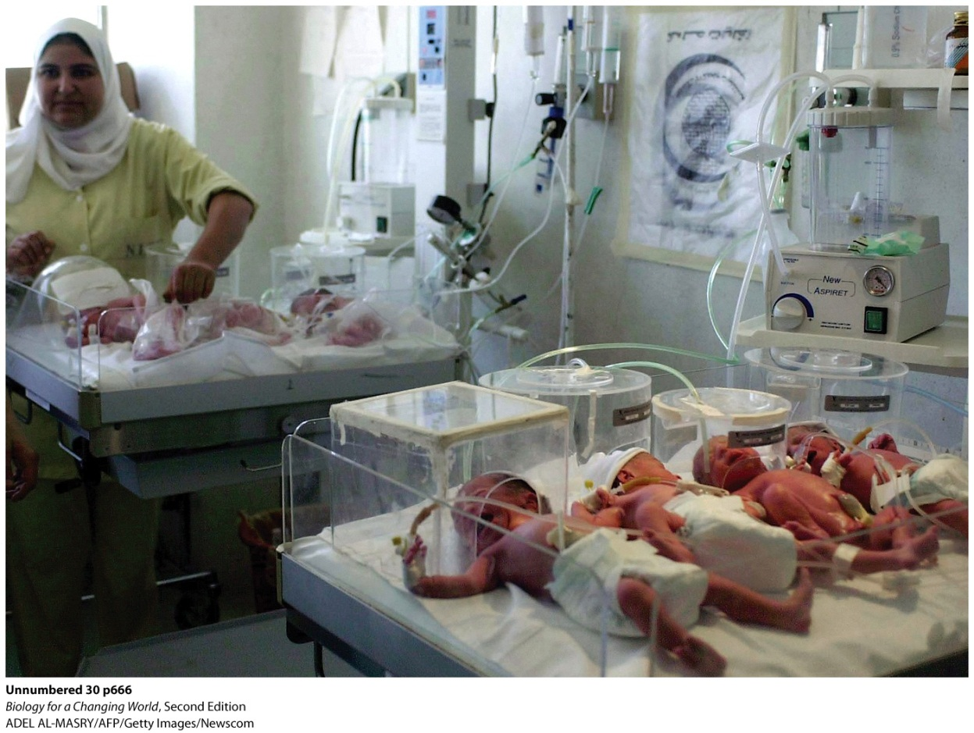
Assisted reproductive technology
Correlates with increase in multiple births
Births are often premature
Increased risks for mother
Notes:
Multiples are often born prematurely, and underweight, as were these septuplets born in Alexandria, Egypt, in 2008.

Slide 5
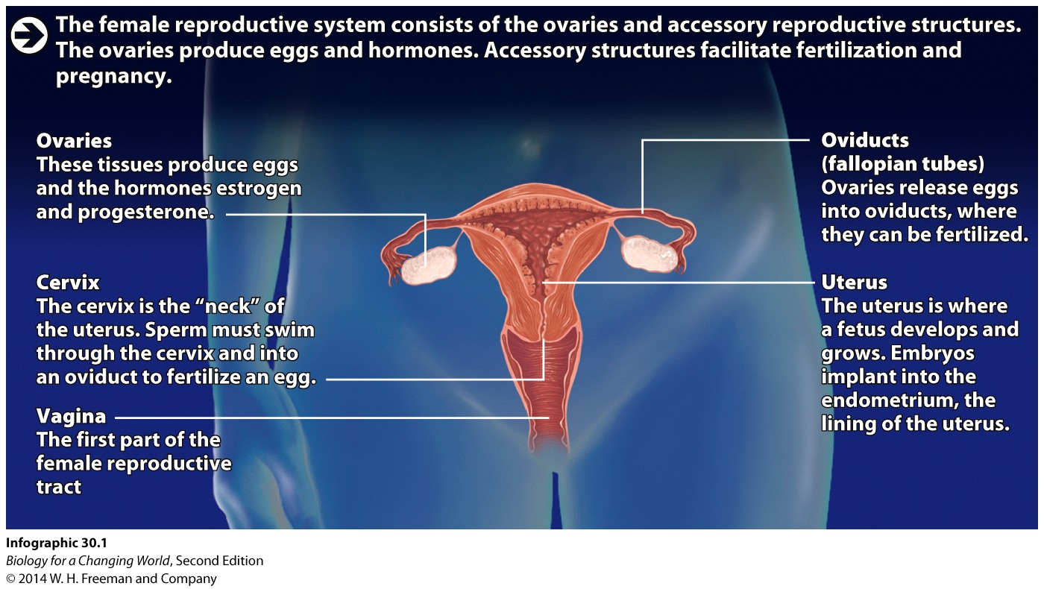
The female reproductive system
Ovaries and accessory structures

Slide 6
The female reproductive system
Ovaries
contain eggs
produce the hormones estrogen and progesterone
Monthly release of one egg into oviduct (aka fallopian tube)
Connects ovary and the uterus
Notes:
Ovaries: paired female reproductive organs; the ovaries contain eggs and produce estrogen and progesterone
Estrogen: a female sex hormone produced by the ovaries
Progesterone: a female sex hormone produced by endocrine cells in the ovaries (particularly in the cells of the corpus luteum) that prepares and maintains the uterus for pregnancy
Oviduct: the tube connecting an ovary and the uterus in females; eggs are ovulated into and fertilized within the oviducts

Slide 7
The female reproductive system
Egg travels via an oviduct to the uterus
Elastic muscular compartment that can support a growing fetus
Lined with tissue: endometrium
enriched with blood vessels to support a potential pregnancy
Notes:
Endometrium: the lining of the uterus

Slide 8
The female reproductive system
Vagina
First part of female reproductive tract
Extends to cervix
opening of the uterus
Notes:
The vagina is also known as the birth canal.

Slide 9
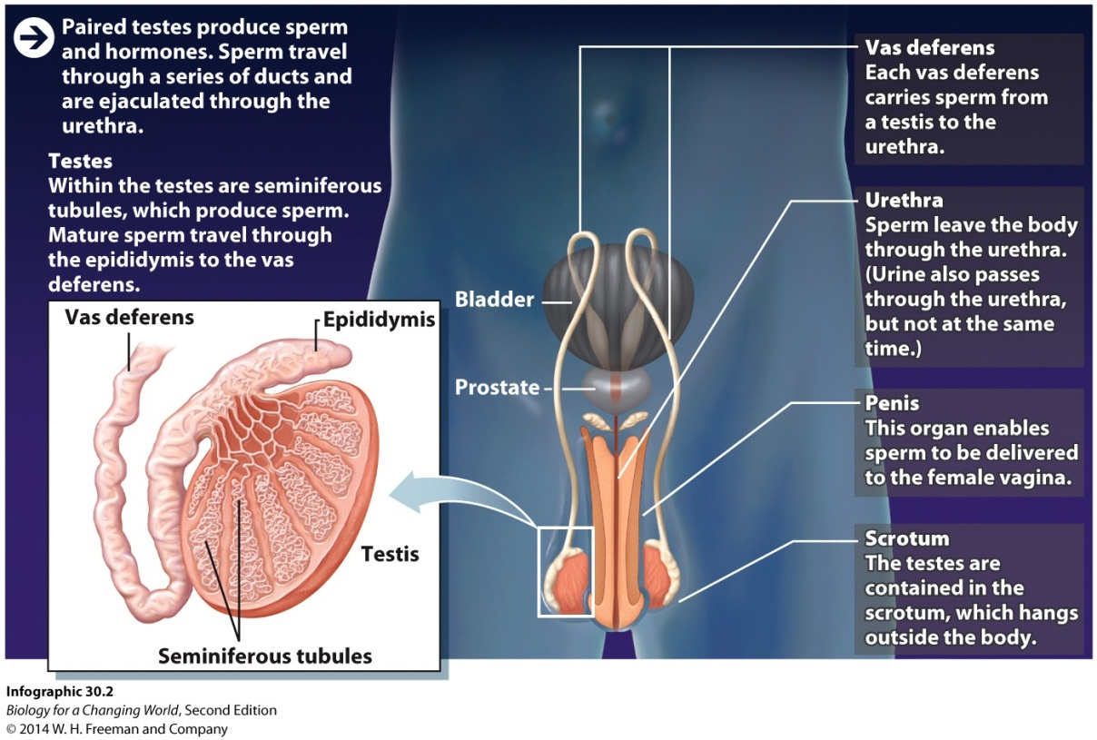
The male reproductive system
Testes (or testicles)
Paired glands
Produce testosterone
Contained in a sac of skin: scrotum
Notes:
Testosterone is one of the androgens—a class of hormones that are present in higher amounts in males than in females.
The scrotum hangs outside the body (an arrangement that keeps the testes slightly cooler than body temperature, ensuring proper sperm development).

Slide 10
The male reproductive system
Seminiferous tubules
Tightly coiled tubes
Site of sperm development
Sperm mature in epididymis
Travel through vas deferens
Exit the body through urethra
Notes:
Seminiferous tubules: coiled structures that constitute the bulk of the testes and in which sperm develop
Epididymis tubes: where sperm mature and are stored before ejaculation
Vas deferens: paired tubes that carry sperm from the testes to the urethra
Urethra: a tube that connects the bladder to the genitals and carries urine out of the body; in males, the urethra travels through the penis and also carries sperm

Slide 11
The male reproductive system
Prostate
Adds fluid to sperm
Semen
Ejaculated sperm and fluid
Penis
Organ that delivers sperm to female vagina
Notes:
Semen: the mixture of fluid and sperm that is ejaculated from the penis
The fluid contains the sugar fructose as an energy source, alkaline bases that help buffer the acidic pH in the vagina and protect the sperm DNA from being damaged, and mucus that helps keep the sperm mobile in the female reproductive tract.

Slide 12
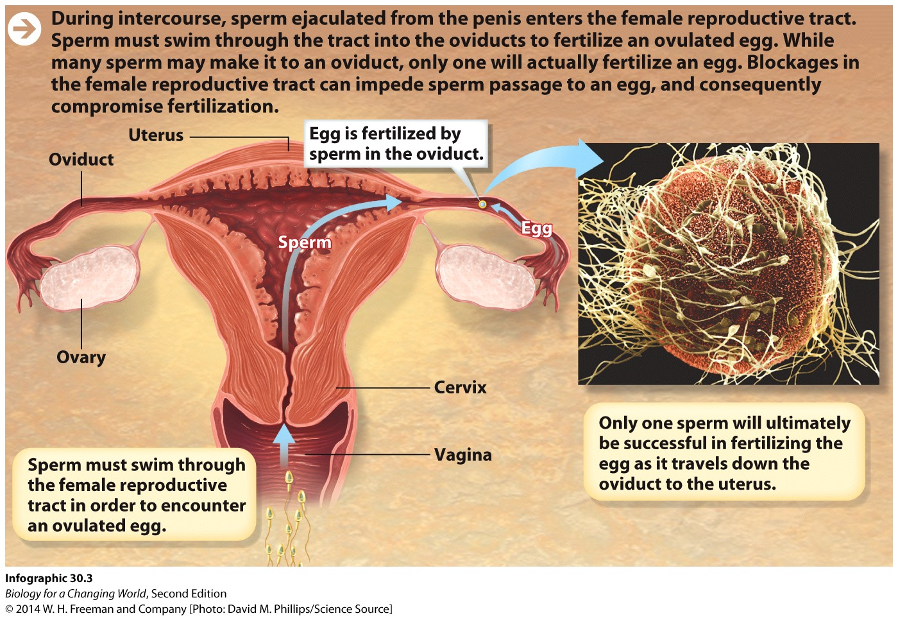
Fertilization
Man ejaculates into a woman’s vagina
Sperm swim up reproductive tract
Through cervix into oviducts

Slide 13
Fertilization
Single sperm fuses with an egg
Fertilized
Notes:
Fertilization: the fusion of an egg and a sperm

Slide 14
Infertility
Damage to reproductive organs can prevent fertilization
Blocked or damaged oviduct
Obstructions in vas deferens or epididymous will block sperm transport

Slide 15
Female infertility
Notes:
Blocked oviduct prevents eggs from entering the uterus or sperm from getting into the oviduct.
A common cause of blocked tubes is pelvic inflammatory disease, which can be caused by sexually transmitted diseases such as chlamydia, a bacterial infection.
Obstructions in vas deferens or epididymous will block sperm transport.

Slide 16
In vitro fertilization (IVF)
If damage cannot be corrected…
IVF
Assisted reproductive technology
Fusion of egg and sperm outside the body
Fertilized egg develops into embryo
Transferred to uterus
Notes:
In vitro fertilization (IVF): a form of assisted reproduction in which eggs and sperm are brought together outside the body and the resulting embryos are inserted into a woman’s uterus
Embryo: an early stage of development; an embryo forms when a zygote undergoes cell division

Slide 17
In vitro fertilization
Notes:
IVF may also be recommended in cases of low sperm number, abnormal sperm, and even in cases in which the cause of infertility can’t be determined.

Slide 18
Hormones and fertility
Hormones regulate production of sperm and egg
Females
Estrogen and progesterone drive reproductive cycle
Males
Testosterone stimulates sperm to develop
Notes:
Hormones are produced by endocrine glands, which secrete hormones into the circulation. These hormones then travel through the bloodstream to reach their target cells. Hormones interact with their target cells by binding to specific receptors on the target cells, influencing a range of physiological processes.

Slide 19
Hormones and female fertility
Hypothalamus
Works with anterior pituitary
Releases follicle-stimulating hormones (FSH) and luteinizing hormones (LH)
FSH stimulates immature eggs in follicles to mature
Follicles make estrogen
Notes:
Hypothalamus: a master control region in the brain that regulates a variety of physiological functions, including hunger, thirst, temperature regulation, and reproduction.
Anterior pituitary: the gland in the brain that secretes luteinizing hormone and follicle-stimulating hormone
Follicle-stimulating hormone (FSH): a hormone secreted by the anterior pituitary; in females, FSH triggers eggs to mature at the start of each monthly cycle

Slide 20
Hormones and female fertility
Rising estrogen levels trigger release of luteinizing hormone (LH)
LH triggers ovulation
release of an egg from a follicle into oviduct
corpus luteum (remains of follicle) secretes progesterone
promotes thickening of endometrium
Notes:
During each cycle, estrogen and progesterone levels rise and fall, triggering the ovaries to release an egg and prepare a woman’s uterus for pregnancy should an egg be fertilized.
Luteinizing hormone (LH): a hormone secreted by the anterior pituitary; in females, a surge of LH triggers ovulation
Ovulation: the release of an egg from an ovary into the oviduct
Corpus luteum: the structure in the ovary that remains after ovulation and secretes progesterone

Slide 21
Hormones and female fertility
If egg not fertilized within 24 hours of ovulation
Corpus luteum degenerates
Progesterone levels drop
Uterine lining sloughs off
leading to menstruation
Notes:
Menstruation: the shedding of the uterine lining (the endometrium) that occurs when an embryo does not implant

Slide 22
Hormones and female fertility
Notes:
Identical twins occur when a single egg is released and fertilized and then splits into two embryos early in embryonic development.
Fraternal twins result from multiple ovulations within the same cycle.

Slide 23
Hormones and female fertility
If fertilization occurs
Fused sperm and egg are called a zygote
Implants in uterus
Human chorionic gonadotropin (hCG) is released
Progesterone from corpus luteum thickens endometrium
Placenta forms
Notes:
Human chorionic gonadotropin (hCG): a hormone produced by an early embryo that helps maintain the corpus luteum until the placenta develops
Placenta: a structure made of fetal and maternal tissues that helps sustain and support the embryo and fetus

Slide 24
Hormones and female fertility
Notes:
Fetus: beyond the eighth week after fertilization, the embryo is referred to as a fetus

Slide 25
Hormones and female fertility
Menopause
Ovaries stop responding to FSH and LH
Ovulation and menstruation stops

Slide 26
Contraception
Notes:
Hormonal methods of contraception are designed to interfere with the normal female hormone cycle.

Slide 27
Hormones and male fertility
Men do not have a monthly hormone cycles
Sperm go through stages of development
precursor sperm in seminiferous tubules that go through meiosis and specialization
produce mature sperm cells
stimulated by testosterone

Slide 28
Hormones and male fertility
Notes:
Although men produce testosterone continuously throughout their adult lives, they produce slightly less of the hormone as they age; consequently, sperm production declines over time.

Slide 29
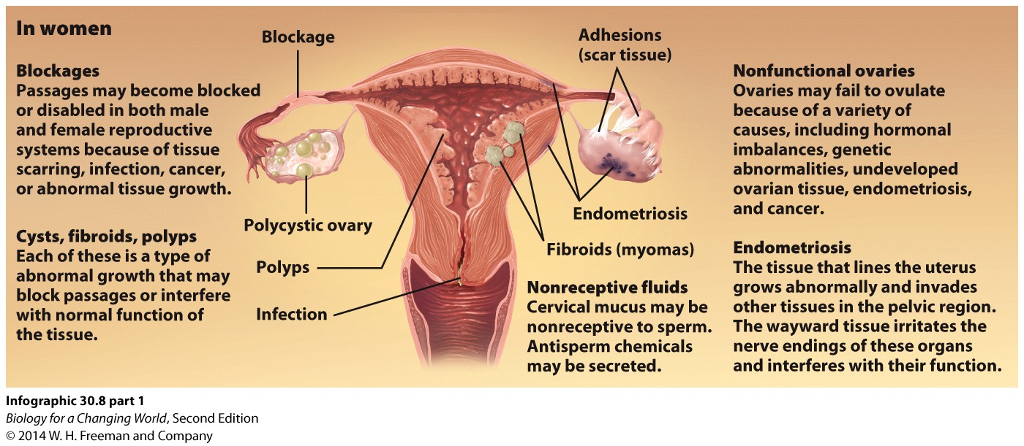
Infertility
Hormone imbalances can also contribute to female infertility

Slide 30
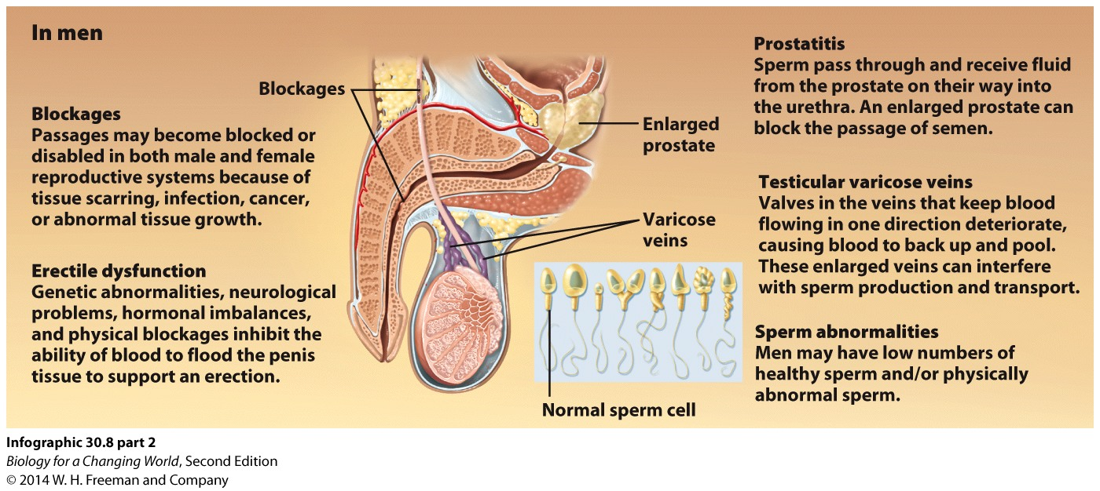
Infertility
Hormone imbalances and physical damages can lead to male infertility

Slide 31
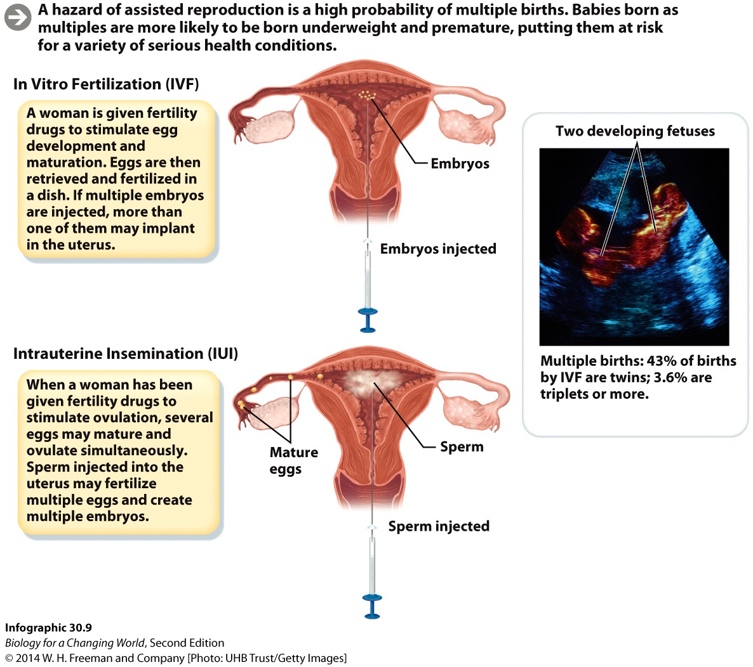
Assisted reproductive technologies
IVF
Intrauterine insemination (IUI)
— Sperm are injected directly into the uterus
Usually in combination with fertility drug
FSH and LH
Notes:
Intrauterine insemination (IUI), in which sperm are injected directly into the uterus, is also known as artificial insemination. It is used most often when infertility can be traced to low sperm count, or to the fact that the sperm are “slow swimmers.”

Slide 32
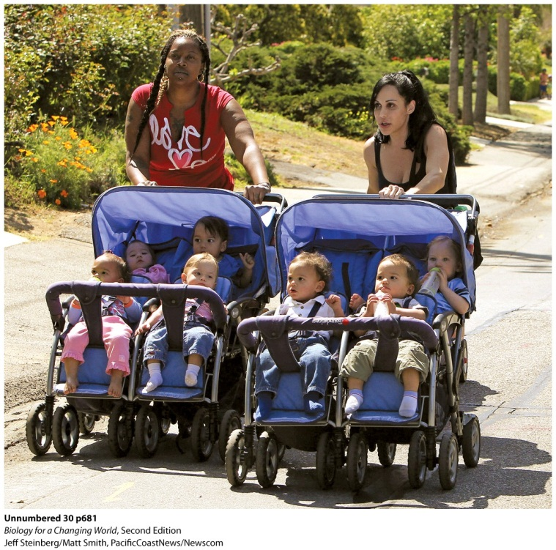
Fertility drugs can lead to multiples
Fertility drugs cause multiple ovulations
Can control fertilization and implantation rates in IVF
Difficult to control in IUI
Notes:
Suleman (right) with some of her 14 children

Slide 33
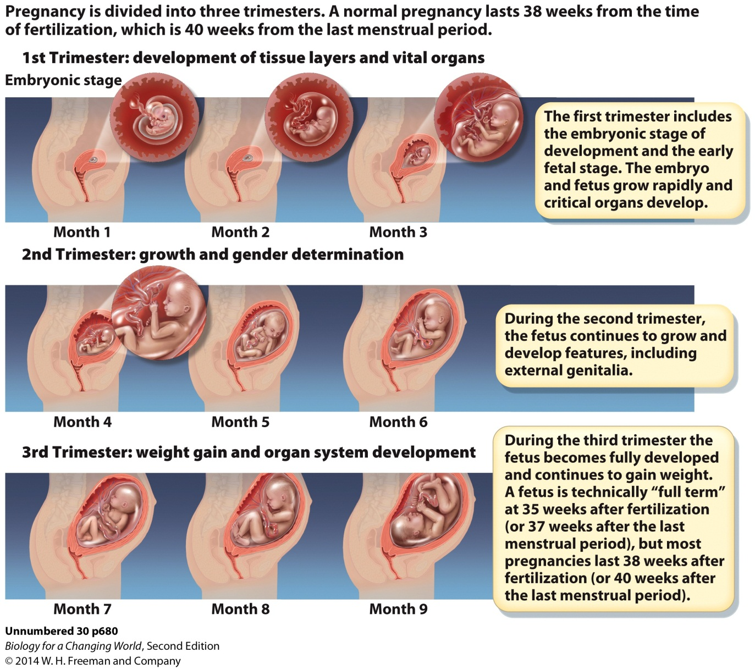
Pregnancy stages
Pregnancy is divided into three trimesters

Slide 34
Pregnancy stages
First trimester

Slide 35
Pregnancy stages
Second trimester

Slide 36
Pregnancy stages
Third trimester

Slide 37
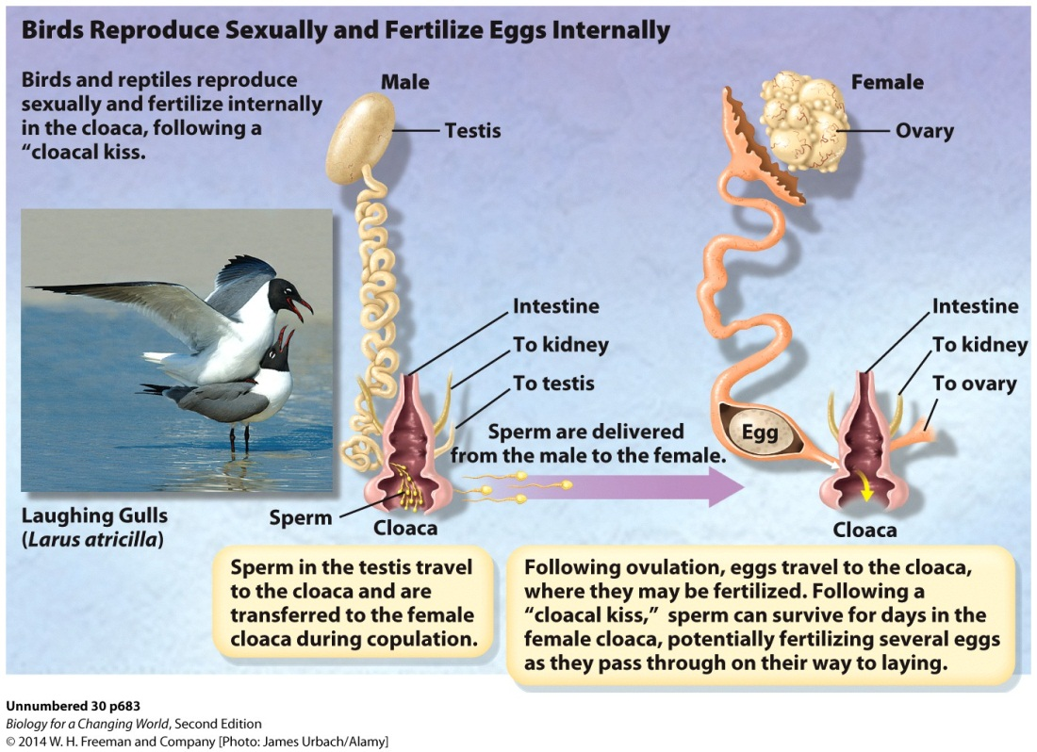
How do other organisms reproduce?
Birds and reptiles
Sexual reproduction
Internal fertilization occurs in the cloaca
shared opening for solid waste, urine, and the reproductive system

Slide 38
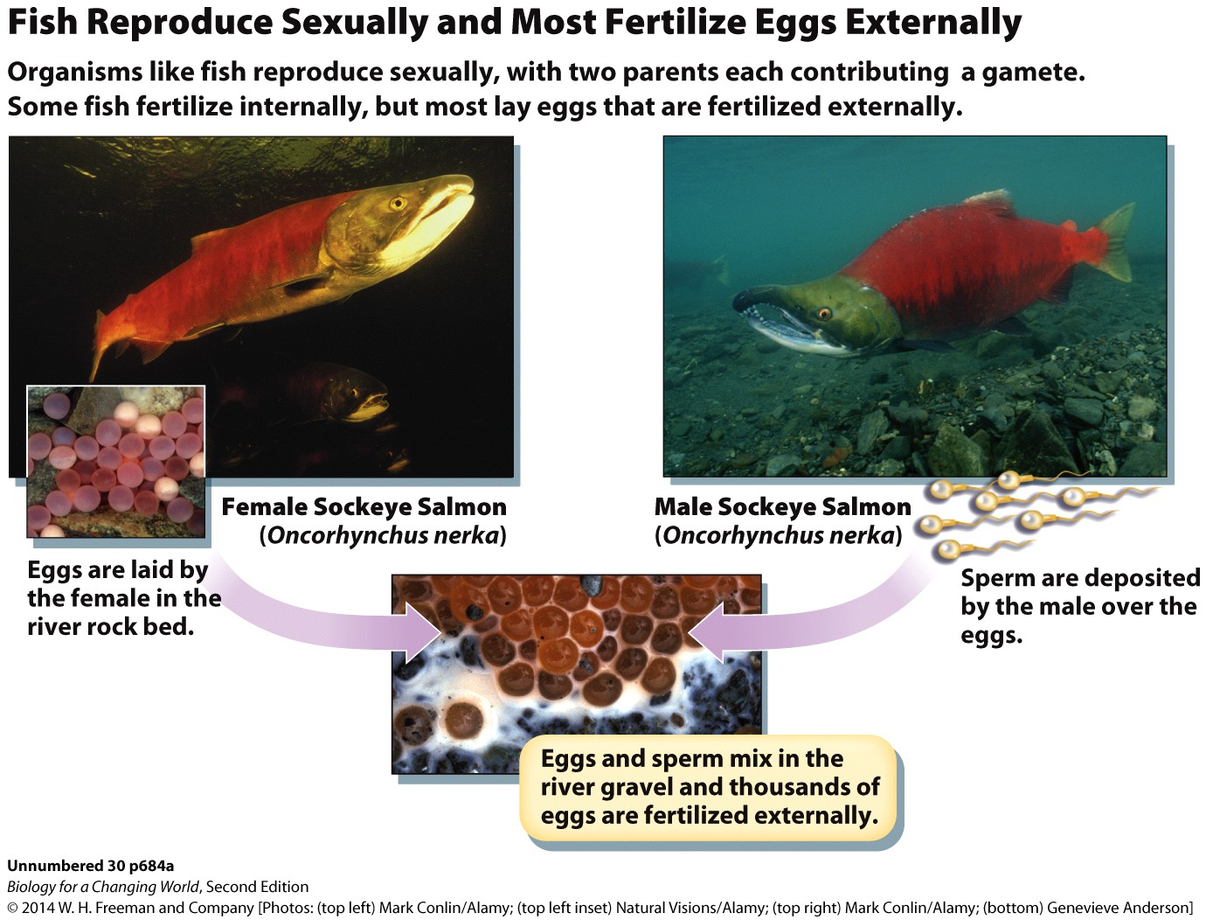
How do other organisms reproduce?
Fish
Sexual reproduction
External fertilization

Slide 39
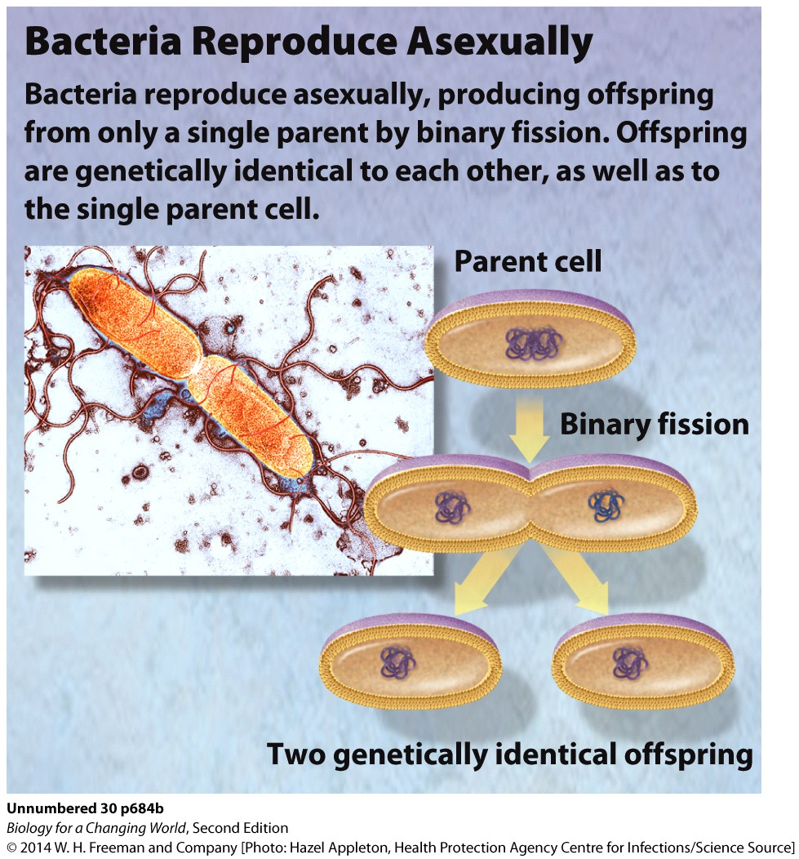
How do other organisms reproduce?
Bacteria
Asexual reproduction

Slide 40
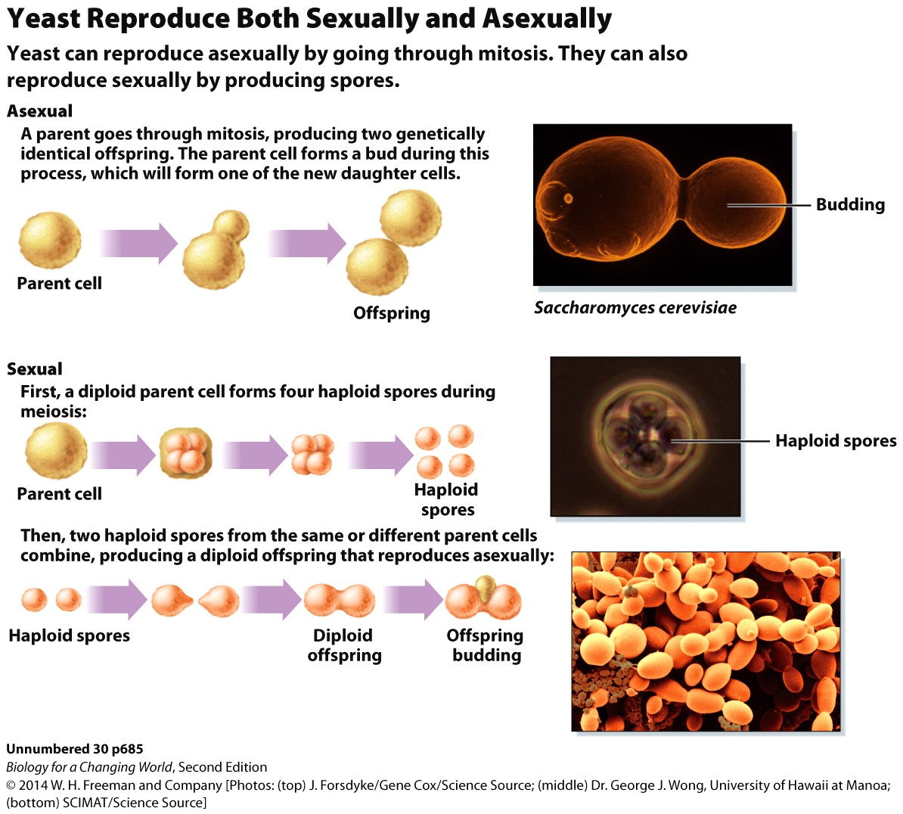
How do other organisms reproduce?
Yeast
Both asexual and sexual reproduction

Slide 41
Summary
The female reproductive system consists of paired ovaries, which produce eggs and secrete the hormones estrogen and progesterone, and accessory structures that enable fertilization and support pregnancy.
The male reproductive system consists of paired testes, which produce sperm, the hormone testosterone, and accessory structures that enable fertilization.
Fertilization of an egg by a sperm occurs in a female oviduct.
The female reproductive cycle is coordinated by a complex balance of hormones that is controlled by the brain.
Sperm develop in the seminiferous tubules of the testes. The process is stimulated by testosterone.
There are many approaches to contraception, including barriers between sperm and eggs and manipulation of reproductive hormones.
Assisted reproduction involves artificially bringing sperm and egg together, either inside the body (in IUI) or outside the body (in IVF).

