Slide 1
Michèle Shuster • Janet Vigna • Gunjan Sinha • Matthew Tontonoz
Biology for a
Changing World
SECOND EDITION
Lecture PowerPoint
CHAPTER 31
Immune System
Copyright © 2014 by W. H. Freeman and Company

Slide 2
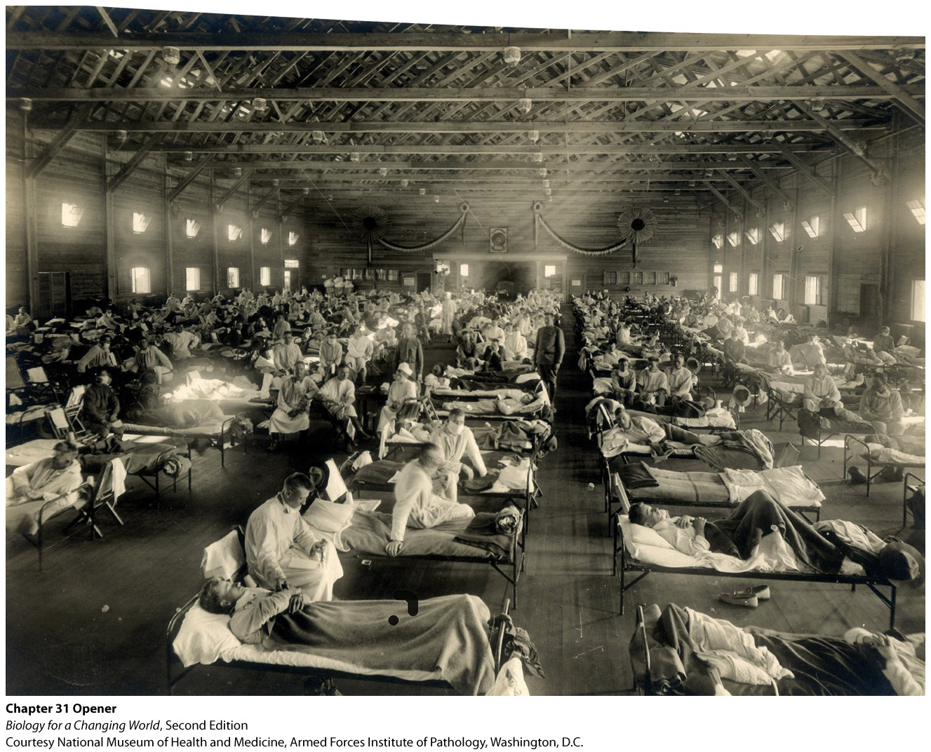
Chapter 31
Immune System

Slide 3
Driving Questions
1. What is the structure of a virus, and how do viruses cause disease?
2. What is innate immunity?
3. What is adaptive immunity, and how does vaccination rely on
adaptive immunity?
4. What are specific features of influenza virus that allow it to cause
worldwide outbreaks?

Slide 4
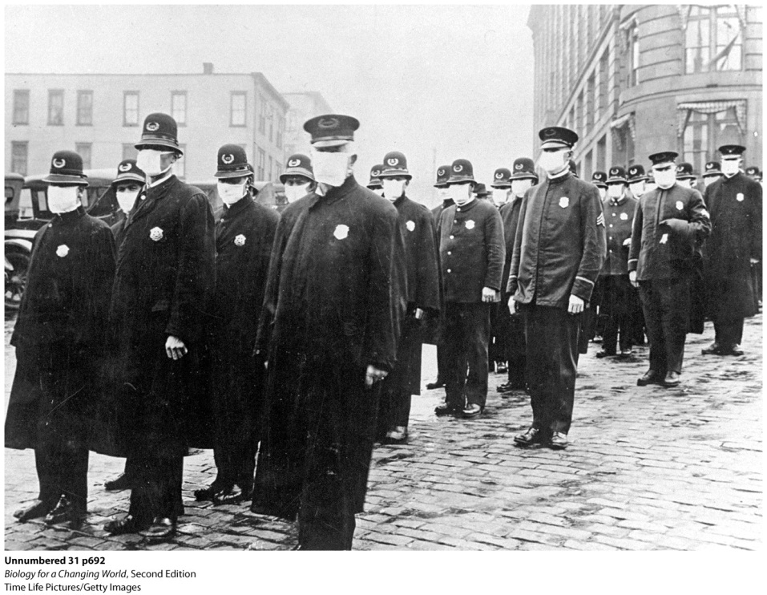
Flu pandemic of 1918
Influenza
“Flu” spread throughout the world
Troops of World War I transmitted the virus
50 million–100 million people died
Notes:
The 1918 flu struck down people in the prime of life: people aged 20 to 40 were the hardest hit.

Slide 5
Viruses
Virus
Acellular infectious particle consisting of nucleic acid surrounded by a protein shell
Considered nonliving: not made of cells
Can store their genetic information in the form of either DNA or RNA
Notes:
RNA viruses include the influenza virus and the viruses that cause colds, measles, and mumps. Diseases caused by DNA viruses include hepatitis B, chicken pox, and herpes. Each type of virus has a characteristic shape and a distinctive protein shell.

Slide 6
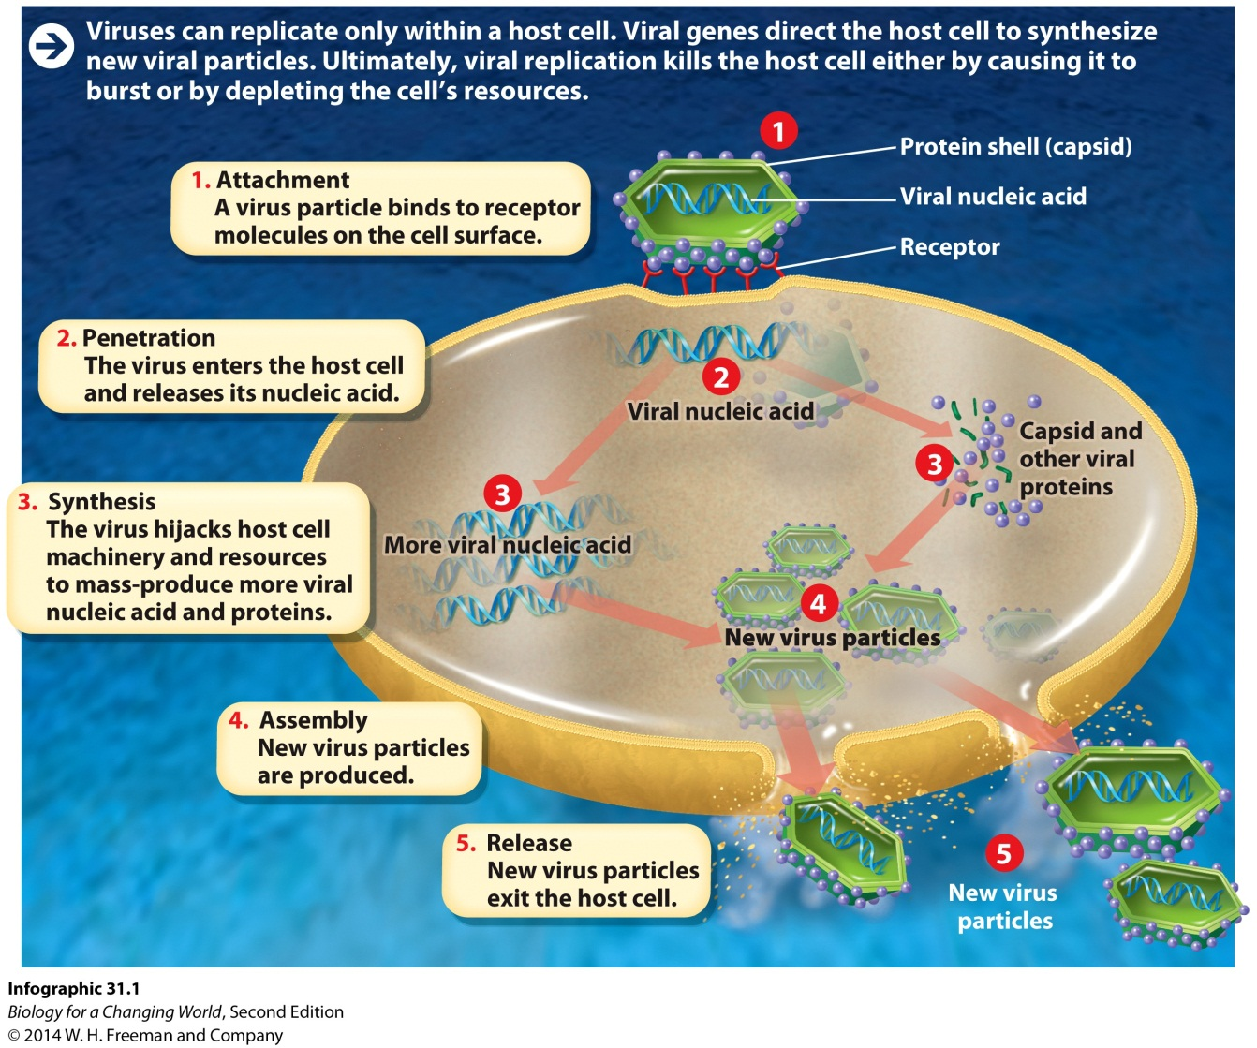
Viruses
Must infect a host cell to reproduce
.

Slide 7
The immune system
A system of cells and tissues that acts to defend the body against pathogens
foreign particles such as viruses, bacteria, and parasites that cause an immune response
Reacts against foreign or “nonself”

Slide 8
The immune system

Slide 9
The immune system
Two primary lines of defense provide immunity
the resistance to a given pathogen conferred by the activity of the immune system
Innate immunity
Adaptive immunity

Slide 10
The immune system
Innate immunity
Nonspecific defenses
Present from birth and are always active
physical and chemical barriers and specialized white blood cells

Slide 11
The immune system
Adaptive immunity
Mediated by specialized white blood cells called lymphocytes
Highly diverse
Long-lasting immunity against specific pathogens

Slide 12
The immune system

Slide 13
Innate immunity
Physical barriers
Antimicrobial chemicals
enzymes in saliva
nasal hair and mucus
cilia
runny nose, coughs, sneezes
complement proteins
Notes:
Complement proteins: proteins in blood that help destroy pathogens by coating or puncturing them.

Slide 14
Innate immunity
Interferon proteins
Released by virus-infected cells
Impedes viral replication
Help protect adjacent cells from becoming infected

Slide 15
Innate immunity
Inflammation
activated by infection or tissue damage
release histamine: blood vessel leakage
attracts white blood cells
Notes:
Histamine: a molecule released by damaged tissue and during allergic reaction

Slide 16
Innate immunity
White blood cells
phagocytes
macrophages
neutrophils
natural killer cells
Notes:
Phagocyte: a type of white blood cell that engulfs and ingests damaged cells and pathogens
Macrophage: a phagocytic cell that resides in tissues and plays an important role in the inflammatory response
Neutrophil: a phagocytic cell in the circulation system that plays an important role in the inflammatory response
Natural killer cell: a type of white blood cell that acts during the innate immune response to find and destroy virally infected cells and tumor cells

Slide 17
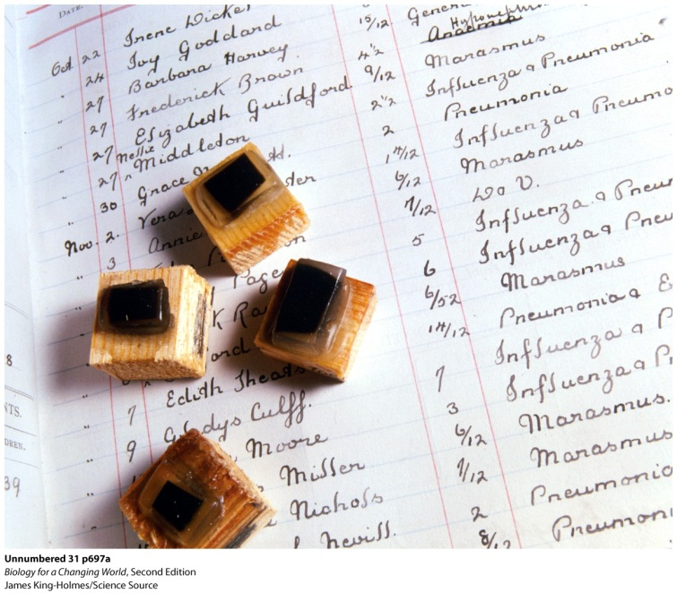
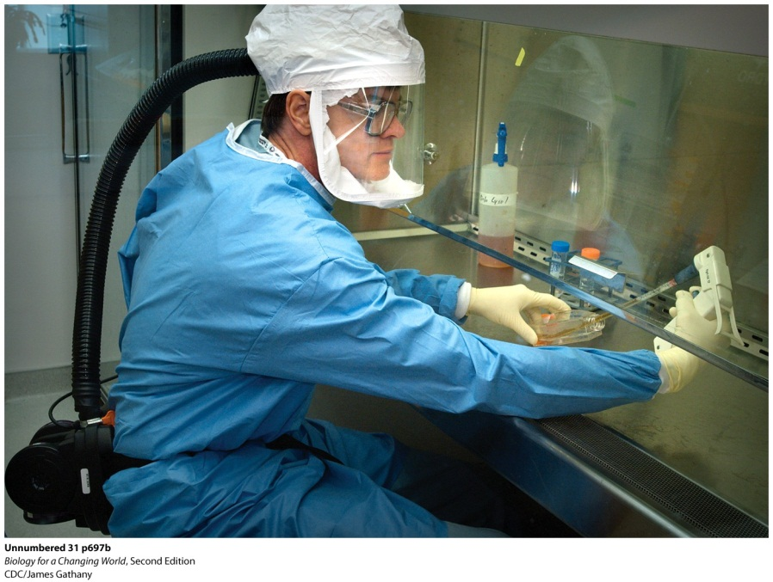
Why was 1918 flu so deadly?
Four genes allowed flu virus to penetrate the lungs
Bypass mouth, nose
Massive inflammatory response in lungs
Lungs destroyed
Notes:
Sample blocks containing lung and brain tissue from victims of the 1918 “Spanish flu” sit atop a list of child victims.
A CDC researcher works with samples of recreated 1918 flu virus.

Slide 18
Why was 1918 flu so deadly?
Notes:
This aggressive immune response also explains why victims with the strongest immune systems (people aged 20 to 40) were the ones who suffered most.

Slide 19
Adaptive immunity
Body develops a memory of every pathogen encountered
Two lymphocytes involved
B cells: from bone marrow
T cells: from thymus
Both cells wait for pathogens in lymph nodes of the lymphatic system
Notes:
B cells: white blood cells that mature in the bone marrow and produce antibodies during the adaptive immune response
T cells: white blood cells that mature in the thymus and can destroy infected cells or stimulate B cells to produce antibodies, depending on the type of T cell
Thymus: a gland in the chest
Lymph nodes: small organs in the lymphatic system where B and T cells may encounter pathogens
Lymphatic system: the system of vessels and organs that works with the immune system, allowing B and T cells to respond to pathogens

Slide 20
Adaptive immunity

Slide 21
Adaptive immunity
Humoral immunity
Targets free-floating pathogens in body fluids
Specialized helper T cells and B cells work together to recognize bacterial and viral antigens
Involves antibodies produced by B cells
proteins that circulate in body fluids and help to fight infections
Notes:
Humoral immunity: the type of adaptive immunity that fights free-floating pathogens in the blood and lymph fluid
Antibody: a protein produced by B cells that binds to antigens and either neutralizes them or flags other cells to destroy pathogens
Antigen: a specific molecule (or part of a molecule) to which specific antibodies can bind, and against which an adaptive response is mounted

Slide 22
Adaptive immunity
Humoral immunity
B and T cells recognize same antigen
B cell is activated to divide
plasma cells secrete many copies of antibody specific to that antigen
memory cells
Notes:
Plasma cell: an activated B cell that divides rapidly and secretes an abundance of antibodies
Memory cell: a long-lived B or T cell that is produced during an immune response and can “remember” the pathogen; they can be called on in the future to secrete antibodies in response to an infection

Slide 23
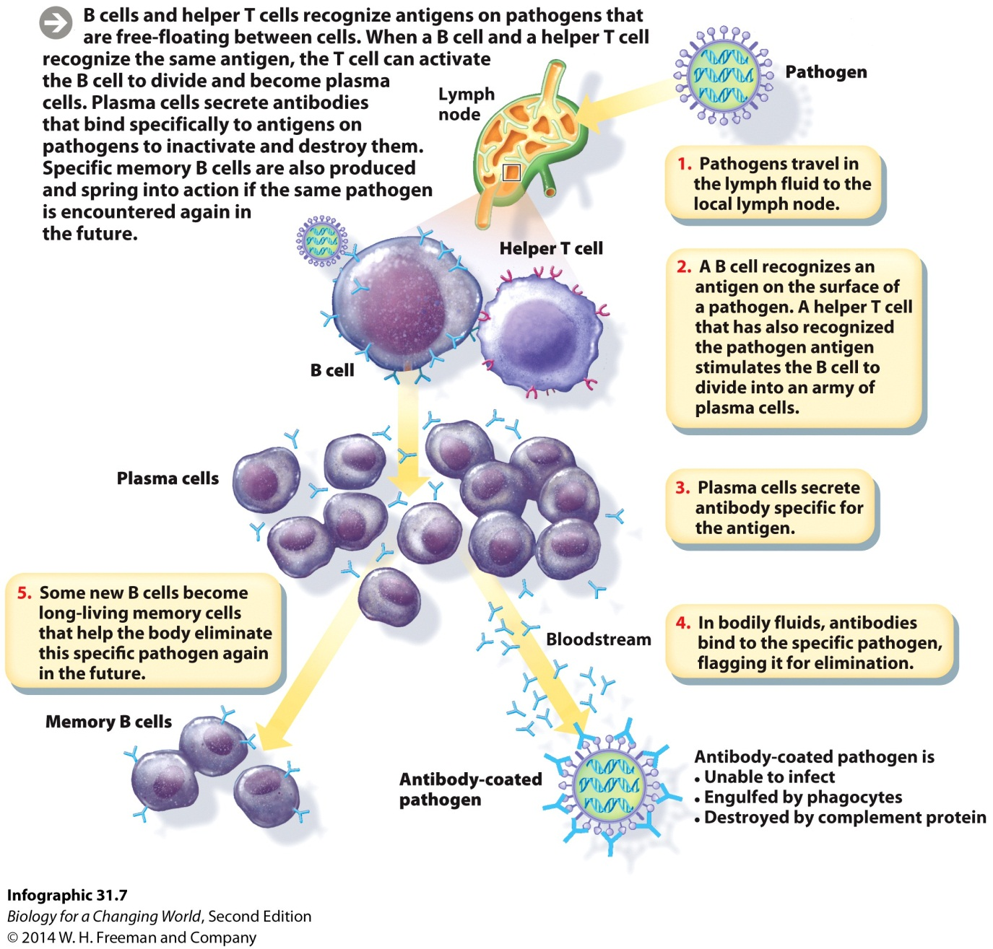
Adaptive immunity
Notes:
Each B cell produces only one type of antibody.
The body can produce more than a billion unique B cells, so there are that many different kinds of potential antibodies.

Slide 24
Adaptive immunity
Cell-mediated immunity
Targets infected or altered body cells
Cytotoxic T cell
activated by foreign antigen on phagocyte surface
also target foreign cells
Notes:
Cell-mediated immunity: the type of adaptive immunity that rids the body of infected, cancerous, or foreign cells
Cytotoxic T cell: a type of T cell that destroys infected, cancerous, or foreign cells

Slide 25
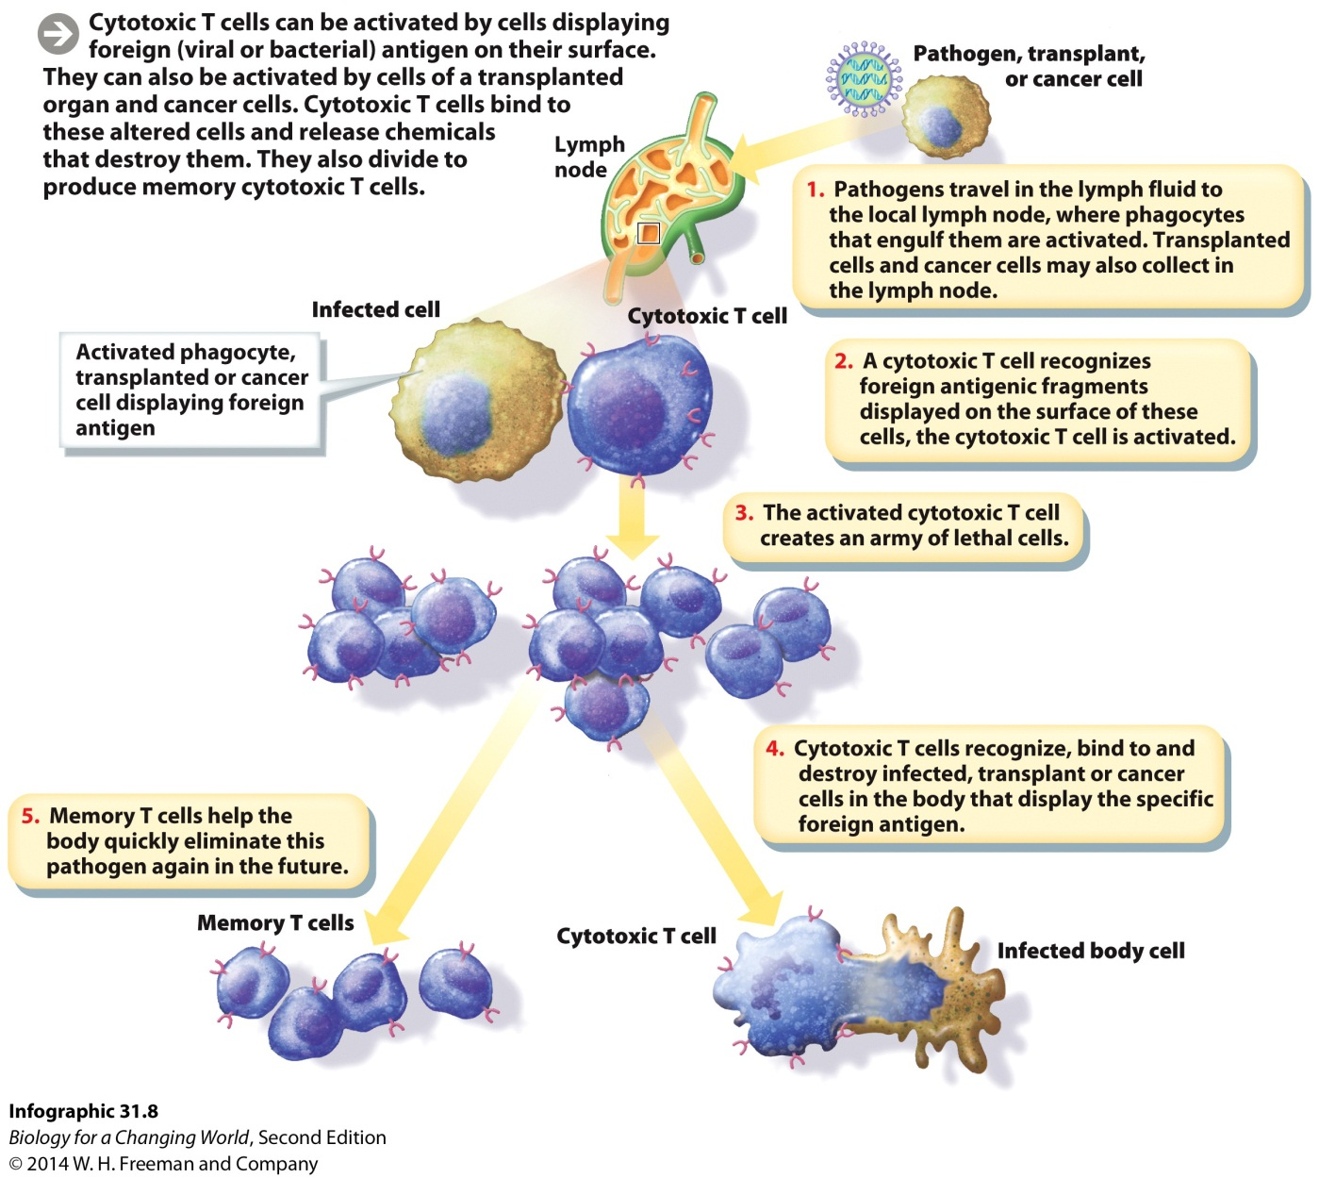
Adaptive immunity

Slide 26
Other immune responses
Allergies
Immune system attacks harmless antigens from outside the body
dust or certain types of food
Autoimmune disease
Immune system attacks the body’s own healthy cells
Notes:
Allergy: a misdirected immune response against environmental substances such as dust, pollen, and foods that causes discomfort in the form of physical symptom
Autoimmune disease: a misdirected immune response in which the immune system attacks healthy cells

Slide 27
Building adaptive immunity
Primary response
Initial exposure to pathogen
T and B cells are activated
Antibody levels increase
Memory cells produced
7-10 days to develop
Secondary response
Confers immunity to a particular pathogen
Notes:
Primary response: the adaptive response mounted the first time a particular antigen is encountered by the immune system
Secondary response: the rapid and strong response mounted when a particular antigen is encountered by the immune system subsequent to the first encounter

Slide 28
Building adaptive immunity

Slide 29
Building adaptive immunity
Vaccines
Secondary response
Source is pathogen
Create a primary response
Create memory cells
Notes:
Vaccine: a preparation of killed or weakened microorganisms or viruses that is administered to people or animals to generate an immune response

Slide 30
Evolution of new viruses
Mutation
Antigenic drift
gradual accumulation of mutations
causes small changes in the antigens on the virus surface

Slide 31
Evolution of new viruses
Gene swapping
Antigenic shift
viruses exchange genetic material
changes in the antigens on the virus surface

Slide 32
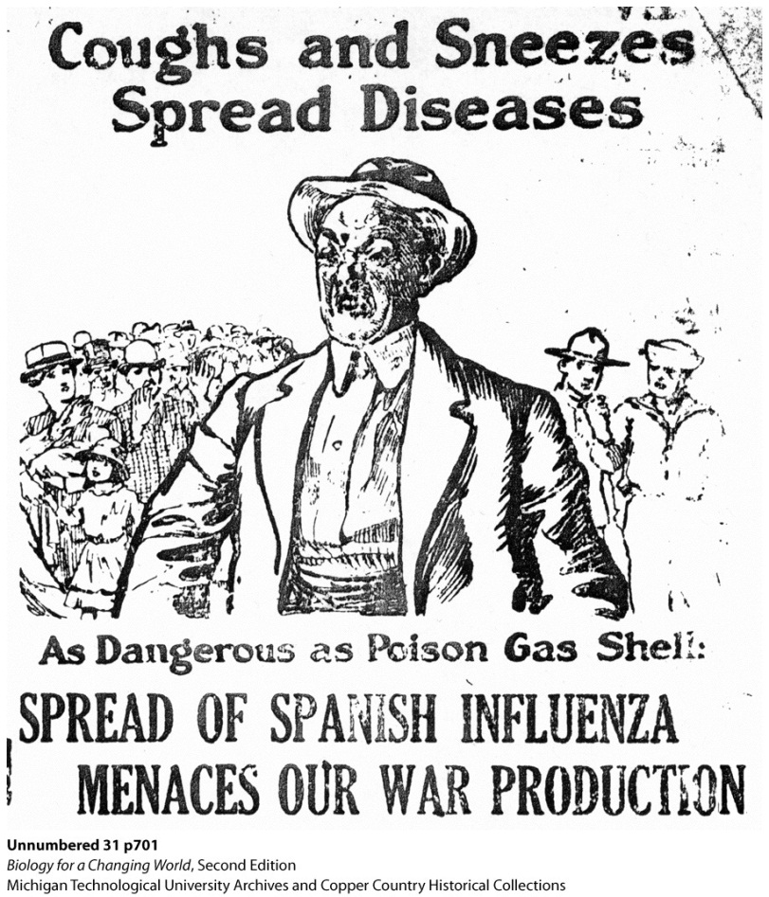
Evolution of new viruses

Slide 33
How do other organisms defend themselves?
Sea sponges
Physical and chemical defenses

Slide 34
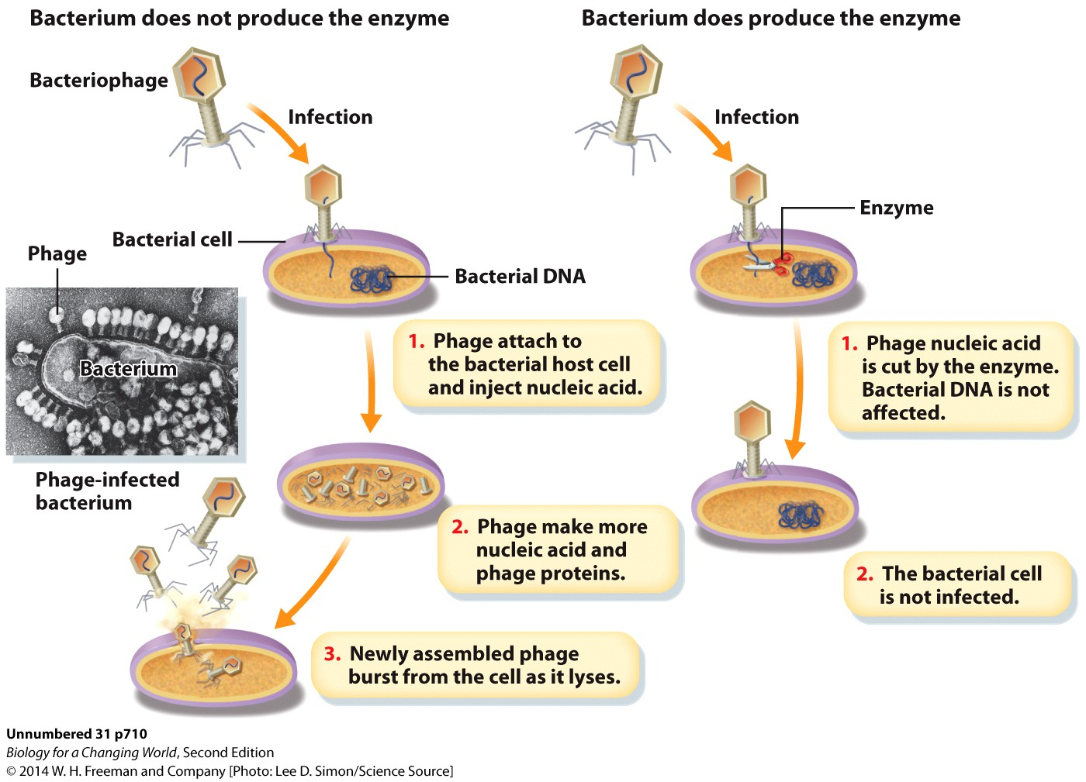
How do other organisms defend themselves?
Bacteria
Use enzymes

Slide 35
How do other organisms defend themselves?
Sea stars
Innate cellular defenses

Slide 36
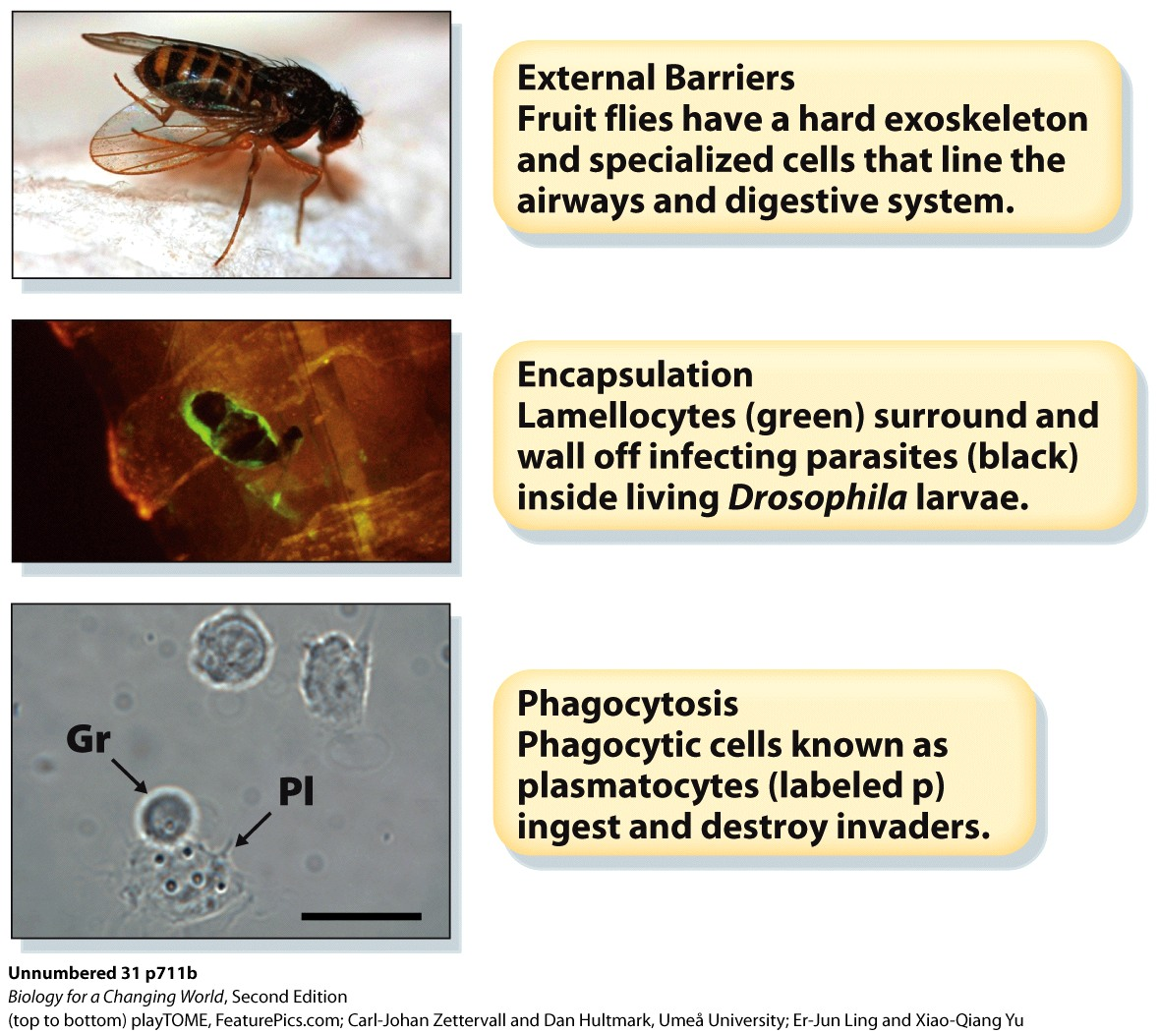
How do other organisms defend themselves?
Fruit flies
Multiple physical, chemical, and cellular defenses

Slide 37
Summary
The immune system defends the body against infection by pathogens. It has two main components: innate immunity and adaptive immunity.
The innate immune system includes defenses with which we are born, and which are always active.
Adaptive immunity is conferred by specialized lymphocytes called B and T cells and is is highly specific for particular pathogens.
Pathogens are infectious agents that cause an immune response; they include certain bacteria, viruses, fungi, and parasites.
Viruses are acellular; they consist of a genome of nucleic acid (DNA or RNA) contained within a protein shell.

