Slide 1
Michèle Shuster • Janet Vigna • Gunjan Sinha • Matthew Tontonoz
Biology for a
Changing World
SECOND EDITION
Lecture PowerPoint
CHAPTER 32
Plant Physiology
Copyright © 2014 by W. H. Freeman and Company

Slide 2
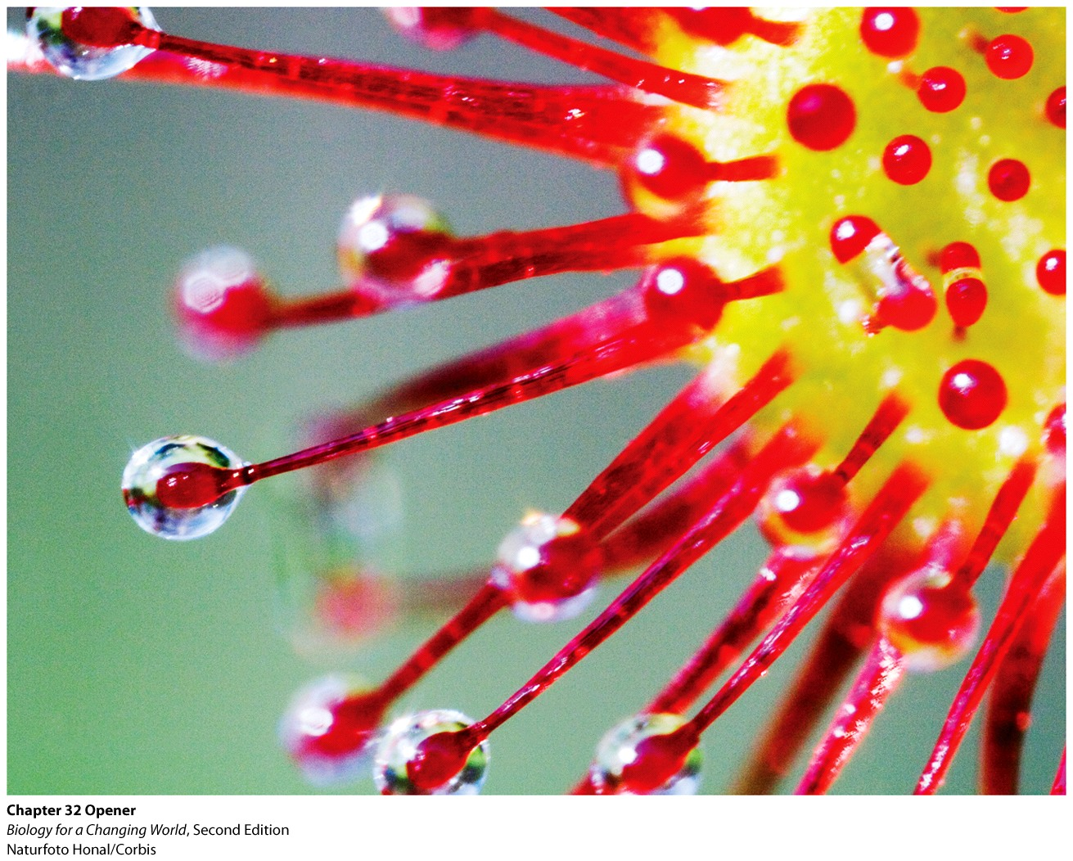
Chapter 32
Plant Physiology
Notes:
Bugs are drawn to what look like dewdrops on this carnivorous plant, the Australian sundew. The “dewdrops” are actually sticky mucus bubbles that trap insects that the plant will consume.

Slide 3
Driving Questions
1. How is a plant body structured, and how
do plants obtain water and grow?
2. How do plants obtain nutrients?
3. How do plants reproduce, respond to
stimuli, and protect themselves?

Slide 4
How do plants stand up?
Land plants share same basic design
Root system
underground
absorbs water and nutrients
Shoot system
aboveground
stems and leaves
Notes:
Root system: the underground parts of a plant, which anchor it and absorb water and nutrients
Shoot system: the aboveground parts of a plant, including the stem and photosynthetic leaves

Slide 5
How do plants stand up?
Plants are eukaryotes
Cells have organelles, including a nucleus
Plant specific feature
cell wall
chloroplasts
central vacuole

Slide 6
How do plants stand up?
Cell wall
Rigid layer
Made of cellulose
Chloroplasts
Organelles of photosynthesis
Central vacuole
Fluid-filled compartment
Cell rigidity
Notes:
Cell wall: a rigid layer surrounding the cell membrane of some cells, providing shape and structure. In plant cells, the cell wall is made of cellulose, a complex carbohydrate
Chloroplast: the organelle in plant cells in which photosynthesis takes place
Central vacuole: a fluid-filled compartment in plant cells that contributes to cell rigidity by exerting turgor pressure against the cell wall

Slide 7
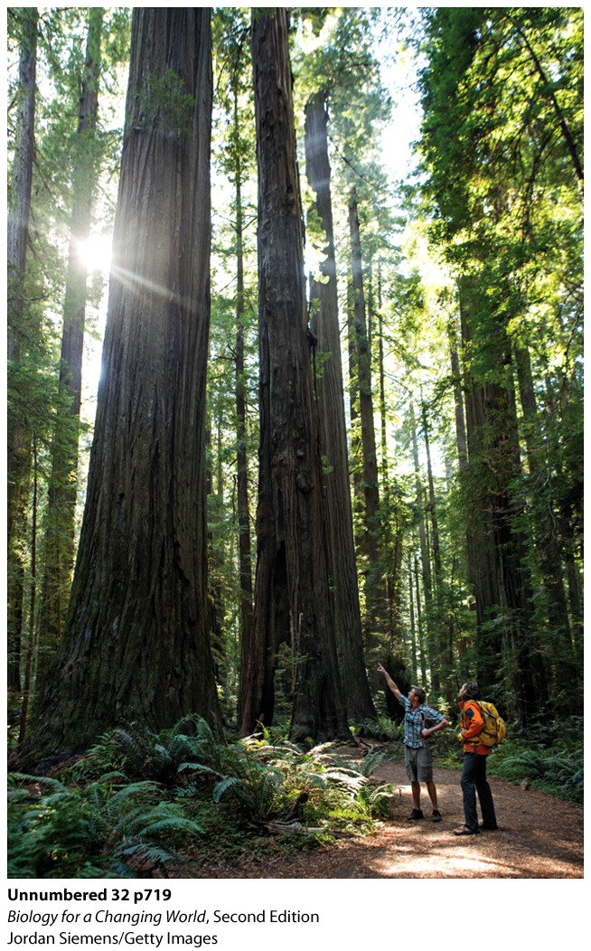
How do plants stand up?
Turgor pressure
Exerted by central vacuole
Keeps plant rigid and upright
Lignin
A hard, durable material
Inner cell wall
Makes plant tissues woody
Notes:
When the vacuoles are less than full, turgor pressure is reduced, and the plant wilts.
Turgor pressure: the pressure exerted by the water-filled central vacuole against the plant cell wall, giving a stem its rigidity
Lignin: a stiff strengthening agent found in secondary cell walls of plants

Slide 8
How do plants stand up?
Root system
Anchors plant
Root hairs increase the surface area
Enhances absorption water and nutrients
Taproots
Water access and storage
Notes:
Root hairs: tiny extensions of root cells that increase the surface area of roots and enhance their ability to absorb water and nutrients
Taproot: a long, straight root produced by some plants that stores water and carbohydrates

Slide 9
How do plants stand up?

Slide 10
Why don’t plants bleed?
Plants have a vascular system
Transports fluids
Water and sugar
Xylem: water transport
Phloem: two-way transport of sugar
Notes:
Vascular system: tube-shaped vessels and tissues that transport nutrients throughout an organism’s body
Xylem: plant vascular tissue that transports water from the roots to the shoots
Phloem: plant vascular tissue that transports sugars throughout the plant

Slide 11
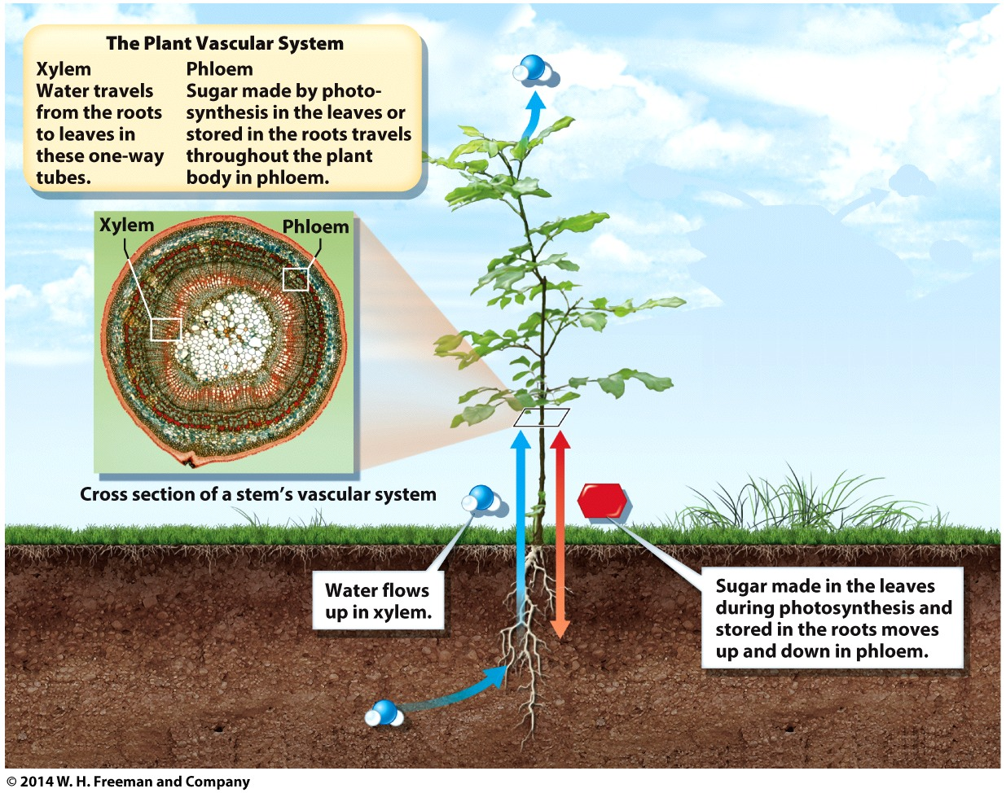
Why don’t plants bleed?

Slide 12
Why don’t plants bleed?
Transpiration
Loss of water from leaves by evaporation
Powers transport through vascular system
Takes advantage of cohesive property of water
Notes:
Unlike animals, which have a heart to pump blood along, plants have no such mechanical help. Instead, plants rely on evaporation of water from the leaves to draw water up the plant, a process called transpiration. Because water is a polar molecule that can form hydrogen bonds with other water molecules, it has great cohesive strength. As water evaporates from leaves into the air, water in the xylem is pulled up to replace it. The cohesive strength of water is enough to counteract the force of gravity and pull water up to astonishing heights.
To control the amount of water lost by transpiration, a plant’s leaves are coated with a waxy cuticle that functions somewhat like a rubber suit, sealing in moisture.

Slide 13
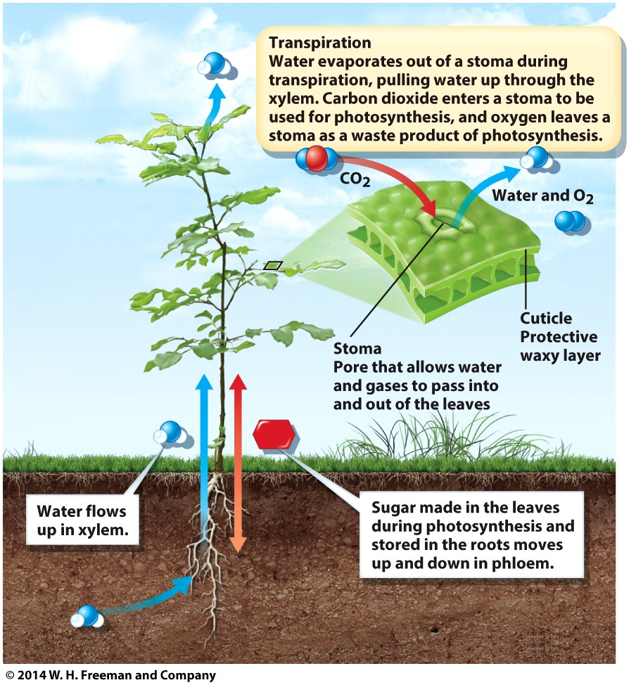
Why don’t plants bleed?
Cuticle
Waxy coating
Leaves and stems
Prevents water loss
Stomata
Pores on leaves
Exchange of oxygen and carbon dioxide
Allow water
Notes:
At regular intervals, the cuticle is punctuated by pores, called stomata (singular: stoma), which open and close. When stomata are open, water vapor leaves freely and other gases enter and exit. When stomata are closed, water and gases are sealed inside.

Slide 14
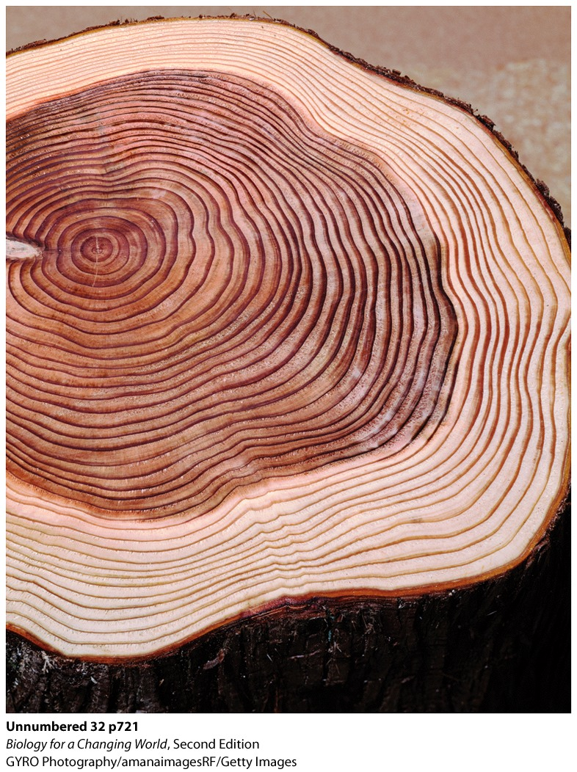
What are tree rings?
Plants grow in two ways
Primary growth (length)
Secondary growth (width)
Wood
Secondary growth of xylem tissue
Increases trunk diameter
Occurs yearly
Notes:
Each dark ring represents the end of one year of growth. This tree was 37 years old.

Slide 15
What do plants eat?
Plants are autotrophs
Carbohydrates from CO₂, water
Nitrogen, phosphorous, sulfur from soil

Slide 16
What do plants eat?
Nitrogen fixation
Converting atmospheric nitrogen into a form that plants can use
Aided by symbiosis
Predation: carnivorous plants

Slide 17
Can plants photosynthesize at night?
Light-absorbing part of photosynthesis occurs in daylight hours
Exchange carbon dioxide during the night
conserves water

Slide 18
Why do leaves change color in the fall?
Chlorophyll
Dominant pigment of photosynthesis
Reflects green wavelengths; plants look green
Xanthophyll: yellow-reflecting
Carotene: orange-reflecting
lesser photosynthetic pigments

Slide 19
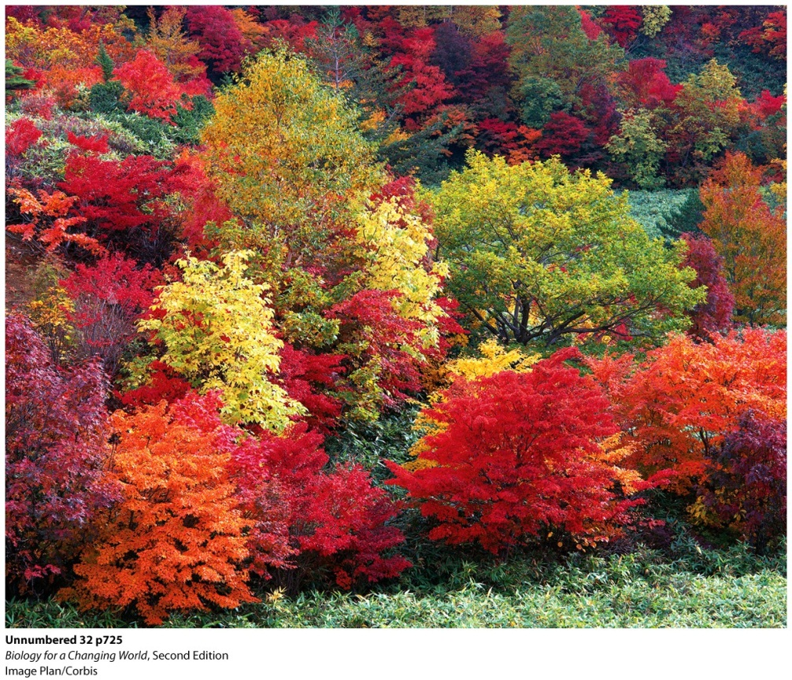
Why do leaves change color in the fall?
Temperatures cool and daylight wanes
Plants reduce photosynthesis
Stop production of pigments
Chlorophyll levels drop fastest
Notes:
Xanthophyll and carotene capture additional wavelengths of light and therefore expand the range of light that is effective for photosynthesis. During the spring and summer, the leaves are full of green chlorophyll, camouflaging the other hues.

Slide 20
Why do leaves change color in the fall?

Slide 21
Do plants have sex?
Plants have male and female reproductive organs
Housed within a plant’s flowers
Produce haploid gametes: sperm and egg

Slide 22
Do plants have sex?
Male sexual organ
Stamen: filament and anther
Pollen
contain cells that will develop into sperm
Female sex organs
Pistil and ovules
Notes:
Stamen: the male sexual organ of a flower
Pollen: small, thick-walled structures that contain cells that will develop into sperm
Pistil: the female reproductive organ of a flower
Pollination: the transfer of pollen from a male stamen to a female pistil

Slide 23
Do plants have sex?

Slide 24
What spins like a helicopter, shoots like a rocket, and contains its own parachute?
Plants disperse their offspring through seeds
embryonic plant contained in a protective structure.

Slide 25
What spins like a helicopter, shoots like a rocket, and contains its own parachute?
Gymnosperms
Cone-bearing seed plants
Angiosperms
Flowering plants
Seeds are located inside fruit or nut

Slide 26
Can plants see?
Respond to their environment
Phototropism
Growth of the stem of a plant toward light
Auxin
plant hormone
promotes cell elongation

Slide 27
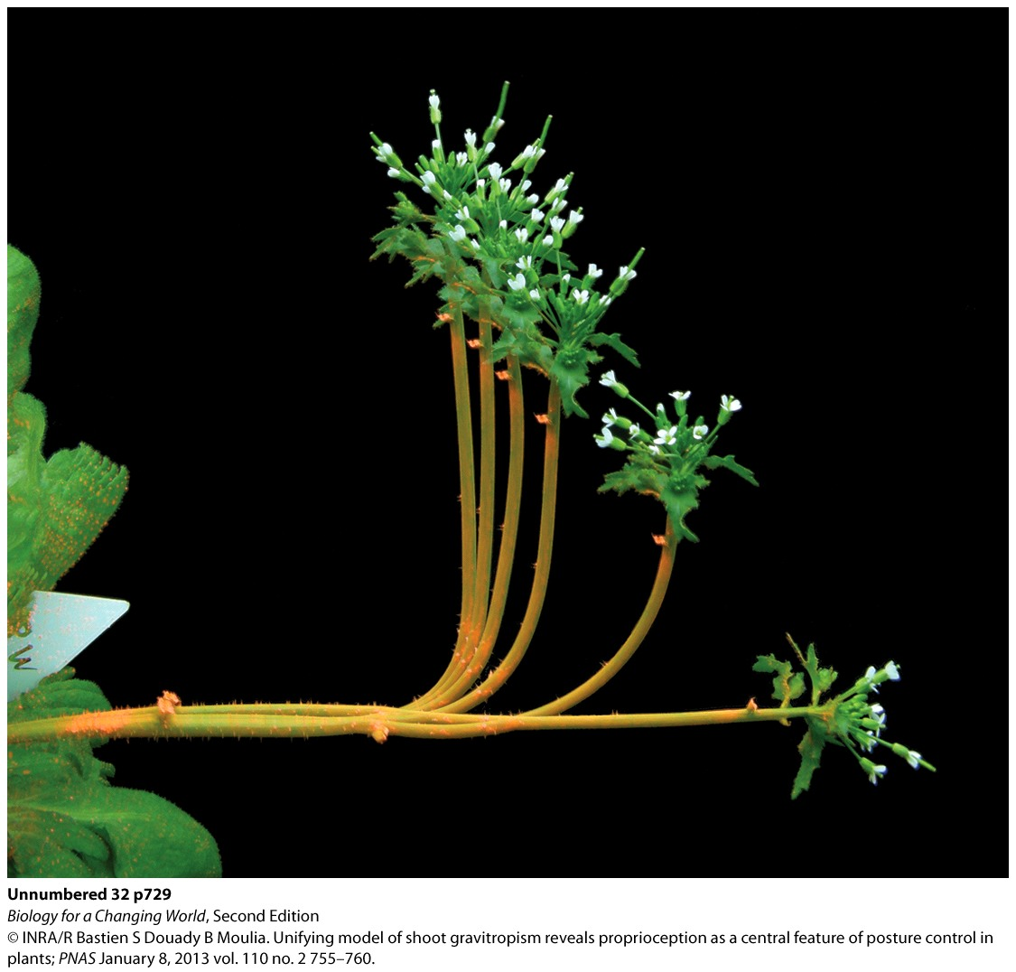
Can plants see?
Gravitropism
Growth of plants in response to gravity
Roots grow downward
Shoots grow upward
Auxin, too!
Notes:
Auxin is again the main player in this mechanism. When a plant is placed on its side, more auxin is sent to the down side of the stem, in the direction of gravity. This causes the cells on the down side to elongate more. Stems begin to curve away from gravity. Root cells, however, respond the opposite way to auxin: more auxin on the gravity side of roots inhibits root cell elongation on the down side, so roots bend toward gravity.

Slide 28
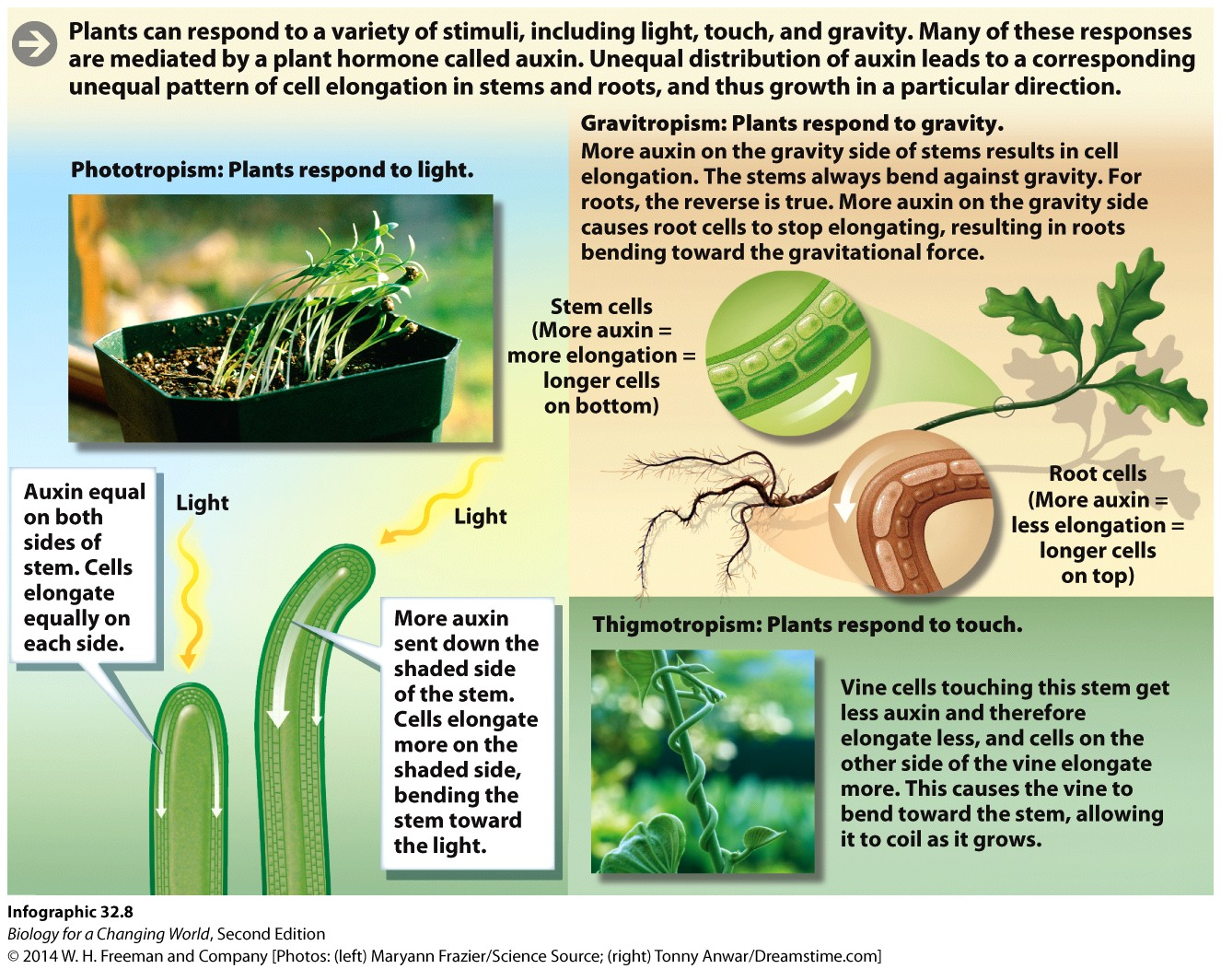
Can plants see?
Thigmotropism
Response of plants to touch and wind
Auxin, too!

Slide 29
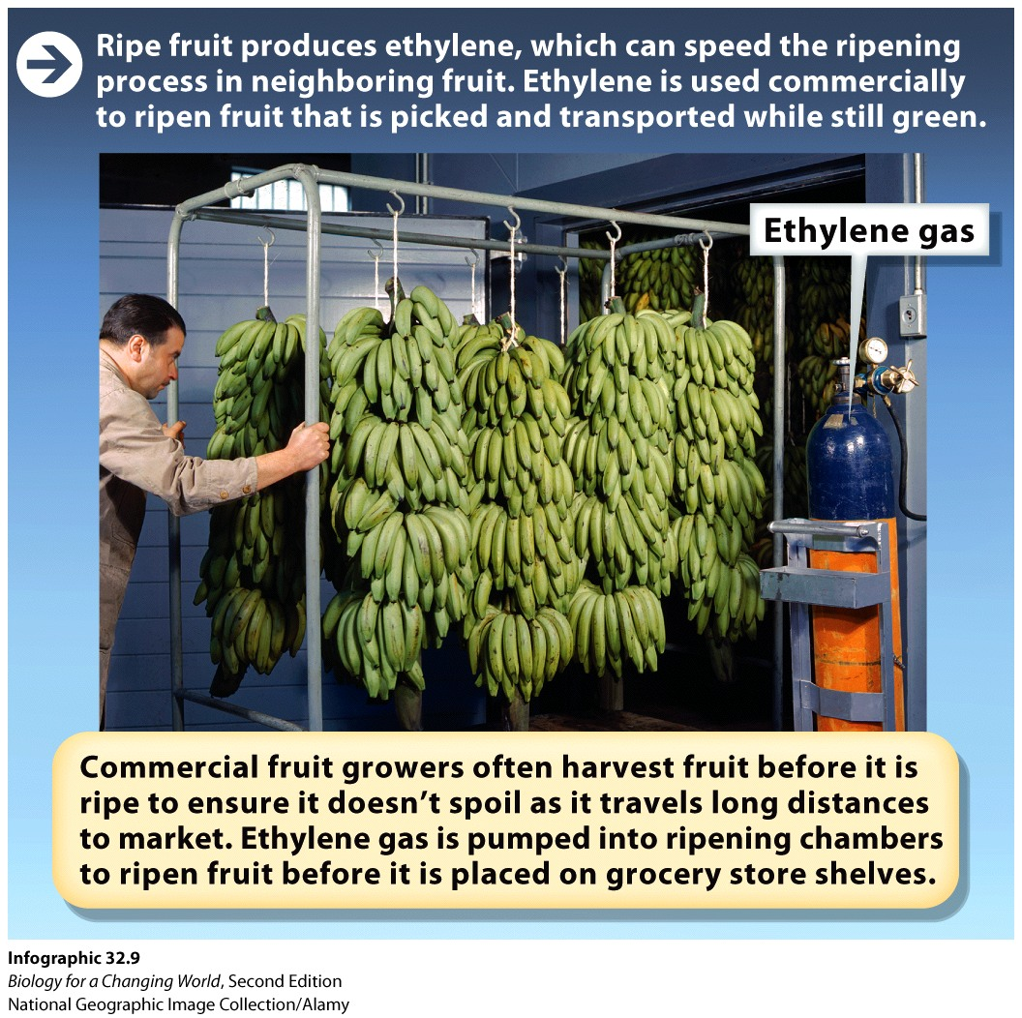
Does one bad apple really spoil the bunch?
Ethylene
Gaseous plant hormone
Promotes ripening
Produced by ripe plants

Slide 30
Can plants take hormones to improve their performance?
Gibberellins
Plant hormone
Stem elongation
Cell division
Germination
Abscisic acid (ABA)
Plant hormone
Promotes dormancy

Slide 31
Can plants take hormones to improve their performance?

Slide 32
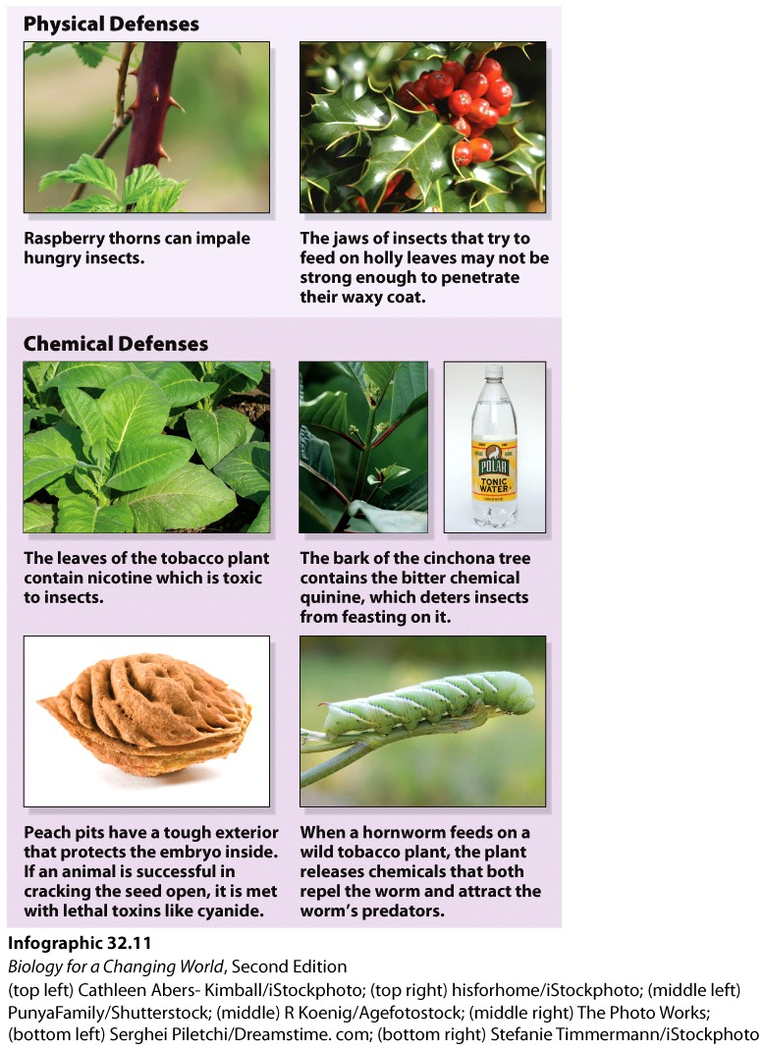
Why are some plants poisonous?
Defense mechanism against herbivores
Toxic or distasteful chemicals
Spines
Waxy coatings

Slide 33
Summary
Nearly all plants share the same basic structure: an aboveground shoot system and an underground root system.
Plants have a vascular system. Xylem transports water and dissolved nutrients from the roots to the shoots. Phloem transports dissolved sugars throughout the plant body.
Plants undergo primary (vertical) and secondary (horizontal) growth. Secondary growth is mostly growth of xylem tissue.
Plants are autotrophs, able to make their food by photosynthesis of sunlight and carbon dioxide absorbed from the air.
A variety of pigments assist with photosynthesis.
Many plants reproduce sexually and have male and female sexual organs that produce haploid gametes.
Plants respond to their environment by various tropisms.
Plants produce hormones that contribute to growth and development.

