Slide 1
chapter 1
Succeeding in College

Slide 2
Factors that Contribute to Success
Focus on Success
Manage Your Time
Organize a Writing and Study Area
“Study Smarter”
Manage Stress

Slide 3
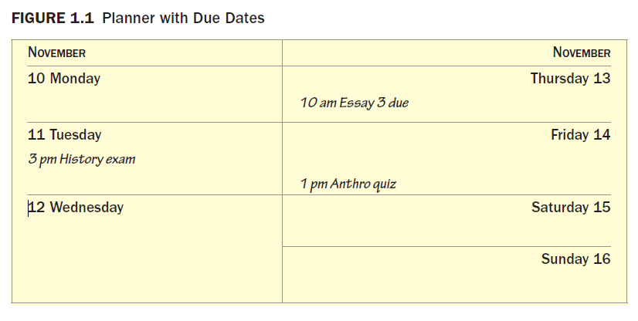

Slide 4
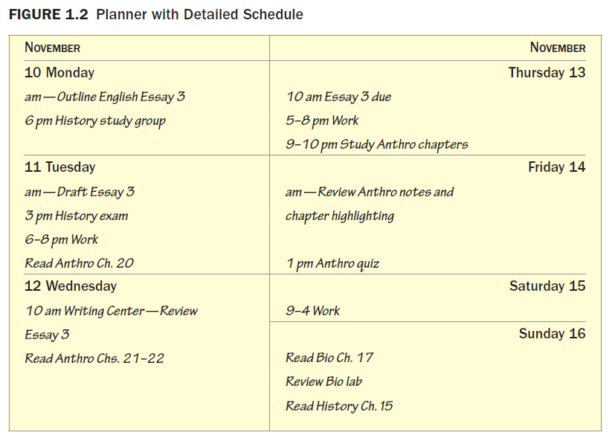

Slide 5
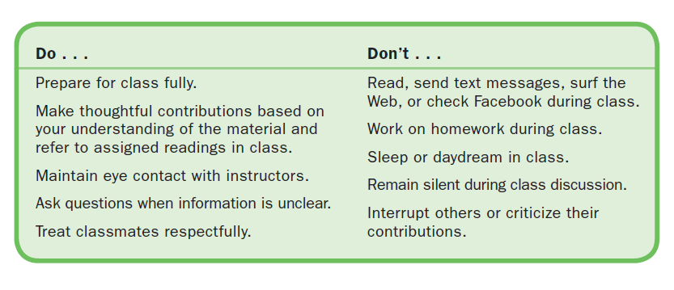
Classroom Skills
Polish Your Academic Image

Slide 6
Demonstrate Academic Integrity
Communicate Effectively with Your Instructors
Use Electronic Tools Effectively
Listen Carefully and Critically
Ask and Answer Questions Appropriately
Synthesize Your Ideas and Experiences with What You Are Learning
Collaborate with Classmates

Slide 7
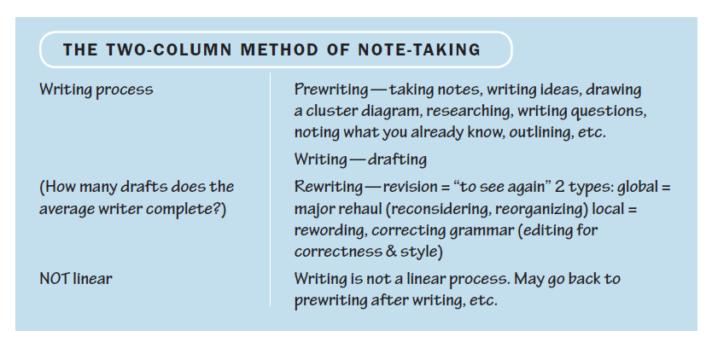
Take Effective Notes in Class

Slide 8
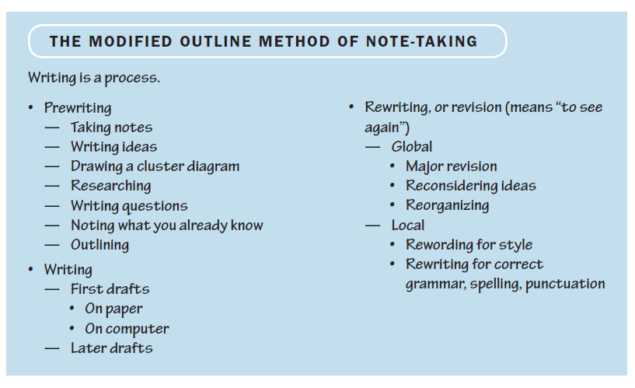

Slide 9
Manage Online Courses Responsibly
Avoid online courses in your first term in college.
Set regular hours to devote to your online course.
Plan on doing a lot of reading and writing.
Maintain your concentration.
Take your online postings seriously.

