Slide 1
chapter 10
Editing Sentences and Words

Slide 2
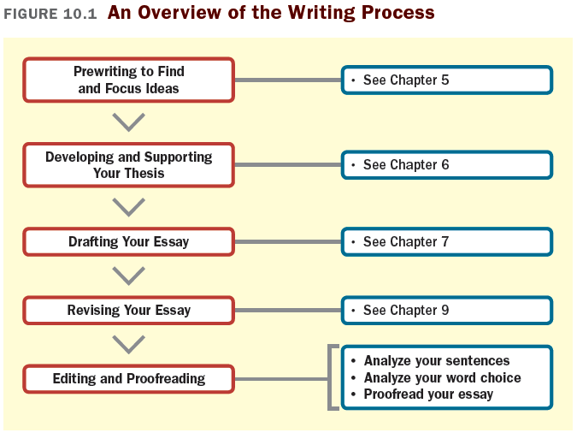

Slide 3
Analyzing Your Sentences
Effective sentences
are clear and concise
are varied
use parallel structure for similar ideas
contain strong, active verbs

Slide 4
Are Your Sentences Concise?
Avoid wordy expressions.
Eliminate redundancy.
Eliminate unnecessary sentence openings.
Eliminate unnecessary adverbs.
Eliminate unnecessary phrases and clauses.
Avoid weak verb-noun combinations.

Slide 5
Are Your Sentences Varied?
How To Vary Sentence Type
Use simple sentences (sentences consisting of only one independent clause) for emphasis and clarity.
Use compound sentences (sentences consisting of two or more independent clauses) to show relationships between equally important ideas.
(continued)

Slide 6
Use complex sentences (sentences consisting of one independent and at least one dependant clause) to show that one or more ideas are less important than (or subordinate to)another idea.
Use compound-complex sentences (sentences containing one or more dependant clauses and two or more independent clauses) occasionally to express complicated relationships.

Slide 8
How To Vary Sentence Length:
Vary sentence type. Simple sentences tend to be short, compound and complex sentences tend to be longer, and compound-complex sentences tend to be the longest.
Use shorter sentences to move ideas along quickly; use longer sentences to create a leisurely, unhurried pace.

Slide 9
How to Vary Sentence Pattern:
Modifier last: subject-verb-modifier.
Modifier first (or, periodic sentences): modifier-subject-verb.
(continued)

Slide 10
How to Vary Sentence Pattern (continued)
3. Modifier in the middle: subject- modifier-verb.
4. Modifiers used throughout.

Slide 11
Are Your Sentences Parallel in Structure?
Parallelism means that similar ideas in a sentence are expressed in similar grammatical form.
Nouns in a series should be parallel.
Adjectives in a series should be parallel.
Verbs in a series should be parallel.
Phrases and clauses within a sentence should be parallel.
Items being compared should be parallel.

Slide 12
Do Your Sentences Have Strong, Active Verbs?
Use active, not passive verbs.
1. In sentences with active verbs, the subject (Jane) performs an action:
Jane chucked the ball over the fence.
2. Passive verbs are forms of the verb to be combined with a past participle. With passive verbs, the subject receives the action:
The ball was chucked over the fence by Jane.

Slide 13
Analyzing Your Word Choice
Consider the following:
Tone and level of diction
Word connotations
Concrete and specific language
Figures of speech

Slide 14
Are Your Tone and Level of Diction Appropriate?
Formal Diction is serious and dignified, common in scholarly publications, operation manuals, and in most academic fields.
Popular Diction is casual, common in magazines and newspapers.
Informal Diction is the language of everyday speech and conversation and is rarely used in academic writing.

Slide 15
Diction in Academic Writing
Use the third person (he, she, it) rather than the first person (I, we), unless you are expressing a personal opinion.
Use standard vocabulary, not slang or a regional or ethnic dialect.
Use correct grammar, spelling, and punctuation.
Aim for a clear, direct, and forthright tone.

Slide 16
Do You Use Words with Appropriate Connotations?
Denotation is a word’s precise dictionary definition.
Connotation is the collection of feelings and attitudes the word evokes. Compare
Grandma’s house is filled with keepsakes.
with
Grandma’s house is littered with knickknacks.

Slide 17
Do You Use Concrete Language?
Concrete, specific words add life to your writing. Compare
The red flowers were blooming in our yard.
with
Crimson and white petunias were blooming in our yard.

Slide 18
Do You Use Fresh, Appropriate Figures of Speech?
A figure of speech is a comparison between two things that makes sense imaginatively or creatively but not literally.
Use metaphors, similes, or personification.
Metaphor: For little Charlie, the bathtub was an ocean.
Simile: The watermelon seeds suddenly shot from his mouth like a round of bullets.
Personification: The blank page taunted me.

Slide 19
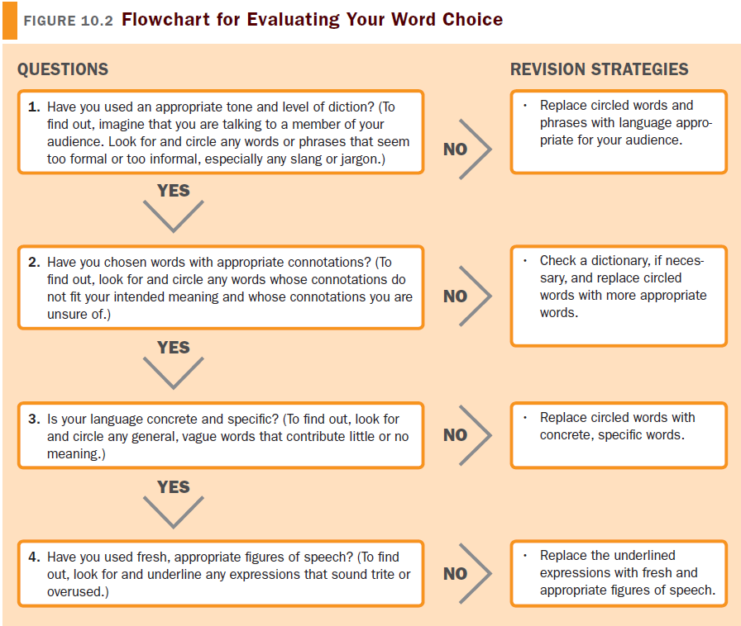
Evaluating Your Word Choice

Slide 20
Suggestions for Proofreading
Review your paper once for each type of error.
Read your essay backwards, from the last sentence to the first.
Use the spell-check and grammar-check function cautiously.
Read your essay aloud.
Ask a classmate to proofread your paper.

