Slide 1
chapter 12
Narration: Recounting Events

Slide 2
Contents of Chapter 12
Characteristics of a Narrative
Reading: “Right Place, Wrong Face,” by Alton Fitzgerald White
Visualizing a Narrative: A Graphic Organizer
Reading: “Writing about What Haunts Us,” by Peter Orner
Integrating Narration into an Essay
Reading Actively and Thinking Critically
What to Look For, Highlight, and Annotate
Analyzing Narratives
A Guided Writing Assignment

Slide 3
Contents for Chapter 12
Readings: Narration in Action
Student Essay: “Being Double,” by Santiago Quintana
Narrative Essay: “The Lady in Red,” by Richard LeMieux
Narration Combined with Other Patterns: “The Alternate History of Susan Chung: One Woman’s Quest to Find Her Birthparents,” by Nicole Soojung Callahan
Applying Your Skills: Additional Essay Assignments

Slide 4
What Is Narration?
A narrative relates a series of events, real or imaginary, in an organized sequence.

Slide 5
Characteristics of a
Narrative
Narratives
make a point.
convey action and detail.
present a conflict and create tension.
sequence events.
use dialogue.
are told from a particular point of view.
Reading
“Right Place, Wrong Face,” by Alton Fitzgerald White

Slide 6
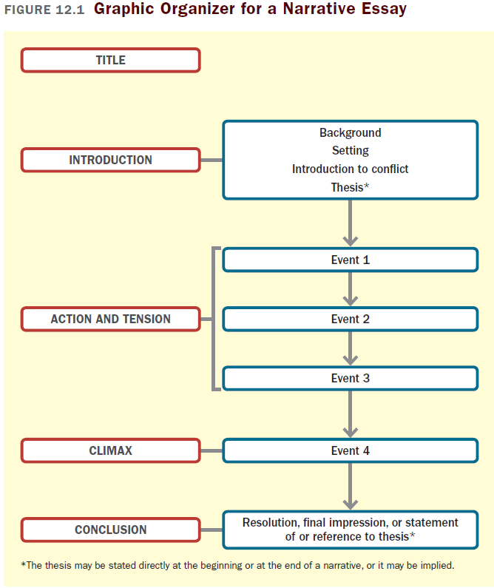

Slide 7
Reading
“Writing about What Haunts Us,” by Peter Orner

Slide 8
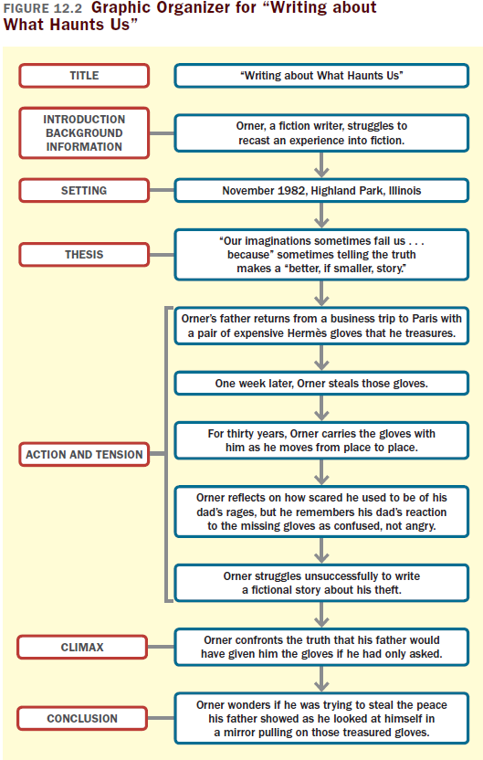

Slide 9
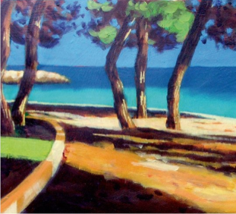
Integrating Narration into
An Essay
Use a story.
Keep the narrative short.
Introduce the story with a transitional sentence or clause.
Use descriptive language, dialogue, and action.

Slide 10
Reading Actively and
Thinking Critically
What to Look For, Highlight, and Annotate
Preview.
Understand the sequence of events.
Think about the meaning.
Consider your reactions.
Analyzing Narratives
How objective is the writer?
What is the writer’s tone?
What does the writer leave unspoken or unreported?

Slide 11
A Guided Writing Assignment
Your Essay Assignment
Prewriting
Select a topic.
Consider your purpose, audience, and point of view.
Gather details about the experience or incident.
Evaluate your ideas to make sure they describe your experience or incident vividly and meaningfully.
(continued)

Slide 12
A Guided Writing Assignment
Organizing and Drafting
Focus and place your thesis effectively.
Choose a narrative sequence.
Write a first draft of your narrative essay.
Revising
Evaluate your draft and revise as necessary.
Editing and Proofreading
Edit and proofread your essay.

Slide 13
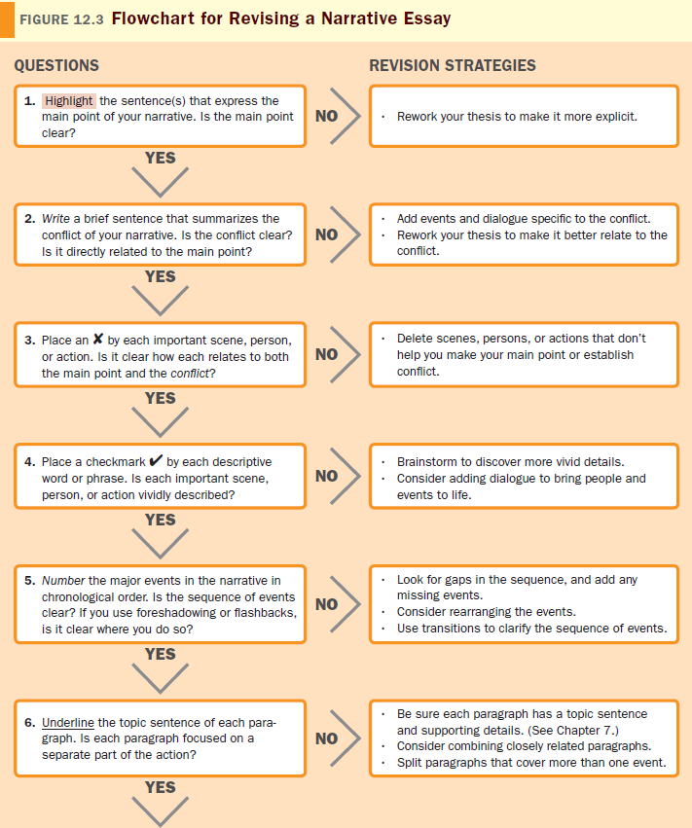
(continued)

Slide 14
