Slide 1
chapter 13
Description: Portraying People, Places, and Things

Slide 2
Contents of Chapter 13
Characteristics of Descriptive Writing
Reading: “Bad Dog,” by Rachel Maizes
Visualizing a Description: A Graphic Organizer
Reading: “You Are Your Bike,” by Mary Roach
Integrating Description into an Essay
Reading Actively and Thinking Critically
What to Look For, Highlight, and Annotate
Analyzing Descriptions
A Guided Writing Assignment

Slide 3
Contents for Chapter 13
Readings: Description in Action
Student Essay: “Heatstroke with a Side of Burn Cream,” by Ted Sawchuck
Description Essay: “Eating Chili Peppers,” by Jeremy MacClancy
Description Combined with Other Patterns: “Speaking Quiché in the Heart of Dixie,” by Gabriel Thompson
Applying Your Skills: Additional Essay Assignments

Slide 4
What Is Description?
Description presents information in a way that appeals to one or more of the five senses—sight, sound, smell, taste, and touch—usually creating an overall impression or feeling.

Slide 5
Characteristics of
Descriptive Writing
Description
uses sensory details:
sight
sound
smell
taste
touch.
uses active verbs and varied sentences.
creates a dominant impression.
uses connotative language effectively.
(continued)

Slide 6
Description (cont.)
uses comparisons.
follows a method of organization:
spatial order
chronological order
most-to-least or least-to-most
clustering details by the five senses.
Reading
“Bad Dog,” by Machel Maizes

Slide 7
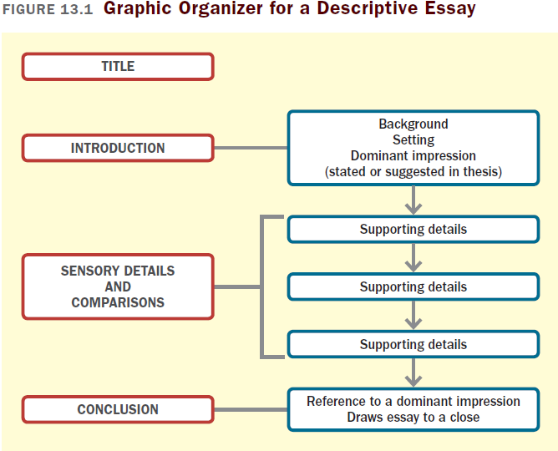

Slide 8
Reading
“You Are Your Bike,” by Mary Roach

Slide 9
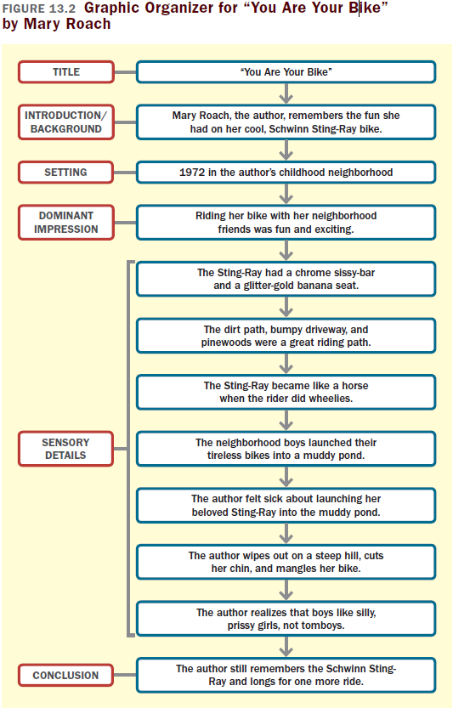

Slide 10
Integrating Description into
An Essay
Include only relevant details.
Keep the description focused.
Make sure the description fits the essay’s tone and point of view.

Slide 11
Reading Actively and
Thinking Critically
What to Look For, Highlight, and Annotate
Preview.
Identify the dominant impression.
Think about the meaning.
Consider your reactions.
Analyzing Descriptions
What is the writer’s attitude toward the subject?
What details does the reader omit?

Slide 12
A Guided Writing Assignment
Your Essay Assignment
Prewriting
Select a topic.
Consider your purpose, audience, and point of view.
Choose an aspect of your subject to emphasize, and collect sensory details.
Evaluate your details.
(continued)

Slide 13
A Guided Writing Assignment
Organizing and Drafting
Create a dominant impression.
Choose a method of organization.
Write a first draft of your descriptive essay.
Revising
Evaluate your draft and revise as necessary.
Editing and Proofreading
Edit and proofread your essay.

Slide 14
