Slide 1
chapter 16
Comparison and Contrast: Showing Similarities and Differences

Slide 2
Contents of Chapter 16
Characteristics of Comparison and Contrast Essays
Reading: “Amusing Ourselves to Depth: Is The Onion Our Most Intelligent Newspaper,” by Greg Beato
Visualizing a Comparison and Contrast Essay: Two Graphic Organizers
Reading: “Dearly Disconnected,” by Ian Frazier
Integrating Comparison and Contrast into an Essay
Reading Actively and Thinking Critically
What to Look For, Highlight, and Annotate
Analyzing Comparison and Contrast

Slide 3
Contents for Chapter 16
A Guided Writing Assignment
Readings: Comparison and Contrast in Action
Student Essay: “Border Bites,” by Heather Gianakos
Comparison and Contrast Essay: “His Marriage and Hers: Childhood Roots,” by Daniel Goleman
Comparison and Contrast Combined with Other Patterns: “Defining a Doctor, with a Tear, a Shrug, and a Schedule,” by Abigail Zuger
Applying Your Skills: Additional Essay Assignments

Slide 4
What are Comparison and
Contrast?
Comparison and contrast involve looking at both similarities and differences.

Slide 5
Characteristics of Comparison
and Contrast Essays
Comparison and Contrast
has a specific audience and a clear purpose:
to express ideas
to inform
to persuade.
considers shared characteristics.
is organized point by point or subject by subject.
fairly examines similarities, differences, or both.
(continued)

Slide 6
Comparison and Contrast (cont.)
makes a point.
considers significant and relevant shared characteristics.
Reading
“How Not to Say the Wrong Thing,” by Susan Silk and Barry Goldman

Slide 7
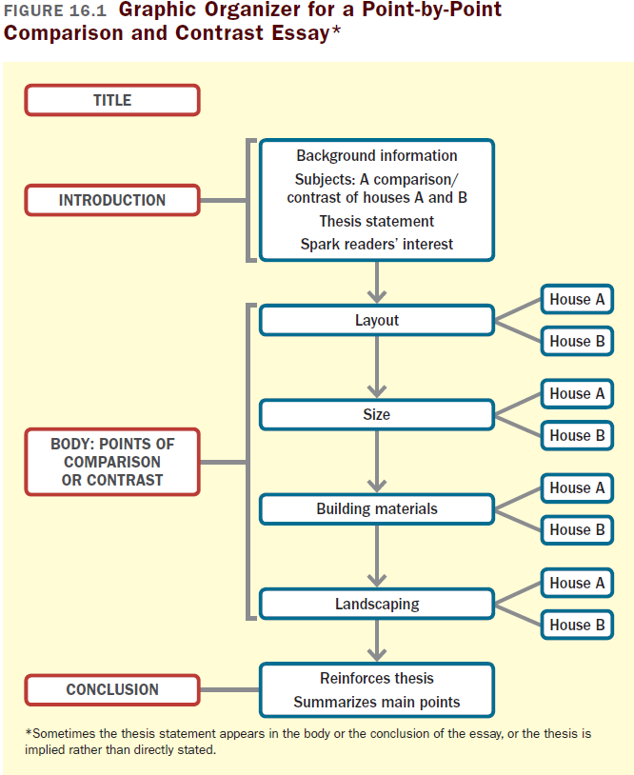

Slide 8
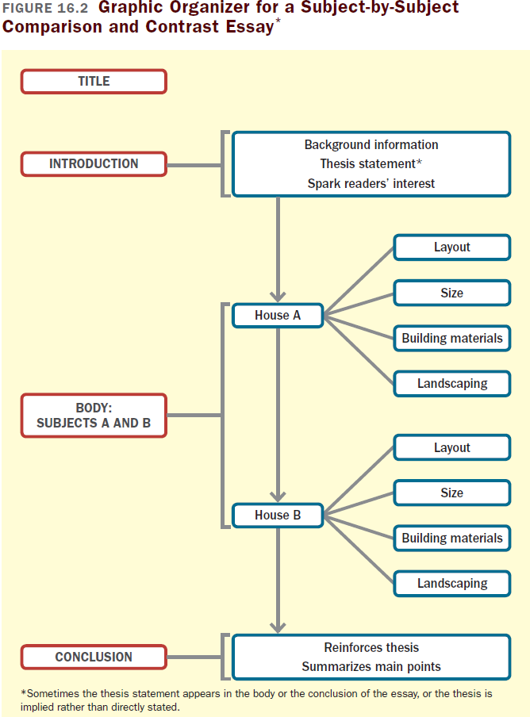

Slide 9
Reading
“Dearly Disconnected,” by Ian Frazier

Slide 10
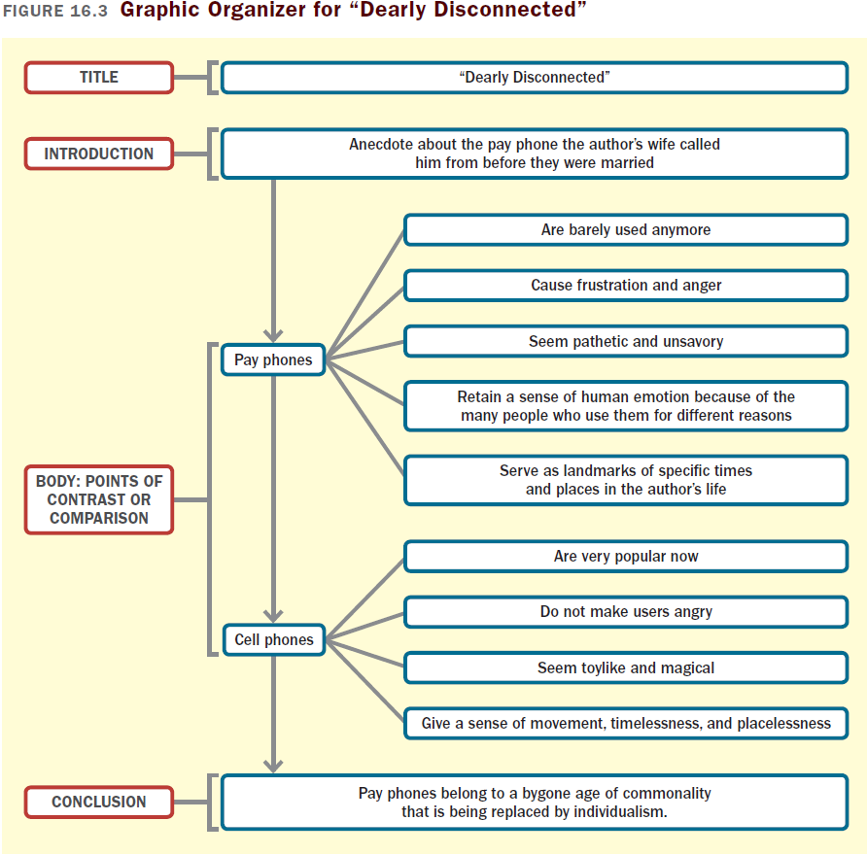

Slide 11
Integrating Comparison and
Contrast into an Essay
Determine the purpose of the comparison or contrast.
Introduce the comparison or contrast clearly.
Keep the comparison or contrast short and to the point.
Organize the points of the comparison or contrast appropriately.

Slide 12
Reading Actively and
Thinking Critically
What to Look For, Highlight, and Annotate
Preview.
Understand the main point.
Identify the basis of comparison and main points of comparison.
Think about the meaning.
Consider your reactions.
Analyzing Comparison and Contrast
Does the author treat each subject fairly and equally?
How does the organization affect meaning?
Are important points of comparison omitted?

Slide 13
A Guided Writing Assignment
Your Essay Assignment
Prewriting
Select a topic.
Consider your purpose, audience, and point of view.
Explore your subjects and develop points of comparison.
(continued)

Slide 14
A Guided Writing Assignment
Organizing and Drafting
Draft your thesis statement.
Choose a method of organization.
Write a first draft of your comparison or contrast essay.
Revising
Evaluate your draft and revise as necessary.
Editing and Proofreading
Edit and proofread your essay.

Slide 15
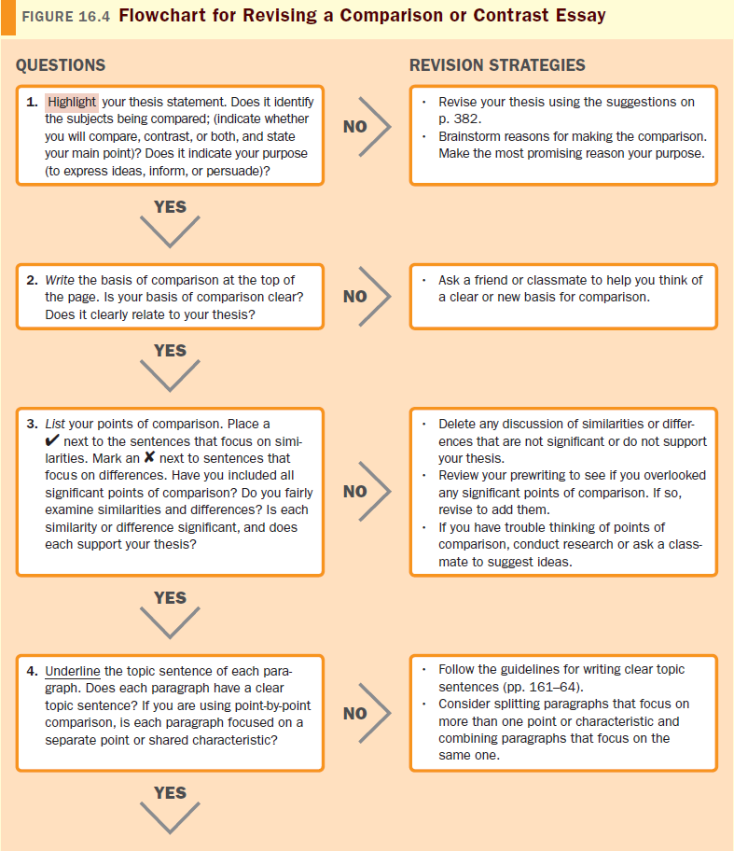

Slide 16
