Slide 1
chapter 17
Classification and Division: Explaining Categories and Parts

Slide 2
Contents of Chapter 17
Characteristics of Classification and Division Essays
Reading: “My Secret Life on the McJob: Fast Food Managers,” by Jerry Newman
Visualizing a Classification or Division Essay: A Graphic Organizer
Reading: “The Language of Junk Food Addiction: How to ‘Read’ a Potato Chip,” by Michael Moss
Integrating Classification or Division into an Essay
Reading Actively and Thinking Critically
What to Look For, Highlight, and Annotate
Analyzing Classification and Division

Slide 3
Contents for Chapter 17
A Guided Writing Assignment
Readings: Classification and Division in Action
Student Essay: “The Use and Abuse of Facebook,” by Allison Cava
Classification and Division Combined with Other Patterns: “The Dog Ate My Flash Drive, and Other Tales of Woe,” by Carolyn Foster Segal
Applying Your Skills: Additional Essay Assignments

Slide 4
What Are Classification and Division?
A classification or division essay explains a topic by describing types or parts.
Classification is a process of sorting people, things, or ideas into groups or categories to help make them more understandable.
Division, conversely, takes one item and breaks it down into parts.

Slide 5
Characteristics of Classification
and Division Essays
Classification and Division
groups and divides ideas according to one principle.
has a clear purpose and audience that drive the writer’s choice of a principle.
uses categories and parts that are exclusive and comprehensive.
fully explains each category or part.
includes a thesis.
Reading
“My Secret Life on the McJob: Fast Food Managers,” by Jerry Newman

Slide 6
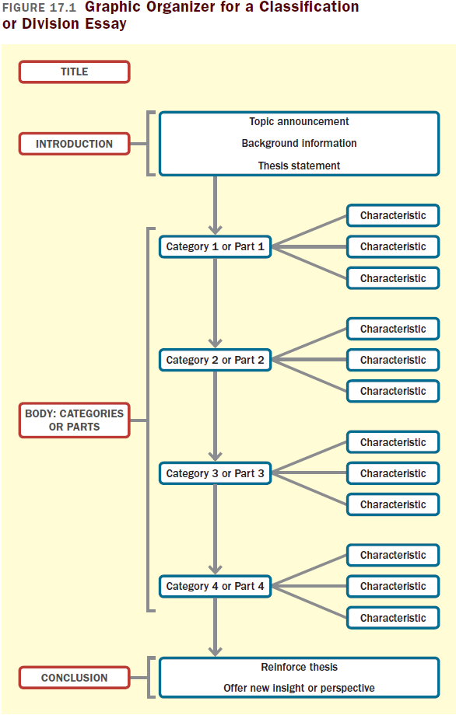

Slide 7
Reading
“The Language of Junk Food Addiction: How to ‘Read’ a Potato Chip,” by Michael Moss

Slide 8
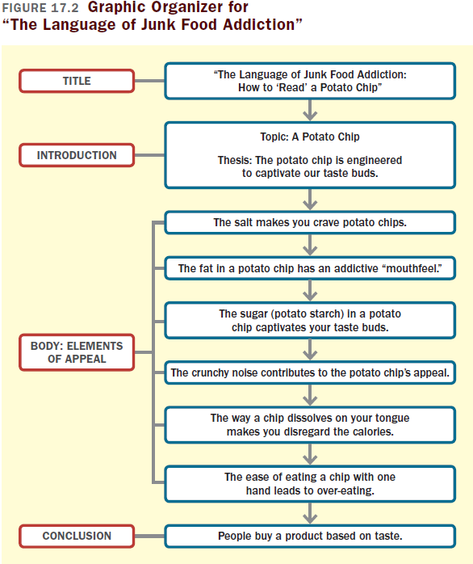

Slide 9
Integrating Classification or
Division into an Essay
Avoid focusing on why the classification or division is meaningful.
State the principle of classification briefly and clearly.
Name the categories or parts.

Slide 10
Reading Actively and
Thinking Critically
What to Look For, Highlight, and Annotate
Preview.
Understand the principle of classification or division and the category or parts use.
Identify how the writer explains each part or category.
Think about the meaning.
Consider your reactions.
(continued)

Slide 11
Analyzing Classification and Division
Does the classification or division cover all significant categories or parts?
Does the writer provide sufficient detail about each category?
Is the principle of classification or division appropriate given the writer’s purpose?

Slide 12
A Guided Writing Assignment
Your Essay Assignment
Prewriting
Select a topic, devise a principle of classification or division, and list the categories.
Consider your purpose, audience, and point of view.
Generate supporting details.
(continued)

Slide 13
A Guided Writing Assignment
Organizing and Drafting
Draft your thesis statement.
Choose a method of organization.
Draft your classification or division essay.
Revising
Evaluate your draft and revise as necessary.
Editing and Proofreading
Edit and proofread your essay.

Slide 14
