Slide 1
chapter 24
Drafting, Revising, and Formatting a Research Project

Slide 2
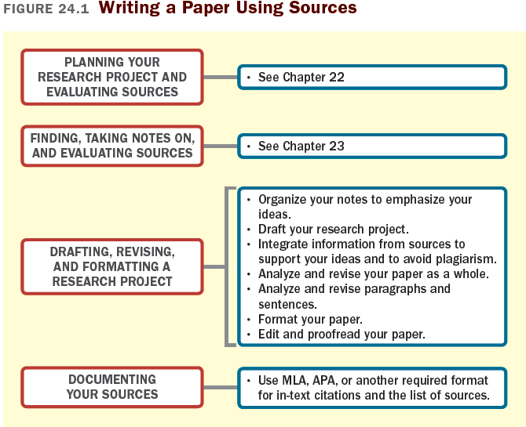

Slide 3
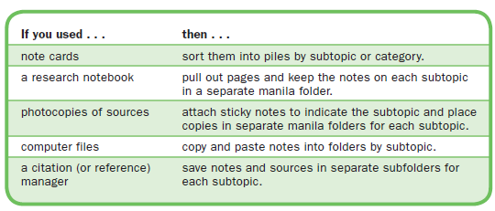
Organizing Your
Research Project
Arrange Your Notes
Develop an Outline or Graphic Organizer

Slide 4
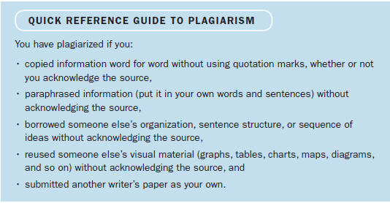
Avoiding Plagiarism
What Is Plagiarism?
Plagiarism is the use of someone else’s ideas, wording, or organization without acknowledgment, whether accidental or deliberate.
(continued)

Slide 5
How to Avoid Plagiarism
Take careful notes
Separate your ideas from your sources’
Never copy and paste directly from online sources
Paraphrase carefully
Record all citation information
Deciding What to Document
Common knowledge is information that is widely available and undisputed.

Slide 6
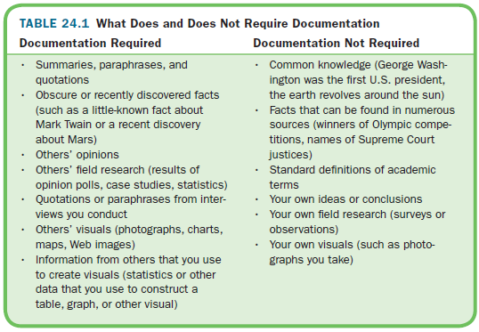

Slide 7
Drafting Your
Research Project
Guidelines for drafting your project:
Remember your audience.
Format with an introduction, (with thesis), body, and conclusion.
Follow your outline or graphic organizer.
Refer to source notes frequently.
(continued)

Slide 8
State and support the main point of each paragraph.
Use strong transitions.
Use source information responsibly.
Include sources purposefully.
Incorporate in-text citations as you draft.
(continued)

Slide 9
Use Research to Support Your Ideas
(continued)

Slide 10
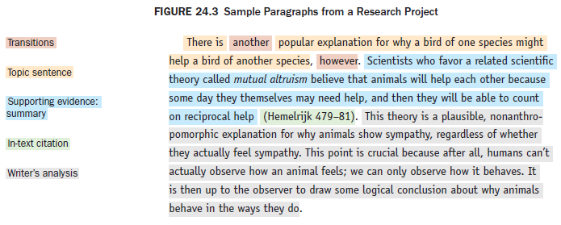
Use In-Text Citations to Integrate Source Information
Use a signal phrase.
Use a parenthetical citation.
(continued)

Slide 11
Integrate Quotations into Your Research Project
Use quotations carefully: when the author’s wording is unusual, noteworthy, or exact.
Format long quotations appropriately.
Punctuate quotations correctly.
Adapt quotations correctly to fit your own sentence constructions.

Slide 12
Revising Your
Research Paper
Analyze and Revise Your Paper as a Whole
Analyze and Revise Paragraphs and Sentences

Slide 13
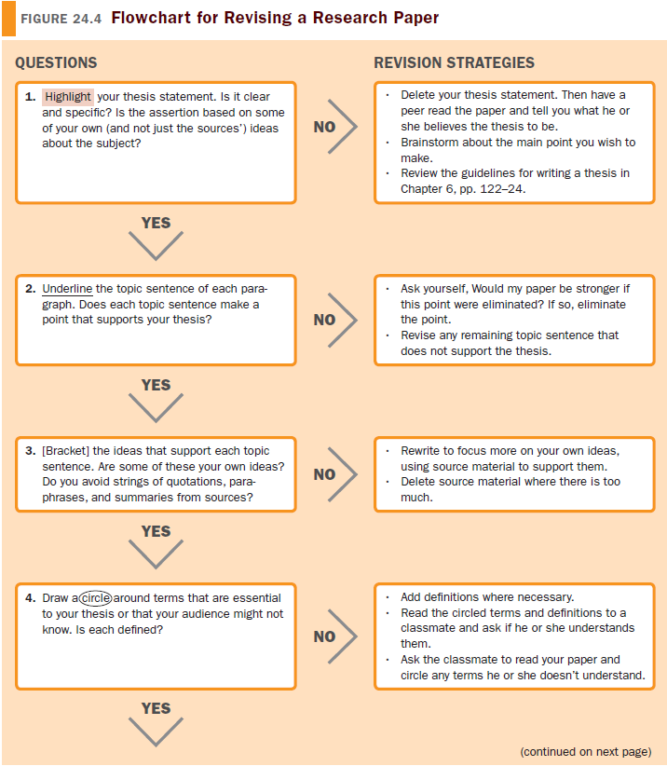

Slide 14
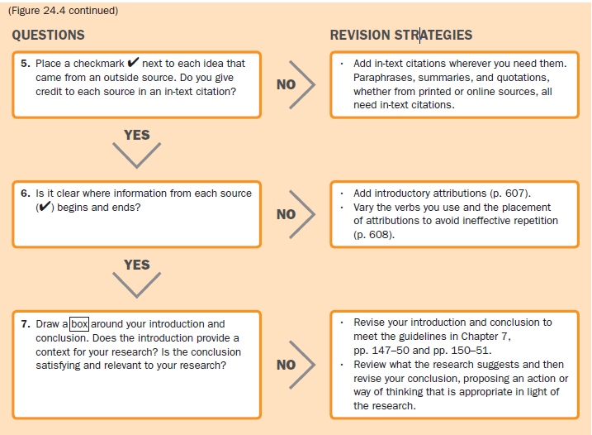

Slide 15
Preparing Your Final Draft
Format your paper.
Edit and proofread your paper.

Slide 16
Documenting Your Sources:
MLA Style
MLA Style for In-Text Citations
Use an attribution (or signal phrase).
Use a parenthetical citation.

Slide 17
MLA Style for the List of Works Cited
List only the sources you cite in your paper.
Put the list on a separate page at the end of your paper.
Alphabetize the list by authors’ last names.
Capitalize the first word and all other words in a title except a, an, the, to, coordinating conjunctions (such as and or but), and prepositions (such as in or on).
(continued)

Slide 18
MLA Style for the List of Works Cited
Italicize titles of books and names of periodicals.
Insert quotation marks before and after the titles of articles, short stories, and other short works.
Give inclusive page numbers of articles in periodicals.
Indent the second and all subsequent lines half an.
Double-space the entire list.

Slide 19
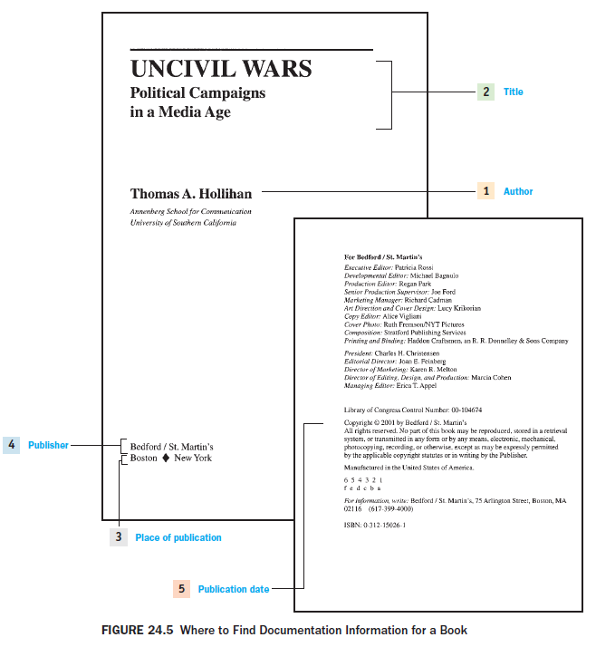

Slide 20
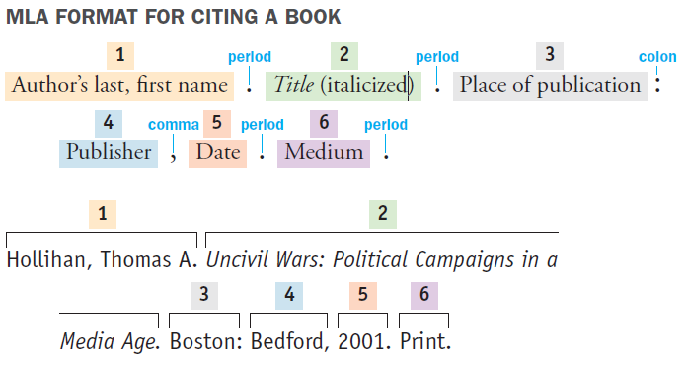

Slide 21
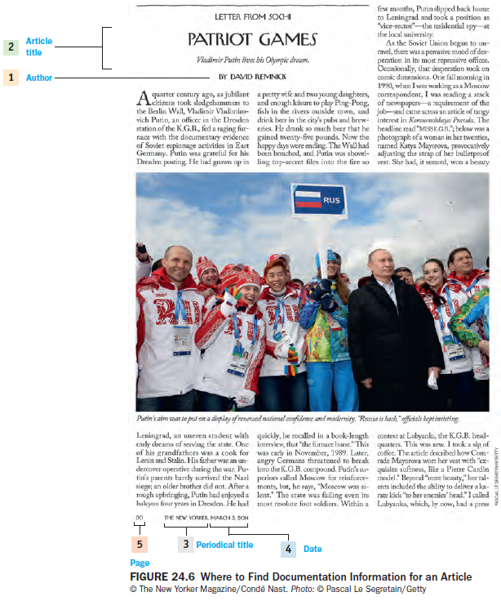

Slide 22
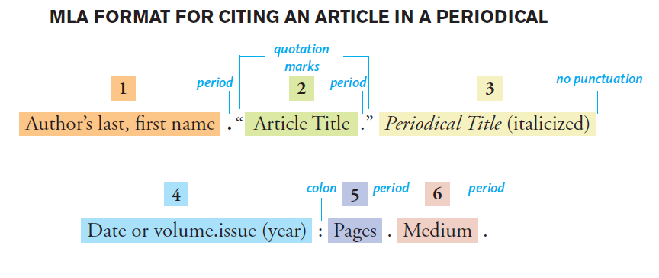

Slide 24
Documenting Your Sources:
APA Style
APA Style for In-Text Citations
Use an attribution and a parenthetical citation.
Use only a parenthetical citation.

Slide 25
APA Style for the List of References
List only the sources you cite in your paper.
Put the list on a separate page at the end of your paper.
Alphabetize the list by authors’ last names.
Put the publication date in parentheses after the author’s name.
Capitalize the first word of the titles of books and articles, the first word following a colon, and any proper nouns.
(continued)

Slide 26
APA Style for the List of References
Include the word A, An, or The at the beginning of titles.
Italicize titles of books and names of journals, newspapers, and magazines.
For magazine and journal articles, italicize the volume number.
Indent the second and all subsequent lines half an inch.
Double-space the entire list.

Slide 27
