Slide 1
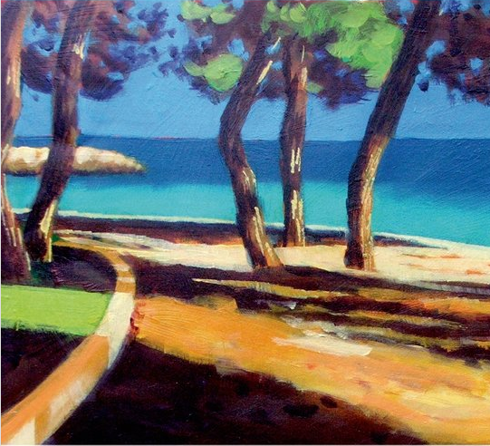
chapter 25
Reading and Writing about Literature

Slide 2
What Is Literary Analysis?
A literary analysis essay (sometimes called literary criticism or a critique) analyzes and interprets one or more aspects of a literary work.

Slide 3
A General Approach to
Reading Literature
Read with an open mind.
Preview the work before reading it.
Read slowly and carefully.
Note that literature often “bends the rules” of grammar and usage.
Establish the literal meaning first.
(continued)

Slide 4
Reread the work to focus on your interpretation.
Anticipate a gradual understanding
Interact with the work.
Identify themes and patterns.
Write one or more paragraphs identifying the conflict, its resolution, and the main theme.

Slide 5
Understanding the
Language of Literature
Similes, Metaphors, and Personification
Symbols
Irony

Slide 6
Analyzing Short Stories
Reading: “The Secret Lion,” by Alberto Rios
Setting
Characters
Point of View
Plot
Theme
Reading: “The Story of an Hour,” by Kate Chopin

Slide 7
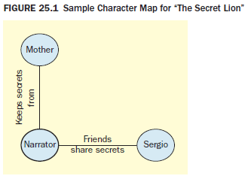
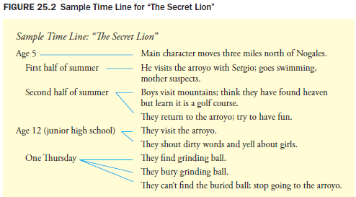

Slide 8
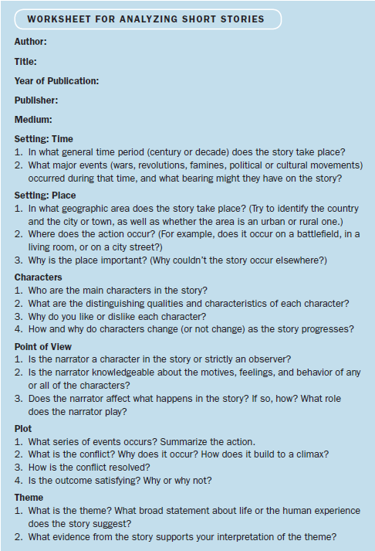

Slide 9
Analyzing Poetry
Read the poem through once.
Use punctuation to guide your comprehension.
Visualize as you read.
Read the poem several more times.
Check unfamiliar references.
Identify the speaker and tone.
(continued)

Slide 10
Identify to whom the poem is addressed.
Analyze the language of the poem.
Analyze the poem’s theme.
Write a response.
Reading: “Two Look at Two,” by Robert Frost
Reading: “How I Discovered Poetry,” by Marilyn Nelson

Slide 11
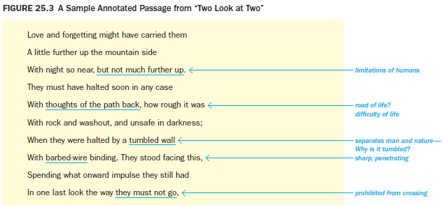

Slide 12
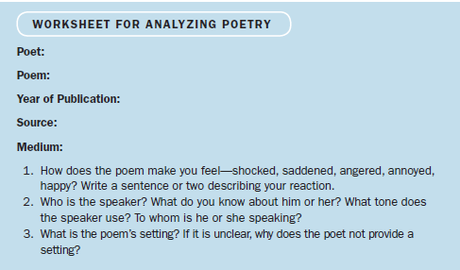
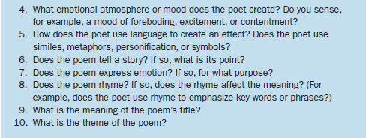

Slide 13
A Guided Writing Assignment
Your Essay Assignment
Prewriting
Read an analyze your writing assignment carefully.
Explore the work of literature and generate ideas.
Conduct background research.
Evaluate your ideas and choose an approach to your literary analysis.
(continued)

Slide 14
A Guided Writing Assignment
Organizing and Drafting
Draft your thesis statement.
Choose a method of organization.
Draft your literary analysis.
Revising
Evaluate your draft and revise as necessary.
Editing and Proofreading
Edit and proofread your essay.

Slide 15
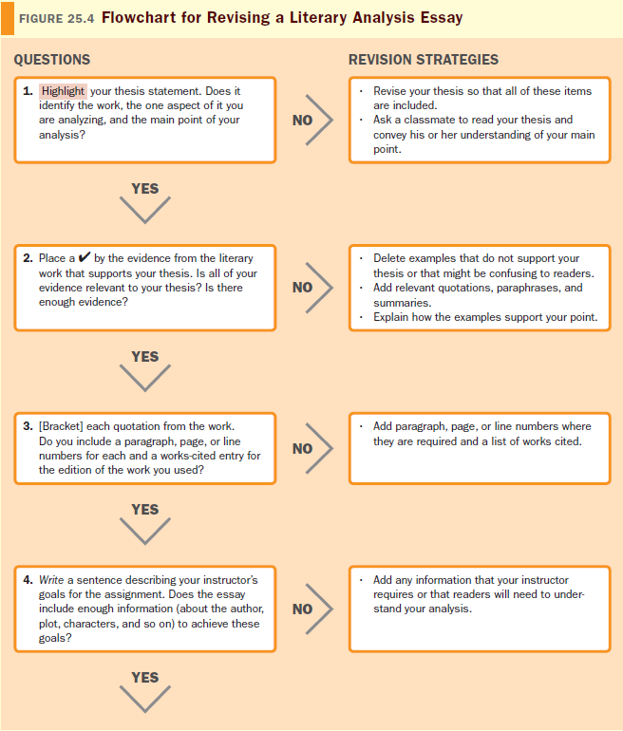
(continued)

Slide 16
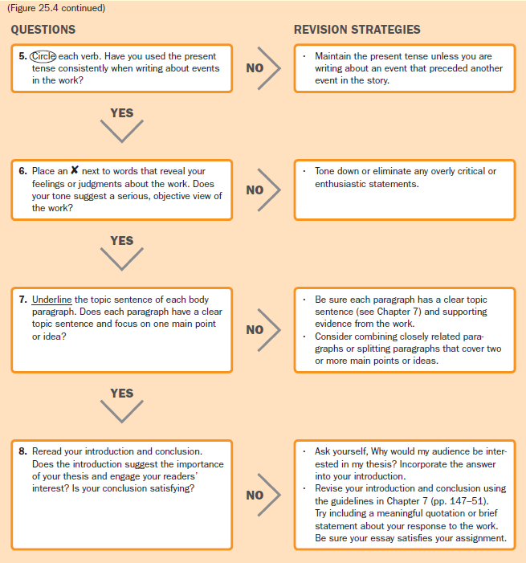

Slide 17
Reading
“The Keeping of ‘The Secret Lion,’” by Andrew Decker

