Slide 1
chapter 27
Multimedia Presentations and Business Writing

Slide 2
Multimedia Presentations
Plan your presentation.
Organize and draft your presentation.
Using presentation software.
Rehearse your presentation.
Overcome apprehension.
Deliver an effective presentation.
Prepare a Web-based presentation.

Slide 3
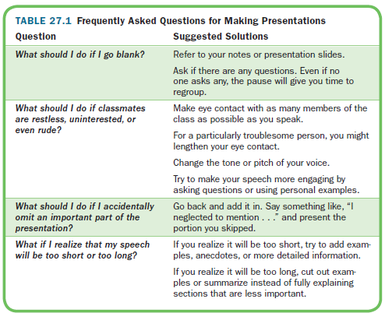

Slide 4
Business Writing
Prepare a Résumé and Job Application Letter
Use Electronic Media for Business Writing

Slide 5
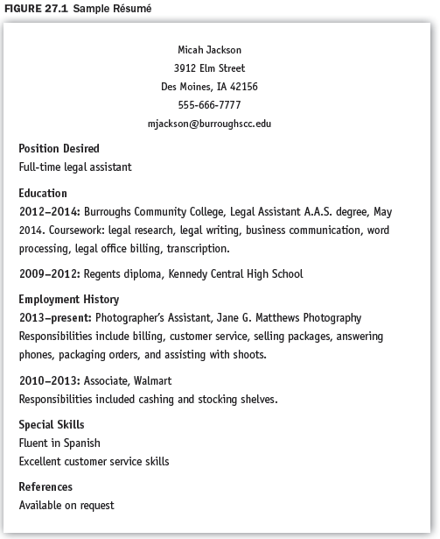

Slide 6
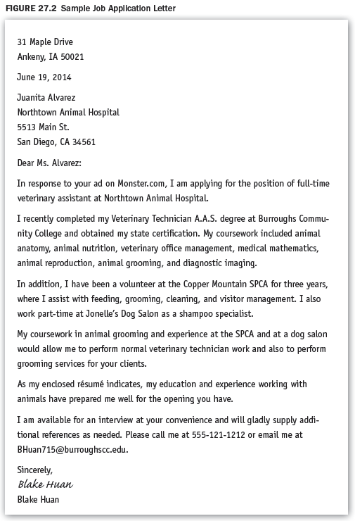

Slide 7
