Slide 1
chapter 3
Reading and
Responding to Text

Slide 2
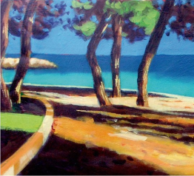
Contents for Chapter 3
Academic Reading: What to Expect
A Guide to Active Reading
Reading: “American Jerk: Be Civil, or I’ll Beat You to a Pulp” by Todd Schwartz
Before Reading
While Reading
After Reading
(continued)

Slide 3
Contents for Chapter 3
A Guide to Responding to Text
Analyze the Assignment and Decide on an Approach
Synthesize the Writer’s Ideas with Your Own
Analyze the Reading
(continued)

Slide 4
Contents for Chapter 3
Working with Text
Reading: “Superhero or Supervillain? If science gives people superpowers, will they use them for good or evil?” by Will Oremus
Analyze Student Essays
Student Essay: “‘American Jerk’? How Rude! (but True)” by Karen Vaccaro

Slide 5
Academic Reading:
What to Expect
Expect to be responsible for your own learning
Expect to read selections for academic audiences
Expect to read selections in different genres and with different purposes
Expect to read critically
Expect to use readings as models
Expect to respond to readings in writing
(continued)

Slide 6
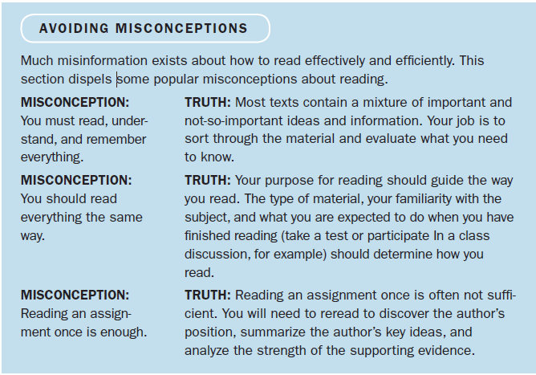

Slide 7
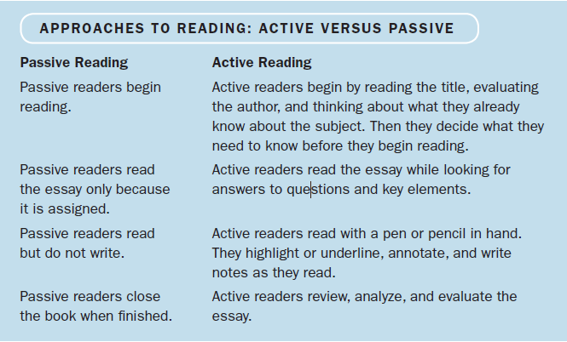
A Guide to Active Reading

Slide 8
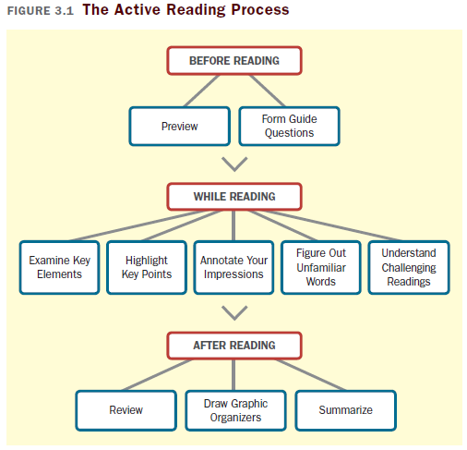

Slide 9
Before Reading
Preview
Read the title, subtitle, and author.
Read the introduction or the first paragraph.
Read any headings and the first sentence following each one. (If there are no headings, read the first sentences in a few paragraphs on each page.)
Look at any photographs, tables, charts, and drawings.
Read the conclusion or summary.
Read any end-of-assignment questions.
Form Questions to Guide Your Reading
Ask questions based on the sections you previewed, then try to answer them as you read.
(continued)

Slide 10
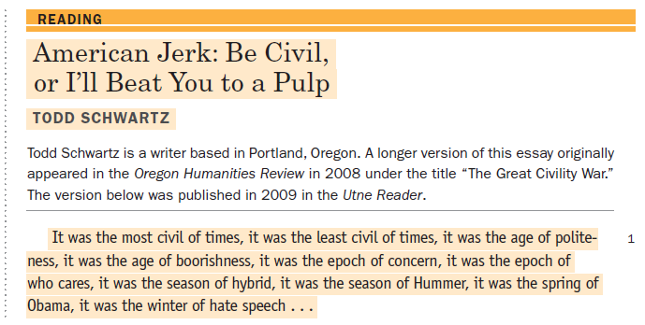
Previewing “American Jerk”

Slide 11
While Reading
Examine Key Elements
Title and subtitle
Introduction
Author’s main point
Support and explanation
Conclusion
Highlight Key Points
Know what you’re looking for
Read first; then highlight
Highlight key elements, words, and phrases
(continued)

Slide 12
Annotate to Record Your Impressions
As you read, jot down any questions that come to mind, personal reactions, or quick summaries of main points.
Figure Out the Meaning of Unfamiliar Words
Instead of going straight to the dictionary, use context clues and look to the parts of the word to find its definition.
Understand Challenging Readings

Slide 13
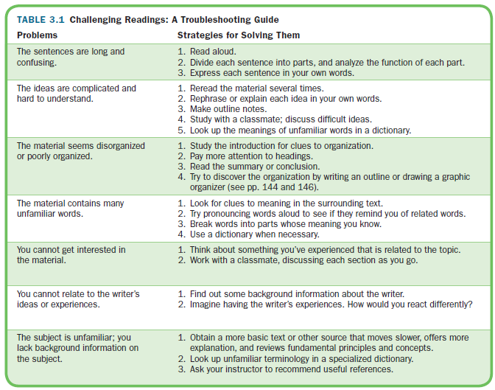

Slide 14
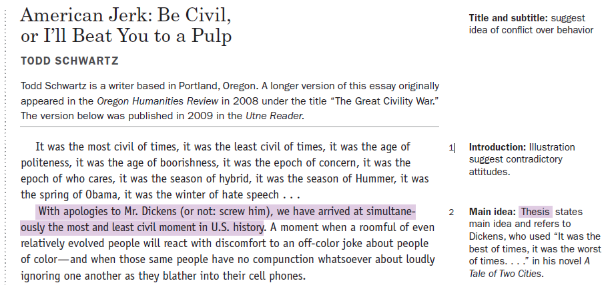
Examining key elements of “American Jerk”

Slide 15
After Reading
Review
Write a short summary of the reading and take a quick look through your annotations and highlighted words and phrases to help lock the information in your memory.
Draw a Graphic Organizer
Create a diagram that shows how the key points are organized throughout the reading.
Summarize to Check Your Understanding
Write a brief restatement of major points to help remember the material and be sure you have understood what you have read.
(continued)

Slide 16
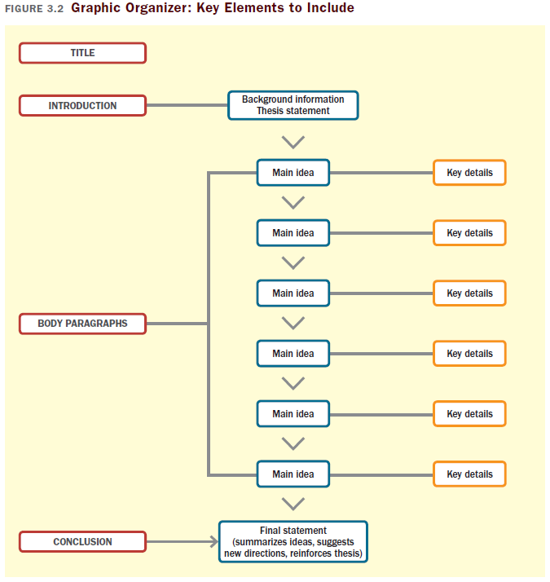

Slide 17
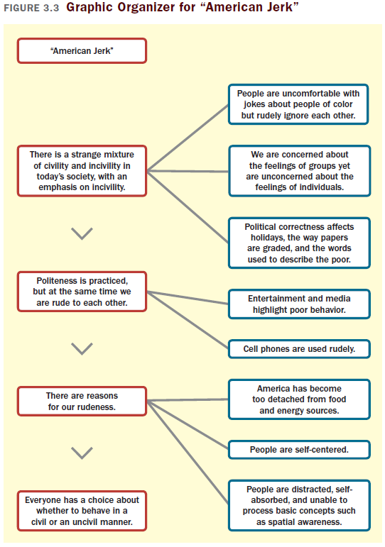

Slide 18
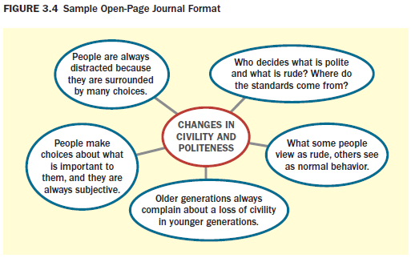
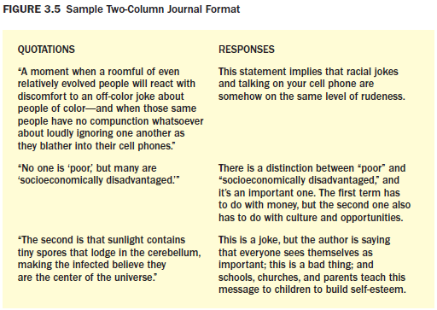
Keep a Response Journal
Keep a record of what you’ve read, including summaries and personal responses, in an open-page or two-column format.
(continued)

Slide 19
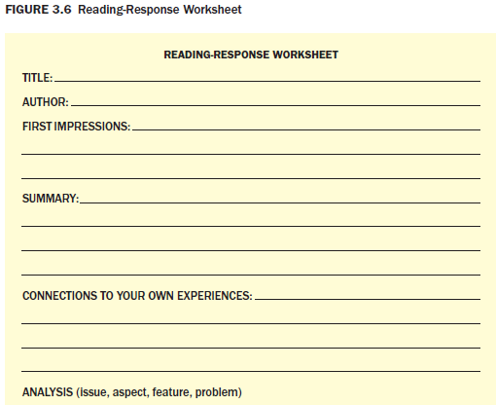
Use a Reading-Response Worksheet
Fill in a worksheet (like the one in Figure 3.6 on p. 58) that guides your reading responses.
Use Your Learning Style
Pay attention to the way you prefer to learn and use strategies related to that learning style to enhance your reading and writing
(cont.)

Slide 20
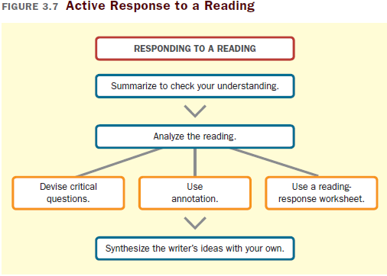
Analyze the Assignment and Decide on an Approach
Before you begin writing your response to a reading, be sure you understand the assignment and your instructor’s expectations
A Guide to Responding
to Text
(continued)

Slide 21
Synthesize the Writer’s Ideas with Your Own
Connect your own ideas and experiences with the ideas you find expressed in the reading and see how you might relate the information to real life, other readings, or your emotional response.
Analyze the Reading
Devise critical questions
Use annotation
Use a reading-response worksheet

Slide 22
Working with Text
Reading
“Superhero or Supervillain? If science gives people superpowers, will they use them for good or evil?” by Will Oremus

Slide 23
Analyze Student Essays
Student Essay
“‘American Jerk’? How Rude! (but True)” by Karen Vaccaro

