Slide 1
chapter 4
Thinking Critically
About Text and Visuals

Slide 2
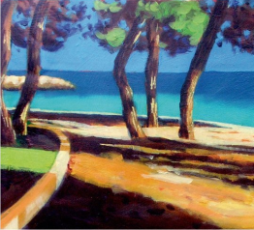
Contents for Chapter 4
Thinking and Reading Critically
Analyze the Author’s Ideas
Analyze the Author’s Language
Analyze the Author’s Assumptions, Generalizations, and Omissions
Use the Patterns of Development to Think and Read Critically
Use Synthesis to Think and Read Critically
Reading Visuals Critically
Reading Photographs Actively
Reading Graphics Actively
Thinking Critically about Photos and Graphics

Slide 3
Thinking and Reading Critically
Analyze the Author’s Ideas
Make reasonable inferences
Assess the evidence
Distinguish fact from opinion

Slide 4
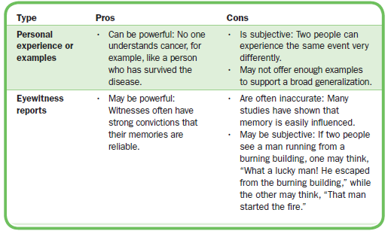
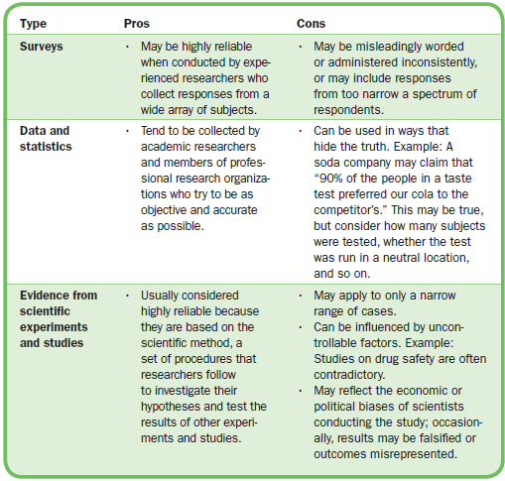
Assess the Evidence

Slide 5
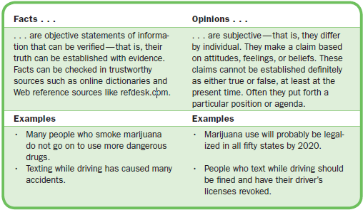
Distinguish Fact from Opinion

Slide 6
Analyze the Author’s Language
Consider denotation (literal meaning) versus connotation (associated meanings)
Assess figurative language
Personification
Symbolism
Simile
Metaphor
Identify euphemisms (Does it use words and phrases that avoid the true words?) and douplespeak (Does it sugar-coat reality?)
(continued)

Slide 7
Analyze the author’s tone

Slide 8
Analyze the Author’s Assumptions, Generalizations, and Omissions
Recognize the author’s assumptions (ideas or principles accepted as truth)
Assess the author’s generalizations (broad claims based on specific examples)
Look for purposeful omissions

Slide 9
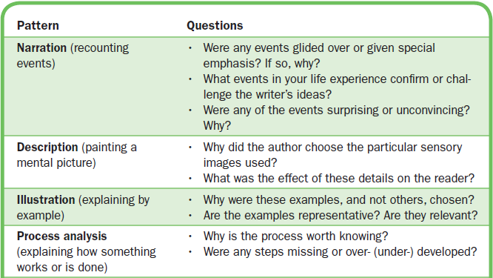
Use the Patterns of Development to Think and Read Critically
(continued)

Slide 10
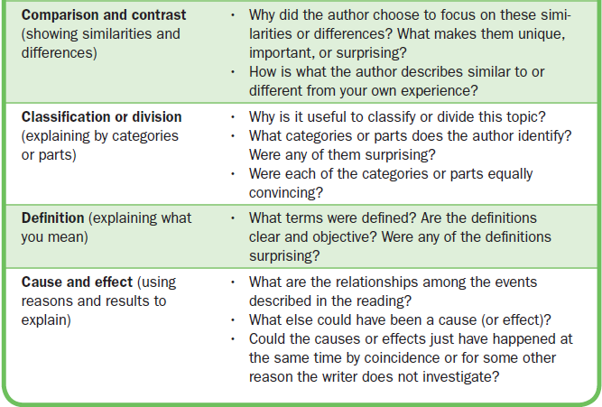
Using the Patterns (cont.)

Slide 11
Use Synthesis to Think and Read Critically
Combine, or merge, information and ideas from sources with your own knowledge and experience
Test what you learn from your sources against your own ideas and knowledge

Slide 12
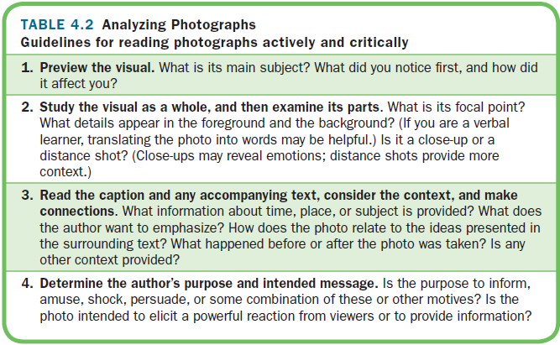
Reading Visuals Critically

Slide 13
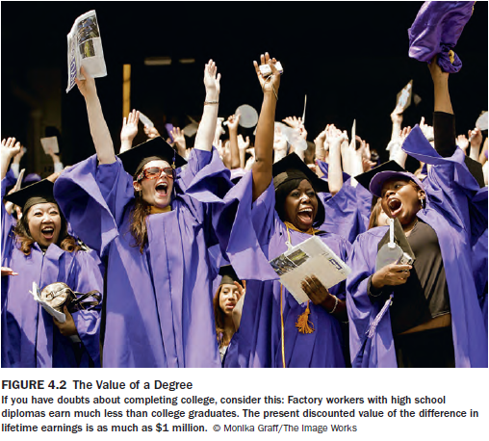

Slide 14
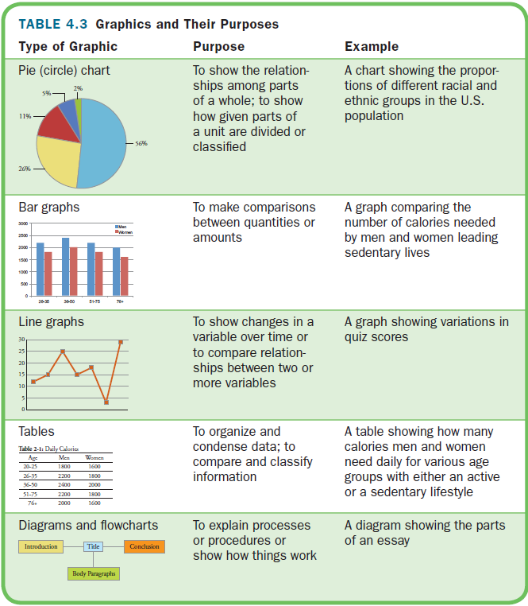
Read Photographs and Graphics Actively

Slide 16
Think Critically about Photos and Graphics
Use the same guidelines as when you examine words you read.
Check to see whether the photos or graphics distort information by cropping or skewing information in line or bar graphs.

Slide 17
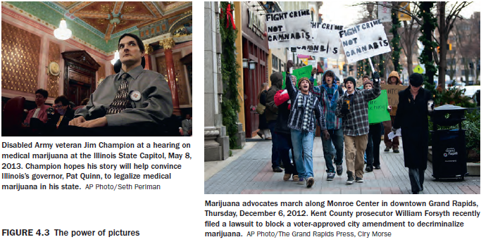

Slide 18
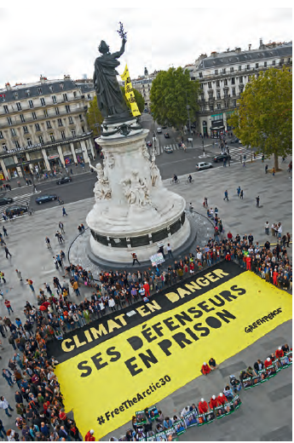
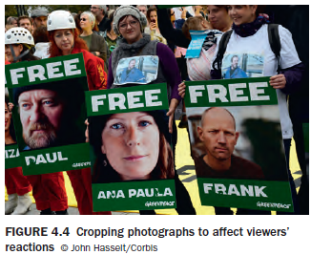

Slide 19
