Slide 1
chapter 7
Drafting an Essay

Slide 2
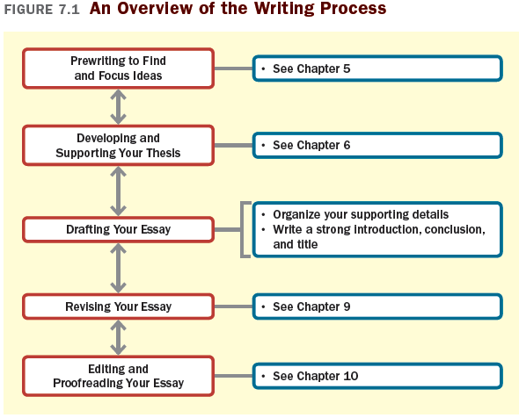
The Structure of an Essay

Slide 3
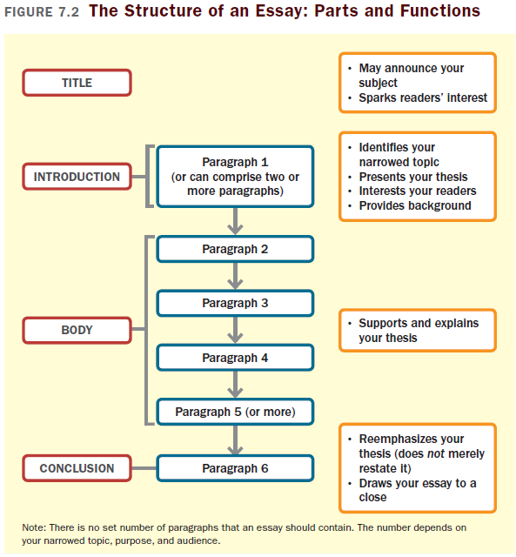

Slide 4
Organizing Your Supporting Details
Select a method of organization:
Most-to-least or least-to-most important order
Chronological (time) order
Spatial order

Slide 5
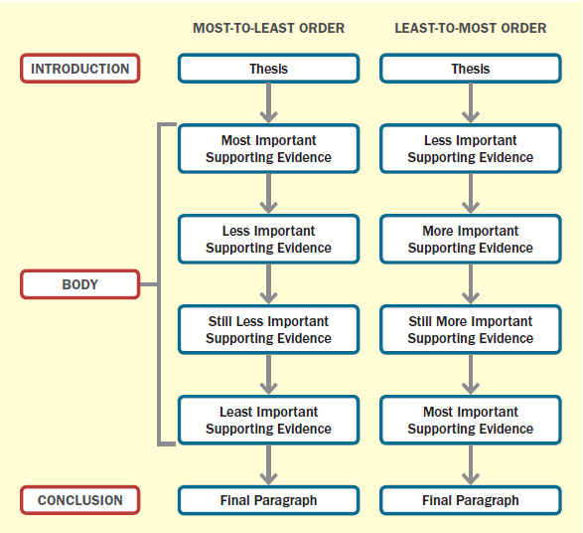
Most-to-Least (or Least-to-Most) order

Slide 6
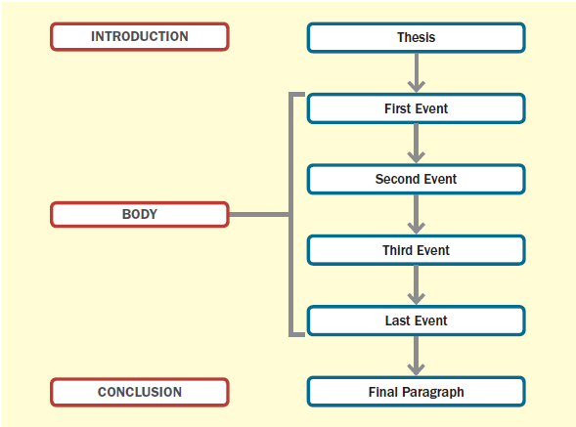
Chronological Order

Slide 7
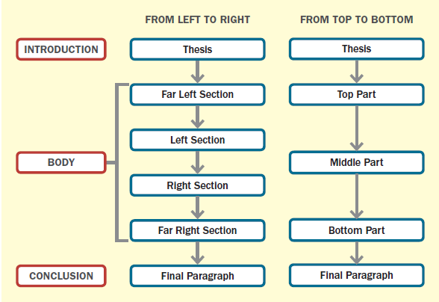
Spatial Order

Slide 8
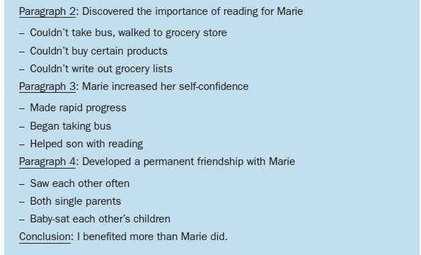
Prepare an Outline or a Graphic Organizer
Informal outline: Use key words and phrases to list main points and subpoints

Slide 9
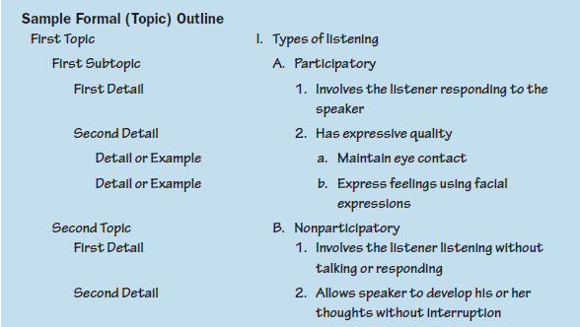
Formal outline: Use key words and phrases to list main points and subpoints
Graphic Organizer: Sketch a visual outline of your essay using lines and brackets to show different elements and levels of importance

Slide 10
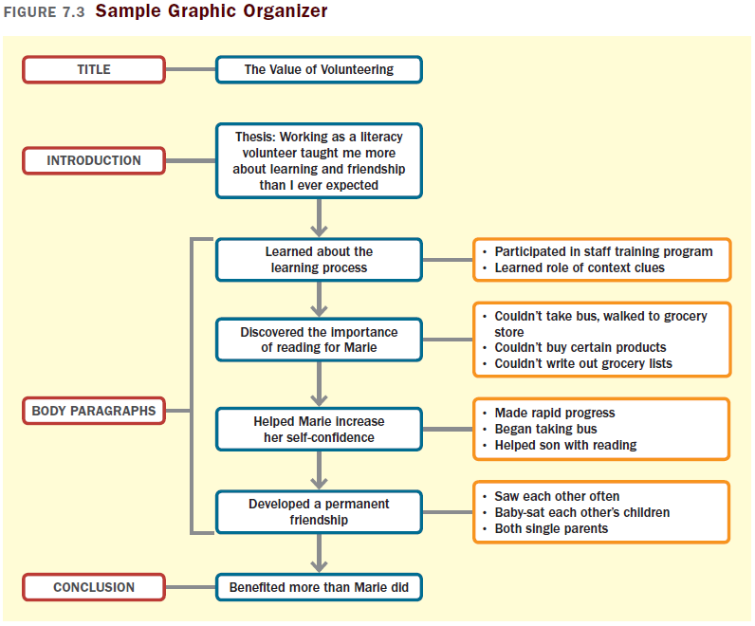

Slide 11
Writing Your Introduction, Conclusion, and Title
Writing a Strong Introduction
An introduction should
Establish your topic and your focus, approach, and point of view
Set the tone of your essay
Interest your reader
Present your thesis statement

Slide 12
Suggestions for a Strong Introduction
Ask a provocative or disturbing question
Begin with a story or anecdote
Offer a quotation
Cite a little-known or shocking fact or statistic
State a commonly held misconception or a position that you oppose
Describe a hypothetical situation
Make a comparison to a familiar or interesting topic

Slide 13
Writing an Effective Conclusion
A conclusion should
Reiterate (without directly restating) the importance of the thesis
Bring the essay to a satisfying close

Slide 14
Suggestions for a Strong Conclusion
Take your readers beyond the scope of your essay
Remind readers of the relevance of the issue.
Offer a recommendation or make a call to action.
Discuss broader implications.
Conclude with a fact, a quotation, an anecdote, or an example that emphasizes your thesis.

Slide 15
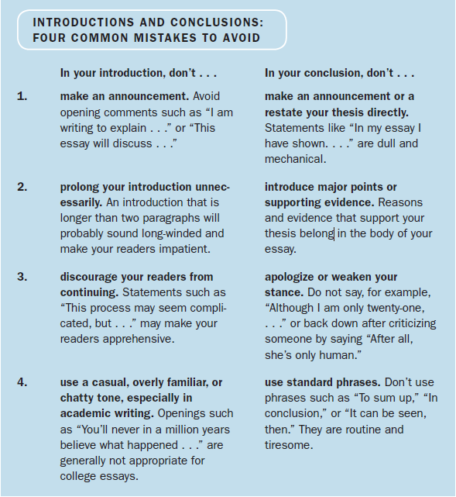

Slide 16
Writing a Good Title
A title should
Suggest your topic
Spark readers’ interest
Suggestions for a Good Title
Write straightforward, descriptive titles for most academic essays.
Ask a question that your essay answers.
Use alliteration.
Use a play on words or a catchy or humorous expression for less formal essays.
Avoid broad, vague titles that sound like labels (such as “Baseball Fans” or “Gun Control”).

