Slide 1
chapter 9
Revising Content and Organization

Slide 2
Why Revise?
Revision is a process of making changes to improve both what your essay says and how it is said.
Why Revise?
Revision can make the difference between a C and an A paper.
It will help you streamline and clarify your ideas.
It can bring to light organizational or structural issues in your essay.

Slide 3
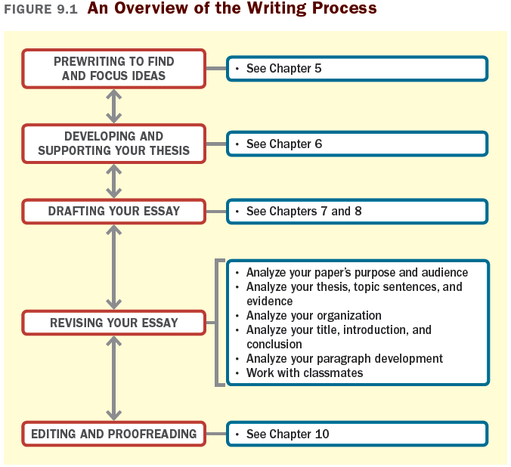

Slide 4
Allow time between drafting and revising.
Read your draft aloud.
Ask a friend to read your draft aloud to you.
Seek the opinions of classmates.
Look for consistent problem areas.
Use a typed and printed copy.
Draw a graphic organizer or an outline.
Useful Techniques
for Revision

Slide 5
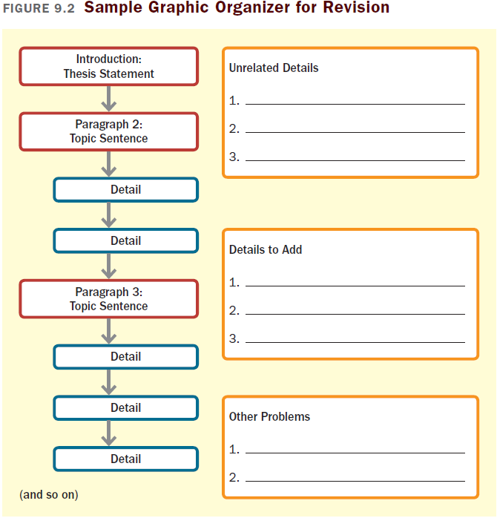

Slide 6
Does your essay clearly convey a purpose, address an appropriate audience, and state a thesis?
Do you have enough reasons and evidence to support your thesis?
Do the ideas in your essay fit together?
Is each paragraph well developed?
Does your essay have a strong introduction and conclusion?
Key Questions for Revision

Slide 7
Analyzing Your Purpose and Audience
Write a sentence stating what your paper is supposed to accomplish. If you can’t write such a sentence, do some brainstorming to find a clear purpose.
Write a sentence or two describing your intended readers. If you are unable to do so, imagine a particular audience and revise your essay with them in mind.

Slide 8
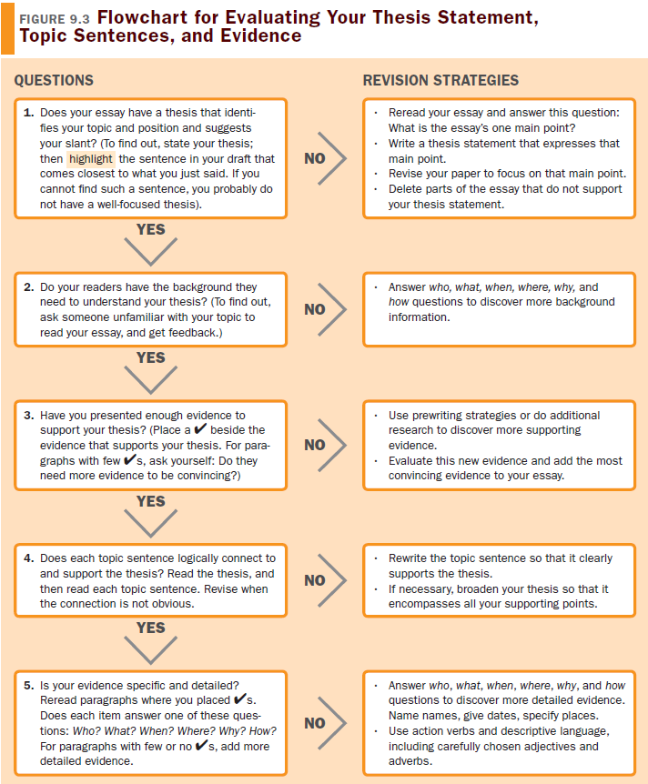
Analyzing Your Thesis, Topic Sentences, and Evidence

Slide 9
Analyzing Your Organization
Use your graphic organizer or an outline of your draft to analyze the draft’s organization and discover any flaws.
Ask a classmate to read your draft and explain to you how your essay is organized. If he/she can’t describe your essay’s organization, you have work to do.

Slide 10
Analyzing Your Introduction, Conclusion, and Title
Will your introduction interest your reader and provide needed background information?
Will your conclusion draw your essay to a satisfactory close and reinforce your thesis statement?
Does your title accurately reflect the content of your essay?

Slide 11
Analyzing Your Paragraph Development
Study each paragraph separately in conjunction with your thesis statement. Does each paragraph clearly support your thesis?
Do any of your paragraphs contain irrelevant information or lack a clearly focused topic sentence?

Slide 12
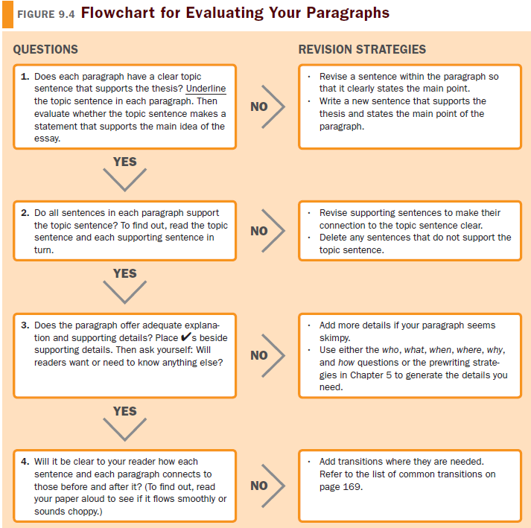

Slide 13
Find a Good Reviewer
Classmates who know the material
Someone outside of the class who has taken and done well in the class
Writing center tutors
Working with Classmates
to Revise Your Essay

Slide 14
Suggestions for the Writer
Be sure to provide a readable copy.
Do some revision yourself first.
Offer specific questions or guidelines to your reviewer.
Be open to criticism and new ideas.
Don’t feel obliged to accept all of the advice you are given.

Slide 15
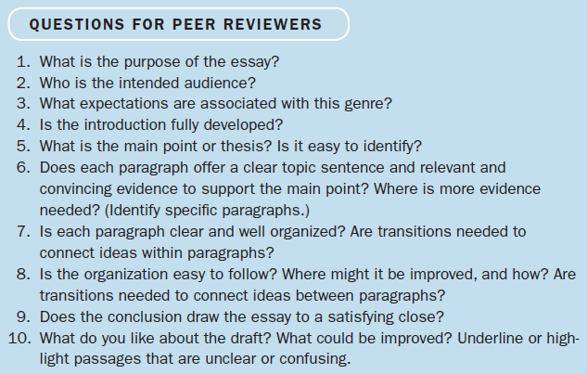

Slide 16
Suggestions for the Reviewer
Read the draft through completely before making any judgments or comments.
Concentrate on content; pay attention to what the paper says.
Offer some positive comments.
Be specific.
Use questions from the writer (and Questions for Peer Reviewers) to guide your review.
(continued)

Slide 17
Write notes and comments directly on the draft. At the end, write a note that summarizes your overall reaction, pointing out both strengths and weaknesses.
If you are reviewing a draft on a computer, use the software’s Comment feature, type your comments in brackets following the appropriate passage, or highlight them in some other way.
Do not rewrite paragraphs or sections of the paper.

Slide 18
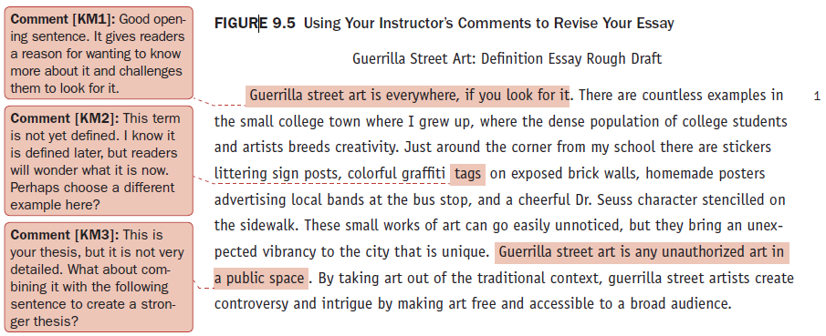
Using Your Instructor’s Comments
Revising an Essay Using Your Instructor’s Comments
Read your instructor’s comments carefully. They can provide a roadmap for revision. Consider the example below:

Slide 19
Using Your Instructor’s Comments to Improve Future Essays
Reread your essay more than once.
If you did not get a high grade, try to determine why.
For grammar errors, make sure you understand (and can correct) the error.
Record grammar errors in your error log.
Highlight or mark weaknesses that your instructor identified.
If any of your instructor’s comments are unclear, first ask a classmate if he or she understands them.

Slide 20
Considering Your Learning Style When You Revise
Tips for Various Learning Styles
If you are an independent learner, you may need extra time for reflection between drafting and revising.
If you are a social learner, discuss your revision plan with classmates.
If you are a verbal learner, use outlining to evaluate your paper’s organization.
If you are a spatial learner, a graphic organizer is a better bet.

Slide 21
If you are a rational learner, focus on livening your essay with vivid descriptions and personal examples where appropriate.
If you are an emotional learner, though, make sure you state your ideas directly.
If you are a concrete learner, make sure the big picture elements—the thesis and topic sentences—are clearly stated.
If you are an abstract learner, make sure you have enough supporting details.

