Slide 1
Coral Reefs
A Presentation by Lauren Mack

Slide 2
Standing in my staff shirt at the top of the Giant Ocean Tank at the New England Aquarium, I get asked plenty of questions. The answers to most of them are easy, like the species of turtles found in the exhibit or the size of the tank itself. Recently, though, I was asked a question that left me speechless:
“Why is this tank here?”
My first instinct was to reply, “Why not?,” but then I began to think: Why IS it here?

Slide 3
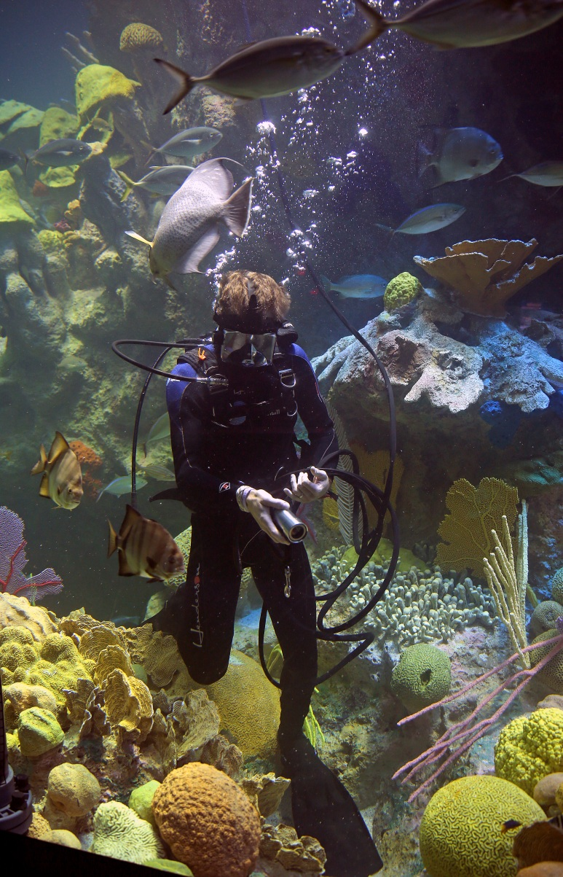
The Giant Ocean Tank
The Giant Ocean Tank (GOT) at the New England Aquarium (NEAq) is a 200,000-gallon exhibit that is meant to replicate a Caribbean coral reef ecosystem. It proudly boasts over 2,000 animals of about 130 different species coexisting around a fake reef—that meaning corals made of fiberglass instead of living creatures surrounded by calcium carbonate.
Knowing all this, it would make sense to find reefs of the same splendor down in the warm tropical waters of the Caribbean; so then why did they seem so drastically different when I went to explore them myself in the Florida Keys? The answer could lie within the choice of color used to paint the corals, yes; but there is something bigger happening here. Coral reefs are dying at an alarming rate—not just in the Caribbean, but around the world [15]. It is estimated that as much as 80% of Caribbean coral has been lost in recent years, and that figure could rise if something is not done to fix this problem [8], which raises the question: What ARE we doing?
Fig. 1: A diver in the GOT.
Source: Boston Globe/Getty Images

Slide 4
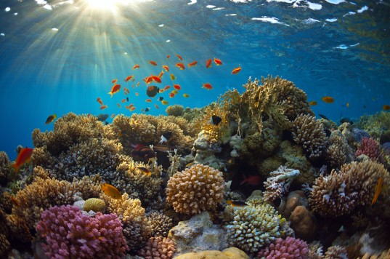
Rainforests of the Ocean
Despite covering less than 1% of the ocean floor, reefs are home to over 25% of the world’s fish biodiversity; even large fish that are mostly thought of as pelagic (meaning deep, open water fish) will spend the first part of their lives in the protection of the reef [2][8].
With such high rates of biodiversity, coral reefs have been heralded as the “rainforests of the ocean” [1].
Fig. 2: Many would agree that coral reefs are beautiful, magical even; but they serve a much bigger purpose than merely being aesthetically pleasing to humans. Source: http://assets.inhabitat.com/wp-content/blogs.dir/1/files/2012/09/coral-reef.jpeg
Fig. 3: This graphic depicts the levels of biodiversity in various parts of the ocean. Note that the high figures on the chart coincide with coral reef environments. Source: http://marinebio.org/oceans/coral-reefs.asp

Slide 5
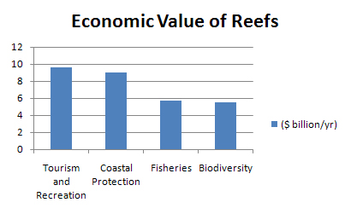
Importance to Humans
Coral reefs have an estimated worth of $30 billion worldwide [9]. Should coral reefs disappear, it is likely that there would be a significant backlash in the fishing industry since a large portion of marine life that we eat—such as snapper, grouper, scallop, and many more are found in those habitats [2].
Those in the fishing industry aren’t the only ones making a living off these beautiful ecosystems. In addition to providing food, they also boost their local economies by providing jobs in ecotourism through scuba diving, snorkeling, and recreational fishing [9][1].
Coral reefs also have a reputation for saving us in more ways than one. Not only do reef structures protect our shoreline communities from maritime destruction, but scientists have also discovered that reefs hold a huge potential for medical advancements with compounds found only in coral reef environments [1].
Fig. 4: A chart depicting the difference economic values of coral reefs. Source: NOAA, http://coralreef.noaa.gov/aboutcorals/values/

Slide 6
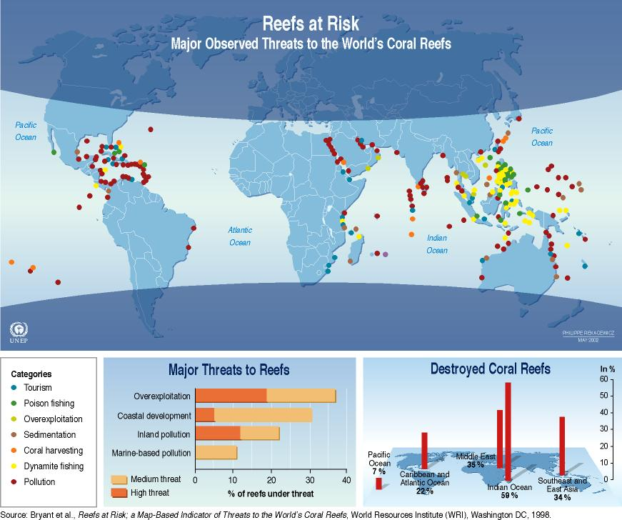
Threats to Coral Reefs
Coral reefs were once a resilient ecosystem, easily overcoming natural disasters like hurricanes and tsunamis. Lately, coral reefs have been faced with much tougher challenges. Many human activities, such as fishing and tourism, impact reefs in a negative way. One of the biggest threats to coral reefs, especially in the U.S., is pollution [4][8].
Fig. 5: Reefs around the world are at risk for a variety of reasons. Source: www.coralreef.noaa.gov

Slide 7
Pollution Problems
Pollution has led to events such as global climate change and rising ocean temperatures, making it one of the major factors contributing to the loss of coral reef ecosystems [14].
Reef problems associated with pollution include:
Bleaching
Ocean Acidification
Marine Debris

Slide 8
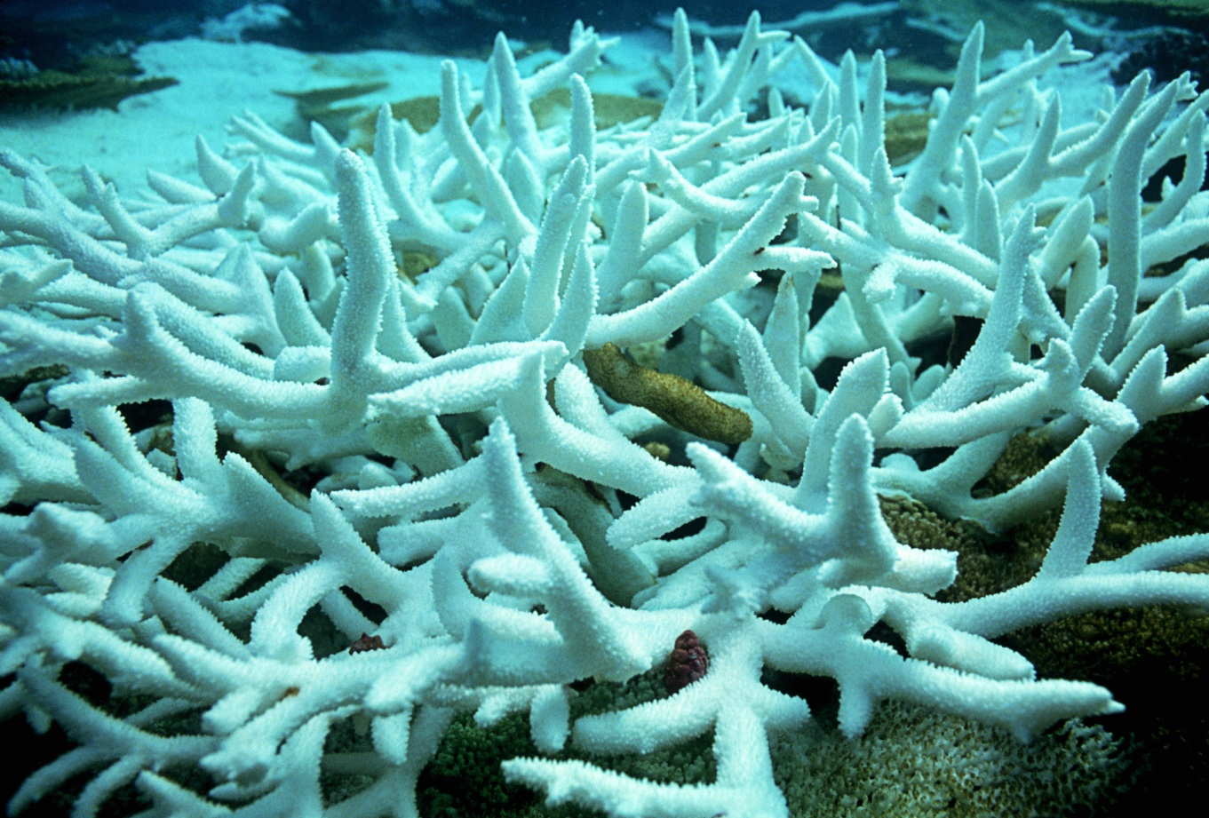
Coral Bleaching
Large CO2 emissions have led to overall ocean temperatures that have risen a little over 1ºF [4][17]. While this may seem like a negligible amount to some, it can have devastating effects on the life below the surface. This increase is already being seen with corals in a phenomenon known as bleaching. Coral bleaching is when corals lose their characteristic bright colors and it has been sighted in reefs around the world [6][15].
Bleaching means exactly what you think. are cWhile there is no actual “bleach” involved, corals affected by bleaching haracterized by their bone-white appearance, as shown by the coral on the right in Fig. 7.
Fig. 6: Bleached coral
Source: Peter Scoones/Science Source

Slide 9
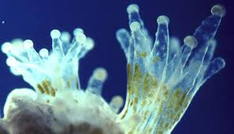
Coral Bleaching (cont.)
Corals have a symbiotic relationship with the photosynthetic algae, known as zooxanthellae, that live within their tissue and give them their characteristic bright colors. The corals protect the zooxanthellae, and in return the zooxanthellae provide food and oxygen that the corals then consume—similar to the way a plant uses chloroplasts to photosynthesize [3].
When corals detect a change in their environment, such as a rise in temperature, they become stressed and expel their zooxanthellae, which leaves the coral white and deprived of food and nutrients [14].
Fig. 7: This animation depicts the symbiotic relationship between coral polyps and zooxanthellae.
Source: www.oceanservice.noaa.gov
Fig. 8: A close-up of a coral polyp; you can see the tiny zooxanthellae within its tentacles. Source: http://ocean.si.edu/corals-and-coral-reefs

Slide 10
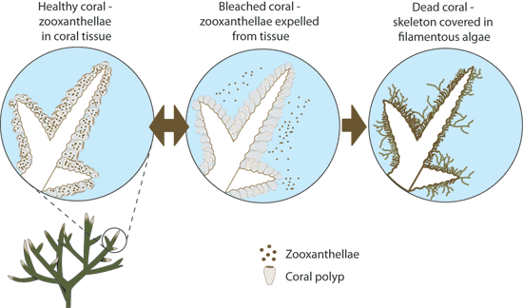
Coral Bleaching (Cont.)
While bleaching does not necessarily kill corals, it leaves them in a vulnerable position that can seriously damage an ecosystem; for example, NOAA mentions a huge bleaching event in the Caribbean in 2005:
“In 2005, the U.S. lost half of its coral reefs in the Caribbean in one year due to a massive bleaching event. The warm waters centered around the northern Antilles near the Virgin Islands and Puerto Rico expanded southward. Comparison of satellite data from the previous 20 years confirmed that thermal stress from the 2005 event was greater than the previous 20 years combined” [8].
If the stressful conditions that caused the bleaching subside, then the zooxanthellae will return and the colony will continue to grow, but if other pressures are present then the reef will suffer, as shown in Fig. 10 [10].
Fig. 9: This graphic illustrates the timeline of coral bleaching. Note how the coral can recover from becoming bleached. Source: http://ecosystemsatrisk.wikispaces.com

Slide 11
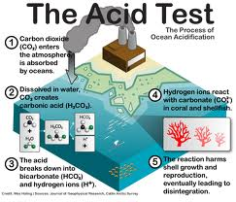
Ocean Acidification
Ocean acidification is caused by the absorption of carbon dioxide into the world’s oceans, causing the oceans’ pH to steadily decrease. This poses a severe threat to any calcifying organism, since a low pH can dissolve the bonds that binds its calcium carbonate shell or exoskeleton together and prevent the animal from building any further [17].
Corals build their skeletons out of calcium carbonate, making them one of the animals vulnerable to acidic oceans [5][10].
In simpler terms, the more CO2 that is released into the atmosphere, the higher the rate at which the ocean becomes more acidic due to carbonic acid.
Fig. 10: This picture depicts the carbon cycle and outlines the issues associated with too much CO2 in the air. Source: earthjustice.org

Slide 12
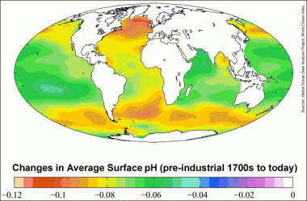
Ocean Acidification (cont.)
Studies show that such high levels of CO2 are actually changing the chemistry of the ocean. It is estimated that the oceans absorb a third of all CO2 emissions— that’s roughly 22 million tons a day! [17] Regarding ocean acidification, UNESCO states:
“Ocean acidity has increased by 30% since the beginning of the Industrial Revolution. This increase is 100 times faster than any change in acidity experienced by marine organisms for at least the last 20 million years” [5].
Fig. 11: This image shows how much the average surface pH has gone down since the pre-industrial era.
Source: insideclimatenews.org
We have yet to learn how to reverse the process of ocean acidification, but scientists and lawmakers are working to at least slow it down.

Slide 13
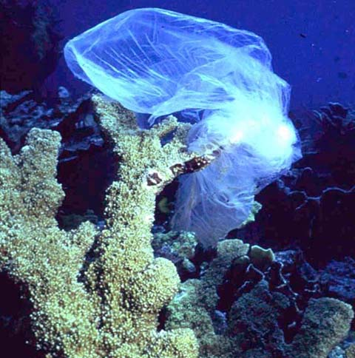
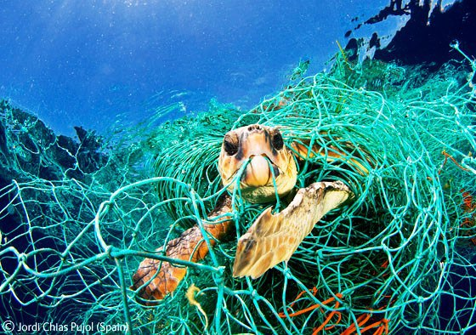
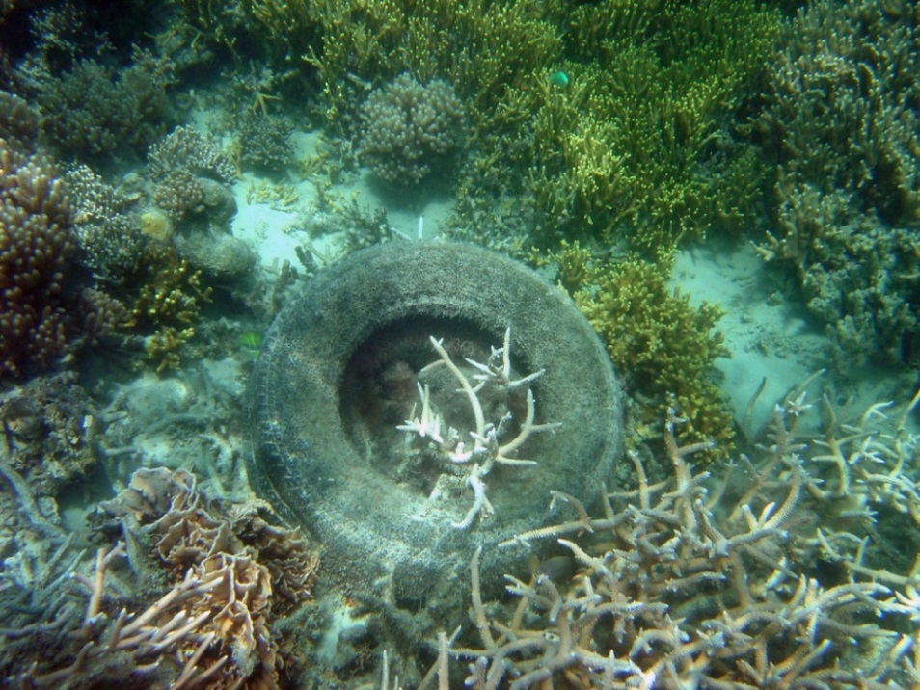
Marine Debris
Another form of pollution that is impacting coral reefs is marine debris. Marine debris is man-made trash bits that can range from a huge abandoned fishing net to a forgotten plastic bag and many things in between.
Fig. 12: A plastic bag wrapped around a coral. Source: noaa.gov
Fig. 13: Sea turtles are especially susceptible to entanglement. Source: ghostfishing.org
Fig. 14: Abandoned car tires are among the many trash objects found on reefs. Source: noaa.gov
Marine debris can harm reefs in many different ways. Plastic bags can smother corals, large pieces of debris such as tires or plywood can crush or break corals, and the animals that live in reef ecosystems can become entangled or die from ingesting bits of trash [14].

Slide 14
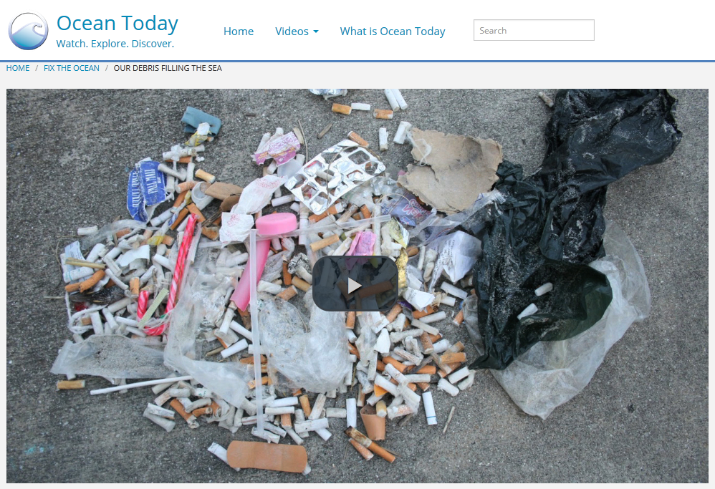
Marine Debris (cont.)
Fig. 15 Marine Debris
Source: http://oceantoday.noaa.gov/marinedebris/welcome.html
Sometimes the destructive force of storms and floods will contribute to the amount of marine debris in the water, but the majority of trash in the water comes from the negligence of humans such as fishermen and beachgoers [17].

Slide 15
Pollution Solutions
Yes, the future seems grim for coral reefs, but there are people who are making great efforts to rehabilitate degraded reefs back to their magnificent glory.
Among them is Ken Nedimyer and his team at the Coral Restoration Foundation.
Fig. 16: The logo for the Coral Restoration Foundation™. Source: coralrestoration.org Trademarked logo of the Coral Restoration Foundation (coralrestoration.org).

Slide 16
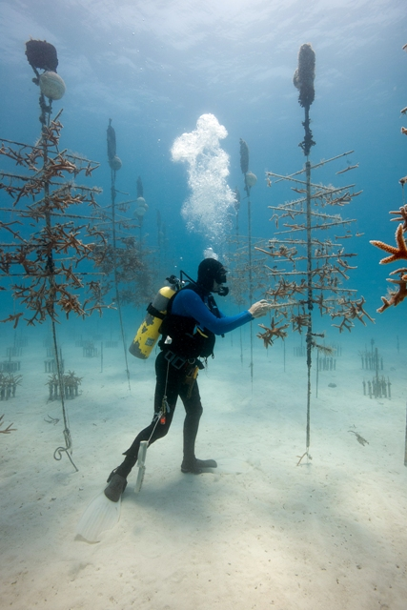
The Coral Restoration Foundation
This nonprofit group based in the Florida Keys works to grow two kinds of hard, fast-growing, branching corals, Staghorn (Acropora cervicornis) and Elkhorn (Acropora palmata), in their offshore nurseries. They then take the young corals and “plant” them on local, often deteriorating reefs in hopes of restoring the threatened coral populations [11].
Fig. 17: A diver attends to the coral nursery “trees.” Source: floridasportsman.com

Slide 17
Pollution Solutions
The Coral Restoration Foundation is only one of many organizations trying to save what’s left of our coral reefs. While people like Ken are making great progress in the preservation of coral reefs, ordinary people are making choices every day to help clean up the oceans and save these beautiful ecosystems.
Fig. 18: Some things you can do to keep the oceans clean, even if you don’t live near the coast!
Source: oceanconservancy.org

Slide 18
You Can Help, Too!
Responsibly recycling and disposing of trash
Using fewer fossil fuels
Conserving water to reduce runoff waste
Contacting policy makers about ocean health
Educating yourself and others
Some everyday pollution solutions include:
Source: http://coralreef.noaa.gov/getinvolved/whatyoucando/
Anyone can help, and no act is too small or insignificant!

Slide 19
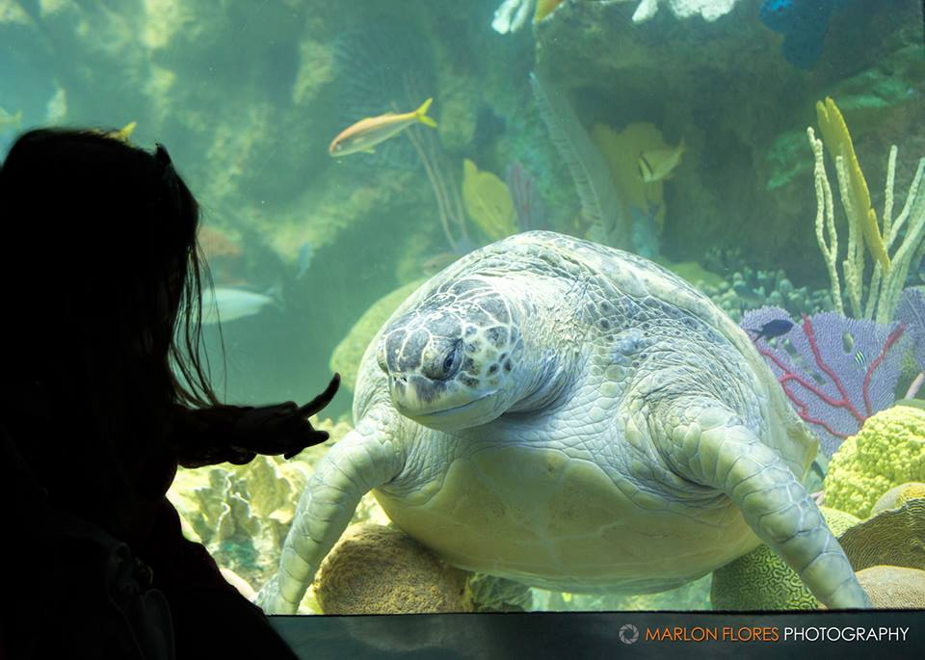
. . . So why is the Giant Ocean Tank present at the New England Aquarium?
Chris Bauernfeind, one of the Senior Aquarists at the NEAq, explains:
“Having this exhibit here in Boston gives people, some who may never see a real coral reef, the chance to experience a slice of nature that is not only magnificent, but also disappearing.
“I think that puts [the NEAq] in a unique position where we can educate, inspire, and conserve all at the same time.”
Fig 19. A young girl points to Myrtle, a green sea turtle, in the NEAq’s Giant Ocean Tank.
Photo: Marlon Flores

Slide 20
Works Cited
[1] "Coral Reef Protection: What Are Coral Reefs?" Water.epa.gov. United States Environmental Protection Agency, 14 May 2012. Web. 22 Jan. 2014. <http://water.epa.gov/type/oceb/habitat/ coral_index.cfm>.
[2] "Coral Reefs." MarineBio.org. MarineBio Conservation Society, n.d. Web. 11 Feb. 2014.
<http://marinebio.org/oceanscoralreefs.asp>.
[3] "Corals and Coral Reefs." Smithsonian Ocean Portal. Smithsonian Museum of Natural History, 2013. Web. 23 Jan. 2014. <http://ocean.si.edu/corals-and-coral-reefs>.
[4] "Corals: Protecting Coral Reefs." NOAA National Ocean Service Education. U.S. Department of Commerce, 11 Dec. 2009. Web. 25 Jan. 2014. <http://oceanservice.noaa.gov/education/tutorial_corals/coral11_protecting.html>.
[5] "Facts and Figures on Ocean Acidification." UNESCO.org. United Nations Educational, Scientific, and Cultural Organization, n.d. Web. 11 Feb. 2014. <http://www.unesco.org/new/en/natural-sciences/ioc
-oceans/priority-areas/rio-20-ocean/blueprint-for-the-future-we-want/ocean-acidification/facts-and- figures-on-ocean-acidification/>.
[6] Harborne, A. R., et al. "Reduced Density of the Herbivorous Urchin Diadema antillarum Inside a Caribbean Marine Reserve Linked to Increased Predation Pressure by Fishes." Coral Reefs 28.3 (2009): 783-91. ProQuest. Web. 25 Jan. 2014.
[7] McClanahan, T. R., Charles Sheppard, and David O. Obura. Coral Reefs of the Indian Ocean: Their Ecology and Conservation. New York, NY: Oxford UP, 2000. Print.
[8] "NOAA's Coral Reef Conservation Program." NOAA's Coral Reef Conservation Program. National Ocean Service, 29 Oct. 2013. Web. 11 Feb. 2014. <http://coralreef.noaa.gov/>.
[9] "NOAA's Coral Reef Information System (CoRIS)." Coral Ecosystem Publications RSS. NOAA Coral Reef Conservation Program, 17 Jan. 2013. Web. 11 Feb. 2014. <http://www.coris.noaa.gov/about/diseases/>.
[10] NOAA Ocean Acidification—The Other Carbon Dioxide Problem. YouTube. GlobalClimateNews, 2 Jan. 2012. Web. 11 Feb. 2014. <http://www.youtube.com/watch?v=MgdlAt4CR-4&feature=youtu.be>.
[11] "Our Work." Coral Restoration Foundation RSS. Coral Restoration Foundation, 2012. Web. 25 Jan. 2014. <www.coralrestoration.org>.

Slide 21
[12] "Restoring Coral Reefs, One Gamete at a Time." NOAA. U.S. Department of Commerce, n.d. Web. 25 Jan. 2014. <http://www.noaa.gov/features/resources_0109/coralreefs.html>.
[13] Saving the Coral Reef One Stitch at a Time. Prod. Jess Righthand and Ryan R. Reed. Perf. Margaret Wertheim. Smithsonianmag.com. Smithsonian Institution, n.d. Web. 11 Feb. 2014. <http://www.smithsonianmag.com/videos/ category/3play_processed_94/saving-the-coral-reef-one
-stitch-at-a-time/>.
[14] "Threats to Coral Reefs." Coral.org. The Coral Reef Alliance, n.d. Web. 25 Jan. 2014. <http://www.coral.org/resources/about_coral_reefs/threats_to_coral_reefs>.
[15] Somerfield, P. J., et al. "Changes in Coral Reef Communities among the Florida Keys, 1996-2003." Coral Reefs 27.4 (2008): 951-65. ProQuest. Web. 25 Jan. 2014.
[16] The Blue Planet, Seas of Life: Coral Seas. Perf. David Attenborough. Netflix. Netflix, Inc, 2001. Web. 25 Jan. 2014.
[17] "The Ocean." National Geographic. National Geographic, n.d. Web. 11 Feb. 2014.<http://ocean.nationalgeographic.com/ocean/critical-issues-ocean-acidification/?source=A-to-Z>.

