Slide 1
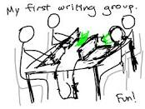
Understanding the Unique Affordances of Multimodal, Creative Writing and Academic Writing
Laura Hartigan
Research Question: To what extent can standard academic and creative multimodal expression help students develop authorial identity and the skills they need to flourish in and out of school?
Purpose. In order to assess
the intrinsic value and necessity for schools to consider the inclusion of multimodal writing, the study focuses on analyzing the students’ sense of authorial power in both their academic and creative assignments.
Key Finding
Genre matters little if a student’s context fails to provide a sense
of safety and the assignment fails to elicit personal meaning.
Safety
Ownership
Cllaboration

