Slide 1
Michèle Shuster • Janet Vigna • Matthew Tontonoz • Gunjan Sinha
Biology for a
Changing World
SECOND EDITION
Lecture PowerPoint
CHAPTER 1
Process of Science
Copyright © 2014 by W. H. Freeman and Company

Slide 2
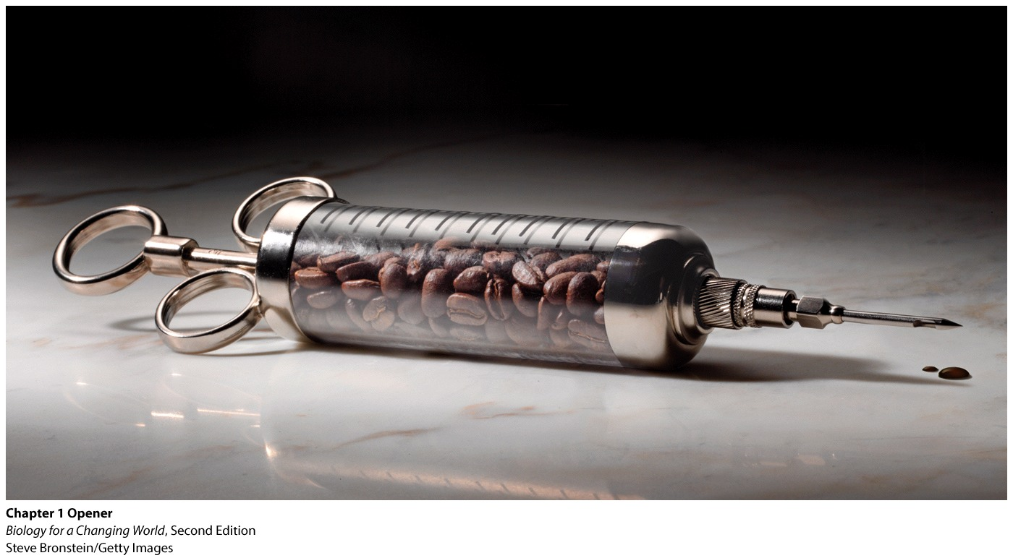
Chapter 1
Java Report

Slide 3
Driving Questions
How is the scientific method used to test hypotheses?
What factors influence the strength of scientific studies and whether the results of any given study are applicable to a particular population?
How can you evaluate the evidence in media reports of scientific studies?
How does the scientific method apply in clinical trials designed to investigate important issues in human health?

Slide 4
What is science?
A method to answer questions
A process of using observations and experiments to draw evidence-based conclusions
A way of knowing

Slide 5
How do scientists draw conclusions?
Reports in the news:
Coffee causes cancer
Coffee prevents some diseases
Caffeine can be poisonous

Slide 6
How do scientists draw conclusions?
Ask: Was the science performed properly?
Use best evidence available

Slide 7
How do scientists draw conclusions?
Conclusion may be modified in the future
Science is a never-ending process
Notes:
Conclusions based on today’s evidence may be modified in the future as other scientists ask different—and sometimes better—questions. Moreover, with improved technology, researchers may uncover better data; new information can cast a new light on old conclusions.

Slide 8
Science is a process: make an observation
Start with an interesting, informal observation
Often unreliable, untested
Anecdotal evidence
Notes:
Ask a student to make an observation based on the photo and some of the information about coffee discussed in previous slide.
Anecdotal evidence that may be interesting but is often unreliable, since it isn’t based on systematic study.
Anecdotal evidence can lead to the formulation of questions.

Slide 9
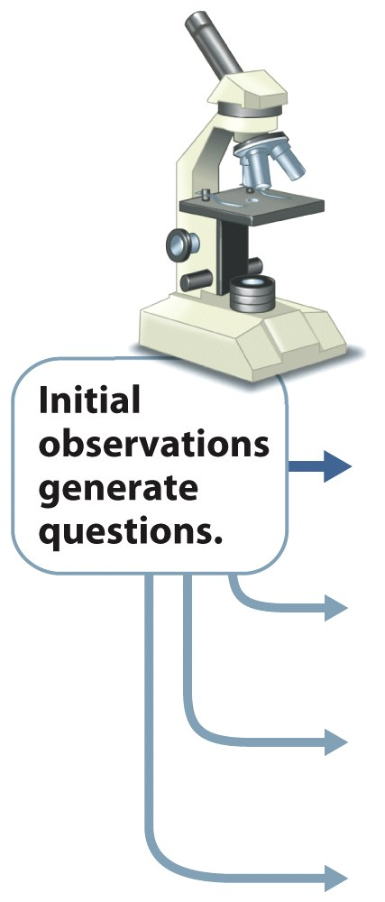
Science is a process: formulate a question
Use observation to devise a question
“ Does coffee help improve mental performance?”

Slide 10
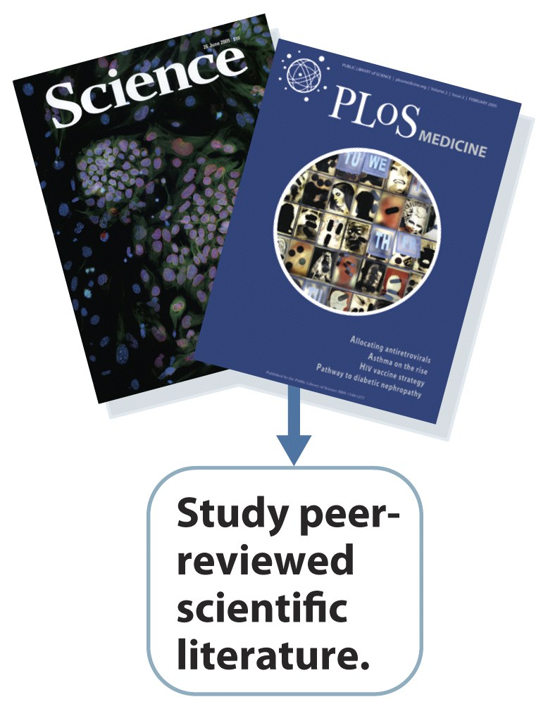
Science is a process: studying previous research
Read relevant literature
See current information on the subject of interest
Study peer-reveiwed scientific literature

Slide 11
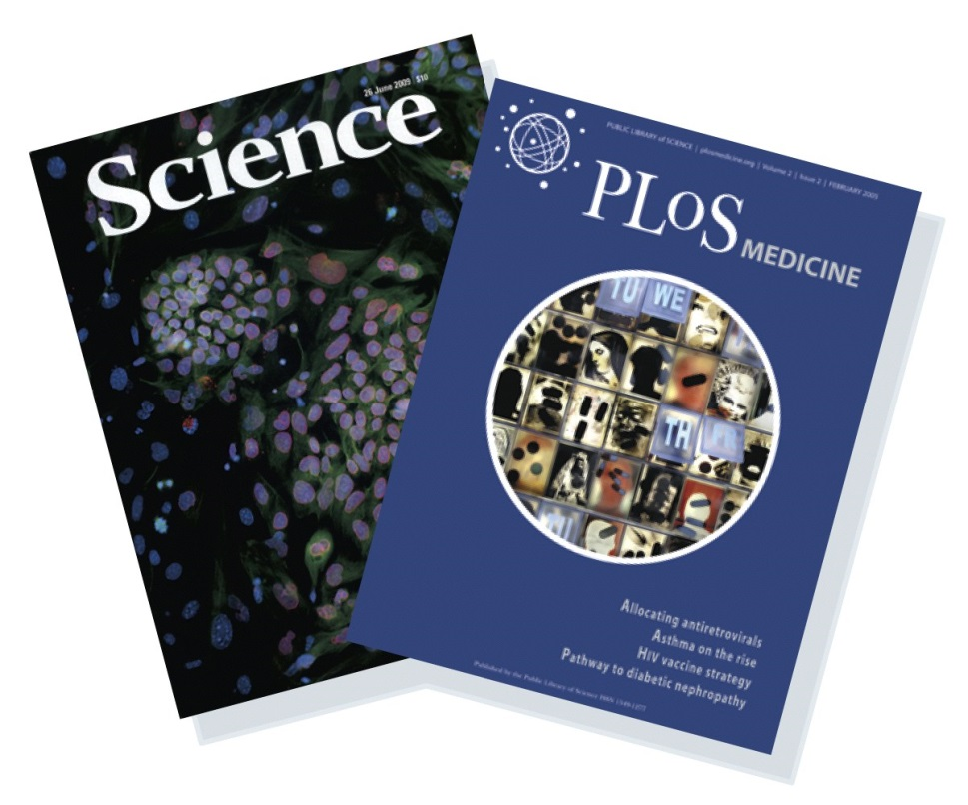
Science is a process: studying previous research
Peer review: review of an article by experts before publication
ensures that the authors have appropriately designed and interpreted their study
weeds out sloppy research

Slide 12
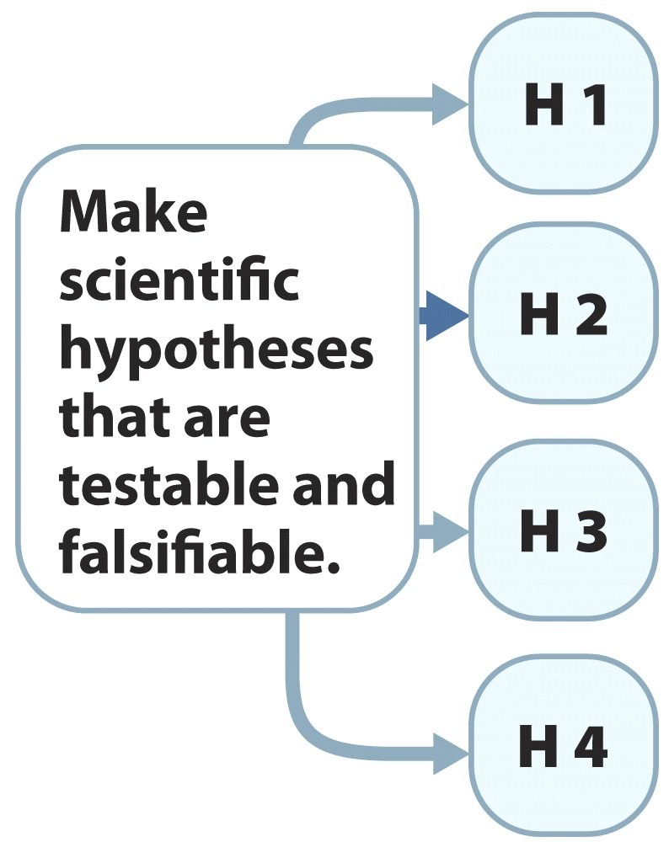
Science is a process: forming scientific hypotheses
use information to formulate a scientific hypothesis
a testable and falsifiable explanation for a scientific observation or question
“Caffeinated coffee improves memory.”

Slide 13
Science is a process: forming scientific hypotheses
testable : supported or rejected by carefully designed experiments or nonexperimental studies
falsifiable: can be ruled out by data
Notes:
A hypothesis is testable if it can be supported or rejected by carefully designed experiments or observational studies.

Slide 14
Science is a process: forming scientific hypotheses
Not all explanations are scientific hypotheses
An explanation that cannot be tested or refuted, falls outside the realm of scientific explanation
Notes:
Statements of opinion or ones that use supernatural or mystical explanations that cannot be tested or refuted fall outside the realm of scientific explanation.
Give an example; astrology.

Slide 15
Science is a process: forming scientific hypotheses
A hypothesis is never proven
If false, it is rejected and no longer considered a possible answer to the original question
If the data support the hypothesis, it will be accepted until further testing and data show otherwise
Notes:
It is impossible to test whether a hypothesis is true in every possible situation.

Slide 16
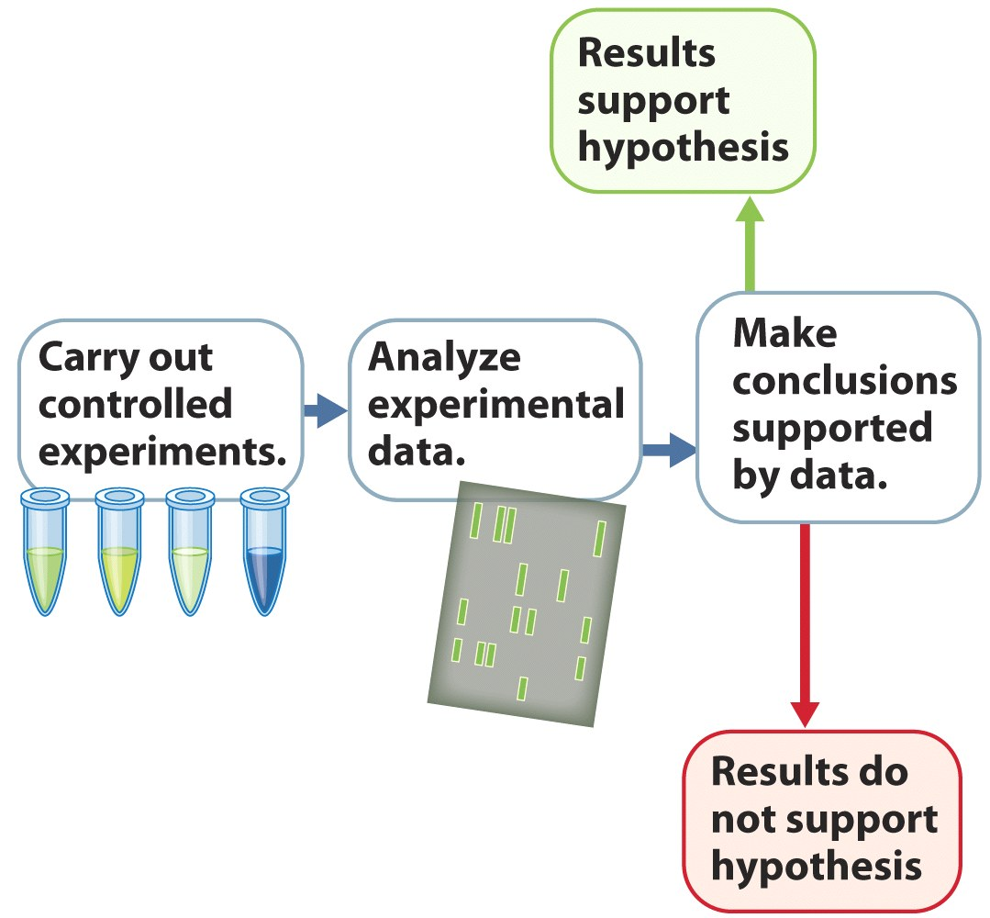
Science is a process: experimentation
Hypotheses can be tested using experimentation
An experiment is a carefully designed test
The results of an experiment either support or rule out a hypothesis

Slide 17
Science is a process: experimentation
The experiment: measure the effects of coffee drinking on a group of participants

Slide 18
Science is a process: experimentation
experimental group: experiences the experimental intervention or manipulation
control group: experiences no experimental intervention or manipulation
Basis for comparison

Slide 19
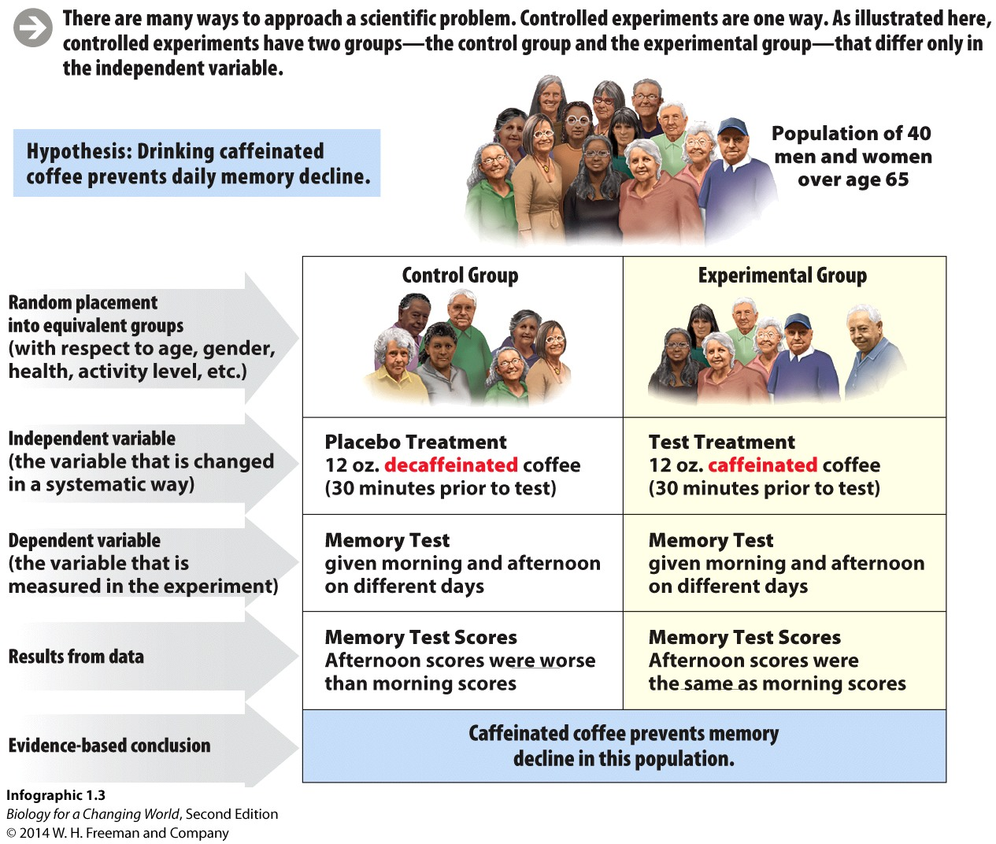
Science is a process: experimentation

Slide 20
Science is a process: experimentation
The experimental group experiences the independent variable
That is, the factor being deliberately changed in the experimental group

Slide 21
Science is a process: experimentation
The control group receives a placebo
A placebo is a fake treatment that mimics the experience of the experimental groups
Notes:
The placebo effect is the effect observed when members of a control group display a measurable response to a placebo because they think they are receiving a “real” treatment. In order to rule this out, the participants in the experiment do not know whether they are receiving a placebo or the experimental treatment.

Slide 22
Science is a process: experimentation
The dependent variable is the measured result of an experiment
Analyzed in both the experimental and control groups

Slide 23
Science is a process: experimentation
Evidence-based conclusions can be drawn from results
Notes:
In a controlled experiment, the control group and experimental group differ only in the independent variable, so the results of the experiment provide evidence-based conclusions.

Slide 24
Science is a process: drawing conclusions
Confidence in the conclusions drawn from experimentation is increased by the repetition of the experiment by other scientists

Slide 25
Science is a process: drawing conclusions
Sample size is important
It is the number of experimental subjects or the number of times an experiment is repeated

Slide 26
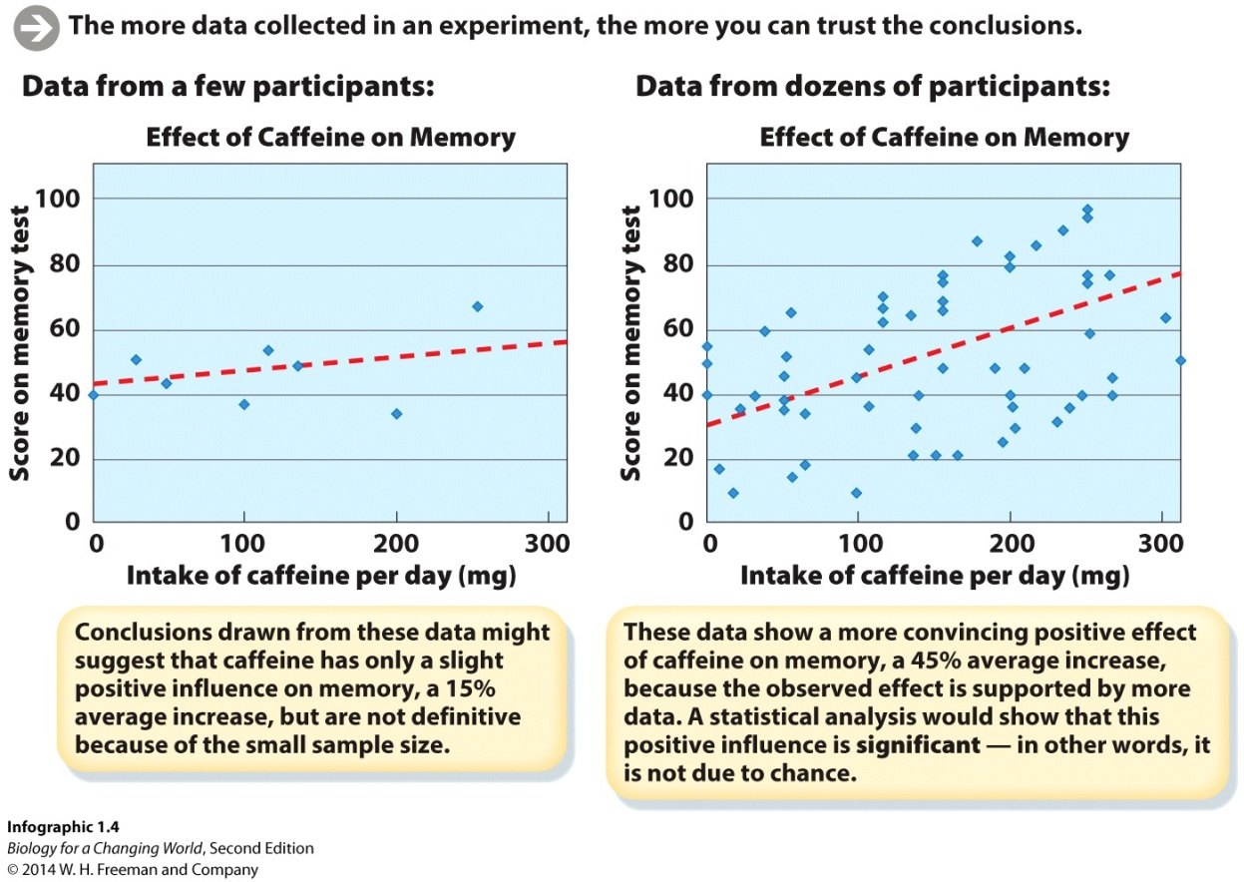
Science is a process: drawing conclusions
The larger the sample size, the more likely the results will have statistical significance.
Statistical significance is a measure of confidence that the results obtained are “real,” rather than due to random chance.

Slide 27
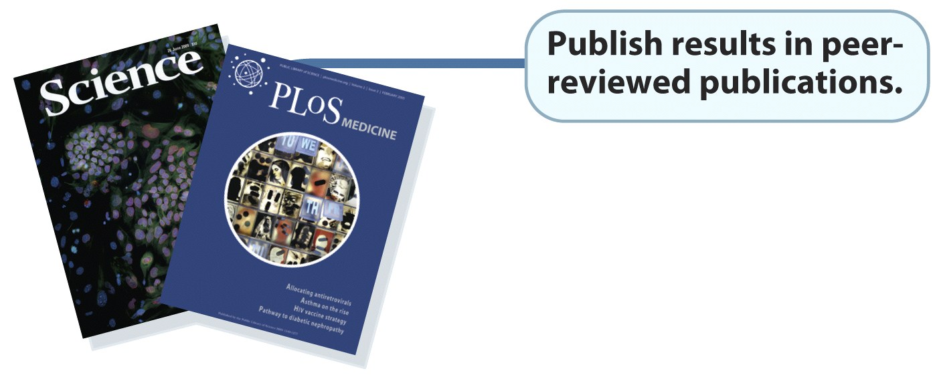
Science is a process: publication
Experimental results are published in peer-reviewed journals.

Slide 28
Science is a process: drawing conclusions
A hypothesis that continues to hold up after many years of rigorous testing may eventually be considered a scientific theory.
Notes:
The more experiments that support a hypothesis, the more confident we can be that it is true.

Slide 29
Science is a process: scientific theory
Notes:
We may say something is “just a theory,” meaning it isn’t proved. But in science, a theory is an explanation of the natural world that is supported by a large body of evidence com- piled over time by numerous researchers. Far from being a fuzzy or unsubstantiated claim, a theory is a scientific explanation that has been extensively tested and has never been disproved.

Slide 30
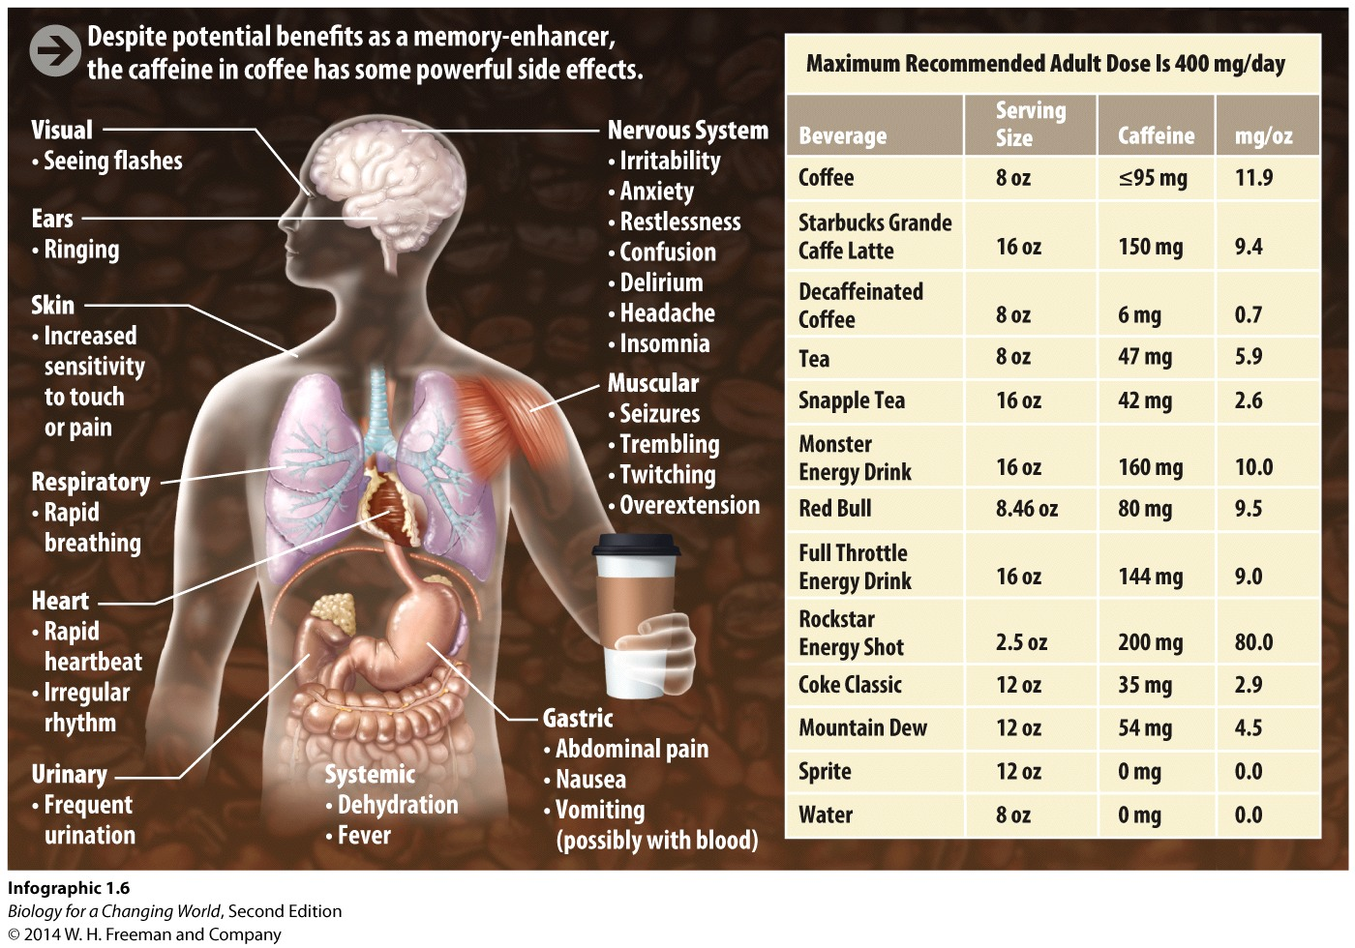
Science is a process: scientific theory
A large body of evidence reveals the
effects of caffeine
Notes:
A theory is an explanation of the natural world that is supported by a large body of evidence compiled over time by numerous researchers.

Slide 31
Science is a process: finding patterns
Some questions cannot be tested through controlled experiments
Through careful observations or comparisons of phenomena in nature, scientists can find patterns and help answer questions
Epidemiology is the study of patterns of disease in populations
Notes:
Epidemiological studies answer questions that could not be tested through controlled laboratory experiments for ethical or practical reasons.
-Relatively inexpensive to conduct
-Can study factors that are considered harmful (such as excess alcohol or smoking)
-Have the power of numbers and time

Slide 32
Science is a process: finding patterns
Is there a relationship between coffee drinking and the incidence of Parkinson disease?
Notes:
Find patterns among coffee drinkers.

Slide 33
Science is a process: finding patterns
Observing patterns can show a consistent relationship or link, between variables
Correlation
Correlation between two variables does not prove that one variable causes the other

Slide 34
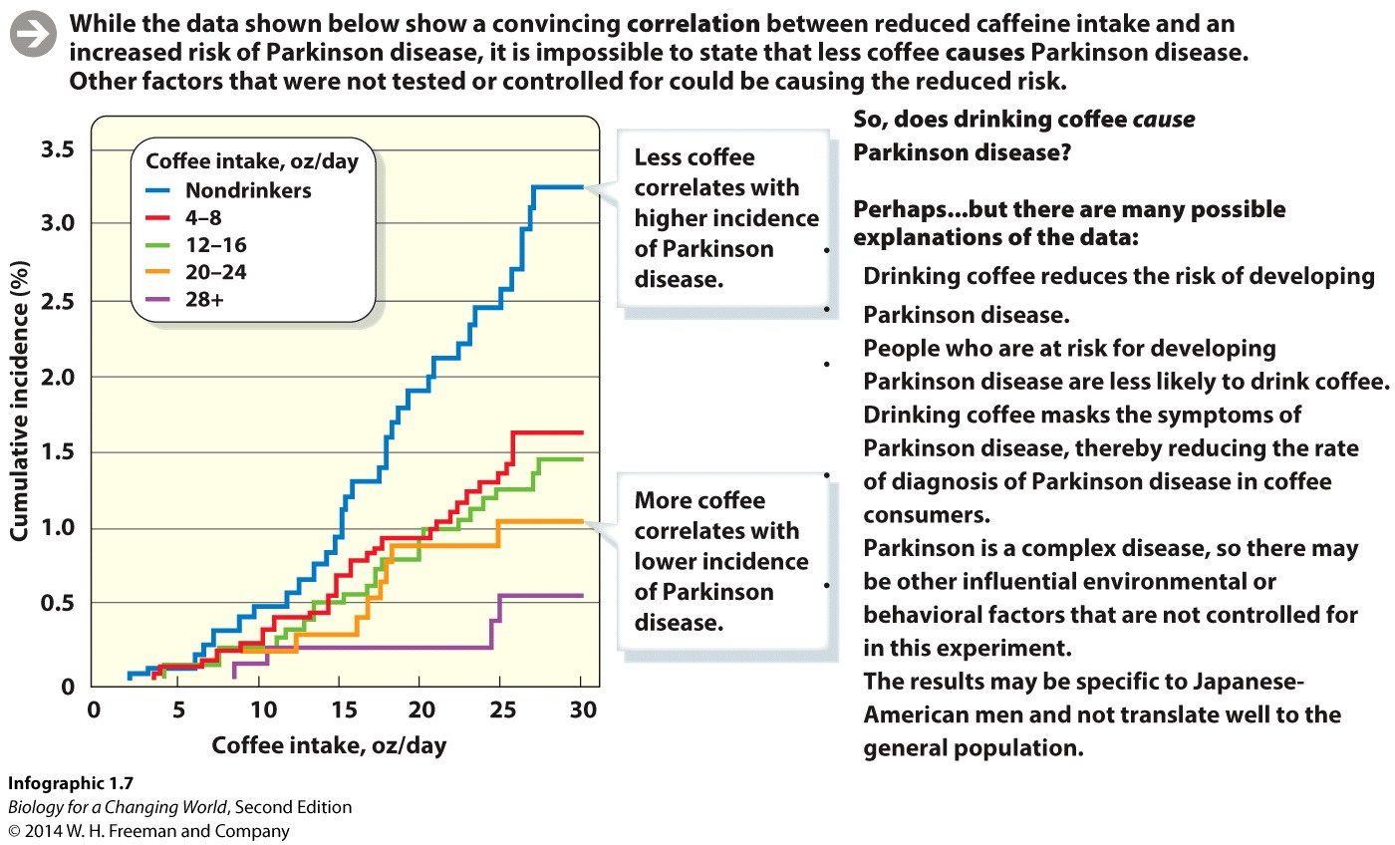
Science is a process: finding patterns

Slide 35
Science is a process: finding patterns
Coffee drinkers had a lower incidence of Parkinson disease
But: Correlation is not causation!
Notes:
So does coffee (specifically, caffeine) prevent Parkinson disease?
The occurrence and progression of many diseases are affected by a complex range of factors, including age, sex, diet, genetics, and exposure to bacteria and environmental chemicals, as well as lifestyle factors like drinking, smoking, and exercise.

Slide 36
Science as a process: drawing conclusions
Exercise caution when evaluating epidemiology results
Hard to control for complexity of a disease
Small sample sizes
Notes:
The specific population of the study may not be representative of the general population.

Slide 37
Science is a process
Use a known correlation to design a controlled experimental study
Conduct a randomized clinical trial
Randomly chosen subjects used in control and experimental groups to test an independent variable
Notes:
Or controlled medical experiments, in which subjects who are randomly chosen to receive either an investigational treatment or a placebo are used to measure the effects of a variable under controlled conditions.

Slide 38
Randomized clinical trial
Experimental group drinks caffeinated coffee
Control group drinks decaf
Follow both groups for a number of years to see which one has the higher incidence of disease

Slide 39
Evaluating scientific information
Data are often very complex and the public
often receives them as isolated media headlines
Notes:
Scientists rely on peer-reviewed scientific reports to learn about new advances, but the public often relies on brief media reports that are not always completely accurate in their portrayal of the conclusions of scientific studies.

Slide 40
Summary
Science is an ongoing process in which scientists conduct carefully designed studies to answer questions or test hypotheses.
Scientific hypotheses are tested in controlled experiments or in observational studies, the results of which can support or rule out a hypothesis.
Scientific hypotheses can be supported by data but cannot be proved absolutely, as future studies may provide new findings.

