Slide 1
Michèle Shuster • Janet Vigna • Matthew Tontonoz • Gunjan Sinha
Biology for a
Changing World
SECOND EDITION
Lecture PowerPoint
CHAPTER 2
Chemistry and Molecules of Life
Copyright © 2014 by W. H. Freeman and Company

Slide 2
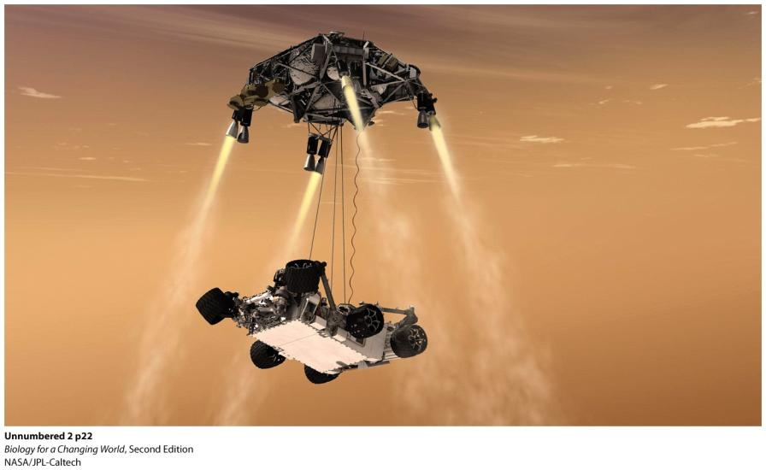
Chapter 2
Chemistry and Molecules of Life

Slide 3
Driving Questions
How is matter organized into molecules of living organisms?
What is the definition of life, and how could Martian life be recognized?
What is the basic structural unit of life?
Why is water so important for life and living organisms?

Slide 4
Looking for life on Mars
Notes:
The purpose of NASA’s trip to Mars— the seventh to date—is to find out whether the planet could have once supported life.

Slide 5
What is life?
“Our experience with life is limited to familiar earth life and we know that all known life on earth descends from a last universal common ancestor.”
^{— Carol Cleland}

Slide 6
All living things have five functional traits in common
Growth
Reproduction
Homeostasis
Sense and respond to stimuli
Ability to obtain and use energy

Slide 7
All living things have five functional traits in common
Growth: the process of increasing in size

Slide 8
All living things have five functional traits in common
Reproduction: the process of producing new organisms

Slide 9
All living things have five functional traits in common
Homeostasis: the maintenance of a relatively constant internal environment

Slide 10
All living things have five functional traits in common
Sense and respond to stimuli: the process of reacting to their environment
Notes:
This helps organisms maintain homeostasis.

Slide 11
All living things have five functional traits in common
Ability to obtain and use energy; allowing them to do work
Notes:
Energy comes from sunlight or food, which living things break down through a series of chemical reactions, the sum total of which is called metabolism.

Slide 12
All living things have five functional traits in common
Energy comes from sunlight or food
Organisms use energy to break down food
Metabolism: sum total of all chemical reactions occurring in living things

Slide 13
All life is composed of the same chemical building blocks
Matter is anything that takes up space and has mass
All matter is made of elements – substances that cannot be chemically broken down

Slide 14
All life is composed of the same chemical building blocks
The smallest unit of an element that still retains the property of that element is called an atom

Slide 15
All life is composed of the same chemical building blocks
Atoms have distinct chemical properties
Determined by the number of subatomic particles

Slide 16
All life is composed of the same chemical building blocks
The nucleus is the dense core of an atom

Slide 17
All life is composed of the same chemical building blocks
Protons are positively charged subatomic particles found in the nucleus of an atom

Slide 18
At its most basic level, all life is composed of chemicals
Neutrons are electrically uncharged subatomic particles found in the nucleus of an atom

Slide 19
At its most basic level, all life is composed of chemicals
Electrons are
negatively charged
subatomic particles
They orbit the nucleus with negligible mass

Slide 20
All life is composed of the same chemical building blocks
The periodic table of elements represents all known elements on Earth
Reports atomic number and atomic mass
Notes:
Each element is placed in order by its atomic number, the number of protons found in the nucleus of its corresponding atom.

Slide 21
All life is composed of the same chemical building blocks
Atomic number is the number of protons
Atomic mass is the total number of protons and neutrons

Slide 22
Carbon is a versatile component of life’s molecules
Carbon
fourth most common element in the universe
second most common element in human body
One of six elements that make up most of humans
Oxygen (65%)
Carbon (18.5%)
Hydrogen (9.5%)
Nitrogen (3.3%)
Phosphorus and sulfur (2%)

Slide 23
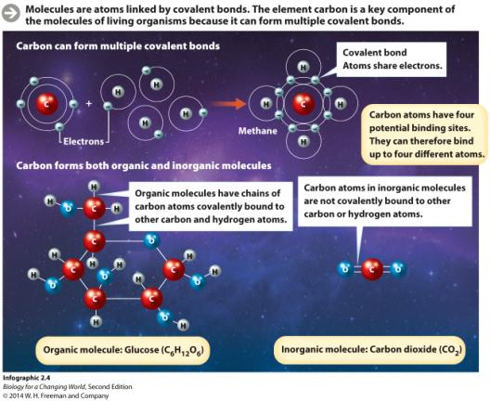
Carbon is a versatile component of life’s molecules
Carbon is a key component of the molecules of living organisms
It can form multiple covalent bonds, the sharing of a pair of electrons between two atoms
Notes:
Strong chemical bonds

Slide 24
Carbon is a versatile component of life’s molecules
Molecules form when atoms are linked by covalent bonds
Carbon atoms can bond up to four atoms

Slide 25
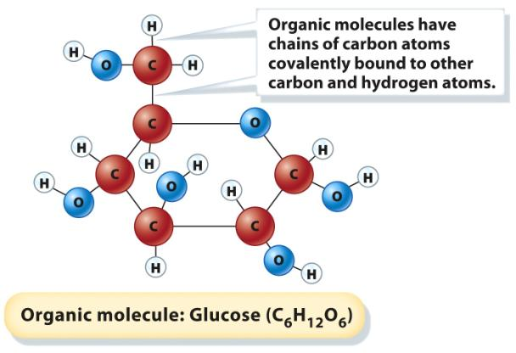
Carbon is a versatile component of life’s molecules
Organic molecules have carbon-based backbones and at least one C-H bond

Slide 26
Carbon is a versatile component of life’s molecules
Inorganic molecules lack carbon-based backbones and C-H bonds

Slide 27
Molecules of life
Macromolecules
Large organic molecules
Composed of subunits called monomers
Monomers link together to form polymer chains

Slide 28
Molecules of life
Four types of complex macromolecules make up living things
Carbohydrates
Proteins
Lipids
Nucleic acids
Notes:
Organic molecules

Slide 29
Molecules of life: carbohydrates
Carbohydrates are made up of sugar monomers
Notes:
Simple sugars are monosaccharides.

Slide 30
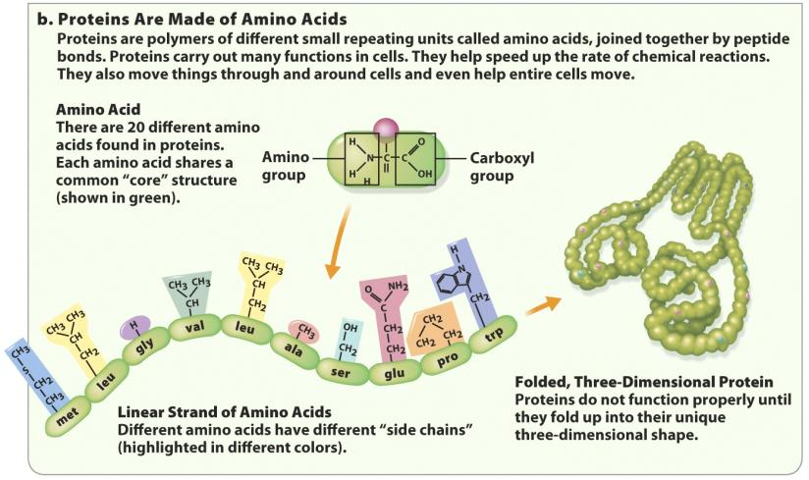
Molecules of life: proteins
Proteins are made up of amino acid monomers

Slide 31
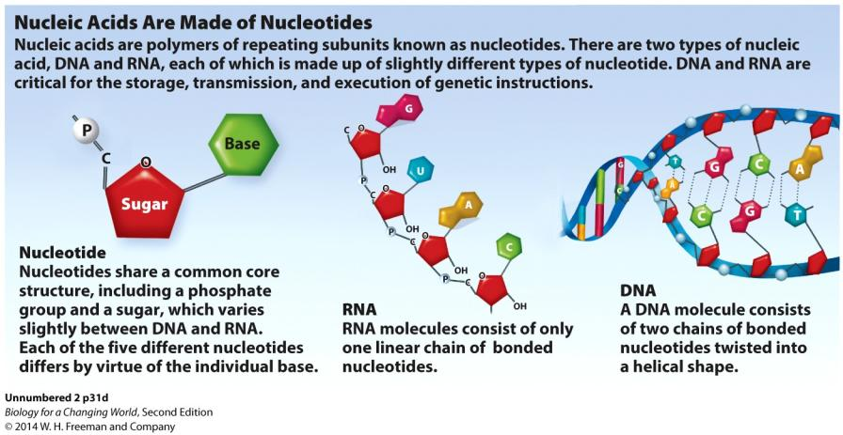
Molecules of life: nucleic acids
Nucleic acids are made up of nucleotides monomers

Slide 32
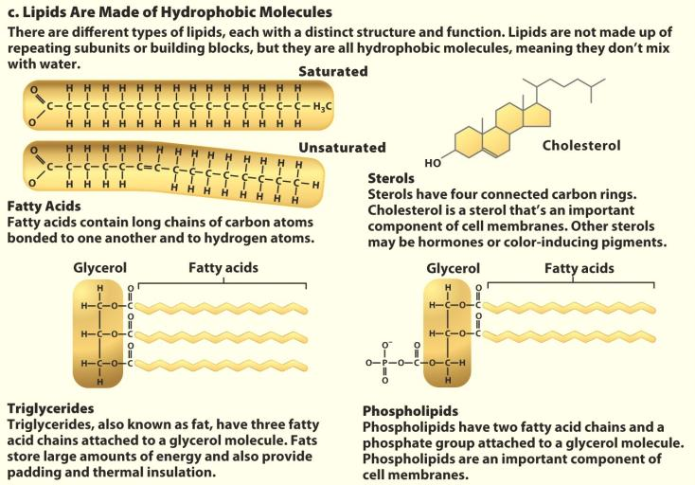
Molecules of life: lipids
Lipids are not made of repeating monomers
Notes:
Lipids are hydrophobic – they don’t mix with water.

Slide 33
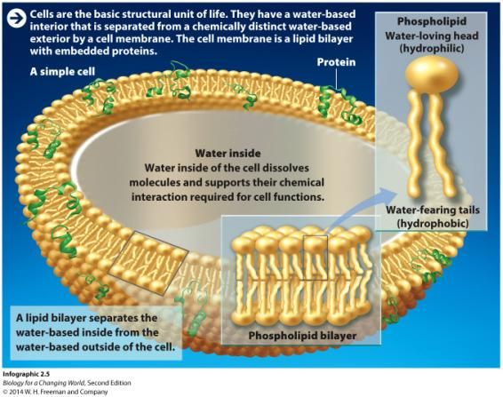
The cell
Basic structural unit of life
All cells have some basic architecture
Notes:
Water-filled sacs, bounded by a cell membrane

Slide 34
Phospholipids define cell boundaries
Cells are bounded by a cell membrane
Have a double layer (bilayer)
Separate the contents of a cell from its environment
Notes:
Different types of lipids; all are hydrophobic

Slide 35
Phospholipids define cell boundaries
Phospholipids have a hydrophilic (water-loving) head and hydrophobic (water-hating) tails

Slide 36
Water
Proxy for life
All of life’s chemical reactions take place in water

Slide 37
Water
Composed of oxygen and hydrogen atoms
Many of its functions are due to its shape
Notes:
Water is such a good solvent because it is a polar molecule – a molecule in which electrons are not shared equally between atoms – causing a partial negative charge at one end and a partial positive charge at the other.

Slide 38
Water
Polar molecule
Electrons in bonds not shared equally between atoms
Partial negative charge at one end and a partial positive charge at the other

Slide 39
Water
Forms special electrostatic attractions, known as hydrogen bonds, with both water and other molecules

Slide 40
Properties of water
Hydrogen bonds give water its unique properties
Cohesion: water molecules cling together
Adhesion: water molecules cling to surfaces
Large liquid range
Solid water is less dense than liquid water, so ice floats

Slide 41
Properties of water
Universal solvent: a substance in which other substances can dissolve
Can transport all of life’s dissolved molecules, or solutes
Notes:
Water transports all of life’s dissolved molecules, or solutes, from place to place, making life essentially a water-based solution.

Slide 42
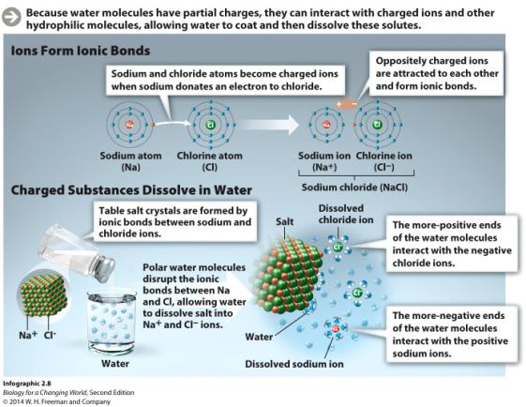
Properties of water
Dissolves other polar molecules and substances that contain ionic bonds
Strong bonds formed between oppositely charged ions
Ion: a charged atom due to loss or gain of electron

Slide 43
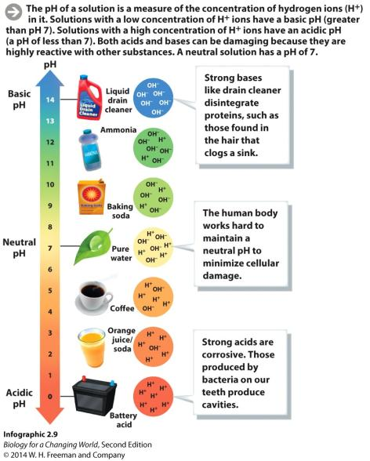
Properties of water
Water molecules (H₂O) split briefly into separate hydrogen
(H⁺) and hydroxide (OH−) ions.
pH is the concentration of hydrogen ions (H⁺) in a solution
pH ranges from 0 to 14
Notes:
In pure water, the number of separated H⁺ ions is exactly equal to the number of separated OH⁻ ions, and the pH is therefore 7, or neutral.

Slide 44
Properties of water
Acids have a higher concentration of hydrogen
ions (H⁺) and a pH closer to 0
Bases have a lower concentration of hydrogen
ions (H⁺) and a pH closer to 14

Slide 45
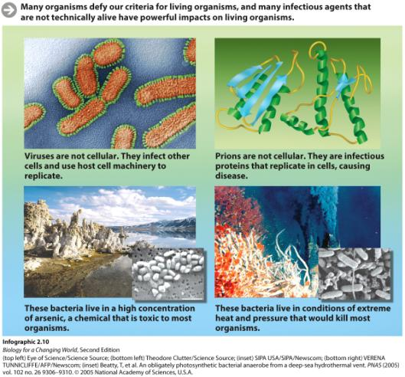
Weird life?
Many infectious agents and microbes defy our definition of being alive

Slide 46
Summary
Living organisms grow and reproduce, maintain homeostasis, sense and respond to their environment, and rely on energy to carry out their functions.
All matter is composed of elements.
Four types of carbon-based organic molecule make up living things: proteins, carbohydrates, nucleic acids, and lipids.
Living organisms are made of cells, the smallest unit of life.
The concentration of H+ ions in a solution determines its pH.

