Slide 1
Michèle Shuster • Janet Vigna • Gunjan Sinha • Matthew Tontonoz
Biology for a
Changing World
SECOND EDITION
Lecture PowerPoint
CHAPTER 3
Cell Function and Structure
Copyright © 2014 by W. H. Freeman and Company

Slide 2
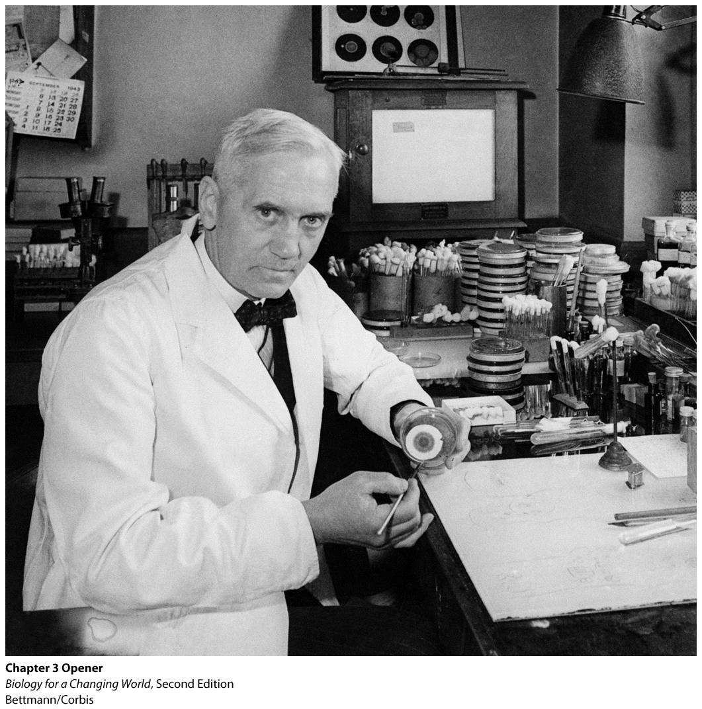
Chapter 3
Cell Structure and Function

Slide 3
Driving Questions
1. What structural features are shared by all cells, and what are
the key differences between prokaryotic and eukaryotic cells?
2. How do solutes and water cross membranes, and what
determines the direction of movement of solutes and water in
different situations?
3. How do antibiotics target bacteria, and in what situations is
antibiotic therapy indicated?
4. What are some key eukaryotic organelles and their functions?

Slide 4
Wonder drug
In 1928, biologist Alexander Fleming observed that the fungus Penicillium notatum was capable of killing many kinds of bacteria.

Slide 5
Wonder drug
Notes:
A fortuitous observation by Fleming led to the discovery of the first antibiotic. He realized that the fungus on his culture plate was somehow inhibiting the reproduction of bacteria.

Slide 6
Wonder drug
Antibiotic
chemical that can slow or stop the growth of bacteria
often naturally produced by living organisms
For example, penicillin is produced by Penicillium notatum
Notes:
Flemming was the first to study antibiotics scientifically and publish the results.

Slide 7
Wonder drug
Antibiotics
Preferentially kill bacteria without harming human or animal host
Target what is unique about bacterial cells
Notes:
To understand why antibiotics affect bacteria cells, you must understand cells in general.

Slide 8
Cells
Cell theory
All living things are made of cells
Every new cell comes from the division of a pre-existing cell

Slide 9
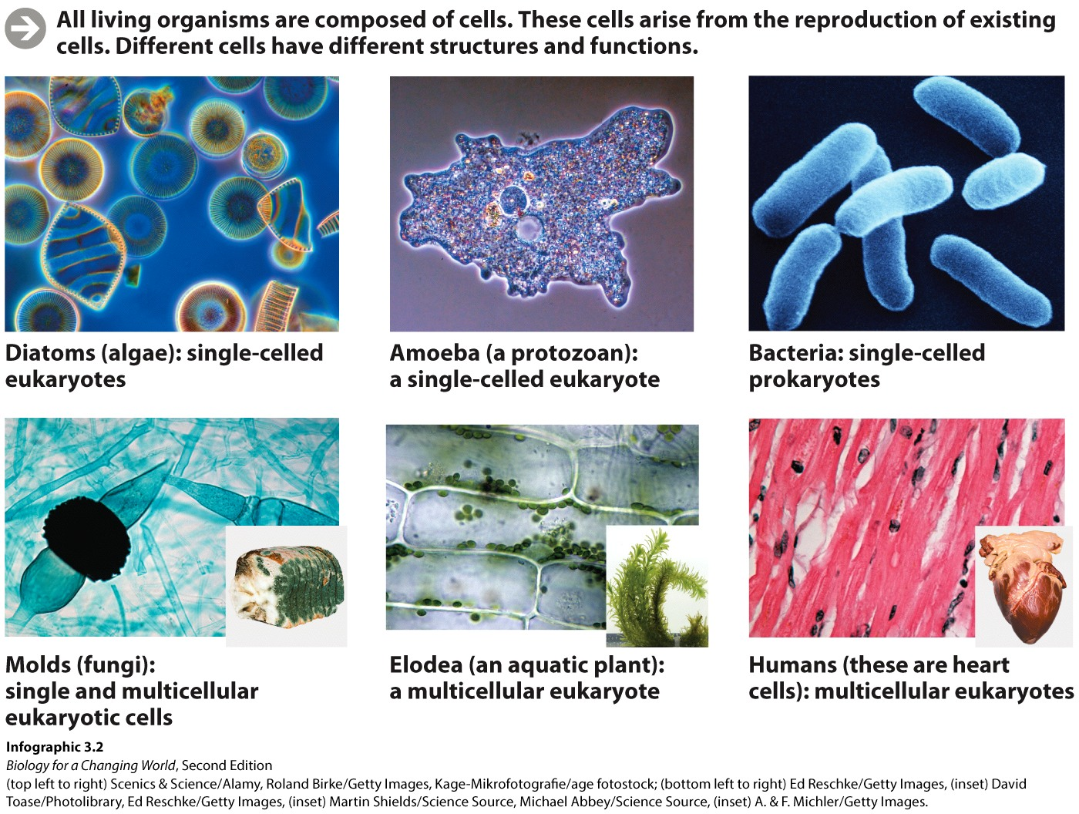
Cells
Notes:
Not all cells are alike. Cells come in many shapes and sizes and perform various functions, depending on where they are found.

Slide 10
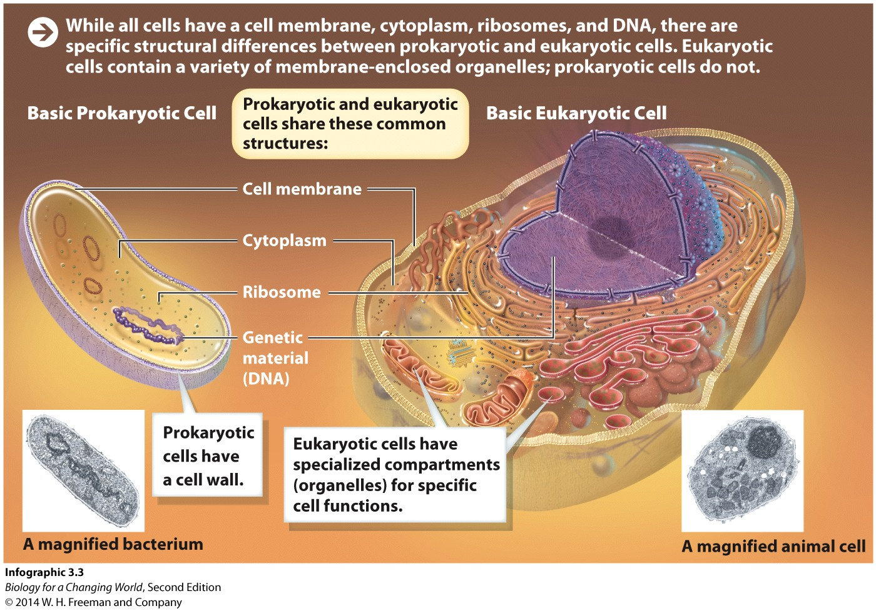
Cells
Prokaryotic cells: lack internal membrane-bound organelles
Eukaryotic cells: membrane-bound organelles, including a nucleus
Notes:
Organelles: the membrane-bound compartments of eukaryotic cells that carry out specific functions

Slide 11
Cells
Prokaryotic and eukaryotic cells have
A cell membrane of phospholipids and proteins
Cytoplasm: gelatinous aqueous interior.
Ribosomes: a complex of RNA and protein that carry out
protein synthesis
DNA as a molecule of heredity
Notes:
Membrane: a flexible yet sturdy structure that forms a boundary between the external environment and the cell’s watery cytoplasm

Slide 12
Cells
Only eukaryotic cells have
A nucleus: an organelle that contains the DNA
Many organelles
Only prokaryotic cells have
Their DNA floating freely in cytoplasm
No organelles
Cell wall; rigid structure enclosing cell membrane

Slide 13
Cells

Slide 14
Antibiotics target prokaryotic cells
Bacterial cell walls are rigid due to peptidoglycan
a polymer made of sugars and amino acids
allows bacteria to survive in watery environment

Slide 15
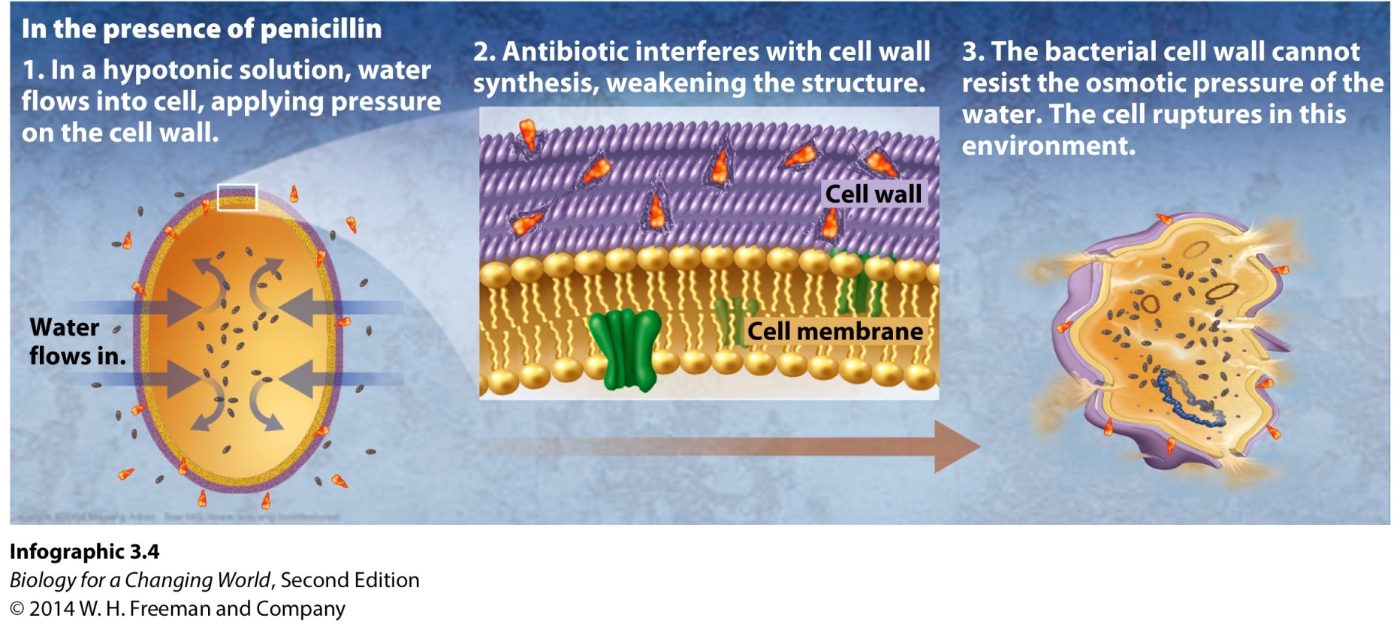
Antibiotics target prokaryotic cells
Penicillin weakens cell wall
Bacterial cells fills up with water and burst due to osmosis
Notes:
Bacteria are not the only organisms with a cell wall (plant cells and fungi have them, too) but they are the only ones that have a cell wall made of peptidoglycan. This is why penicillin is such a selective bacteria killer.

Slide 16
Antibiotic target prokaryotic cells
Osmosis
The diffusion of water across a semipermeable membrane from an area of lower-solute concentration to an area of higher-solute concentration
Hypotonic vs. hypertonic vs. isotonic
Notes:
Cells placed in a lower-solute, or hypotonic, solution will tend to take up water and swell.
Cells placed in a higher-solute, or hypertonic, solution will tend to lose water and shrivel.
In an isotonic solution, where the solute concentration is the same as the cell’s cytoplasm, there is no net movement of water into or out of the cell.
In all cases, water moves in a direction that will tend to even out the solute concentrations on each side of the membrane.

Slide 17
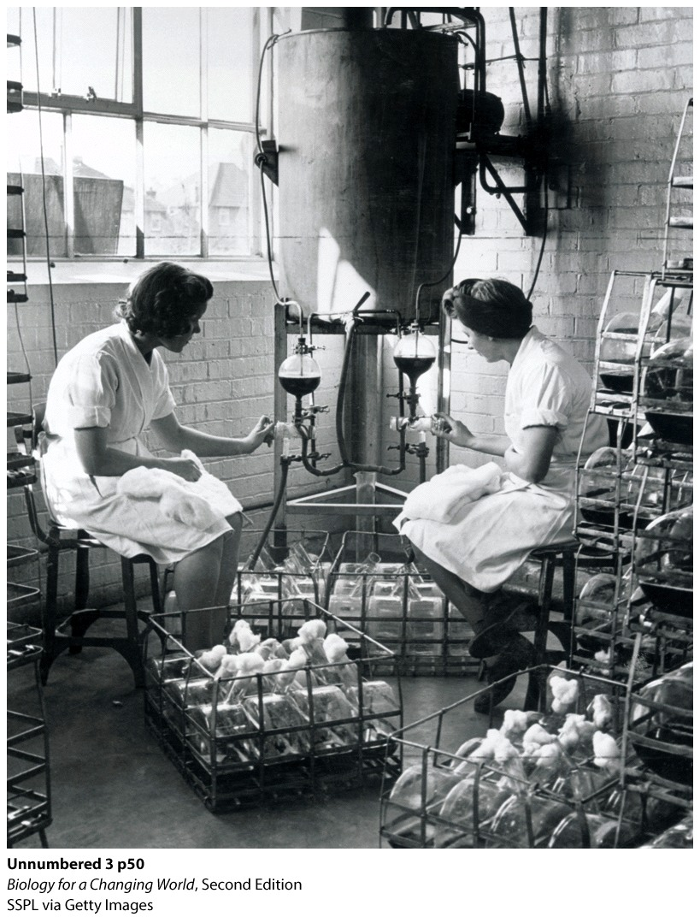
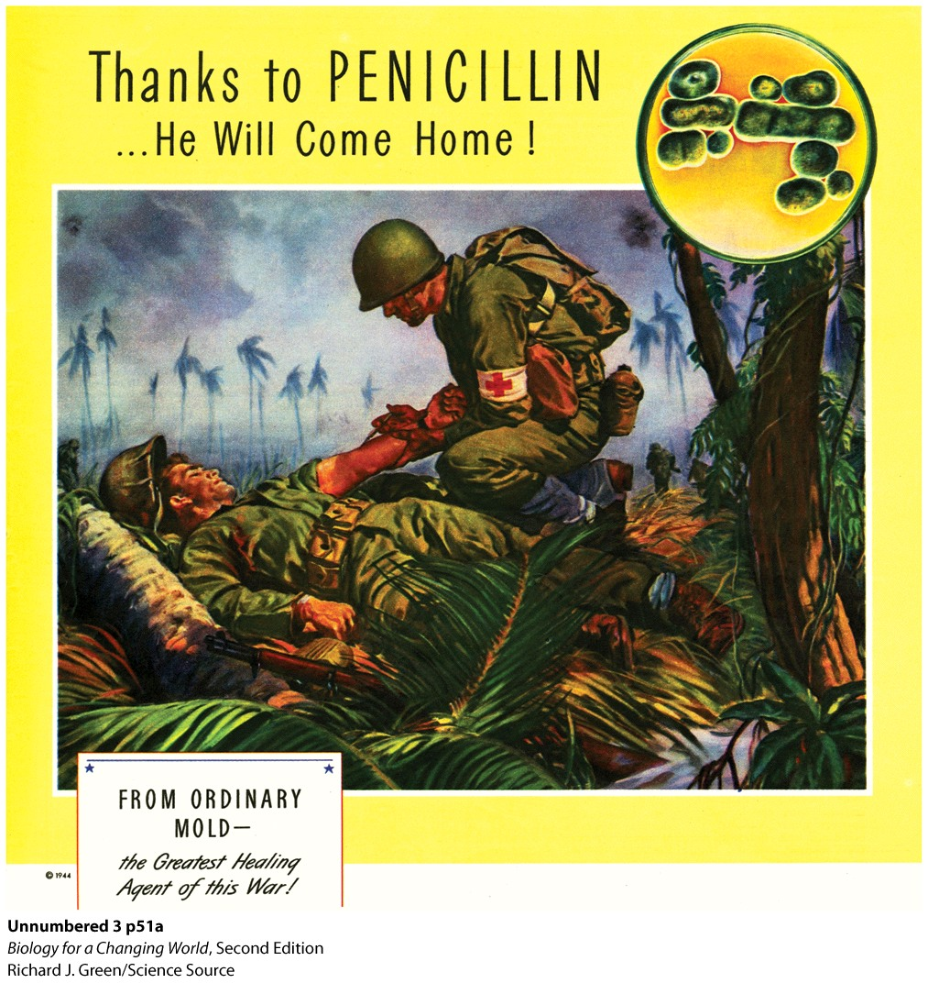
Antibiotic target prokaryotic cells
Wide-scale manufacture of penicillin in 1940s
Penicillin became the new wonder drug of World War II
Notes:
Millions of soldiers and civilians had died in World War I, many from infected wounds. With few other antibacterial medicines available, penicillin suddenly became the focus of research during World War II. In 1941, when Oxford scientists approached the U.S. government and asked for help in growing penicillin on a large scale.
By using a byproduct of large scale corn processing as a culture in which to grow the fungus, the scientists were able to produce penicillin in much greater quantities.

Slide 18
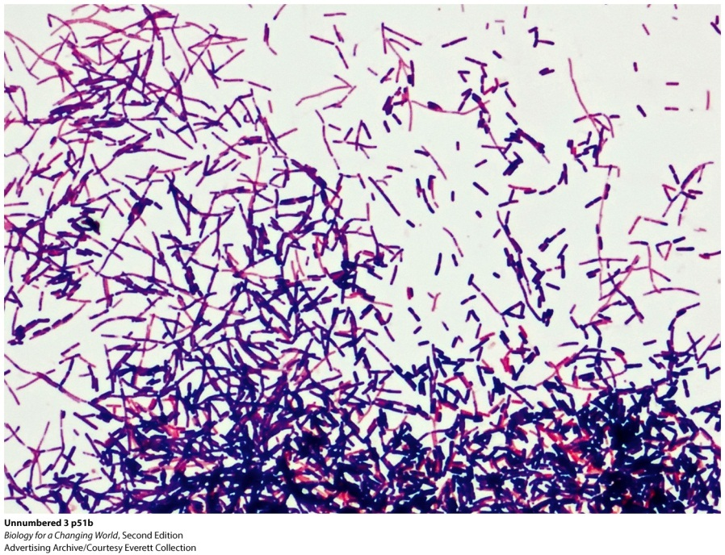
Antibiotics target prokaryotic cells
Bacteria cells are either
Gram-positive
—cell wall with layer of peptidoglycan that retains the Gram stain
Gram-negative
— cell wall layer of peptidoglycan surrounded by lipid membrane that does not retain the Gram stain
— prevents penicillin from reaching the peptidoglycan underneath

Slide 19
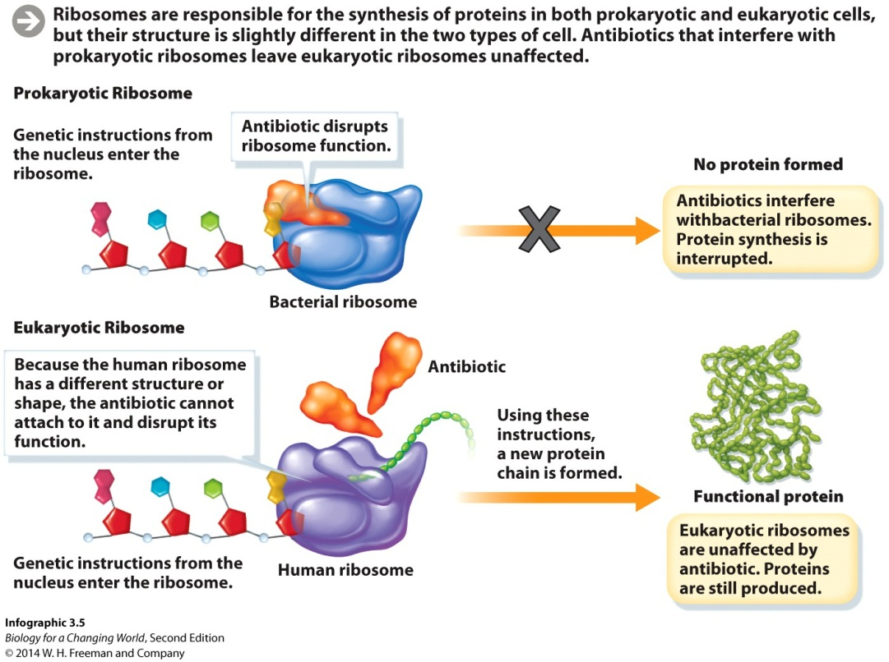
Antibiotics target prokaryotic cells
Additional methods of killing bacteria needed
Streptomycin: interferes with prokaryotic ribosomes
Leaves eukaryotic ribosomes unaffected
Notes:
Both eukaryotic and prokaryotic cells have ribosomes, but their ribosomes are of different sizes and have different structures. Because streptomycin targets features specific to bacterial ribosomes, it doesn’t harm the human who is taking it .

Slide 20
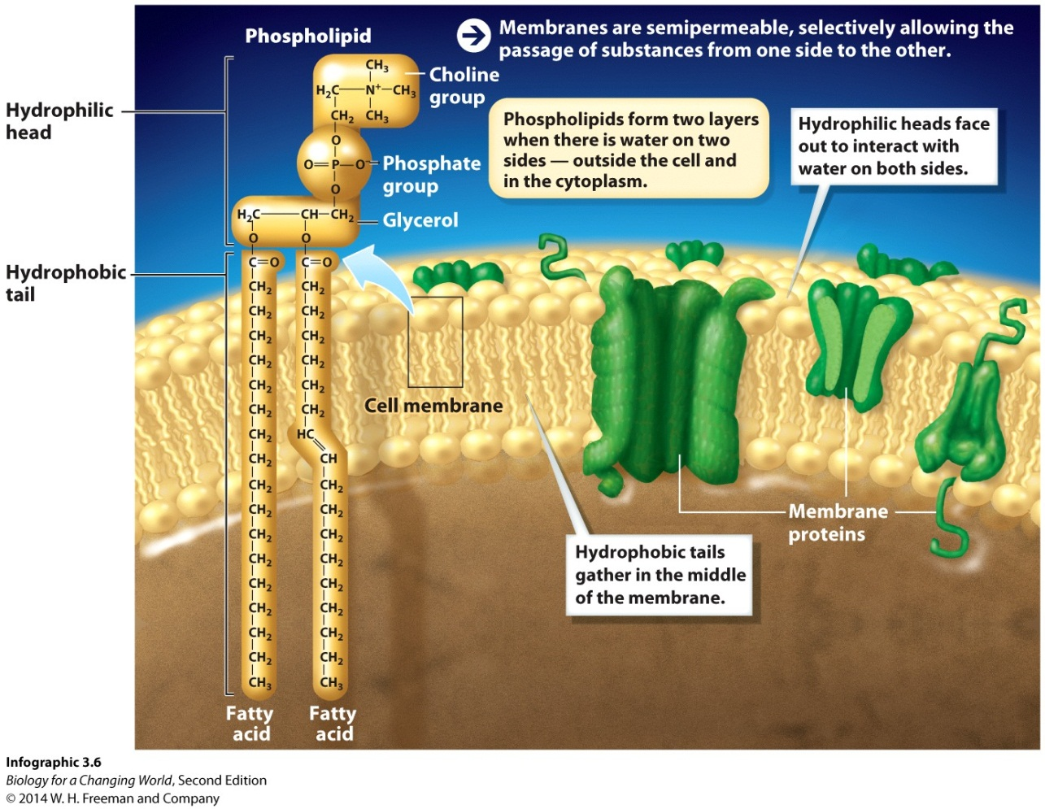
The cell membrane
All cells surrounded by a cell membrane
a phospholipid bilayer with embedded proteins that forms the boundary of all cells
Semipermeable
Notes:
The membrane is semipermeable: only certain substances can cross it freely.

Slide 21
The cell membrane
Semipermeable
Structure is partly hydrophobic and hydrophilic
In aqueous environment, phospholipids forms a bilayer
Hydrophilic heads out toward water
Hydrophobic tails in away from water

Slide 22
The cell membrane
Prevents many large molecules, like glucose, and hydrophilic (charged) substances, like sodium ions, from crossing
Allows small uncharged substance to cross
via diffusion

Slide 23
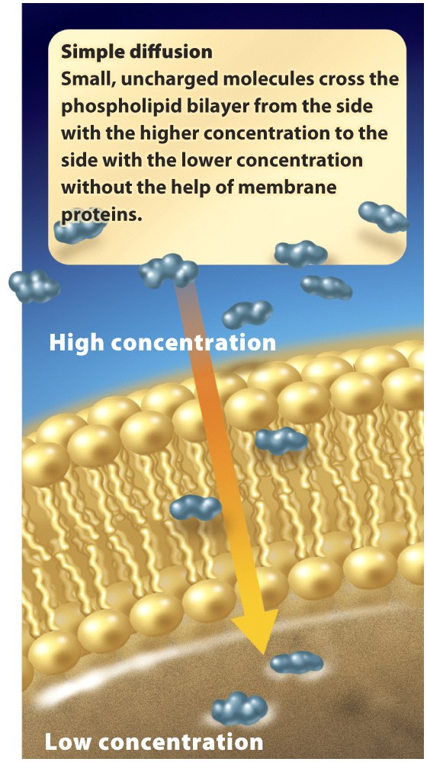
The cell membrane
Simple diffusion
Natural tendency of dissolved substances to move from an area of higher concentration to one of lower concentration
No energy required

Slide 24
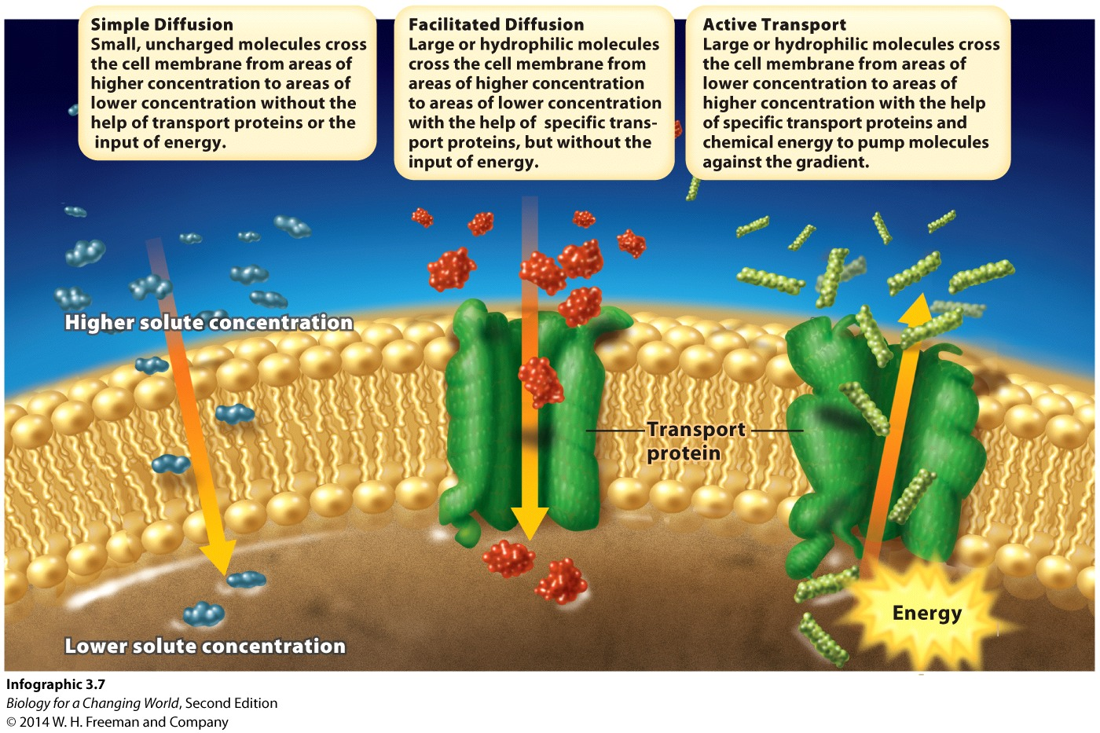
The cell membrane
Large or hydrophilic molecules cross the membrane by assistance of transport proteins

Slide 25
The cell membrane
Transport proteins
Sit in the membrane bilayer
Act as a channel, carrier, or pump
Provide a passageway
Can move substance with or against concentration gradient
Specific

Slide 26
The cell membrane
Facilitated diffusion
Large or hydrophilic solutes move across a membrane from higher concentration to lower concentration with the help of transport proteins
Does not require energy

Slide 27
The cell membrane
Active transport
Solutes are pumped from lower concentration to higher concentration with the help of transport proteins
Requires energy

Slide 28
Antibiotics target prokaryotic cells
Antibiotics can cross prokaryotic cell membrane using transport proteins
Bacteria can resist antibiotics using transport proteins as well
Pump out antibiotic
Notes:
Microorganisms like these have evolved chemical defenses as a way to protect themselves from other organisms. In turn, their combatants have evolved countermeasures that give them resistance.

Slide 29
Eukaryotic cells
Distinct from prokaryotic cells in many ways
Resist effects of antibiotics
For example, organelles
each performs a specific function

Slide 30
Eukaryotic organelles

Slide 31
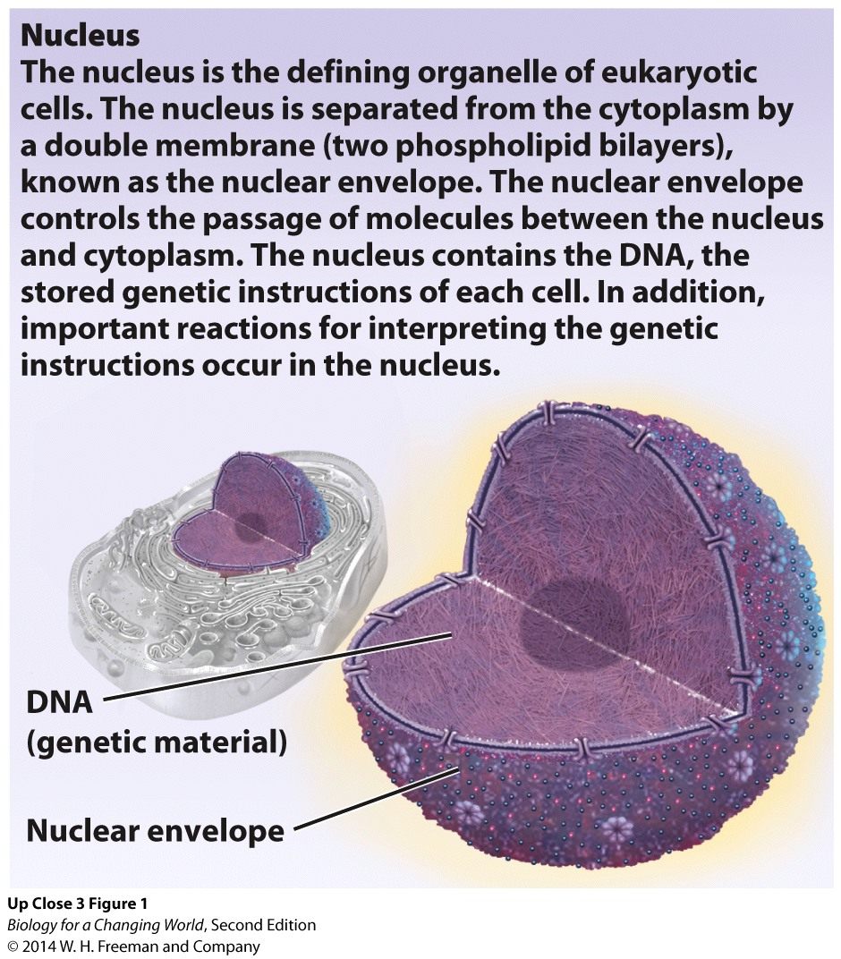
Eukaryotic organelles
Nucleus
Encloses the cells DNA
Reactions for interpreting the genetic instructions take place here
Surrounded by the nuclear envelope
Notes:
Nuclear envelope: a double membrane made of two lipid bilayers

Slide 32
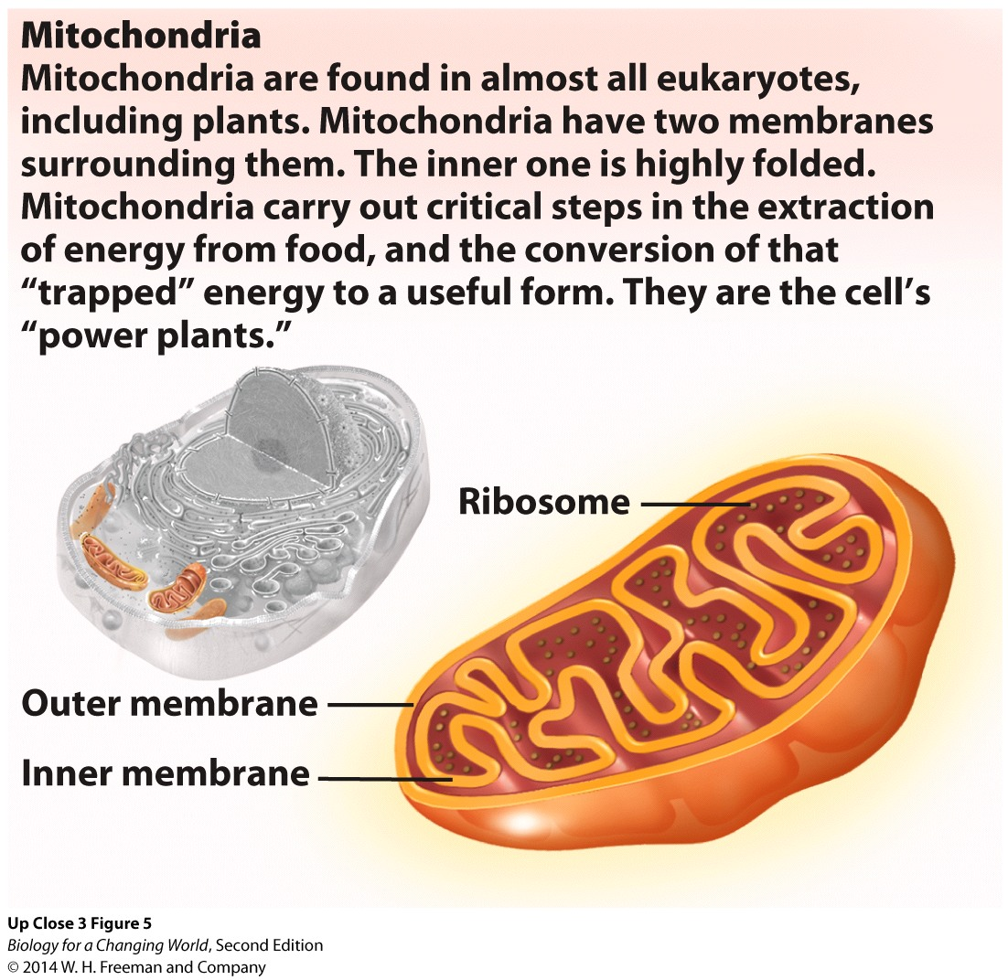
Eukaryotic organelles
Mitochondria
Cells power plants
Extract energy from food
Convert energy into a useful form

Slide 33
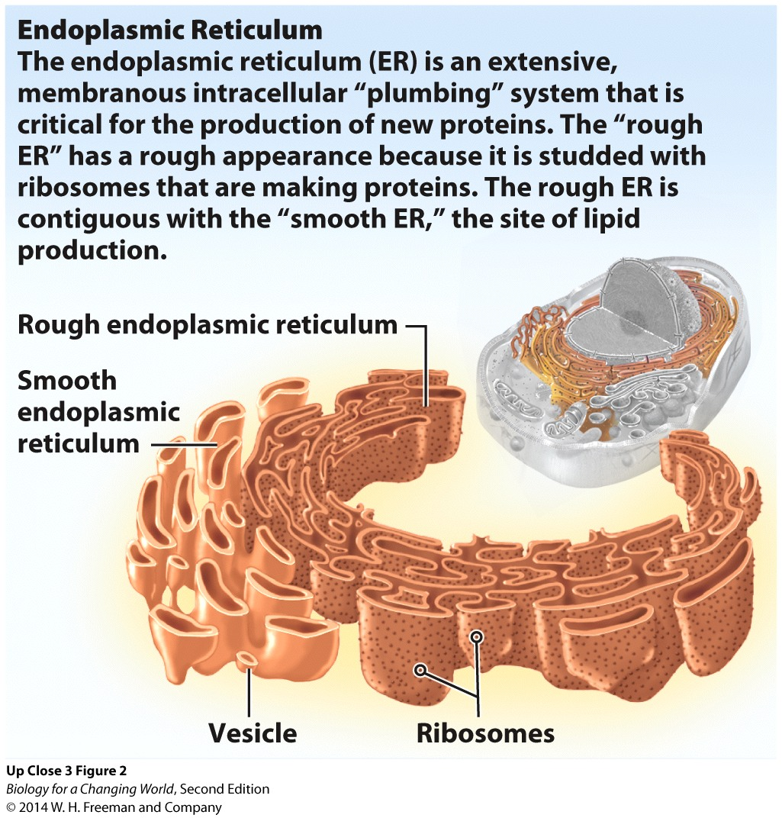
Eukaryotic organelles
Endoplasmic reticulum (ER)
Network of membrane-covered “pipes”
Proteins and lipids synthesized here
Rough ER
Smooth ER
Notes:
“Rough ER” is studded with ribosomes making proteins; the “smooth ER” makes lipids.

Slide 34
Eukaryotic organelles
Golgi apparatus
Stacked membranous discs
Packages and transports proteins

Slide 35
Eukaryotic organelles
Nucleus, ER, and Golgi apparatus work together to produce and transport proteins

Slide 36
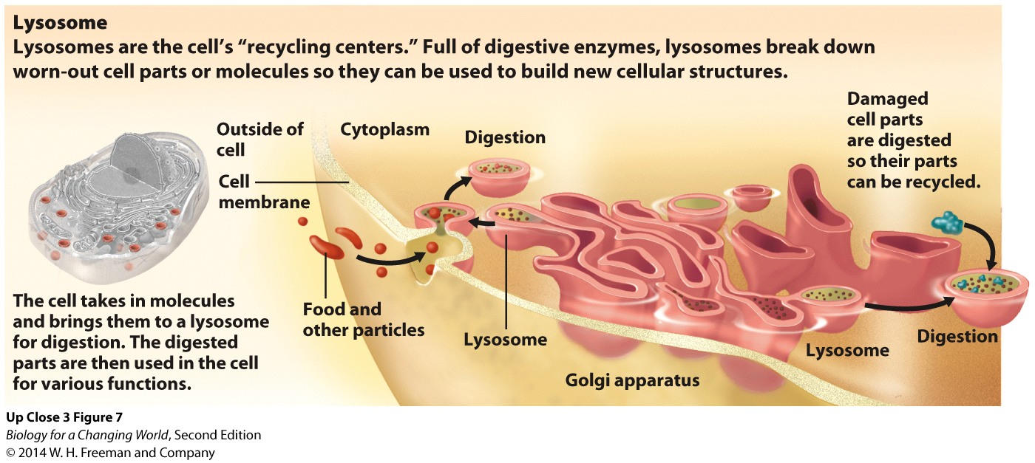
Eukaryotic organelles
Lysosomes
Full of digestive enzymes
Break down worn-out cell parts or molecules
Recycle

Slide 37
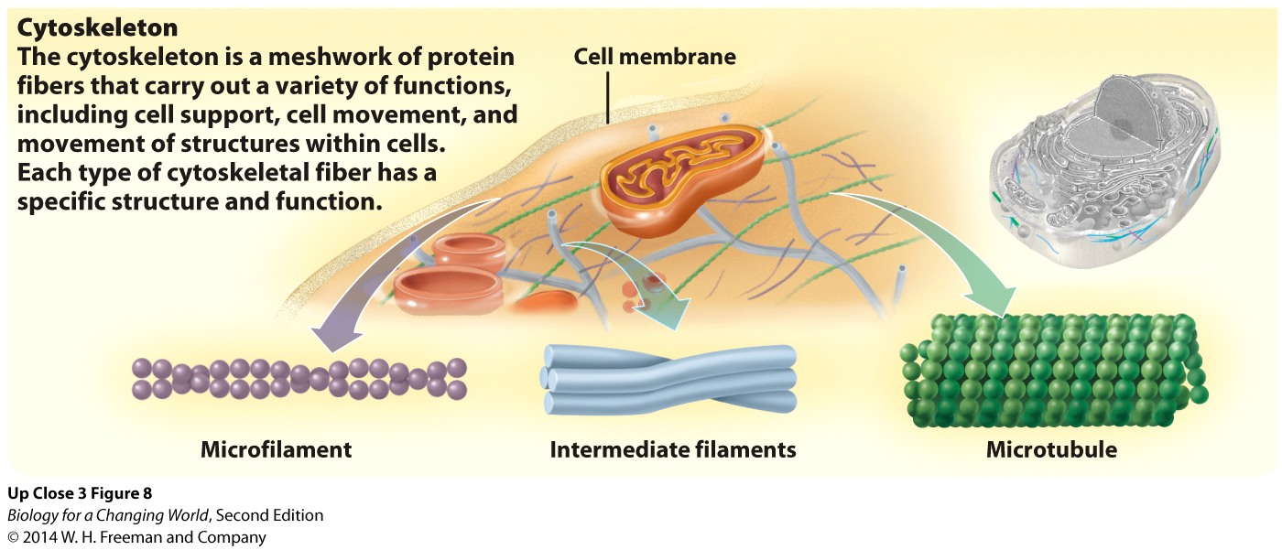
Eukaryotic organelles
Cytoskeleton
Network of protein fibers
Variety of functions, including cell support, cell movement, and movement of structures within cells
Three types of proteins

Slide 38
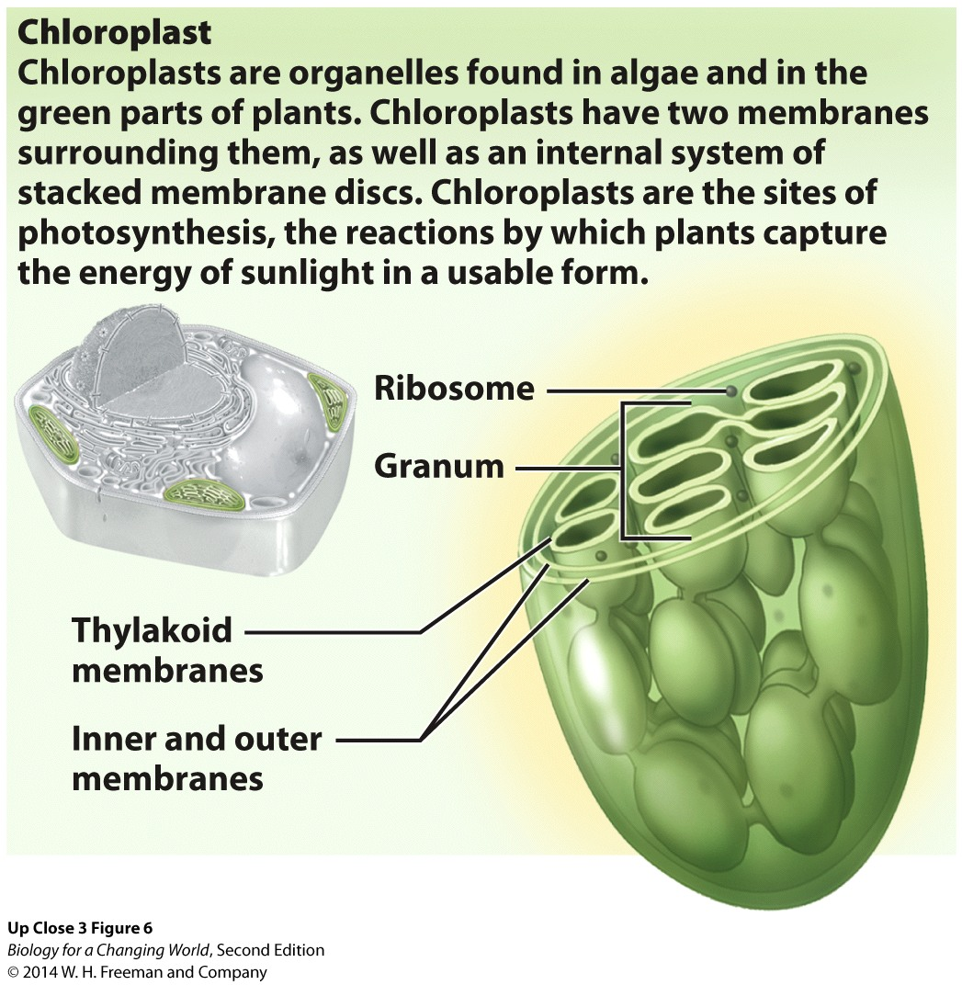
Eukaryotic organelles
Chloroplasts
Plant and algae cells
Two membranes
Internal system of stacked membrane discs
Sites of photosynthesis
capture and conversion of sunlight energy into a usable form

Slide 39
Evolution of eukaryotic cells
Endosymbiosis theory
Free-living prokaryotic cells engulfed other free-living prokaryotic cells billions of years ago, forming eukaryotic organelles
Mitochondria and chloroplasts

Slide 40
Summary
Antibiotics are chemicals, originally produced by living organisms, that selectively target and kill bacteria.
All living organisms are made of cells, and new cells arise from existing cells.
Two types of cells, distinguished by their structure: prokaryotic and eukaryotic.
All cells are enclosed by a cell membrane, which controls the passage of molecules between the exterior of the cell and the cytoplasm.
Substances cross cell membranes by simple or facilitated diffusion or by active transport.
Water crosses cell membranes by osmosis.
All cells have ribosomes: complexes of RNA and proteins that synthesize new proteins.
Eukaryotic cells contain a number of specialized organelles.

