Slide 1
Michèle Shuster • Janet Vigna • Gunjan Sinha • Matthew Tontonoz
Biology for a
Changing World
SECOND EDITION
Lecture PowerPoint
CHAPTER 7
DNA Structure and Replication
Copyright © 2014 by W. H. Freeman and Company

Slide 2
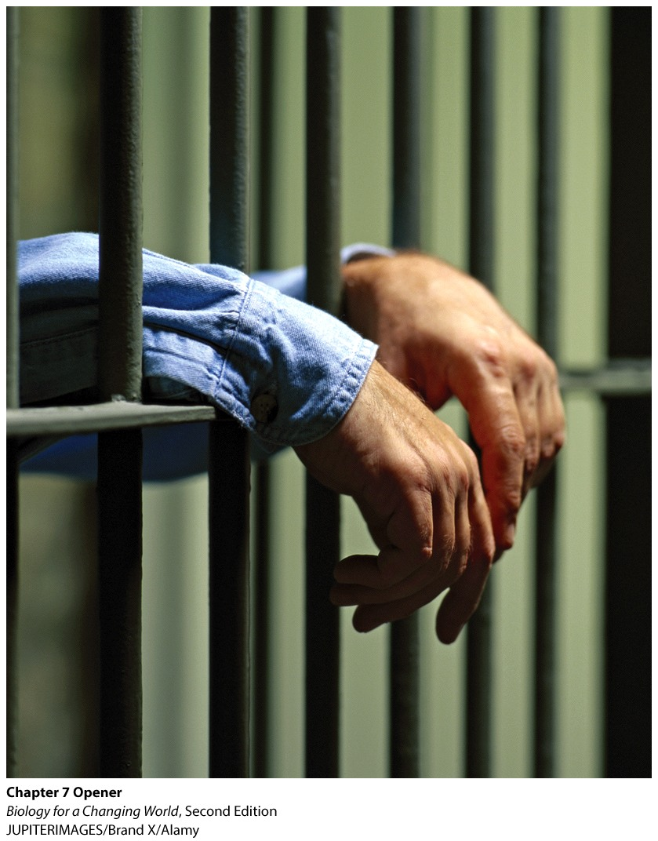
Chapter 7
DNA Structure and Replication

Slide 3
Driving Questions
1. What is the structure of DNA, and how is DNA
organized in cells?
2. How is DNA copied in living cells, and how can
DNA be amplified for forensics?
3. How does DNA profiling make use of genetic
variation in DNA sequences?
4. How does DNA evidence fit into forensic
investigations?

Slide 4
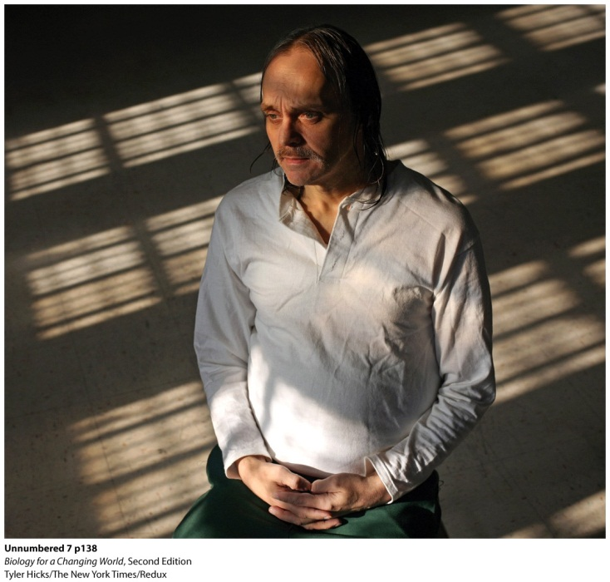
The Innocence Project
Uses DNA as evidence to free people wrongly convicted of crimes
DNA testing is standard part of court cases
Extremely accurate way to match crime scene evidence to perpetrators
Notes:
In 1991, Roy Brown was found guilty of homicide and sentenced to 25 years to life in prison.

Slide 5
What is DNA?
Deoxyribonucleic acid (DNA)
hereditary molecule that is passed from parents to offspring
common to all living organisms
serves as the instruction manual for how to build an individual

Slide 6
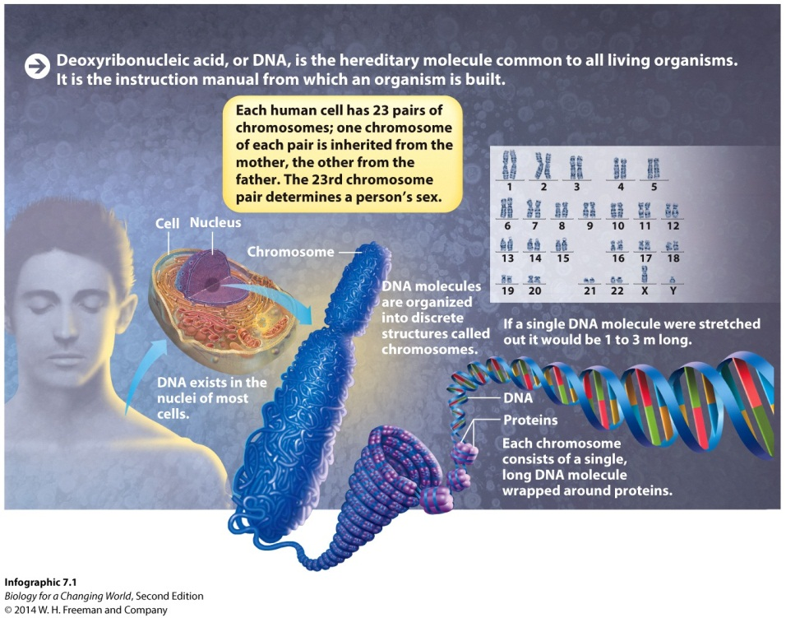
DNA
found in the nucleus of eukaryotic cells
in the form of a chromosome
single DNA molecule wrapped around proteins

Slide 7
Human DNA
Humans have 23 pairs of chromosomes
One chromosome from each pair is inherited from the biological mother
One chromosome from each pair is inherited from the biological father

Slide 8
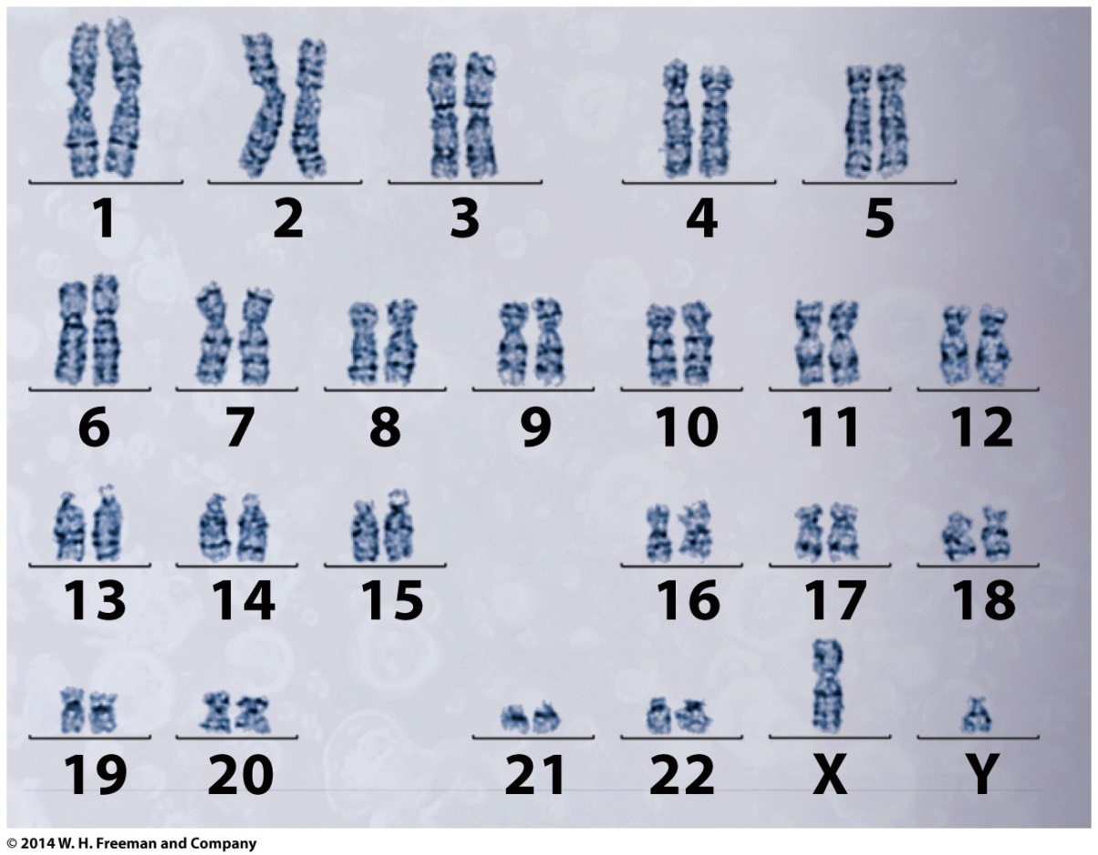
Human DNA
23rd chromosome pair determines sex
XX = female
XY = male

Slide 9
Human DNA
Each person’s DNA is unique
Consider its structure to understand why

Slide 10
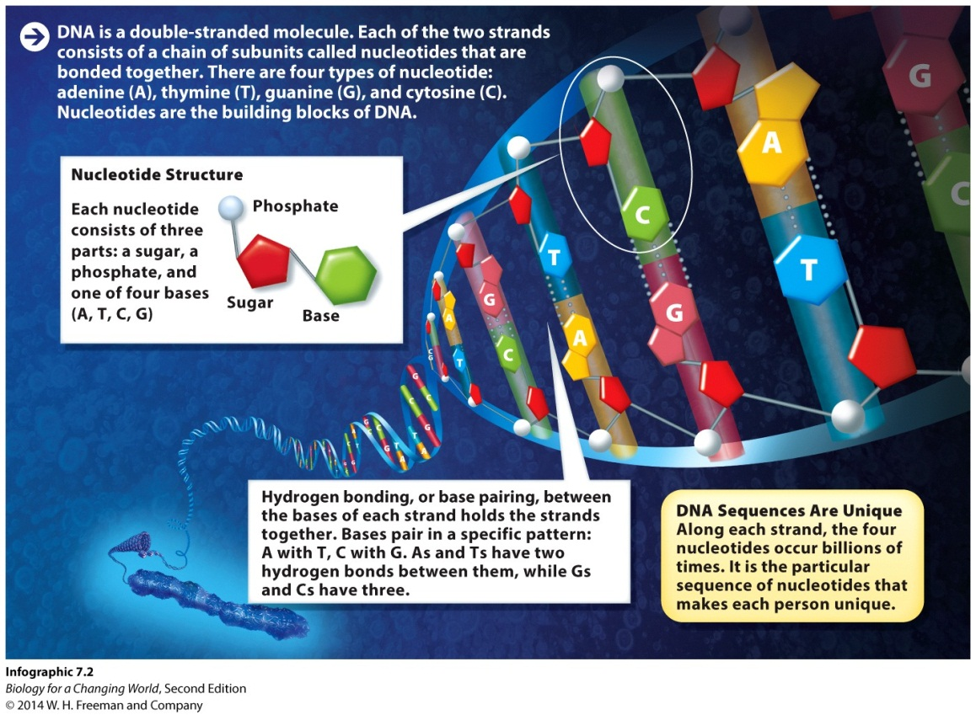
The structure of DNA
DNA is composed of nucleotides
Each nucleotide consists of a sugar, a phosphate, and a base

Slide 11
The structure of DNA
Nucleotides have one of four bases
adenine (A)
thymine (T)
guanine (G)
cytosine (C)

Slide 12
The structure of DNA
Two strands of nucleotides pair up and twist around each other to form a spiral-shaped double helix
sugars and phosphates form the outside “backbone”
bases form the internal “rungs”

Slide 13
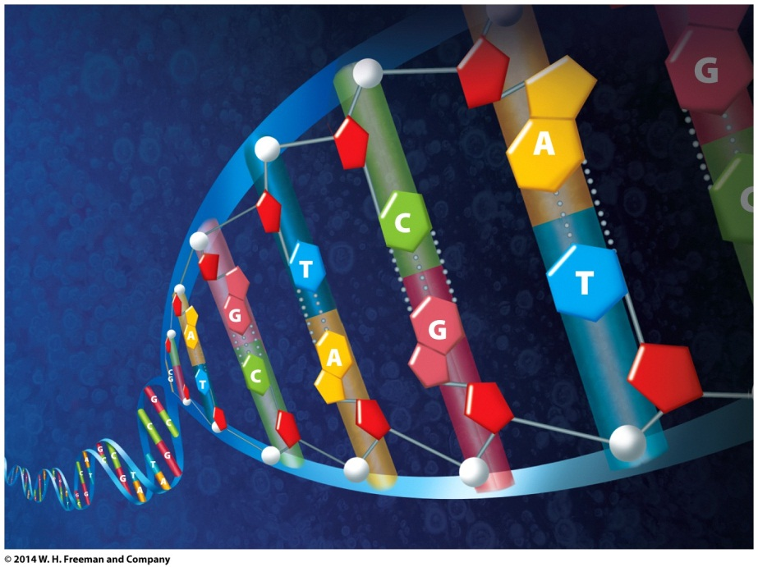
The structure of DNA
Two strands of DNA double helix are held together by base pairing (hydrogen bonding) between the bases of each strand
Complementary base pairing
A always pairs with T
C always pairs with G

Slide 14
The structure of DNA
Specific sequence of nucleotides along a strand of DNA is unique to each individual
Extract the DNA from the cells to create an individual’s DNA profile
visual representation of a person’s unique DNA sequence
need many copies of their DNA

Slide 15
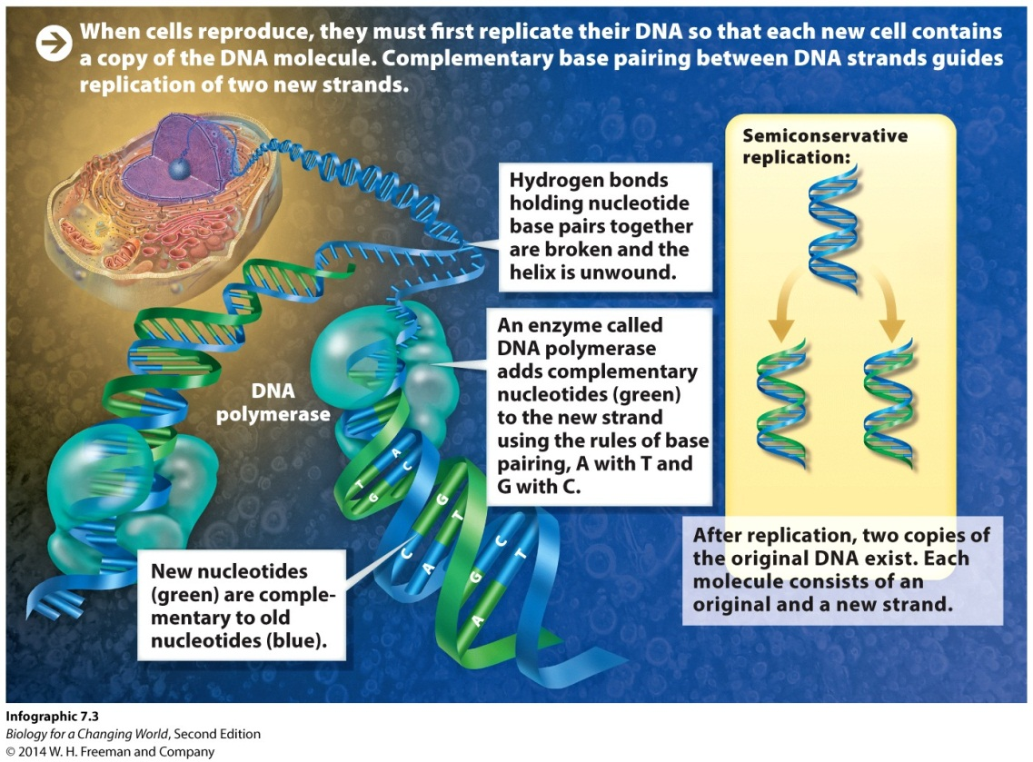
DNA replication
Natural process by which cells make an identical copy of a DNA molecule
Takes advantage of complimentary base-pairing rules

Slide 16
DNA replication
First, hydrogen bonds that hold base pairs together are broken and the helix is unwound

Slide 17
DNA replication
DNA polymerase reads the DNA and adds complementary nucleotides using the rules of base pairing

Slide 18
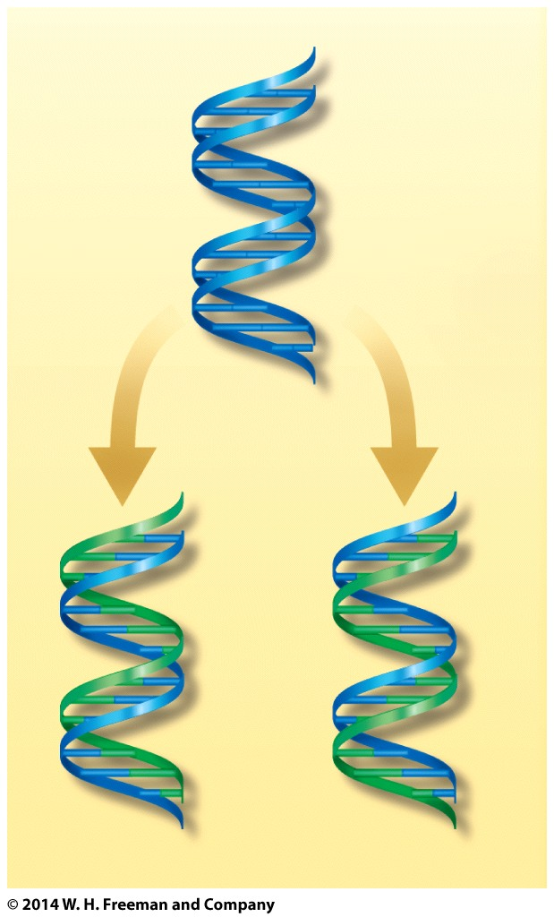
DNA replication
Semi-conservative mechanism
produces two copies of the original DNA molecule
each molecule consists of one of the strands of the original DNA molecule and a new strand.

Slide 19
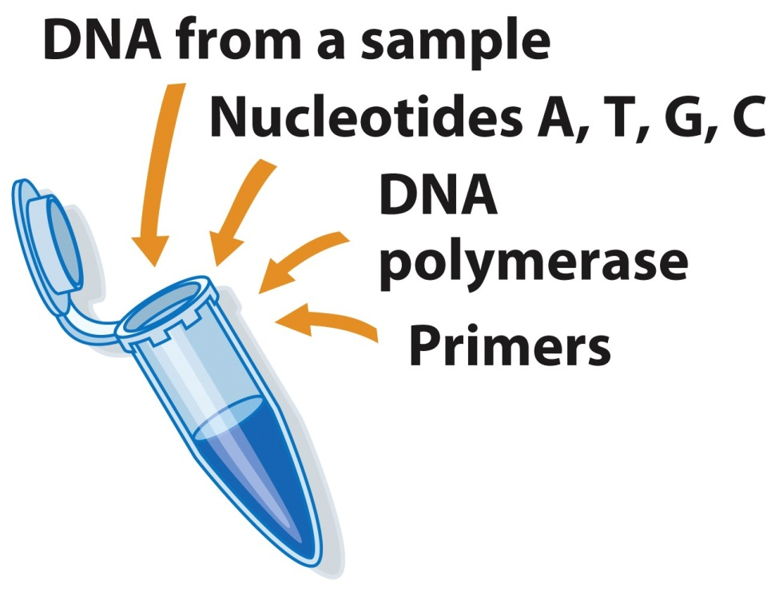
The polymerase chain reaction (PCR)
PCR is a laboratory technique used to replicate and amplify a specific DNA segment
Primers: short segments of DNA that guide DNA polymerase to the section of DNA to copy
Notes:
DNA is first heated to separate the strands, and then cooled to allow new nucleotides to be added. From a starting sample of just a few DNA molecules, PCR can make billions of copies of a specific region of the DNA in less than a few hours.

Slide 20
PCR
Heating
Strand separation
DNA replication

Slide 21
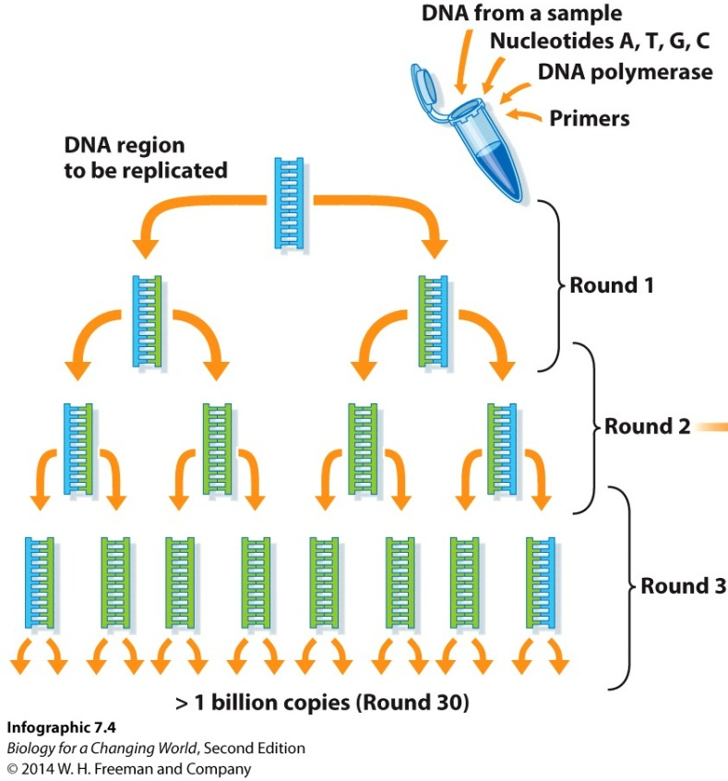
PCR
Allows DNA replication to occur many times
Can make billions of copies from a starting sample of just a few molecules of DNA

Slide 22
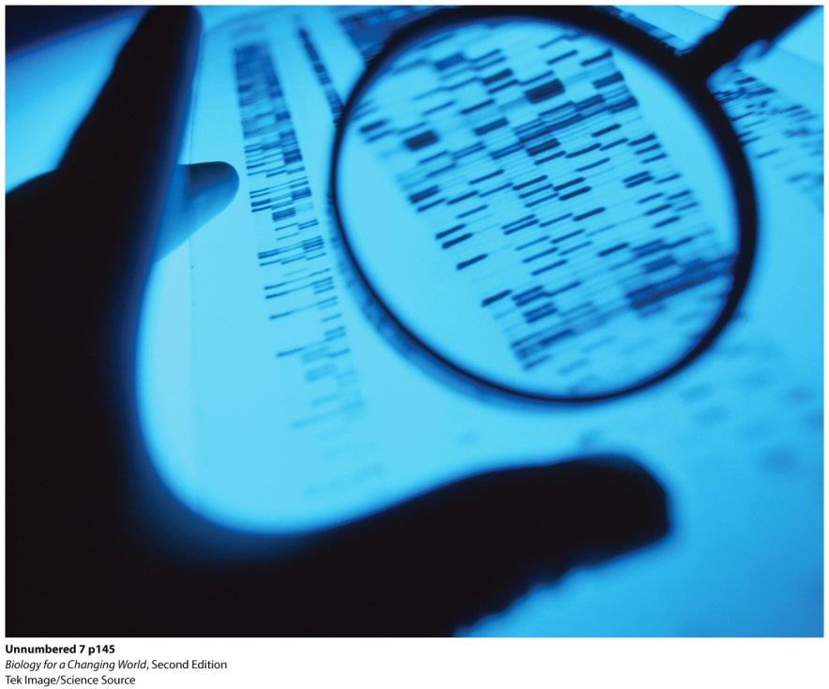
DNA profiling
DNA profiling takes advantage of the fact that no two people have the exact same DNA sequence
Genome
one complete set of genetic instructions encoded in the DNA of an organism
Notes:
Each person’s DNA sequence is unique and can be used as a kind of molecular “fingerprint.”

Slide 23
DNA profiling
Determining sequence of entire genome is extremely time consuming and expensive
Use shortcut
use PCR to amplify only specific segments of DNA
short tandem repeats (STR)

Slide 24
DNA profiling
STRs are sections of a chromosome in which DNA sequences are repeated
For example, sequence AGCT may be repeated over and over again

Slide 25
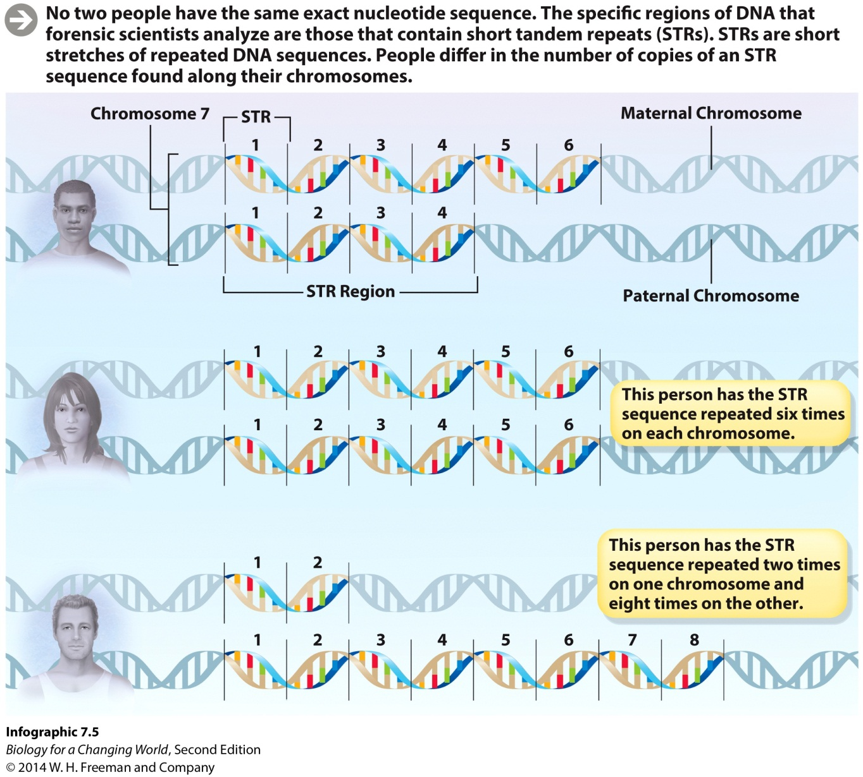
DNA profiling
STRs are in the same places along chromosomes
Exact length of STR varies from person to person
Notes:
At a single STR site, one person may carry the AGCT sequence repeated six times while another person might carry the AGCT sequence repeated four times.

Slide 26
Making a DNA profile
Collect cells and extract DNA

Slide 27
Making a DNA profile
Use PCR to amplify multiple STR regions

Slide 28
Making a DNA profile
Separate STRs using gel electrophoresis
laboratory technique that separates fragments of DNA by size
Notes:
Shorter STRs (those with fewer numbers of repeats) are smaller and travel farther in the gel; longer ones do not travel as far.

Slide 29
Making a DNA profile
Separated fragments of DNA create a specific pattern of bands
Visible using fluorescence
Unique to each person
Compare patterns of DNA
Different individuals have different DNA banding patterns
Notes:
When visualized with a detection technique known as fluorescence (the same kind of light released from glowing jellyfish), the separated segments of DNA create a specific pattern of bands that is unique to each person. This pattern is a person’s DNA profile.
Scientists can compare band patterns of DNA from a crime scene to DNA from a suspect. DNA profiles have other applications like paternity or ancestry testing.

Slide 30
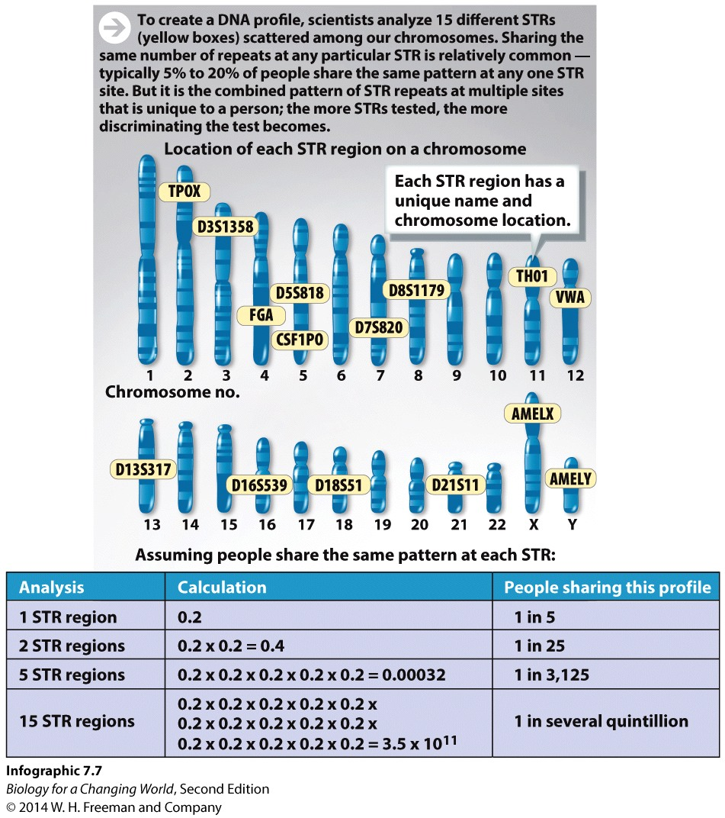
DNA profiling
Look at multiple STRs
Combined pattern of STR repeats at multiple sites is unique to a person
Notes:
The likelihood that any two unrelated people will have the same number of repeated sequences at all 15 regions is 1 in some number of quintillions (billions of billions).

Slide 31
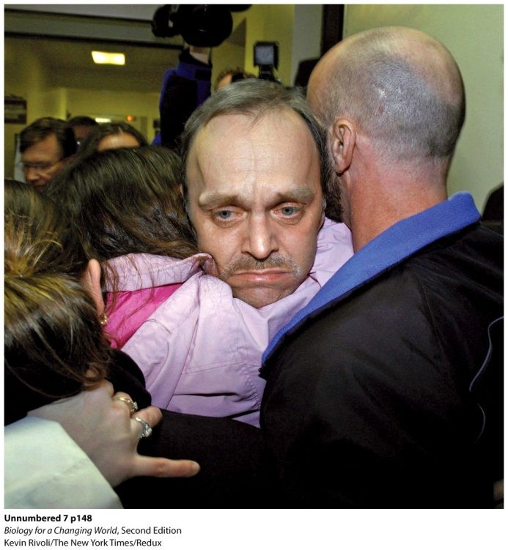
The Innocence Project
DNA evidence is more reliable than other forms of evidence
error rates for bite mark identification can be as high as 91%
hair analysis can only exclude a suspect, not positively identify one
Except for identical twins, no two people share exactly the same DNA
Notes:
Roy Brown with his family upon his release from prison.

Slide 32
Summary
DNA is the hereditary molecule of all living organisms.
DNA in a eukaryotic cell is packaged into chromosomes located in the nucleus.
Humans have 23 pairs of chromosomes in their cells—one chromosome of each pair inherited from the mother, the other from the father.
DNA is a double helix. Each strand is made of nucleotides. The two linear strands of a DNA molecule are bound together by complementary pairing of the nucleotides.
Complementary pairing of DNA strands guides DNA replication.
PCR enables scientists to increase the number of copies of specific DNA sequences.
Forensic scientists use STRs to create a DNA profile.

