Slide 1
Michèle Shuster • Janet Vigna • Gunjan Sinha • Matthew Tontonoz
Biology for a
Changing World
SECOND EDITION
Lecture PowerPoint
CHAPTER 8
Genes to Proteins
Copyright © 2014 by W. H. Freeman and Company

Slide 2
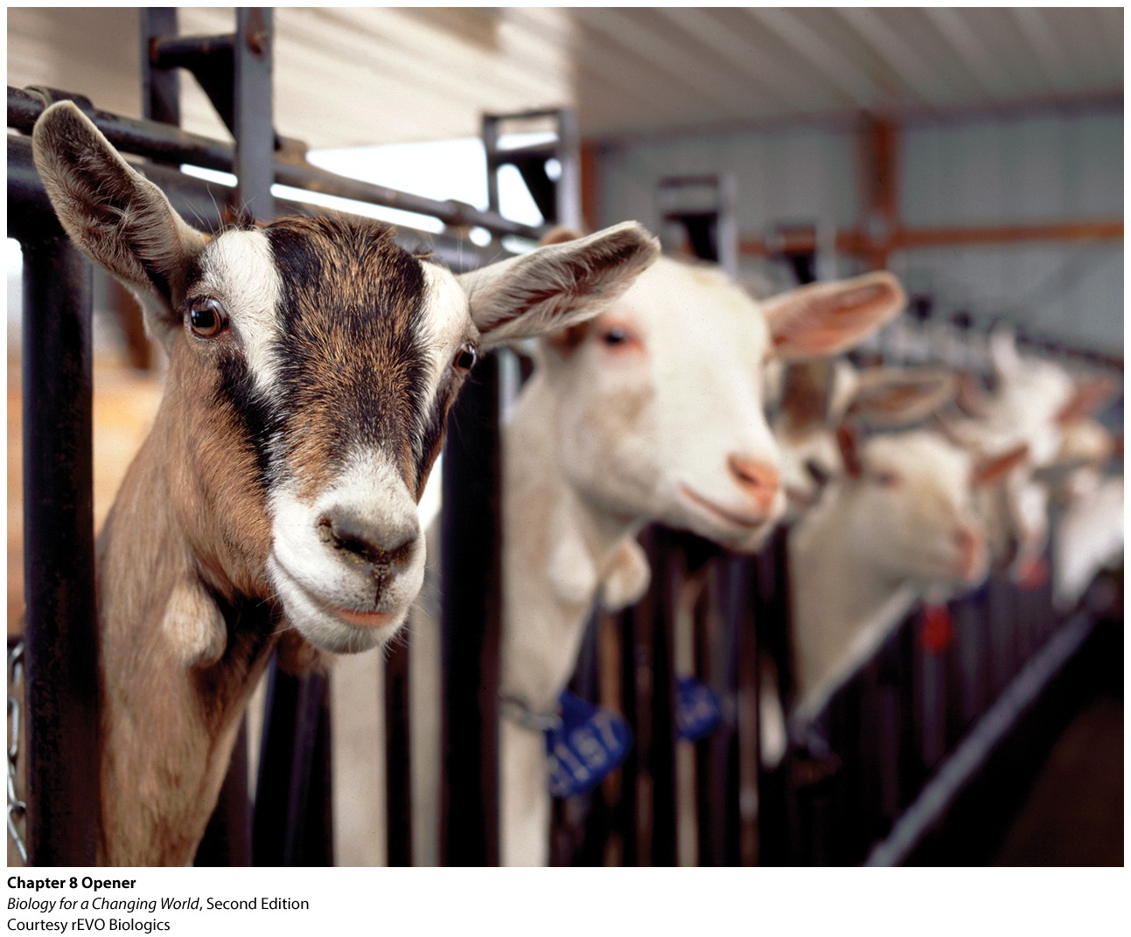
Chapter 8
Genes to Proteins
Notes:
Scientists genetically modify animals to make medicine.

Slide 3
Driving Questions
1. What determines the shape of a protein
molecule?
2. What are the steps of gene expression, and
where do they occur in a cell?
3. How can animals be genetically modified to produce
human proteins (with therapeutic uses)?
4. What are some practical applications of
genetically modified organisms

Slide 4
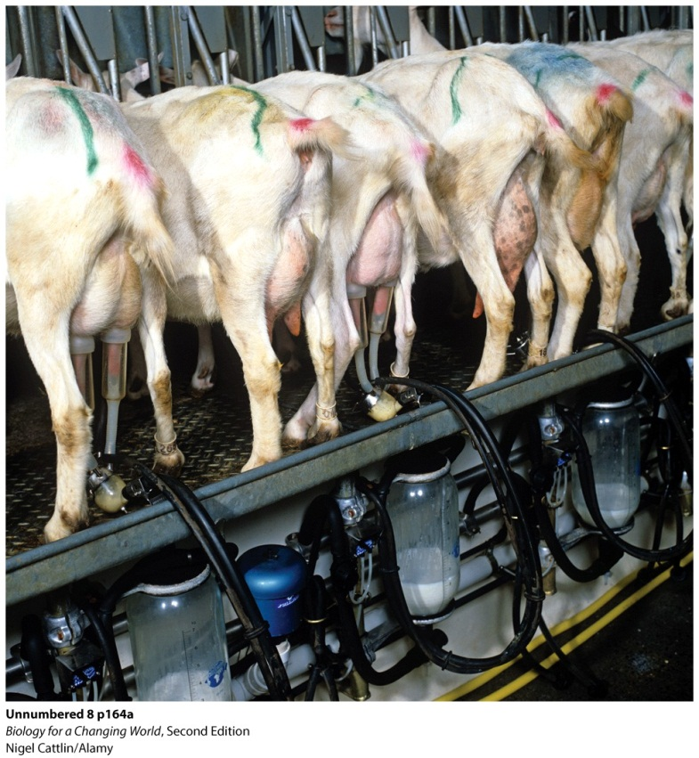
Pharming
using genetically modified animals to make pharmaceutical drugs
human protein (antithrombin) is extracted from the goats’ milk
Notes:
Genetically modified goats can produce massive amounts of the drug in a relatively short period. There is also less risk of transmitting infections such as HIV and hepatitis to healthy people with this method.

Slide 5
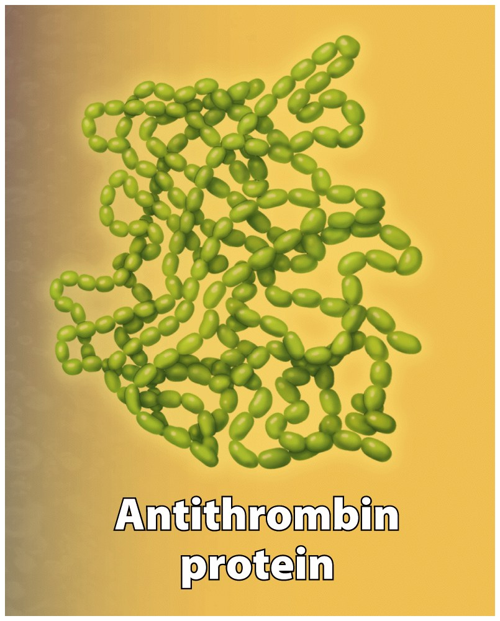
What is a protein?
macromolecule made of repeating amino acid subunits
many functions
for example: muscle contraction, facilitate chemical reactions, fight infection

Slide 6
Amino acids
building blocks of proteins
20 different amino acids
all have the same basic core structure
each also has a unique chemical side group

Slide 7
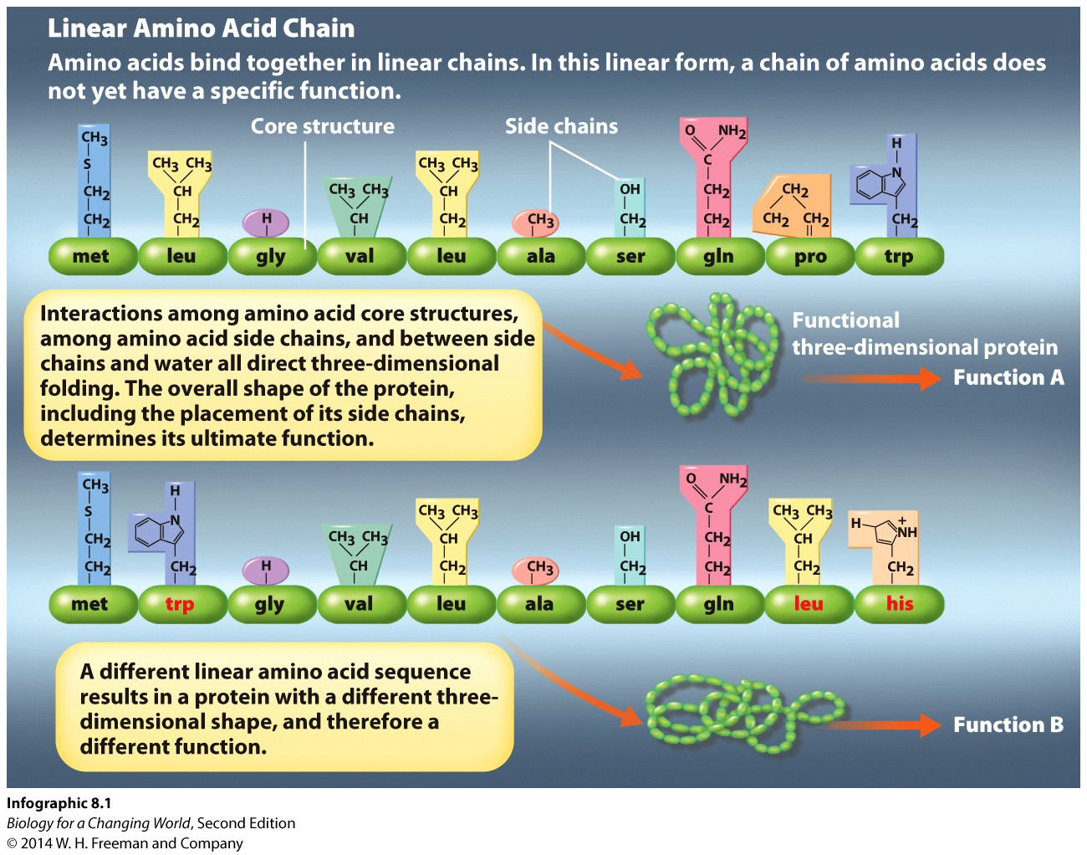
Amino acids
bond together to form linear chains
chain folds into a 3-D protein based on the sequence of amino acids
determine the shape and function of a protein

Slide 8
Amino acids
changing an amino acid in the sequence changes the 3-D shape of the protein
shape of the protein determines its function

Slide 9
Where do proteins come from?
instructions to make proteins are encoded by genes
a sequence of DNA that contains the instructions to make at least one protein

Slide 10
Where do proteins come from?
genes are found on chromosomes
each chromosome carries a unique set of genes
synthesis of a protein from a gene is called gene expression

Slide 11
Antithrombin protein
Antithrombin protein helps prevent blood clots (thrombosis)
antithrombin gene is on chromosome 1
gene is expressed by cells in the liver
release antithrombin into bloodstream.

Slide 12
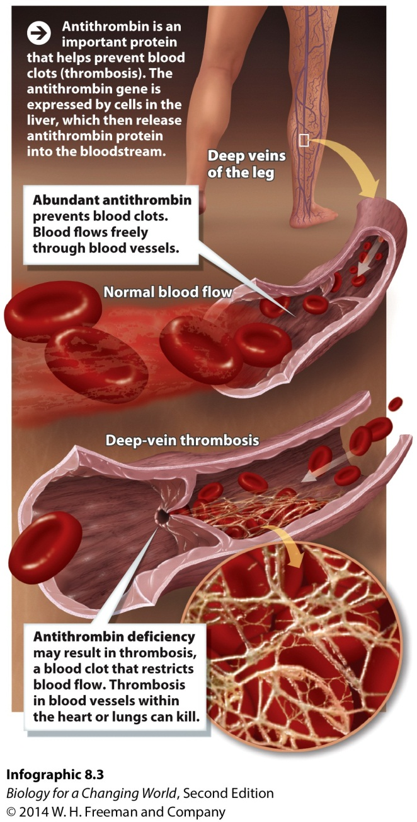
Antithrombin protein
inherit genetic defect
antithrombin deficiency

Slide 13
Antithrombin protein
antithrombin deficiency
one or both copies of antithrombin gene defective
humans have two copies of every gene
either identical in nucleotide sequence, or slightly different
different version of same gene is called allele

Slide 14
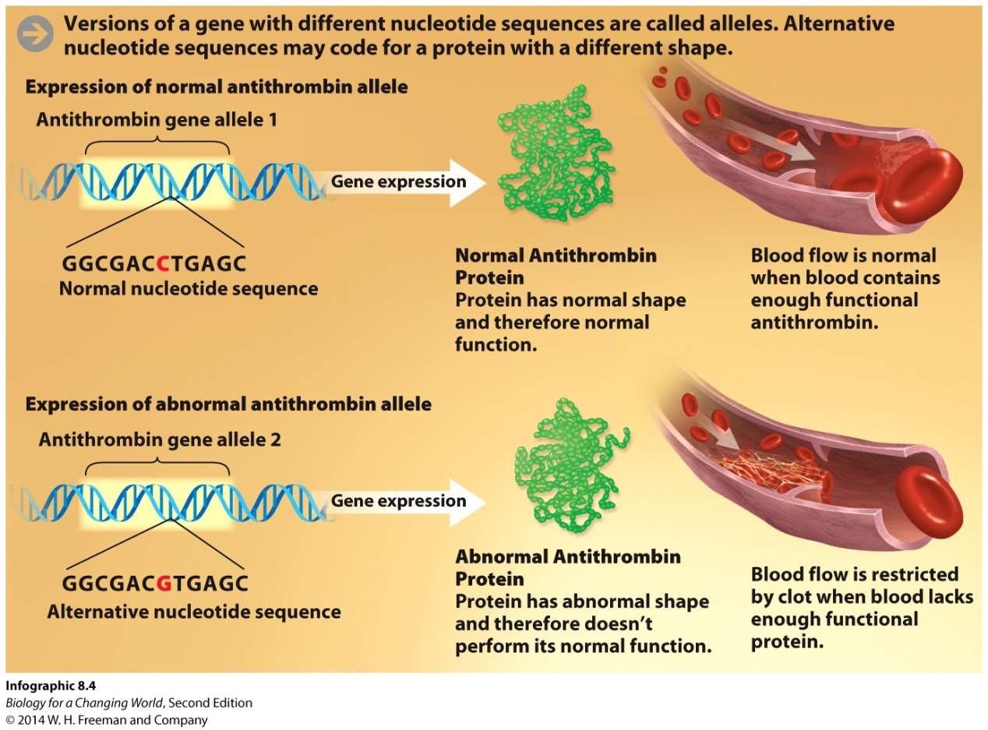
Alleles
alternative versions of the same gene
have different nucleotide sequences
different alleles influence protein function

Slide 15
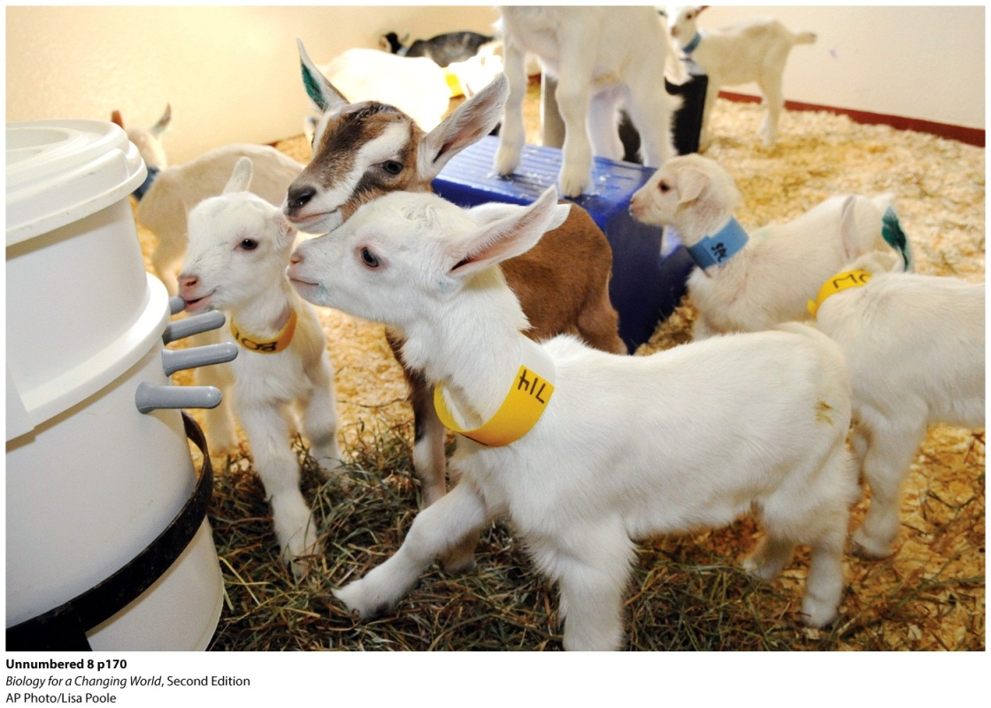
Genetically modified animals
Animals that have been genetically altered are called transgenic organisms
Isolate gene of interest from human chromosome
Insert it into animal embryo
Gene must be a hybrid so human protein is expressed in animal
Notes:
To make sure the human gene is expressed when the goat produces milk, Meade and his colleagues had to create a hybrid gene that was part human and part goat.
Photo: baby goats, or kids, in the nursery at the rEVO Biologics farm.

Slide 16
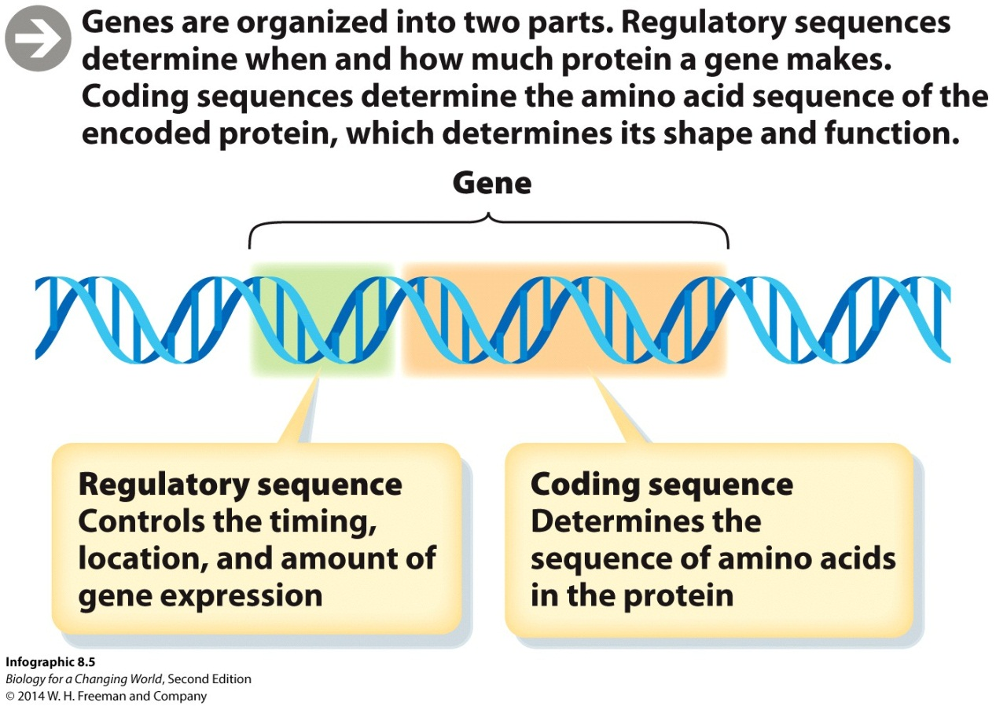
Genes have two parts
Regulatory sequences determine when and how much protein a gene makes
Coding sequences determine the amino acid sequence of the encoded protein

Slide 17
Genetic engineering
process of assembling new “hybrid” genes
novel combinations of regulatory and coding sequences
recombinant gene

Slide 18
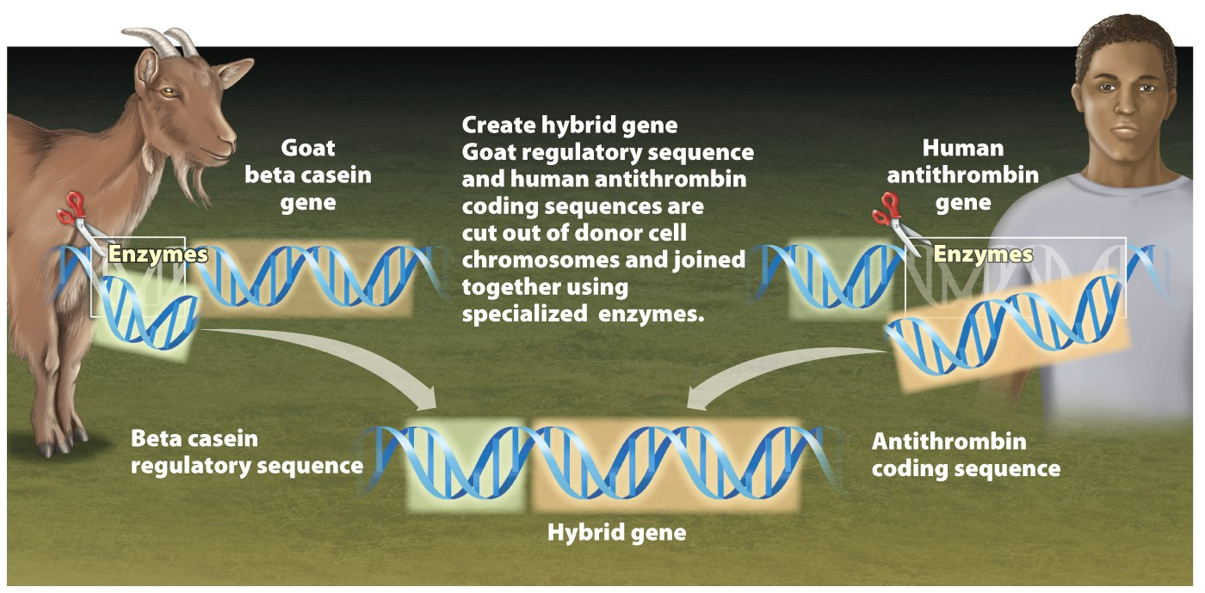
Antithrombin recombinant gene
use regulatory sequence of a milk gene
use coding sequence of antithrombin
ensures that antithrombin is expressed only in the mammary cells
Insert infographic top half 8.6 (step 1 only)

Slide 19
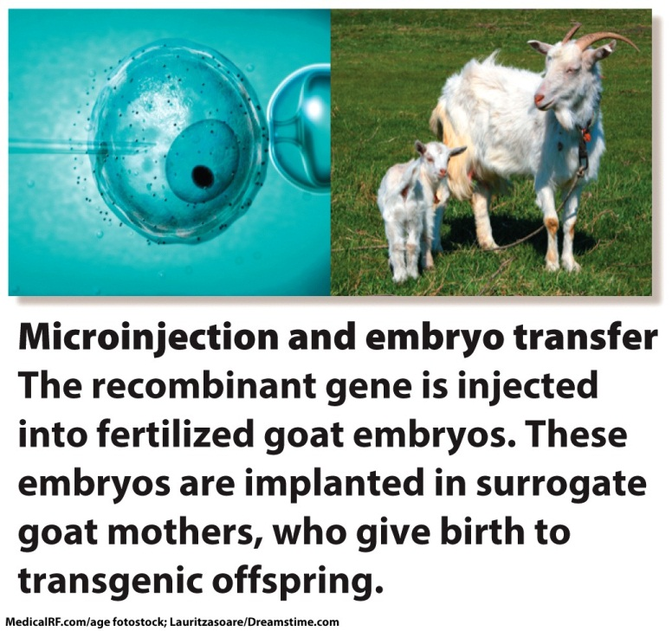
Making transgenic organisms
use needle to inject the recombinant gene into a fertilized single-cell goat embryo
transgenic embryo is implanted into mother
embryo grows and inserted gene is replicated and passed on to every cell

Slide 20
Making transgenic organisms
harvest transgenic milk and purify protein

Slide 21
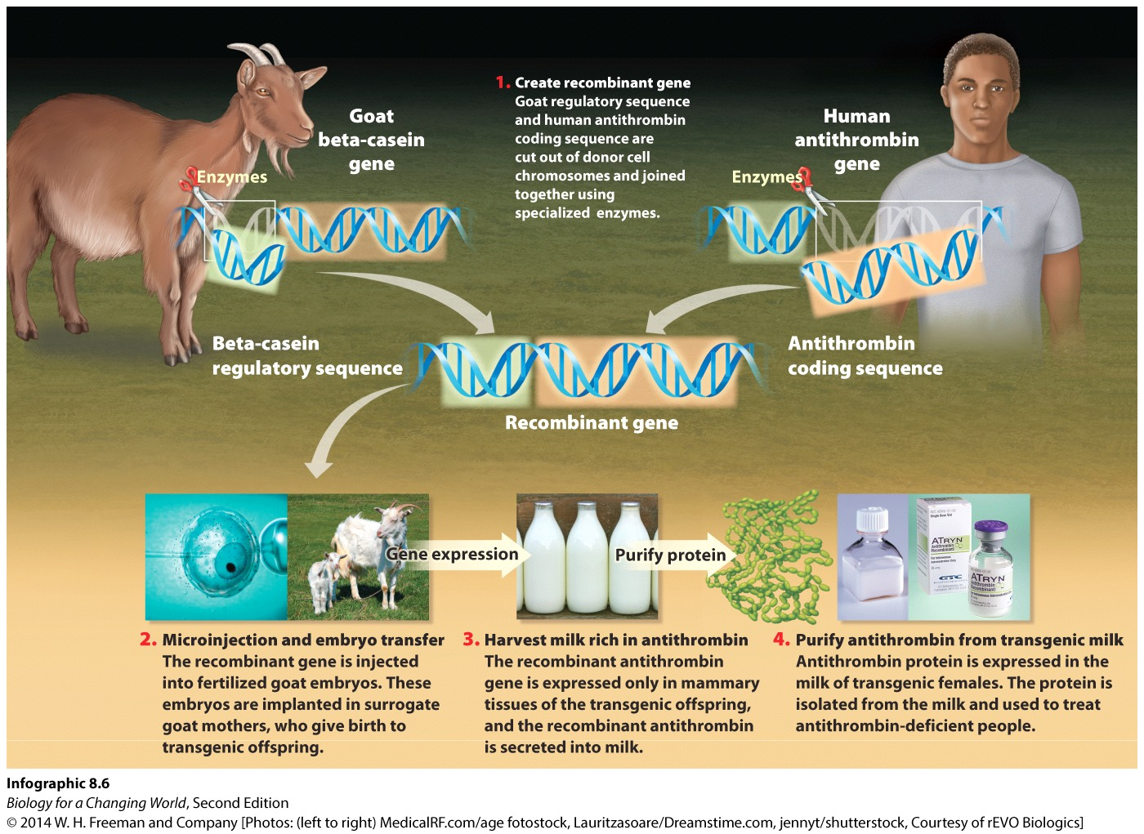
Making transgenic organisms
aka genetically modified organism (GMO)
Notes:
Genetically modified organism (GMO): an organism that has been genetically altered by humans.

Slide 22
Genetically modified organisms
Transgenic crops modified to contain genes for natural pesticides
Transgenic animals used to research a gene’s function or produce marketable products

Slide 23
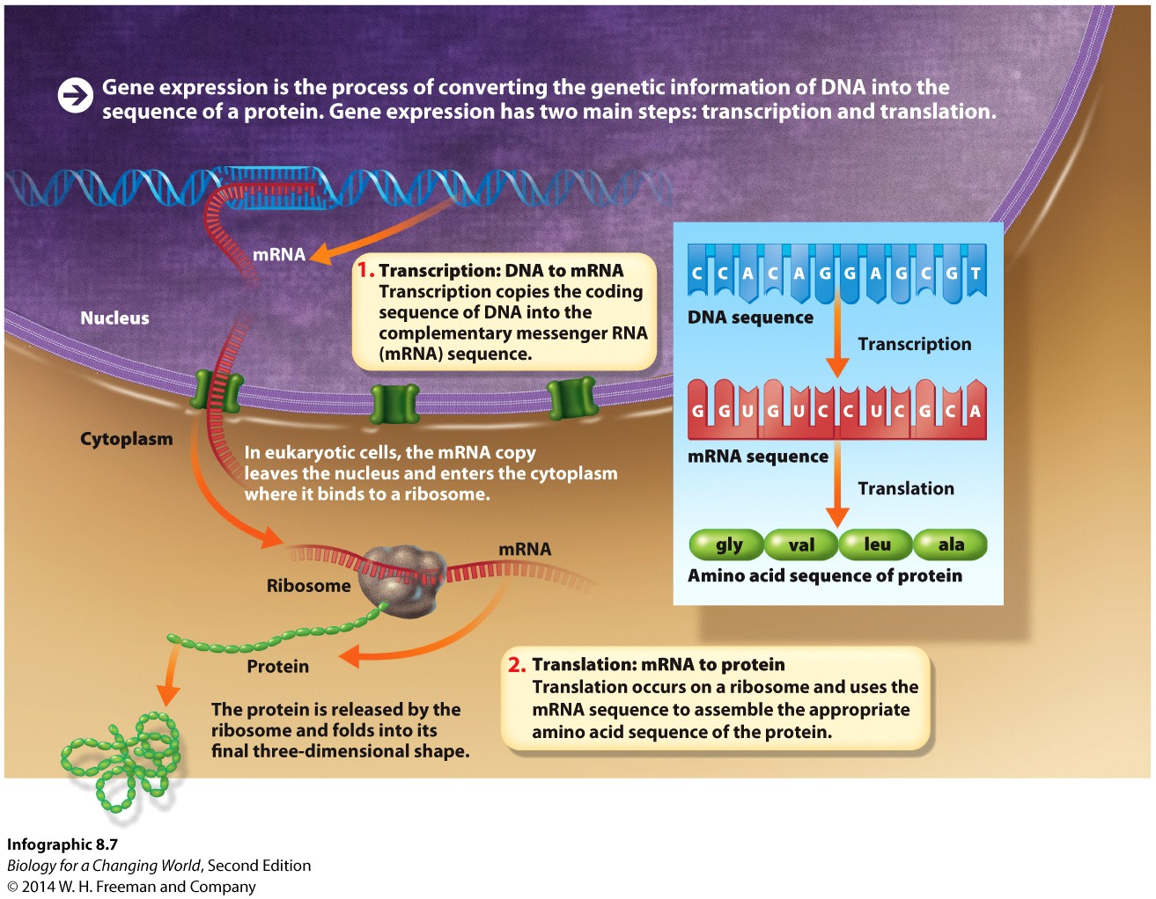
Gene expression: an overview
process of converting genetic information into protein
two main steps: transcription and translation

Slide 24
Gene expression: an overview
Transcription occurs in the nucleus of eukaryotic cells and cytoplasm of prokaryotic cells
Translation occurs on ribosomes in cytoplasm

Slide 25
Gene expression: transcription
Transcription: molecules of messenger RNA (mRNA) are synthesized from the instructions encoded in genes

Slide 26
Gene expression: transcription
RNA polymerase binds to the regulatory of the genes coding region. The DNA strands unwind, exposing the coding sequence of the gene.

Slide 27
Gene expression: transcription
RNA polymerase copies a strand of DNA into a complementary strand of mRNA by “reading” the gene coding sequence

Slide 28
Gene expression: transcription
complementary mRNA forms from a DNA template according to the rules of base pairing, except that in RNA, adenine (A) pairs with uracil (U)

Slide 29
Gene expression: transcription
mRNA strand is formed, detaches from DNA sequence, and DNA reforms its double-helix

Slide 30
Gene expression: transcription
completed mRNA molecule leaves the nucleus
gene remains part of chromosome in nucleus
can be used again for transcription

Slide 31
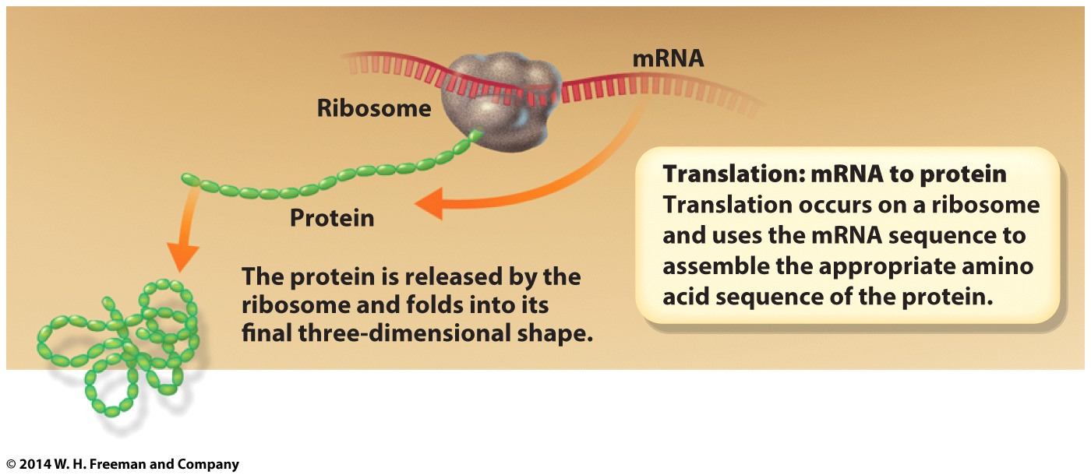
Gene expression: translation
mRNA molecules used to assemble the corresponding amino acid sequence of the protein

Slide 32
Gene expression: translation
mRNA molecule associates with a ribosome

Slide 33
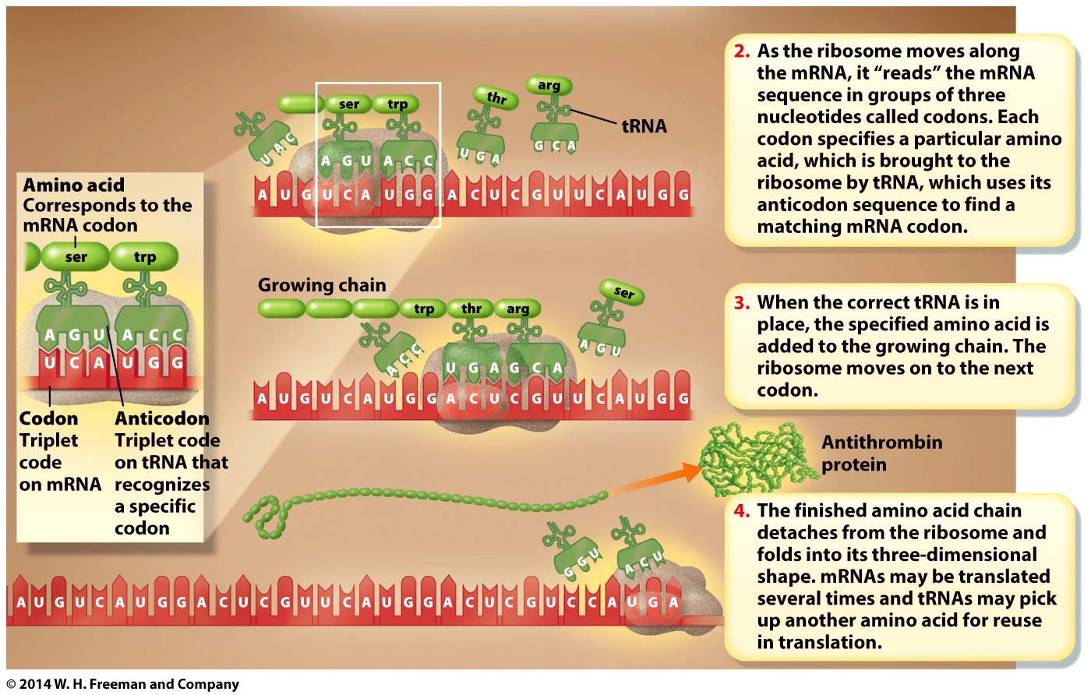
Gene expression: translation
ribosome moves along the mRNA, “reading” it in groups of three nucleotides (codons)
A codon specifies a particular amino acid

Slide 34
Gene expression: translation
Transfer RNA (tRNA) carries an amino acid to the mRNA and ribosome by using its anticodon to find a matching mRNA codon

Slide 35
Gene expression: translation
when correct tRNA is in place, the specified amino acid is added to the growing chain
the ribosome moves on to the next codon

Slide 36
Gene expression: translation
completed amino acid chain detaches from the ribosome and folds into its 3-D shape

Slide 37
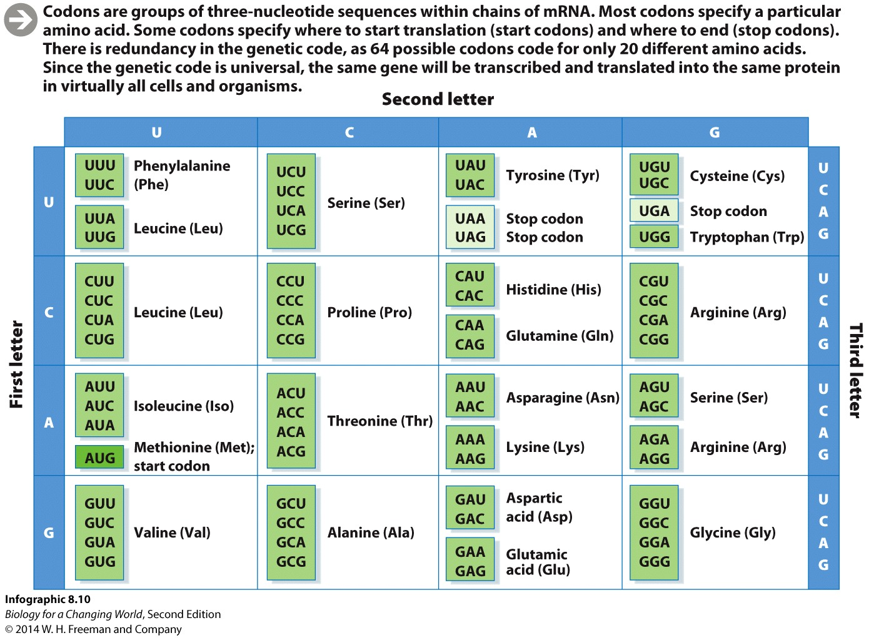
The genetic code
set of rules relating particular mRNA codons to particular amino acids
redundant and universal
Notes:
Codons are groups of three-nucleotide sequences within chains of mRNA. Most codons specify a particular amino acid. Some codons specify where to start translation (start codons) and where to end (stop codons). There is redundancy in the genetic code, as 64 possible codons code for only 20 different amino acids. Since the genetic code is universal, the same gene will be transcribed and translated into the same protein in virtually all cells and organisms.

Slide 38
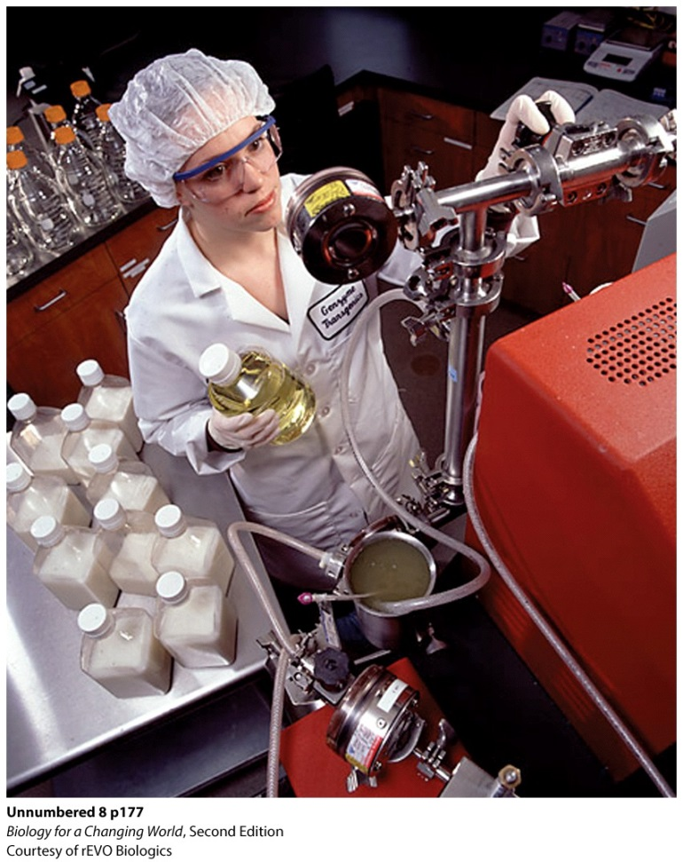
Advantages of “pharming”
makes complex human proteins
makes large amount of protein
less expensive
clinically equivalent
Notes:
Transgenic goats can produce large quantities of drug in their milk for one-tenth the cost of conventional methods.

Slide 39
Summary
Genes provide instructions to make proteins. in a process called gene expression.
Proteins are folded chains of amino acids.
Amino acid sequences determine the shape and function of a protein.
A change in the DNA sequence of a gene can change the corresponding amino acid sequence, and therefore the function, of a protein.
Different versions of the same gene are called alleles.
Every gene has two parts: a coding sequence and a regulatory sequence.
Gene expression occurs in two stages, transcription and translation.

