Slide 1
Michèle Shuster • Janet Vigna • Gunjan Sinha • Matthew Tontonoz
Biology for a
Changing World
SECOND EDITION
Lecture PowerPoint
CHAPTER 10
Mutations and Cancer
Copyright © 2014 by W. H. Freeman and Company

Slide 2
Chapter 10
Mutations and Cancer

Slide 3
Driving Questions
1. What are mutations, and how can they occur?
2. How does cancer develop, and how can people
reduce their risk?
3. Why do people with “inherited” cancer often
develop cancer at a relatively young age?

Slide 4
Heredity and cancer
Cancer
- disease of uncontrolled cell division
Genes BRCA1 and BRCA 2
located on chromosome 17 and 13
mutation increases risk of developing breast cancer

Slide 5
Heredity and cancer
Mutation
change in the nucleotide sequence of DNA
Affects structure and function of proteins
Cancer can result if mutation affects normal functioning of cell cycle

Slide 6
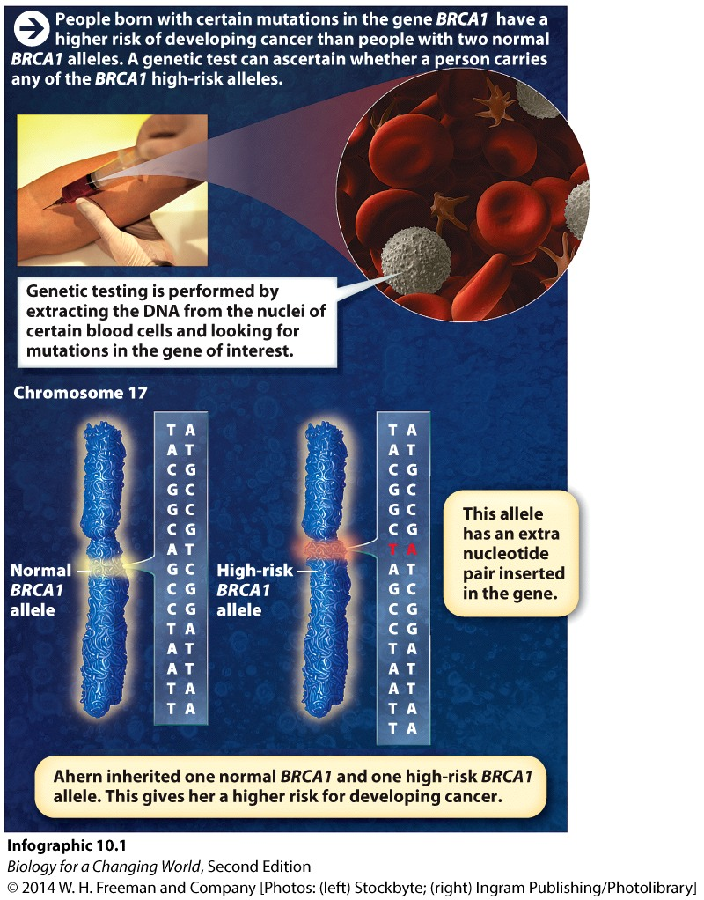
Heredity and cancer
Allele: alternative form of a gene
Mutations give rise to alleles
Nucleotides are substituted, deleted, or inserted within a gene
Notes:
Some of these alleles put women at high risk for developing cancer.

Slide 7
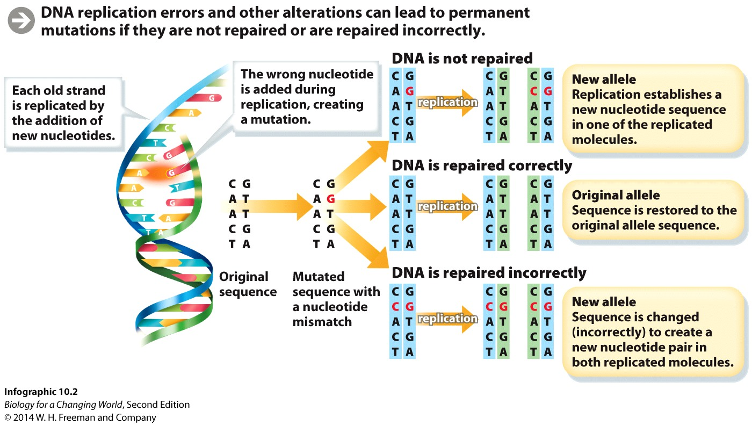
How do mutations arise?
Mistakes can occur during DNA replication
DNA polymerase sometimes adds the wrong nucleotide; too many or too few bases in a specific location
1/10,000 to 1/100,000 times
Notes:
DNA polymerase is the enzyme responsible for adding nucleotides to a new strand of DNA.

Slide 8
How do mutations arise?
Mistakes in the nucleotide order can be repaired
Cell’s error correction machinery
“Proofreading” machinery
Notes:
Groups of enzymes “proofread” the nucleotides added to the new DNA strand. If a newly added nucleotide is not complementary to its partner on the template strand (for example, if a G is incorrectly paired with an A) these enzymes replace that nucleotide with the correct one.

Slide 9
How do mutations arise?
If damage is irreparable, the cell self-destructs.
Fewer than one mistake in a billion nucleotides
If mutation is not repaired: new allele

Slide 10
Mutations
Germ-line mutation occurs in gametes and is passed on to offspring.
In every cell of the body
Heritable mutations
Notes:
Germ-line mutations accumulate over thousands of years in a population. As long as a mutation does not affect ability to reproduce, it will be passed on to future generations through sexual reproduction. The result is that a single gene such as BRCA1 can have hundreds of different nucleotide sequences, or alleles, in a population.

Slide 11
Mutations
Somatic mutation occurs in a body (nongamete) cell and is not passed on to offspring
passed only to daughter cells of mutated cell
sporadic mutation

Slide 12
Mutations
Notes:
An MRI showing several malignant tumors in the breast of a 32-year-old woman.

Slide 13
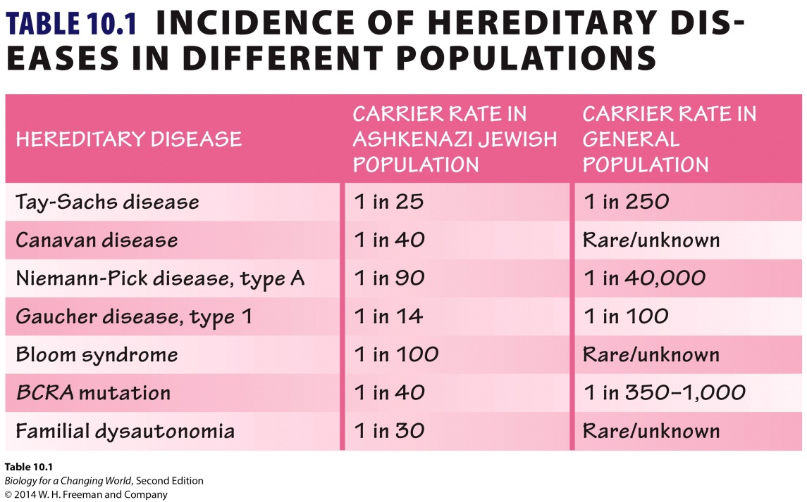
Mutations
Ethnic groups have homogeneous genetic backgrounds
Increased likelihood of passing certain mutations to offspring

Slide 14
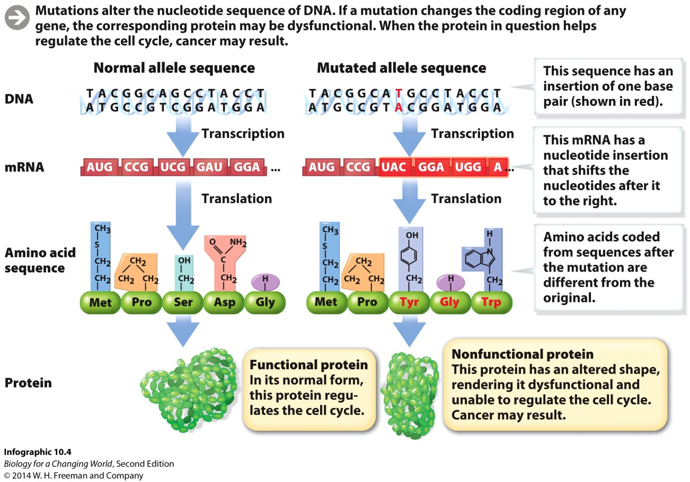
Mutations
Mutations are a problem when amino acid sequence of the corresponding protein is altered
Could alter the shape of the protein
Change its function
Notes:
BRCA proteins produced from mutated alleles do not perform their job as cell cycle regulators, thus making cells more likely to divide uncontrollably and become cancerous.

Slide 15
Multihit model of cancer
Heredity cancer often requires additional nonhereditary mutations to accumulate
Single mutation is not sufficient
Sporadic cancer also requires multiple somatic mutations to accumulate
Multihit model
Hit = mutation
Notes:
Where each “hit” is a mutation, and multiple hits are needed to cause the disease.

Slide 16
Multihit model of cancer
Mutations (hits) can arise through
errors in DNA replication
environmental insults
chemicals, ultraviolet light, radiation
factors that damage DNA
Mutagens
any chemical or physical agent that can cause DNA mutation
Carcinogens
any chemical agent that causes cancer by causing DNA mutations
Notes:
Not all mutagens originate outside the body. Some of the reactions that occur in the mitochondria during cellular respiration (see Chapter 6), for example, produce DNA-damaging molecules known as free radicals.

Slide 17
Mutations

Slide 18
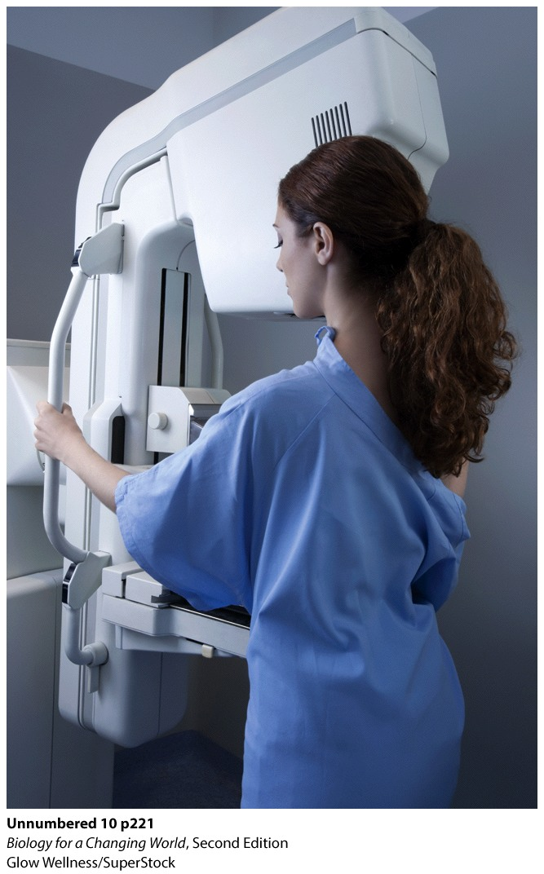
Mutations and cancer
Cancer-causing mutations typically occur in two categories of genes
proto-oncogenes
tumor suppressor genes

Slide 19
Mutations and cancer
proto-oncogenes
normally promote cell division and differentiation
can be mutated to become permanently activated
oncogenes
tumor suppressor genes
normally pause cell division, repair DNA or initiate cell death
can be mutated to become inactivated
for example, BRCA1 and BRCA2

Slide 20
Mutations and cancer

Slide 21
Mutations and cancer
cell will become cancerous due to multiple mutations in several genes
mutated genes often regulate the cell cycle or repair DNA
combination of both tumor suppressor and proto-oncogenes
cells accumulate mutations over time due to exposure to carcinogens and repeated rounds of cell division
chance of cancer increases with age

Slide 22
Mutations and cancer
Tumors develop in stages following mutations
noncancerous tumor forms first
does not spread throughout body
benign tumor
cancerous tumor then may develop
spread and invade other tissues (metastasize)
malignant tumor
Notes:
In the multi-hit model, tumors develop in stages following mutations. (After one or two hits, a benign tumor may form. After several more, a malignant tumor may form.)

Slide 23
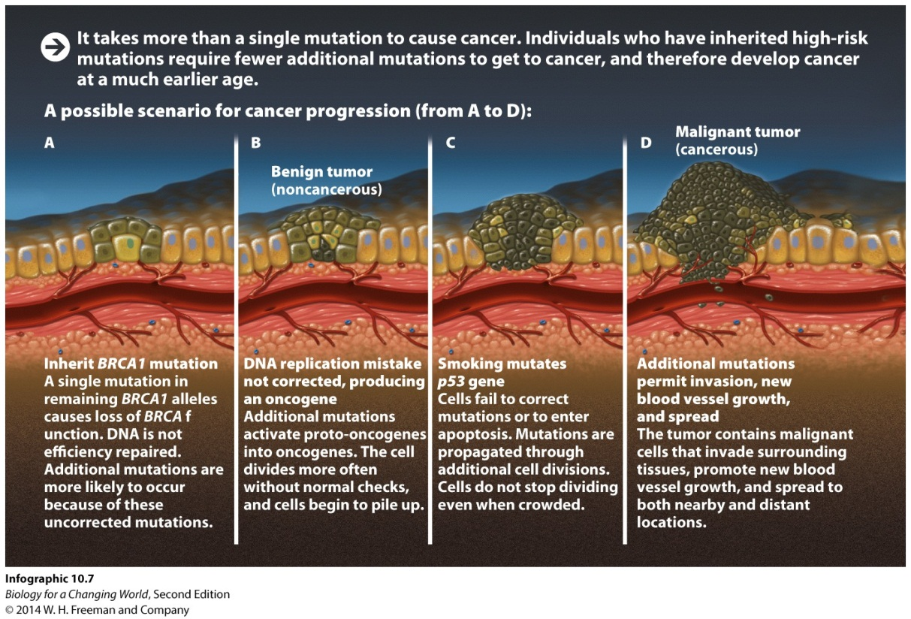
Mutations and cancer
Multihit model, tumors develop following multiple mutations
Inheritance of high-risk mutations increases the chance of developing cancer
fewer additional hits needed

Slide 24
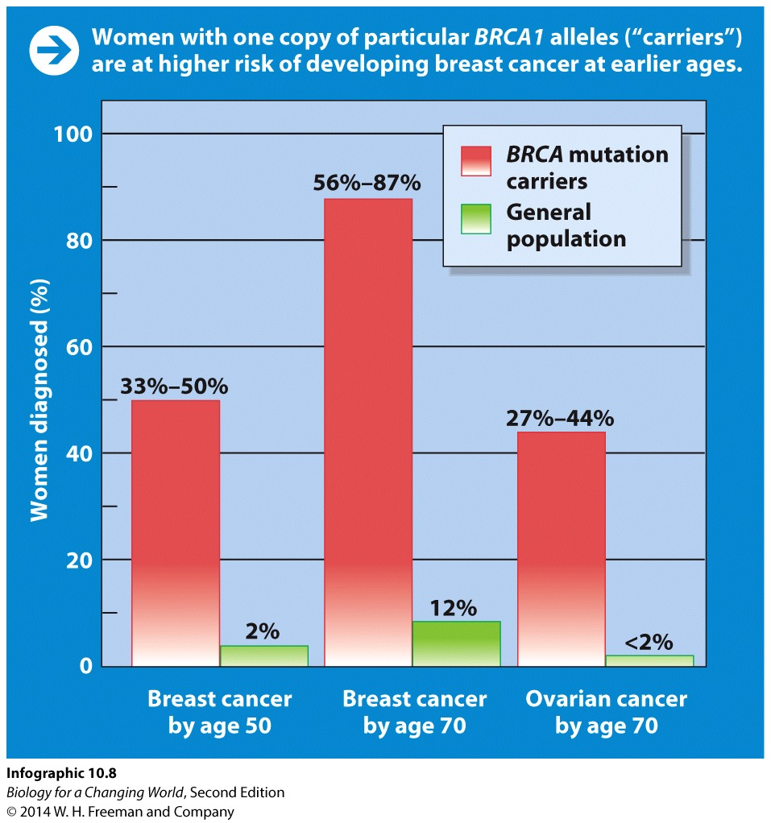
Mutation and cancer
BRCA mutations reduces ability to repair DNA damage
more mutations can accumulate
cancer rates are higher

Slide 25
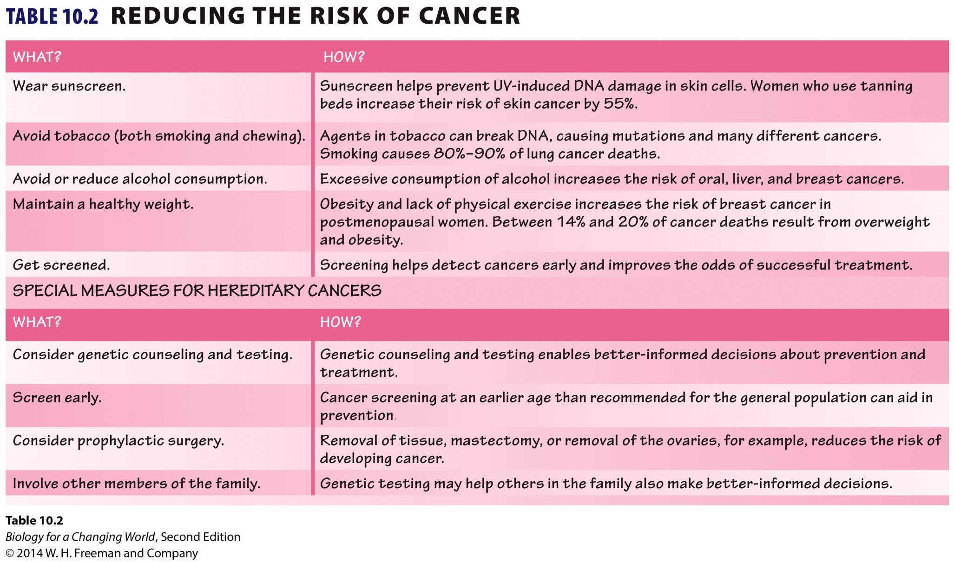
Reducing the risk of cancer

Slide 26
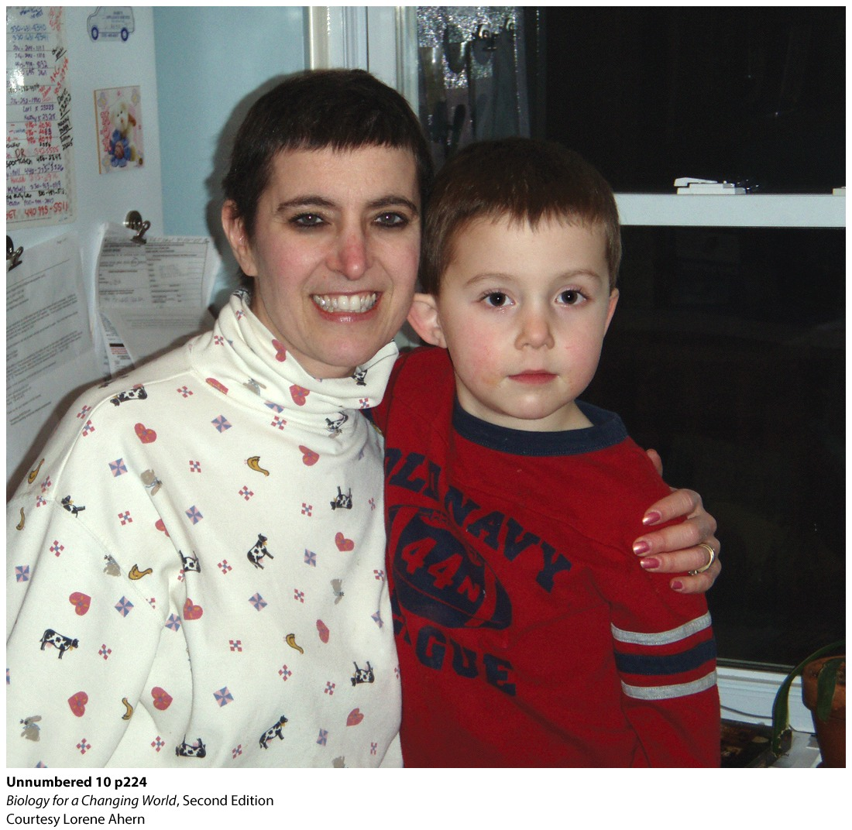
Reducing the risk of cancer

Slide 27
Summary
Cancer is uncontrolled cell division caused by mutations in DNA.
Mutations occur spontaneously during DNA replication. They can also be caused by environmental triggers.
Mutations in certain genes can lead to cancer if they damage the normal function of the proteins they encode
Mutations in two types of gene, proto-oncogenes and tumor suppressors, cause most cancer.
Multiple mutations must occur in the same cell for it to become cancerous.
Mutations introduce new alleles into the population.
Certain alleles are more common in ethnic groups.

