Slide 1
Michèle Shuster • Janet Vigna • Gunjan Sinha • Matthew Tontonoz
Biology for a
Changing World
SECOND EDITION
Lecture PowerPoint
CHAPTER 11 Single-Gene Inheritance and Meiosis
Copyright © 2014 by W. H. Freeman and Company

Slide 2
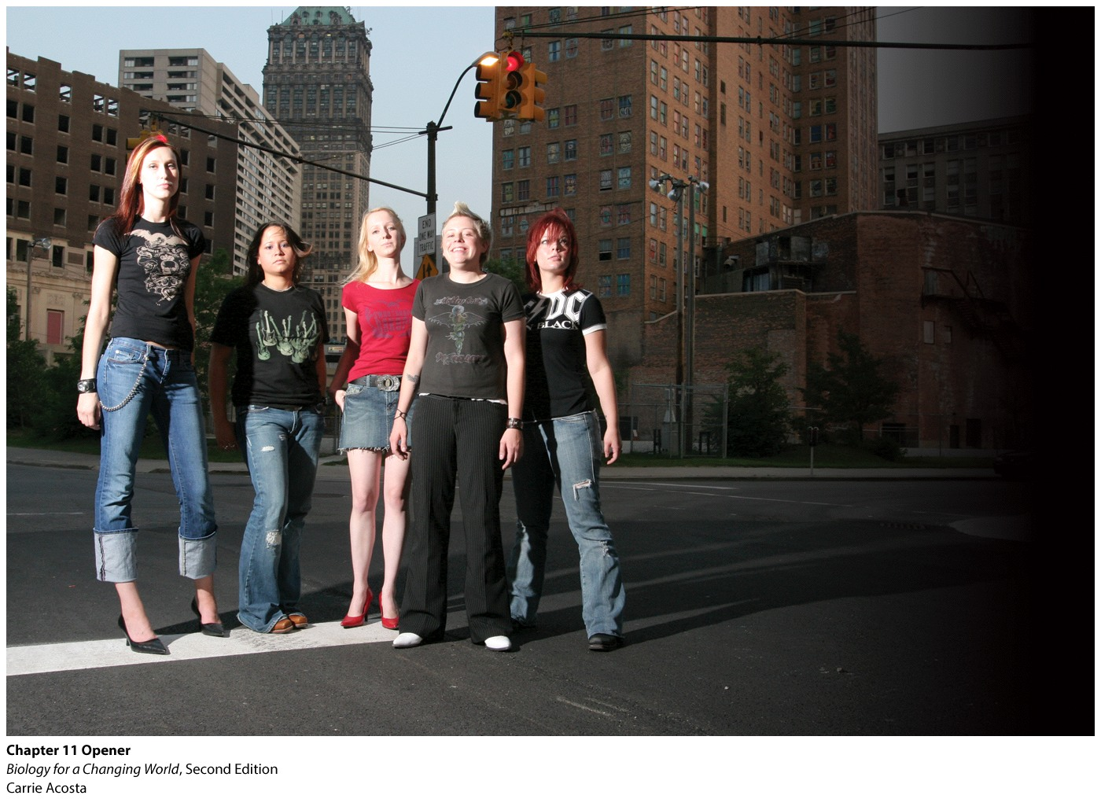
Chapter 11
Single-Gene Inheritance and Meiosis
Notes:
In 2003, Emily and her friends launched an all-girl band called Hellen. From left to right: Katie, Charmain, Becca, Emily, and Amanda.

Slide 3
Driving Questions
1. How does the organization of chromosomes, genes,
and their alleles contribute to human traits?
2. How does meiosis produce gametes?
3. Why do different traits have different inheritance
patterns?
4. What are some practical applications of
understanding the genetic basis of human disease?

Slide 4
Cystic fibrosis (CF)
Genetic disease
Caused by a single gene mutation
change in nucleotide sequence of DNA
creates a new mutant allele
Allele of the CFTR gene

Slide 5
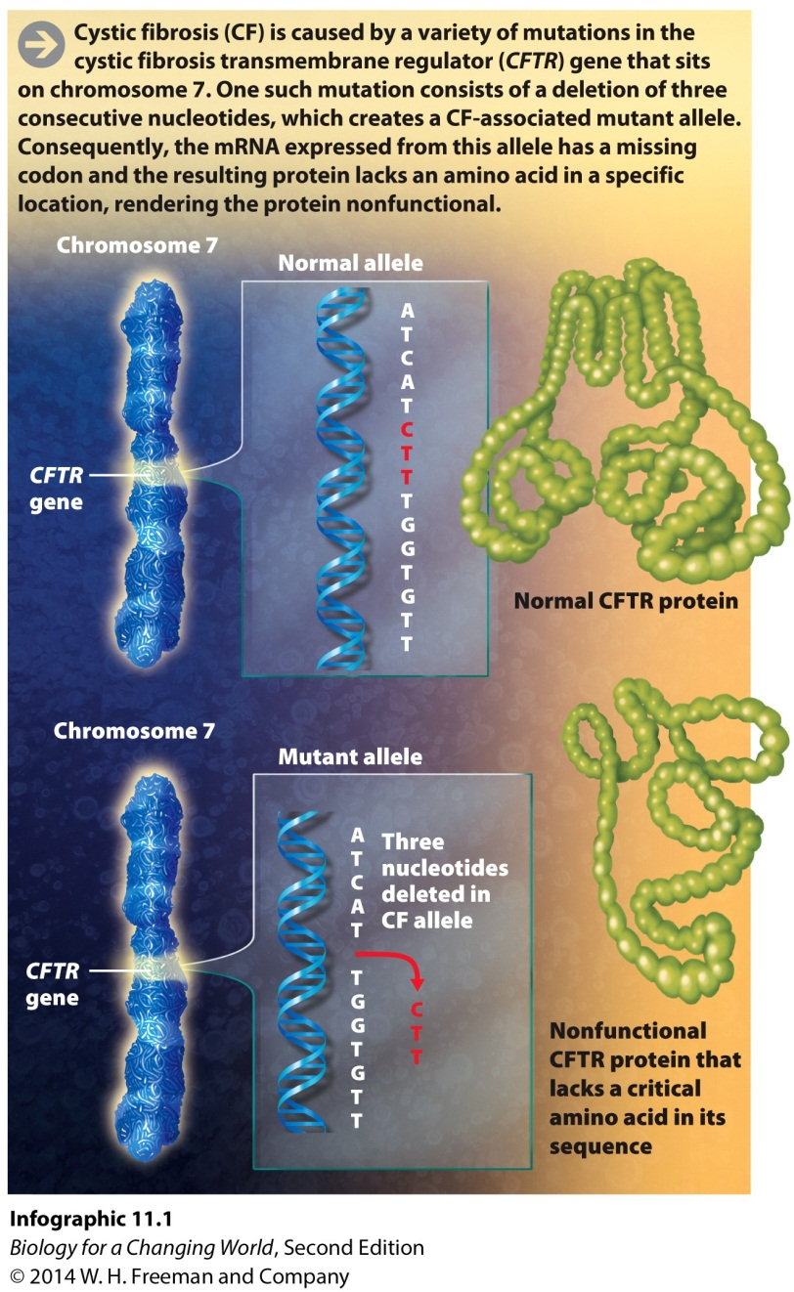
Cystic fibrosis (CF)
CFTR gene codes transmembrane regulator protein
Moves ions in and out of cells

Slide 6
How are genes inherited?
Genes provide instructions for making proteins
Physically transmitted from parent to offspring
Two copies of each chromosome (and each gene) in diploid organisms
homologous chromosomes
one from each parent passed to offspring
Notes:
Homologous chromosomes: A pair of chromosomes that both contain the same genes. In a diploid cell, one chromosome in the pair is inherited from the mother, the other from the father.

Slide 7
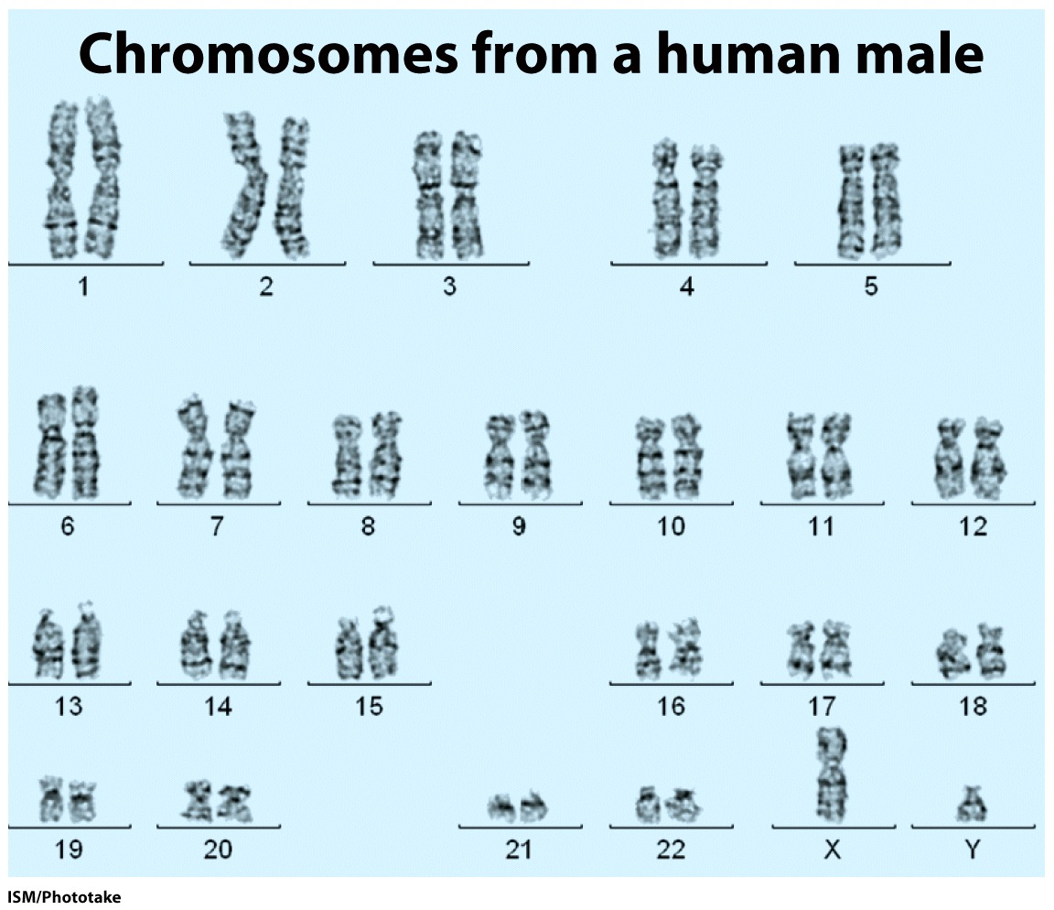
Humans are diploid organisms

Slide 8
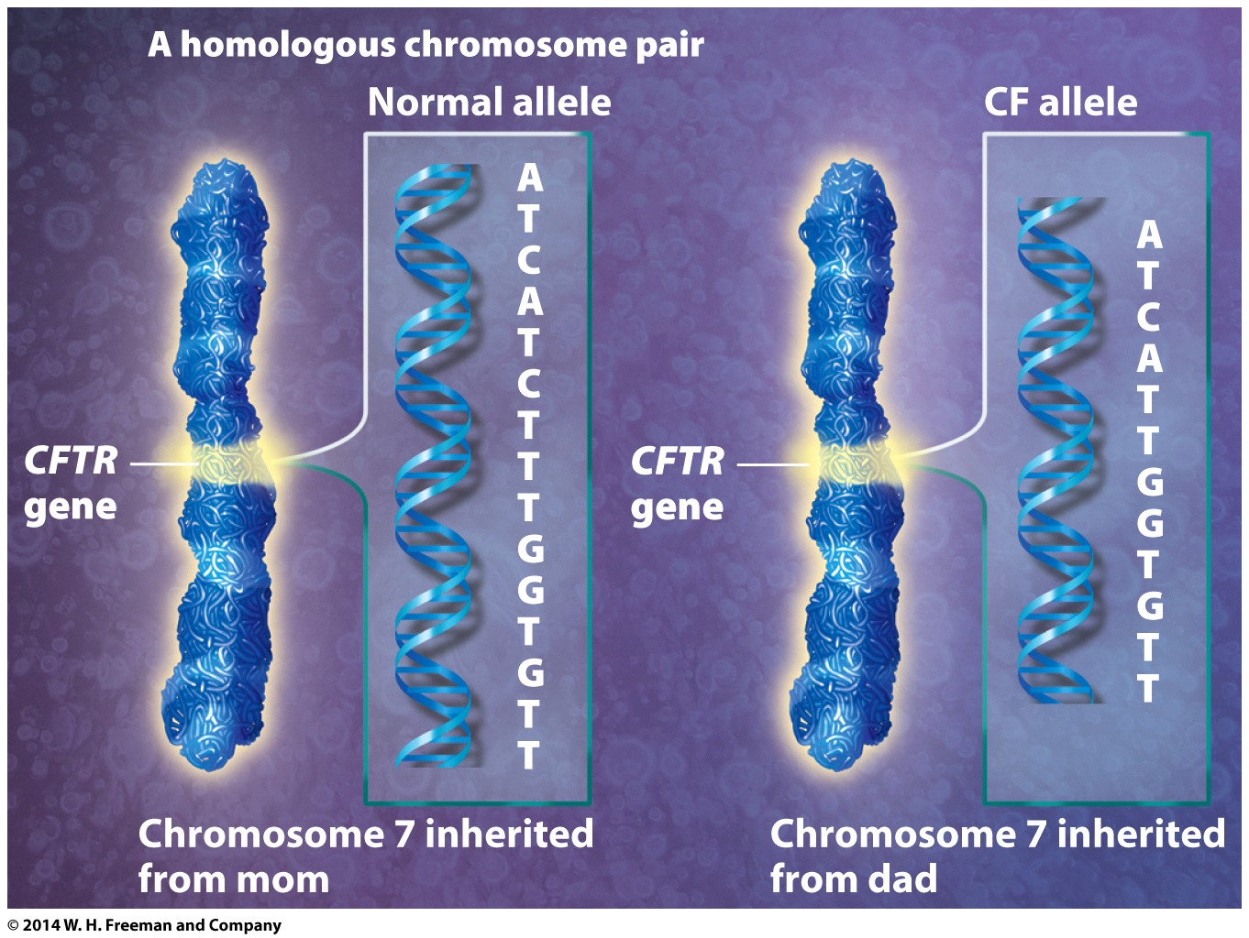
Humans are diploid organisms
Two copies of genes found on homologues have same function but DNA sequence may differ
may have two different alleles of same gene

Slide 9
Humans are diploid organisms
Genotype is the particular genetic or allele makeup of an individual
Phenotype is the observable or measurable features of an individual

Slide 10
Sexual reproduction
Combination of maternal and paternal alleles
Join during fertilization
Determines genotype and contributes to phenotype

Slide 11
Sexual reproduction
Requires special sex cells: sperm, egg
Gametes: reproductive cells that carry one copy of each chromosome
haploid
Special cell division needed to reduce from diploid to haploid
meiosis

Slide 12
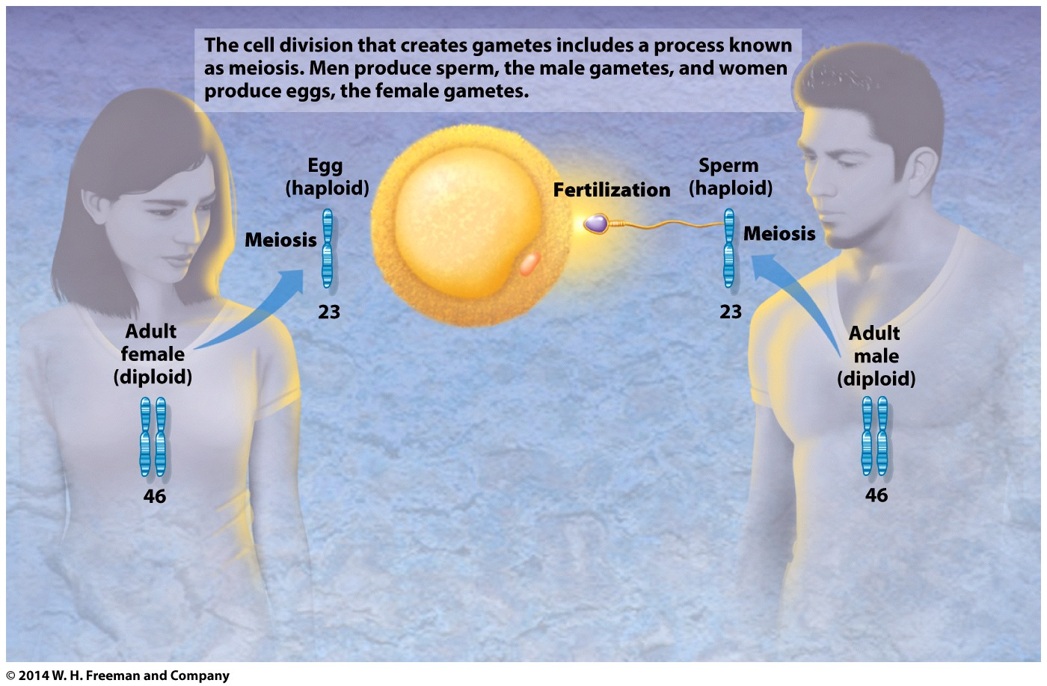
Sexual reproduction
Meiosis generates genetically unique haploid gametes
Notes:
In humans, meiosis halves the number of chromosomes from 46 to 23.

Slide 13
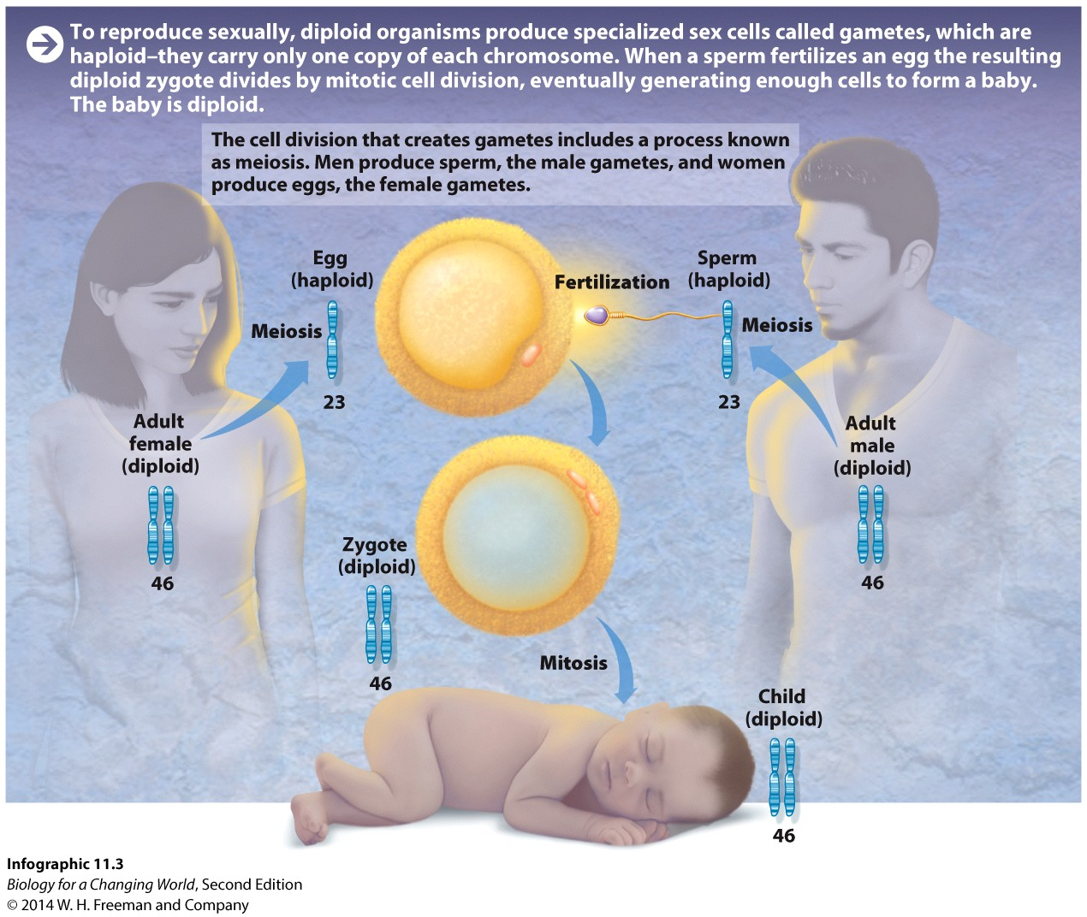
Sexual reproduction
Haploid sperm fertilizes haploid egg
The result is a diploid zygote
Zygote divides by mitosis into an embryo
Notes:
Zygote: A cell that is capable of developing into an adult organism. The zygote is formed when an egg is fertilized by a sperm and is diploid.
Embryo: An early stage of development reached when zygote undergoes cell division to form a multicellular structure.

Slide 14
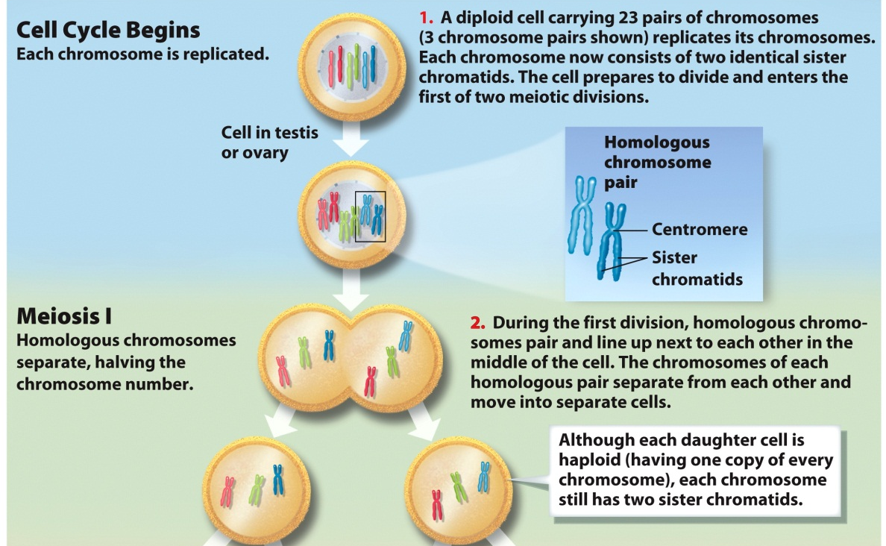
Meiosis
Two separate divisions steps
Meiosis I
separates homologous chromosomes
each daughter cell is haploid
each chromosome still has two sister chromatids

Slide 15
Meiosis
Meiosis II
separates sister chromatids
four haploid daughter cells
develop into egg or sperm

Slide 16
Meiosis and genetic diversity
No two gametes are identical
Due to recombination and independent assortment

Slide 17
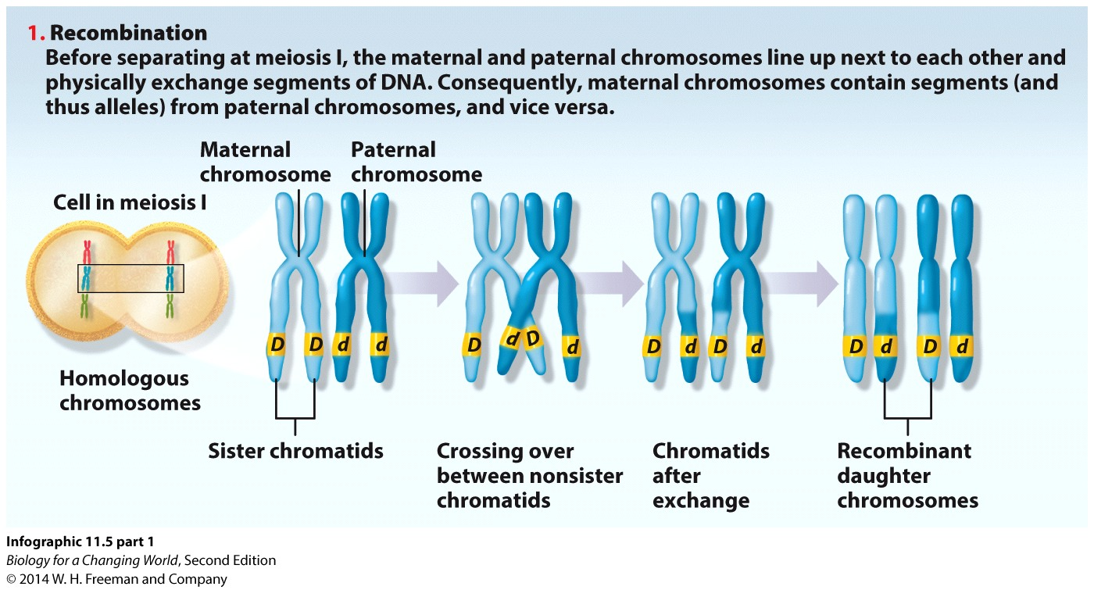
Meiosis and genetic diversity
Recombination: when maternal and paternal chromosomes pair and physically exchange DNA segments
Notes:
As a result of recombination, also called crossing over, maternal chromosomes actually contain segments (and therefore alleles) from paternal chromosomes and vice versa.

Slide 18
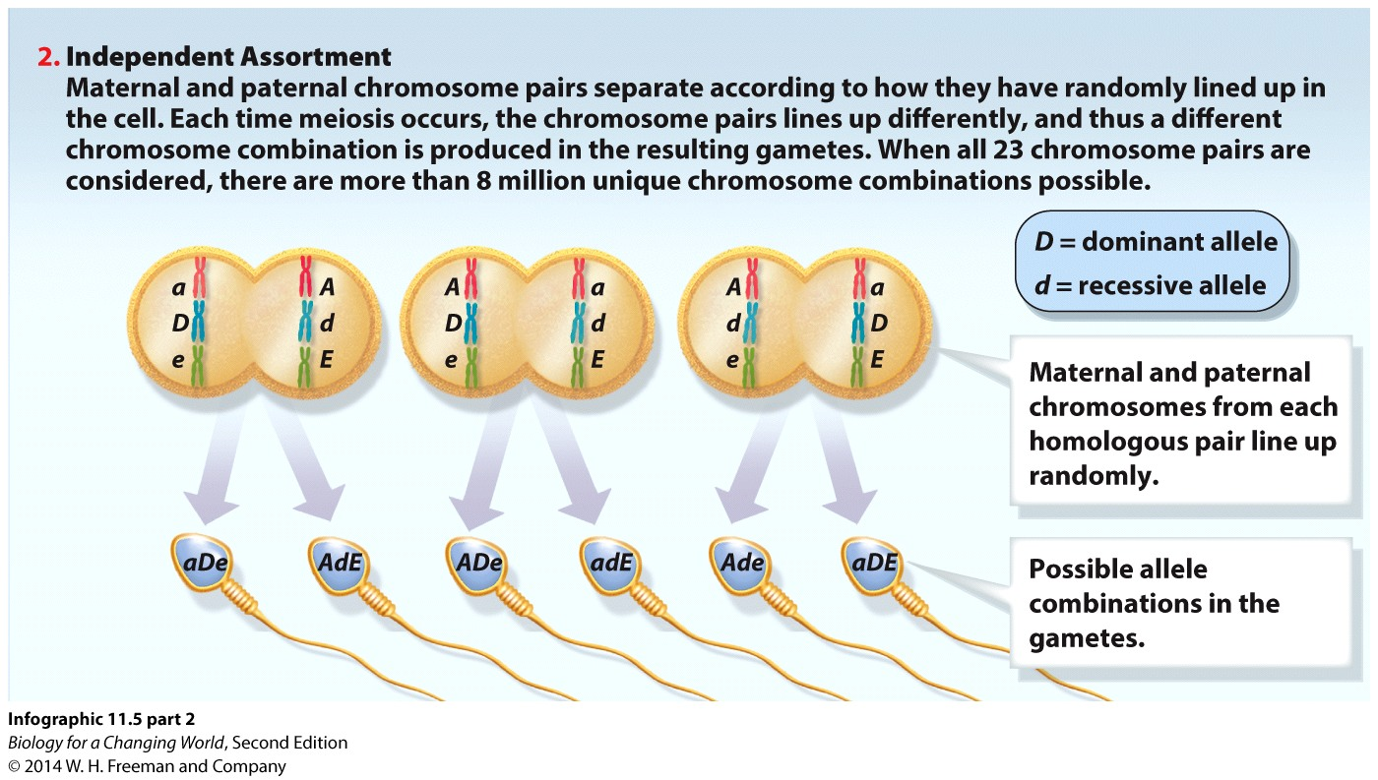
Meiosis and genetic diversity
Independent assortment; alleles of different genes are distributed independently of one another
Notes:
Alleles of different genes are distributed independently of one another, not as a package. Maternal and paternal chromosomes are distributed randomly to sex cells in meiosis. During meiosis I, maternal and paternal chromosomes line up next to each other along the midline of the cell and segregate into newly forming cells.
Pairs can line up in different ways.

Slide 19
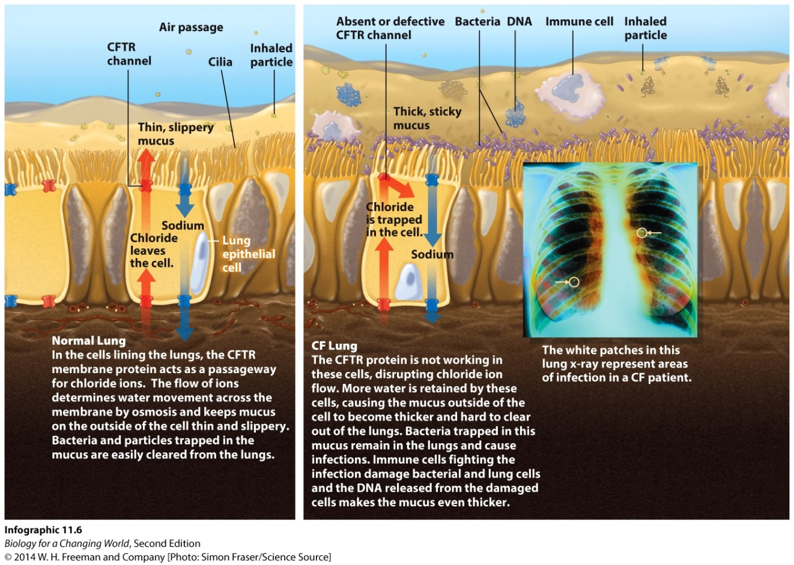
Cystic fibrosis
CFTR protein is distorted.
Abnormally thick mucus builds up in the lungs

Slide 20
Inheriting cystic fibrosis
People with normal phenotypes can still pass CF allele to offspring
People with CF will not necessarily have offspring with CF
Why?

Slide 21
Cystic fibrosis is recessive
CF is caused by a recessive allele
an allele that affects phenotype only if the organism has two copies of that allele
hidden by normal or dominant allele
recessive allele designated by a lower-case letter (a)
dominant allele designated by upper-case letter (A)
Notes:
Recessive allele reveals in phenotype only if a masking dominant allele is not present. Dominant allele masks the presence of a recessive allele in the genotype.

Slide 22
Genotype: recessive and dominant
Heterozygote: two different alleles (Aa)
phenotype is normal
individual is a carrier
Homozygote: two identical alleles
Homozygous dominant (AA)
phenotype is normal
Homozygous recessive (aa)
phenotype is CF (mutant)
Notes:
Heterozygous carrier: a individual will carry the recessive allele for CF, but will not have the disease because the allele’s effect is masked by the dominant allele.
Carrier: an individual who is heterozygous for a particular gene of interest, and therefore can pass on the recessive allele without showing any of its effects.

Slide 23
Genotype: recessive and dominant
Punnett square
A diagram to determine the probabilities of offspring having particular genotypes
Based on genotypes of the parents
Matches up all possible gametes

Slide 24
Inheritance of recessive trait

Slide 25
Inheritance of dominant trait

Slide 26
Dominant and recessive traits

Slide 27
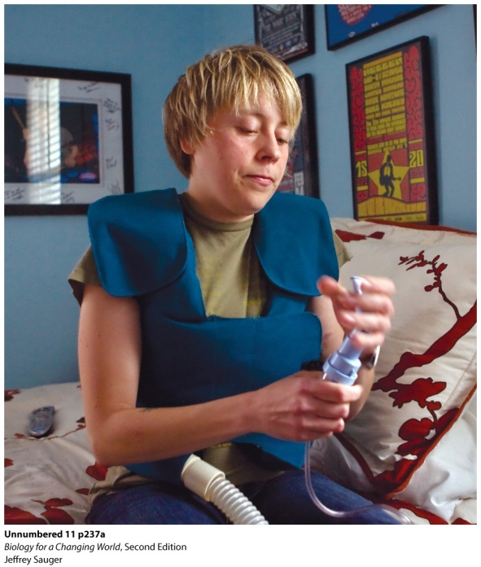
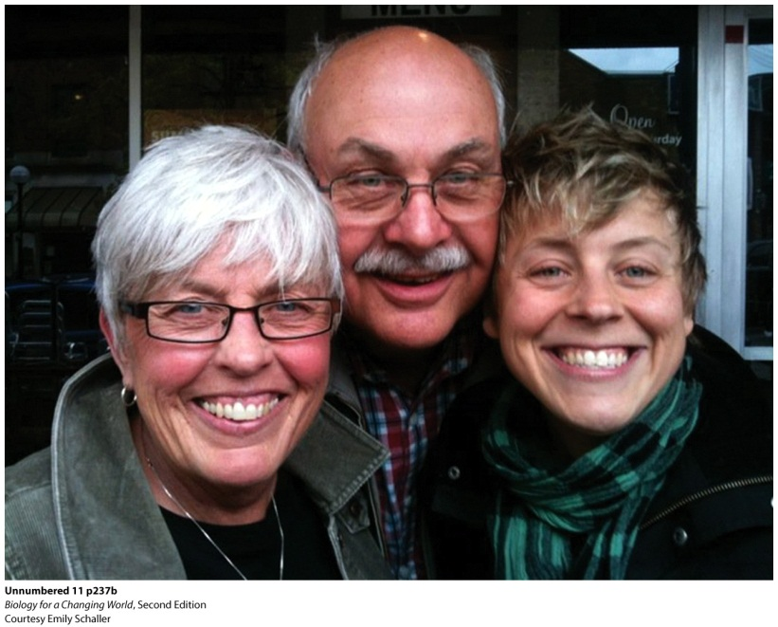
Multiple genes can contribute to phenotypes
CF severity influenced by genes on other chromosomes
For example: TGFβ1 influences immune response to infection
Notes:
Cystic fibrosis patients like Emily wear vibrating vests to loosen the mucus in their lungs while inhaling a saltwater mist to thin out the mucus.
Emily with her parents, Debbie and Lowell.

Slide 28
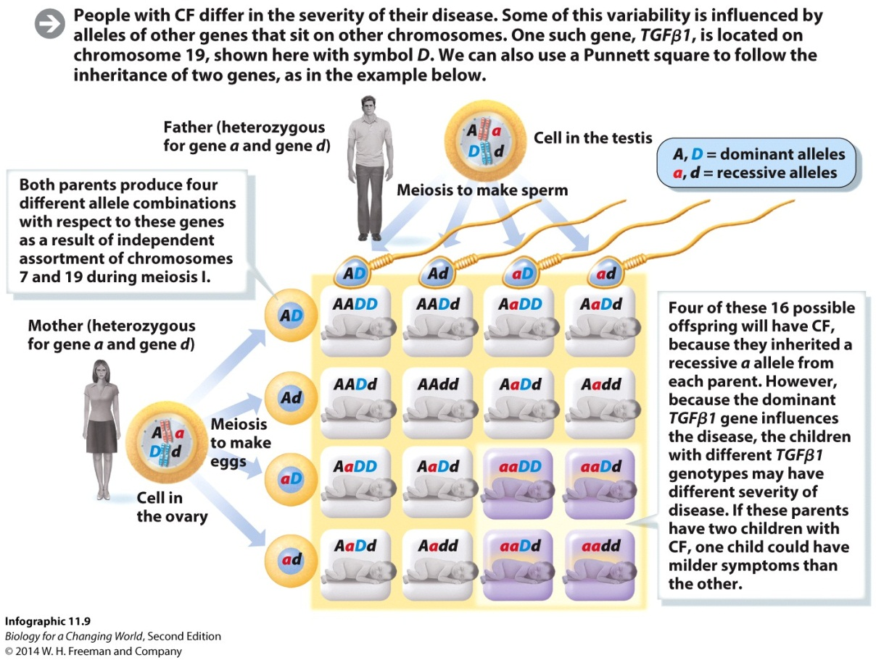
Multiple genes can contribute to phenotypes
Can follow alleles through gamete formation using Punnett square
Predict likelihood of offspring being homozygous recessive for disease
Notes:
Parents who are heterozygous carriers of CF, for example, have a 1 in 4 (25%) chance of having a child who has CF. If these two parents are also heterozygous for TGFβ1, then the probability that their child will be homozygous recessive for TGFb1 is also 1 in 4 (25%). The chance of two independent events occurring together is calculated by multiplying the two independent chances together. So the probability of being homozygous recessive for both CFTR and TGFb1 is 1/4 × 1/4, or 1 in 16.

Slide 29
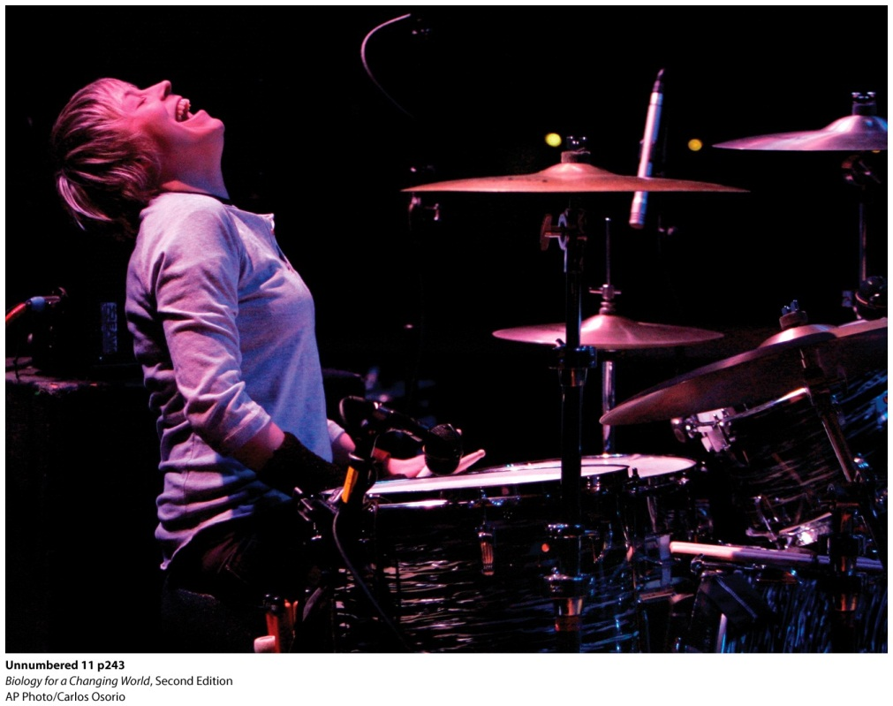
Treating CF
Understanding how “modifier” genes contribute to the disease may point the way to even more therapies
For example, Kalydeco is effective at restoring function to the malfunctioning CFTR channel
Notes:
Through all her fund-raising activities, Emily has raised more than $300,000 to benefit research on cystic fibrosis.

Slide 30
Summary
Genes, which code for proteins, are the units of inheritance, physically passed down from parents to offspring.
An organism’s physical traits constitute its phenotype; its genes constitute its genotype.
Diploid organisms have two copies of each chromosome in their cells.
Different versions of the same gene are called alleles. Alleles arise from mutations that change the nucleotide sequence of a gene.
Alleles may be dominant or recessive. Dominant alleles can mask the effects of recessive alleles, which can be hidden.
Meiosis is a type of cell division that produces genetically distinct, haploid sperm and egg.
A Punnett square can help predict a child’s genotype and phenotype when the pattern of inheritance, dominant or recessive, is known.

