Slide 1
Michèle Shuster • Janet Vigna • Gunjan Sinha • Matthew Tontonoz
Biology for a
Changing World
SECOND EDITION
Lecture PowerPoint
CHAPTER 12
Complex Inheritance
Copyright © 2014 by W. H. Freeman and Company

Slide 2
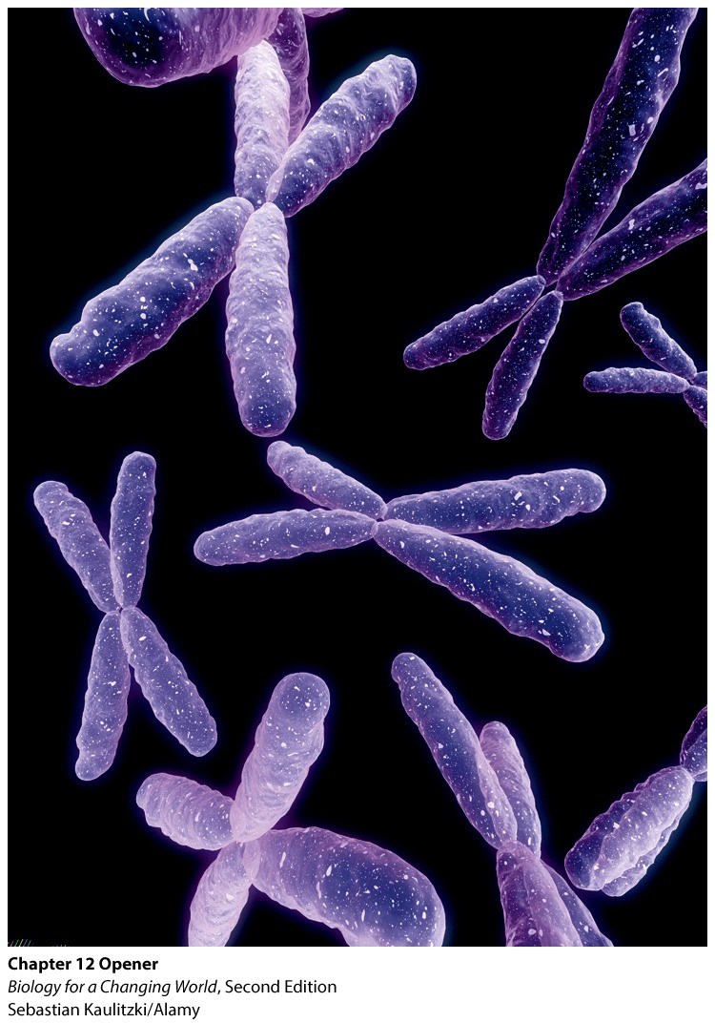
Chapter 12
Complex Inheritance

Slide 3
What determines biological sex?
What makes a man?
Notes:
Bruce as a baby underwent a procedure that involved burning off the foreskin. The procedure went awry, and Bruce’s penis was singed nearly completely off, beyond surgical repair. Bruce’s parents decided to have their little boy surgically turned into a little girl and to rear him as “Brenda.”
He was eventually changed back to a man through surgery.

Slide 4
What determines biological sex?
Sex hormones produced by gonads
ovaries in females, testes in males
Androgens: testosterone, estrogen
Males produce higher levels of testosterone
Females produce higher levels of estrogen

Slide 5
What determines biological sex?
In a fetus, sex hormones shape development of sexual anatomy
Depends on the set of chromosomes fetus receives from parents

Slide 6
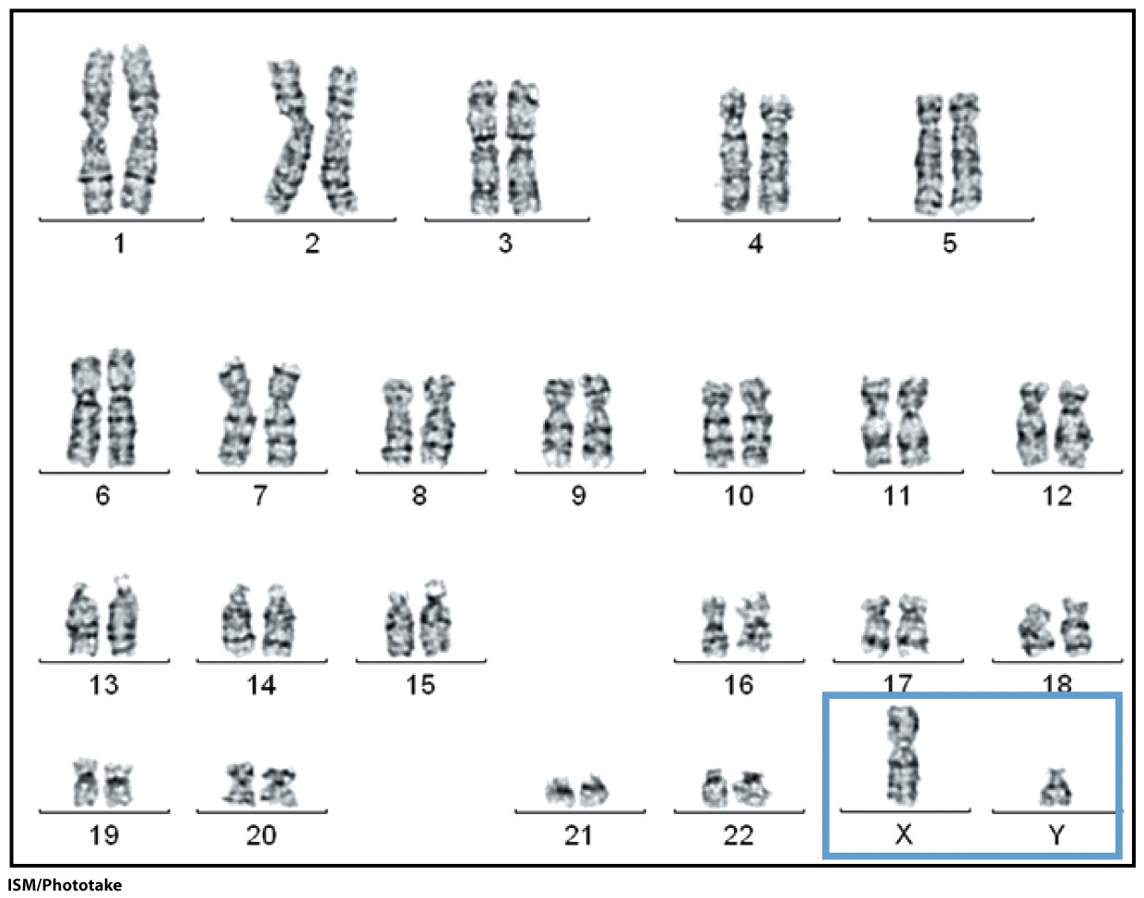
What determines biological sex?
Humans have 23 pairs of chromosomes
22 pairs are autosomes
1 pair are sex chromosomes
Notes:
Male karyotype: XY
Autosomes: paired chromosomes present in both males and females; all chromosomes except the X and Y chromosomes
Sex chromosomes: paired chromosomes that differ between males and females, XX in females, XY in male

Slide 7
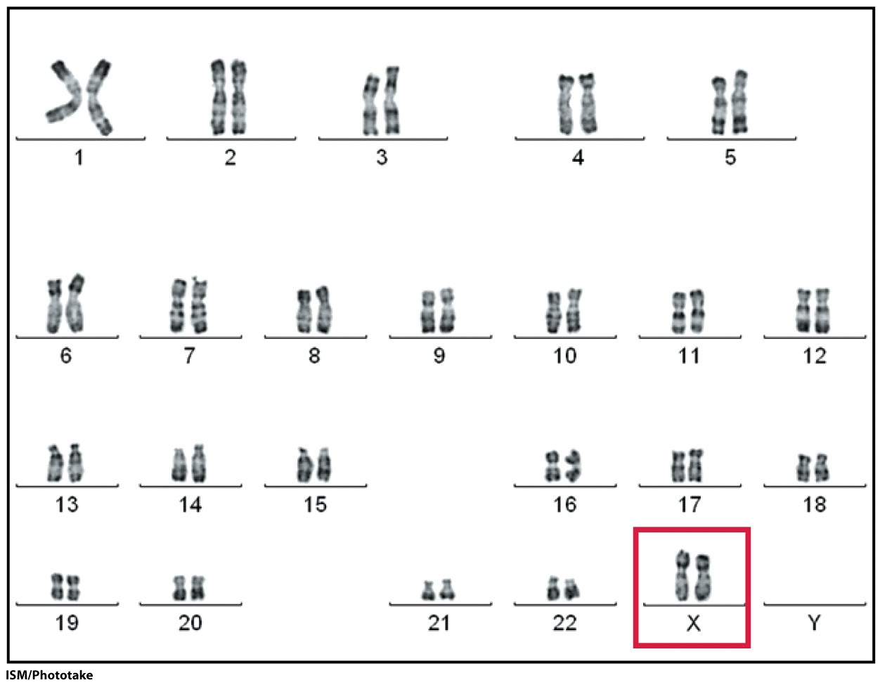
What determines biological sex?
In the absence of a Y chromosome, a fetus will develop into a female
females are XX
males are XY
Notes:
Female karyotype: XX

Slide 8
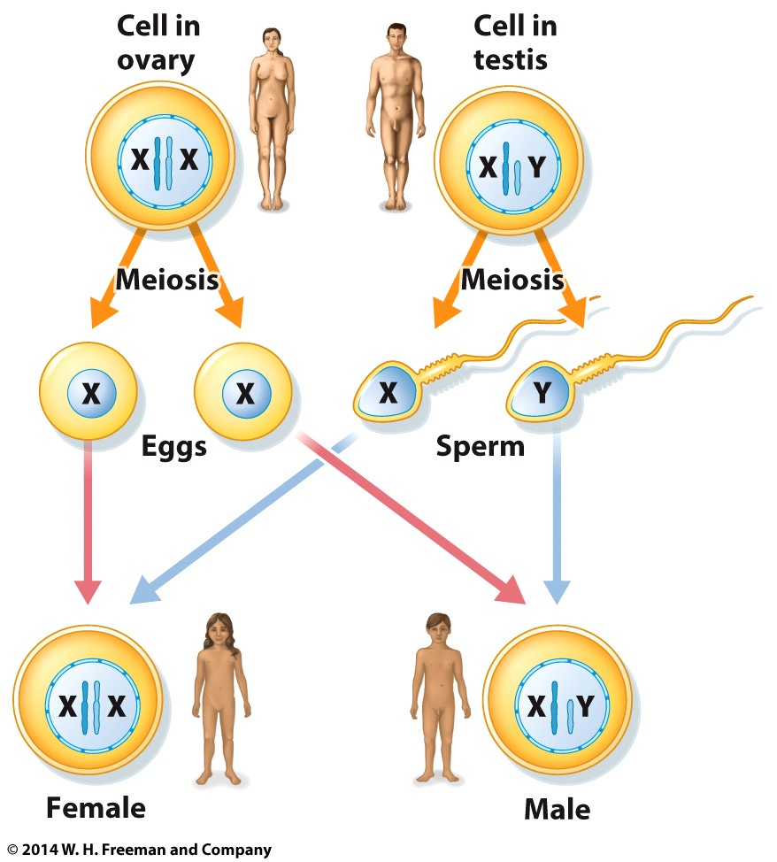
What determines biological sex?
Sons inherit Y chromosome from father and X chromosome from mother
Notes:
Fathers determine the sex of a baby.

Slide 9
What determines biological sex?
Daughters inherit one X chromosome from mother and one X chromosome from father.
Notes:
Fathers determine the sex of a baby.

Slide 10
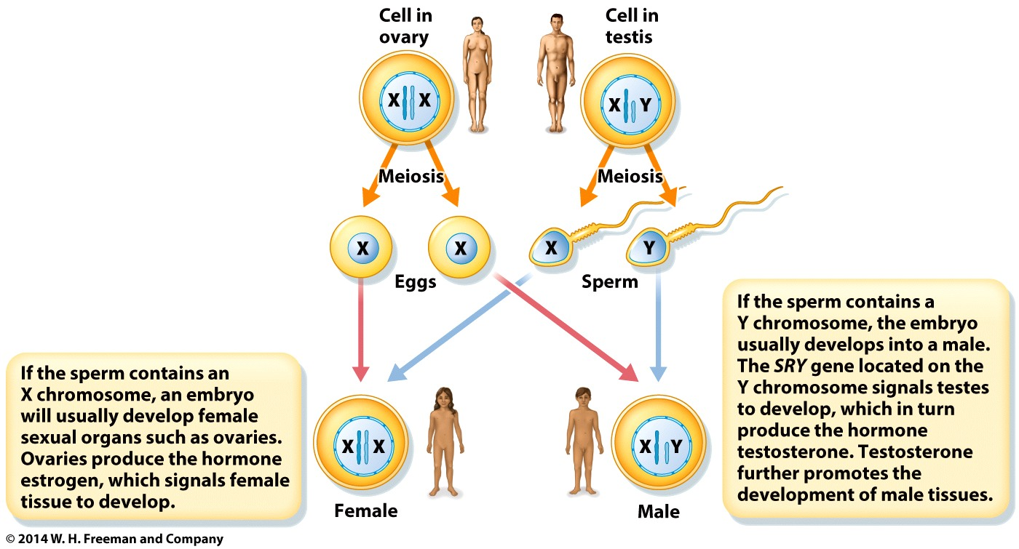
What determines biological sex?
SRY gene on Y chromosome signals testes to develop
Testes produce testosterone

Slide 11
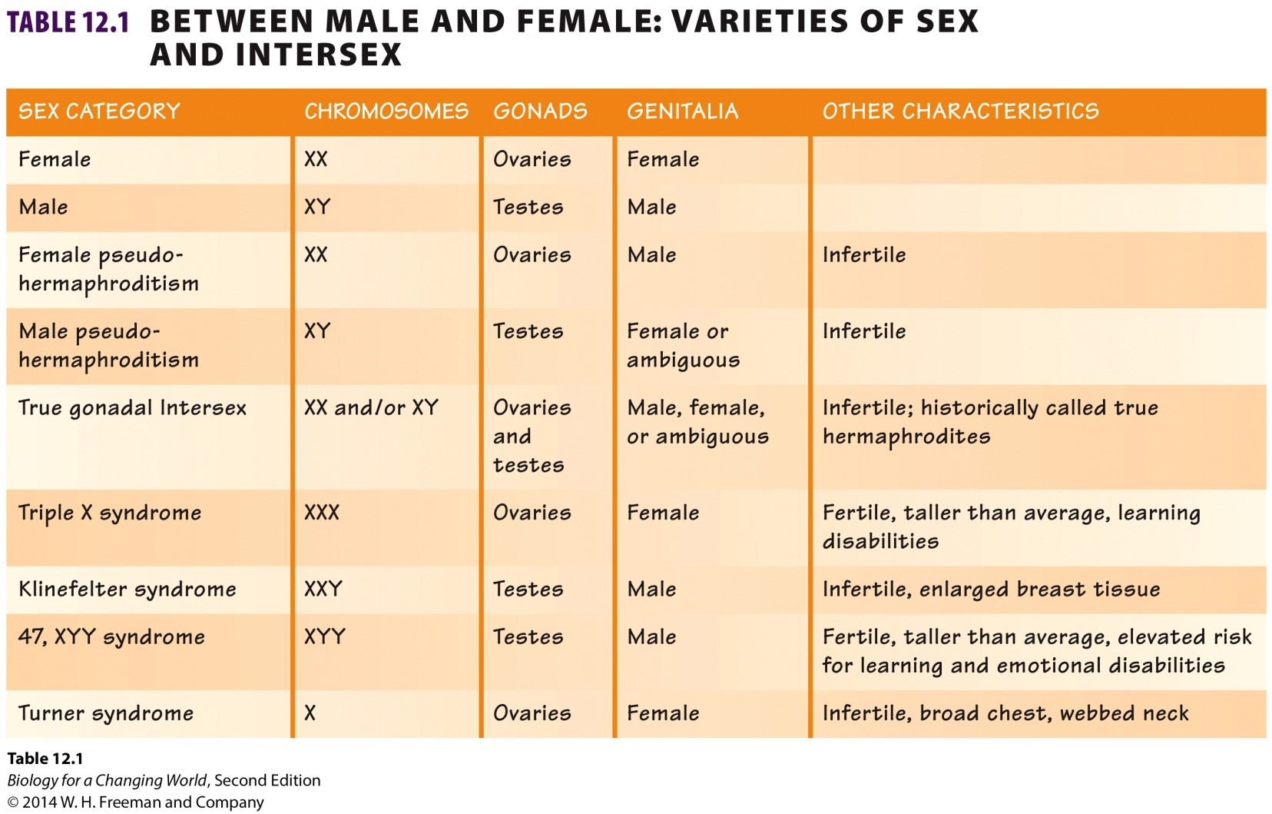
What determines biological sex?
Genetic, hormonal, anatomical and behavioral aspects to sex

Slide 12
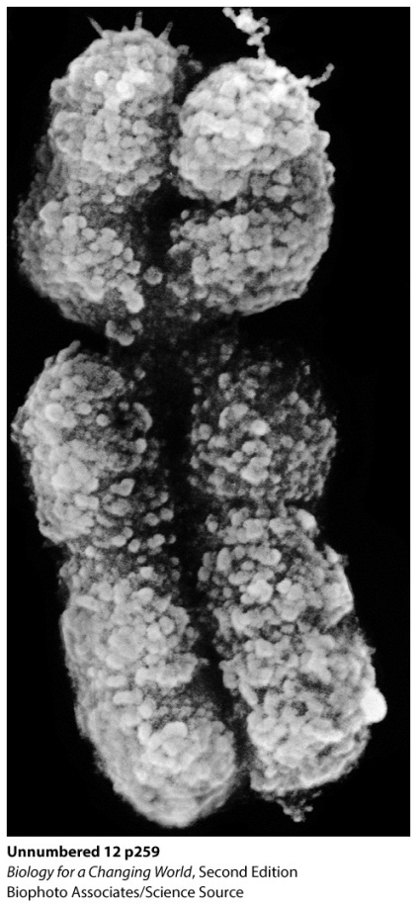
Sex-linked inheritance
Gene located on either of the sex chromosomes, daughters and sons don’t share the same probability of inheriting
X-linked trait
Notes:
Why do some genetic conditions affect sons more often than daughters?

Slide 13
Sex-linked inheritance
X-linked trait is a phenotype that is determined by allele on an X chromosome.
Recessive X-linked trait: normal copy on one X chromosome masks the recessive disease allele on the other X chromosome
For example, Duchenne muscular dystrophy (DMD)

Slide 14
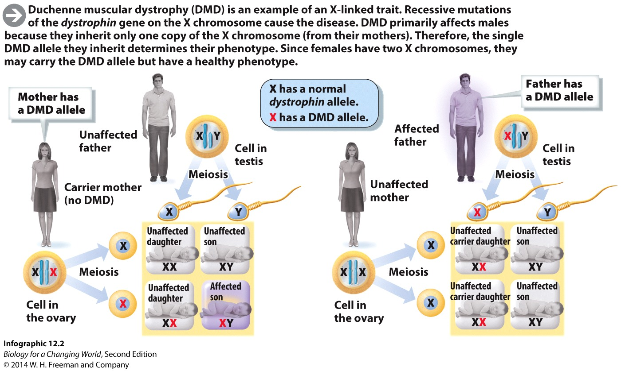
Sex-linked inheritance
A male has a single X chromosome, so he will show the effects of any recessive alleles located on his X chromosome
Notes:
A female can carry the disease allele without showing it.

Slide 15
Sex-linked inheritance
Mother passes one of her X chromosomes to her children
Father passes his only X chromosome to his daughters and his only Y chromosome to his sons
Boys have only one X chromosome and have a higher probability of inheriting X-linked diseases than girls
Use a pedigree to follow inheritance patterns
Notes:
Pedigree: a visual representation of the occurrence of phenotypes across generation.

Slide 16
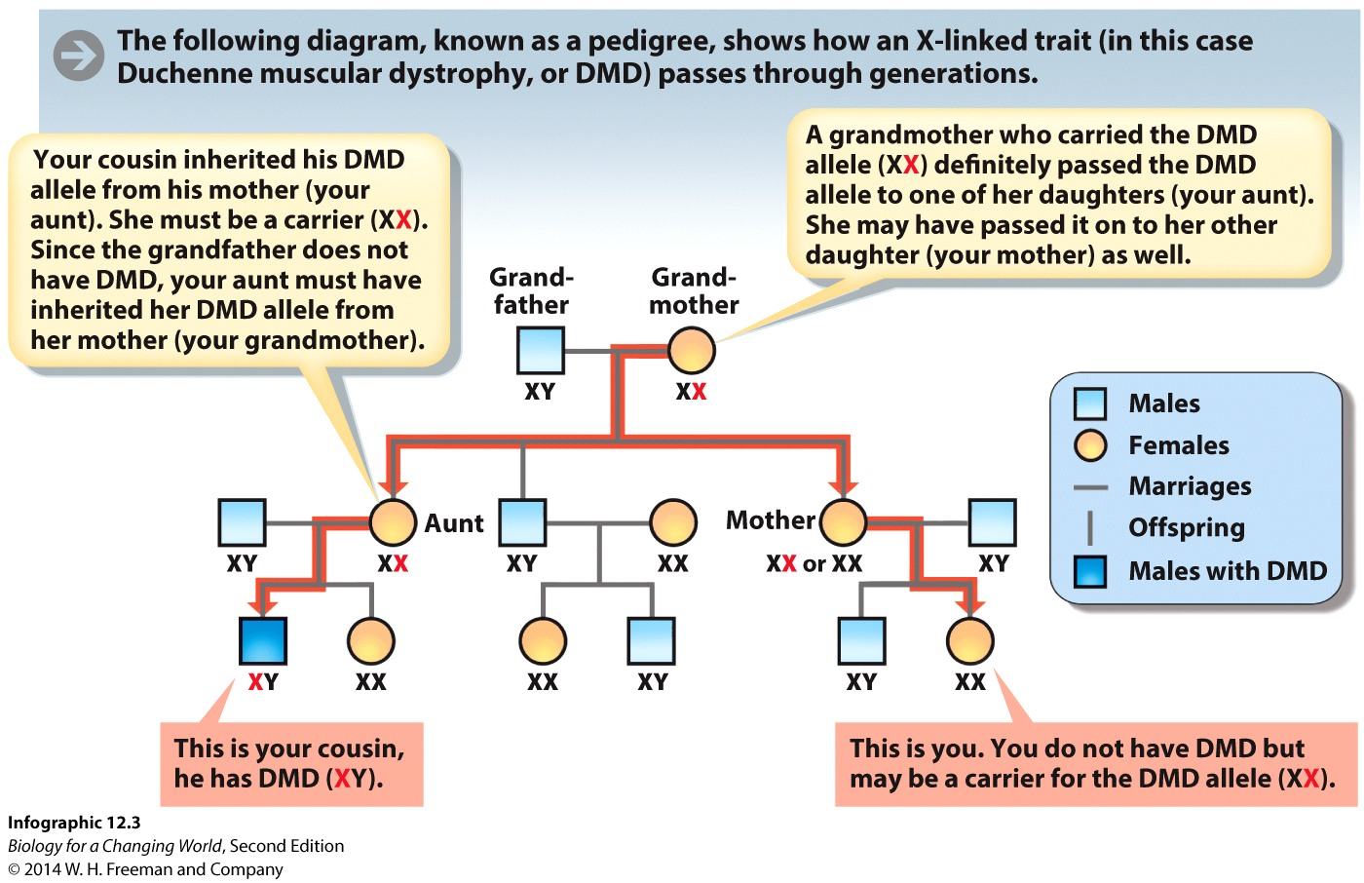
Sex-linked inheritance
Pedigree: visual representation of the occurrence of phenotypes across generations
Notes:
By contrast, boys and girls share the same probability of developing diseases that are carried on autosomes.

Slide 17
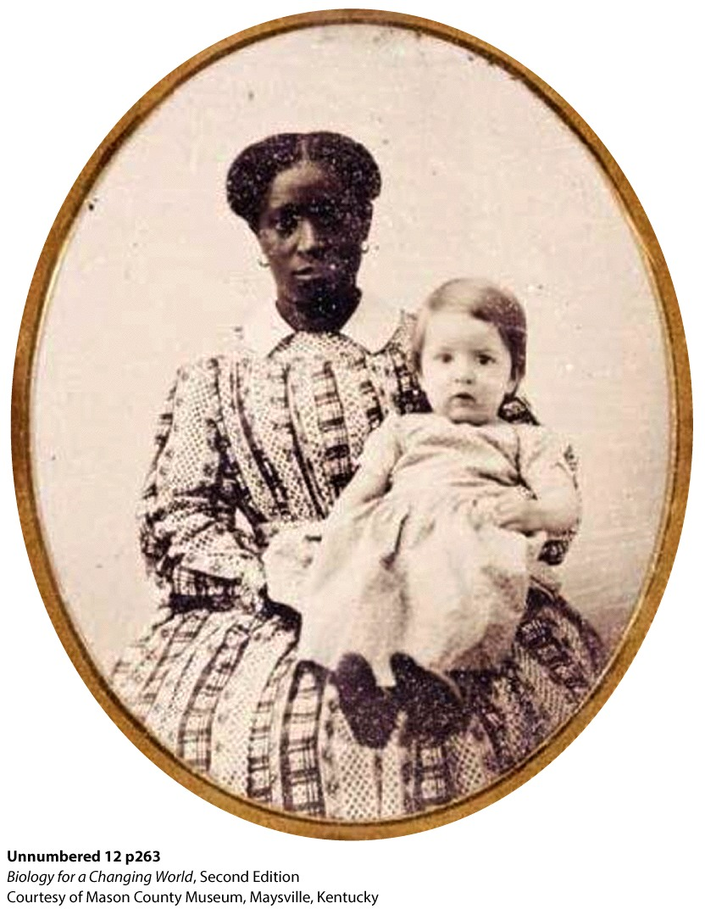
Y chromosome
Y-chromosome analysis
very small and contains few genes
study ancestry and identify paternity
Notes:
Caption: A slave named Lucy, born at Monticello in 1811. Slaves at Monticello often cared for the Jefferson children.
Jefferson was rumored to have fathered at least six children with Sally Hemings, a slave who tended to his family. For decades, historians discredited the rumor as unreliable oral history. In 1998, scientists attempted to find out by testing the DNA of both Hemings’s and Jefferson’s descendants with a technique called Y-chromosome analysis.

Slide 18
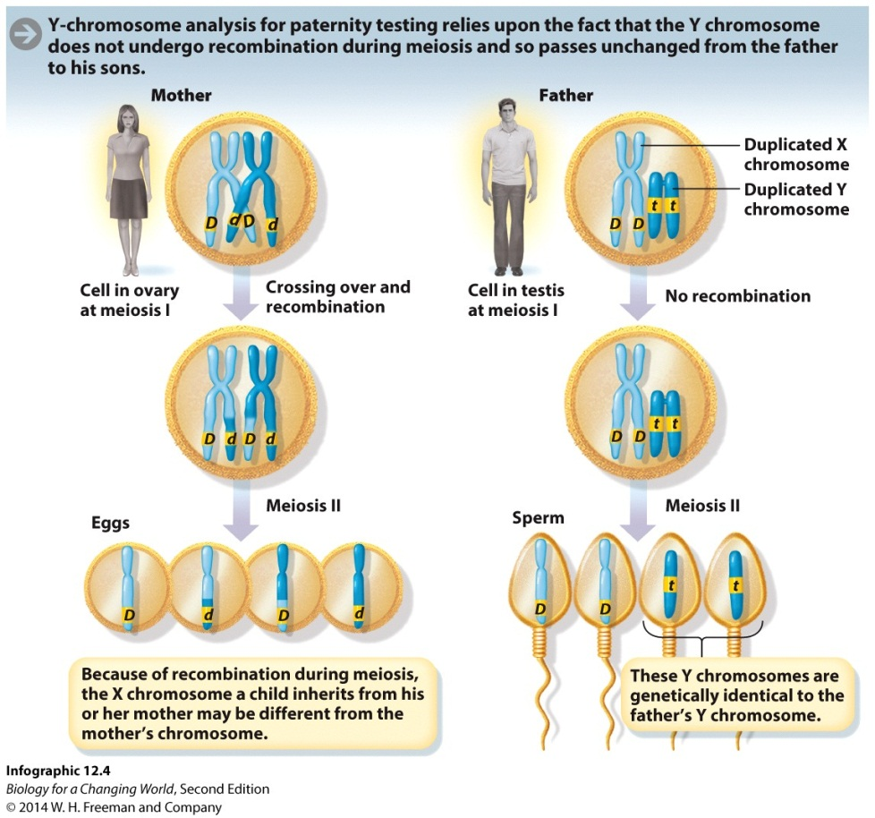
Y chromosome
Sons inherit Y chromosome from fathers
Compare DNA sequences

Slide 19
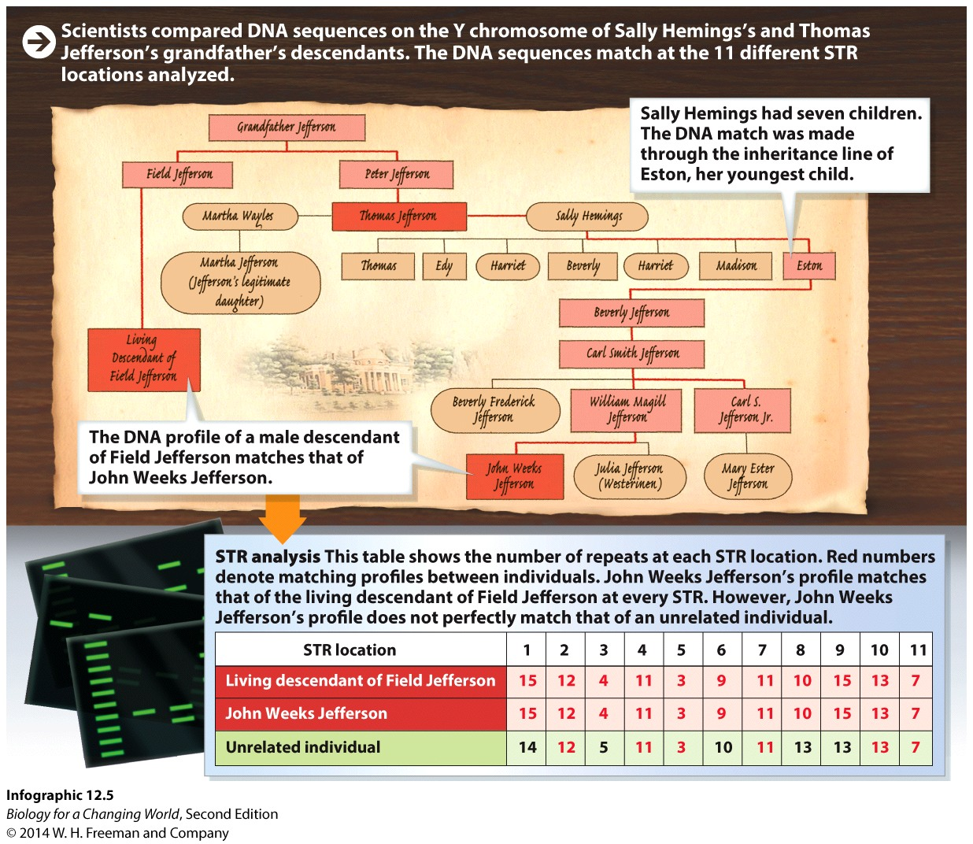
Y chromosome
Compare short tandem repeats (STRs) on Y chromosome
Thomas Jefferson pedigree
Notes:
STRs are short regions of DNA that are repeated a different number of times in different people and are used in DNA profiling.
Eston Hemings has the same Y chromosome as the descendants of Field Jefferson. Consequently, Thomas Jefferson could have fathered Eston Hemings. The study does not prove that he is the father, but it does show that the father was definitely a male Jefferson.

Slide 20
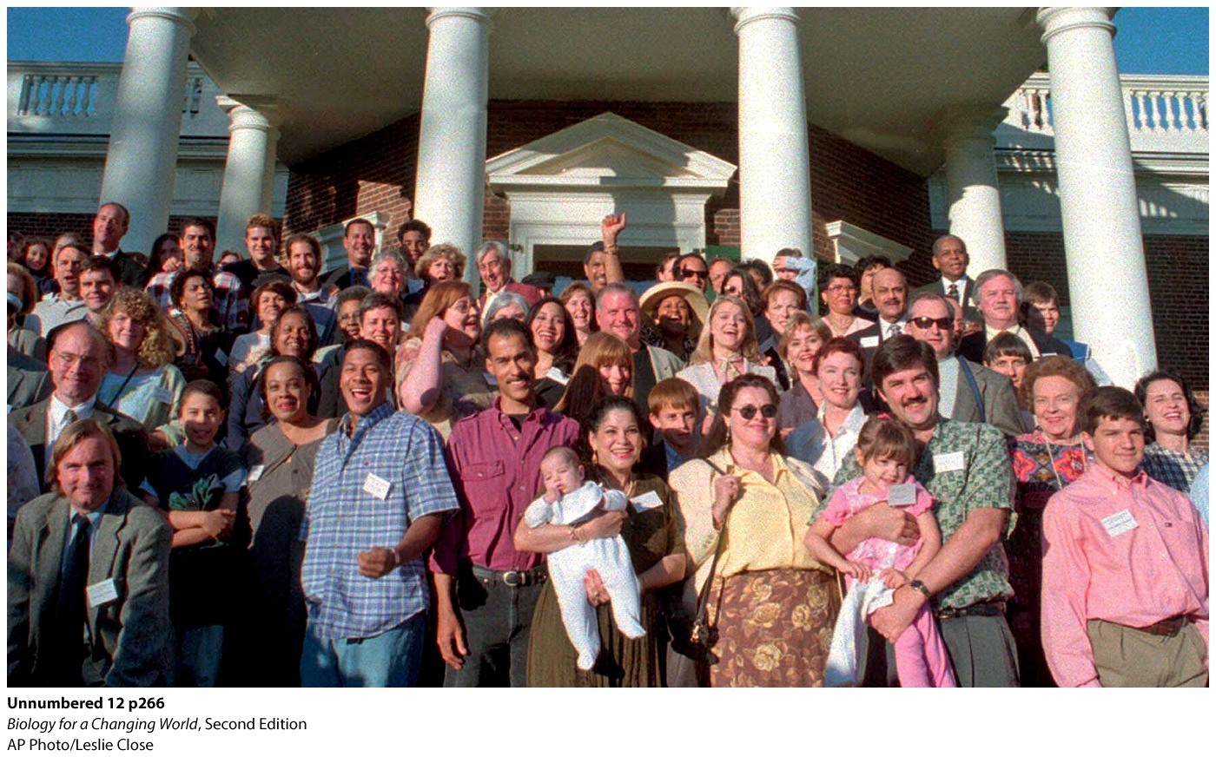
Y chromosome

Slide 21
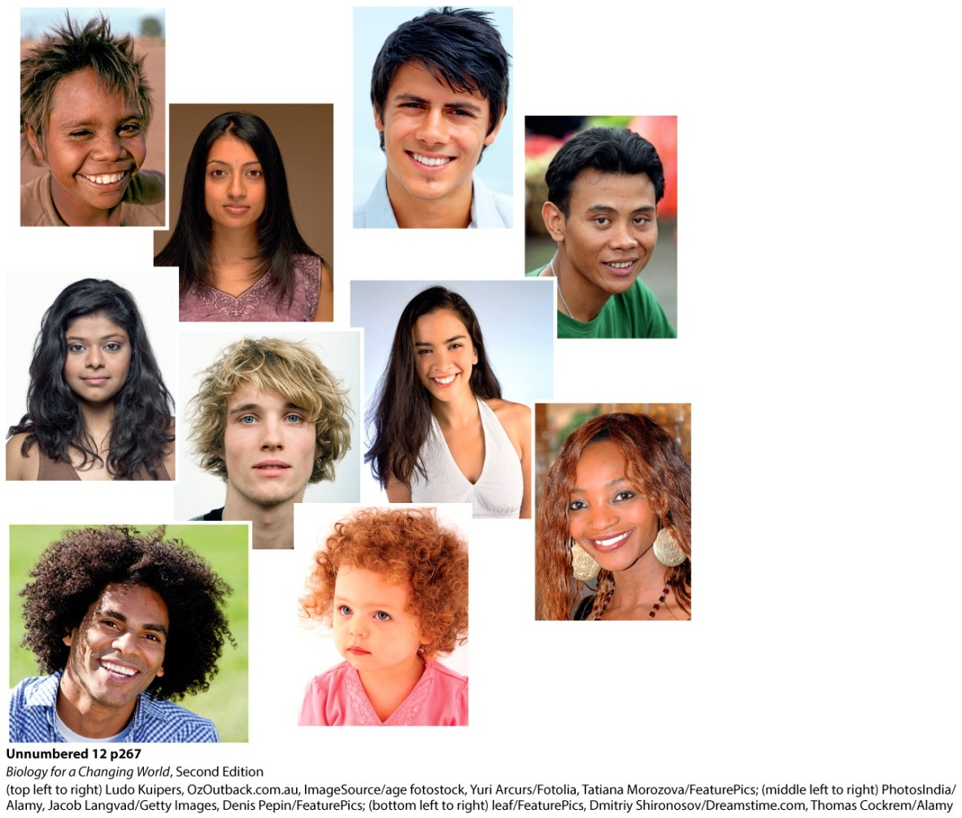
Incomplete dominance
There are two versions of the gene that specify hair texture
But three phenotypes: curly, straight, and wavy

Slide 22
Incomplete dominance
A form of inheritance in which heterozygotes have a phenotype that is intermediate between homozygous dominant and homozygous recessive

Slide 23
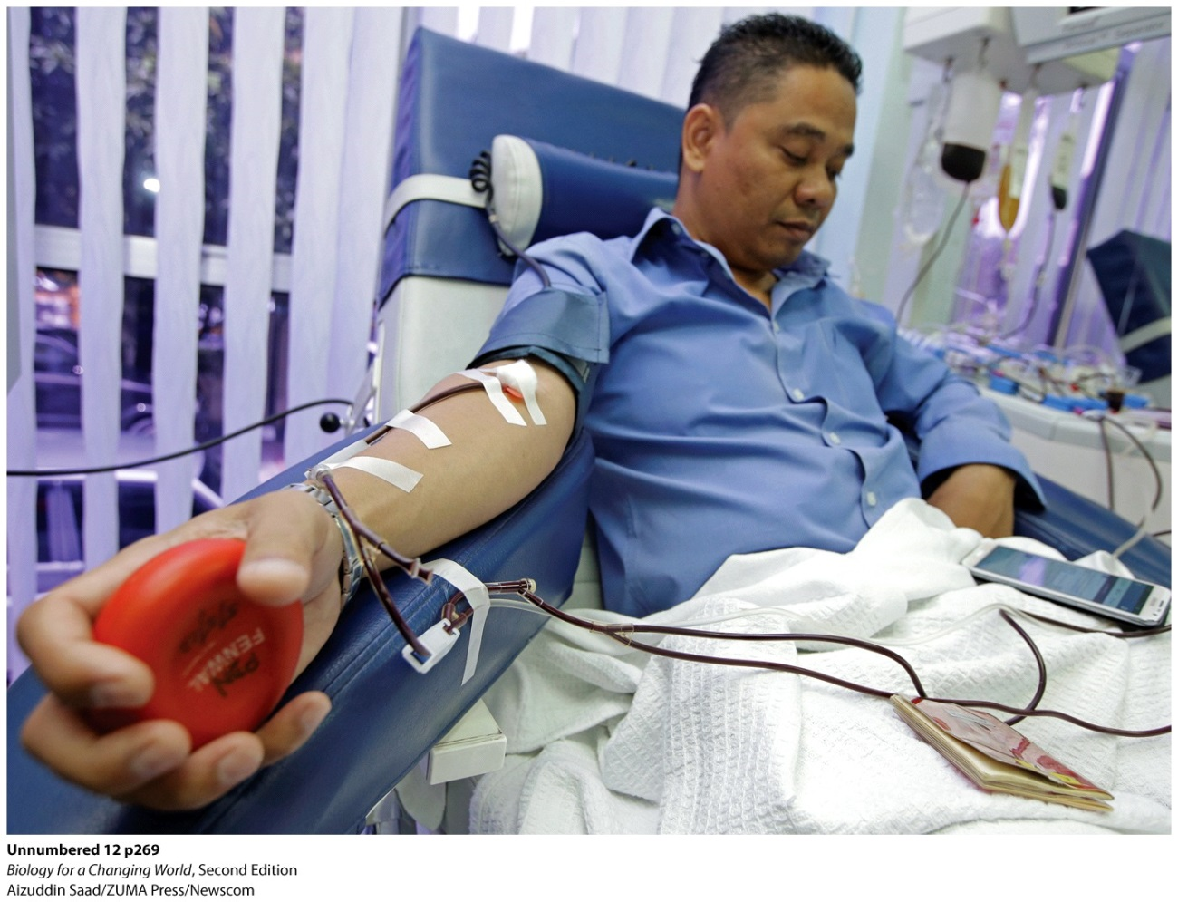
Codominance
Transfused blood must be compatible in ways that are determined by genetics
Notes:
Blood from donors can be used for transfusions, but must be compatible with the recipient.

Slide 24
Codominance
Both maternal and paternal alleles contribute equally and separately to the phenotype
Blood type
three blood group alleles: A, B, and O
genotypes OO, AO, BO, AB, AA, and BB

Slide 25
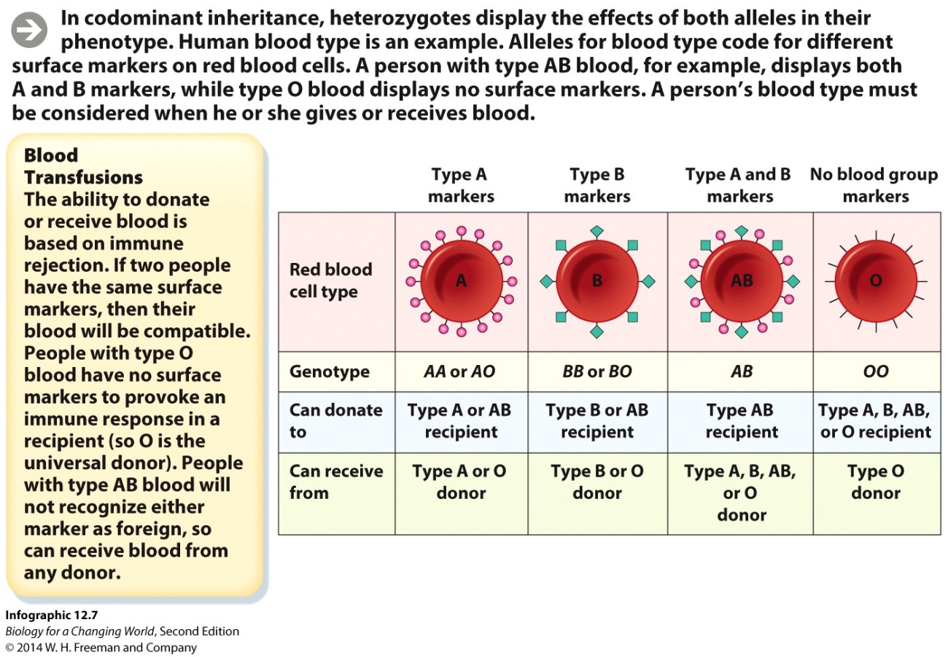
Codominance
Blood type alleles A and B are codominant
O is recessive to both A and B
Notes:
Your blood type indicates the presence or absence of specific protein markers, or “flags,” on your red blood cells. For example, if you have type A blood, your cells display A markers.

Slide 26
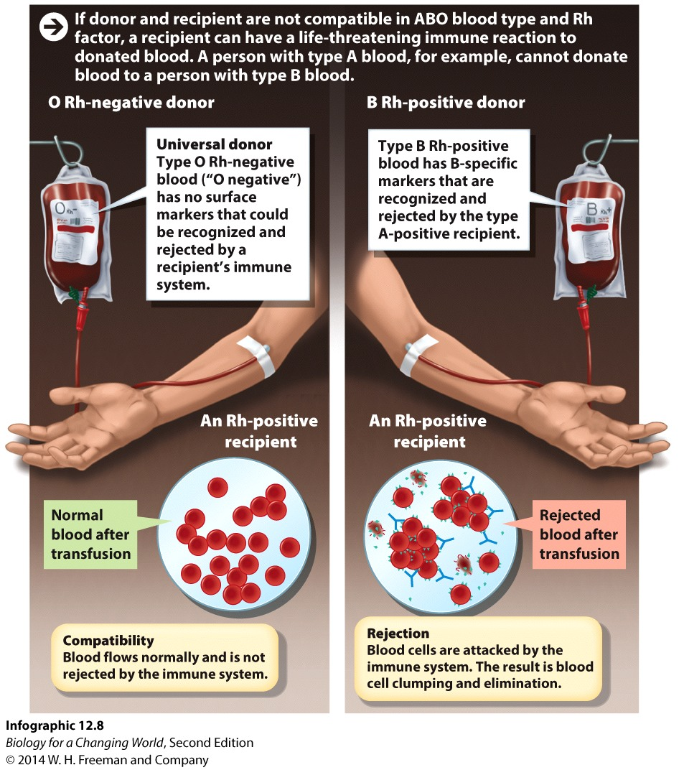
Codominance
Rh (+) or (-)
Presence or absence of Rh proteins on surface of your red blood cells
Dominant or recessive
Notes:
Your Rh status, (1) or (2), indicates the presence or absence of Rh proteins on the surface of your red blood cells. Rh factor genes are inherited in a dominant and recessive fashion.

Slide 27
Polygenic trait
A single trait determined by the interaction between alleles of more than one gene
Human height

Slide 28
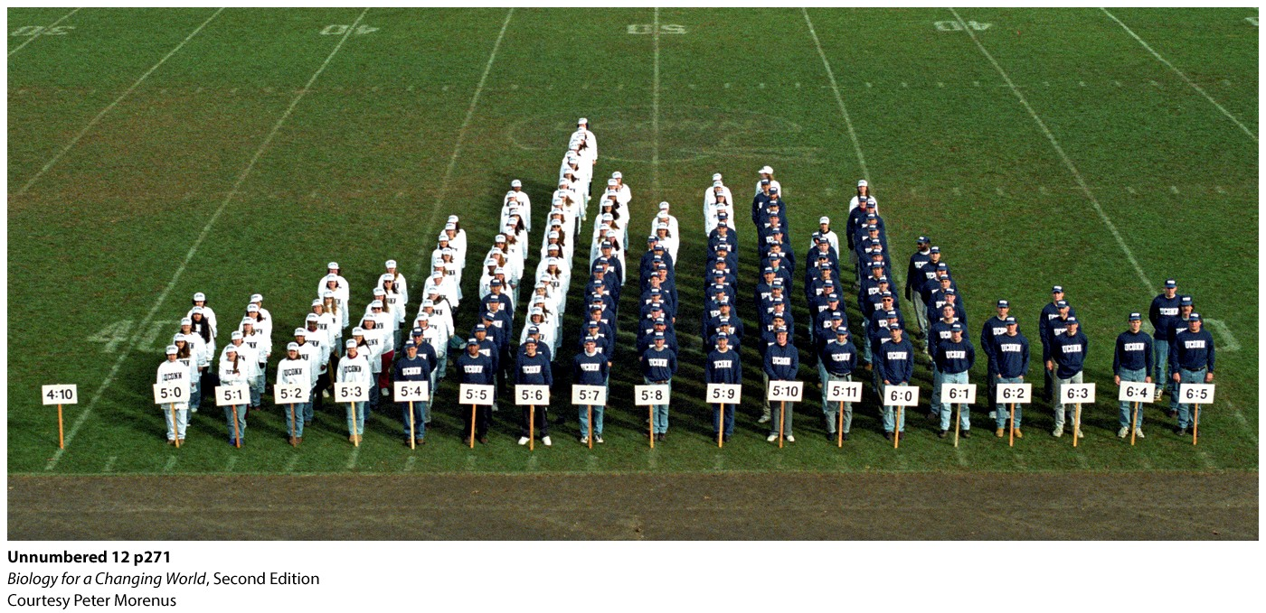
Polygenic trait
Height shows continuous variation
Range of variable phenotypes rather than discrete categories

Slide 29
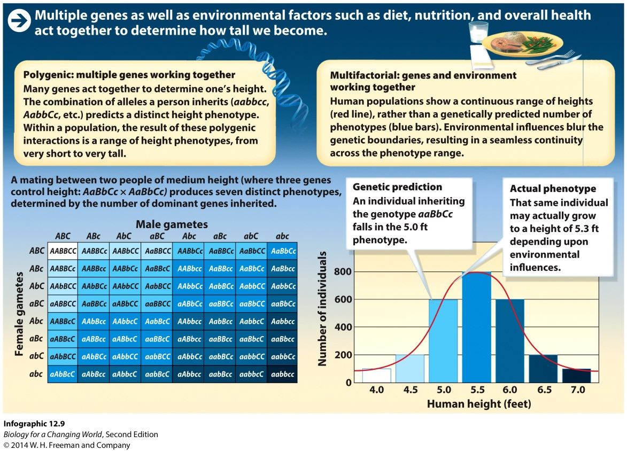
Multifactorial trait
Interactions between gene(s) and environment contributes to a phenotype
Human height!!
Notes:
In developing countries, access to nutrition varies much more, and this variation is reflected in larger variations in height between a given person and his or her relatives. The average height of the U.S. population has almost leveled off in the past decade, suggesting that the environment has almost maximized the genetic potential of height in this country.

Slide 30
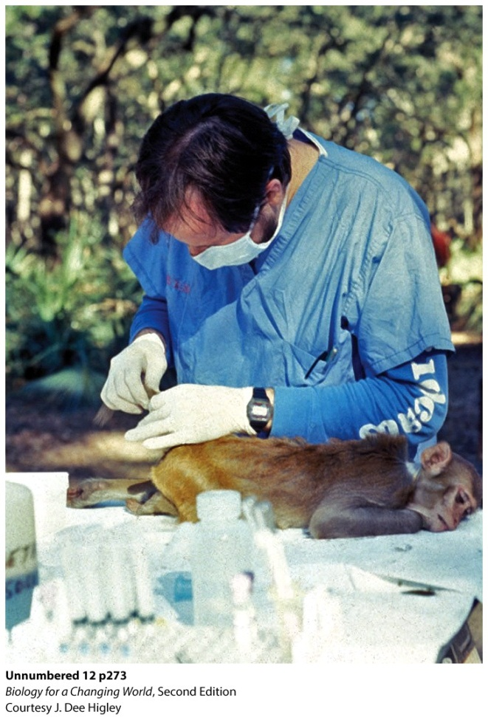
Multifactorial trait
Stress and mental development
Alleles of serotonin transport protein interact with environment
Clinical depression
Notes:
Researchers study how stress affects the mental development of infant monkeys. They were investigating whether certain alleles of a gene that encodes the serotonin transporter protein made infant monkeys more vulnerable to stress early in life.

Slide 31
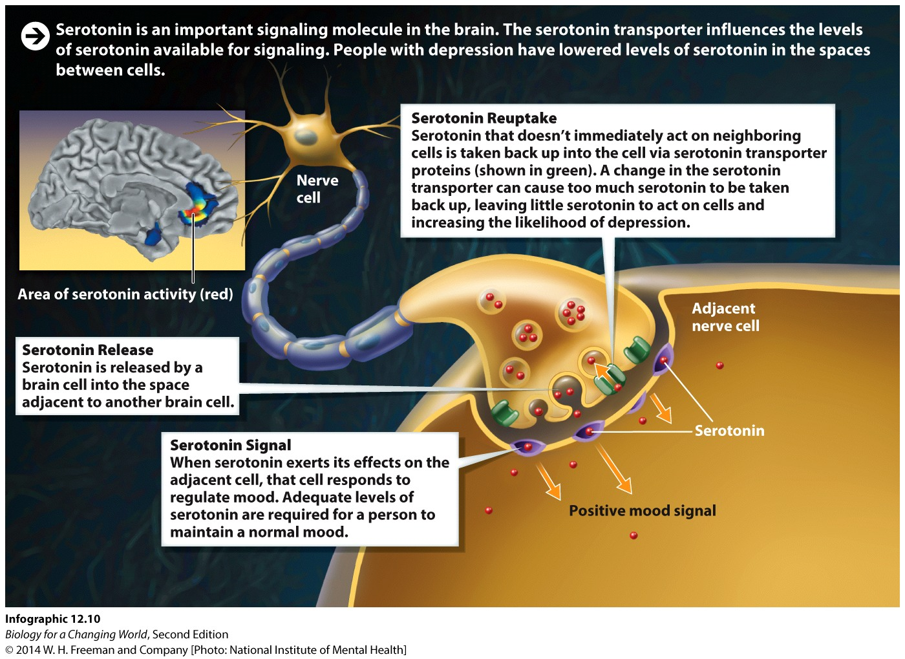
Multifactorial trait
One serotonin allele increases susceptibility to environmental stress
Notes:
There are two common alleles: a short version and a long version. The long version contains about 44 extra base pairs. Previous research had suggested that people who had at least one copy of the short version of this gene were much more likely to have an anxiety disorder.

Slide 32
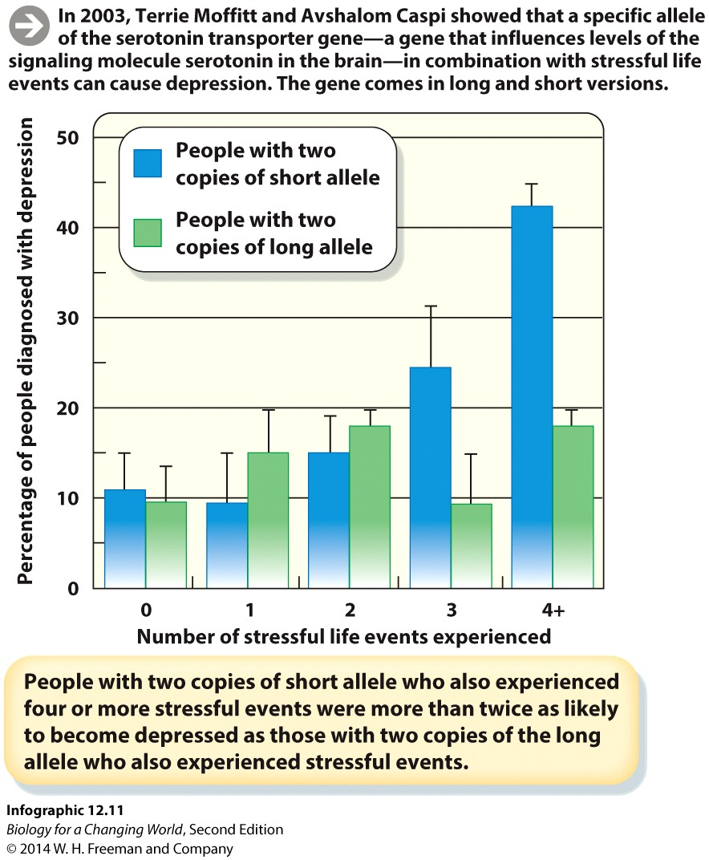
Multifactorial trait
Clinical depression was diagnosed in participants who had two copies of the serotonin allele and had experienced four or more tumultuous events

Slide 33
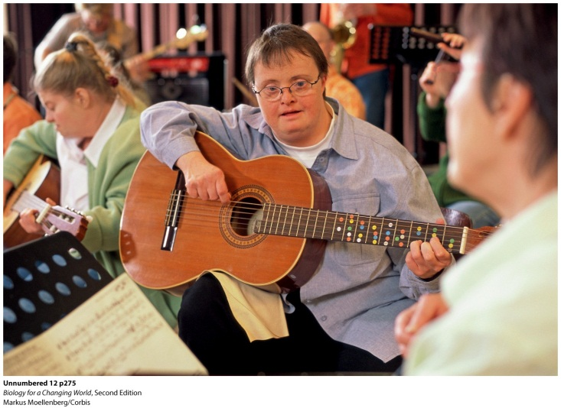
Errors in meiosis
Nondisjunction: failure of chromosomes to separate during cell division
Aneuploidy: an abnormal number of one or more chromosomes
For example, trisomy 21
Risk of both increase with maternal age
Notes:
At age 25, a woman’s risk of having a baby with Down syndrome is 1 in 1,250 births; at age 40 her risk skyrockets to 1 in 100 births.
Trisomy 21, also called Down syndrome, results when an embryo inherits an extra copy of chromosome 21. Anyone can conceive a child with the abnormality, but older women are at much higher risk.

Slide 34
Errors in meiosis

Slide 35
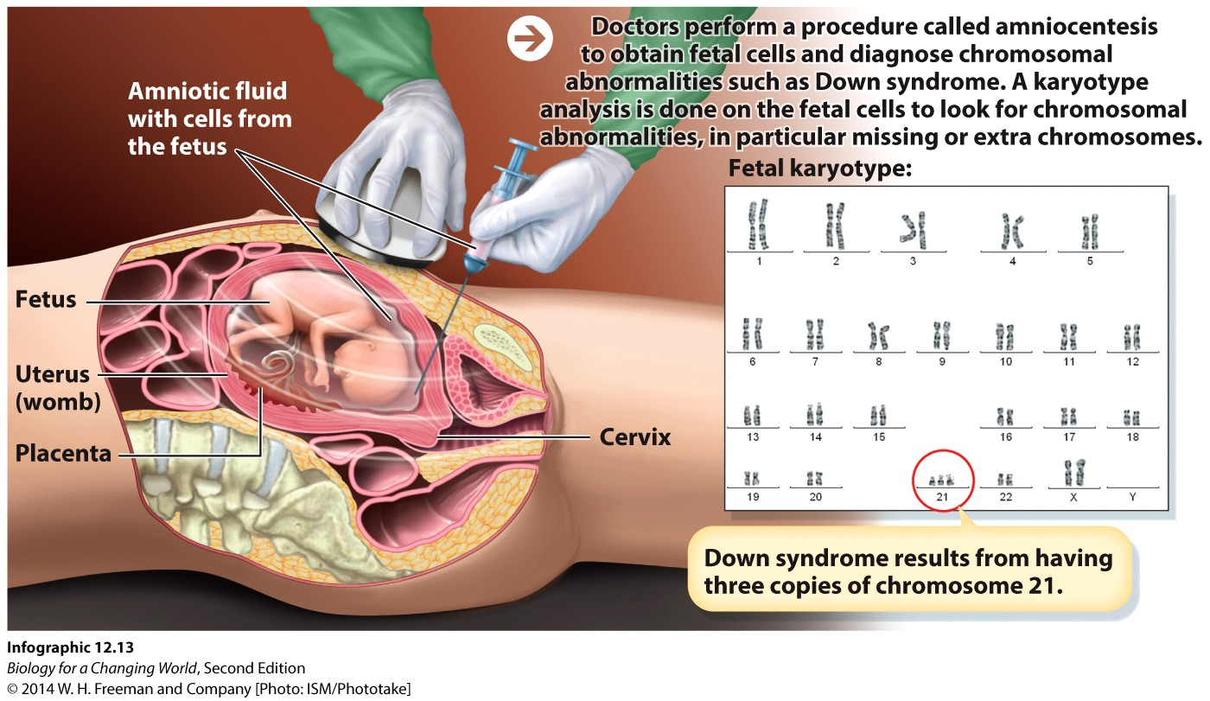
Detecting errors in meiosis
Trisomy 21 (aneuploidy)
Karyotype: chromosomal makeup of cells

Slide 36
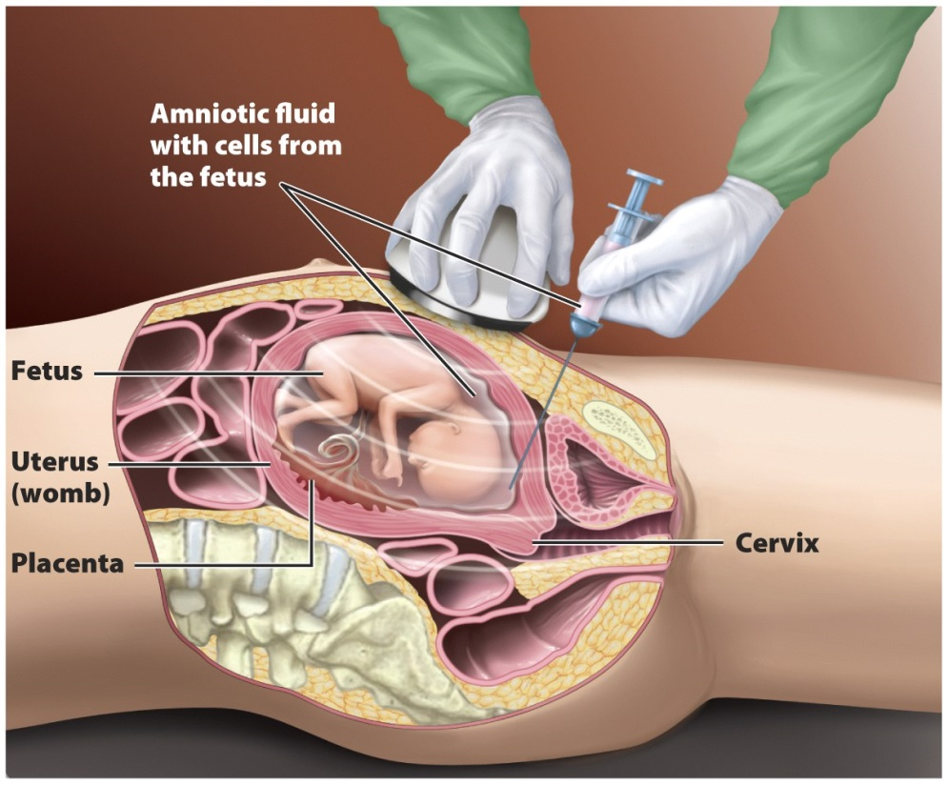
Detecting errors in meiosis
Amniocentesis
Removes fluid surrounding the fetus to obtain and analyze fetal cells to diagnose genetic disorders
Notes:
Performed between 14 and 20 weeks of pregnancy. A long, thin, hollow needle is inserted through a woman’s abdominal wall and into her uterus. Through the needle, the equivalent of 2 to 4 teaspoons of amniotic fluid, which surrounds the growing fetus, is removed. This fluid contains fetal cells that contain the fetus’s DNA.

Slide 37
Summary
Humans have 23 pairs of chromosomes. One pairs is the sex chromosomes: XX in females and XY in males.
Sex determination has genetic, hormonal, anatomical, and behavioral aspects.
The Y chromosome can be used to establish paternity.
Disorders and other traits inherited on X chromosomes are called X-linked traits, and are more common in males than in females.
Incomplete dominance: heterozygotes have a phenotype intermediate between homozygous dominant and homozygous recessive.
Codominant trait: both maternal and paternal alleles contribute equally and separately to the phenotype.

Slide 38
Summary
Polygenic traits are influenced by the additive effects of multiple genes. Polygenic traits often show a continuous, bell-shaped distribution in the population.
Person’s phenotype is determined by both genes and environmental influences; this type of inheritance is described as multifactorial.
Some genetic disorders result from having a chromosome number that differs from the usual 46.

