Slide 1
Michèle Shuster • Janet Vigna • Matthew Tontonoz • Gunjan Sinha
Biology for a
Changing World
SECOND EDITION
Lecture PowerPoint
CHAPTER 13
Stem Cells and Cell Differentiation
Copyright © 2014 by W. H. Freeman and Company

Slide 2
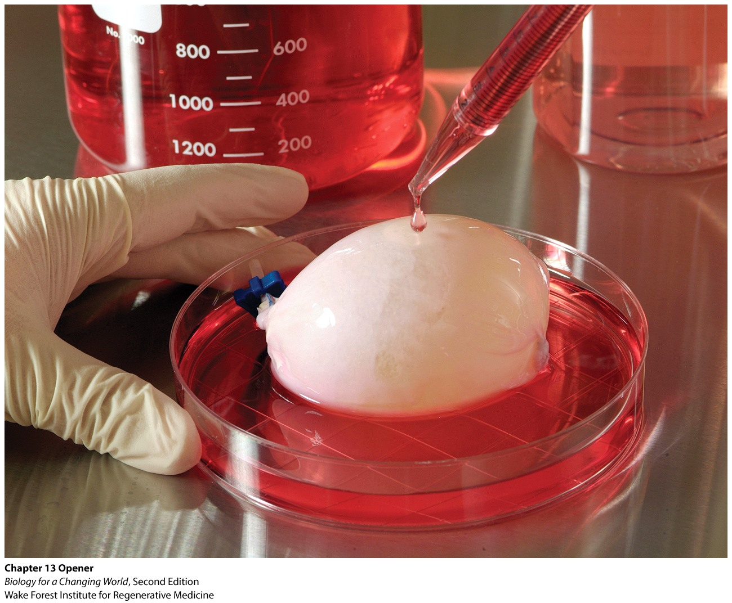
Chapter 13
Stem Cells and Cell Differentiation

Slide 3
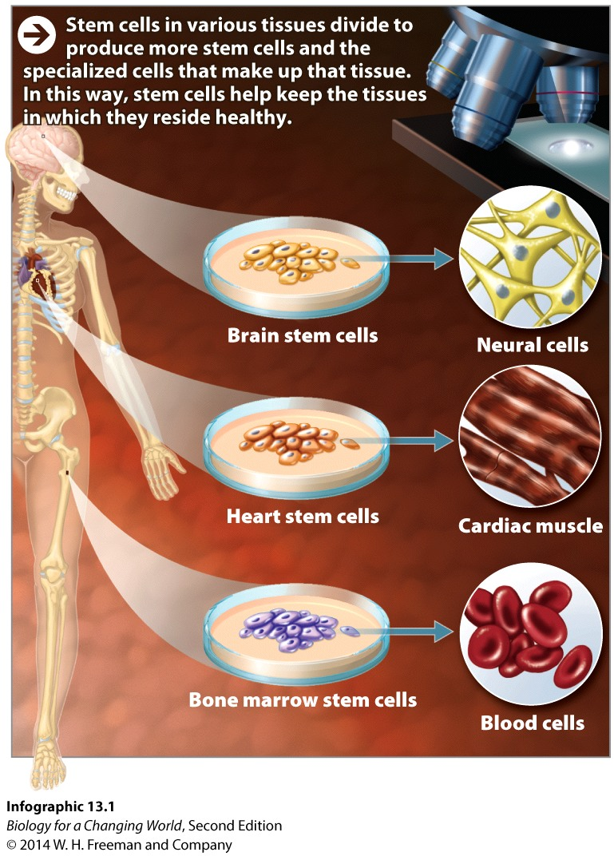
Driving Questions
1. What is the structure of tissues and organs, and how can organs be repaired or replaced?
2. What are the properties of specialized cells in tissues, and how do stem cells differentiate into these specialized cells?
3. How do stem cells contribute to regenerative medicine, and how can we obtain or produce stem cells for this purpose?

Slide 4
Grow your own organs?
Stem cells may be the key
2001, first engineered bladder
“They take a piece of your bladder out. They grow it in a lab for 2 months into a new bladder that’s your own. And they put it back in.”
—Luke Masella
Notes:
In 2001, Luke became one of the first patients in the world to receive an experimental treatment for such bladder problems. An engineered human bladder, one grown from his own cells, was implanted to fix his faulty one.

Slide 5
What are stem cells?
Immature cells that can divide repeatedly and give rise to more specialized cell types
Help regenerate tissues

Slide 6
Tissues, organs, and systems
Tissues are an organized of group of cells that work together to carry out a function

Slide 7
Tissues, organs, and systems
Organs are composed of groups of tissues
Often made of multiple cell types
Layers of tissues

Slide 8
Tissues, organs, and systems
Organs work together to form the body’s systems

Slide 9
Grow your own organs
First, take a biopsy from the organ

Slide 10
Grow your own organs
Stem cells from the tissues are grown
Cells divide

Slide 11
Grow your own organs
Cells are placed onto a scaffold in the shape of the organ and grown

Slide 12
Grow your own organs
Surgeons implant the newly grown organ into the patient’s body
Notes:
Tissues grown from a person’s own cells pose no risk of rejection because the tissue is genetically related to the donor.

Slide 13
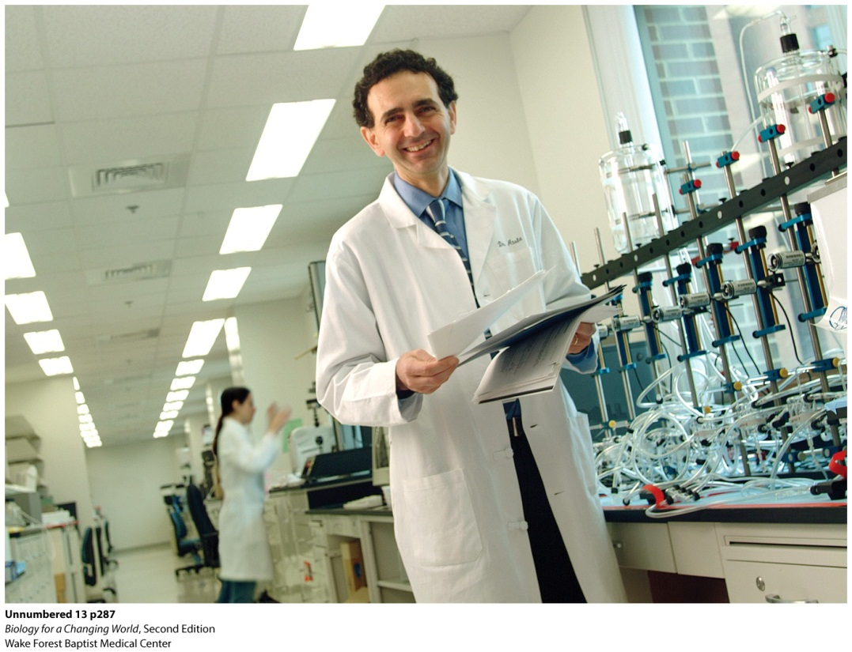
Grow your own organs
Notes:
Atala is using his organ-growing technique to make other organs for transplant. He has used the texhniquw to grow replacement urethras.

Slide 14
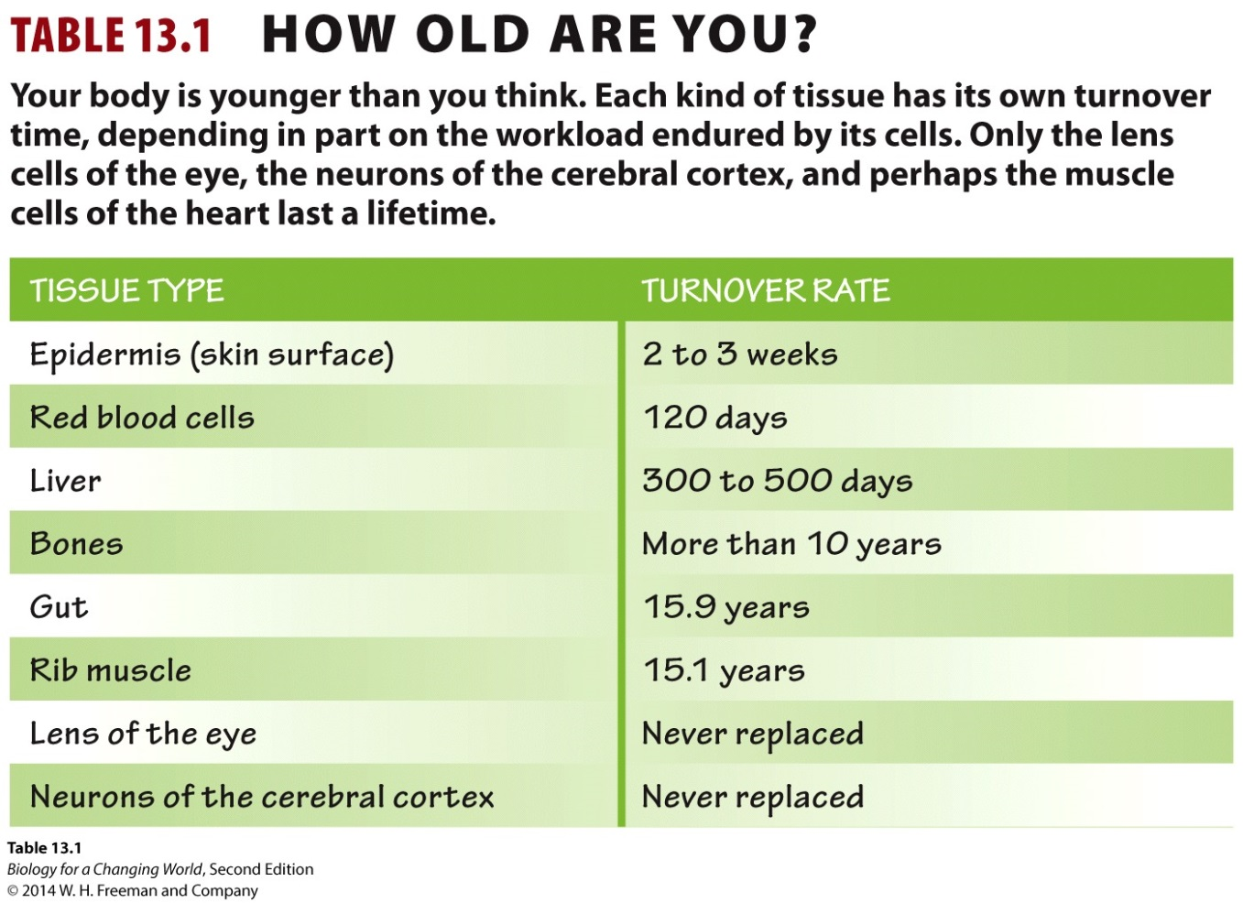
Adult stem cells
The human body is constantly regenerating
Somatic (adult) stem cells are found in mature tissues

Slide 15
Somatic stem cells
Somatic stem cells help heal tissue damage
Cells must go through a process of specialization to replace specific cell types
Cellular differentiation
Cell specializes to carry out a specific function
turn some genes on and others off to achieve this
differential gene expression

Slide 16
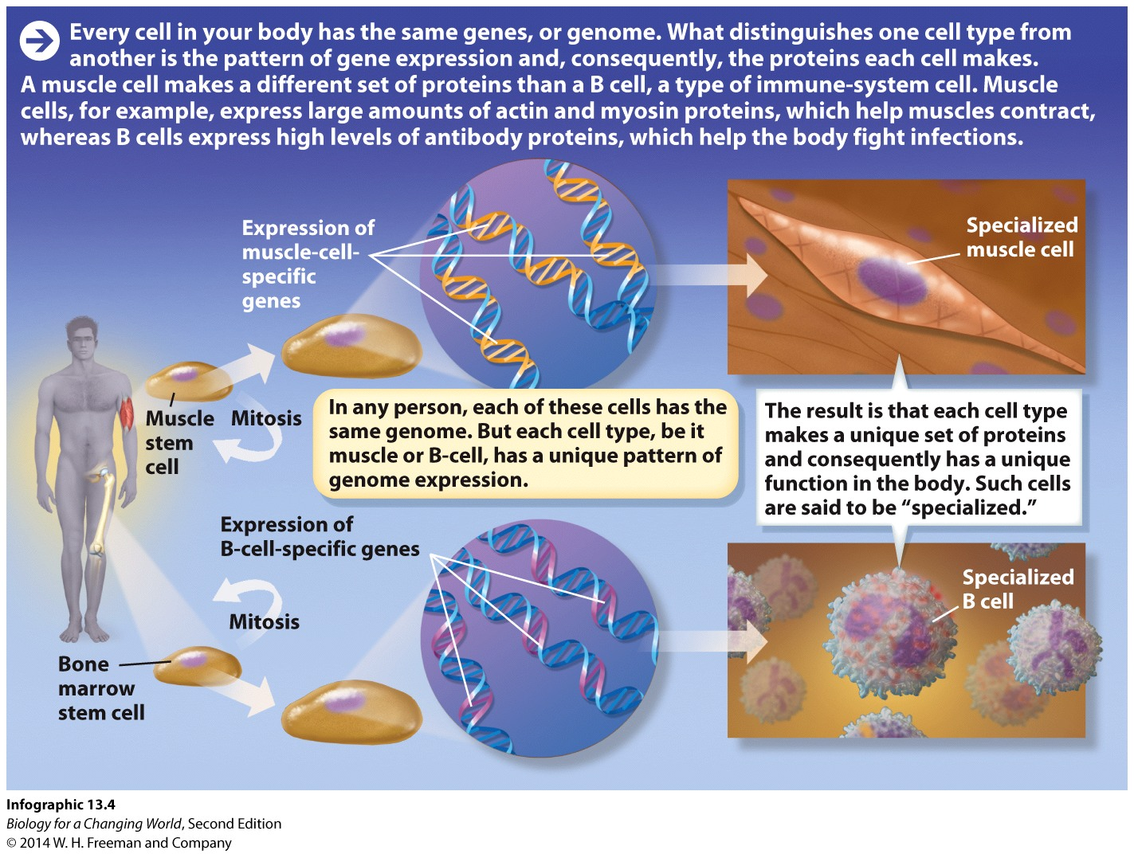
Somatic stem cells
Look at two different cell types: muscle cells and B cells of the immune system
Notes:
Muscle cells, which are long and slender, allow the body to move by contracting and relaxing. B cells are round, with antibody receptors protruding from their surfaces that detect foreign objects like viruses and bacteria, and help the body fight off infection.
A cell’s physical shape and function are determined by the kinds of protein found within it. Muscle cells contain proteins that allow them to contract and cause body movement; B cells contain proteins that allow them to fight infection. Both muscle cells and B cells contain exactly the same DNA, and therefore contain the same genes. Only a subset of those genes is turned on in each cell type.

Slide 17
Regenerative medicine
Using stem cells to regenerate damaged or diseased tissues

Slide 18
Regenerative medicine

Slide 19
Regenerative medicine

Slide 20
Regenerative medicine

Slide 21
All stems cells are not equal
Adult stem cells are limited
Can only differentiate into a few cell types
Multipotent
Notes:
Cells with restricted ability to differentiate are described as multipotent.

Slide 22
All stems cells are not equal
Some stem cells are pluripotent – they can differentiate into nearly any cell type
Embryonic stem cells
Notes:
Stem cells are found in early embryos at what’s known as the blastocyst stage, when the embryo is mostly a hollow ball of cells.
Some scientists argue that embryonic stem cells hold greater potential in treating disease because they are not as specialized as adult stem cells and can therefore differentiate into many more cell types.

Slide 23
All stems cells are not equal
Some stem cells are totipotent – they can differentiate into any of the body’s cell types
Notes:
Totipotent describes a cell with the ability to differentiate into any cell type in the body.

Slide 24
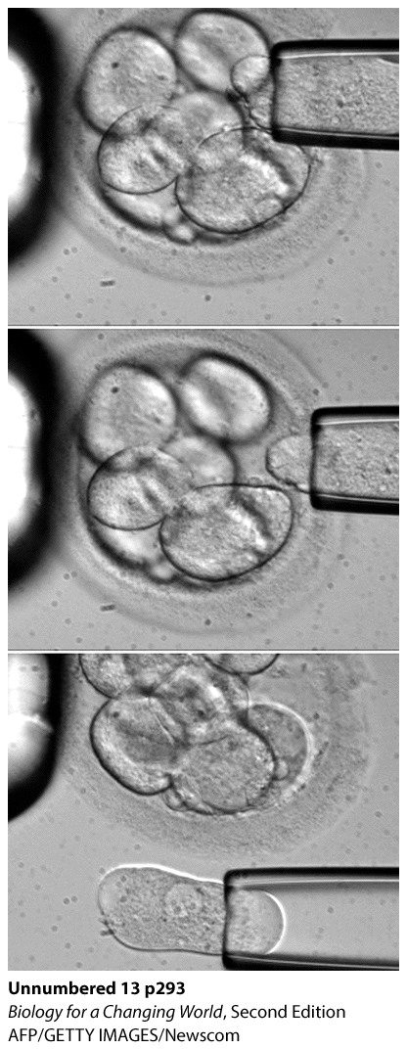
Obtaining embryonic stem cells
Discarded human embryos from fertility clinics
Notes:
Scientists can extract cells from an embryo and place them in media that stimulates them to divide. These cells are then stored, used in research, and could potentially be used in treatment.

Slide 25
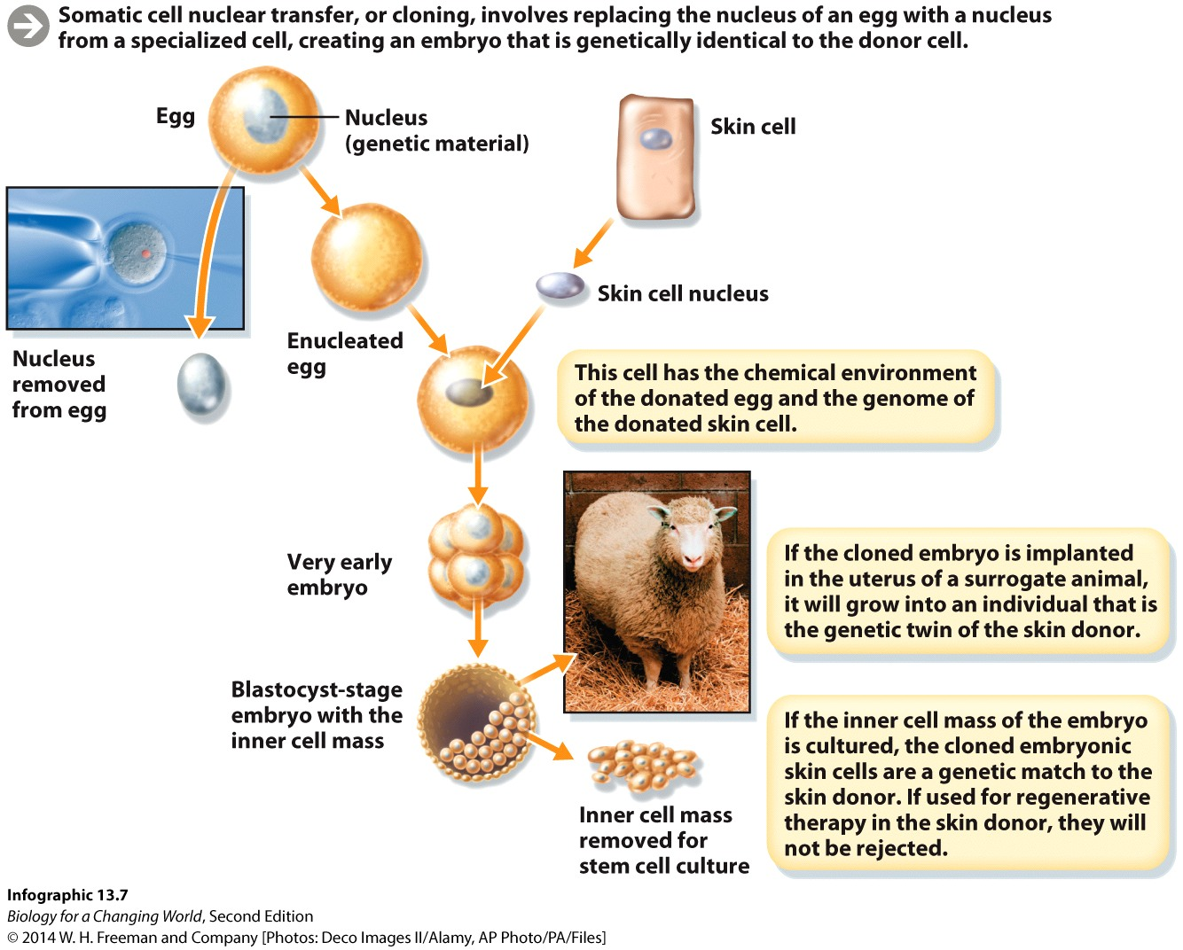
Obtaining embryonic stem cells
Through cloning or somatic cell nuclear transfer
Notes:
Replace the nucleus of a haploid unfertilized human egg with the diploid nucleus taken from another cell and create a new embryo with the same genes as the donor cell.

Slide 26
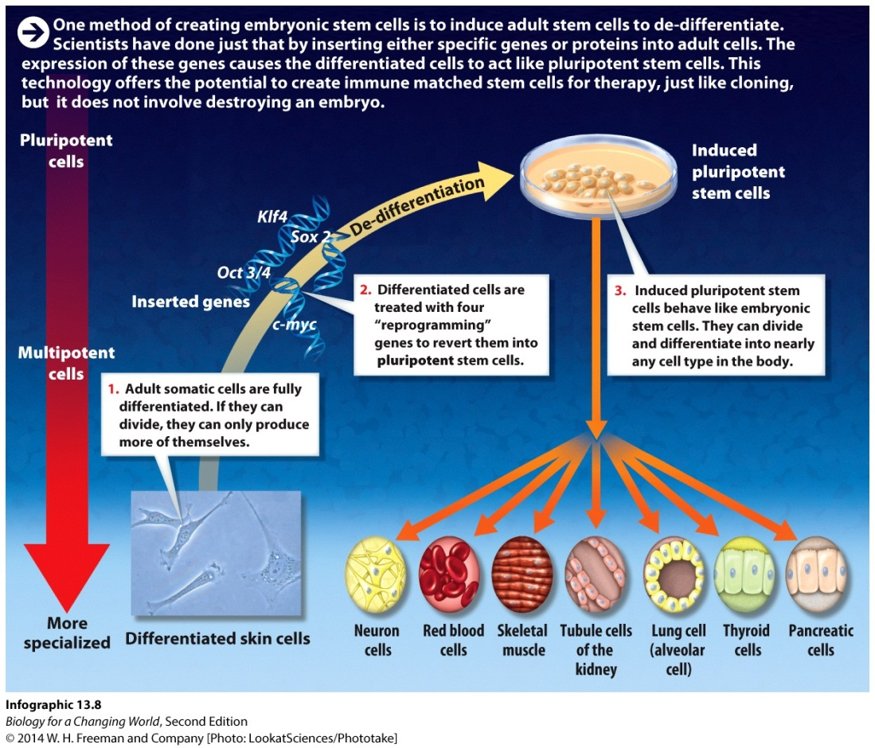
Obtaining embryonic stem cells
Create embryonic-like stem cells
Adding a few genes to differentiated human cell.
Induced pluripotent stem cells
Notes:
A pluripotent stem cell can be generated by the manipulation of a differentiated somatic cell.

Slide 27
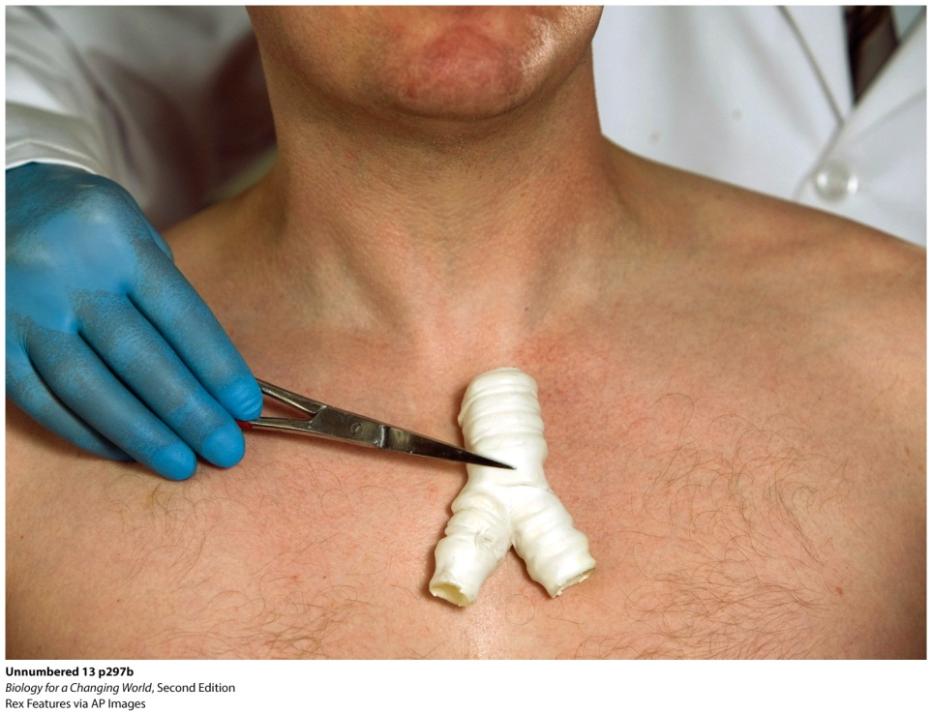
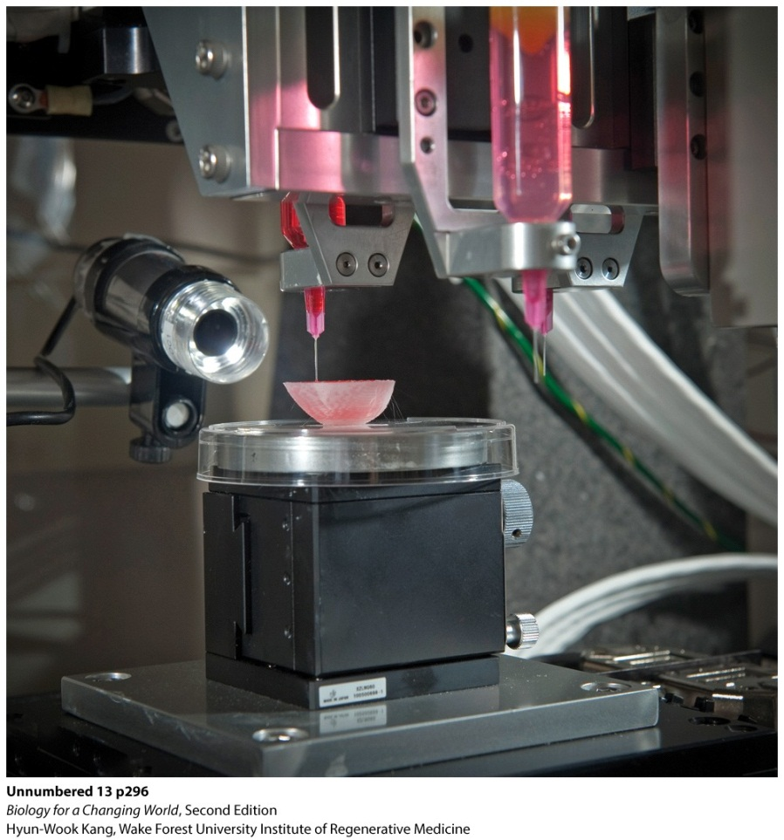
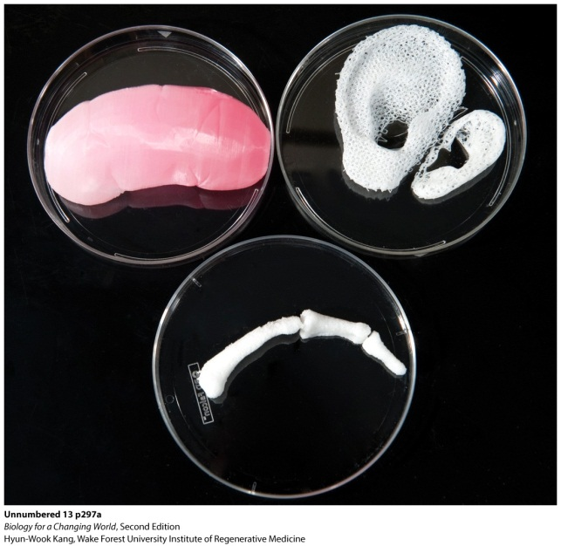
Building organs
Using bioprinters

Slide 28
Summary
Tissues are integrated groups of specialized cells that perform specific functions.
Stem cells are unspecialized cells that can divide and differentiate into different cell types.
Adult stem cells, also known as somatic stem cells, are found in mature tissues; embryonic stem cells make up early embryos.
Adult stem cells are multipotent; embryonic stem cells are pluripotent.
Cell differentiation is the process by which an unspecialized cell becomes a specialized cell with a unique function.
All cells in the body have the same genome but express different genes. Such differential gene expression produces different proteins and different functions.

