Slide 1
Michèle Shuster • Janet Vigna • Matthew Tontonoz • Gunjan Sinha
Biology for a
Changing World
SECOND EDITION
Lecture PowerPoint
CHAPTER 17
Life on Earth
Copyright © 2014 by W. H. Freeman and Company

Slide 2
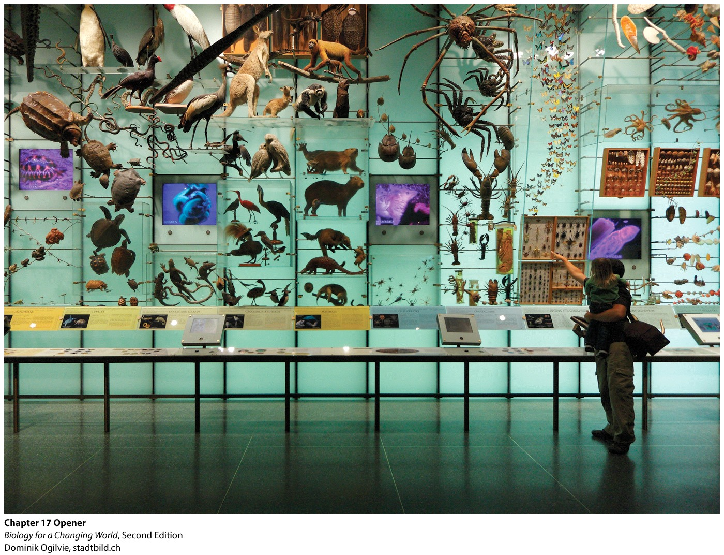
Chapter 17
Life on Earth
Notes:
Visitors admire a display in the Hall of Biodiversity at the American Museum of Natural History in New York City.

Slide 3
Driving Questions
1. What do we know about the history of life on Earth,
and how do we know it?
2. What factors help to explain the distribution of
species on Earth?
3. What are the major groups of organisms, and how
are organisms placed in groups?

Slide 4
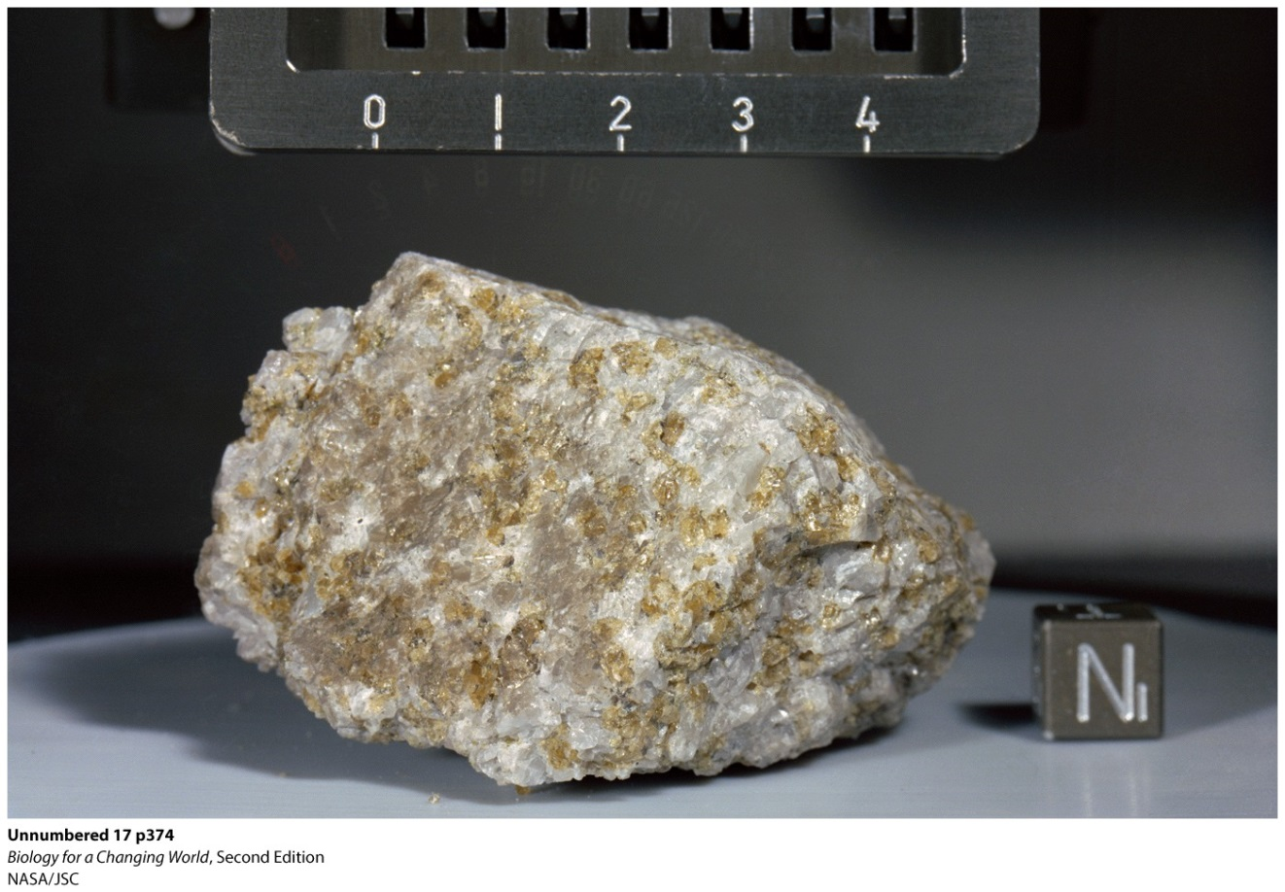
How old is Earth?
Rocks collected from Apollo missions
Estimate age of Earth: 4.5 billion years old
Notes:
The Genesis Rock, a sample of lunar crust from about the time the moon was formed, was retrieved by Apollo 15 astronauts James Irwin and David Scott in 1971.
The oldest known rocks on Earth’s surface, the Acasta Gneiss in a remote region of northern Canada, are 4.0 billion years old. Other ancient Earth rocks, from Western Australia, contain single mineral crystals that are 4.4 billion years old.

Slide 5
How old is Earth?
Radiometric dating
amount of radioactivity present in a rock is used as a geologic clock
Radioactive isotopes
unstable form of an element that decays into another element by emitting energetic particles (radiation)

Slide 6
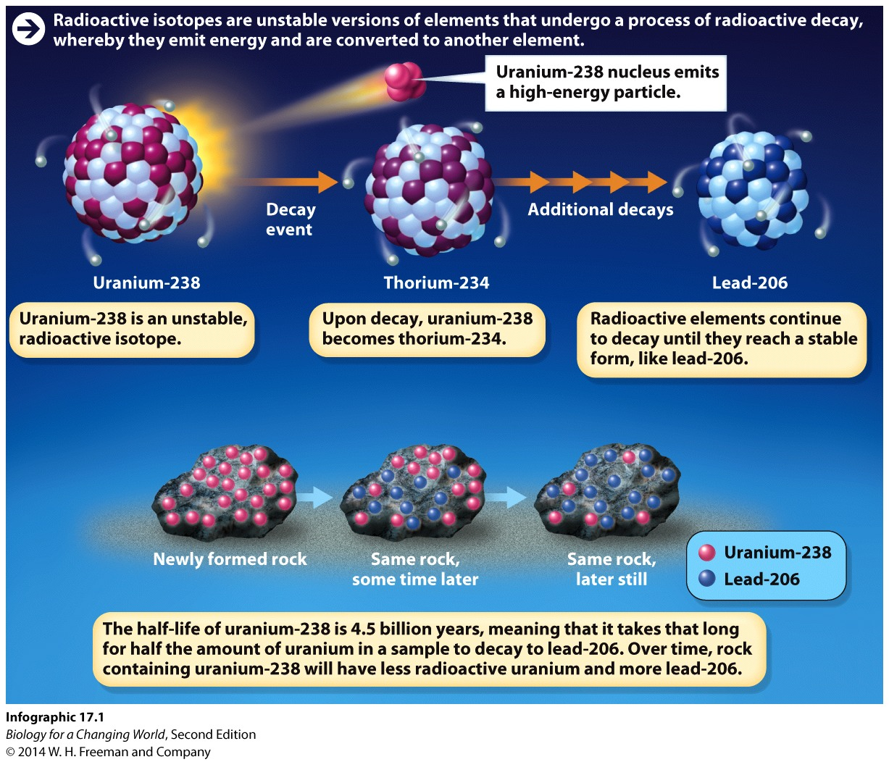
How old is Earth?
Minerals in rocks contain a certain amount of radioactive isotopes, which decay and transform into element

Slide 7
How old is Earth?
The time it takes for half the isotope in a sample to break down is called its half-life
Used to determine the age of the materials in which they’re found
Notes:
Different radioactive elements decay at different rates. Uranium-238 has a half-life of 4.5 billion years, whereas potassium-40 has a half-life of 1.3 billion years. The half-life of carbon-14 (useful for dating once-living, organic remains) is relatively short: it decays to nitrogen-14 in just 5,730 years. Because the isotopes decay at a known and constant rate, they can be used to determine the age of the materials in which they’re found.

Slide 8
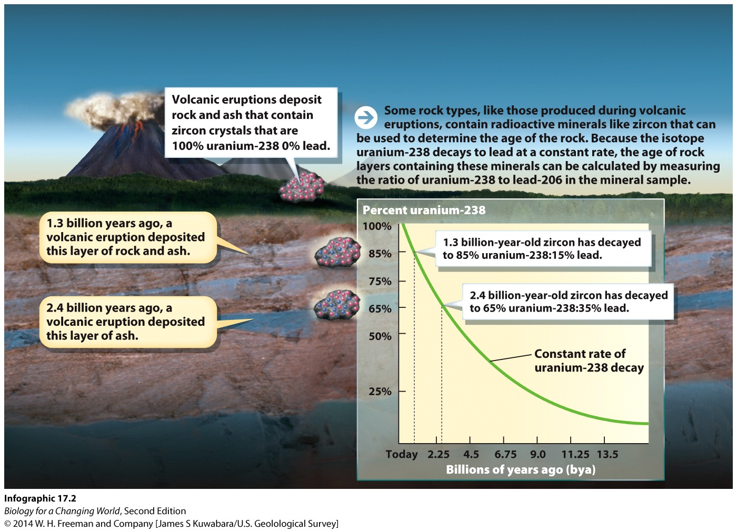
How old is Earth?

Slide 9
When and how did life begin?
3 billion years ago
Left no discernible evidence
We can hypothesize

Slide 10
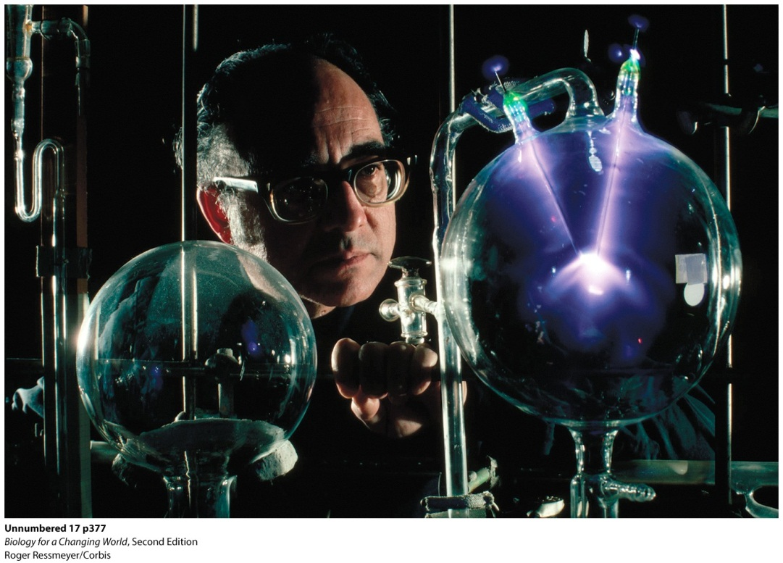
When and how did life begin?
Harold Urey and Stanley Miller hypothesized that they could synthesize organic molecules by replicating the chemical environment of early Earth
Notes:
Scientists combined the gases hydrogen (H₂), methane (CH₄), ammonia (NH₃), and water vapor (H₂O) in a flask filled with warm water. This is the best estimate of what the “primordial soup” was like. They then replicated lightning by discharging sparks into the chamber with an electrode. As the gases condensed and rained back into the flask, a host of new molecules formed from the basic ingredients. Among the molecules were amino acids, the building blocks of protein.

Slide 11
When and how did life begin?
Their experiment yielded new organic molecules, including amino acids
Showed that it was possible to create molecules of life from inorganic materials

Slide 12
What was life like millions of years ago?
Look to the fossil record
Scientists have produced a geologic timescale of Earth

Slide 13
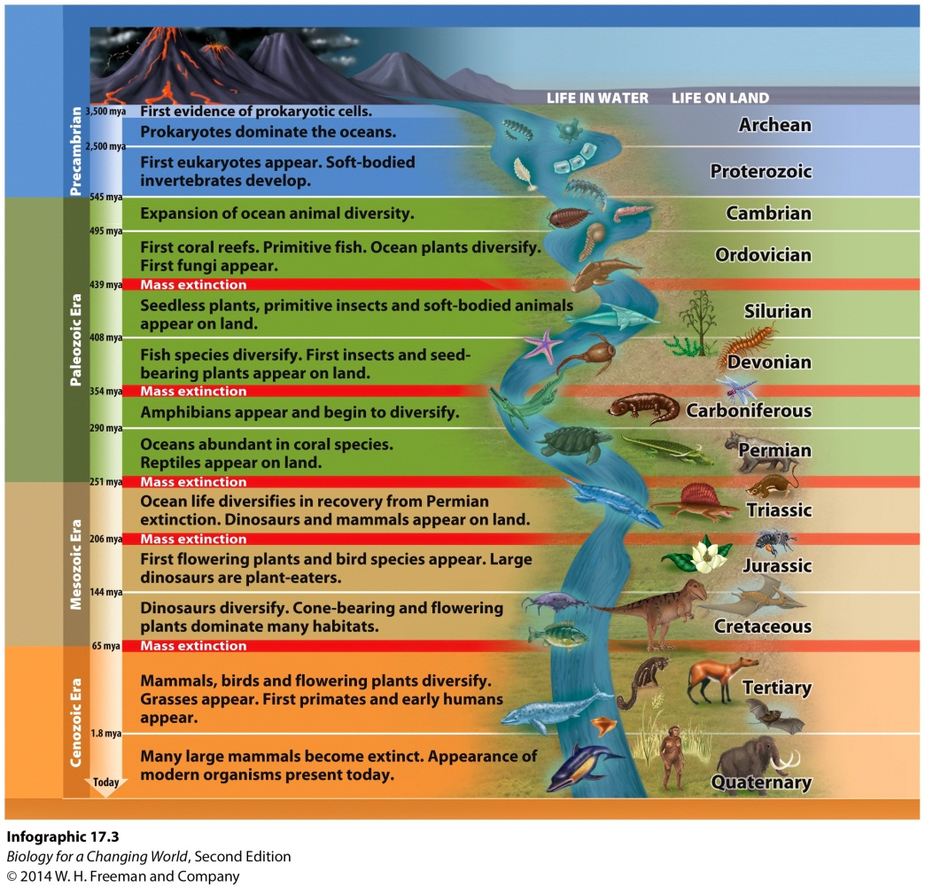
What was life like millions of years ago?
The geologic timeline shows that Earth’s geography and climate have gone through dramatic changes

Slide 14
What was life like millions of years ago?
Oldest known fossils date 3.5 billion years ago
Atmosphere lacked oxygen
Unicellular prokaryotes that used other gases as a fuel source

Slide 15
What was life like millions of years ago?
Emergence of unicellular photosynthetic organisms 3.0 to 2.5 billion years ago
Oxygen began to accumulate in the atmosphere

Slide 16
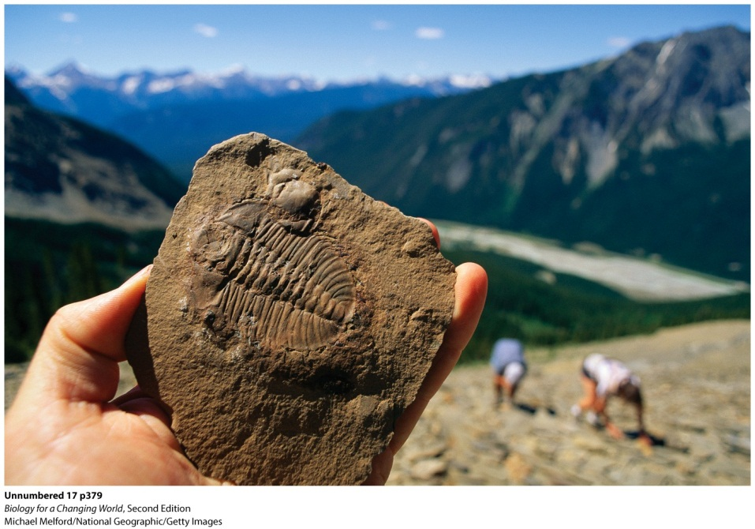
What was life like millions of years ago?
First multicellular eukaryotic organisms: green algae—1.2 billion years ago
Marine invertebrates arrived 600 million years ago
Diverse animal world in Cambrian explosion
Notes:
The Burgess Shale, in the Canadian Rockies, is famous for the fine state of preservation of the soft parts of its fossils.
During the Cambrian explosion the ocean swelled with life. The Opabinia, an organism with five eyes and a snout resembling a vacuum-cleaner hose, was discovered in fossils from this period.

Slide 17
What was life like millions of years ago?
Land colonized by primitive plants 450 million years ago
Mass extinction 250 million years ago
elimination of all individuals in a species
Permian extinction
Notes:
Scientists do not know what caused the Permian extinction, but some hypothesize that massive volcanic activity filled the atmosphere with heat-trapping gases that led to a rapidly changing climate. The Permian extinction wasn’t bad for all organisms. Some organisms flourished as space and resources opened.

Slide 18
What was life like millions of years ago?
Survivors spread and diversified
Colonized newly open habitats
Adaptive radiation
Notes:
Reptiles thrived in the hot dry climate of the following Triassic Period. The most famous group of reptiles, the dinosaurs, dominated the land for nearly 200 million years.

Slide 19
What was life like millions of years ago?
Mass extinction at end of Cretaceous period, 65 million years ago
extinction of between 50% and 90% of all species that occurs relatively rapidly
Dinosaurs died out
Notes:
Evidence now suggests that what killed off the dinosaurs (and 60% of the other species living at the time) was a massive 6-mile-wide asteroid that plowed into Earth with almost unimaginable force, sending a thick layer of soot and ash into the atmosphere and blocking out the sun for months. A crater 110 miles wide in Mexico’s Yucatán peninsula, near the town of Chicxulub, is the likely impact site.

Slide 20
What was life like millions of years ago?
Pattern of extinctions followed by adaptive radiation is seen in the fossil record
Punctuated equilibrium: periodic bursts of species change as a result of sudden environmental change

Slide 21
Why are there no penguins at the North Pole, and no polar bears at the South Pole?
Distribution of organisms reflects their evolutionary history
Biogeography: study of how organisms are distributed in geographical space
Plate tectonics
movement of Earth’s upper mantle and crust
influences the geographical distribution of landmasses and organisms

Slide 22
Why are there no penguins at the North Pole, and no polar bears at the South Pole?

Slide 23
Are creatures that look alike always closely related?
Common ancestry is not the only reason that two species might appear similar
Convergent evolution
Organisms that are not closely related evolve similar adaptations as a result of independent episodes of natural selection
For example, cold water fish
Notes:
In the frigid waters of the Antarctic Ocean, fish have a unique adaptation that keeps them from becoming ice cubes: their blood is pumped full of “antifreeze.” Fish blood contains molecules called glycoproteins that lower the temperature at which body fluids freeze. The glycoproteins surround any tiny ice crystals that may form in the blood and stop them from growing. Arctic fish, at Earth’s other pole, also have “antifreeze proteins,” but the genes that code for them are different.

Slide 24
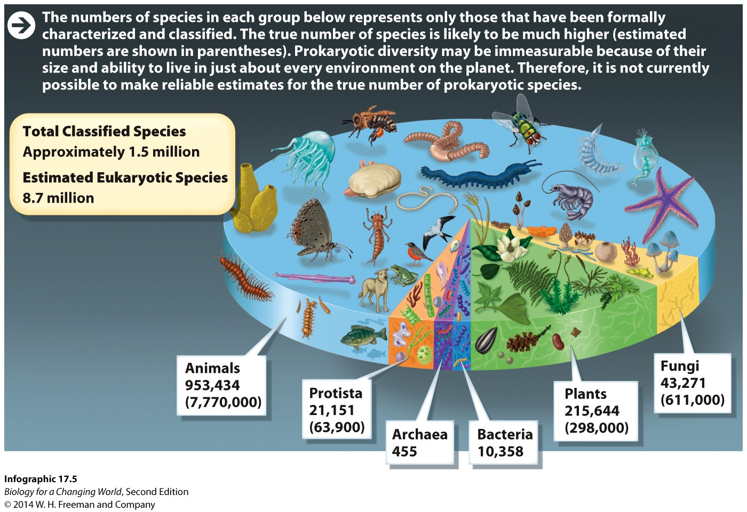
How many species are there on Earth, and how do scientists keep track of them?
Estimated 5 million to 30 million total number of species on Earth
1.5 million or so have been formally described

Slide 25
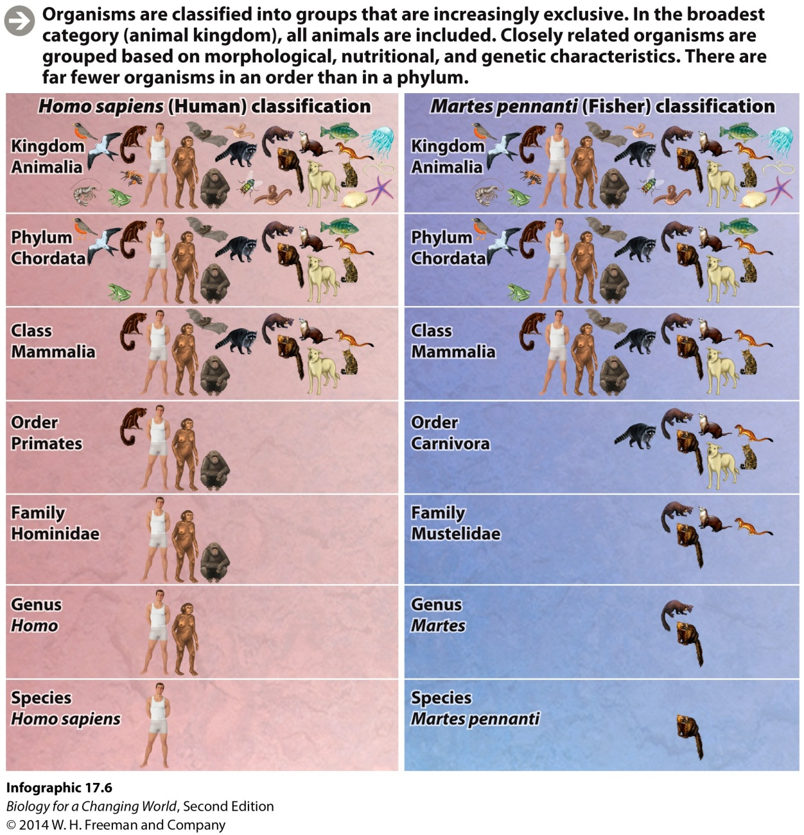
How many species are there on Earth, and how do scientists keep track of them?
Taxonomy
systematically identifying, naming, and classifying organisms on the basis of shared traits
Notes:
Taxonomy is an attempt to impose a human sense of order on this vast array of species, categorizing them on the basis of features they have in common.

Slide 26
How many species are there on Earth, and how do scientists keep track of them?
The categories are increasingly exclusive, until finally only one member is included
Example categories
vertebrates: animals with a rigid backbone
mammals: mammary glands and a body that is covered with hair
Notes:
The genus and species names provide a useful scientific identifier for every living organism. Because the scientific name is in Latin, it can be easily recognized in many languages.

Slide 27
Is a crocodile more closely related to a bird or to a lizard?
Phylogeny
The evolutionary history of a group of organisms
Represented by a diagram called a phylogenetic tree
Notes:
Phylogeny: the evolutionary history of a group of organisms
Phylogenetic tree: a branching diagram of relationships showing common ancestry
Establish relationships between living organism (branches) on the basis of the ancestors they share. The more recently two groups share a common ancestor, the more closely they are related.

Slide 28
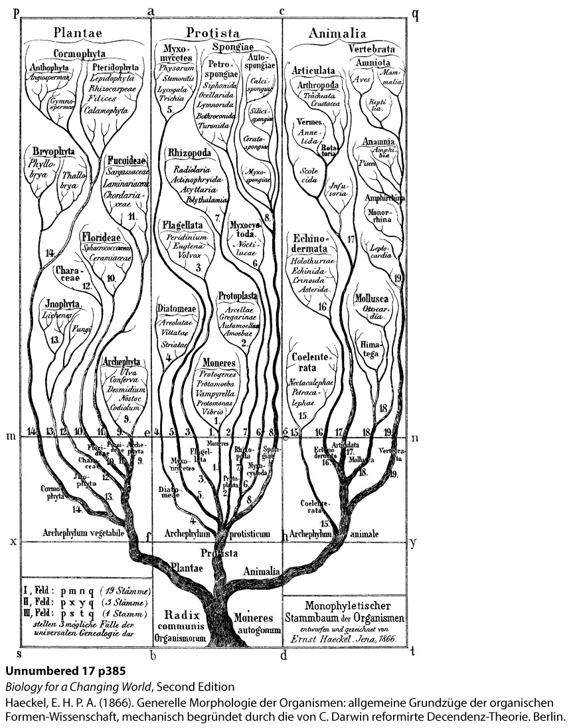
How many branches does the tree of life have?
Since each living species sits on its own branch in a phylogenetic tree, the complete tree of life has as many branches as there are species in the world
Notes:
This is an early version of the tree of life, drawn by Ernst Haeckel in 1866. Haeckel’s tree was the first to include microscopic organisms known as protists.

Slide 29
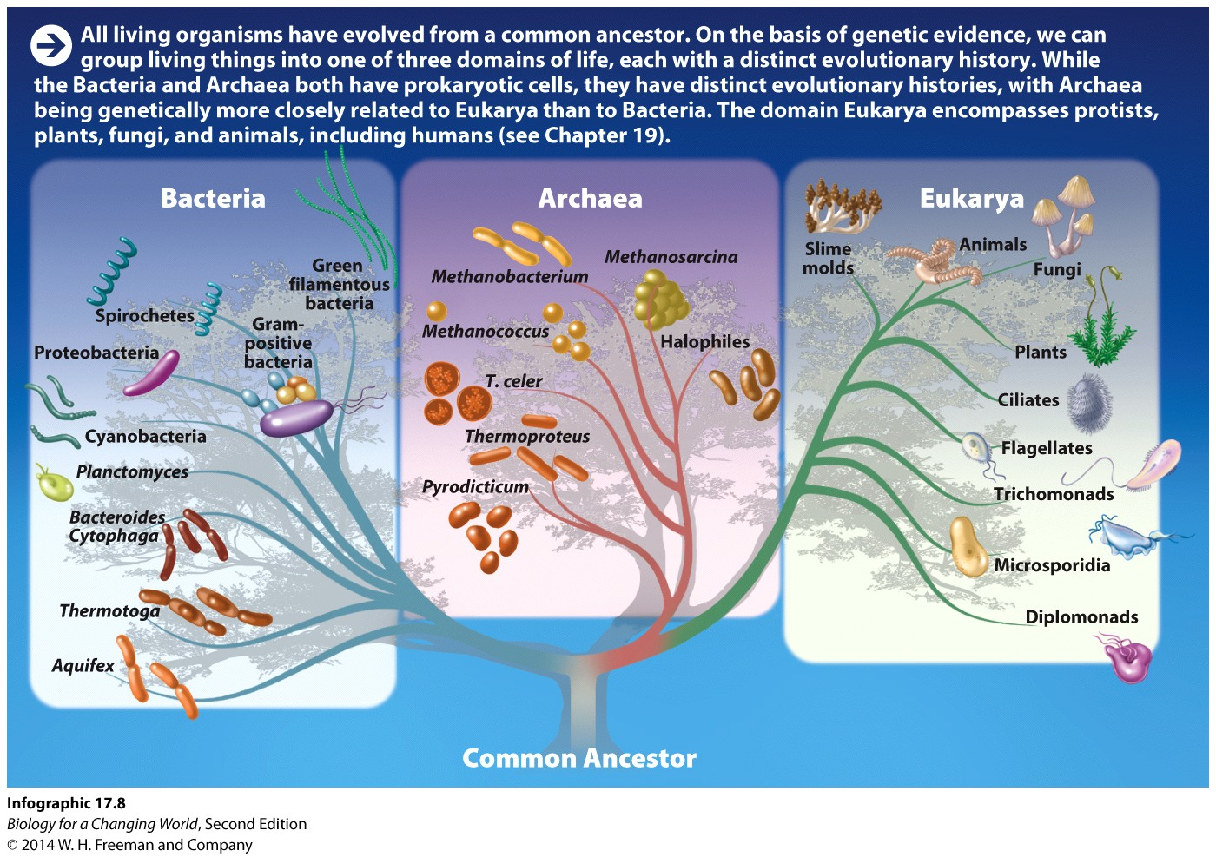
How many branches does the tree of life have?
The highest category in modern classification is the domain

Slide 30
Summary
The age of Earth is determined by measuring the amount of radioactive isotopes present in rocks (radiometric dating).
Life on Earth emerged in stages, as inorganic molecules combined to form organic ones.
Earth’s history can be divided into important eras and periods.
History of life on Earth is marked by repeated extinctions and adaptive radiations (punctuated equilibrium).
Ancient movement of Earth’s major landmasses affected the eventual distribution of species.
Convergent evolution is the evolution of similar adaptations in response to similar environmental challenges.
Biologists sort organisms into a series of nested categories based on shared anatomical and genetic features.

