Slide 1
Michèle Shuster • Janet Vigna • Matthew Tontonoz • Gunjan Sinha
Biology for a
Changing World
SECOND EDITION
Lecture PowerPoint
CHAPTER 18
Prokaryotic Diversity
Copyright © 2014 by W. H. Freeman and Company

Slide 2
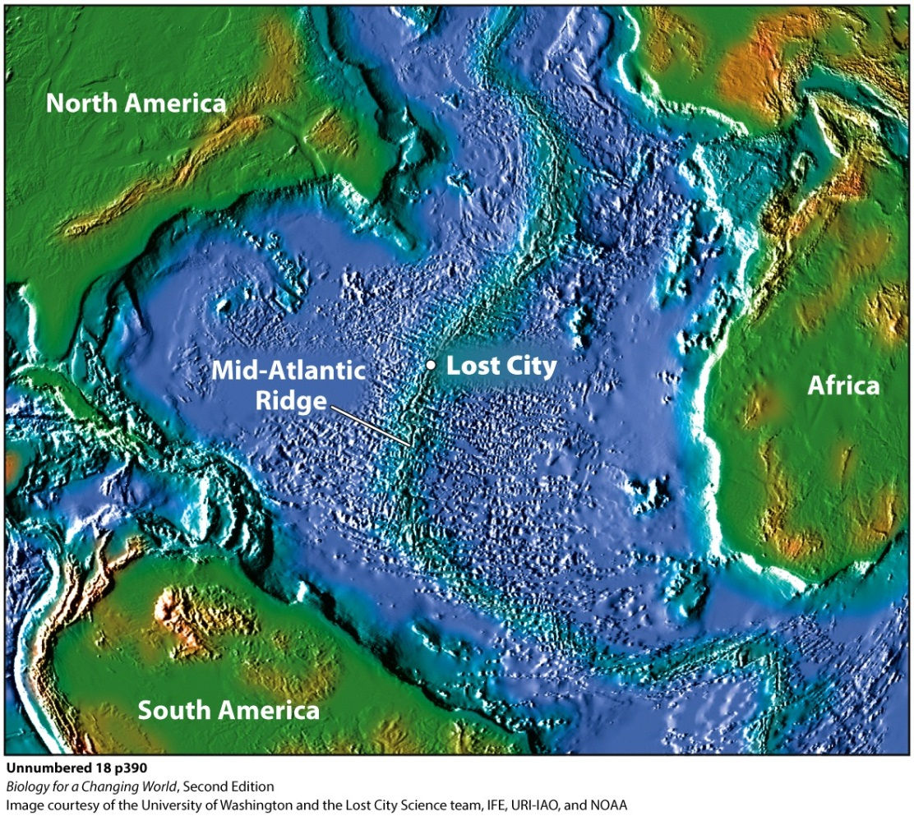
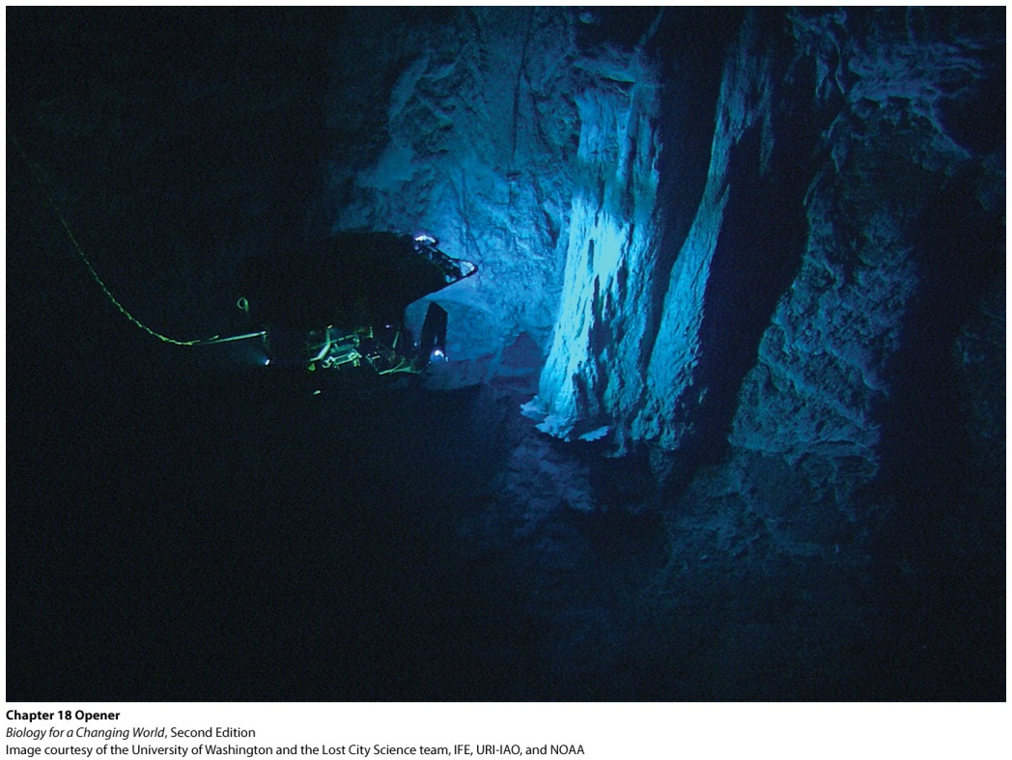
Chapter 18
Prokaryotic Diversity
Notes:
A dense “cityscape” of rocky spires, stretching across roughly six football fields of dark seafloor. This was an uncharted world no one had known existed. Kelley named the undersea world Lost City. She dubbed the tallest tower, measuring 200 feet, Poseidon, after the Greek god of the sea.
Lost City sits 2,600 feet down on an undersea mountain in the middle of the Atlantic Ocean.

Slide 3
Driving Questions
1. What are the prokaryotic domains of life?
2. What are the features of bacteria and of
archaea?
3. What are the challenges faced by organisms
living at Lost City, and how do they face them?

Slide 4
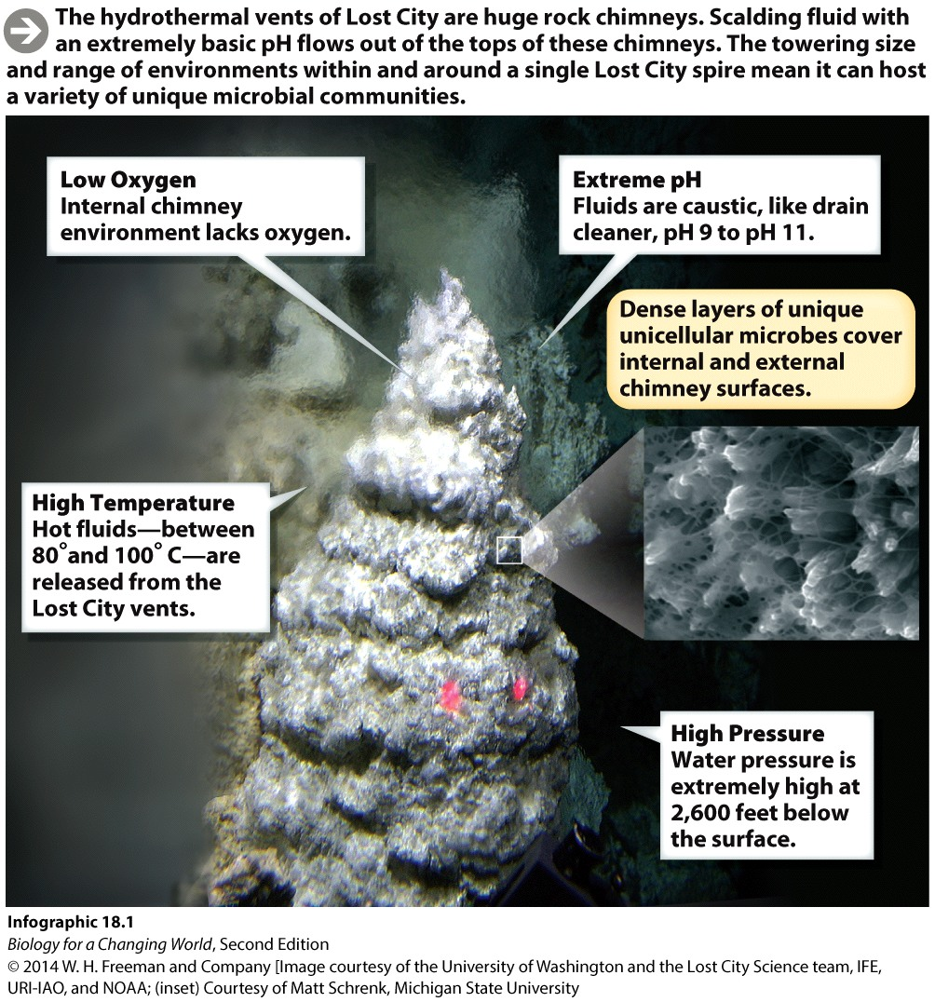
Lost City
Extreme and inhospitable environment
Home to a number of life forms
Unicellular microbes
Notes:
Each tower is a type of underwater chimney, or spring, known as a hydrothermal vent. As rocks beneath Earth’s crust come in contact with seawater, they react chemically, giving off a steady stream of heat and combustible gas that seeps out of each vent. The resulting fluid is highly caustic, with a pH of 9 to 11—similar to that of drain cleaner—and temperatures as hot as 100°C.

Slide 5
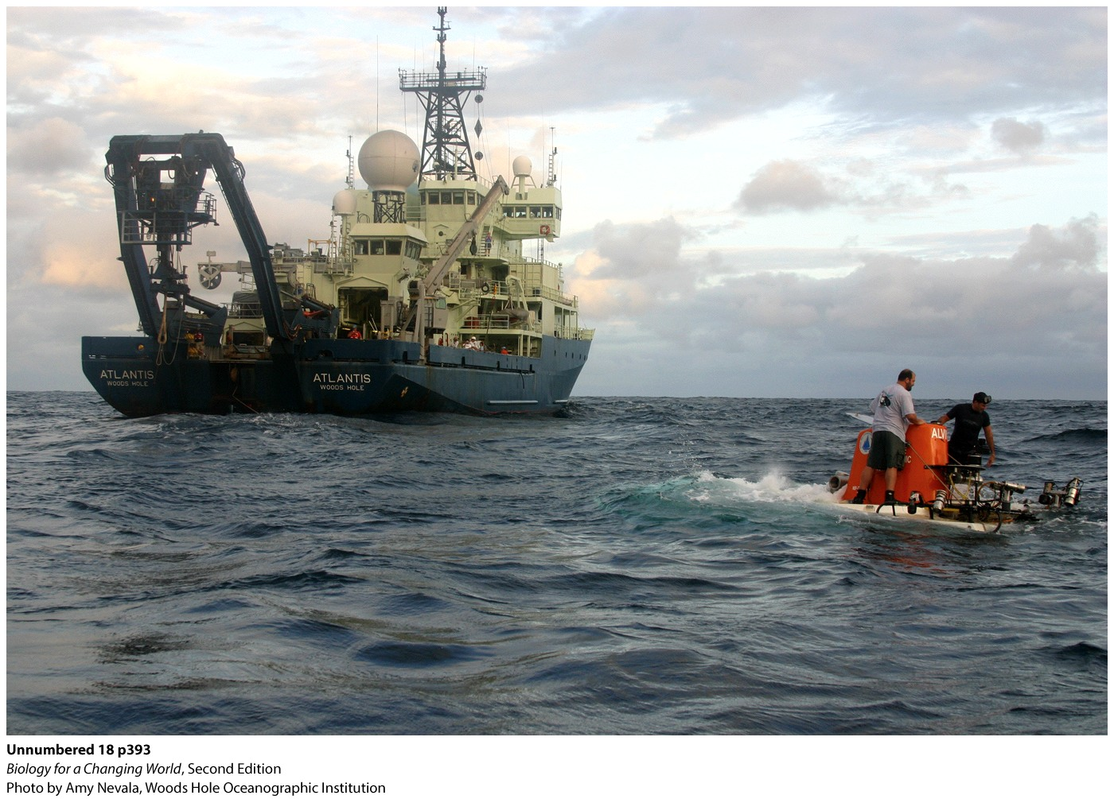
Lost City
Extreme conditions of this environment resemble ancient Earth, some 3.8 billion years ago
Notes:
During month-long expeditions, a team of more than 50 people—scientists, pilots, engineers, and ship crew—works around the clock to orchestrate dives and obtain specimens for research. A squad of sophisticated robotic assistants aids the effort.
Researchers dive to the site in Alvin, a tiny three-person submersible craft.

Slide 6
Lost City
To obtain samples, researchers use a pair of remotely operated mechanical vehicles
Notes:
To collect living specimens, the researchers use what they call a “slurp gun.” A robotic arm aims the gun, which then gulps a sample from the spires. Everything is caught on camera by Hercules.
Because many of the Lost City microbes cannot tolerate oxygen, the biologists have to be careful not to expose them to air. Using a special airtight bag with built-in gloves, the researchers transfer samples of microbes into test tubes without introducing oxygen into their environment.

Slide 7
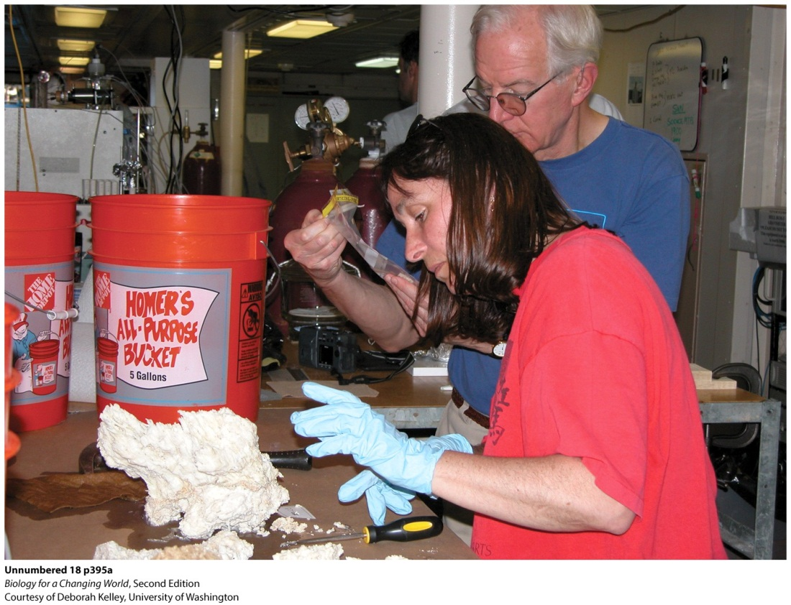
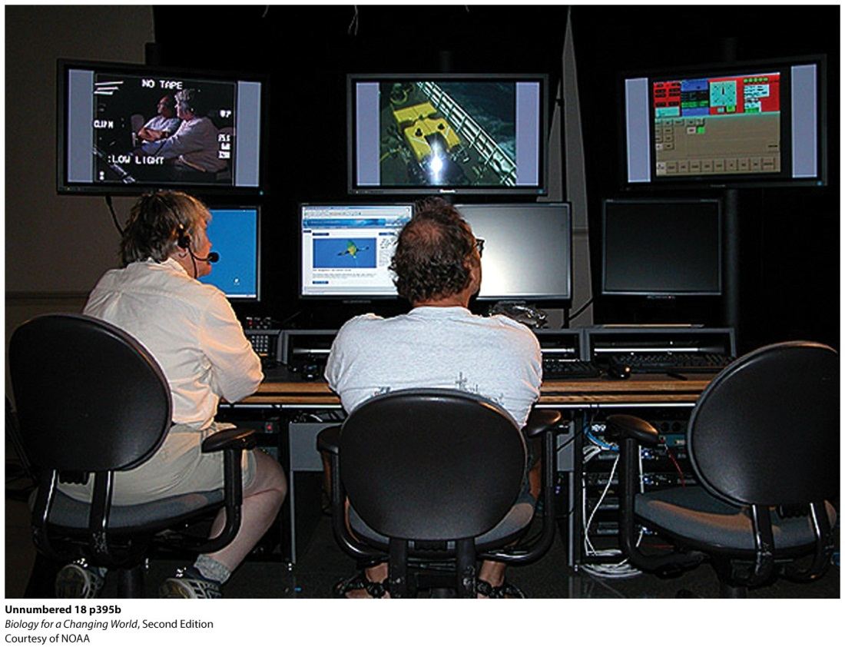
Lost City
Scientists examine rock samples collected from the Lost City and monitor a video feed from a robotic camera

Slide 8
Prokaryotic cells
Prokaryotes
Unicellular
Lack internal membrane-bound organelles
DNA is not contained within a nucleus
Most abundant type of living organism found in the Lost City

Slide 9
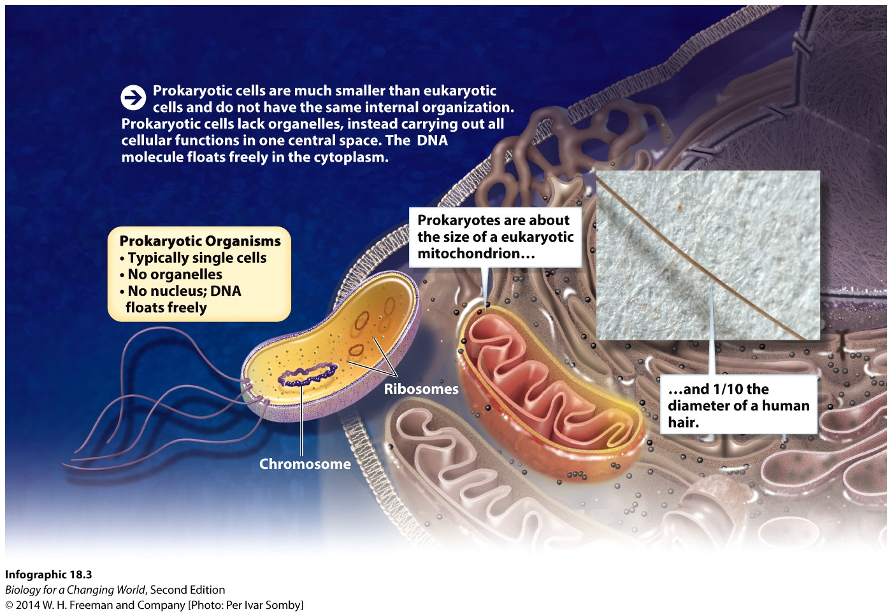
Prokaryotic cells
Unicellular and microscopic
1–10 microns

Slide 10
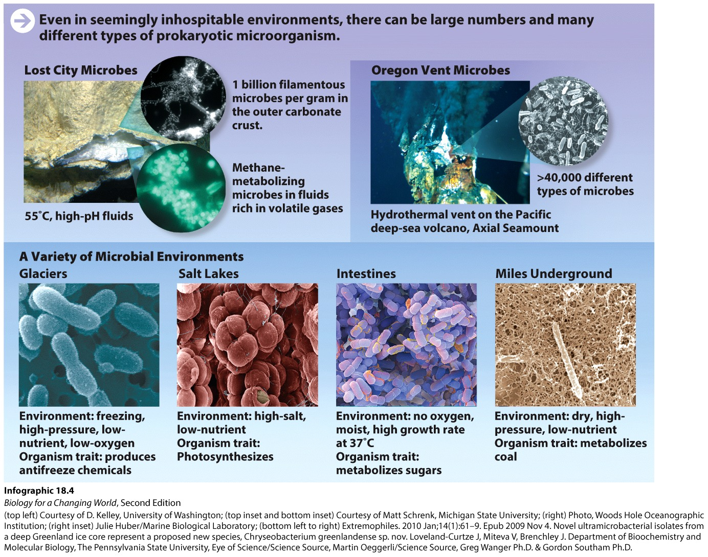
Prokaryotic cells
Endlessly adaptive; can thrive just about anywhere
Notes:
Having first evolved nearly 4 billion years ago, prokaryotic organisms have had plenty of time to adapt to a wide range of environments.
In this deep-sea hydrothermal vent, off the Oregon coast (one with very acidic, extremely hot fluids) scientists have discovered more than 40,000 different kinds of prokaryote.

Slide 11
Prokaryotic cells
Use DNA sequences to identify and compare prokaryotic organisms
The Lost City has new species of archeae
live in hottest temperatures with no oxygen
genetically distinct from bacteria
Lost City bacteria
live in mild temperatures with oxygen
Notes:
Bacteria: one of the two domains of prokaryotic life; the other is Archaea.

Slide 12
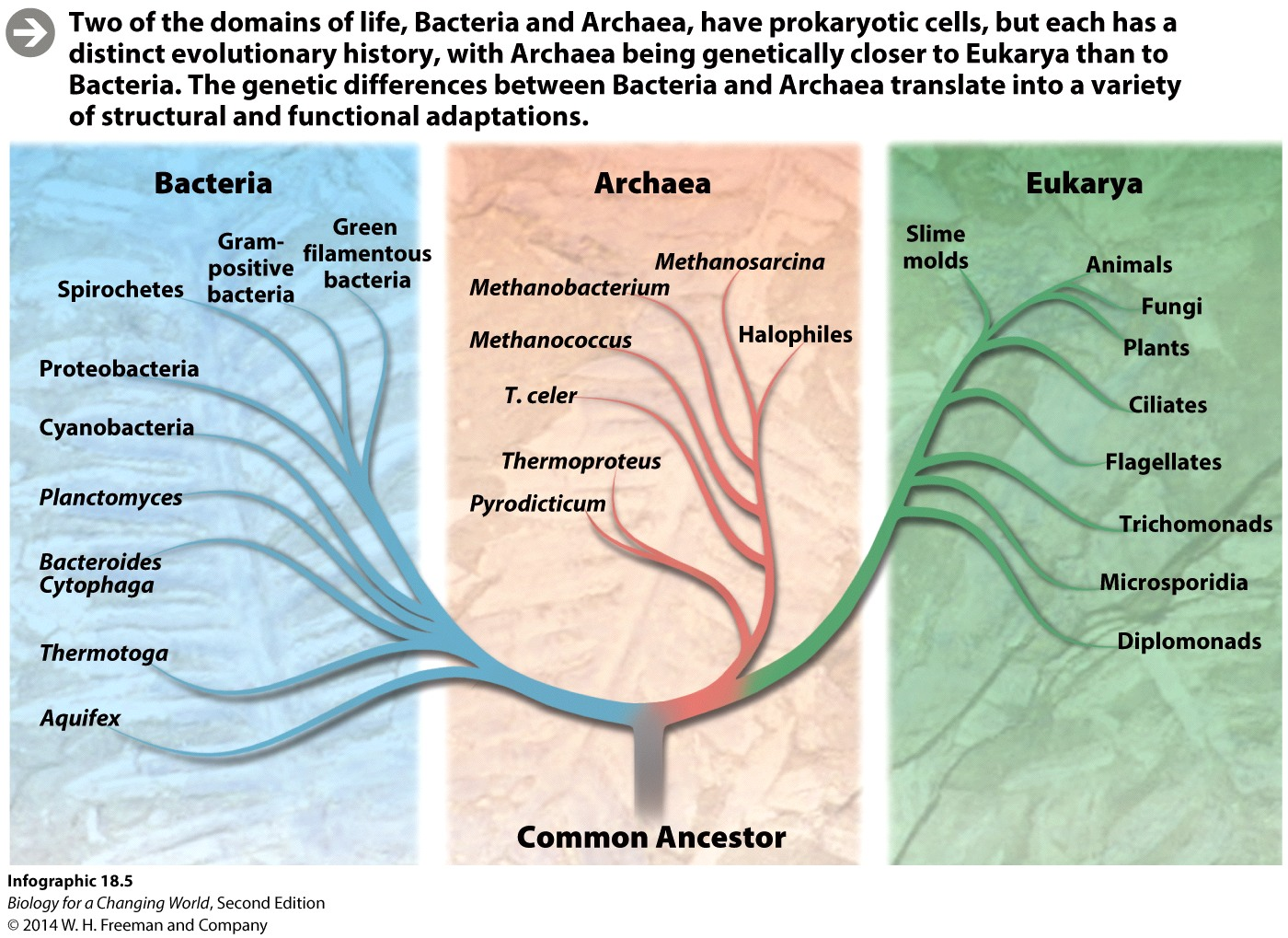
Prokaryotic domains

Slide 13
Bacteria
Most possess a cell wall
Tremendous genetic diversity
Differences in nutrition, metabolism, structure, and lifestyle
Autotrophs: make their own food from material in nonliving environment
Heterotrophs: rely on other organisms as a food source
Notes:
Bacteria includes commonly encountered microbes such as the beneficial strain of Escherichia coli present in the human gut.

Slide 14
Bacteria: autotrophs
cyanobacteria
largest group
in oceans, freshwater, exposed rocks and soil.
photosynthesize
oldest photosynthetic organisms
some perform nitrogen fixation
conversion of atmospheric nitrogen into a form that plants can use for growth

Slide 15
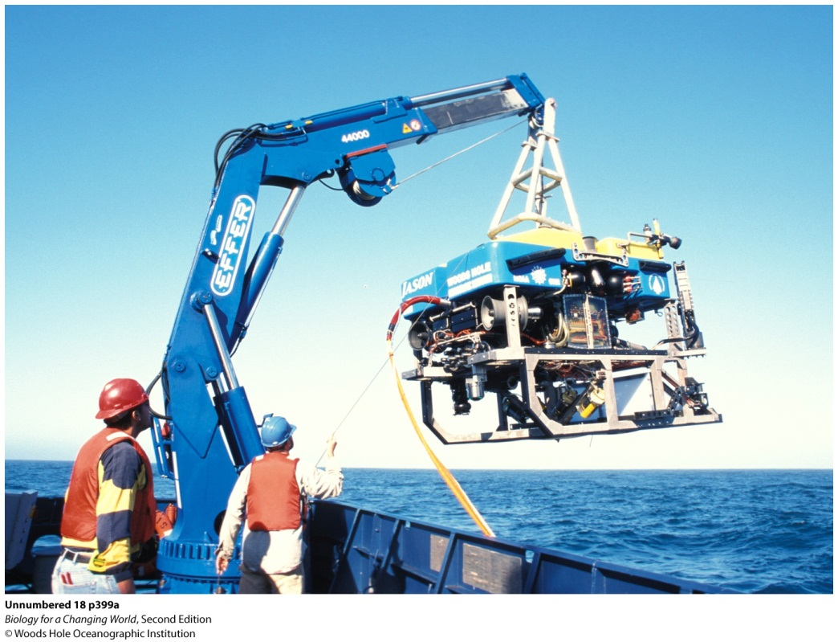
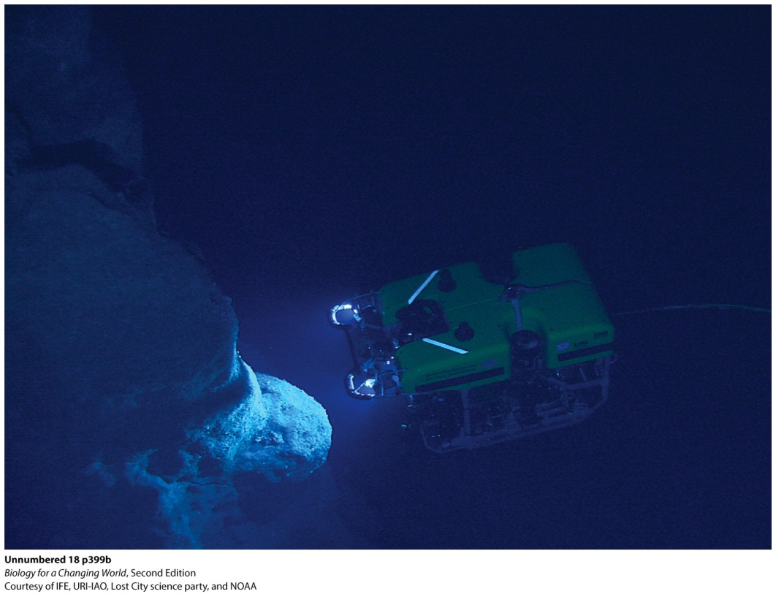
Bacteria: autotrophs
Do not all rely on sunlight
Some obtain energy from geological sources
inorganic gases of hydrothermal vents

Slide 16
Bacteria: heterotrophs
Decomposers (recyclers)
recycle trapped carbon and other elements
Bioremediation
oil spills
Fermenters
Lactobacillus bulgaricus in yogurt
Notes:
Heterotrophic bacteria play an important role in decomposition, allowing carbon and other elements (which would otherwise be trapped in dead organisms, sewage, or landfills) to be recycled. They are also useful in bioremediation projects. For example, some types of bacteria metabolize droplets of oil, much the way humans digest butter, so they naturally help clean up oil spills.

Slide 17
Bacteria: heterotrophs
Many live in close association, or symbiosis, with other organisms
Beneficial
such as Vibrio fischeri, bioluminescent, lives and feeds inside the light organs of certain species of squid

Slide 18
Bacteria: heterotrophs
Pathogens
Disease-causing agents
Cause disease by producing toxins that harm their hosts
strains of Escherichia coli secrete a toxin that causes bloody diarrhea, kidney failure, and sometimes death in its host
Notes:
Not all pathogens produce toxins. Some cause disease by living and reproducing in the body and interfering with its normal processes—an example is the bacterium Treponema pallidum, which causes syphilis, a sexually transmitted disease.

Slide 19
Bacteria: structure
Spherical (cocci)
Rod-shaped (bacilli)
Spiral (spirochetes)
Flagella: tiny whiplike structures that project from the cell and help it move
Pili: shorter, hairlike appendages that enable bacteria to adhere to a surface
Capsule: sticky coating surrounding cells help adhere to surfaces and protects cells

Slide 20
Bacteria

Slide 21
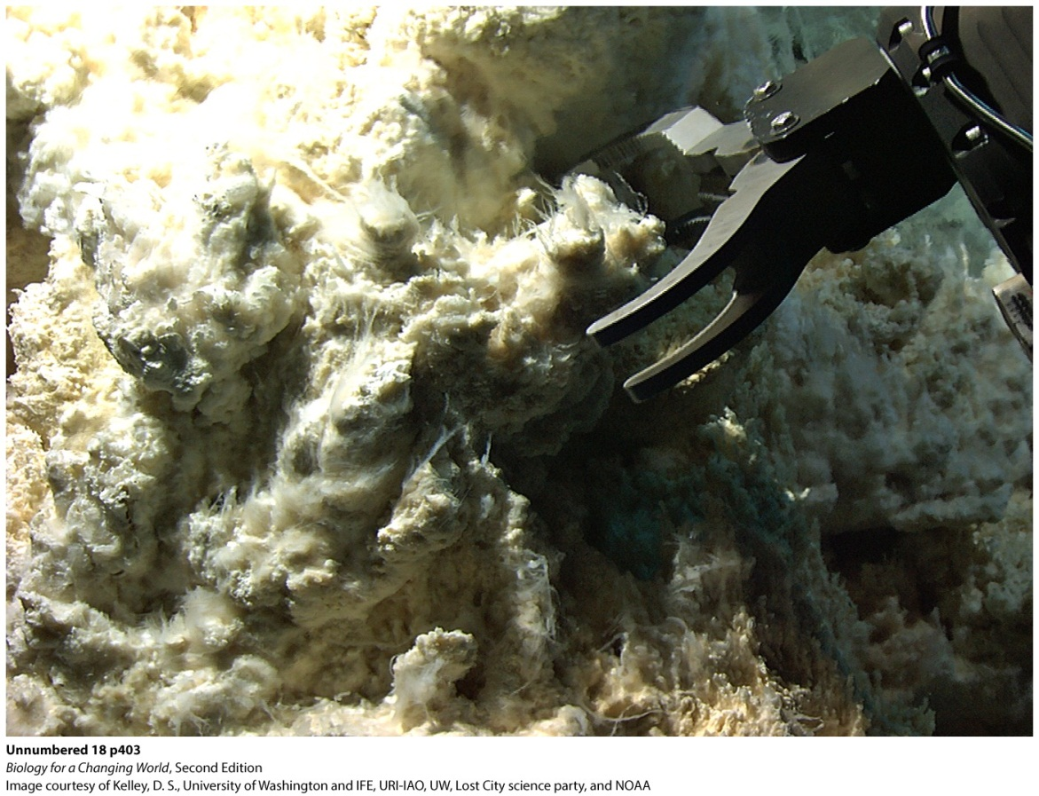
Archaea
Similar to bacteria
Lack a nucleus
Genetically distinct
“Extremophiles”
hyperthermophiles
methanogens
halophiles
Notes:
Hyperthermophiles rely on sulfur instead of oxygen.
Methanogens consume carbon dioxide and hydrogen and produce methane as a by-product in a process called methanogenesis. Because this gaseous meal is completely inorganic, these Archaea are considered autotrophs.
Halophiles, or “salt lovers,” prefer a home saturated in salt.

Slide 22
Archaea

Slide 23
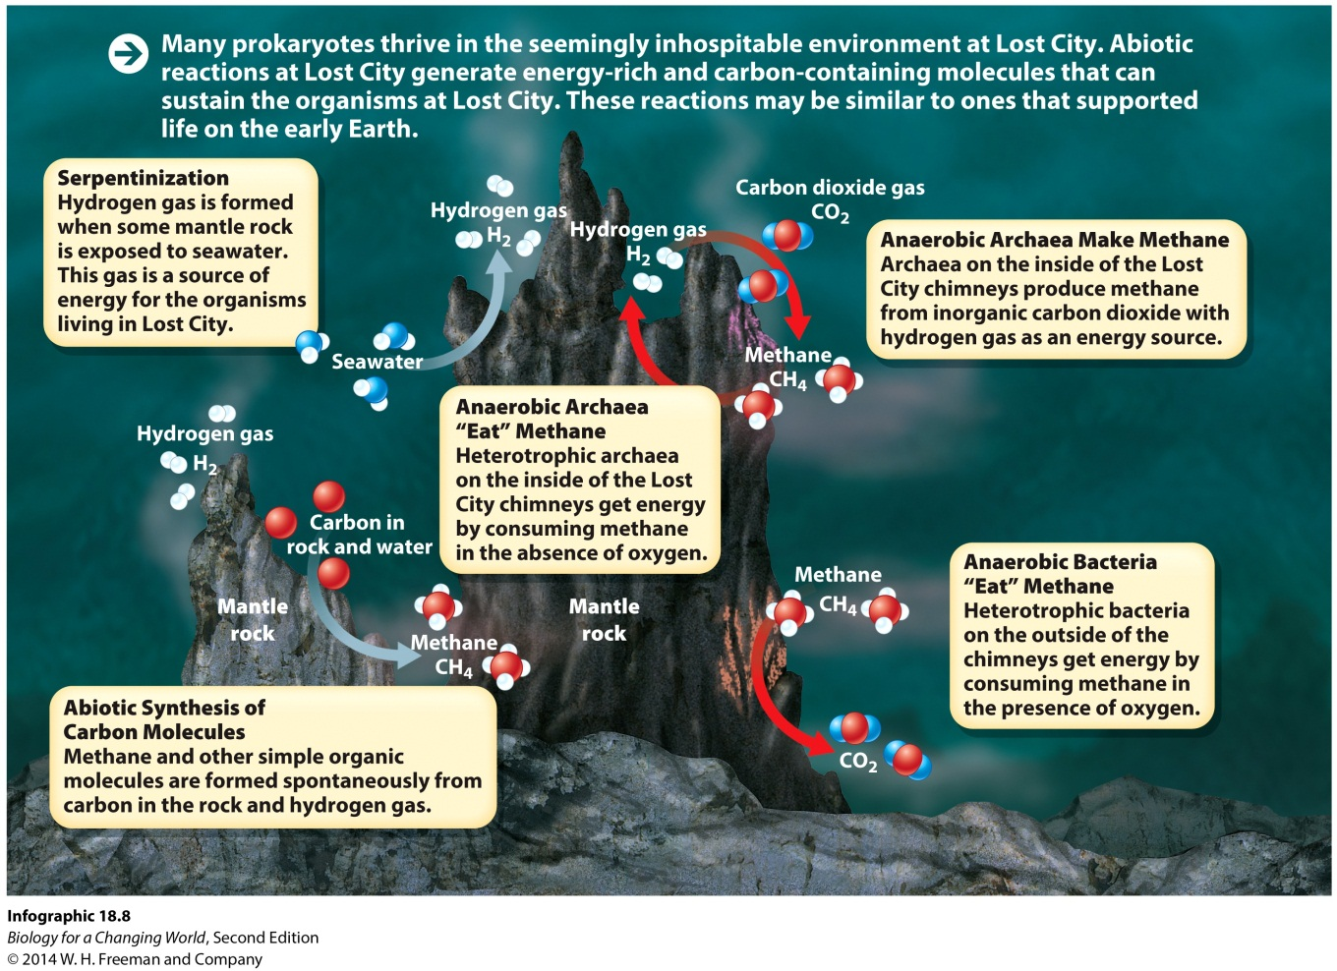
Lost City
May help us understand reactions that occurred during the formation of life on Earth
Notes:
Organic molecules are needed to build living things, but living things are generally the source of organic molecules. So which came first, the organic molecules or the living things? Radiometric dating of the rock layers indicates that Lost City’s vents have been pumping strong for at least 100,000 years.

Slide 24
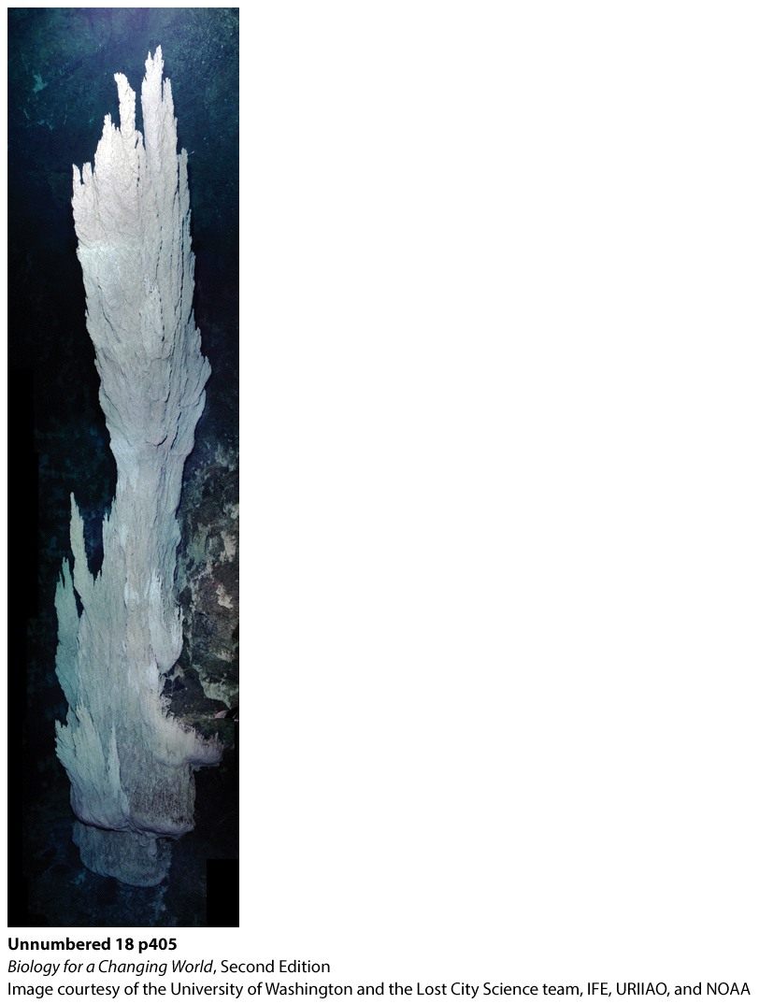
Lost City
A journey to the Lost City is like a journey back in time, to Earth’s primordial past
Notes:
The tallest tower at Lost City is called Poseidon, after the Greek god of the sea.

Slide 25
Summary
Prokaryotes are unicellular organisms that lack internal organelles and whose DNA is not contained in a nucleus.
Prokaryotes are found in virtually every environment on Earth.
Genetic analysis has led to the categorization of life into three domains: Bacteria, Archaea, and Eukarya.
Both bacteria and archaea have prokaryotic cells, but they otherwise differ in their structure, biochemistry, and lifestyles.
Bacteria are a diverse group of prokaryotic organisms with many unique adaptations such as flagella and capsules that allow them to live and thrive in many environments.
Archaea live in some of the most inhospitable conditions on Earth, such as hydrothermal vents.

