Slide 1
Michèle Shuster • Janet Vigna • Gunjan Sinha • Matthew Tontonoz
Biology for a
Changing World
SECOND EDITION
Lecture PowerPoint
CHAPTER 19
Eukaryotic Diversity
Copyright © 2014 by W. H. Freeman and Company

Slide 2
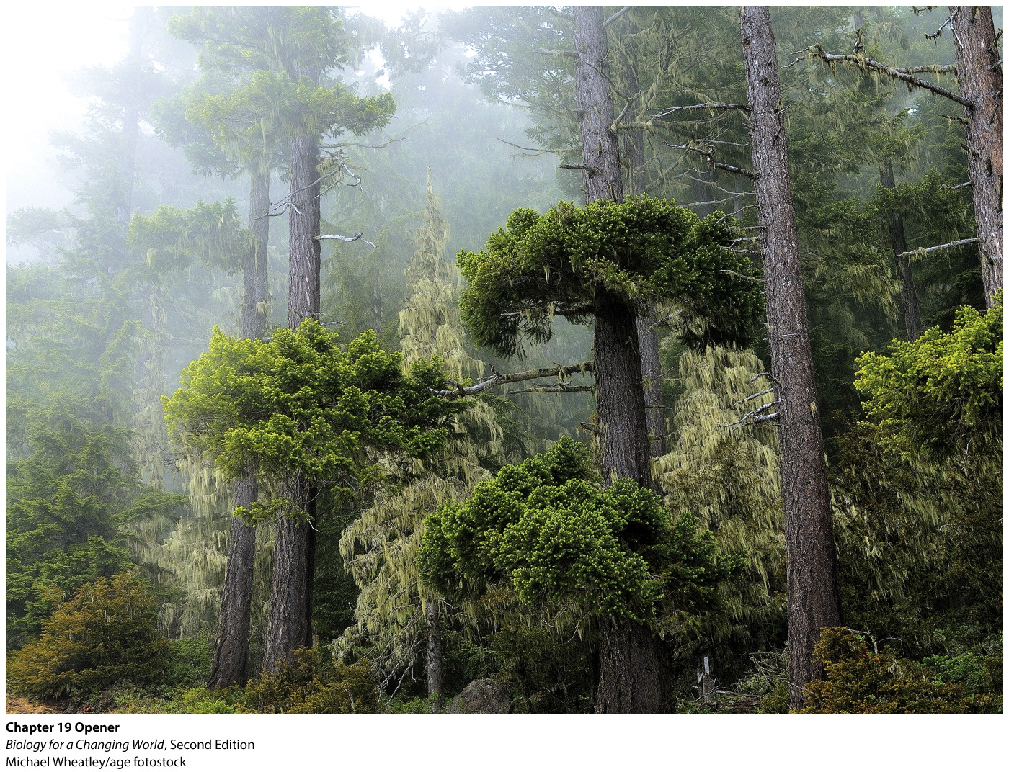
Chapter 19
Eukaryotic Diversity

Slide 3
Driving Questions
1. What are eukaryotic organisms, and what factors
influence their diversity?
2. How are plants defined, and what influences their
diversity?
3. How are animals defined, and what influences their
diversity?
4. How are fungi defined, and what influences their
diversity?
5. What are protists, and what influences their diversity?

Slide 4
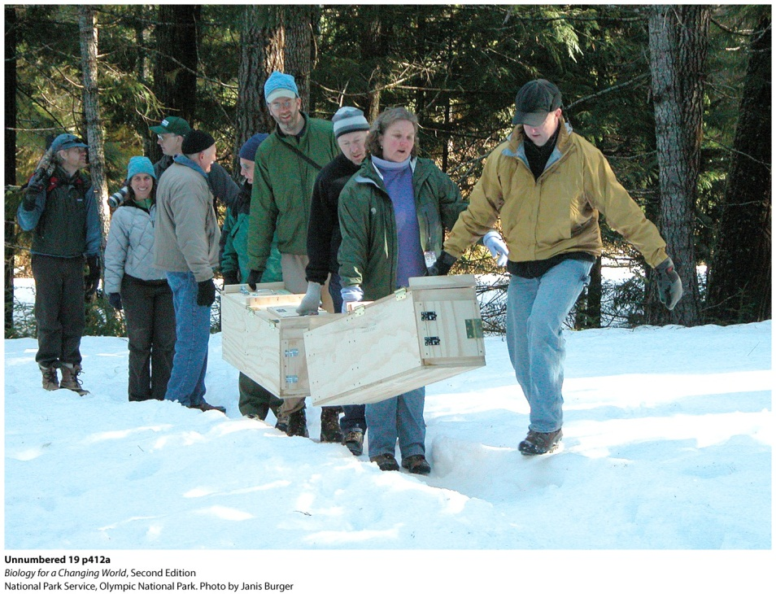
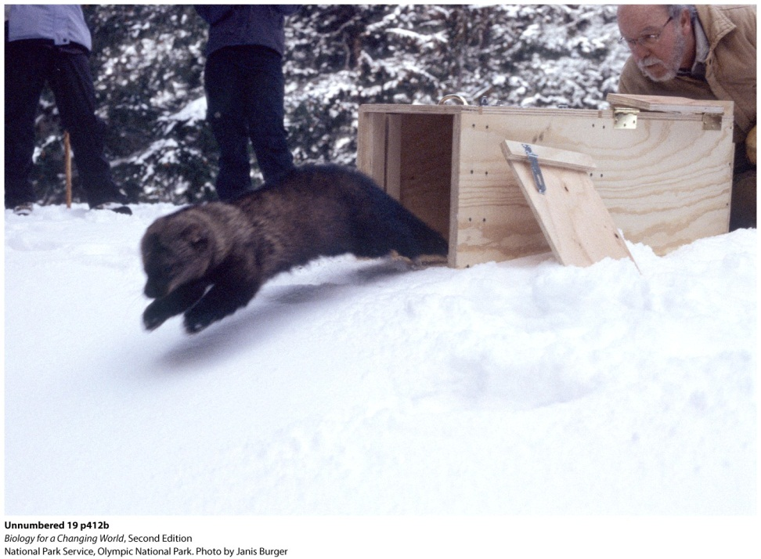
Restoring eukaryotic diversity
Release of fishers into Olympic National Park
Park holds a wide range of eukaryotic organisms
Notes:
The fisher was named a Washington State endangered species in 1998 after a careful investigation failed to find any evidence of a local population. The three animals released that afternoon—two females and one male—were imported from British Columbia, Canada, as part of a coordinated effort to bring fishers back to Washington. They were the first of 90 fishers to be released over 3 years into their new home: Olympic National Park. The fishers released in 2008 are part of a coordinated effort to bring the species back to Washington State.

Slide 5
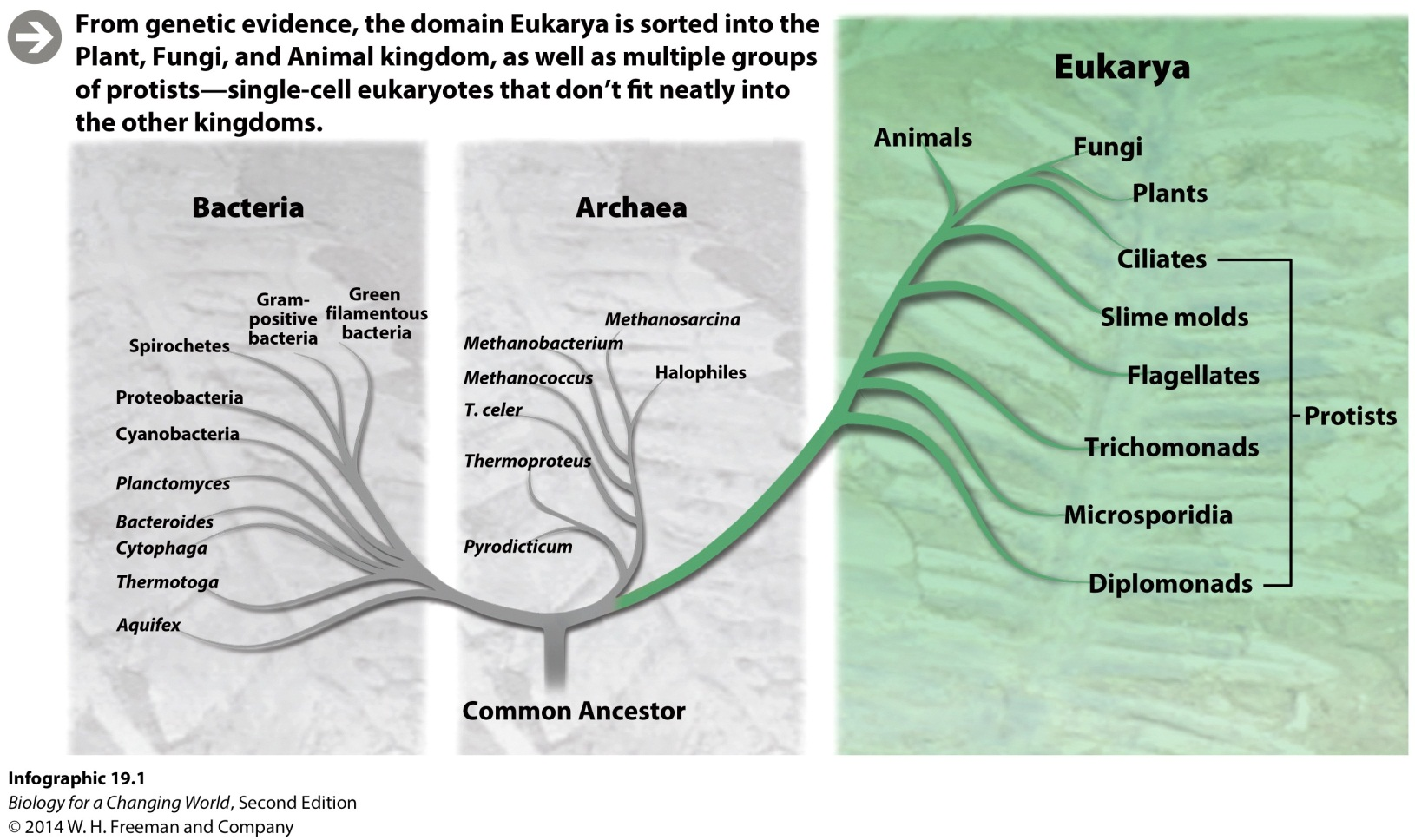
Eukaryotic diversity
Eukaryote
Organism with cells characterized by membrane-enclosed nucleus and organelles

Slide 6
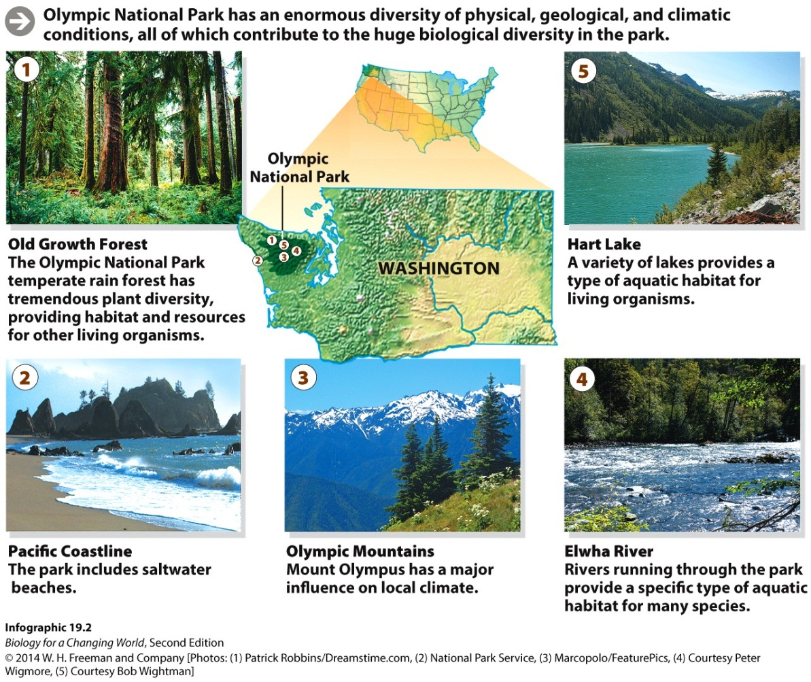
Eukaryotic diversity
Park’s diversity reflects the geological history and ecology of region
Notes:
During the last ice age, the Olympic Peninsula was isolated by glaciers and largely separated from the rest of what is now the United States. Today, it is surrounded by saltwater on three sides and is essentially an ecological island, distinctive in its geography and topography.
Its mosaic of physical, geographic, and climatic conditions provides numerous habitats for the many species of eukaryotes that live here.

Slide 7
Eukaryotic diversity: plants
Plant
multicellular eukaryote
has cell walls
photosynthetic
autotroph
adapted to life on land

Slide 8
Eukaryotic diversity: plants
Bryophytes
earliest plants
nonvascular plant
lack roots and tissue for transporting water and nutrients
grow only in damp environments
does not produce seeds

Slide 9
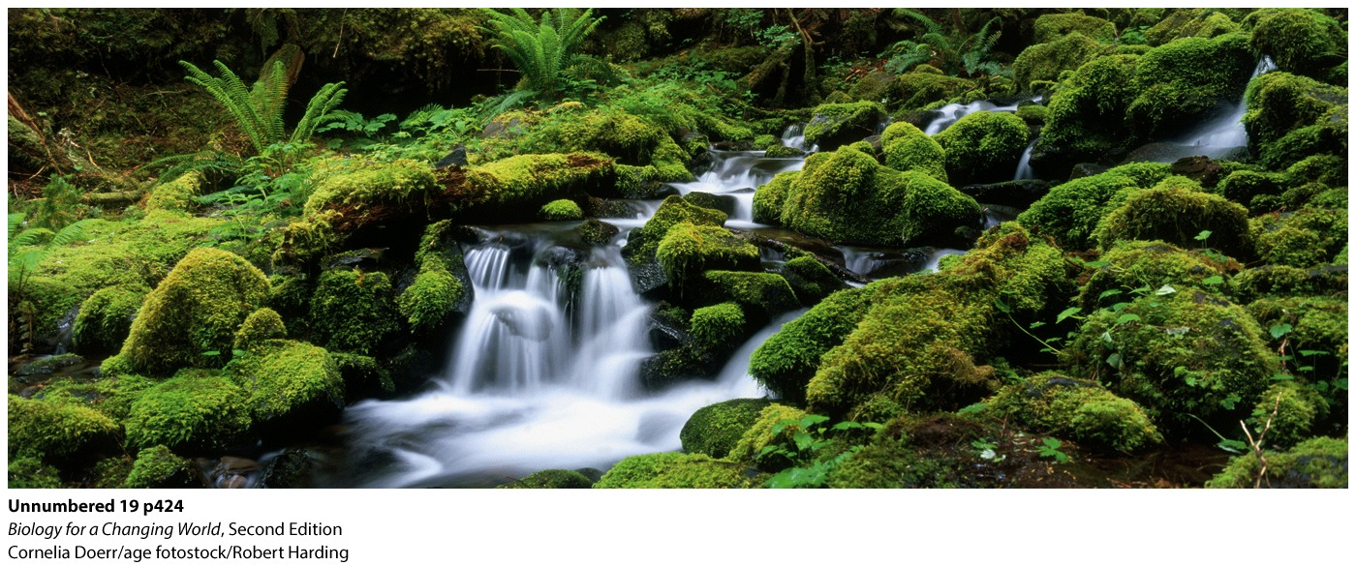
Eukaryotic diversity: plants
Bryophytes
Notes:
The Olympic rain forest is a soggy paradise for bryophytes, such as mosses and liverworts, which appear as squat, spongy mats.

Slide 10
Eukaryotic diversity: plants
Vascular plants
specialized tissues for transport
ferns
angiosperms
gymnosperms

Slide 11
Eukaryotic diversity: plants
Ferns
first vascular plant
no seeds
vascular tissue keeps stems rigid
Notes:
At one time, ferns ruled the plant world, spreading their massive fronds across the entire landscape in the carboniferous period.

Slide 12
Eukaryotic diversity: plants
Angiosperms
seed plants
seeds in fruit
flowering
Notes:
Angio is Greek for vessel or container.
Seed plants first emerged about 360 million years ago, during the late Devonian period. A seed, which envelops a plant’s embryo, is an ideal package for withstanding harsh conditions and traveling to a location where it can grow into a new plant. Today, more than 90% of all living plants are seed plants.

Slide 13
Eukaryotic diversity: plants
Gymnosperms
seed-bearing plants
“naked” seeds
typically held in cones
Notes:
Gymnos is Greek for naked, so the name literally means “naked seeds.”

Slide 14
Eukaryotic diversity: plants

Slide 15
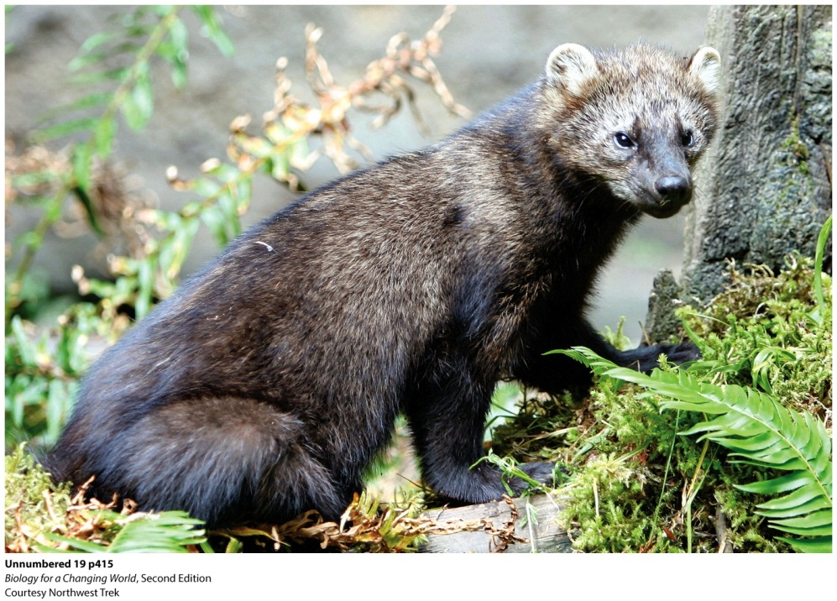
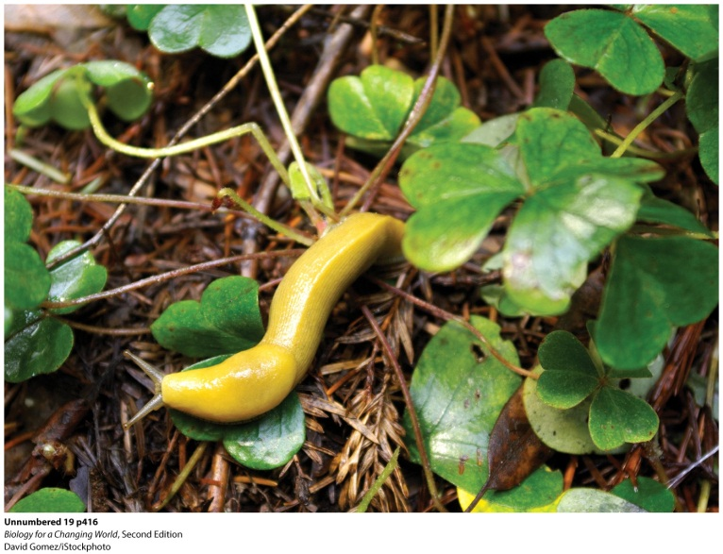
Eukaryotic diversity: animals
Animal
multicellular eukaryote
obtains nutrients by ingesting other organisms
heterotroph
Notes:
A Pacific fisher (martes pennanti).
The banana slug, one of the forest’s most voracious inhabitants, is distasteful to predators.

Slide 16
Eukaryotic diversity: animals
Three main lineages
See three distinct body plans
no definite shape, asymmetrical
radial symmetry
bilateral symmetry
Notes:
Features used to group and sort animals: anatomical and embryological evidence DNA. It is clear that all animals descended from the same common ancestor and diversified into the different forms we see today.

Slide 17
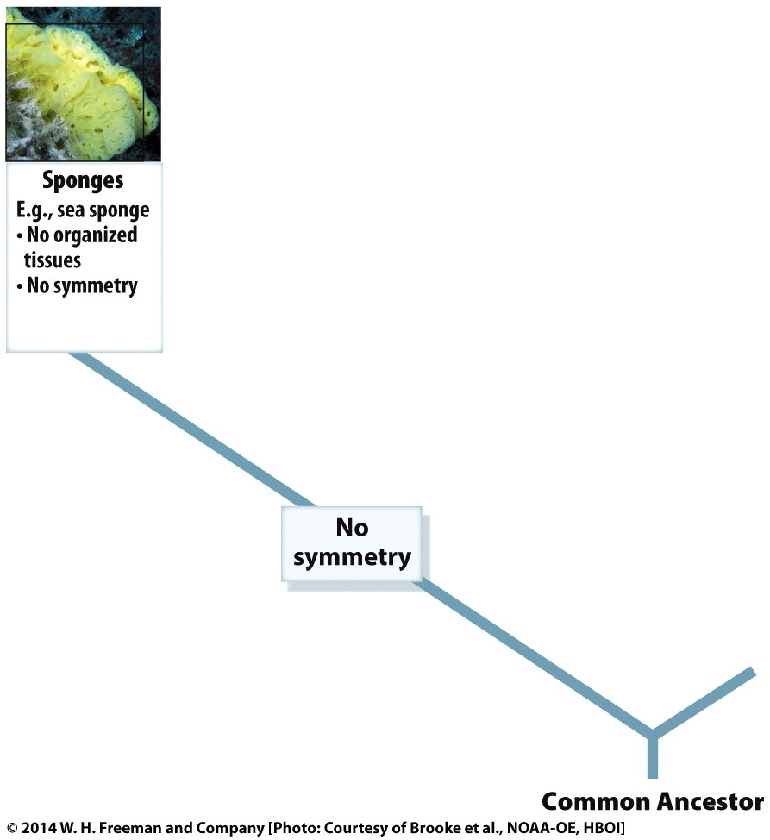
Eukaryotic diversity: animals
Asymmetrical
simplest living animals
lack defined tissues or organs (such as sponges)
Notes:
These are likely similar to the earliest animals to have populated the oceans.

Slide 18
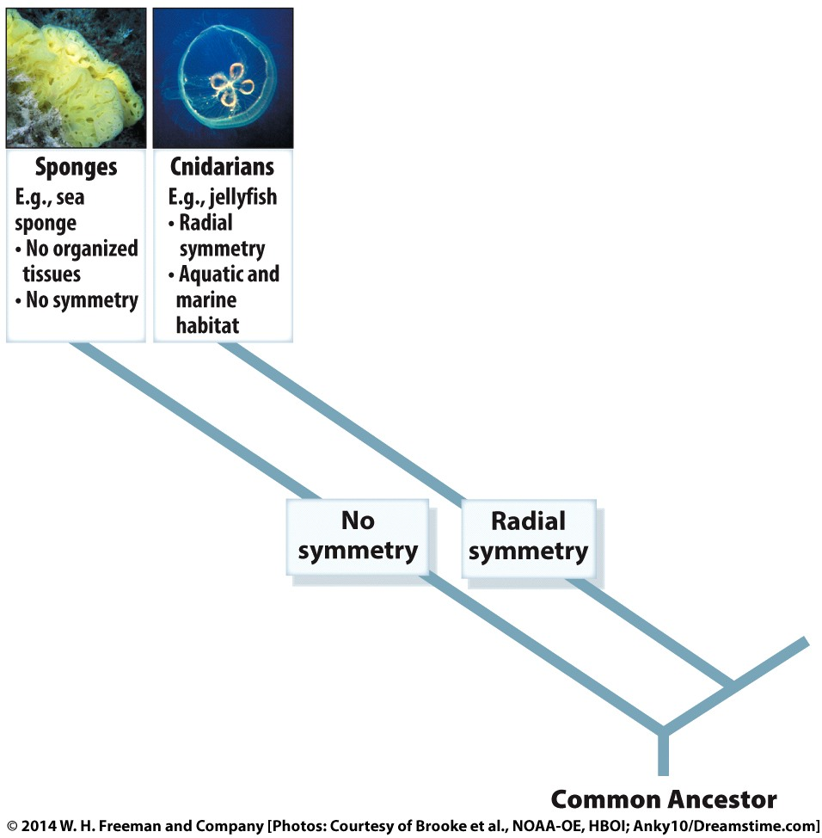
Eukaryotic diversity: animals
Radial symmetry
body plan that is circular
no clear left or right sides

Slide 19
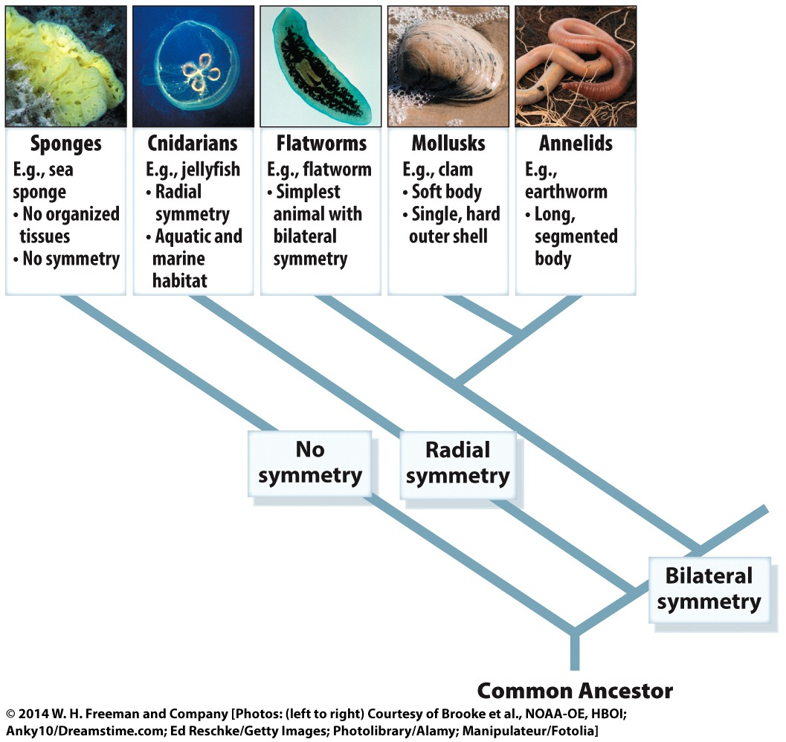
Eukaryotic diversity: animals
Bilateral symmetry
clear right and left halves
mirror images of each other
adaptation for seeking food, stalking prey, and avoiding predators
Notes:
All other animals—everything from worms and insects to fishers and humans—exhibit bilateral symmetry; for instance, bilaterally symmetrical animals have an eye on each side of the face, enabling them to look straight ahead.

Slide 20
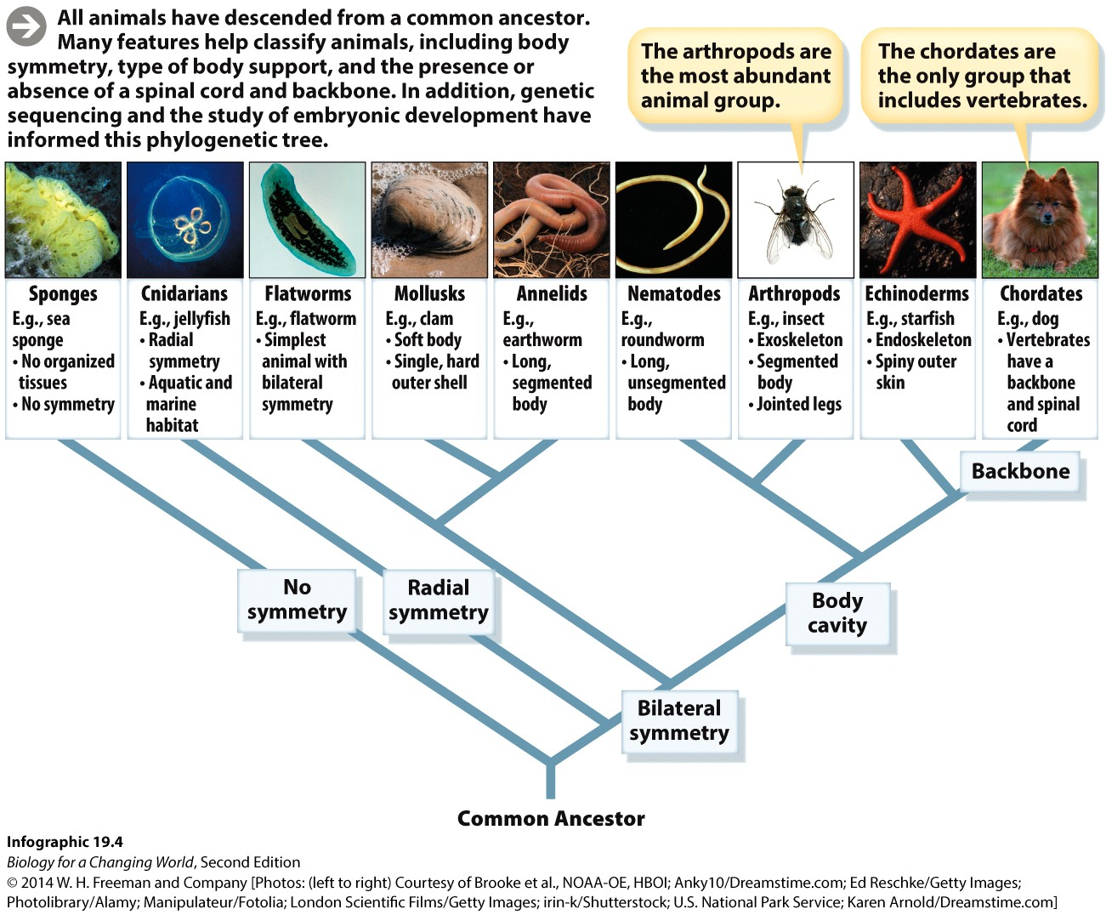
Eukaryotic diversity: animals

Slide 21
Eukaryotic diversity: animals
Invertebrates
grouped based on lack of backbone
95% of animals
mollusks
annelids
nematodes
arthropods
echinoderms
Vertebrate
animal with a bony or cartilaginous backbone
chordates

Slide 22
Eukaryotic diversity: animals
Invertebrates
Mollusk
soft-bodied invertebrate
generally with a hard shell
slugs, snails, clams
Annelid
segmented worm
earthworms
Notes:
Mollusk: shell (which may be tiny, internal, or absent in some mollusks).
By digesting dead plant material, these mollusks help recycle nutrients. And with their calcium-rich shells, snails provide this valuable mineral to the creatures that feast on them, such as rodents and birds.
Annelids create passageways in the soil as they move, allow air and water to enter the soil, which is important for plants and other aerobic organisms that require water and oxygen. By eating and digesting leaf and other plant litter, earthworms also make nutrients available for other plants.

Slide 23
Eukaryotic diversity: animals
Invertebrates
Arthropods
most abundant invertebrates
segmented body, jointed appendages, hard exoskeleton
protects organism from predators, keeps it from drying out, structure and support for movement
insects
Notes:
There are approximately 2 million to 4 million species of arthropods, of which 855,000 have been officially described so far.
Insects: arthropods with three pairs of jointed legs and a three-part body consisting of head, thorax, and abdomen.

Slide 24
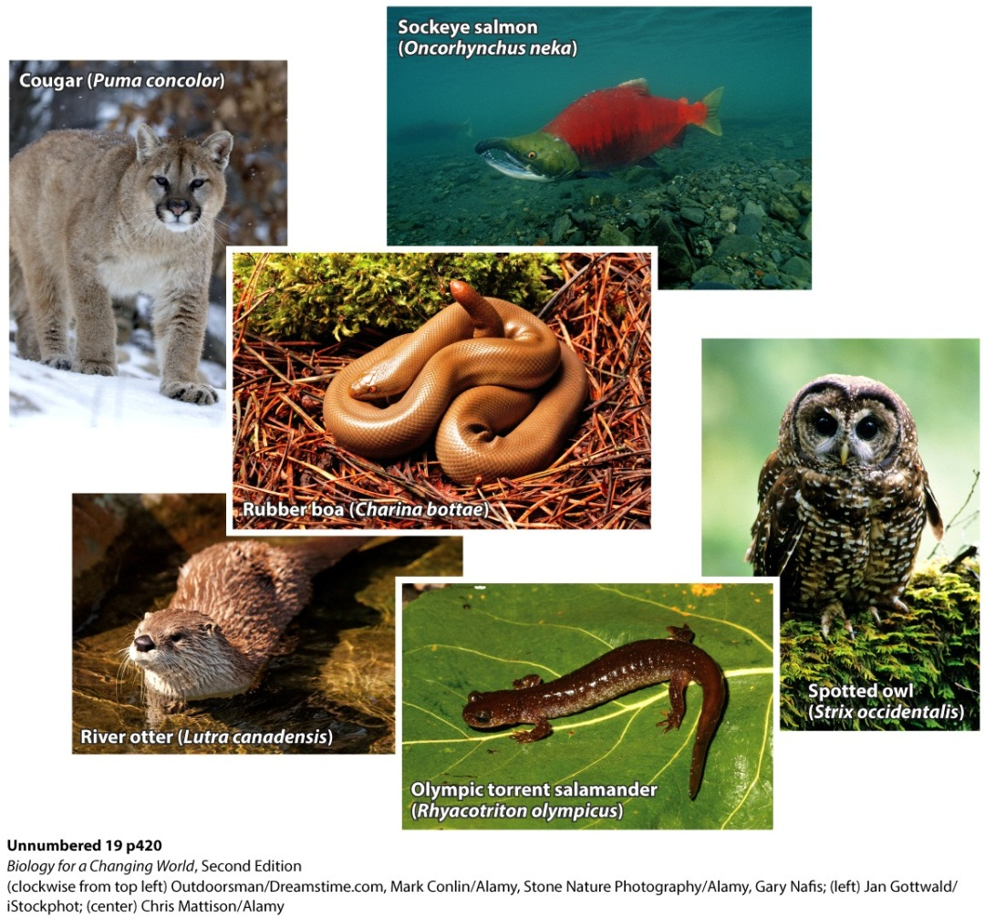
Eukaryotic diversity: animals
Vertebrates
Chordates
mammals
mammary glands
body covered with fur
For example, the fisher
Notes:
These are examples of vertebrates. Olympic National Park is home to a variety of vertebrates, including hundreds of species of mammals, fish, reptiles, birds, and amphibians.

Slide 25
Eukaryotic diversity: animals

Slide 26
Eukaryotic diversity: fungi
Fungus (plural: fungi)
unicellular or multicellular
eukaryotic
obtains nutrients by secreting digestive enzymes onto organic matter and absorbing
decomposers
digest and use organic molecules in dead organisms as sources of nutrients and energy

Slide 27
Eukaryotic diversity: fungi
Fungi
body composed of threadlike structures, hyphae (singular: hypha)
a hypha is a chain of many cells, capable of absorbing nutrients
hyphae interweave to form mycelium
mushrooms, mold, yeast
Notes:
Mycelium (plural: mycelia): a spreading mass of interwoven hyphae that forms the often subterranean body of multicellular fungi.

Slide 28
Eukaryotic diversity: fungi

Slide 29
Eukaryotic diversity: protists
Protist
eukaryote that cannot be classified as a plant, animal, or fungus
usually unicellular
some are heterotrophic
algae
Notes:
Some protists are heterotrophic but because they are unicellular they are not technically animals.
Multicellular algae photosynthesize like plants, but unlike plants they lack specialized adaptations for living on land, such as roots, stems, and leaves.

Slide 30
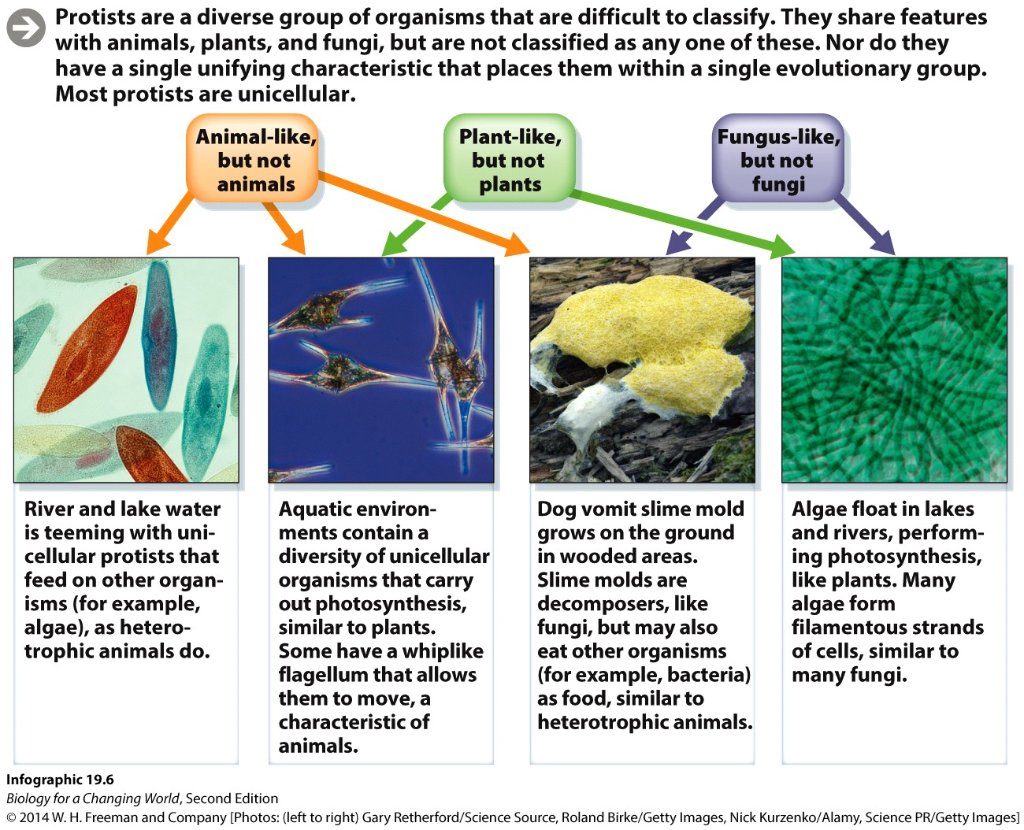
Eukaryotic diversity: protists

Slide 31
Summary
Forest ecosystems are home to a great variety of eukaryotic organisms.
The domain Eukarya encompasses all eukaryotic organisms—plants, animals, fungi, and the many types of protists.
Plants are multicellular eukaryotes that photosynthesize and are adapted to living on land and have cell walls: bryophytes, ferns, gymnosperms, and angiosperms.
Animals are multicellular eukaryotic heterotrophs that obtain nutrients by ingestion: invertebrates and vertebrates.
Fungi are decomposers, acquiring their nutrition by breaking down dead organic matter.
Protists are a diverse group of mostly unicellular eukaryotic organisms that do not cluster on a single branch of the evolutionary tree.

