Slide 1
Michèle Shuster • Janet Vigna • Matthew Tontonoz • Gunjan Sinha
Biology for a
Changing World
SECOND EDITION
Lecture PowerPoint
CHAPTER 20
Human Evolution
Copyright © 2014 by W. H. Freeman and Company

Slide 2
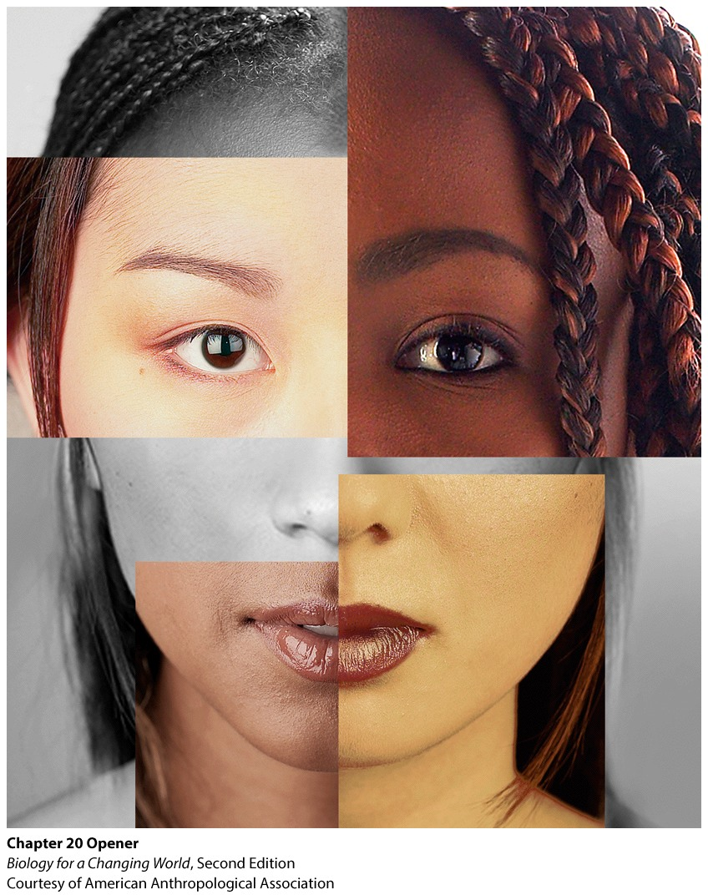
Chapter 20
Human Evolution

Slide 3
Driving Questions
1. What contributes to human skin color, and why is
there so much variation in skin color among
different populations?
2. Where did the earliest humans evolve, and how do
we know?
3. What can we learn about human evolution from the
fossil record?

Slide 4
Humans are all very similar
Homo sapiens: biological species of humans
Highly similar to one another

Slide 5
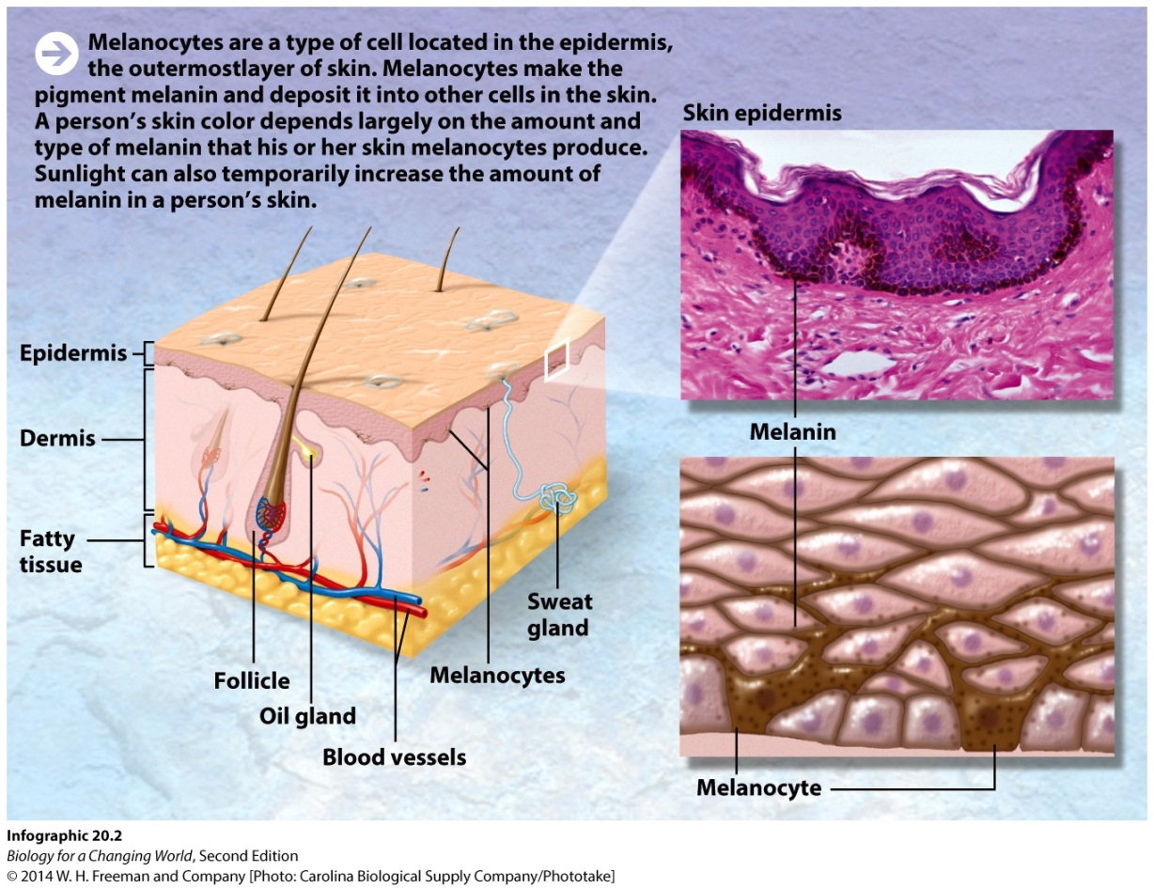
Why did human populations evolve varying skin tones?
Skin tone reflects levels of melanin
pigment produced by a type of skin cell

Slide 6
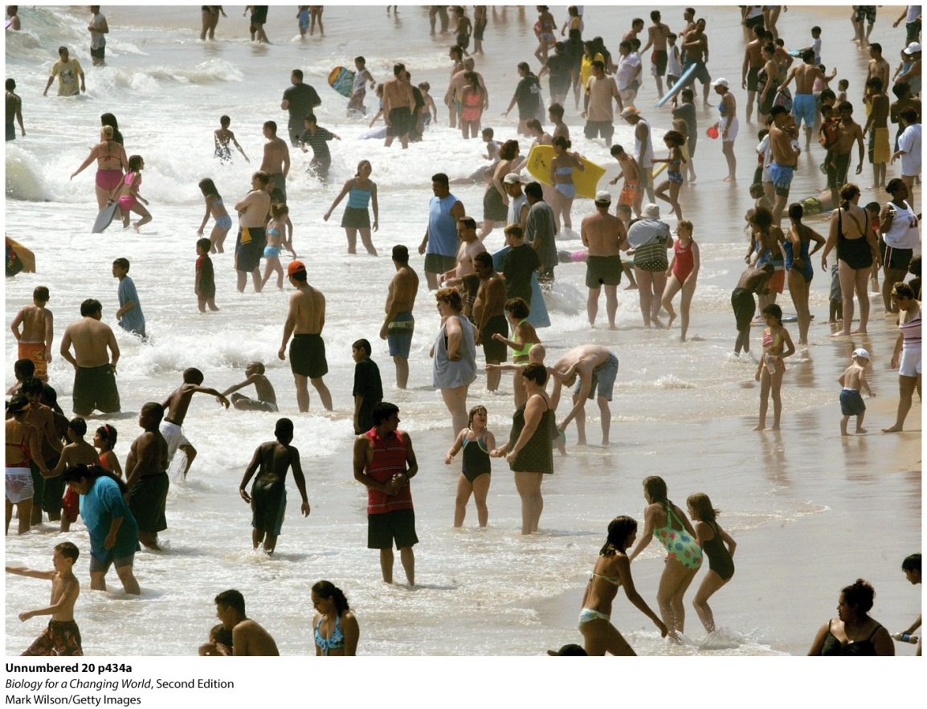
Why did human populations evolve varying skin tones?
Skin tone correlates with geography
Relative position to Earth’s poles
Notes:
In certain environments, is there an evolutionary advantage to light or dark skin?

Slide 7
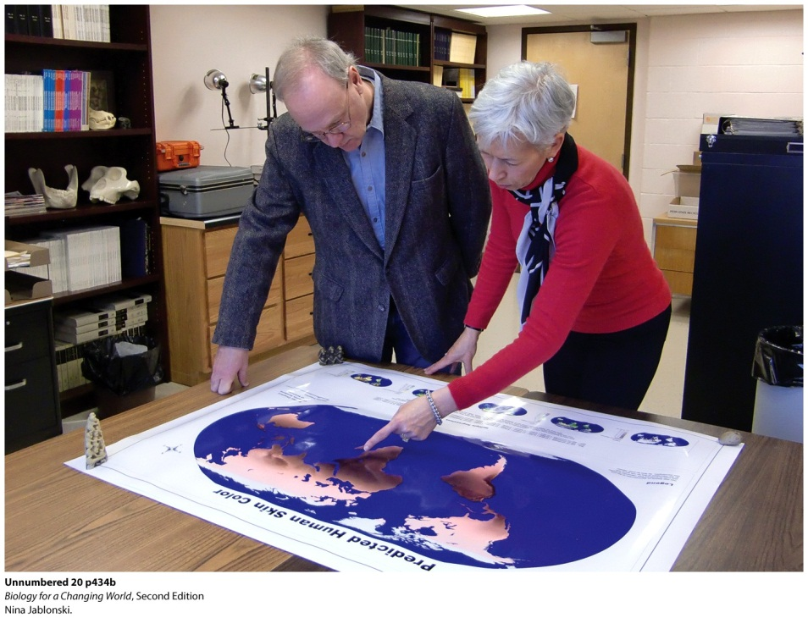
Why did human populations evolve varying skin tones?
Folate (B vitamin) levels are influenced by UV light
Lighter skin, more folate destroyed
Melanin absorbs UV light
Notes:
Jablonksi (right) and Chaplin examine a map of predicted human skin color based on UV light intensity.
Folate: a B vitamin also known as folic acid, folate is an essential nutrient, necessary for basic bodily processes such as DNA replication and cell division. Sunlight can halve the level of an important vitamin known as folate. Low folate levels can cause severe birth defects such as spina bifida.

Slide 8
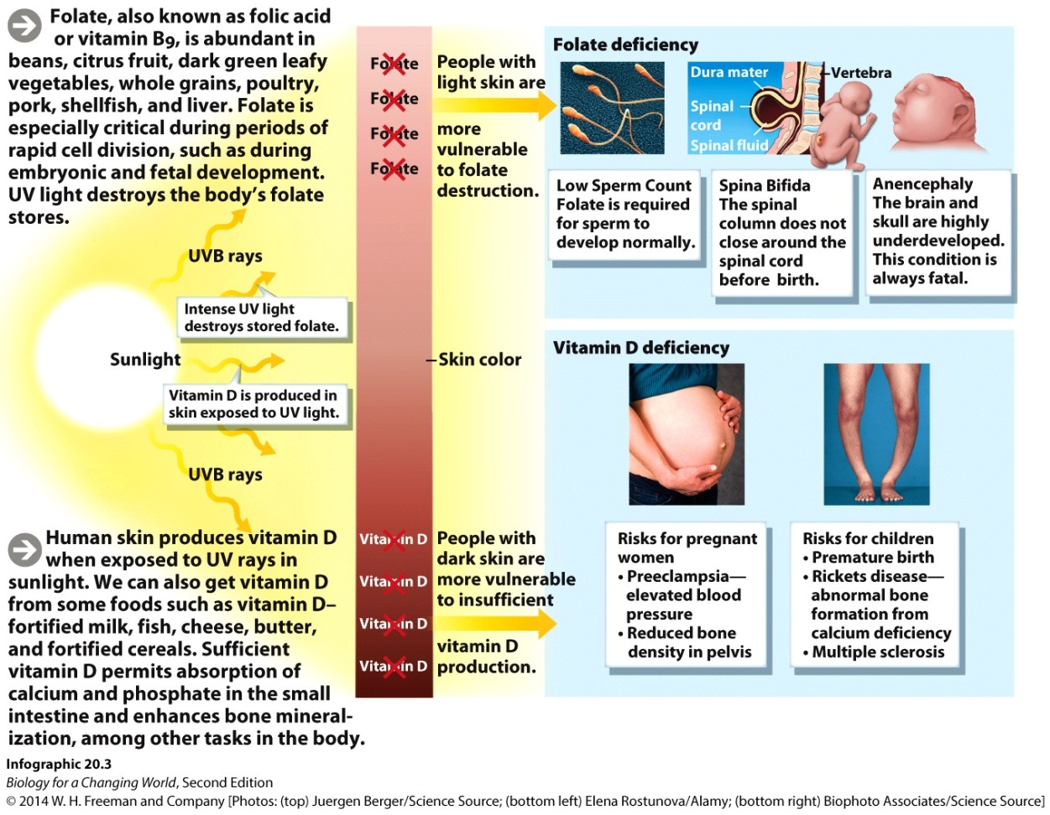
Why did human populations evolve varying skin tones?
Why light skin?
Vitamin D production requires UV light
Notes:
Vitamin D: a fat-soluble vitamin required to maintain a healthy immune system and to build healthy bones and teeth.
The human body produces vitamin D when skin is exposed to UV light.

Slide 9
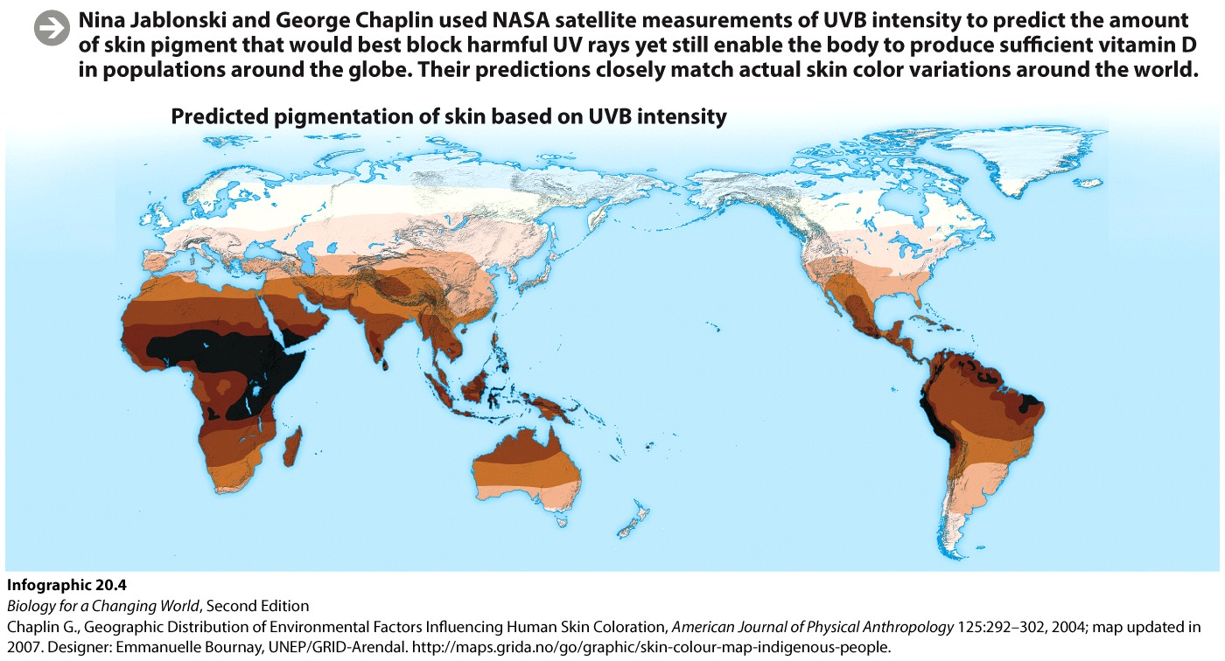
Why did human populations evolve varying skin tones?
Compare skin color with levels of UV light
The weaker the UV light, the fairer the skin
Notes:
This suggests that both dark and light skins are linked to levels of global sunlight.

Slide 10
Why did human populations evolve varying skin tones?
Light skin helps the body produce vitamin D in sun-poor parts of the world
Dark skin helped protect the body’s folate stores in sunny climates
Notes:
The body’s need to balance levels of folate and vitamin D given varied levels of UV light explains why there is so much variation in skin tone around the globe.

Slide 11
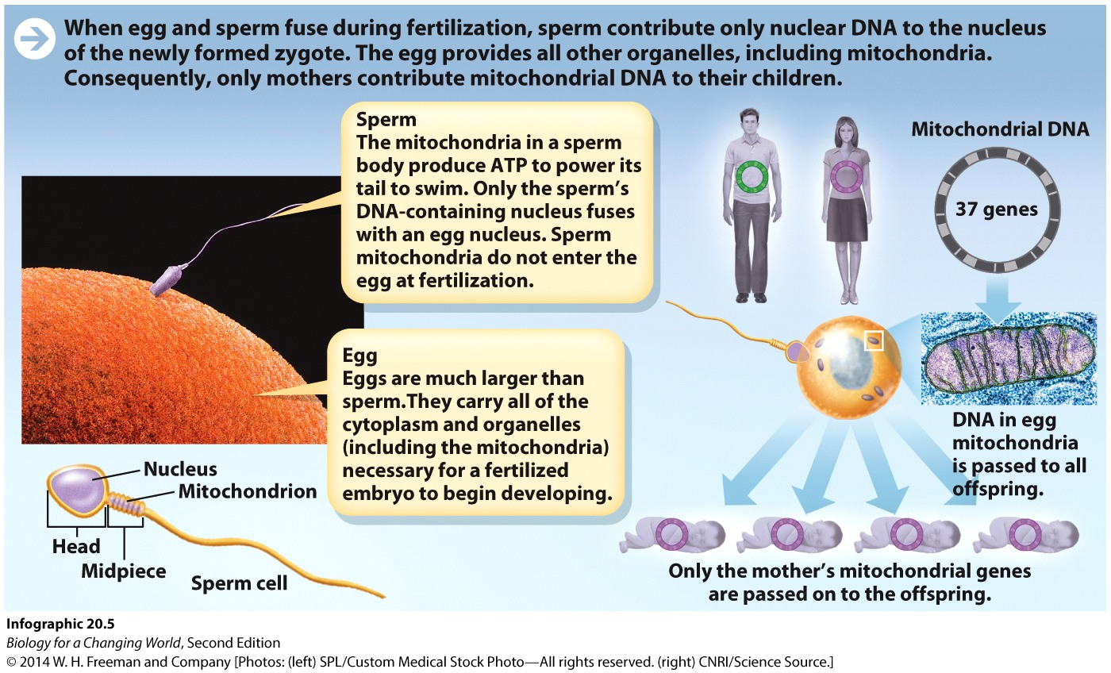
Humans evolved in Africa
Perform genetic analysis to confirm common ancestry
Mitochondrial DNA (mtDNA)
DNA in mitochondria is inherited solely from mothers

Slide 12
Humans evolved in Africa
mtDNA mutates at regular rate
mother with a mutation in her mtDNA will pass it to all her children
can track human ancestry and build evolutionary tree: Eve
Notes:
As mitochondrial DNA mutates at a more or less constant rate, the researchers could also tell how long it had been since groups diverged from one another, based on the number of differences.

Slide 13
Humans evolved in Africa
Notes:
Researchers began by grouping individuals that shared the most similar mtDNA sequences, and then grouping these groups with respect to one another, until finally the largest group—containing all the others—was reached. A computer program helped them choose the most statistically probable tree.
The tree had two major evolutionary branches. One included the ancestors of populations now living in Asia, Australia, Europe, and new Guinea, and one included the ancestors of modern-day Africans.
Traced back to a single female ancestor who lived in eastern Africa some 200,000 to 150,000 years ago.

Slide 14
Humans evolved in Africa
“Out of Africa” hypothesis
Humans originated in Africa
A group migrated to other continents
Additional fossil evidence shows modern humans lived in Africa at time of Eve

Slide 15
Out of Africa hypothesis
Notes:
Fossil discoveries in Ethiopia in 2003 and 2005 represent the oldest known fossils of modern humans (160,000 and 195,000 years old, respectively) and date precisely from the time that mitochondrial Eve lived in eastern Africa.
The fossil discoveries provide evidence that anatomically modern humans were living in that region around the same as Eve. This hypothesis is also supported by research that sampled genetic diversity from nuclear DNA.

Slide 16
Becoming human
Hominid
Any member of the biological family Hominidae
Includes living and extinct great apes
humans, orangutans, gorillas, chimpanzees, and bonobos
Notes:
Humans are grouped with the great apes because fossil evidence shows that modern humans and other present-day great apes evolved from a common ancestor.

Slide 17
Becoming human

Slide 18
Becoming human
Hominidae
Humans and chimpanzees are most closely related
Last common ancestor approximately 7 million years ago; no fossil evidence yet
Homo sapiens characterized by
ability to walk upright
big brain
Notes:
For H sapiens an upright gait meant the hands were free to make and use tools and a big brain enabled them to develop complex language.

Slide 19
Becoming human
Ardipithecus ramidus (4.4 million years ago)
small brain
bones show it could walk upright
also all fours in trees
Australopithecus (2.6. million years ago)
could walk upright
lived on ground
tools

Slide 20
Becoming human
Homo erectus (800,000 years ago)
controlled fire
Homo sapiens (between 800,000-200,000 years ago)
big brain
better communication and problem solving
Notes:
The temperature dramatically shifted from high to low and back several times during this period. Scientists hypothesize that a larger brain would have enabled better communication and problem solving, which would have been very useful to our hominid ancestors as they coped with climate change. This was also around the time that anatomically modern humans like mitochondrial Eve and our own species, Homo sapiens, appeared.

Slide 21
Becoming human

Slide 22
Selection for skin color
Environmental factors played a role
Acts on traits, or phenotypes, which increases or decreases allele frequency in a population
Mutations introduce new alleles into the population
Different environments select for different traits, and therefore different alleles

Slide 23
Selection for skin color
Notes:
Skin color is trait that likely conferred an advantage to humans and underwent natural selection at some point in human history. Otherwise, dark or light skin color wouldn’t be so common among specific populations.

Slide 24
Selection for skin color
Other traits selected for, as well
bipedalism
loss of body hair
development of sweat glands
levels of melanin

Slide 25
Selection for skin color
Notes:
The evolution of skin tone, the folate–vitamin D hypothesis, has the most supporting evidence.

Slide 26
Summary
Humans are 99.9% genetically identical to one another regardless of geographic origin.
All humans are members of a single biological species, Homo sapiens.
Skin color most likely evolved in response to environmental UV levels, an example of evolution by natural selection.
Fossil evidence shows that humans and apes descended from a common ancestor and that walking upright preceded development of a big brain.
Fossil and DNA evidence shows that anatomically modern humans first emerged in Africa, approximately 200,000 years ago.

