Slide 1
Michèle Shuster • Janet Vigna • Matthew Tontonoz • Gunjan Sinha
Biology for a
Changing World
SECOND EDITION
Lecture PowerPoint
CHAPTER 21
Population Ecology
Copyright © 2014 by W. H. Freeman and Company

Slide 2
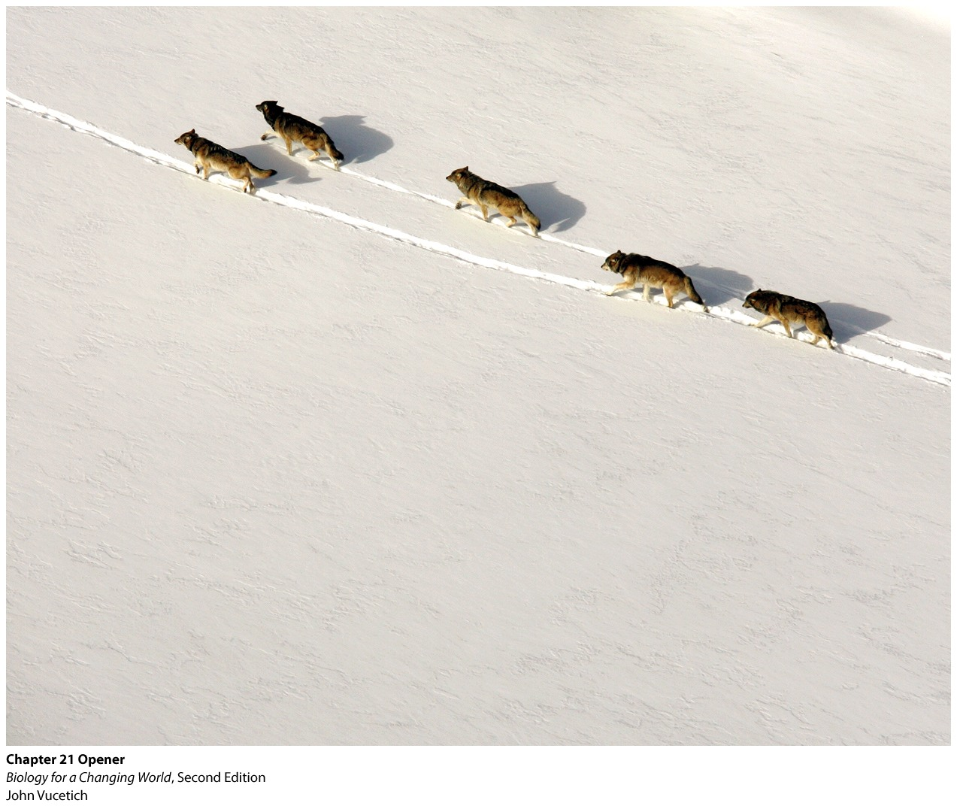
Chapter 21
Population Ecology

Slide 3
Driving Questions
1. What is ecology, and what do ecologists
study?
2. What are the different patterns of population
growth?
3. What factors influence population growth and
population size?

Slide 4
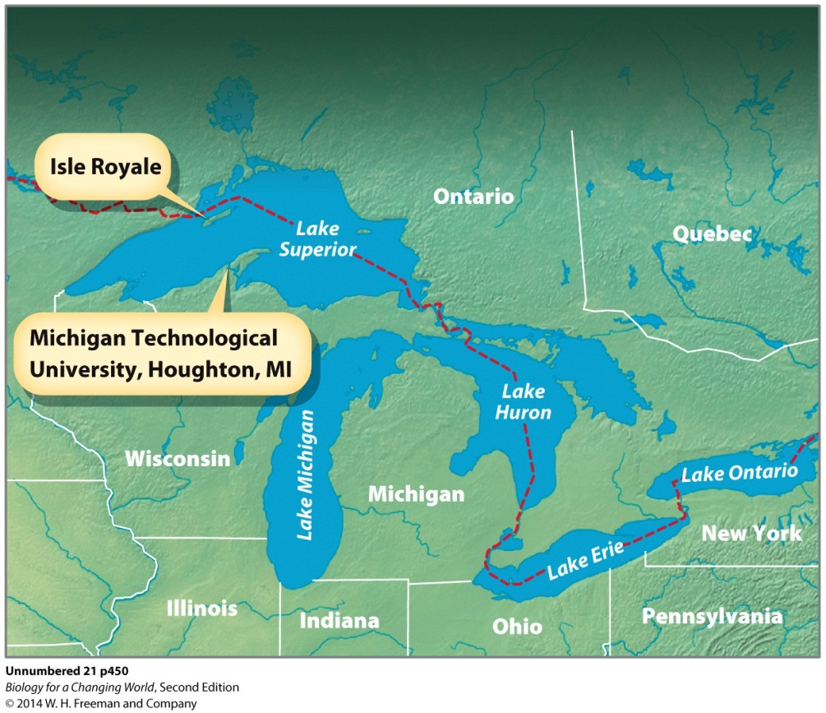
Isle Royale, Canada
Track wolves and moose for many years to understand dynamic fluctuations between these populations
Notes:
The Isle Royale wolf and moose study (begun in 1958) is the longest-running predator–prey study in the world. Isle Royale is uninhabited by humans and is protected as a national park. Scientists can study moose–wolf interactions in a nearly natural environment undisturbed by settlement, hunting, or logging.

Slide 5
Ecology
Ecology
Study of the interactions among organisms and between organisms and their nonliving environment
Individual, population, community, and the ecosystem

Slide 6
Ecology
Individual level: how an individual organism fares in its surroundings

Slide 7
Ecology
Population level

Slide 8
Ecology
Community level
Notes:
Community: interacting populations of different species in a defined habitat

Slide 9
Ecology
Ecosystem level
Notes:
Ecosystem: all the living organisms in an area and the nonliving components of the environment with which they interact

Slide 10
Population ecology
Multidisciplinary science
Biology
Geography
Meteorology
Mathematics

Slide 11
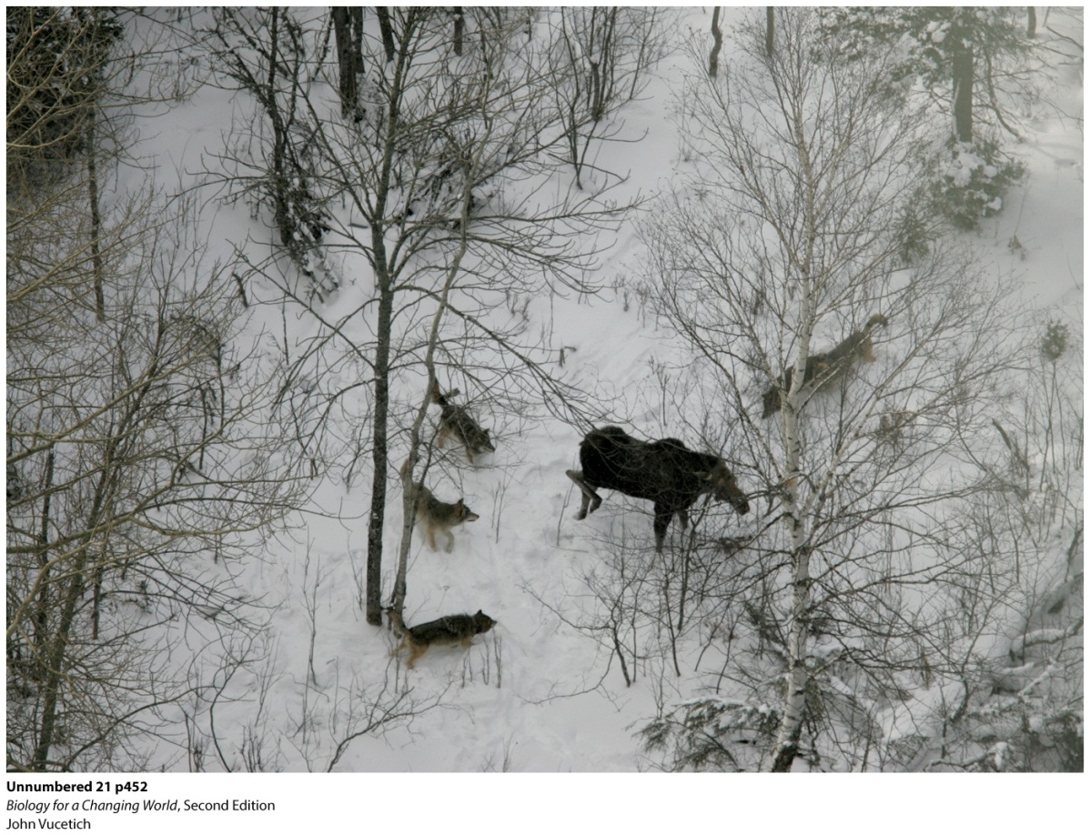
Population ecology
Distribution pattern
Organisms distributed in geographic space
Depends on resources and interactions with other members of the population
Reflect behavioral or ecological adaption

Slide 12
Population ecology

Slide 13
Distribution patterns
Random distribution
May allow individuals to maximize their access to resources
Notes:
Example: Pine trees have air-blown seeds that are spread far and wide by gusty winds, resulting in a random distribution of trees in the forest.

Slide 14
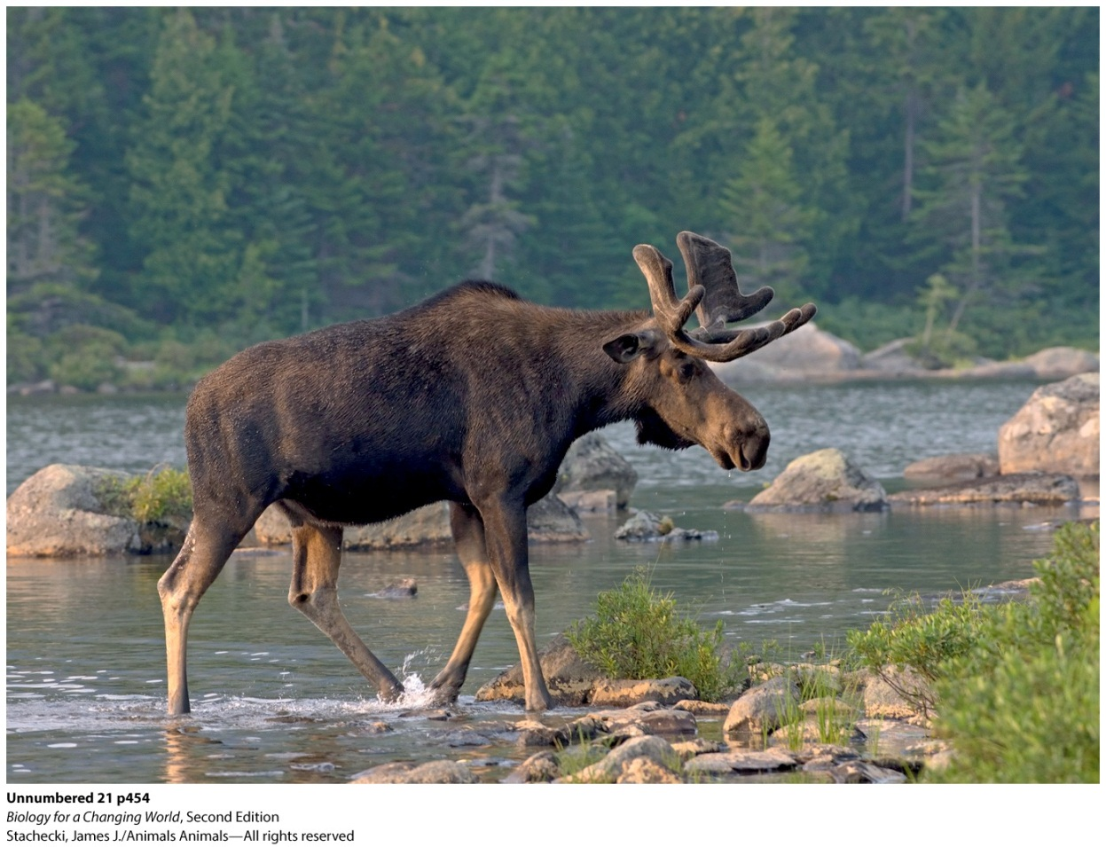
Distribution patterns
Random distribution
Notes:
Moose have a random distribution on Isle Royale.

Slide 15
Distribution patterns
Clumped distribution
When resources are unevenly distributed across the landscape
Or when social behavior dictates grouping
Notes:
Clumping helps wolves gang up on moose; they circle their prey and close in for the kill. Clumping can also be a defense against predation, as it is for a school of fish.

Slide 16
Distribution patterns
Uniform distribution
results from territorial behavior

Slide 17
Distribution patterns

Slide 18
Population growth
Growth rate
Difference between the birth rate and the death rate
Influenced by
immigration: movement of individuals into a population
emigration: movement of individuals out of a population

Slide 19
Population growth
Types of population growth
Exponential growth
unrestricted growth of a population increasing at a constant growth rate
Logistic growth
starts off fast and then levels off
environmental factors will limit an organism’s ability to reproduce
for example, access to habitat: the physical environment where an organism lives and to which it is adapted
Notes:
Various environmental factors such as food availability and access to habitat (the physical environment where an organism lives and to which it is adapted) limit an organism’s ability to reproduce.

Slide 20
Population growth
Carrying capacity
The maximum number of individuals that an environment can support given its space and resources
Upper limit on the size of any population

Slide 21
Population growth

Slide 22
Population growth
Size of a population may fluctuate around the environment’s carrying capacity
Disease or food shortage cause population to shrink
Allows environment time to recover its food supply
Population may begin to grow again
Boom and bust

Slide 23
Population growth
Notes:
Why does the wolf population fall? Because even for wolves, there’s no such thing as a free lunch: The wolves pay a price for predation in the form of a declining food supply. The result is a repeating cycle in the numbers of predator and prey. Rather than growing exponentially and leveling off, the populations cycle through repeated rounds of boom and bust.

Slide 24
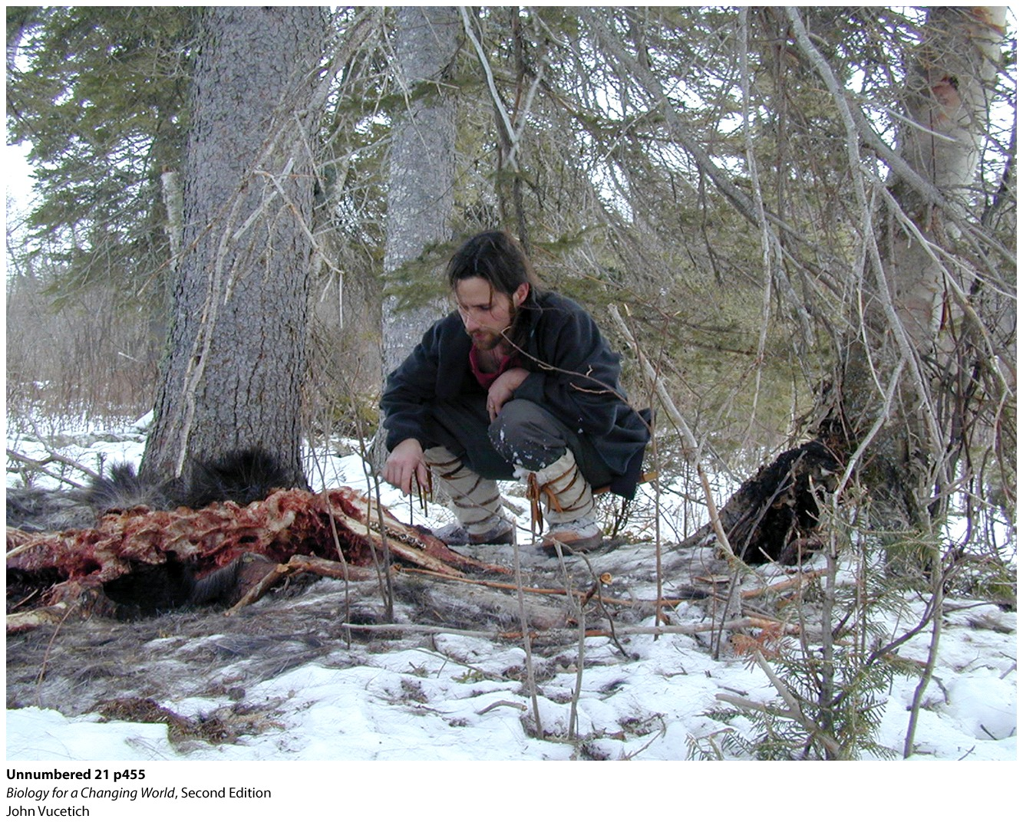
Patterns of population growth
Anything that affects the size of one population could affect the size of other populations in the ecosystem, as well
Isle Royale
Notes:
John Vucetich examines a kill site. There is a correlation between a large wolf population and vigorous tree growth. When wolves are plentiful, they keep the moose population in check. Because trees are the primary food source for moose, more trees exist when fewer moose are eating them.

Slide 25
Patterns of population growth

Slide 26
Population growth
Ecologists use a variety of data to monitor the health of populations

Slide 27
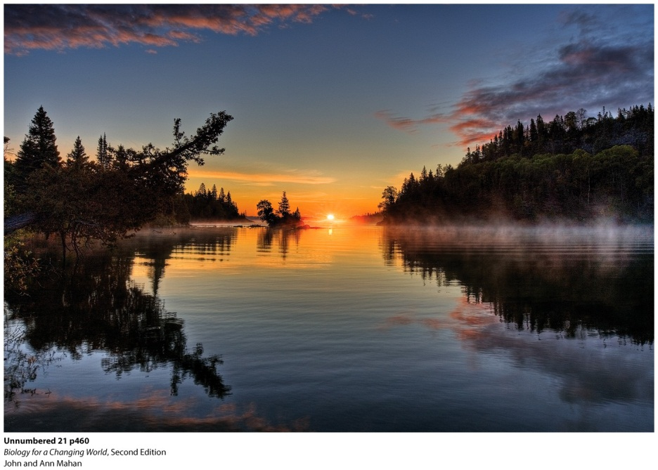
Population growth
Isle Royale: a number of factors influence the likelihood that wolves will kill moose
Population density
Number of organisms per given area
Notes:
As the population density of a species increases, individuals of that species may face food shortages.

Slide 28
Population growth
Density-dependent factors
A factor whose influence on population size and growth depends on the number and crowding of individuals in the population
Such as predation
Density-independent factors
A factor that influences population size and growth regardless of the numbers and crowding within a population
Such as weather

Slide 29
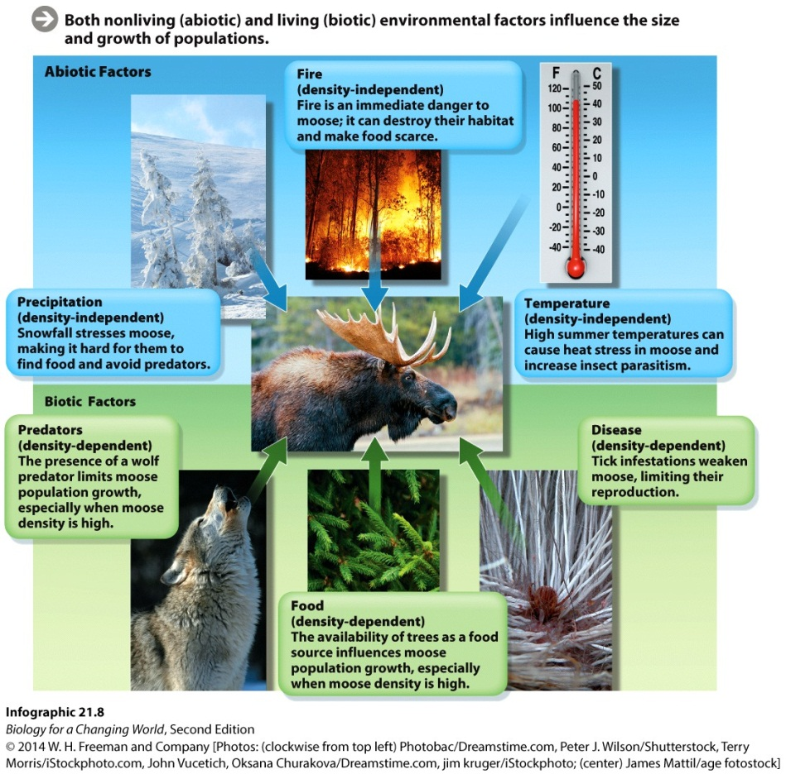
Population growth
Biotic factors: living components of an environment
Abiotic factors: nonliving components of environment

Slide 30
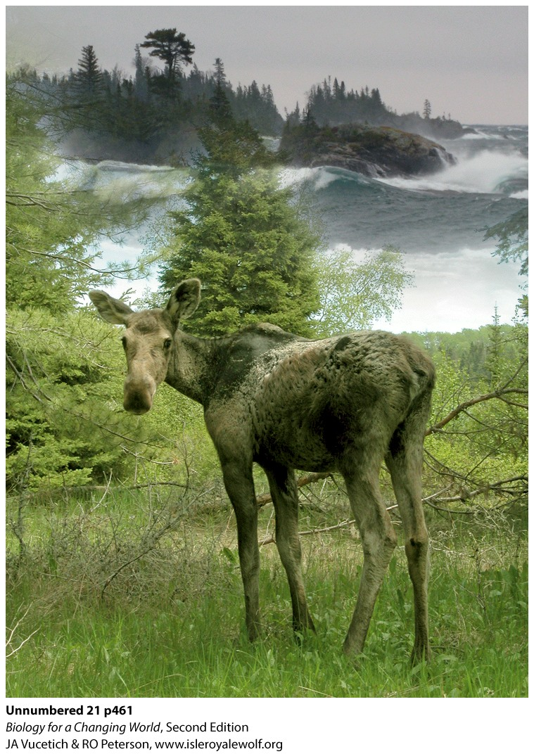
Population growth
Other factors affecting population size
Disease
canine parvovirus (cpV)
Climate change
less eating in warm weather
warm weather favors ticks
Notes:
A young moose on Isle Royale. Note the patchy fur, a sign of tick infestation. Moose scratch themselves against trees and chew their hair out trying to rid themselves of ticks.
A disease called canine parvovirus (cpV) infected Isle Royale’s wolves. The disease killed all but 14 of the island’s wolves and over the next 10 years the moose population skyrocketed.
The warming climate is influencing moose population size. Sweltering summer temperatures hit moose especially hard. The large herbivores get hot easily; they escape the heat by resting in the shade. A lot of time spent resting means less time for eating, and a moose who eats less all summer has less insulation for winter.

Slide 31
Population growth

Slide 32
Summary
Ecology is the study of the interactions among organisms and between organisms and their nonliving environment.
We study these interactions at a number of levels, including population, community, and ecosystem.
Living organisms may have a clumped, random, or uniform distribution pattern.
The growth rate of a population is defined as the birth rate minus the death rate. There are two types: exponential growth and logistic growth.
Carrying capacity is the maximum population size that an area can support, given its food supply and other life-sustaining resources.
Population growth can be limited by a variety of factors, including biotic (living) and abiotic (nonliving) parts of the environment.
Density-independent factors and density-dependent factors contribute to population growth.

