Slide 1
Michèle Shuster • Janet Vigna • Matthew Tontonoz • Gunjan Sinha
Biology for a
Changing World
SECOND EDITION
Lecture PowerPoint
CHAPTER 22
Community Ecology
Copyright © 2014 by W. H. Freeman and Company

Slide 2
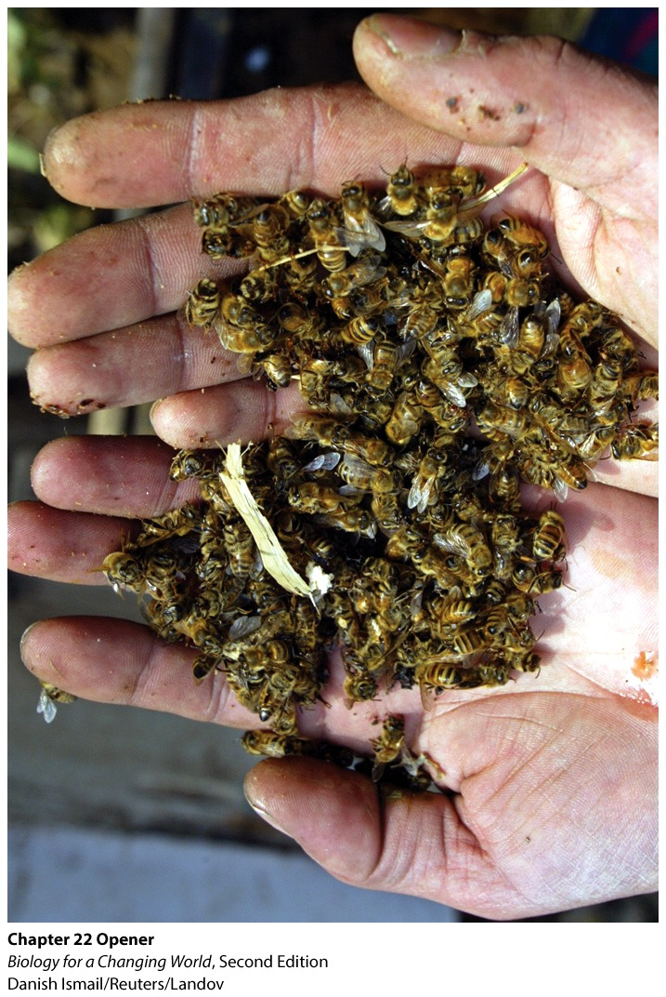
Chapter 22
Community Ecology
Notes:
Over the past 5 years, American beekeepers have lost millions of bee colonies.

Slide 3
Driving Questions
1. What are keystone species in a community, and why
are pollinators considered keystone species?
2. What are food chains and food webs, and how does
energy flow through them?
3. What positive and negative interactions occur among
members of a community?

Slide 4
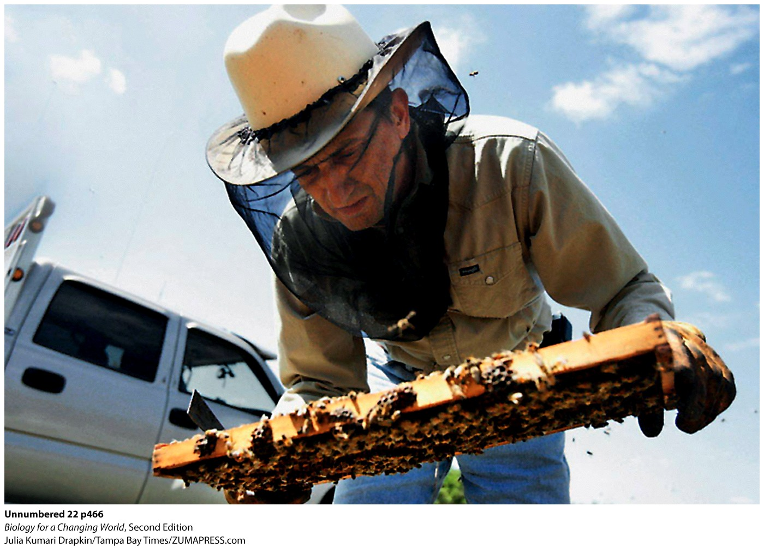
What’s happening to the honey bees?
Colony collapse disorder (CCD)
Notes:
Some 10 million honey bee colonies across the United States have reportedly been wiped out, with American beekeepers losing an average of 30% to 40% of their colonies every year since 2006.
At stake are agricultural crops and the health and diversity of natural ecosystems that rely on the valuable services of bees.

Slide 5
Community ecology
Bees are pollinators
Associated with evolution of flowering plants
Pollen
small, thick-walled plant structures that contain cells that develop into sperm
Pollination
transfer of pollen from male to female plant structures so that fertilization can occur

Slide 6
Community ecology
75% of flowering plants, or angiosperms, are dependent on insect pollinators
Keystone species
species on which other species depend; hold community together
Community
group of interacting populations of different species living together in the same area
Notes:
The removal of a keystone species has a dramatic impact on the community.

Slide 7
Community ecology

Slide 8
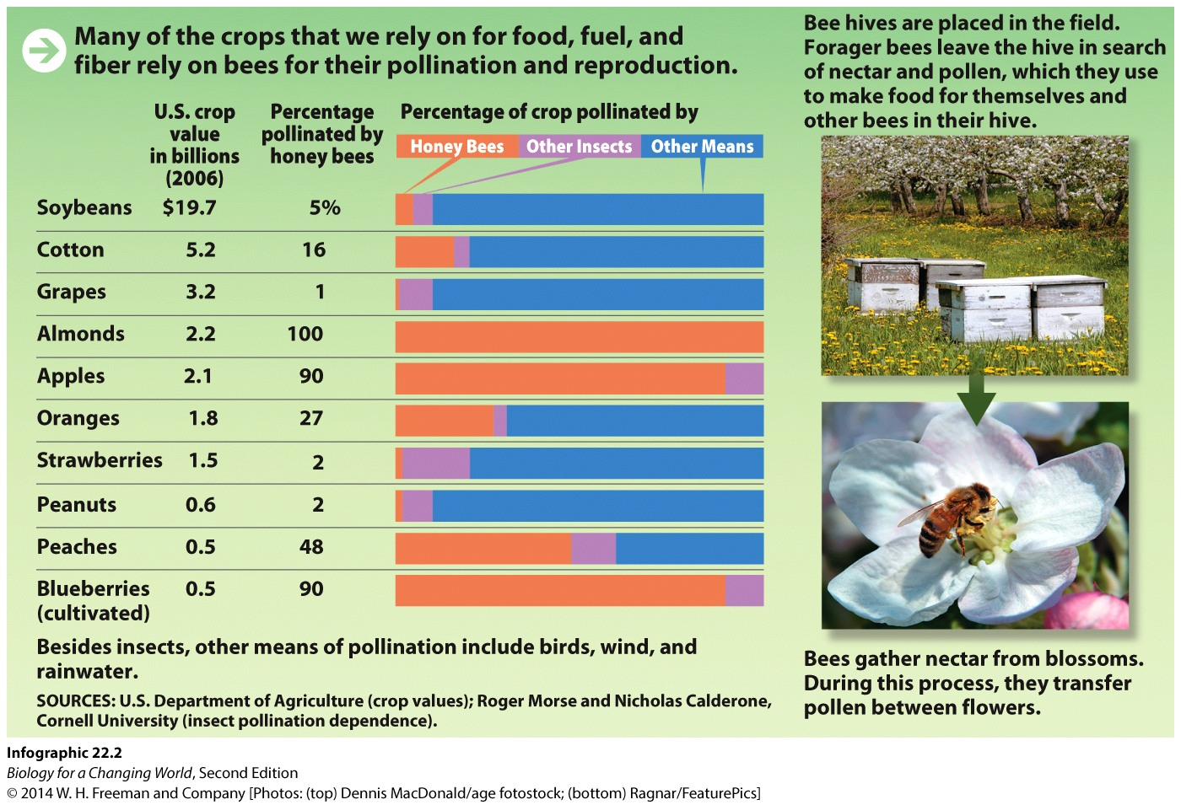
Community ecology
“One in every three bites of food we eat is pollinated directly or indirectly by honey bees.” —Dennis vanEngelsdorp
Notes:
Without honey bees, he says, we wouldn’t starve—we would still have wheat, rice, corn, and other crops that are either wind- or self-pollinated—but many of our favorite foods might no longer grace our table.

Slide 9
Reproductive structures of flowering plants
Male reproductive organ
stamen: stem-like filament topped with a pollen-saturated anther
Female reproductive organ
pistil: topped with a sticky “landing pad” (stigma)
style: a tube-like passage from stigma to the ovary
Notes:
Male pollen (containing sperm) must deliver sperm to female eggs of same species.

Slide 10
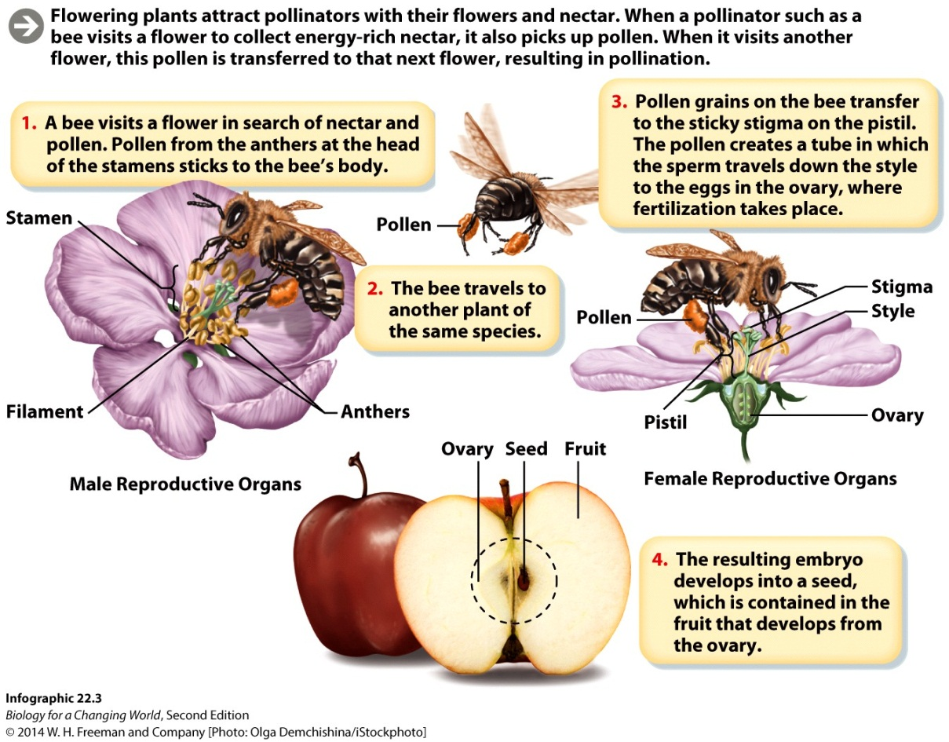
Pollinators
Fertilized egg develops into an embryo-containing seed
Surrounding ovary becomes the fruit
Notes:
Stamen: the male reproductive structure of a flower, made up of a filament and an anther
Pistil: the female reproductive structure of a flower, made up of a stigma, style, and ovary
Stigma: the sticky “landing pad” for pollen on the pistil
Style: the tube-like structure that leads from the stigma to the ovary
Seed: the embryo of a plant, together with a starting supply of food, all encased in a protective covering

Slide 11
Food chains
Food chains: linked sequences of feeding relationships in a community
Organisms categorized by who eats whom
Producers: autotrophs that supply energy to rest of food chain
Consumers: heterotrophs that eat producers
Notes:
Food chain: a linked series of feeding relationships in a community in which organisms further up the chain feed on ones below.
Producers: autotrophs (photosynthetic organisms) that form the base of every food chain
Consumers: heterotrophs that eat other organisms lower on the food chain to obtain energy

Slide 12
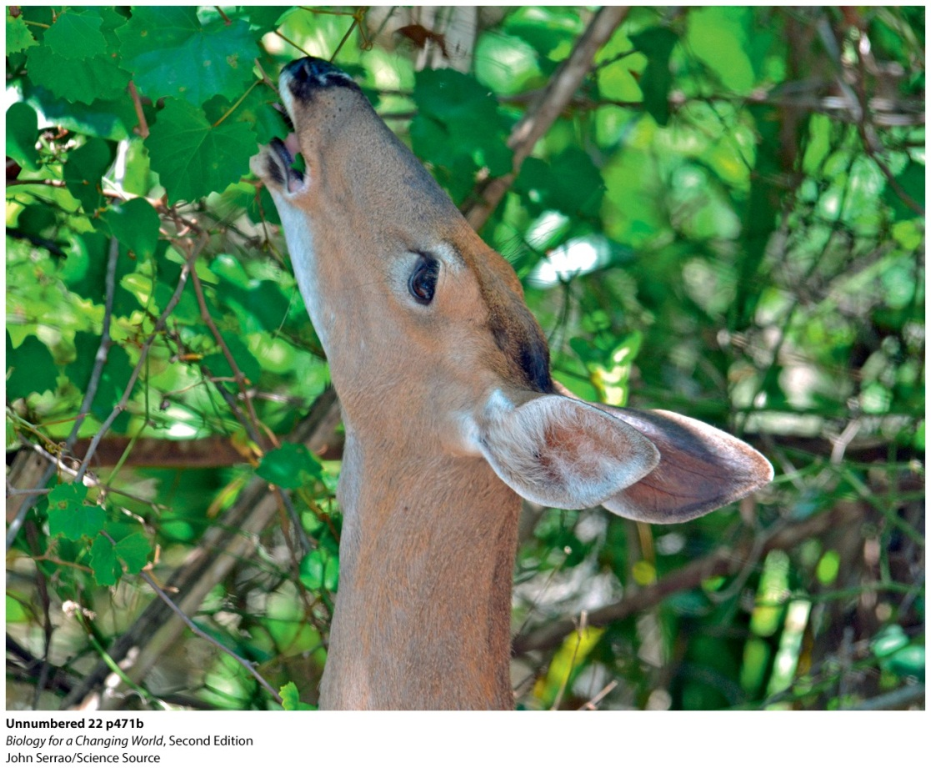
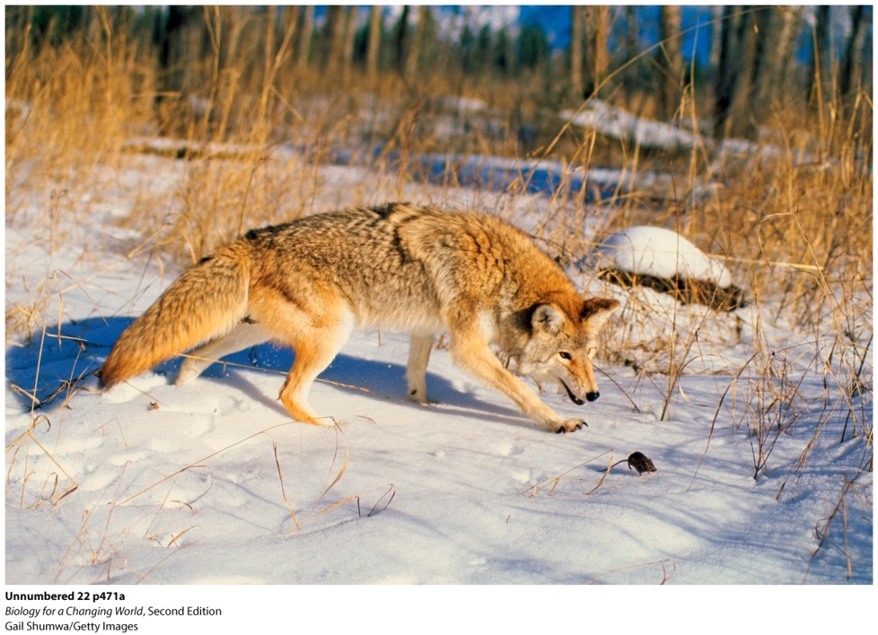
Food chains
Predators: one organism feeds on the other (prey)
Herbivores: predation on plants, which may or may not kill the plant

Slide 13
Food chains
Trophic levels
feeding levels based on positions in a food chain
Notes:
There are downsides to being last in line to eat. For one, it’s harder to obtain the energy necessary to live.
Not all the energy stored in a lower level makes it to the level above it; at each step, much of this energy is lost to the chain.

Slide 14
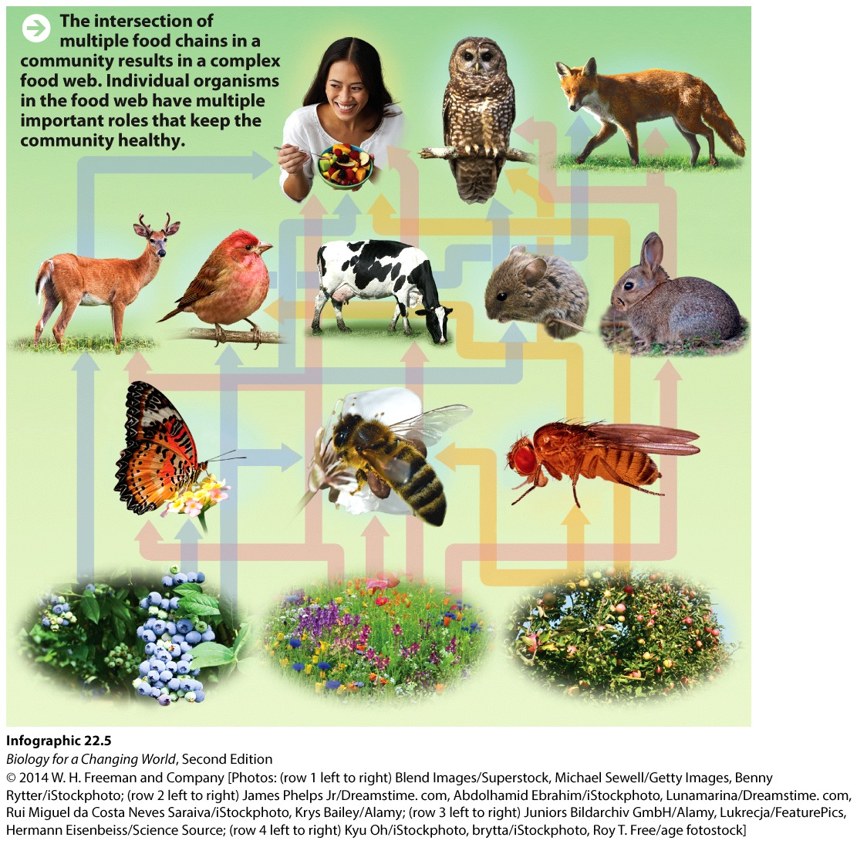
Food webs
Food web
complex, interconnection of feeding relationships in community
omnivores: eat both plants and animals

Slide 15
Symbiotic relationships
Symbiosis: relationship in which two different organisms live together, often interdependently
parasitism
mutualism
commensalism

Slide 16
Symbiotic relationships
Parasitism: symbiotic relationship in which one member benefits at the expense of the other

Slide 17
Symbiotic relationships
Mutualism: symbiotic relationship in which both members benefit

Slide 18
Symbiotic relationships
commensalism: symbiotic relationship in which one member benefits and the other is unharmed

Slide 19
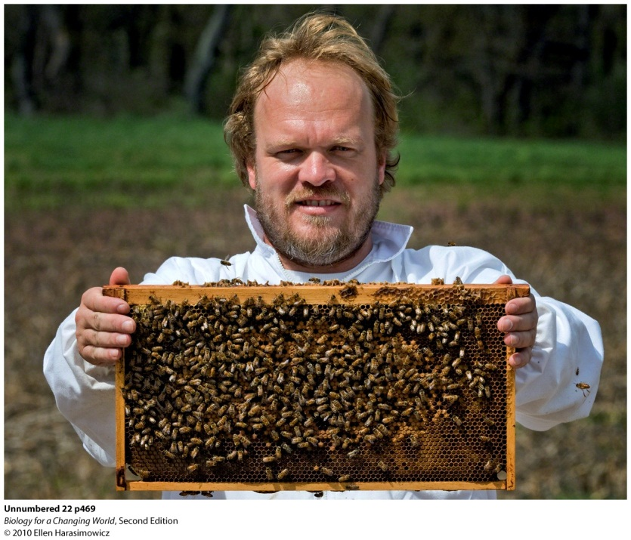
What’s happening to the honey bees?
Is it parasitism?
parasitic varroa mite infestation
parasitic fungus Nosema ceranae
bee AIDS
Israeli acute paralysis virus (IAPV)
invertebrate iridescent virus (IIV)
Is it malnutrition?
Notes:
Apiarist Dennis vanEngelsdorp examines a honey bee colony.
One factor that almost certainly plays a role in exacerbating the condition is poor nutrition. For a number of reasons, honey bees are finding it harder and harder to obtain a nutritious diet.

Slide 20
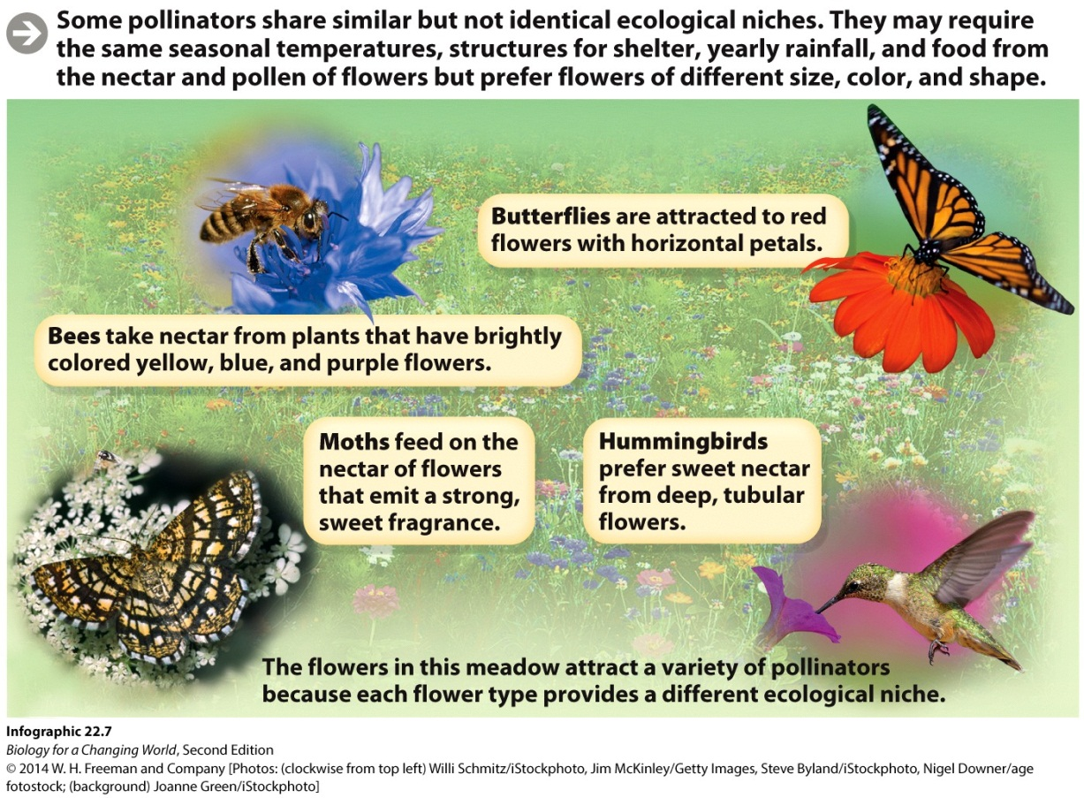
Competing for resources
Honey bees have a broad niche
the space, environmental conditions, and resources that a species needs in order to survive and reproduce
Notes:
Honey bees may visit more than 100 species of flowers within a single geographic region over the course of a season.
Different pollinators generally have different niches because of their varying sizes and preferences for different flower types.

Slide 21
Competing for resources
If niches overlap
two or more species rely on same limited resources
result is competition
Competitive exclusion principle
one of the competing species will be driven to extinction
Notes:
Competition: an interaction between two or more organisms that rely on a common resource that is not available in sufficient quantities.
However, very few species share exactly the same niche, so different species may find a competitive balance by subdividing resources (so-called “resource partitioning”).

Slide 22
Competing for resources
Notes:
For example, Africanized honey bees are much more aggressive than Western honey bees. They will chase away other pollinators from food sources, and even swarm and sting animals that get near their hives—behaviors earning them the colloquial name “killer bees.”

Slide 23
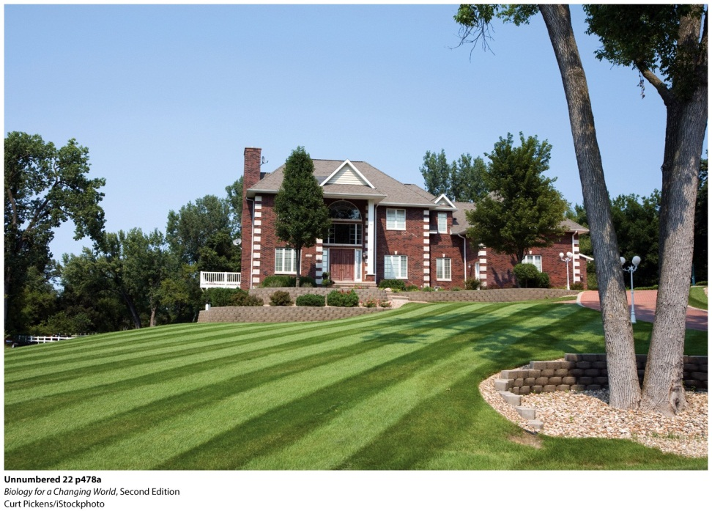
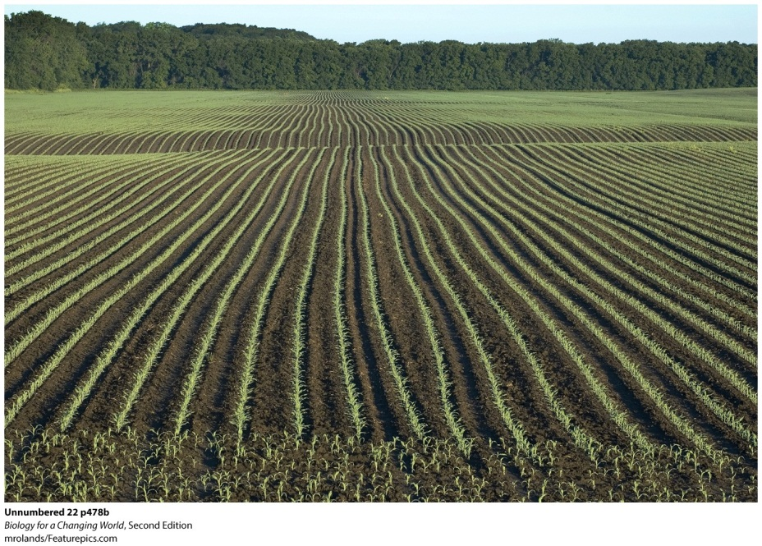
Human impact
Agriculture, suburban sprawl, and development decreased bees’ natural forage areas, and fragmented their habitat into nonoverlapping zones.
Notes:
Well-manicured lawns (top) and farms planted with monocrops (center) are “a desert to pollinators.” Lawns with wildflowers and diverse plants (bottom) are more welcoming to pollinating creatures.

Slide 24
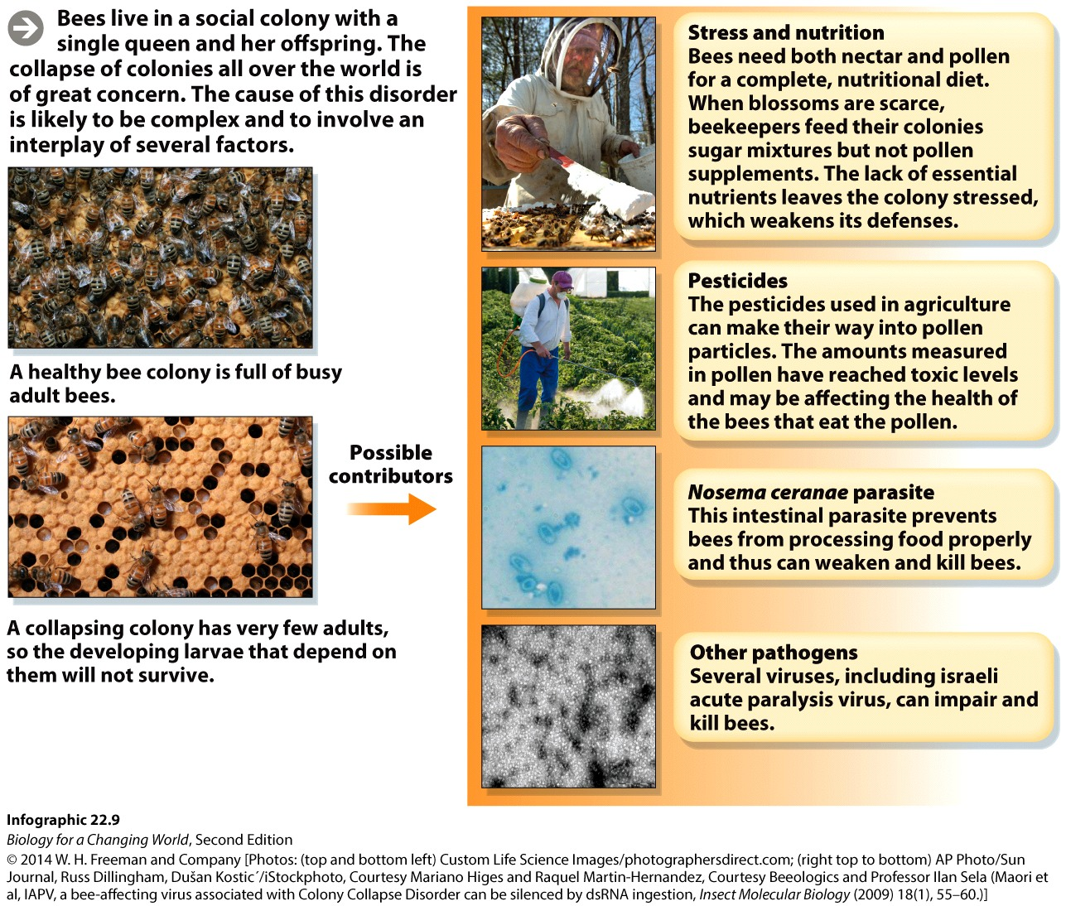
Human impact
Notes:
What’s ailing these insects? in addition to a shrinking and fragmented habitat, a disquieting possibility is that they are being poisoned by pesticides.

Slide 25
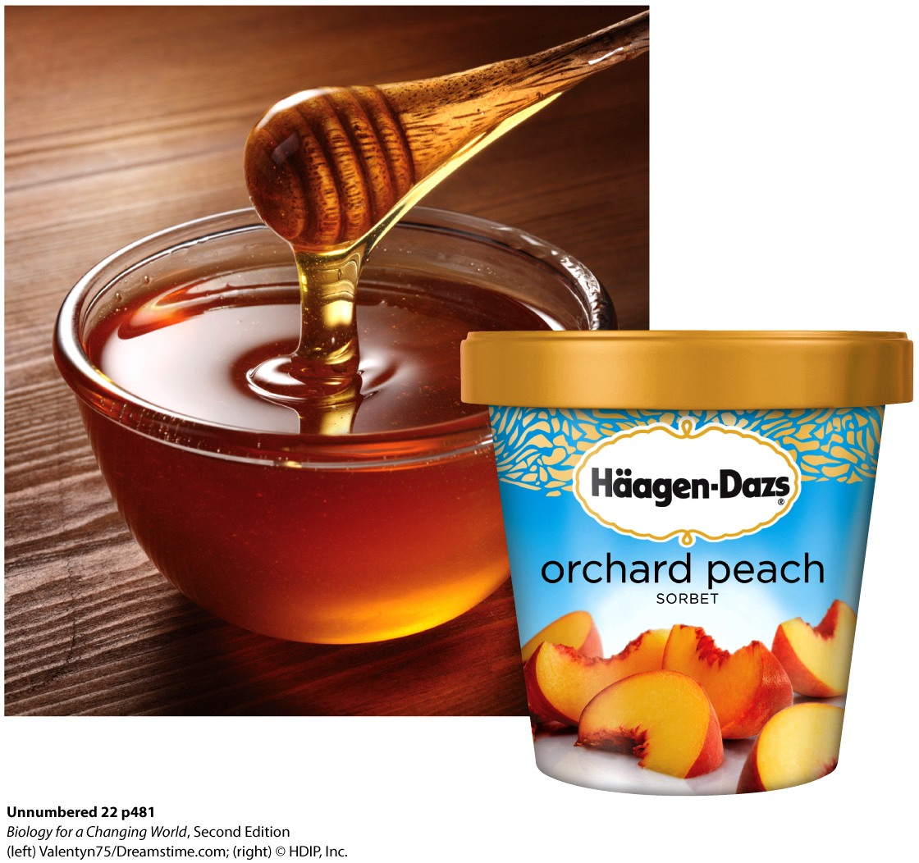
Human impact
Break up fields of monocultures with varied bee-friendly plants
Use pesticides sparingly
Become a beekeeper
Notes:
“One in every three bites of food we eat is pollinated directly or indirectly by honey bees.” —Dennis vanEngelsdorp

Slide 26
Summary
An ecological community is made up of interacting populations of different species.
Bees are keystone species because they play a fundamental role in supporting the entire community; they are primary pollinators.
The organisms in a community are connected by a food chain.
Organisms at the base of the food chain are producers and are higher up the food chain are consumers.
In predation, one organism eats another. Herbivory (eating plants) and parasitism are both types of predation.
Organisms can have different types of symbiotic relationships.
The space and resources, including other members of the community, that a species uses to survive and reproduce define its ecological niche.

