Slide 1
Michèle Shuster • Janet Vigna • Gunjan Sinha • Matthew Tontonoz
Biology for a
Changing World
SECOND EDITION
Lecture PowerPoint
CHAPTER 23
Ecosystem Ecology
Copyright © 2014 by W. H. Freeman and Company

Slide 2
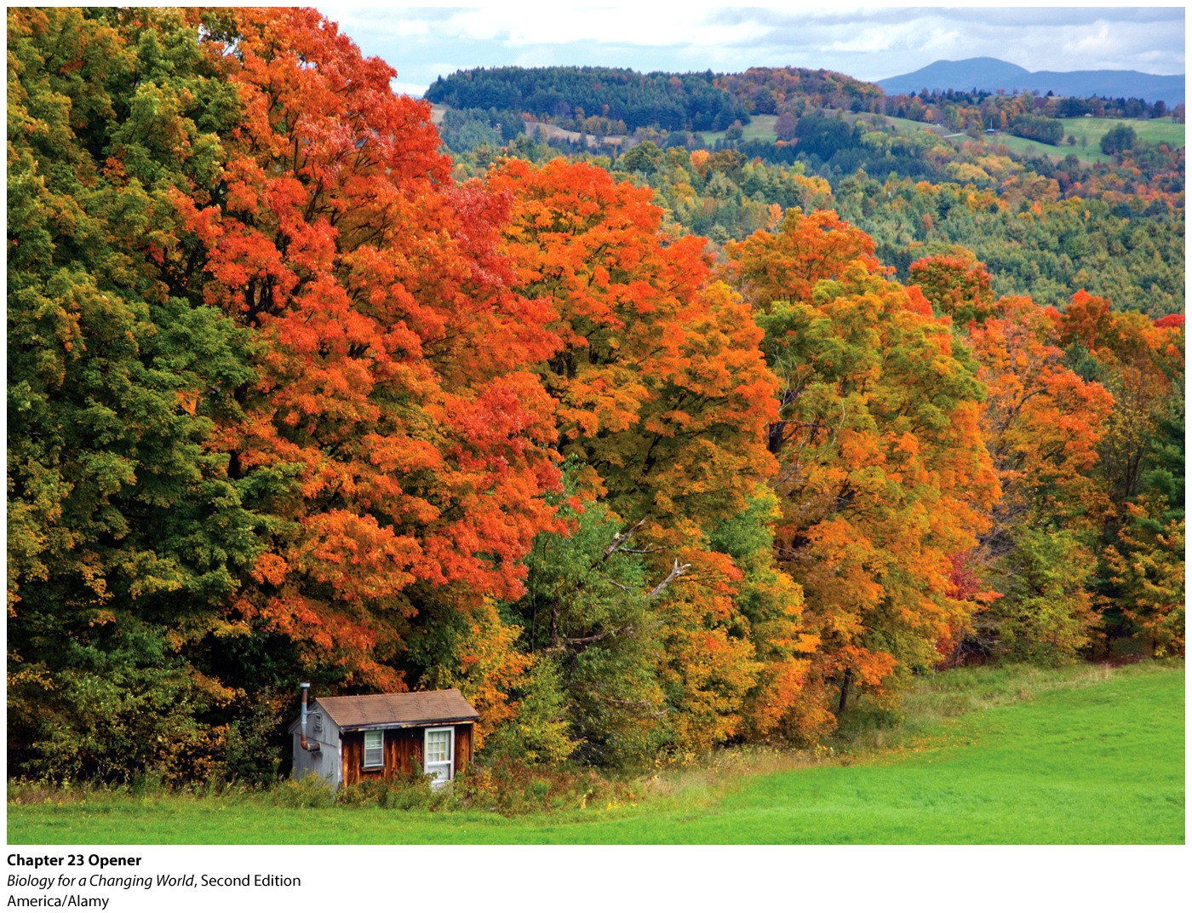
Chapter 23
Ecosystem Ecology

Slide 3
Driving Questions
1. What are ecosystems, and how are ecosystems being affected by climate change?
2. What is the greenhouse effect, and what does it have to do with global warming?
3. How do carbon and other chemicals cycle through ecosystems?
4. How are scientists able to compare present-day levels of atmospheric carbon
dioxide to past levels, and why would they want to?

Slide 4
Climate change and economy

Slide 5
Climate change
Climate change
Any substantial change in climate that lasts for an extended period (decades or more)
Global warming
Recent and continuing increase in the average global temperature
Notes:
Earth’s climate changes naturally, and has done so many times in its long history. But scientists now believe that humans are accelerating the pace of change, with potentially dire consequences for life on our planet.

Slide 6
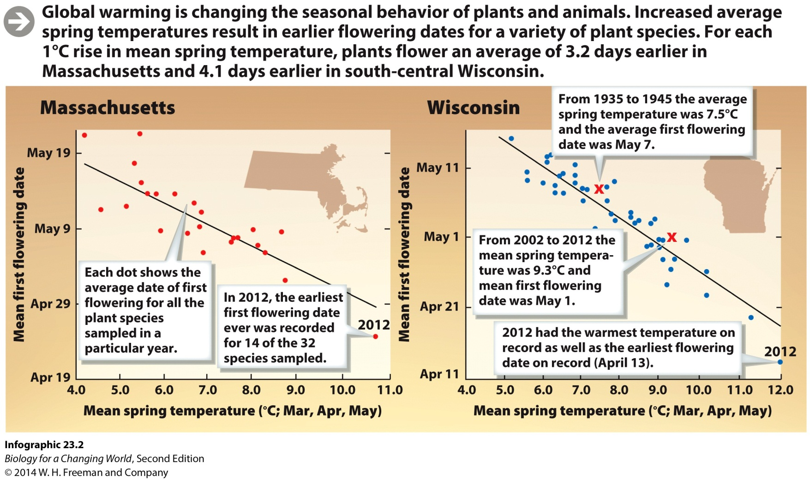
Climate change
Temperature cues seasonal tasks in plants (such as mating or producing flowers)
Rising temperatures interfere with these natural rhythms

Slide 7
Climate change
Ecosystem
Complex, interwoven system of interacting components
Includes both community of living organisms and features of the nonliving environment
Biotic and abiotic parts
Dynamic systems

Slide 8
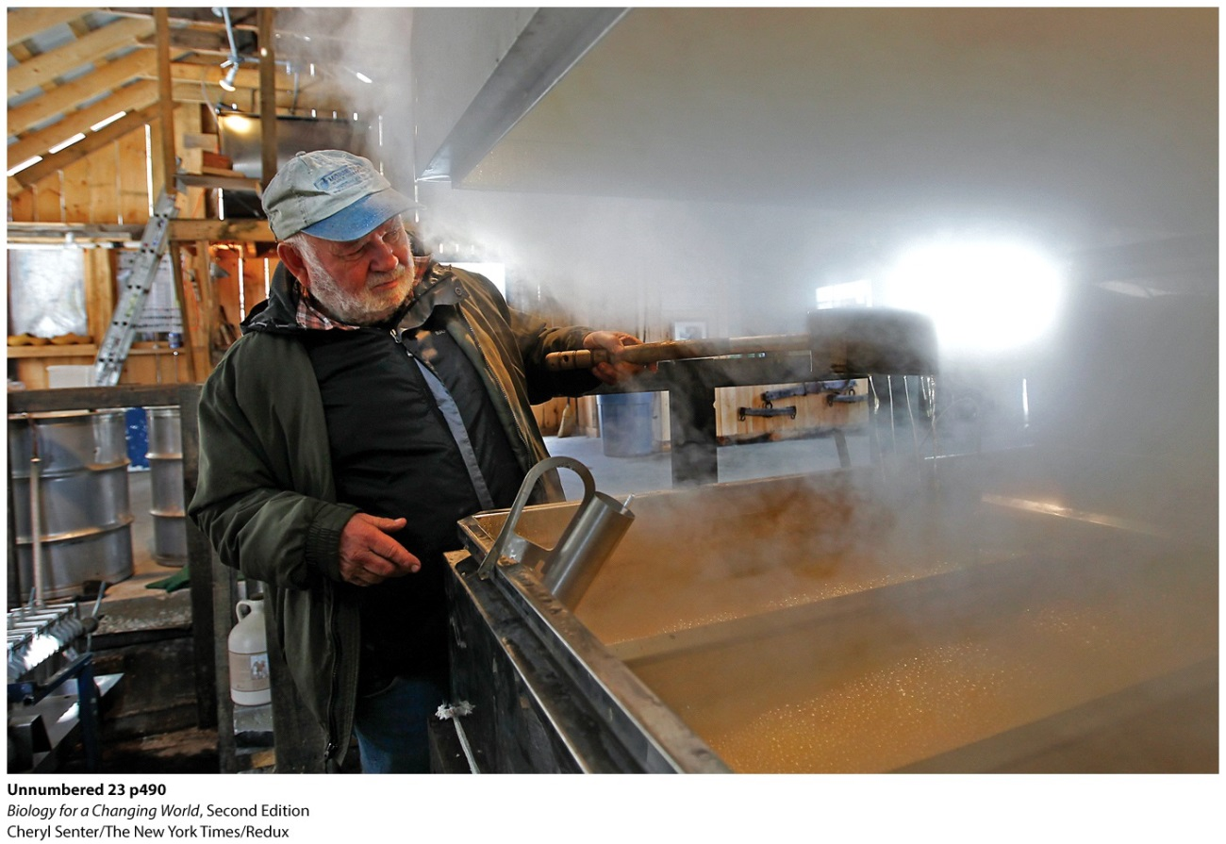
Climate change
Sap from maple trees during the spring season is controlled almost entirely by the daily fluctuation in temperatures

Slide 9
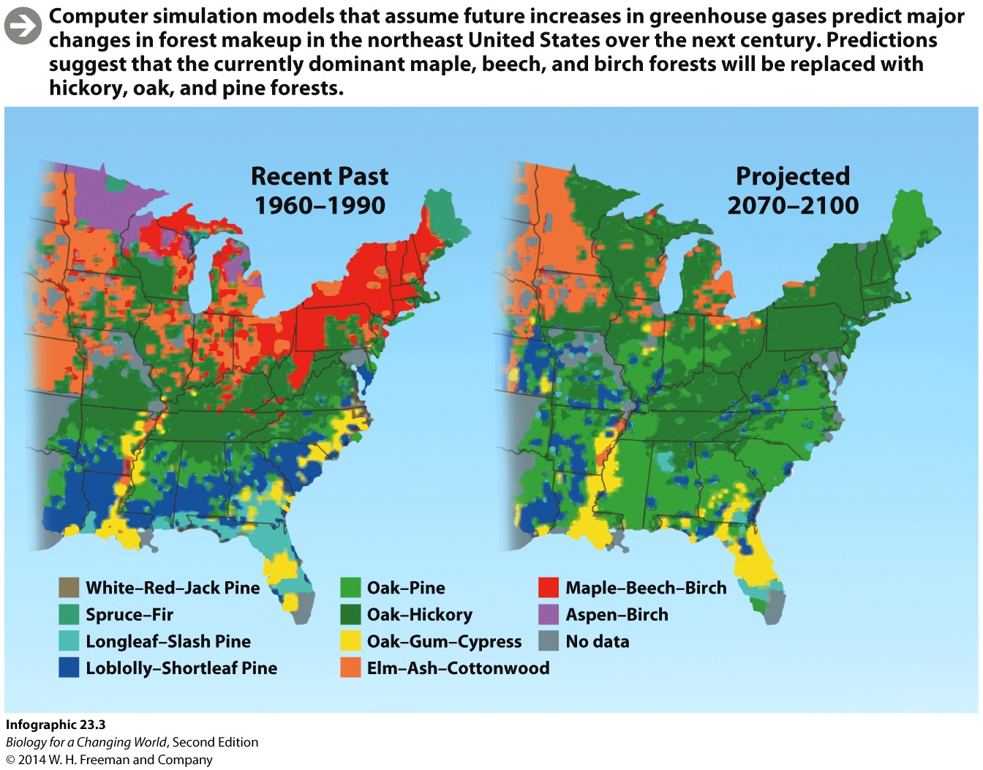
Climate change
May alter habitat for maple trees
Habitat is the physical environment where an organism lives and to which it is adapted

Slide 10
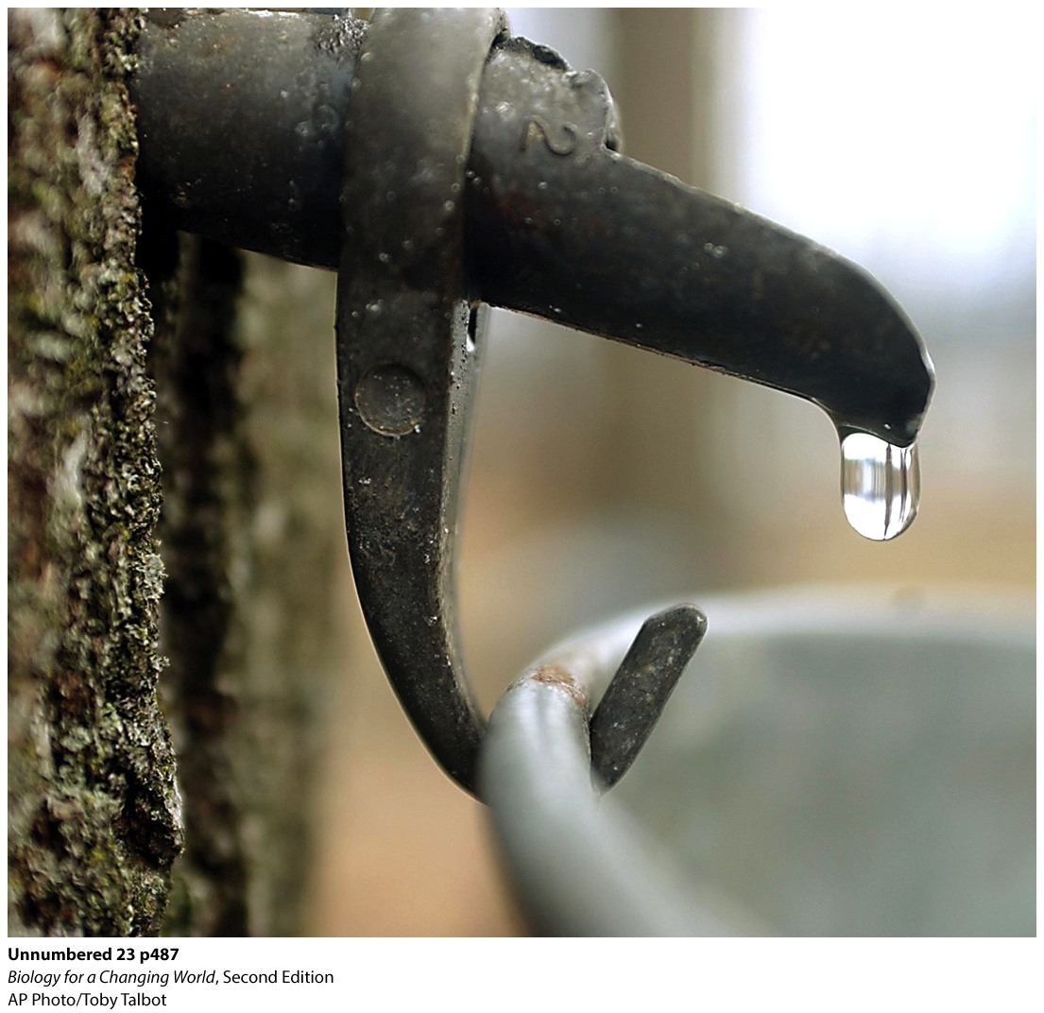
Climate change
Biome
Large geographic area defined by its characteristic plant life
Determined by climatic factors like temperature and rainfall
Temperate deciduous forest
Distinct seasons, trees that lose leaves in fall
Notes:
New England is a temperate deciduous forest biome.

Slide 11
Biomes
Aquatic: marine
Aquatic: freshwater
Tropical forest
Temperate forest
Grassland
Desert
Taiga
Tundra

Slide 12
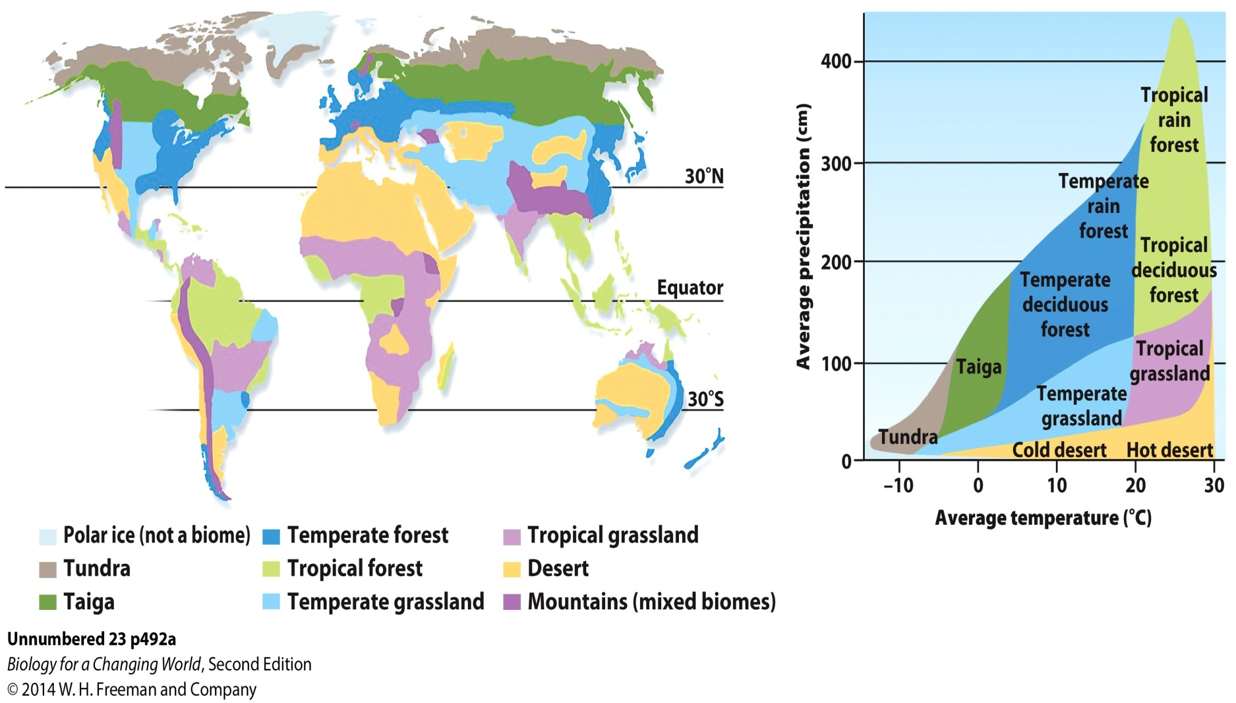
Biomes

Slide 13
The greenhouse effect
Trapping of heat in Earth’s atmosphere
Sunlight warms Earth’s surface
Heat radiates back to atmosphere
Absorbed by greenhouse gases
(for example, carbon dioxide)
Trapped heat raises temperature of atmosphere and Earth’s surface
Notes:
Greenhouse effect: the normal process by which heat is radiated from Earth’s surface and trapped by gases in the atmosphere, helping to maintain Earth at a temperature that can support life

Slide 14
The greenhouse effect
Notes:
The greenhouse effect is a natural process that helps maintain life-supporting temperatures on Earth. Without this greenhouse effect, the average surface temperature of the planet would be a frigid –18°C (0°F).

Slide 15
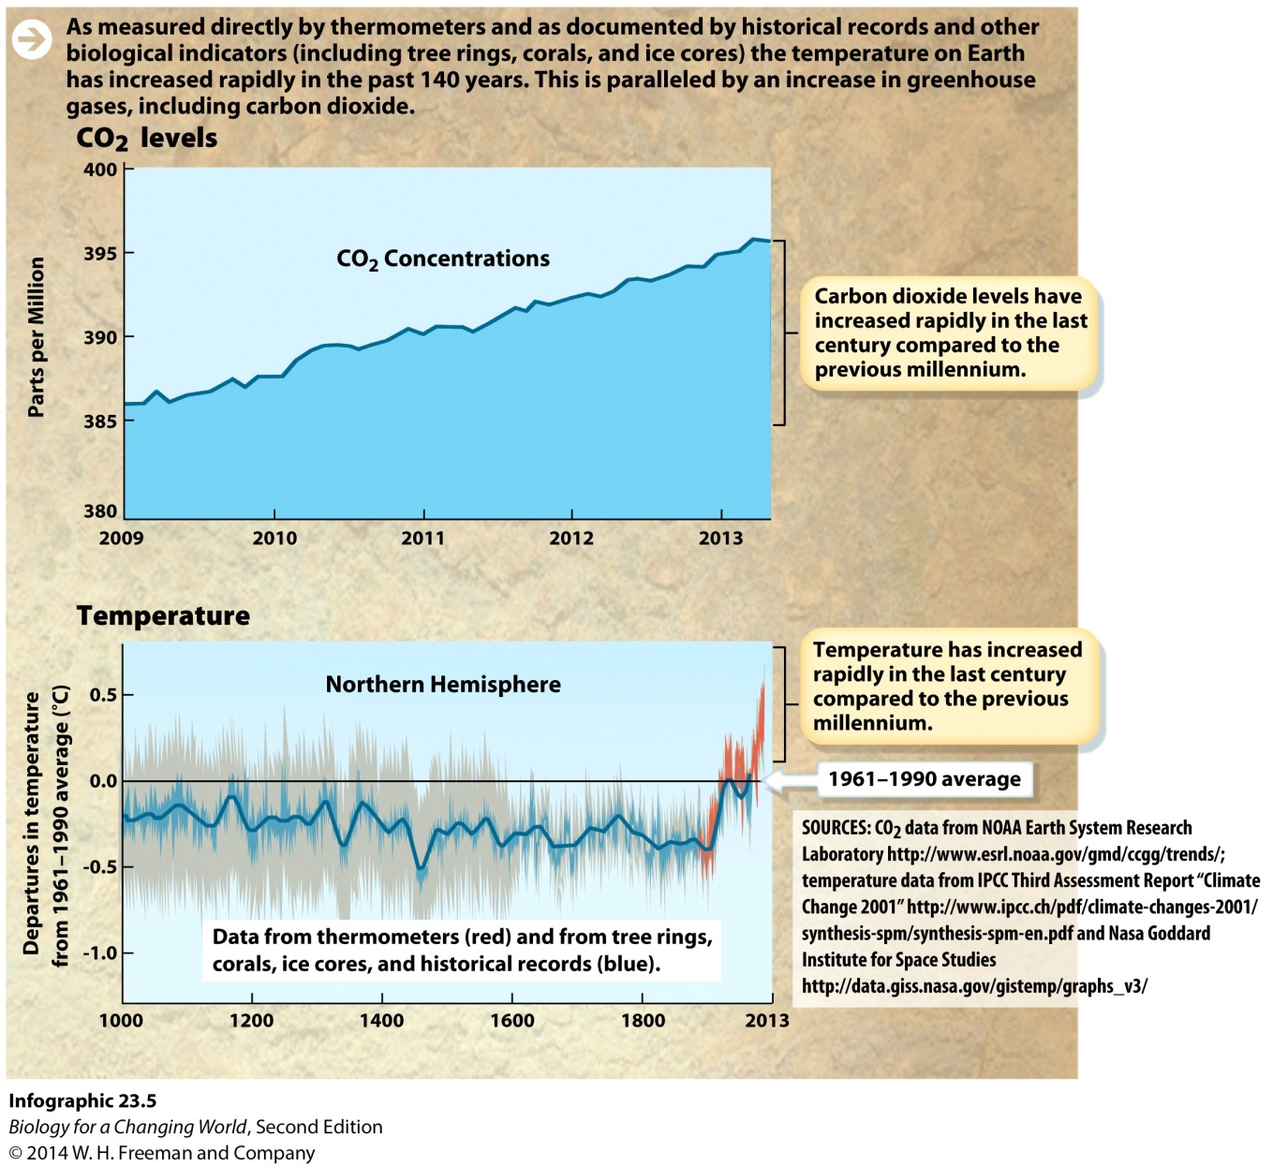
The greenhouse effect
Increase in greenhouse gases enhance the effect
Global warming
Notes:
Global warming: an increase in Earth’s average temperature
The rate of warming has increased. Ten of the warmest years on record have occurred since 1998. The last decade, from 2000 through 2010, was the hottest decade so far.

Slide 16
Climate change and ecosystems
Notes:
Many forests are susceptible to insect attacks. Given their insect-rich diet, birds are a natural form of pest control in these forests. If the birds move north, as evidence suggests they are doing, the forests they leave behind will be more vulnerable to threats from insects that thrive in warmer, drier weather.
One in 10 species could be driven to extinction by 2100 because of climate change.

Slide 17
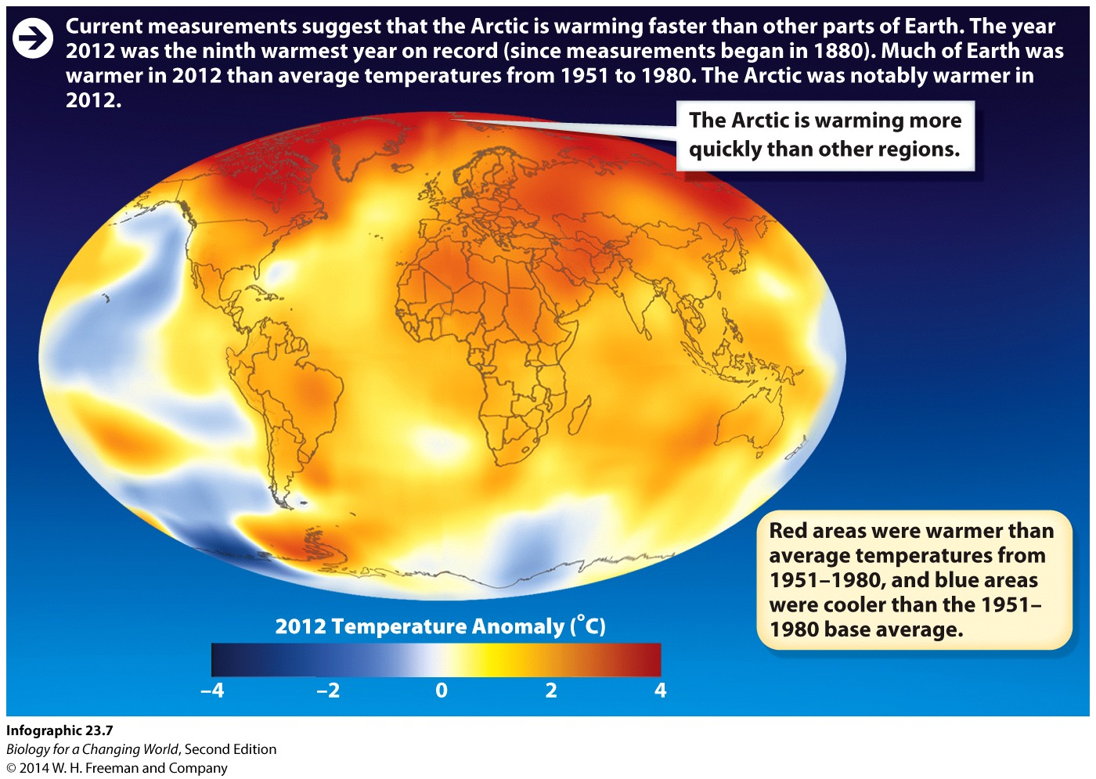
Arctic meltdown
The arctic has warmed twice as much as the rest of the planet: arctic amplification
Notes:
Arctic temperatures are projected to rise by an additional 4° to 7°C (7°–13°F) over the next 100 years.

Slide 18
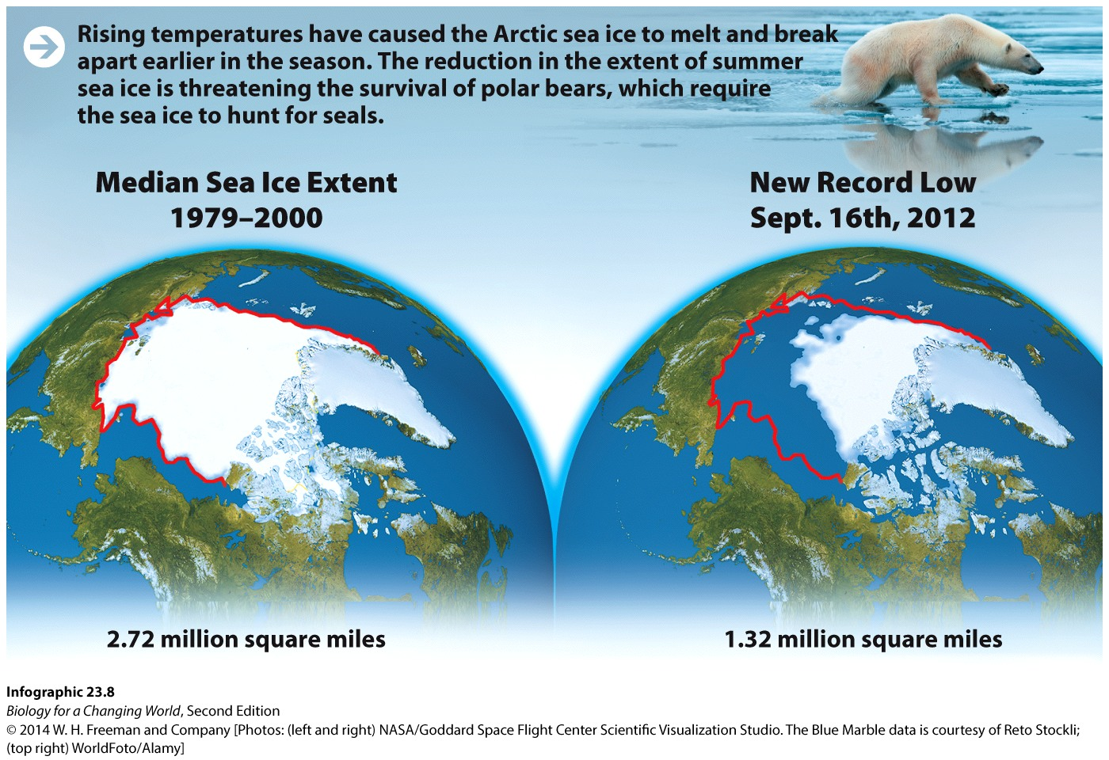
Arctic meltdown
Affects many organisms
Canadian polar bears weigh 55 pounds less than they did 30 years ago
Compromises their reproductive ability

Slide 19
The carbon cycle
Humans are changing the climate
Carbon dioxide concentrations highest in 700,000 years
Fossil fuels
Carbon-rich energy source (coal, petroleum, or natural gas) formed from compressed, fossilized remains of organisms

Slide 20
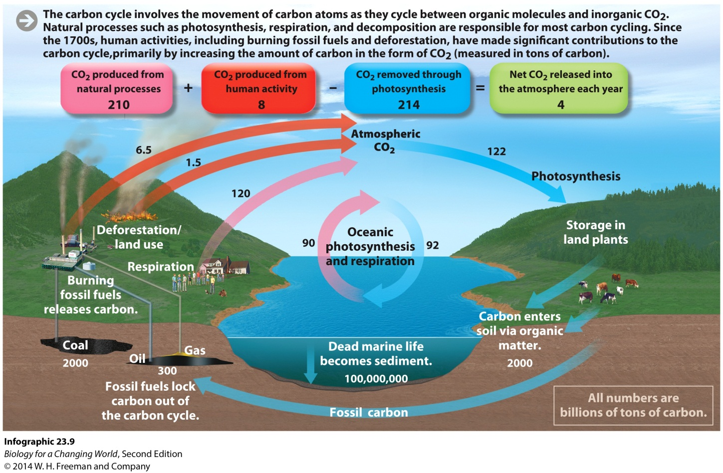
The carbon cycle
Carbon cycle
Movement of carbon atoms between organic and inorganic molecules in the environment
Notes:
Photosynthesis, respiration, and decomposition form a cycle that keeps carbon dioxide at a relatively stable level in the atmosphere. But human actions, like deforestation and burning fossil fuels, inject carbon dioxide that was not otherwise moving into the cycle. Modern drilling and mining methods have unlocked the deep reserves of this ancient planetary energy. The CO₂ released when humans burn fossil fuels is the largest source.

Slide 21
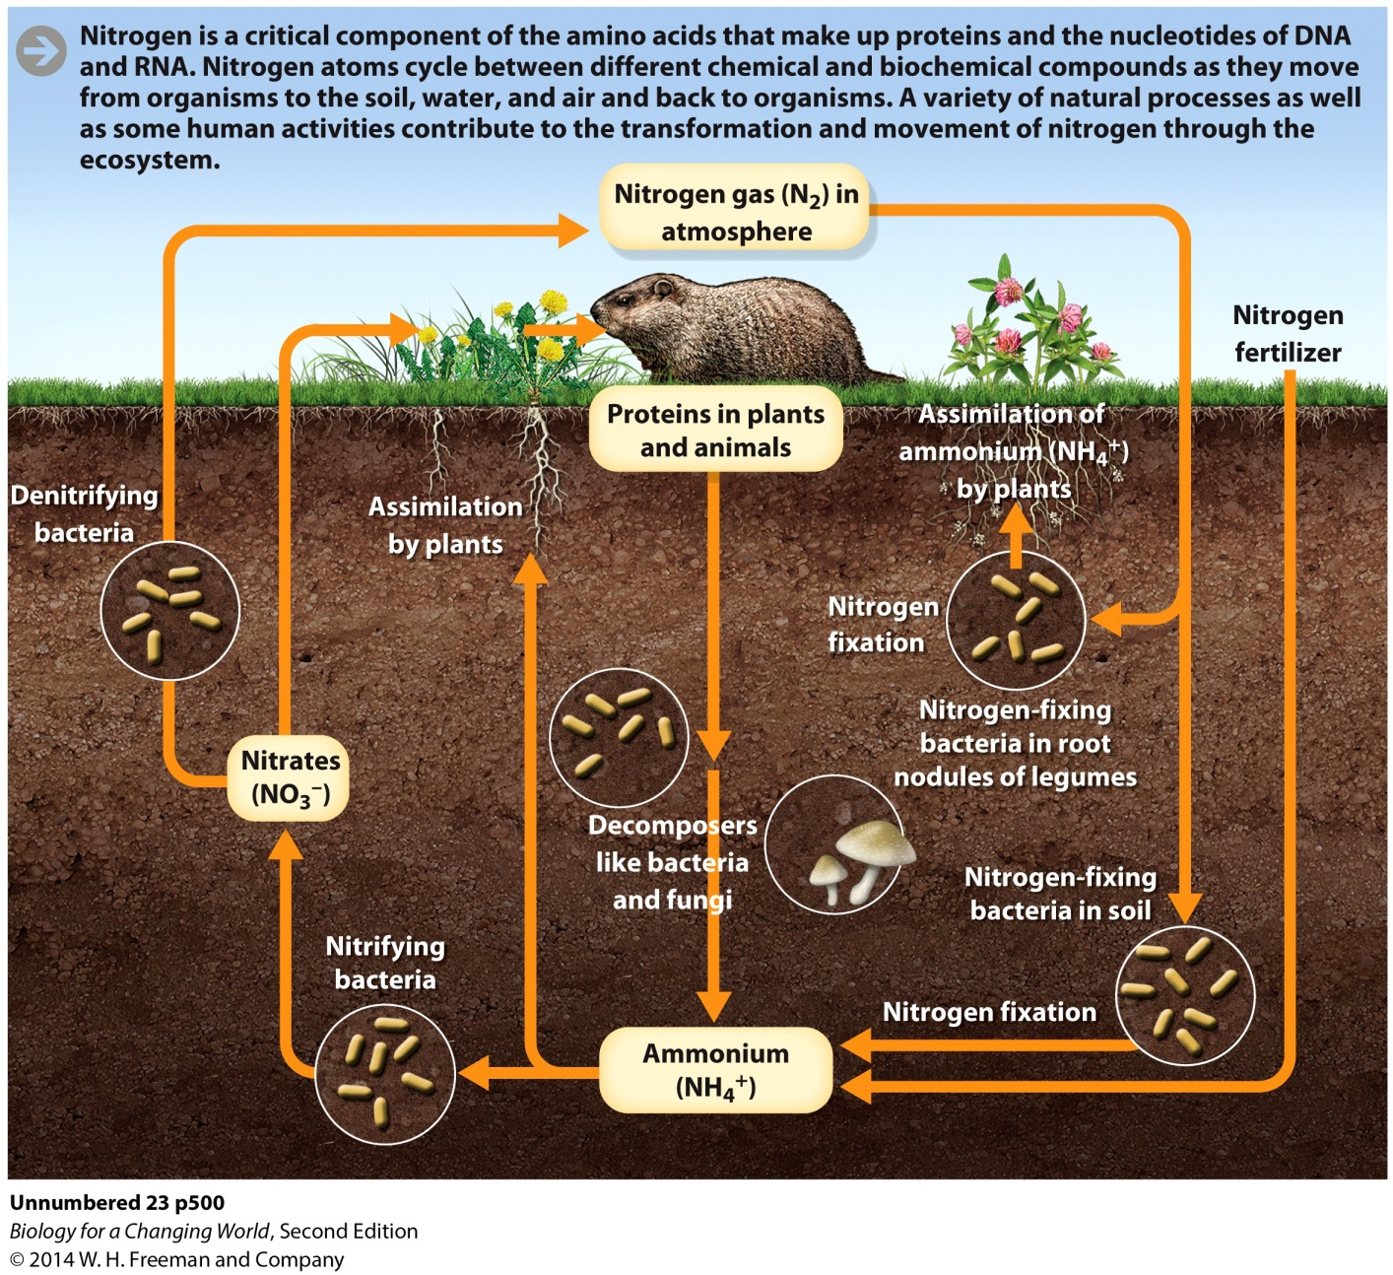
Other element cycles
Notes:
Nitrogen atoms cycle between different chemical and biochemical compounds as they move from organisms to the soil, water, and air, and then back to organisms.

Slide 22
Other element cycles
Notes:
Phosphorus cycles primarily through soil, water, and organisms.

Slide 23
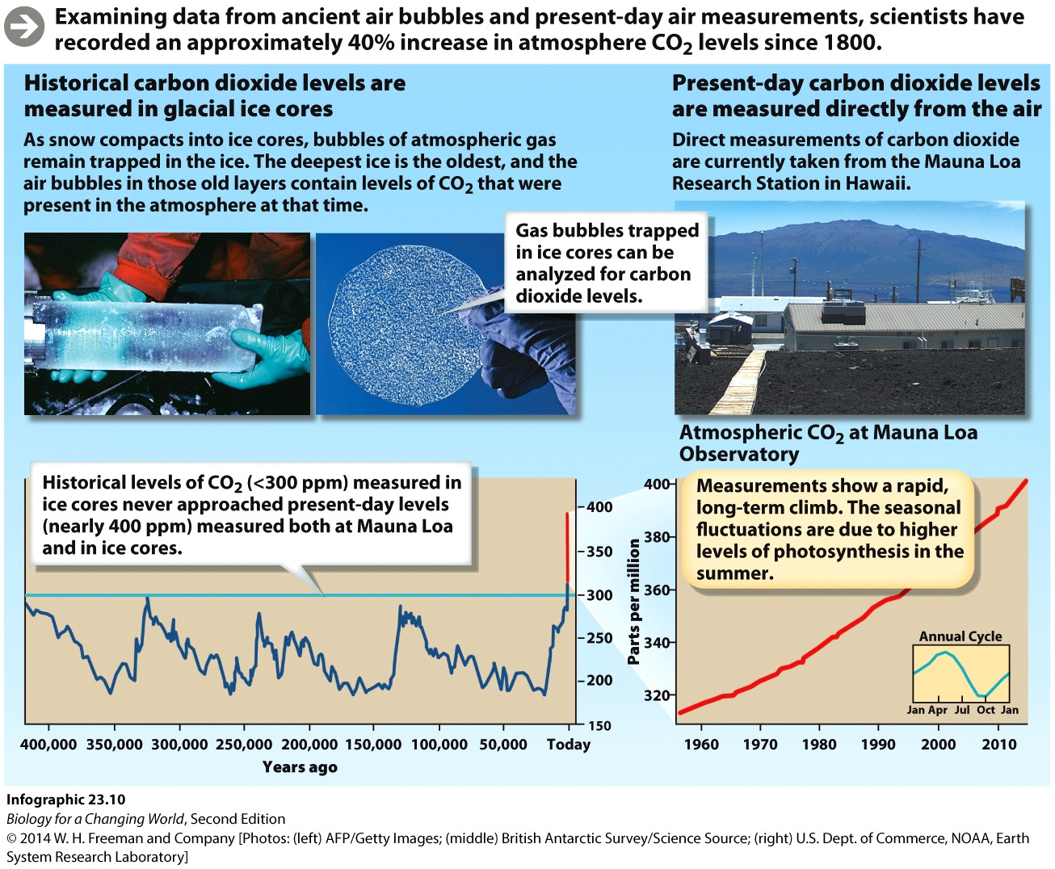
The carbon cycle
Measure changes in CO₂
Ice cores from glaciers
Direct measure of CO₂ in atmosphere
Notes:
Air bubbles trapped in glacial ice from Greenland and Antarctica provide a historical measure of carbon dioxide in the atmosphere.

Slide 24
Our carbon footprint
Carbon footprint: measure of the total greenhouse gases produced by human activities
Burning fossil fuel
Rice and cattle
Deforestation
Concrete production
Notes:
Kyoto Protocol: a United Nations agreement adopted in 1997 that obligates endorsing countries to reduce carbon dioxide emissions
Even if all the world’s greenhouse gas emissions were turned off today like a faucet, we would still face decades of warming and its consequences because of past emissions. This is what climate scientists refer to as heat in the pipeline.

Slide 25
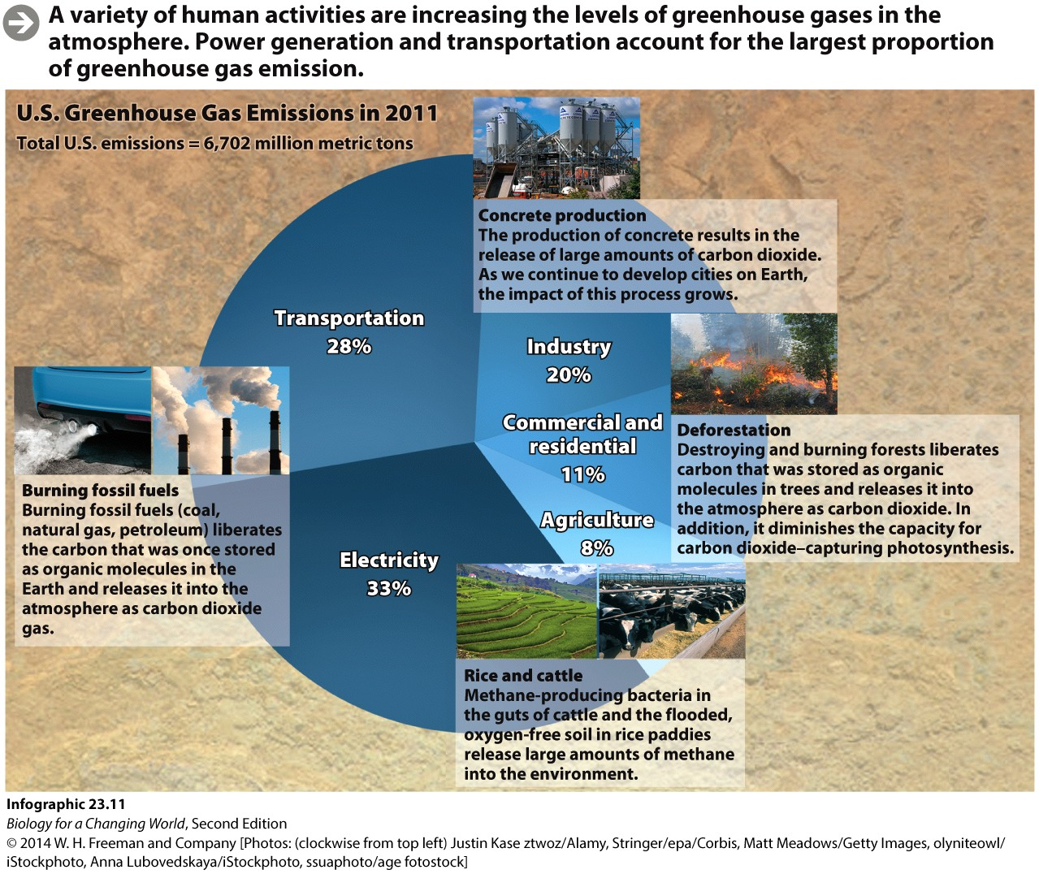
Our carbon footprint

Slide 26
Summary
Ecosystems are made up of the living and nonliving components of an environment.
Temperature is an important physical feature of any ecosystem.
Biomes are large, geographically distinct ecosystems, defined by their characteristic plant life.
Climate change is a persistent pattern of change in Earth’s climate. Global warming is an increase in Earth’s average temperature over time.
The greenhouse effect is a natural process by which heat radiated from Earth’s surface is absorbed by heat-trapping gases in the atmosphere.
Elements cycle through ecosystems.

