Slide 1
Michèle Shuster • Janet Vigna • Gunjan Sinha • Matthew Tontonoz
Biology for a
Changing World
SECOND EDITION
Lecture PowerPoint
CHAPTER 24
Sustainability
Copyright © 2014 by W. H. Freeman and Company

Slide 2
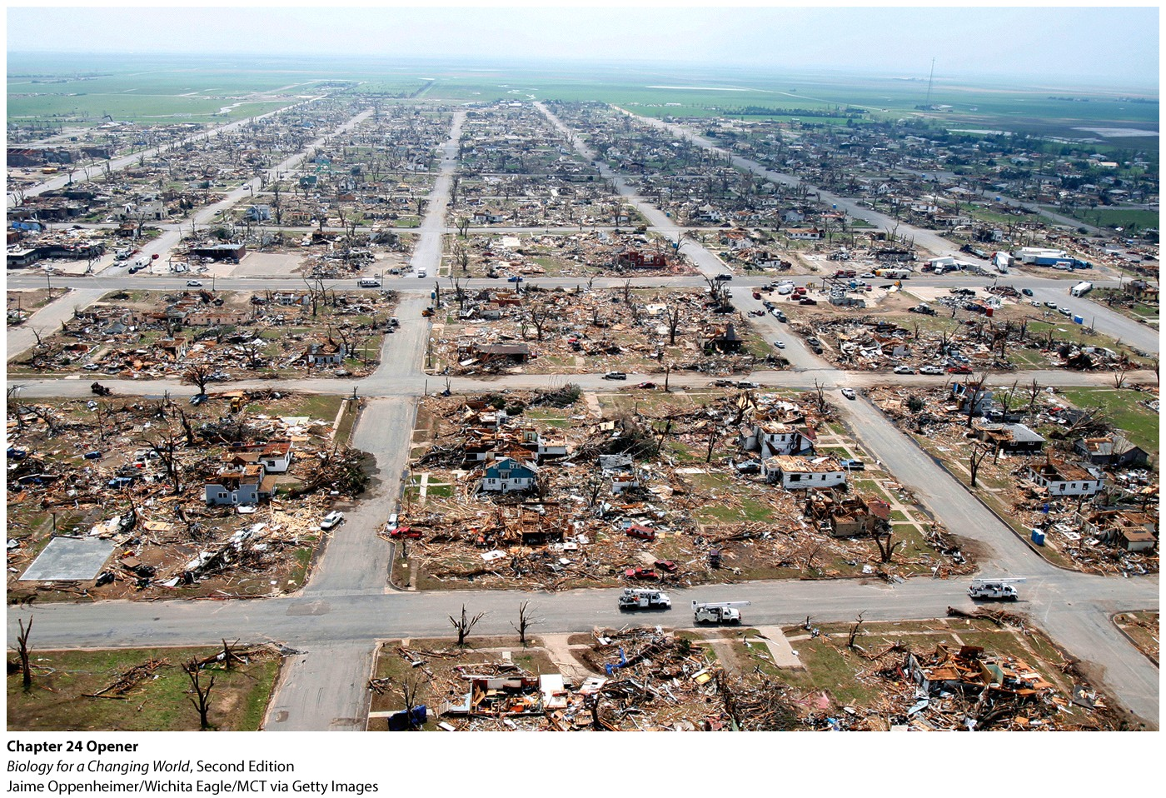
Chapter 24
Sustainability

Slide 3
Driving Questions
1. What human impacts are considered when
determining ecological footprint, and how
does human population size influence our
impact on Earth?
2. What resources do humans rely on, and
which of them are renewable?
3. What is “sustainable living”?

Slide 4
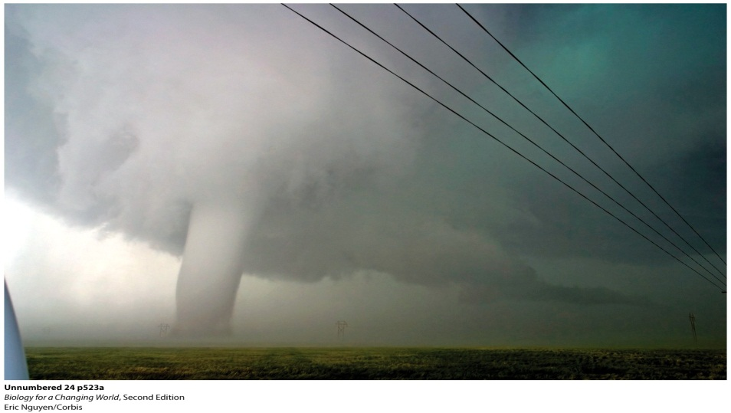
Greensburg goes green
EF-5 tornado levels the town of Greenburg, Kansas in 2007
Town rebuilds “green”
Living more sustainable

Slide 5
Sustainability
Use of Earth’s resources in a way that will not permanently destroy or deplete them
Living within the limits of Earth’s biocapacity
ability to sustain human demand given available resources

Slide 6
Sustainability
Natural resources
Raw materials that are obtained from Earth and are considered valuable even in their relatively unmodified, natural form
Farmland, gasoline, oxygen

Slide 7
Sustainability
Ecological footprint
Collective demand placed on natural resources
Measure of how much land and water is required to supply the resources a person or population consumes and to absorb the waste produced

Slide 8
Sustainability

Slide 9
Sustainability
Ecological footprint is human demand on Earth
Biocapacity is the amount of supplies available to meet demand
Measured in global hectares (gha)
biological productivity of an average hectare
Notes:
A hectare is 10,000 square meters (about the size of a soccer field).
In 2008 Earth’s total biocapacity was 12 billion gha, or 1.8 gha per person. The average ecological footprint was 2.7 gha per person per year.
Because the average human ecological footprint is greater than Earth’s total biocapacity, our demand on Earth’s resources is currently outstripping its supply (by almost 1 gha per person).

Slide 10
Sustainability

Slide 11
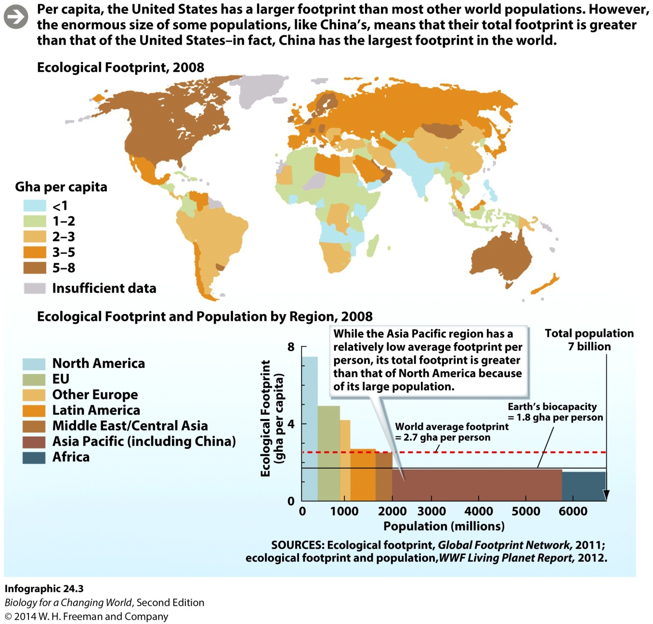
Sustainability
Patterns of consumption vary greatly
Notes:
What is it about the U.S. lifestyle that leaves such a heavy footprint compared with other countries?

Slide 12
Nonrenewable resources
U.S. lifestyle requires energy
Most energy comes from fossil fuels – oil, coal, and natural gas
Notes:
Fossil fuels are considered nonrenewable resources: once depleted, they are essentially gone for good. Besides contributing to our carbon footprint, burning these nonrenewable resources also releases pollutants, such as sulfur dioxide and nitrogen dioxide, which contribute to acid rain.

Slide 13
Nonrenewable resources

Slide 14
Nonrenewable resources

Slide 15
Nonrenewable resources

Slide 16
Nonrenewable resources
Use of these resources also
Contributes to carbon footprint
Releases pollutants
sulfur dioxide and nitrogen dioxide, which contribute to acid rain
arsenic and fluorine, which can cause bone and lung disease

Slide 17
LEED certification
“Leadership in Energy and Environmental Design”
U.S. Green Building Council certification system
Designates buildings as LEED-certified
Notes:
LEED-certified: conserve energy and water, reduce waste sent to landfills, lower greenhouse gas emissions, and be healthier and safer for occupants

Slide 18
LEED certification

Slide 19
Sustainable by design
Greensburg has one of the highest per capita concentrations of LEED-certified buildings in the country
Generate energy from renewable resources
natural resources that are replenished after use
Notes:
Renewable resources: natural resources that are replenished after use, as long as the rate of consumption does not exceed the rate of replacement

Slide 20
Sustainable by design

Slide 21
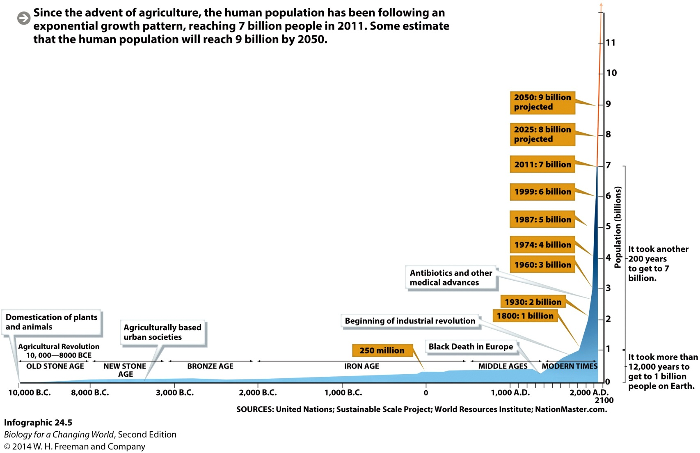
Sustainability
Human population is growing exponentially

Slide 22
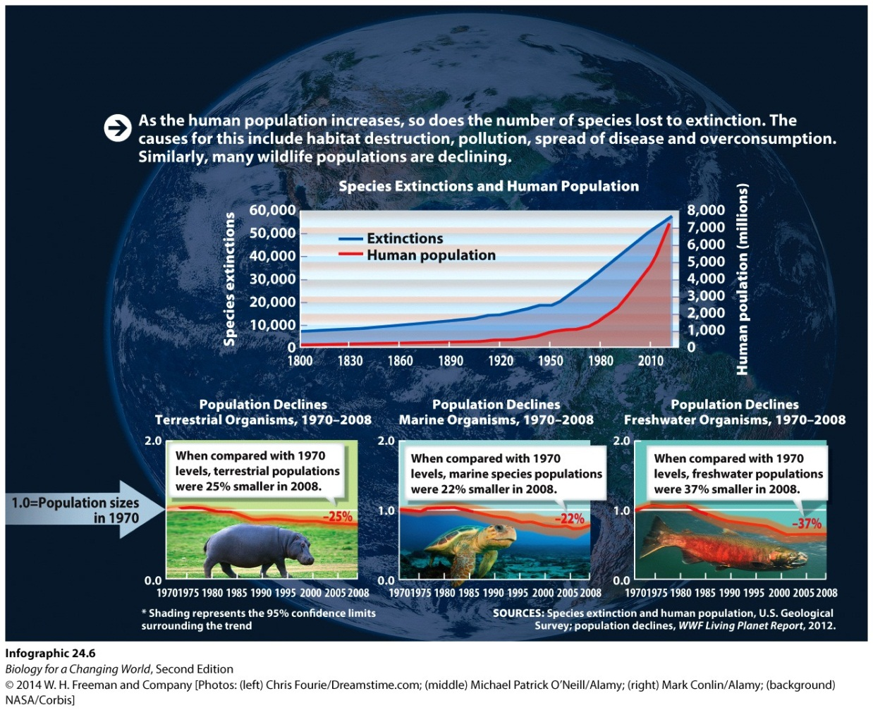
Loss of biodiversity
Rise in human population correlates with loss of biodiversity
number of different species and their relative abundances
Notes:
Biodiversity: the number of different species and their relative abundances in a specific region or on the planet as a whole

Slide 23
Economics of renewable resources
Wind and solar power technologies are currently more expensive than those based on oil, coal, and natural gas
Harder to store and transmit energy produced
from wind and solar
“Carbon offsets”
businesses use to counter-balance their fossil fuel use

Slide 24
Economics of renewable resources

Slide 25
Economics of renewable resources

Slide 26
Economics of renewable resources

Slide 27
Water
Natural resource
Renewable
High demand
Greensburg uses an aquifer
underground layer of porous rock from which water can be drawn for use
limited resource

Slide 28
Water

Slide 29
Water
Notes:
To help conserve water, many buildings in Greensburg have rooftop rain filtration and storage systems, which collect rainwater and use it to flush toilets and irrigate the grounds. Rain barrels to collect water are also becoming quite common.

Slide 30
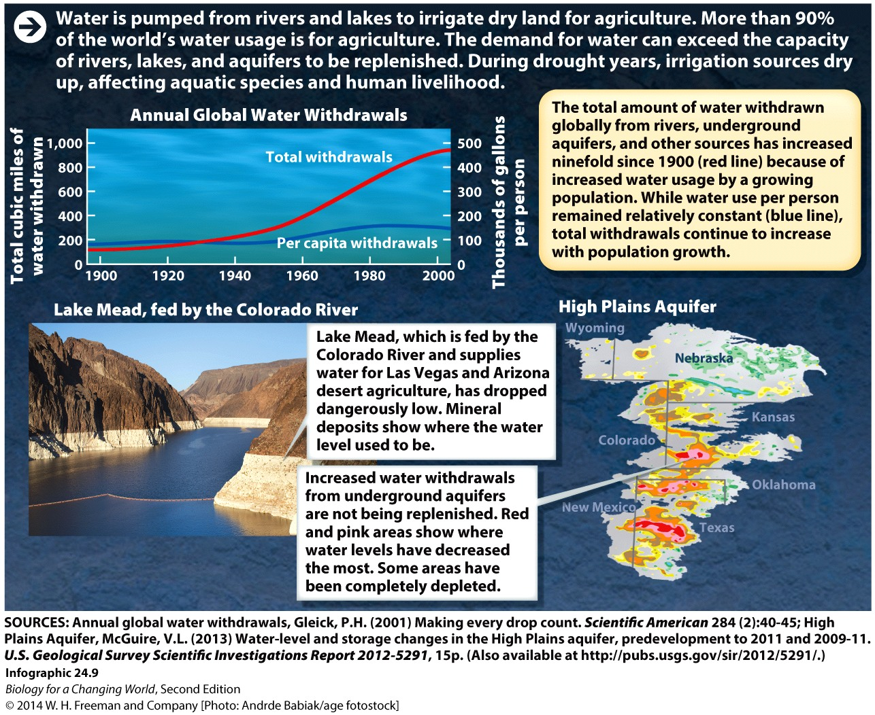
Water overuse
Notes:
A striking example of the consequences of increased water use can be seen in Lake Mead, which is fed by the Colorado River. This reservoir, which provides freshwater to much of the southwestern United States, is at historic lows today.

Slide 31
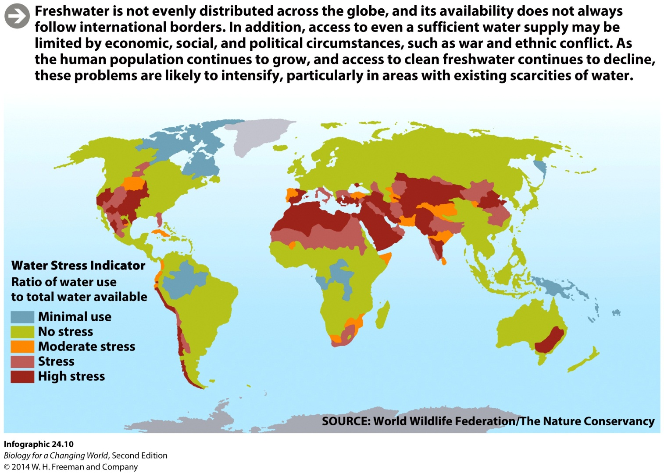
Water
Geographic distribution of freshwater does not always match the distribution of the world’s population

Slide 32
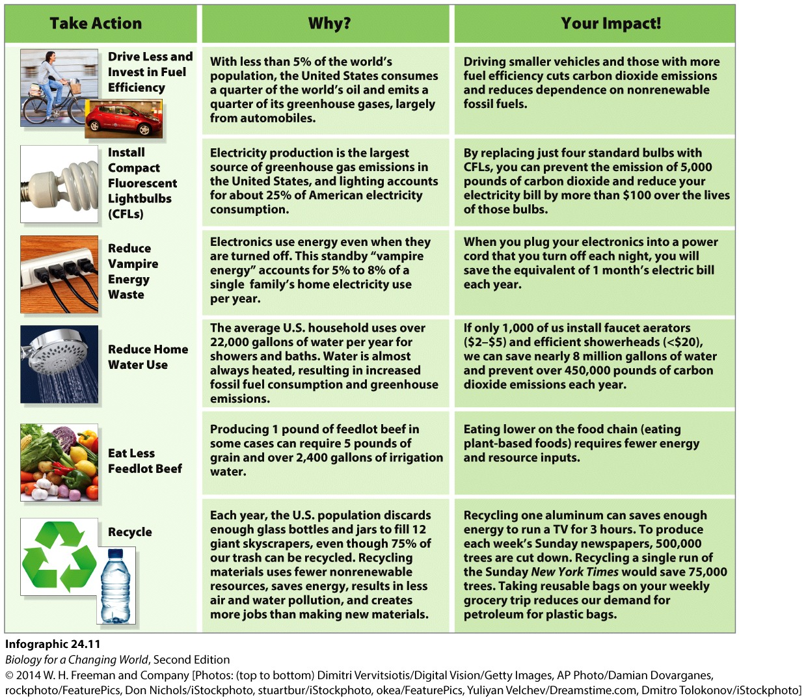
Living sustainably

Slide 33
Summary
Sustainability refers to the ability of humans to live within Earth’s biocapacity.
Natural resources include nonrenewable and renewable resources.
Ecologists measure human demand on Earth’s resources using ecological footprint analysis.
As the human population grows, so does our ecological footprint.
Freshwater is a renewable resource, but the world’s supply is not distributed equally.
Sustainable practices minimize the consumption of nonrenewable resources by using renewable resources.

